Slide 1
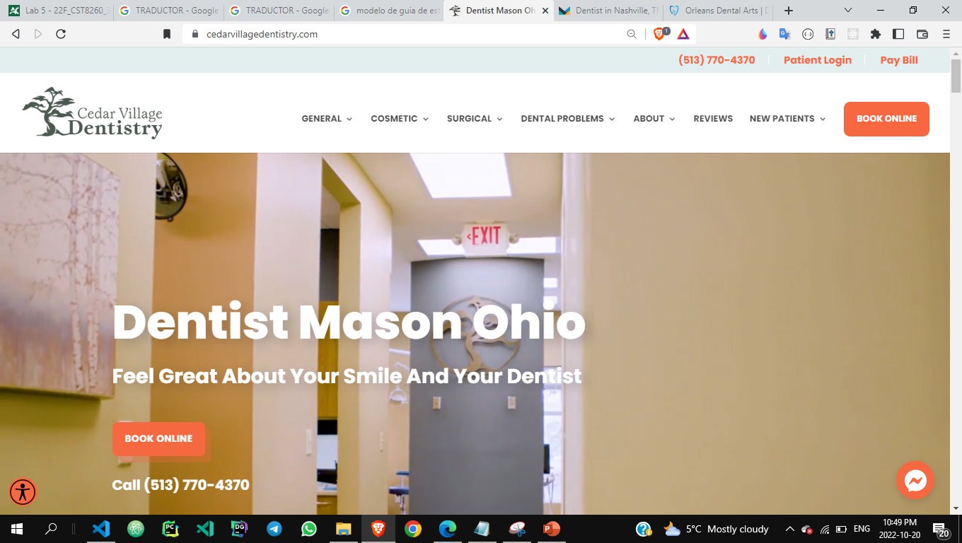
Examples

Slide 2
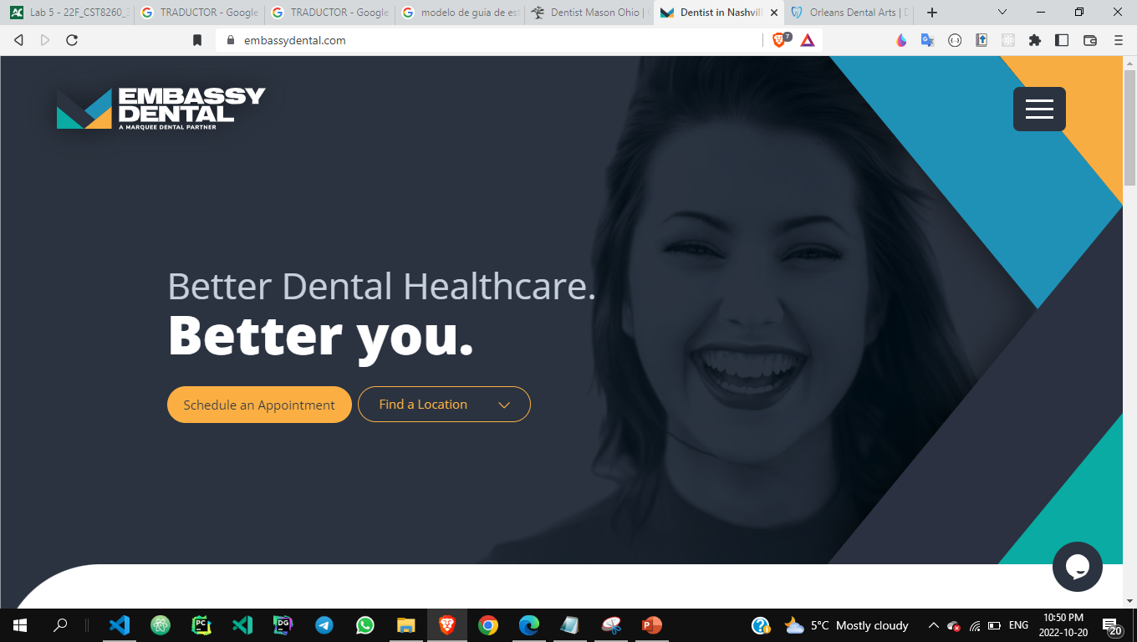

Slide 3
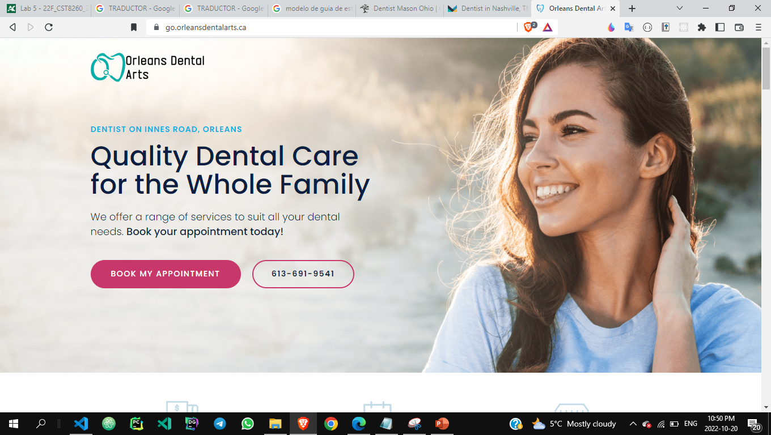

Slide 4

Mockup of Landing Page
HOME SERVICES OUR TEAM SPECIALTIES LOCATIONS BOOK ONLINE
BANNER
SECTION APPOINTMENT
ADDITIONAL INFORMATCION
FOOTER

