Slide 1
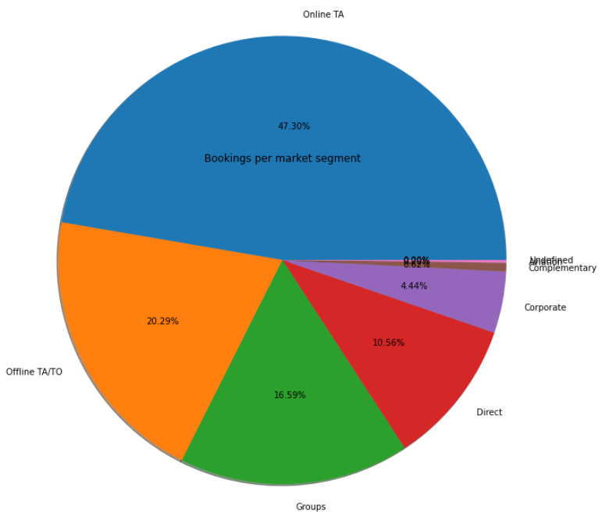
Bookings by market segment
47.30% of bookings were made online, 20.29% offline
The rest were made by groups, corporations, directly at the hotel or by airline packages

Slide 2
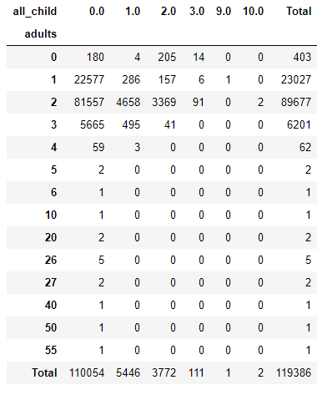
Bookings by market segment
From this table we can deduce that of the 119,000 reservations, 110,054 were reservations for without children, most of them couples, followed by clients traveling alone.
When there are more bookings with children, two adults travel, we can deduce that they are couples and their children

Slide 3
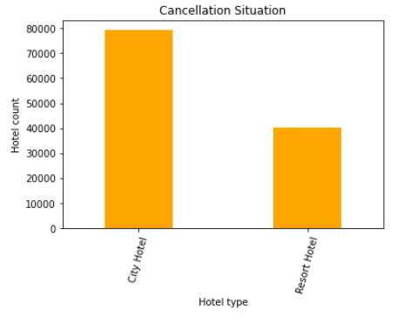
Cancelations
37,04% of total bookings were canceled

Slide 4
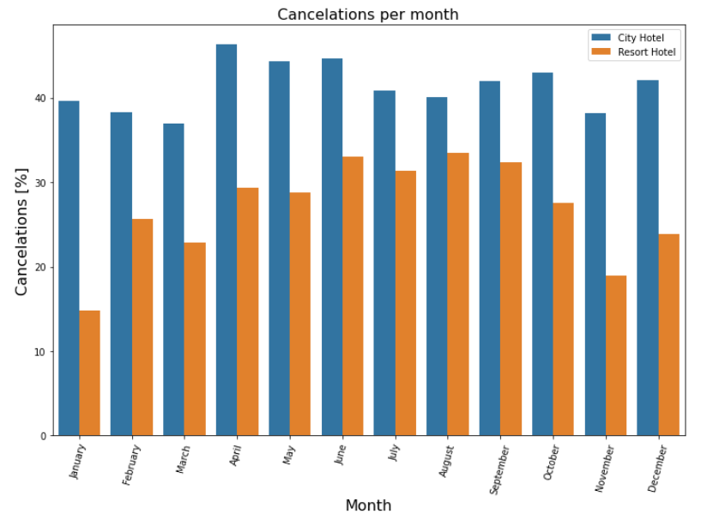
Cancelations per month
August is the month with more cancelations and January is the month with less cancelations
For city hotels there is not much variance between months
For the Resort hotel it is highest cancelations in the summer and lowest during the winter

