Slide 1
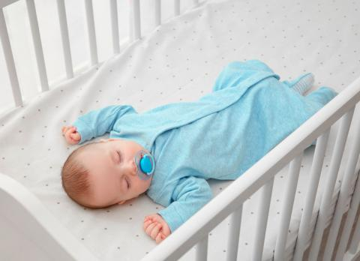
safe sleep
For:
Wendy Mendoza
Carlos Pajuelo
Naydu Ramon Quincho
Biomedical device for the prevention of sudden infant death by sensors

Slide 2
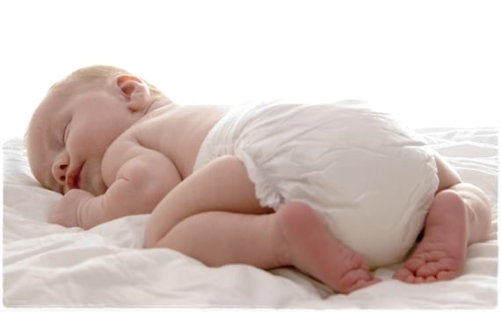
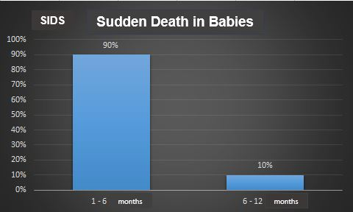
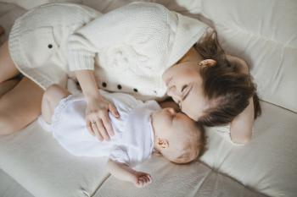
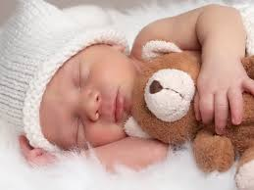
Introduction
Sudden Death around the world
SIDS

Slide 3
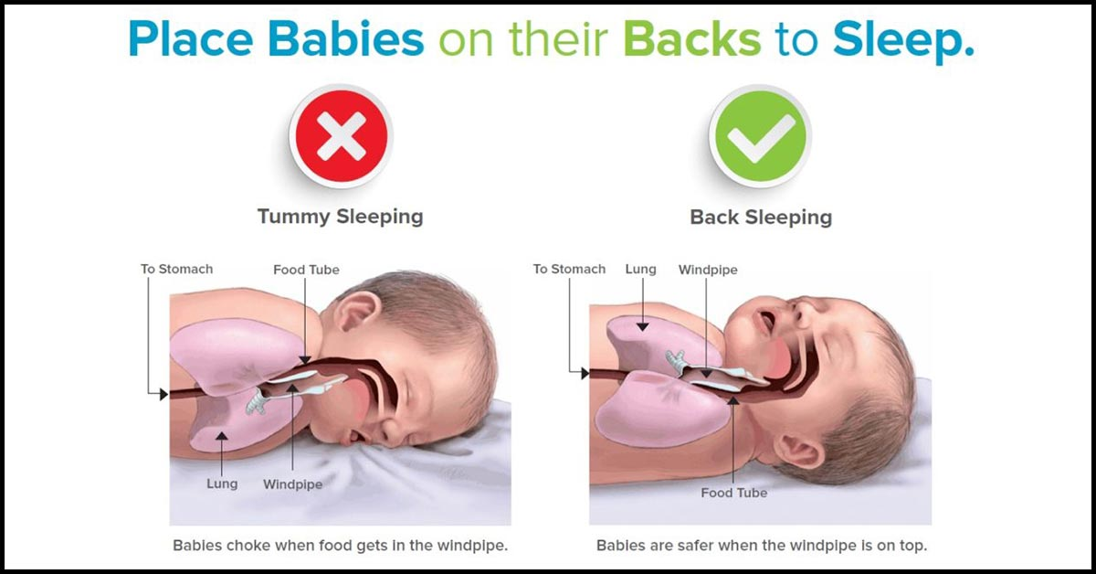
Introduction
Table 1: Average values of heart rate(beats per minute) of babies
Age | Awake | Asleep
Newborn (0 to 1 month) | 85 to 205 | 80 to 160
Baby (One month to one year) | 100 to 190 | 75 to 160
Table 2: Normal values for body temperature in babies
Correct monitoring:
Heart rate (pulse)
Temperature
Baby position
Age | G. Centigrade (°C)
Newborn (0 to 1 month) | 36.1 - 37.7
Baby (One month to one year) | 37.2

Slide 4

detailed description of the invention
It is a system that consists of identifying the body temperature; pressure and movements of a baby or person who is lying a bed, crib, etc., in order to identify their habits when resting and to prevent any syndrome.

Slide 5
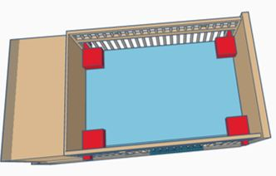
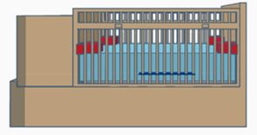
description components

Slide 6
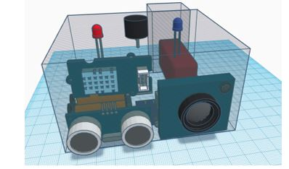
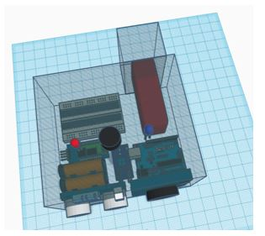

Slide 7
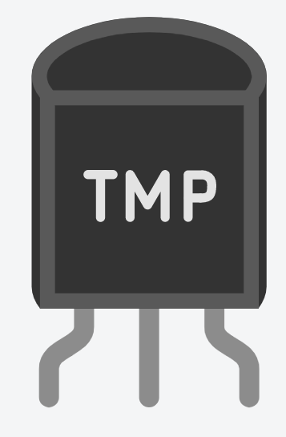
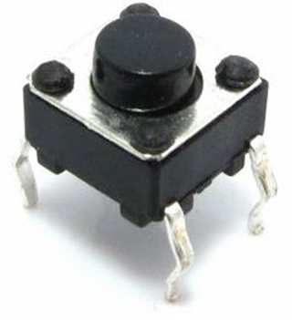
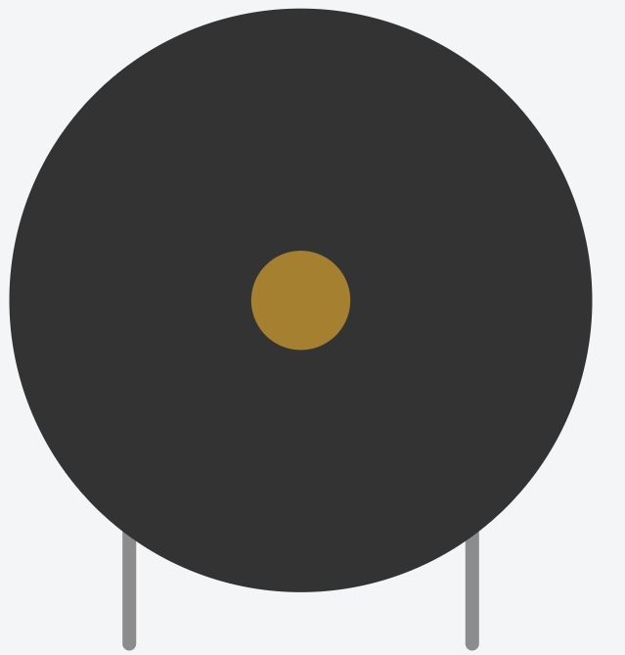
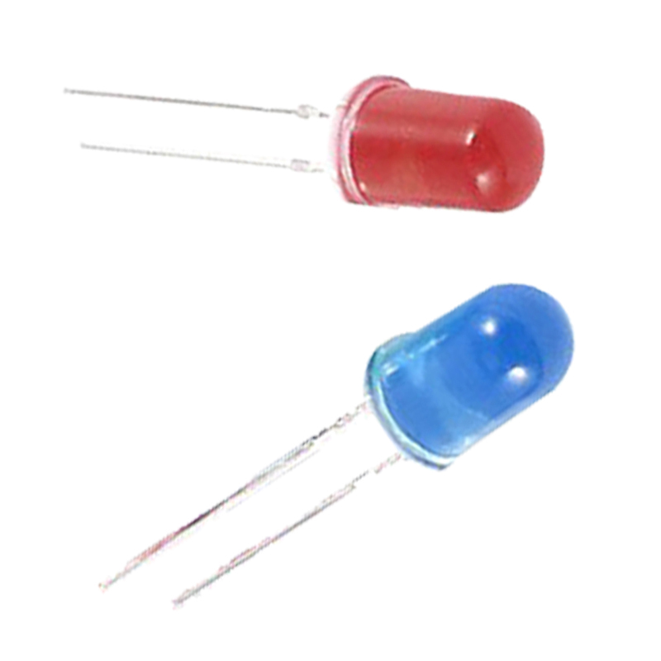
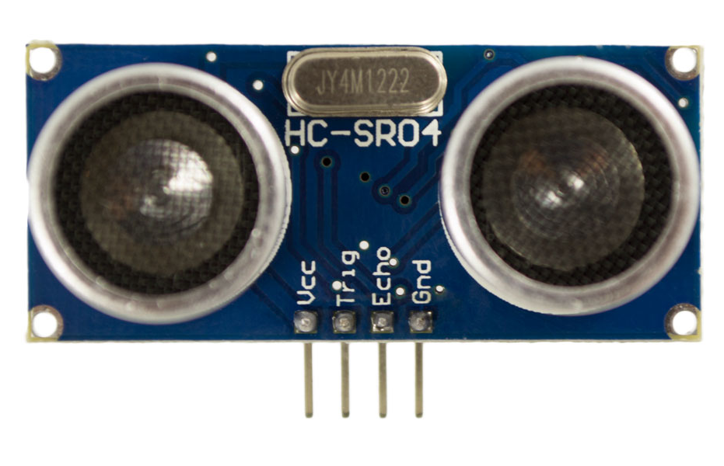
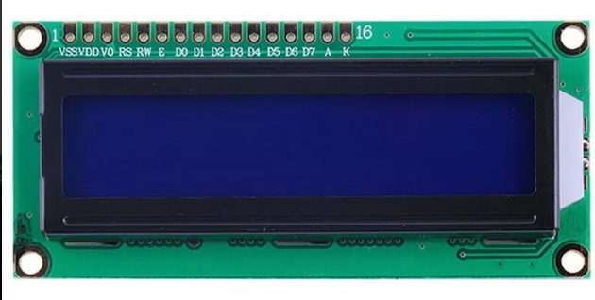
departures
ENTRy

Slide 8
description of the technical problem
The system tries to avoid the cause that SIDS when the infant is in his crib, bassinet or bed. Motion sensors identify the position in which the infant was placed in his crib and thus be able to detect if he is turning. Sensors detect temperature to identify sudden changes in the infant’s body temperature.

Slide 9
description of the background
The first project is Baby Be Well App. It is a free application that allows you to collect photos of the baby in order to track the different moments that occur in their daily activity, for example, in their feeding.
A third project related to sudden death is a wearable that could prevent this type of death. It is a bracelet called the Infant Care System whose function is to control oxygen and heart rate.
A second project on sudden death is called Baby Safety. These are 4 devices that prevent the sudden death of the smallest in different ways. It was created by Iria Ollero, a Biomedical Engineering student at the University of Vigo.
The latest base project on sudden death is a mattress made by researchers from the European Union called Baby Care Sleep. This new non-invasive and intelligent project allows the detection of risk situations.

Slide 10
programming structure
Button | Left exit | Right exit | Led | Screen | Piezo
0 | 0 | 0 | 0 | 0 | 0
0 | 0 | 1 | 0 | 0 | 0
0 | 1 | 0 | 0 | 0 | 0
0 | 1 | 1 | 0 | 0 | 0
1 | 0 | 0 | 0 | 1 | 0
1 | 0 | 1 | 1 | 1 | 1
1 | 1 | 0 | 1 | 1 | 1
1 | 1 | 1 | 0 | 1 | 0
inputs: push button, left and right sensor.
output 1: piezo, blue led, lcd screen.
Table 3: Truth table of 3 inputs(on/off button, left and right movement sensor) and 3 outputs(blue led spotlight, screen and piezo).

Slide 11
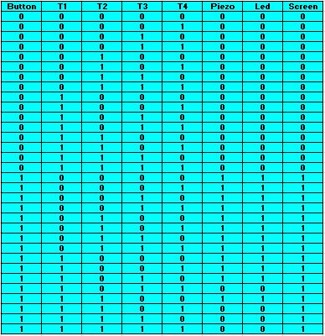
inputs: button, temperature sensors.
output 1: PIEZO, red led, LCD screen.
Table 6: Truth table with 5 inputs(start button, temperature sensors: T1, T2, T3 and T4) and 3 outputs(Lcd screen, alarm and red Led piezo).

Slide 12
test cases
case 1: system power on.
case 2: “all good”.
case 3: high temperature, alarm and red led.
case 4: low temperature, alarm and red led
case 5: “baby moves”, alarm, blue led.

Slide 13
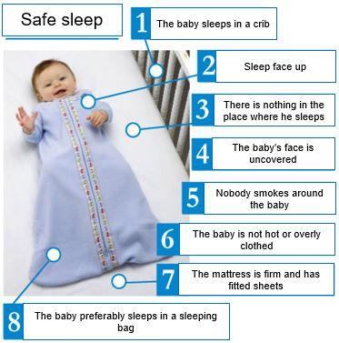
conclusions

