Slide 1
CLT Distribution Proposal
Hybrid textile printing (screen + digital) in Mexico and Latin America
TID México · VSP Printing, Inc. · CEB | October 2026

Slide 2
The opportunity on one page
0
~1,900
30–90
Year 3
formal distributors of Chinese hybrids in Mexico
reachable customers (medium/large firms and shops with carousels)
potential hybrid lines in 5 years
investment payback (base case)
We propose TID / VSP / CEB as CLT’s distributor in Mexico, expanding into the U.S. and Latin America.

Slide 3
The manufacturer
01

Slide 4
CLT: a chemistry company that sells machines
2009
¥568M
founded, Dongguan
2025 revenue (~US$80M)
301618
18%
Shenzhen Stock Exchange (ChiNext)
export sales
Fuente / Source: CLT 2025 annual report

Slide 5
Hybrid technology: the best of two processes
1
Screen base
2
Digital color
3
Special effects
White and effects with low-cost paste: puff, foil, glitter, discharge
Ricoh or Brother heads: photographic gradients, unlimited colors
Glass-like, embroidery-like or 3D silicone over the print
400–450
40–70%
500–5,000
pieces per hour
ink savings vs DTG
pieces: profitable run

Slide 6
How CLT sells today
1
Live-demo trade shows
2
Turnkey package
3
Phased investment
Tests on the customer’s fabric and same-day quote
Machine, chemistry, installation, training and logistics
Press first, digital stations later
4
ROI-based selling
5
Linked consumables
6
Digital lead capture
Savings in ink, operators and floor space
Warranty with genuine chemistry and parts
Multilingual site and WhatsApp
Missing in Mexico: local technical service, in-country inventory, Spanish-language support and a demo showroom

Slide 7
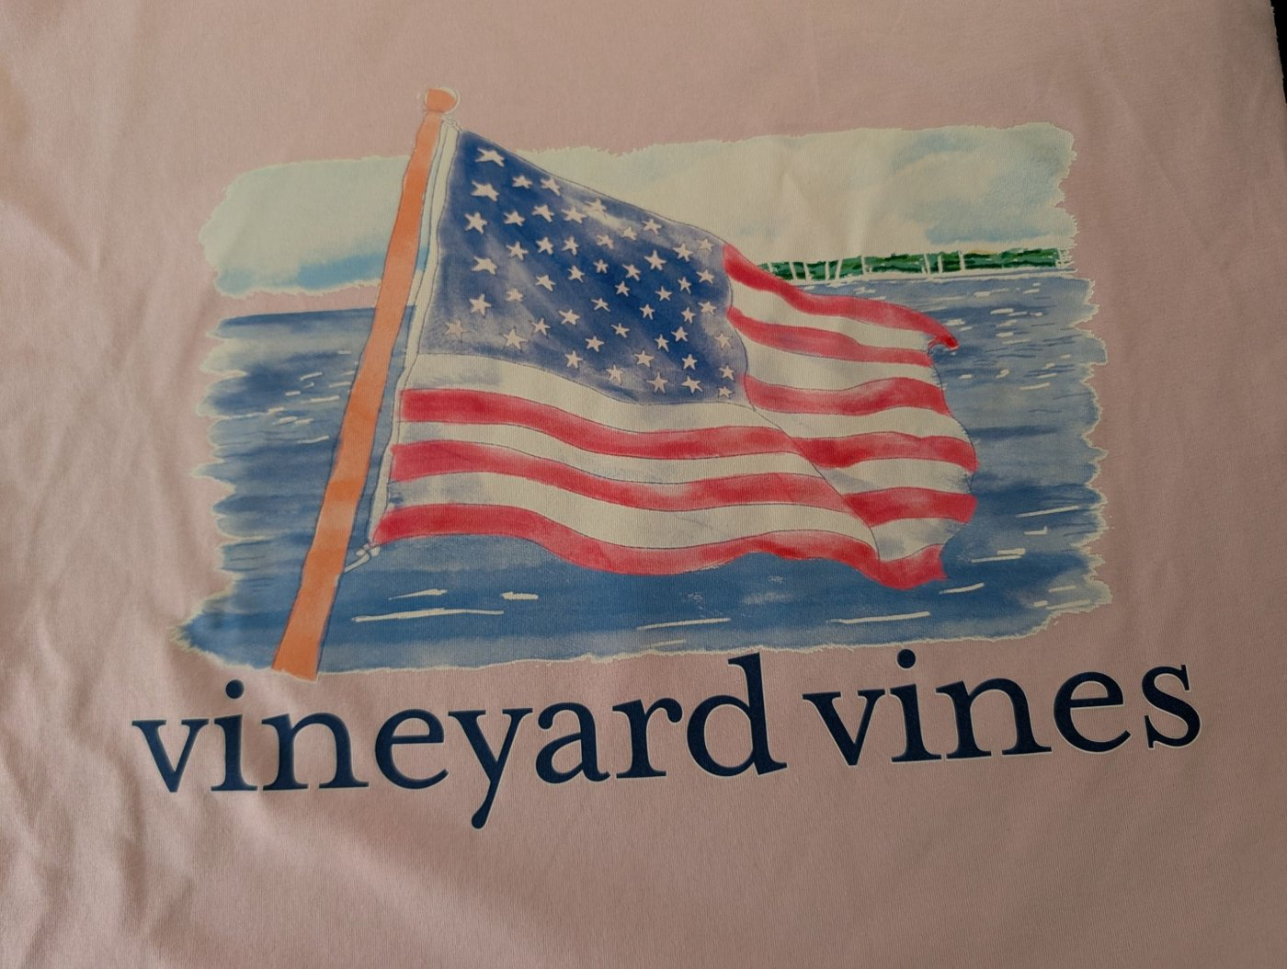
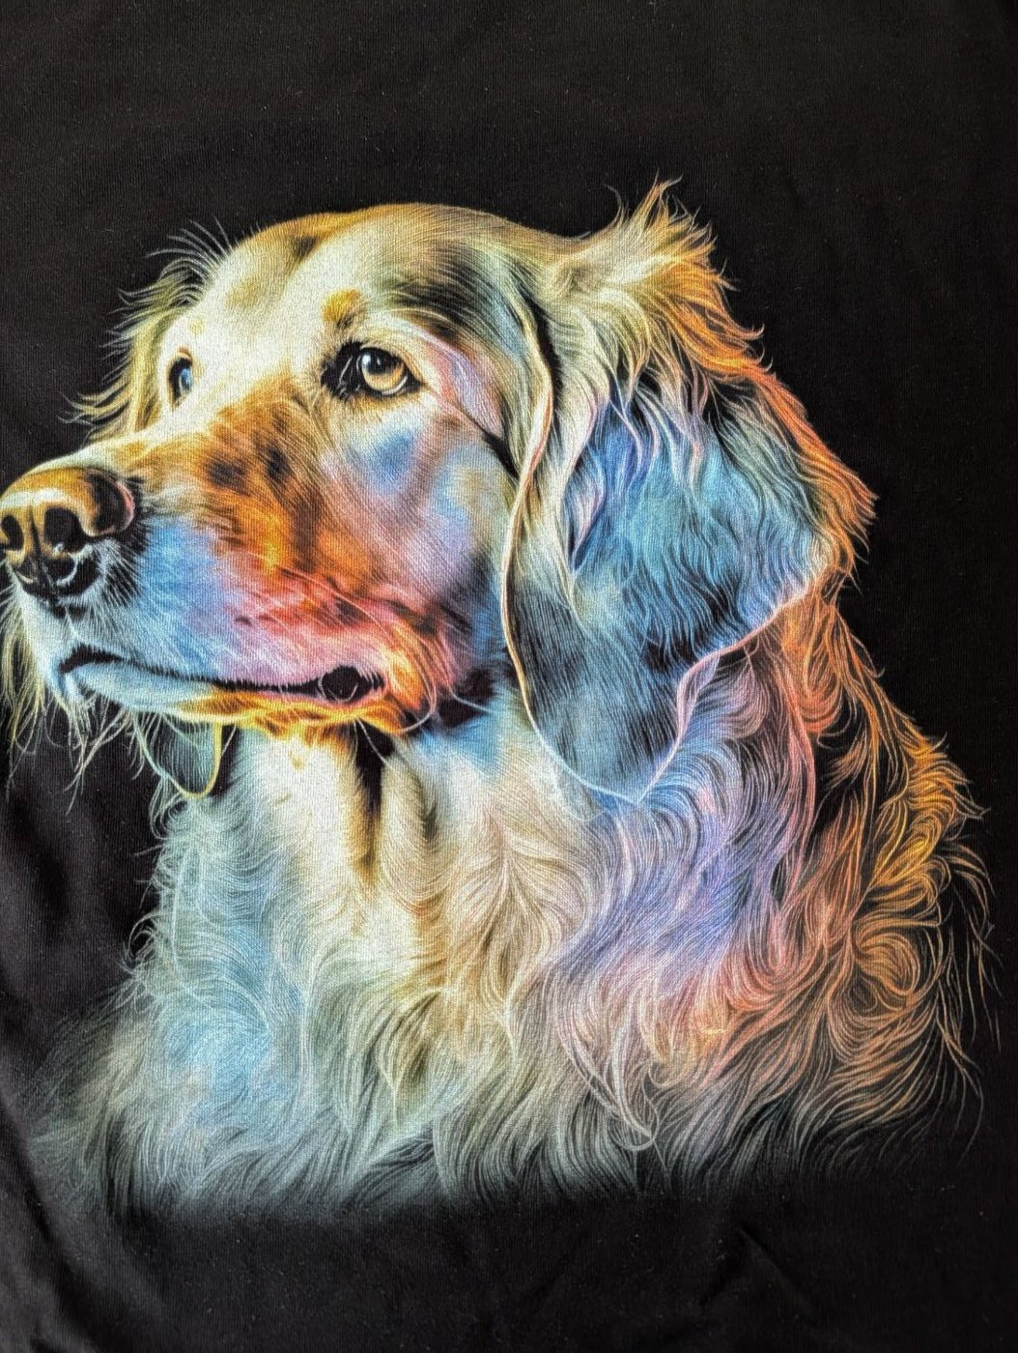
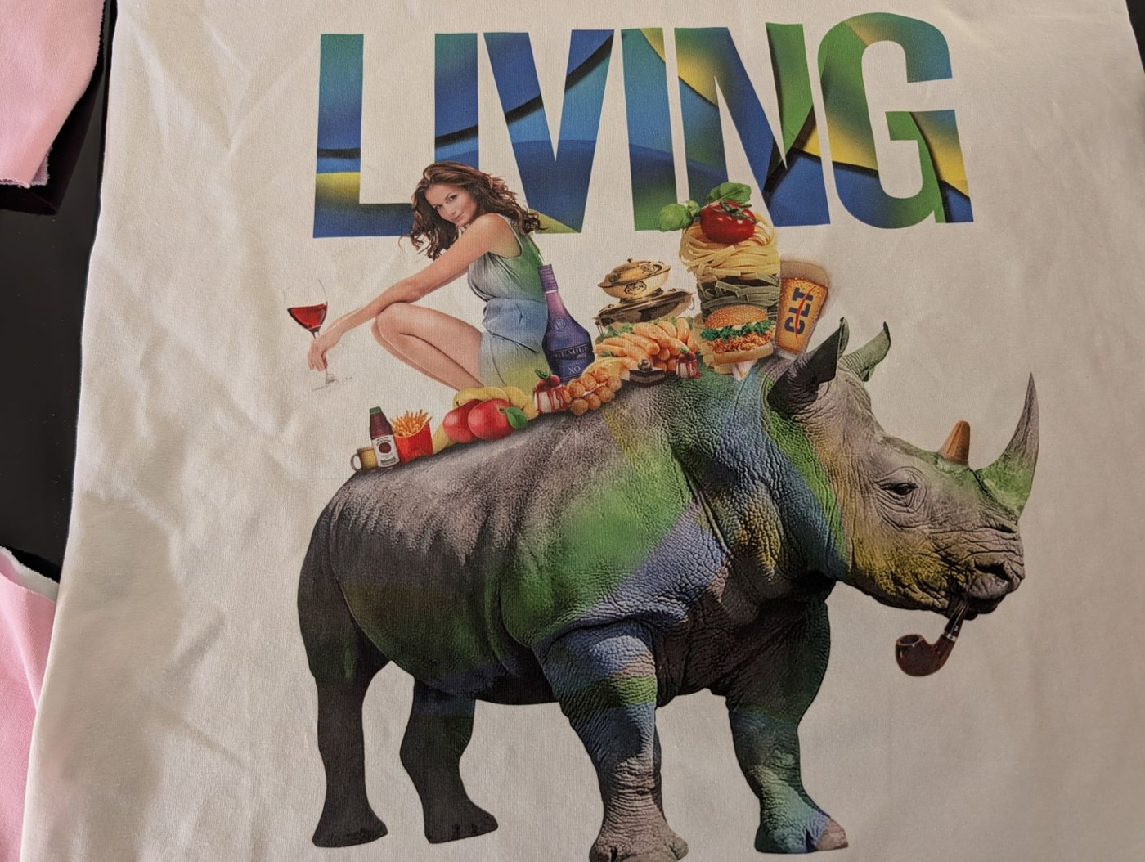
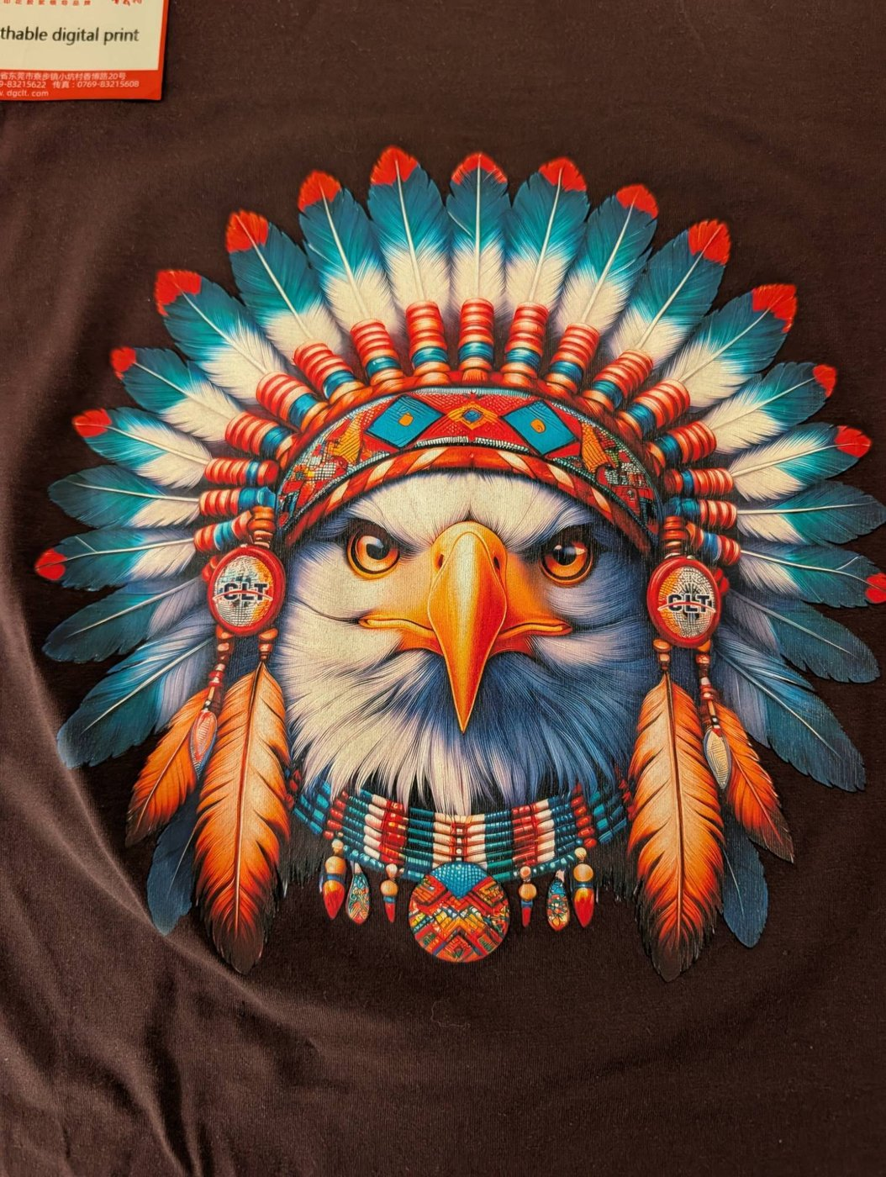
Samples: unlimited digital color
Digital watercolor over white base, colored garment
Photorealism on a dark garment
Full-color photographic collage
Breathable digital print

Slide 8
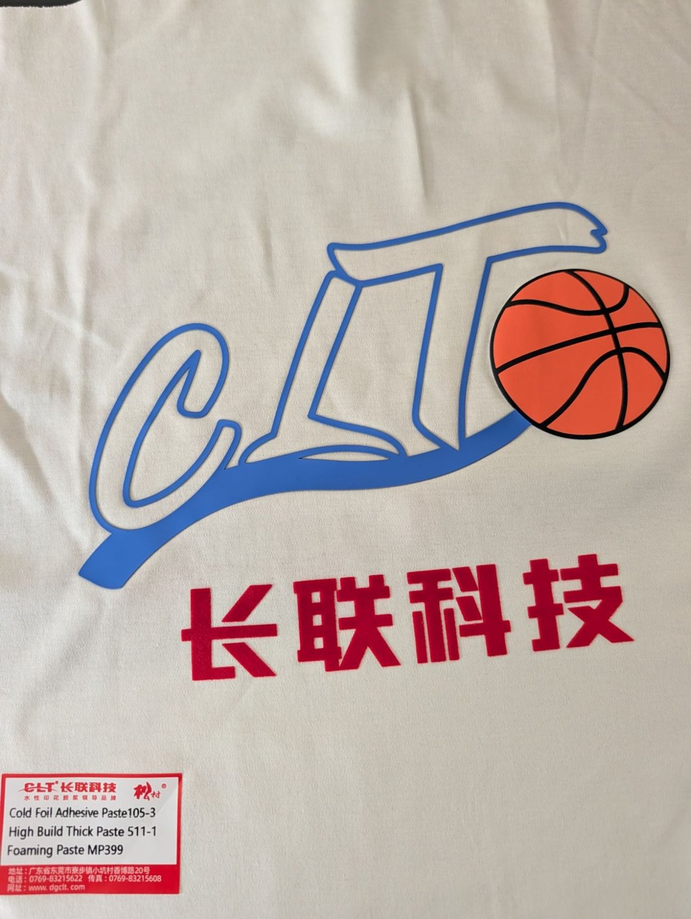

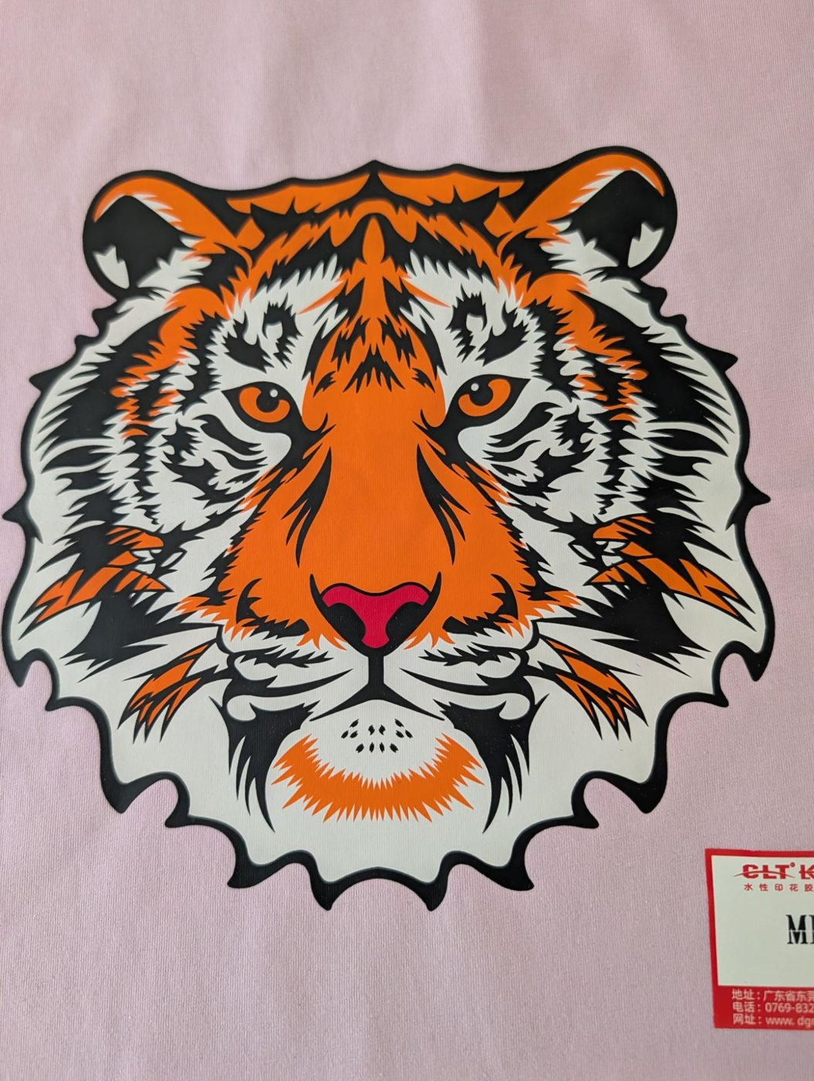
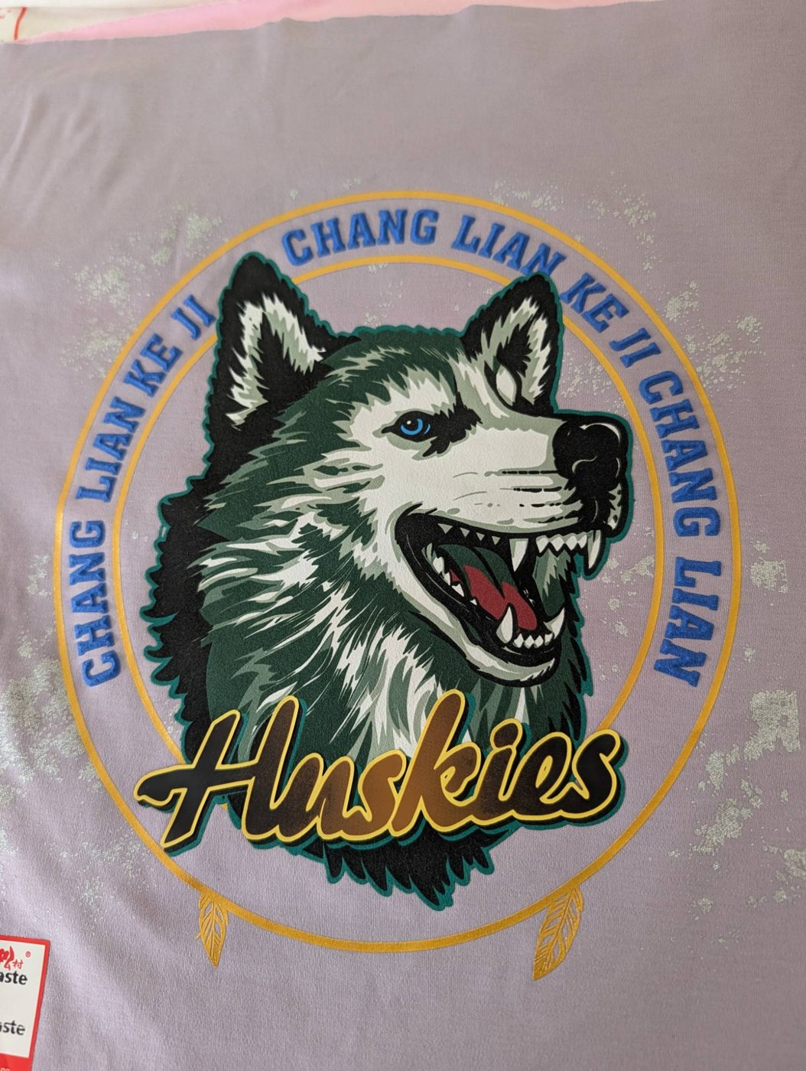
Samples: special effects and uniforms
High build, puff and cold foil
Sports crest with relief and shimmer
Spot-color screen print on colored garment
Relief, gold foil and metallic sparkle

Slide 9
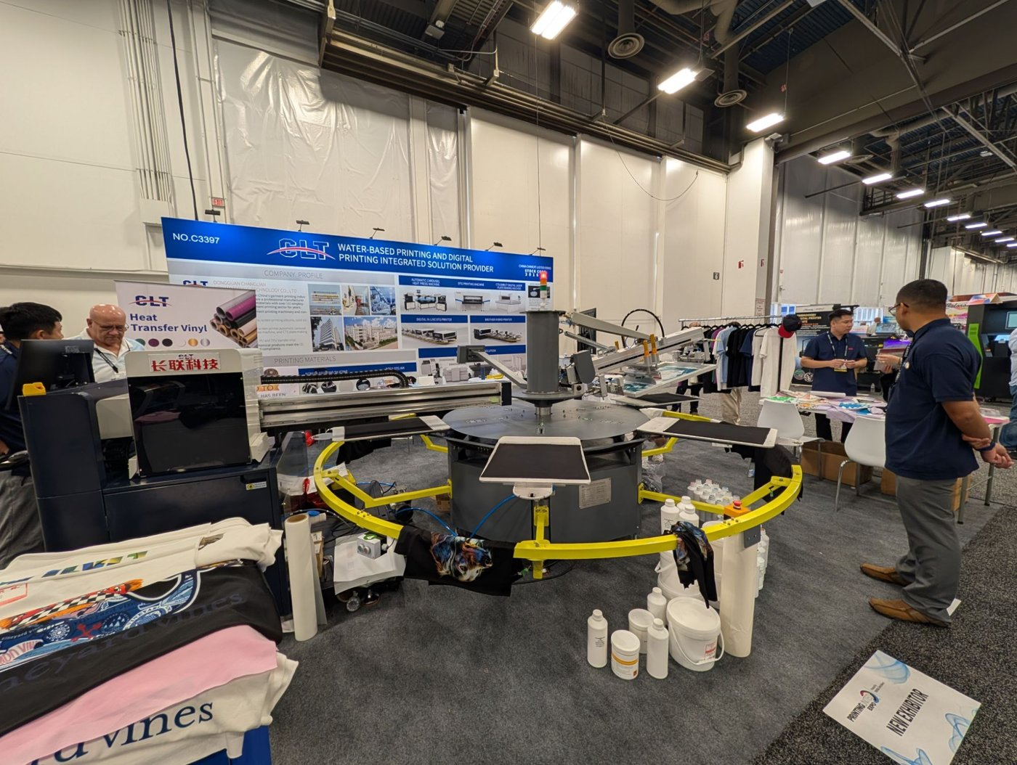
CLT at PRINTING United 2026 (Las Vegas)
Booth C3397
Hybrid line running live
Photos: VSP Printing
VSP meeting with CLT
Automatic carousel with a live digital station: this is how CLT sells, and how we will replicate it in Mexico

Slide 10
The Mexican market
02

Slide 11
An industry that needs to differentiate
MXN 91.2 B
102,492
519k
89%
textile & apparel GDP (2025)
businesses
jobs
of exports go to the U.S.
1
Low-cost imports pressure domestic makers (GDP -8.4% in 2023)
2
2026 tariffs: up to 35% on garments from non-FTA countries, including China
3
The answer: customization, short runs and high-value effects, exactly what hybrid printing does
INEGI 2023–2024 · CANAINTEX 2026 · DOF 2026

Slide 12
Market size
~102,500
Total market: all textile businesses
US$3.6–22M
in equipment over 5 years
~1,400–1,900
Serviceable: medium/large firms and shops with carousels
US$0.9–3M
30–90 lines
Obtainable in 5 years (2–5% adoption)
per year in consumables (50 lines)
Estimate — to be confirmed with CLT’s quotation

Slide 13
Priority regions
1
State of Mexico & CDMX
Printers, brands, promotional
1
Jalisco
Fashion, sportswear, domestic brands
1
Baja California
Export screen printing; TID + VSP at the border
2
Puebla & Tlaxcala
Export maquila, knitwear
2
Guanajuato
Knitwear, wholesale; 1–2 h from TID
3
Laguna, Ags., N.L., Yucatán
Denim, IMMEX, uniforms

Slide 14
80/20: priority prospects (9 of 47)
Company | City | What they do
ADN Serigrafía | Naucalpan, Edo. Méx. | Contract screen printing: 130,000+ pcs/week, up to 18 colors, production for the U.S. and Canada
Serigrafía Textil Automatizada (KW) | Puebla, Pue. | Automated volume screen printing: campaigns, sportswear and promo; 30+ years
Manufacturas Textiles RF (Reitex) | Guadalupe, N.L. | Integrated yarn-to-garment plant; high-volume campaign and promo T-shirts
Diermi (Playeras Mindy) | Zapopan, Jal. | Sports and promo T-shirts in a 5,000 m² automated plant; exports to the U.S.
GOCA'S | Ciudad de México | Large-scale T-shirts and hoodies with in-house screen, sublimation and embroidery; 25+ years
SerigrafiarteSP | Ciudad de México | Contract screen printing (plastisol, water-based, discharge), DTF and sublimation for factories and brands
Grupo Martex | Naucalpan, Edo. Méx. | High-volume textile maker; uniforms (directory cites FIFA uniforms)
Uniformes Carmen | Guadalajara, Jal. | Uniforms with screen, embroidery and transfer; volume print contracting; 30+ years
Charly (Grupo Charly) | León, Gto. | Sports brand: jerseys and licensed apparel for Liga MX clubs (León, Pachuca, Atlas, Santos)
17 of 82 accounts (20%) get 80% of the year-1 sales effort

Slide 15
80/20: priority OEMs (8 of 35)
Company | City | Brands and customers
Vertical Knits | Baca, Yuc. | Nike, Fanatics, Tommy Hilfiger, Patagonia
Ink Throwers de México | Tijuana, B.C. | Disney, Levi's, Marvel
MD International Baja | Ensenada, B.C. | Fanatics, Hurley, REI
Fortune Fashions Baja (Mad Engine) | Ensenada, B.C. | Mad Engine Global, Disney
SOIR Textiles (TJ Factory Clothing) | Ensenada, B.C. | Columbia, Disney
Factory 1 (Factory1 Group) | Ensenada, B.C. | Columbia, Disney
Codipsa (San Fernando ScreenPrinting) | Puebla, Pue. | Puma, Gap, Hot Topic, Macy's, Disney
RMC de México | Linares, N.L. | Under Armour, Nordstrom
17 of 82 accounts (20%) get 80% of the year-1 sales effort

Slide 16
Competition: the gap is local service
Type | Players | Reading
High-end DTG | Kornit (Sun Digital México) | High investment
Automatic presses | M&R, ROQ, MHM, Anatol | Customers for digital stations
Chinese hybrids | Textalk, Hanglory | No visible local structure
Silicones & pastes | ScreenTec (Siltex) | Consumables competition
Substitutes | DTF, sublimation | DTF growing in short runs

Slide 17
Import and regulation
1
CEB imports
2
2026 tariffs
Group company incorporated in Mexico; direct China → Mexico shipping
5–50% on non-FTA countries; confirm lines 8443, 3215 and 3910
3
16% VAT
4
USMCA
Creditable: affects cash flow, not cost
Maquiladoras require OEKO-TEX and fast response

Slide 18
Why TID · VSP · CEB
03

Slide 19
A group present in Mexico and the U.S.
TID México
VSP Printing
CEB
Querétaro
Los Angeles, CA
Mexico
12 years in industrial decoration. Sales, installation and service in Mexico. 2 technicians.
20+ years in industrial printing. U.S. service and technical backup. 1 technician.
VSP subsidiary. Imports CLT equipment and supplies.

Slide 20
Strengths and how we close the gaps
What we bring
Gap → action
Same turnkey model
Consumables-driven business
Technical service in Spanish
Mexico + U.S. coverage
In-house importer (CEB)
Textile experience → dedicated textile division
Textile chemistry → CLT certification
3 technicians → +2 textile technicians
Textile events → FESPA México
Demonstration → showroom with hybrid line

Slide 21
Dedicated team and training
Textile sales
Training program
1
Prospecting, demos, turnkey quotes and closing
Initial at CLT’s plant: machines, chemistry and certification
Customers – machines: operation, calibration and maintenance
Customers – products: silicones, pastes, curing and effects
Ongoing updates with CLT engineers
Customer service
2
Consumables orders, after-sales, warranties and service scheduling
Textile technician
3
Installation, maintenance and support; +1 technician in year 2
Existing support: 2 TID technicians, 1 VSP technician, CEB import and logistics

Slide 22
Plan and investment
04

Slide 23
A four-phase commercial plan
1
2
3
4
Months 0–6
Months 6–18
Months 18–36
Year 3+
Launch
Demonstration
Scale
Latin America
Agreement, hiring, training, consumables, FESPA
Demo showroom, first 2–5 lines
Priority clusters, U.S. via VSP
Central America, Colombia, Peru, D.R.

Slide 24
Initial investment
Recommended
Light
Base
Full
~US$53k
~US$262k
~US$450k
Demo on consignment or at an anchor shop; consumables first
Press + hybrid station, inventory, showroom, launch
Complete line incl. 6-station DTG
Year-1 operating expense: ~US$131k (sales, customer service, technician, training, shows)
Estimate — to be confirmed with CLT’s quotation

Slide 25
Projection: recurring revenue grows every year
Annual result
Year 1
-US$37k
Year 2
+US$89k
Year 3
+US$269k
Assumptions: US$150k line, 20% equipment / 35% consumables margin, ~US$36k consumption per line per year

Slide 26
The proposal
05

Slide 27
What we request and what we commit
We request from CLT
We commit to
Exclusivity in Mexico; LatAm subject to targets
~20% equipment / ~35% consumables margin
Demo on consignment or 30–50% off
Initial inventory on consignment or 90 days
Free training and certification
Mexican leads referred to TID / CEB
Import and local inventory (CEB)
Demo showroom and Spanish service
Sales, customer service and textile technician
Machine and product training
Targets: 2 · 5 · 8 lines in years 1–3
Quarterly reports

Slide 28
Risks and mitigation
!
Cash-strapped industry
!
DTF in short runs
Phased investment and financing
Focus on volume and effects
!
Tariffs
!
Textile learning curve
Confirmed lines; PROSEC; CEB
CLT certification and industry hires

Slide 29
Next steps
1
CLT formal quotation (CLT-016B, CLT-012R, SM60-85, consumables)
2
Meeting with CLT’s owners to review terms
3
Confirm duties with a customs broker
4
Validate consumption with 10–15 shops
5
Letter of intent and 6-month launch plan

Slide 30
Thank you
Carlos Moreno — TID México · carlos.moreno@tidmexico.com.mx · +52 446 479 4420

