Slide 1
Market Study: Hybrid Textile Printing
Opportunity for CLT in Mexico, Latin America and the U.S.
TID México · VSP Printing, Inc. · CEB | October 2026

Slide 2
The study on one page
~1,900
82
180
0
reachable companies in Mexico
prospects in Mexico (35 OEMs)
prospects in Latin America
formal distributors of Chinese hybrids
A market without an owner: the industry needs to stand out, and nobody in Mexico offers a hybrid solution with local chemistry and service.

Slide 3
Contents
01
Scope and methodology
02
The manufacturer: CLT
03
Mexican market
04
Priority accounts (80/20)
05
Competition
06
Trade
07
Latin America and the U.S.
08
Conclusions

Slide 4
Scope and methodology
01

Slide 5
Study parameters
Parameter | What we analyzed
Market | Hybrid equipment, consumables (silicones, pastes, inks) and service; substitutes: screen, DTG, DTF, sublimation
Segments | Export contractors, industrial printers, uniforms and sportswear, brands, shops
Size | Total, reachable and capturable market (TAM / SAM / SOM)
Geography | 9 regions in Mexico + Central America, the Caribbean and South America
Competition | DTG, automatic carousels, Chinese hybrids, inks and silicones
Trade | 2026 tariffs, import through CEB, USMCA
Sources: CLT (website and 2025 annual report), INEGI, CANAINTEX, FESPA México, DOF, Open Supply Hub, company websites and online stores.

Slide 6
The manufacturer: CLT
02

Slide 7
CLT: a chemistry company that sells machines
2009
¥568M
founded, Dongguan
2025 revenue (~US$80M)
301618
18%
Shenzhen Stock Exchange (ChiNext)
export sales
Source: CLT 2025 annual report

Slide 8
CLT portfolio relevant to Mexico
1
Hybrids
2
Oval carousels
CLT-012R/015R/018R (Ricoh, 450 pcs/h) and CLT-014B/016B/018B (Brother, 400 pcs/h)
SM45-85, SM60-85, SM70-95: up to 800 pcs/h, ±0.02 mm
3
DTG and DTF
4
Chemistry
6-station DTG with inline pretreatment; industrial DTF CLT-6900
3D, glass and special silicones (S-1701, S-1703, S-1704-1, S-1714-1); water-based pastes
Certifications stated by CLT: OEKO-TEX, GOTS, ISO 9001 and ISO 14001.

Slide 9
Hybrid technology: the best of two processes
1
Screen base
2
Digital color
3
Special effects
White and effects with low-cost paste: puff, foil, glitter, discharge
Ricoh or Brother heads: photographic gradients, unlimited colors
Glass-like, embroidery-like or 3D silicone over the print
400–450
40–70%
500–5,000
pieces per hour
ink savings vs DTG
pieces: profitable run

Slide 10
How CLT sells today
1
Live-demo trade shows
2
Turnkey package
3
Phased investment
Tests on the customer’s fabric and same-day quote
Machine, chemistry, installation, training and logistics
Press first, digital stations later
4
ROI-based selling
5
Linked consumables
6
Digital lead capture
Savings in ink, operators and floor space
Warranty with genuine chemistry and parts
Multilingual site and WhatsApp
Missing in Mexico: local technical service, in-country inventory, Spanish-language support and a demo showroom

Slide 11
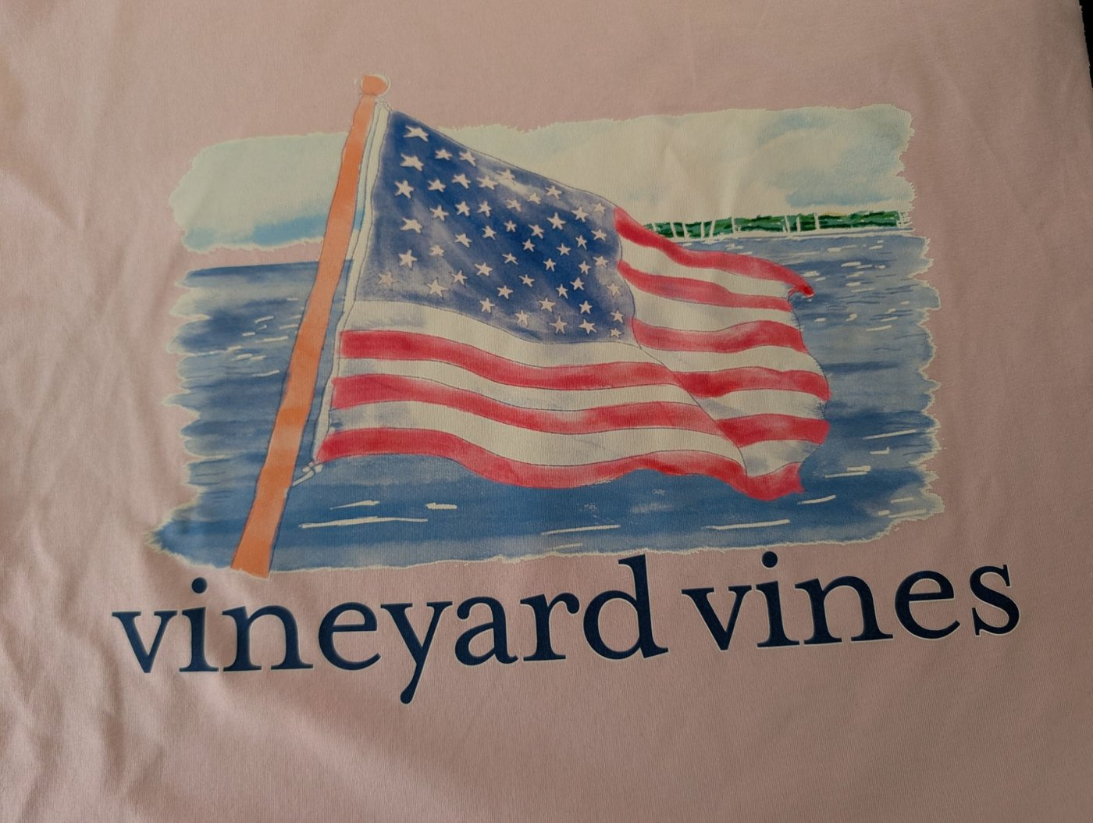
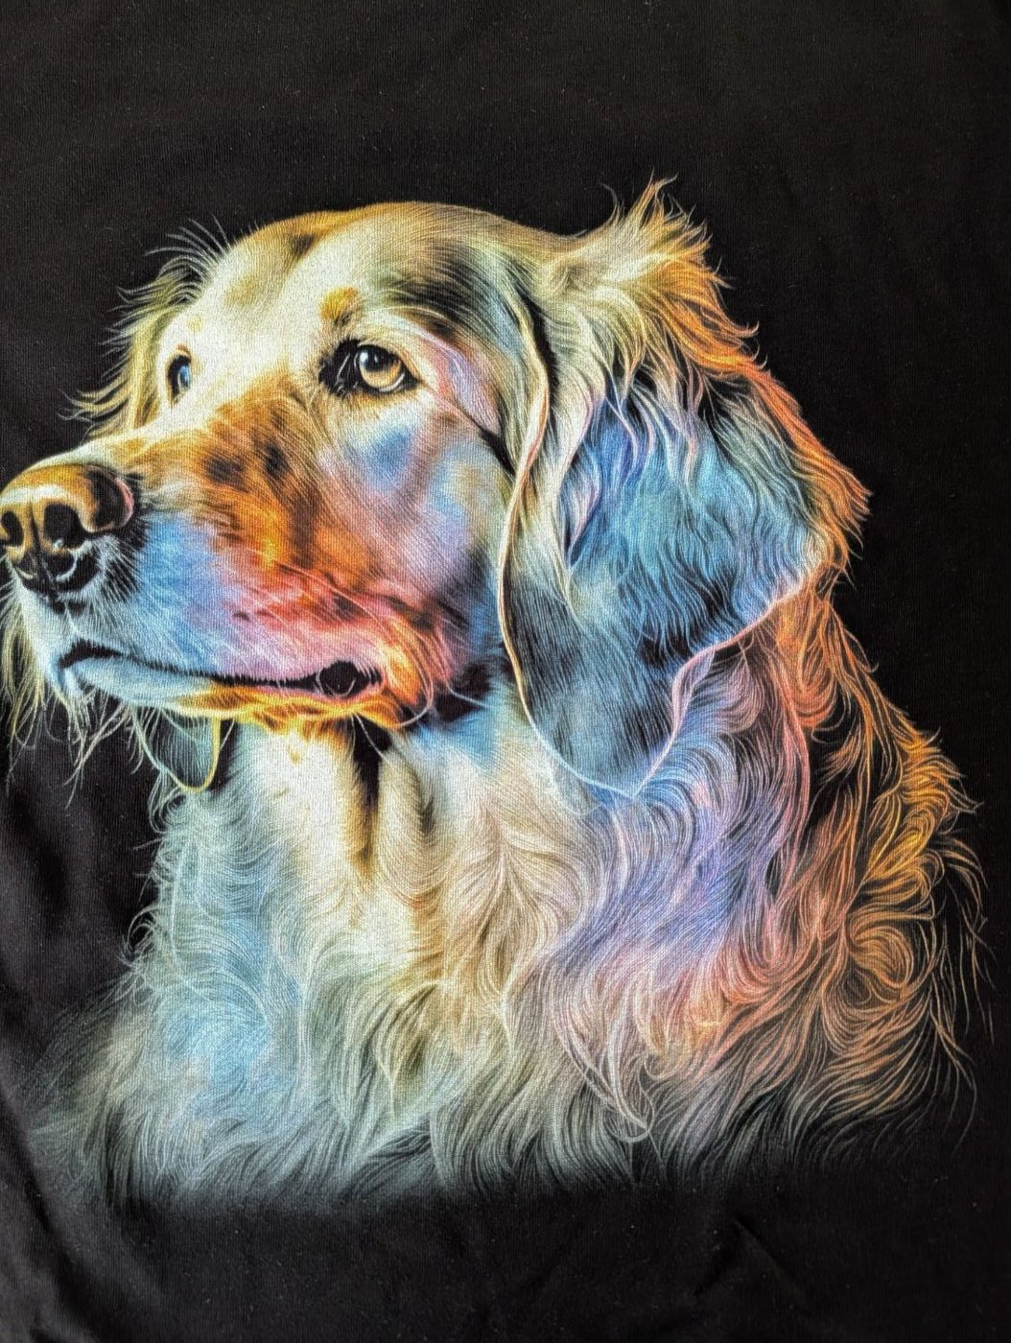
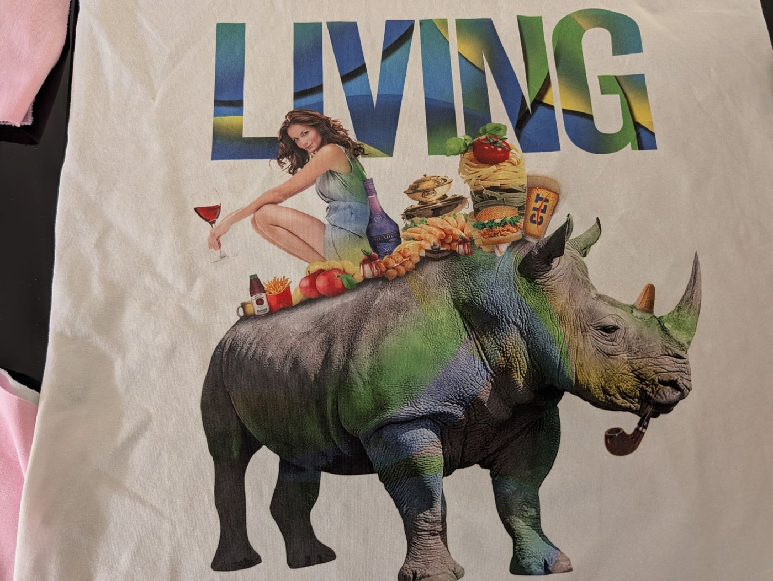
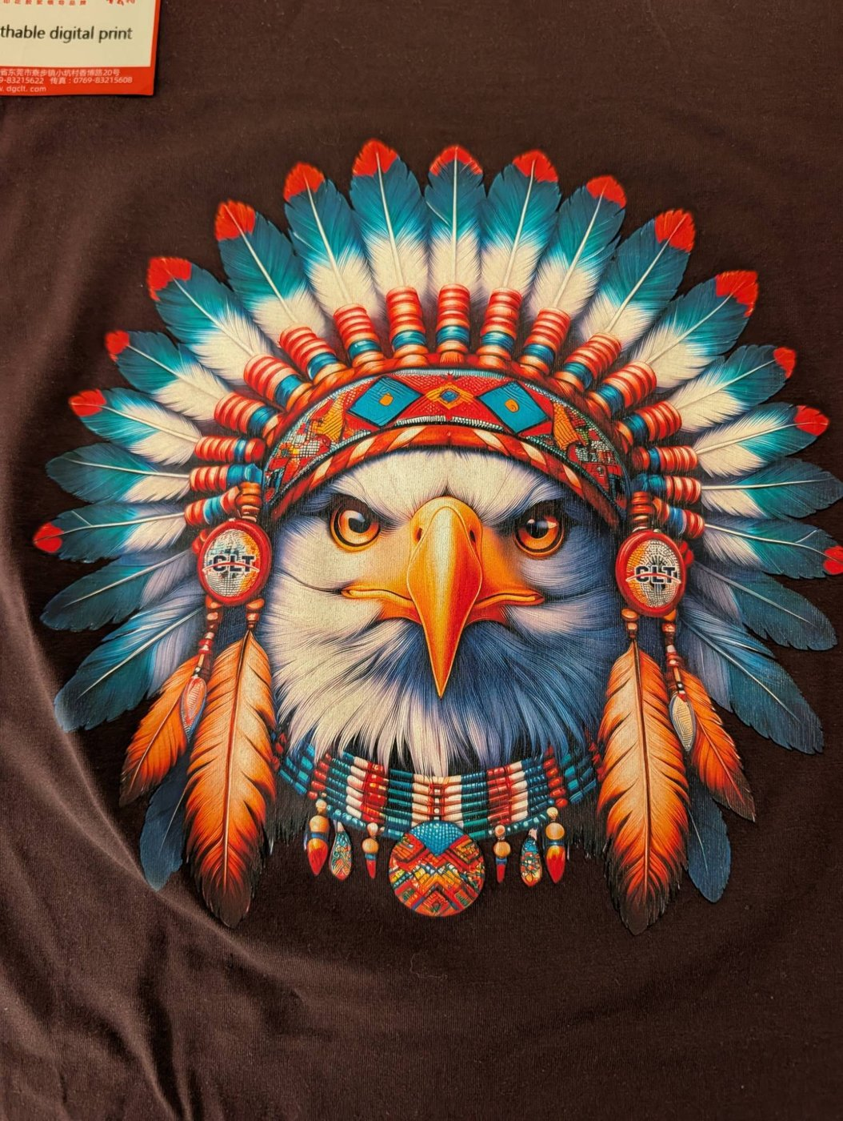
Samples: unlimited digital color
Digital watercolor over white base, colored garment
Photorealism on a dark garment
Full-color photographic collage
Breathable digital print

Slide 12
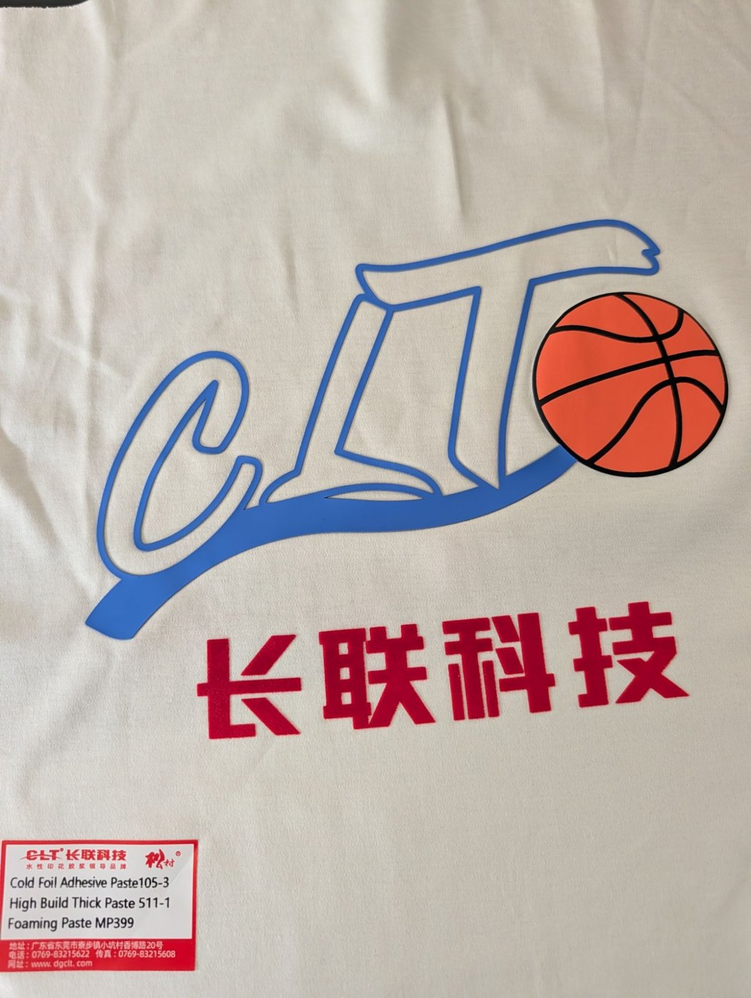

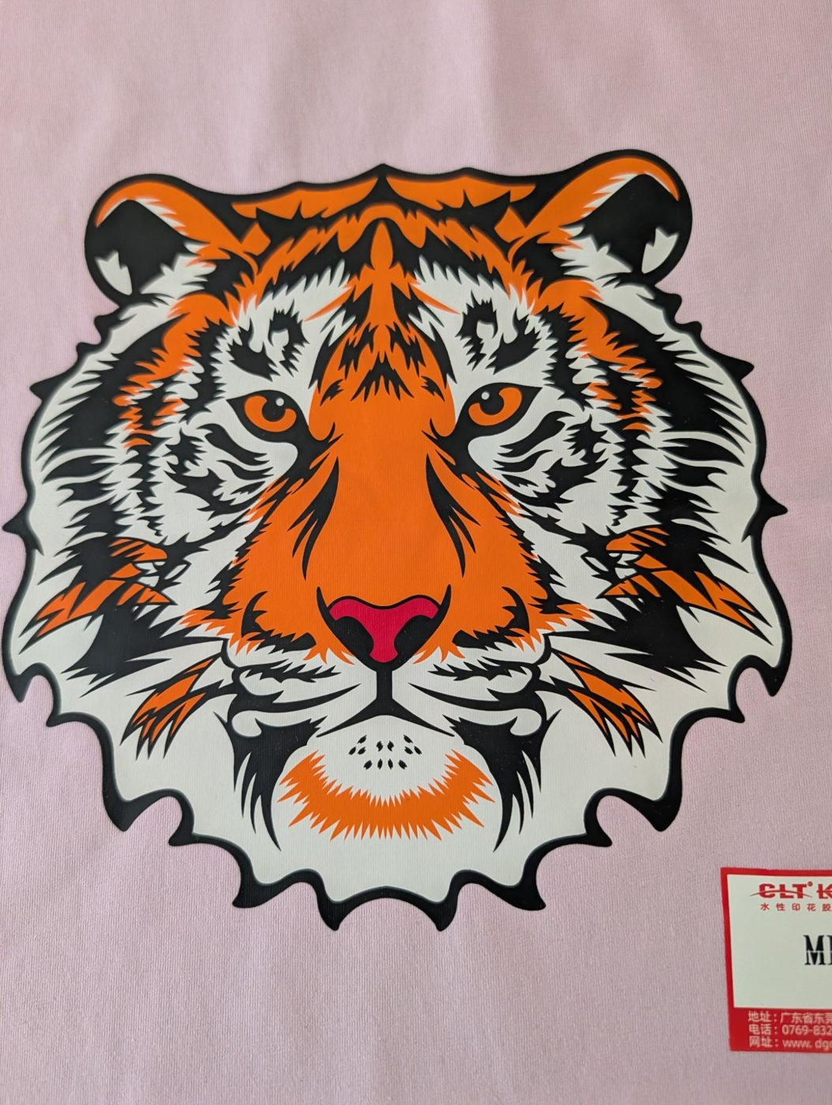
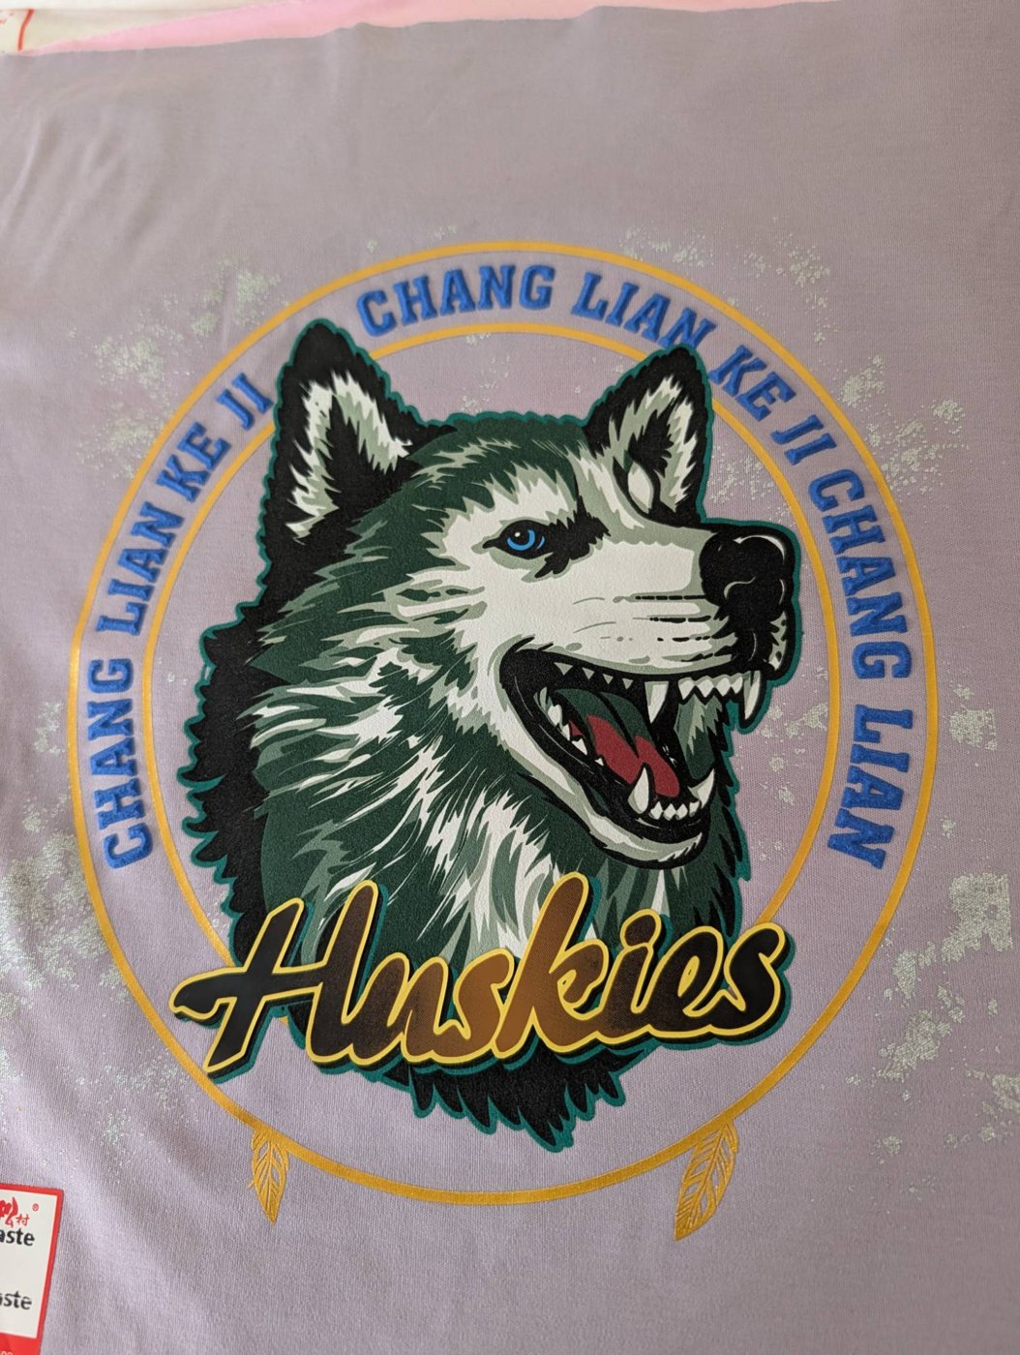
Samples: special effects and uniforms
High build, puff and cold foil
Sports crest with relief and shimmer
Spot-color screen print on colored garment
Relief, gold foil and metallic sparkle

Slide 13
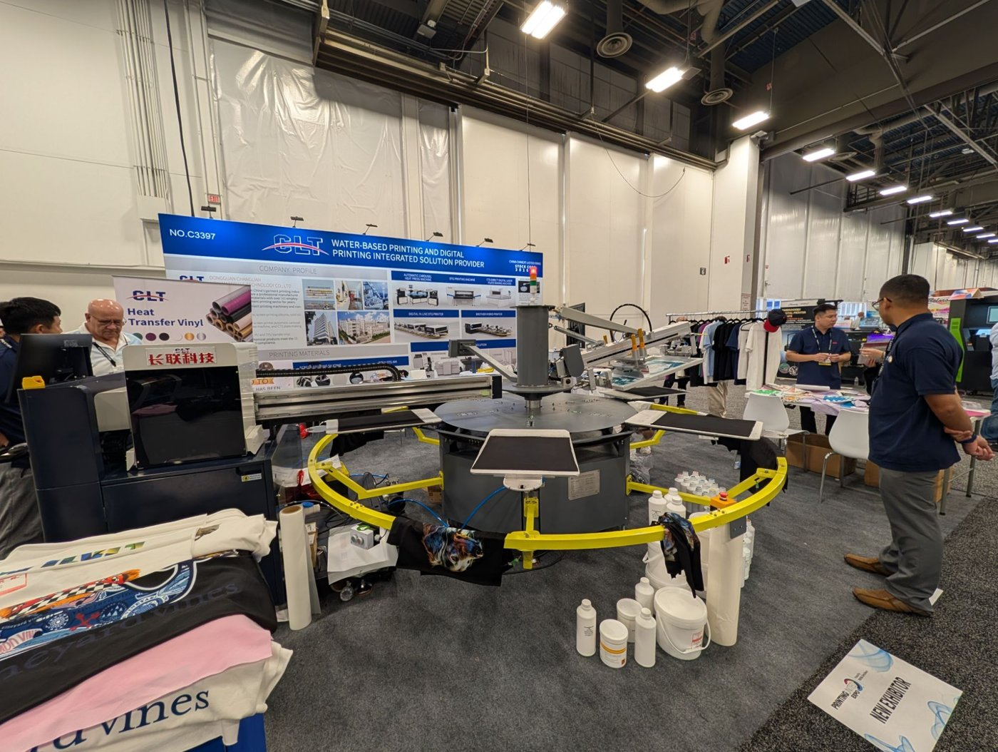
CLT at PRINTING United 2026 (Las Vegas)
Booth C3397
Hybrid line running live
Photos: VSP
VSP Printing meeting with CLT
Automatic carousel with a live digital station: this is how CLT sells, and how we will replicate it in Mexico

Slide 14
Mexican market
03

Slide 15
An industry that needs to differentiate
MXN 91.2 B
102,492
519k
89%
textile & apparel GDP (2025)
businesses
jobs
of exports go to the U.S.
1
Low-cost imports pressure domestic makers (GDP -8.4% in 2023)
2
2026 tariffs: up to 35% on garments from non-FTA countries, including China
3
The answer: customization, short runs and high-value effects, exactly what hybrid printing does
INEGI 2023–2024 · CANAINTEX 2026 · DOF 2026

Slide 16
Industry structure
US$9.3 B
exports (89% to the U.S.)
US$13.3 B
imports (35% from China)
1,130
medium and large firms: the core of the market
INEGI (Censo 2019 y 2023)

Slide 17
Market size
~102,500
Total market: all textile businesses
US$3.6–22M
in equipment over 5 years
~1,400–1,900
Serviceable: medium/large firms and shops with carousels
US$0.9–3M
30–90 lines
Obtainable in 5 years (2–5% adoption)
per year in consumables (50 lines)
Estimate — to be confirmed with CLT’s quotation

Slide 18
Priority regions
1
State of Mexico & CDMX
Printers, brands, promotional
1
Jalisco
Fashion, sportswear, domestic brands
1
Baja California
Export screen printing; TID + VSP at the border
2
Puebla & Tlaxcala
Export maquila, knitwear
2
Guanajuato
Knitwear, wholesale; 1–2 h from TID
3
Laguna, Ags., N.L., Yucatán
Denim, IMMEX, uniforms

Slide 19
82 prospects in 13 regions of Mexico
17
priority A
33
priority B
35
export OEMs
Source: company websites, Open Supply Hub and directories; details in the prospects workbook.

Slide 20
Priority accounts
04

Slide 21
80/20: printers and manufacturers (9 of 47)
Company | City | What they do
ADN Serigrafía | Naucalpan, Edo. Méx. | Contract screen printing: 130,000+ pcs/week, up to 18 colors, production for the U.S. and Canada
Serigrafía Textil Automatizada (KW) | Puebla, Pue. | Automated volume screen printing: campaigns, sportswear and promo; 30+ years
Manufacturas Textiles RF (Reitex) | Guadalupe, N.L. | Integrated yarn-to-garment plant; high-volume campaign and promo T-shirts
Diermi (Playeras Mindy) | Zapopan, Jal. | Sports and promo T-shirts in a 5,000 m² automated plant; exports to the U.S.
GOCA'S | Ciudad de México | Large-scale T-shirts and hoodies with in-house screen, sublimation and embroidery; 25+ years
SerigrafiarteSP | Ciudad de México | Contract screen printing (plastisol, water-based, discharge), DTF and sublimation for factories and brands
Grupo Martex | Naucalpan, Edo. Méx. | High-volume textile maker; uniforms (directory cites FIFA uniforms)
Uniformes Carmen | Guadalajara, Jal. | Uniforms with screen, embroidery and transfer; volume print contracting; 30+ years
Charly (Grupo Charly) | León, Gto. | Sports brand: jerseys and licensed apparel for Liga MX clubs (León, Pachuca, Atlas, Santos)
17 of 82 accounts (20%) receive the year-1 sales focus

Slide 22
80/20: export OEMs (8 of 35)
Company | City | Brands and customers
Vertical Knits | Baca, Yuc. | Nike, Fanatics, Tommy Hilfiger, Patagonia
Ink Throwers de México | Tijuana, B.C. | Disney, Levi's, Marvel
MD International Baja | Ensenada, B.C. | Fanatics, Hurley, REI
Fortune Fashions Baja (Mad Engine) | Ensenada, B.C. | Mad Engine Global, Disney
SOIR Textiles (TJ Factory Clothing) | Ensenada, B.C. | Columbia, Disney
Factory 1 (Factory1 Group) | Ensenada, B.C. | Columbia, Disney
Codipsa (San Fernando ScreenPrinting) | Puebla, Pue. | Puma, Gap, Hot Topic, Macy's, Disney
Industrias Manufactureras MYR | Irapuato, Gto. | adidas, Puma
17 of 82 accounts (20%) receive the year-1 sales focus

Slide 23
Competition
05

Slide 24
Competition: the gap is local service
Type | Players | Reading
High-end DTG | Kornit (Sun Digital México) | High investment
Automatic presses | M&R, ROQ, MHM, Anatol | Customers for digital stations
Chinese hybrids | Textalk, Hanglory | No visible local structure
Inks & silicones | ScreenTec, Avient, Matsui | Price vs. brand approvals
Substitutes | DTF, sublimation | DTF growing in short runs

Slide 25
Competitors in inks, pastes and silicones
Brand (origin) | Reference price | Threat
Avient: Wilflex, Rutland, Union Ink, Printop (U.S.) | High: ~US$40–60/gallon for mixing colors; specialties US$90–310/gallon (U.S. stores) | High with OEMs
Grupo Sánchez / ScreenTec: Seritex, Aquatex, Siltex (Mexico) | Low: MXN 159–217/kg retail (Seritex) | High with shops
Matsui (Japan) | Mid-high; bases from ~US$8–9/kg in Central America | Mid-high
International Coatings (U.S.) | Mid | Mid
Marabu (Germany) | High | Low: limited textile range (nylon, synthetics)
RUCO / RUCOINX (Germany) | High | Low: industrial inks for plastic, glass and metal
Tampoprint (Germany) | High | Low: tagless labels only
Low-cost Mexican brands: Dyssa, Celi Colors, Quitexa, De la Rana | Very low: plastisol white ~MXN 790/gallon | Mid with small shops
Direct Chinese suppliers (Alibaba) | Very low: silicone ~€3.5–5.2/kg | Mid: same origin as CLT
Comex does not make textile screen printing inks: it is an architectural paint brand. Public prices as of October 2026, for reference only; CLT’s price for Mexico is to be confirmed.

Slide 26
SWOT by competitor
Competitor | Strengths | Weaknesses | Opportunity for CLT | Threat to CLT
Avient (Wilflex, Rutland) | Global brand; certified inks approved by brands; full range | High price; imported; very expensive specialties | Silicones and special effects at a lower price; water-based | Export brands already have approved inks: switching is slow
Grupo Sánchez / ScreenTec | Domestic maker; low price; dealer network; Siltex silicones | No machines or hybrid line; focus on the domestic market | Turnkey package: machine + chemistry + service | Price war in consumables
Matsui | Benchmark in water-based, discharge and specialties | Imported; mid-high price | Water-based pastes are 54% of CLT’s sales | Already inside large contractors and shops
Marabu, RUCO, Tampoprint | German quality; strong in graphics, pad printing and industry | Little offer for garment printing | Not head-on competitors in apparel | Tagless label and synthetics niche
Low-cost Mexican brands | Very low price; sold in every store | Uneven quality; no certifications or technical support | Growing shops that need consistent quality | Price war in small shops
Direct Chinese suppliers | Lowest price | No service, no local stock, no warranty | Local service, stock and Spanish-speaking technicians | Same origin: customers compare price against CLT

Slide 27
SWOT: CLT + TID position against the competition
Strengths
Weaknesses
Only turnkey offer: hybrid machine + chemistry + service
CLT chemistry priced below premium brands
Service in Mexico and the U.S.; own importer (CEB)
CLT brand little known in Mexico
No export-brand ink approvals yet
Textile team still to be built
Opportunities
Threats
2026 tariffs on Chinese apparel: more local production
Export OEMs want high-value effects
Few local suppliers of silicones and special effects
Avient tied to brands’ approved-ink lists
Low prices from ScreenTec and Mexican budget brands
DTF in short runs
Tariffs on Chinese inputs

Slide 28
Trade
06

Slide 29
Import and regulation
1
CEB imports
2
2026 tariffs
Group company incorporated in Mexico; direct China → Mexico shipping
5–50% on non-FTA countries; confirm lines 8443, 3215 and 3910
3
16% VAT
4
USMCA
Creditable: affects cash flow, not cost
Maquiladoras require OEKO-TEX and fast response

Slide 30
Latin America and the U.S.
07

Slide 31
Latin America: 180 prospects in 16 countries
42
priority A
44
Central America: contractors for U.S. brands
41 + 35
Colombia and Brazil

Slide 32
Latin America: priority A accounts
Company | Country | Type
TCPL The Caribbean Print Limitada S.R.L. | República Dominicana | Contract printer
The Willbes Dominicana Inc. | República Dominicana | OEM / full-package contractor
The Willbes Haitian | Haití | Contract printer
Cygnus Investments | El Salvador | Contract printer
Techno Screen | El Salvador | Contract printer
ACSA Colors Printing | Guatemala | Contract printer
Topy Top | Perú | OEM / full-package contractor
Industrias Nettalco | Perú | OEM / full-package contractor
Grupo Malwee | Brasil | Marca de moda
Lunelli | Brasil | Marca de moda
Grupo Kyly | Brasil | Marca de moda
Brandili Têxtil | Brasil | Marca de moda
Focus accounts first (volume printing or M&R / hybrid equipment); the rest of priority A is in the workbook.

Slide 33
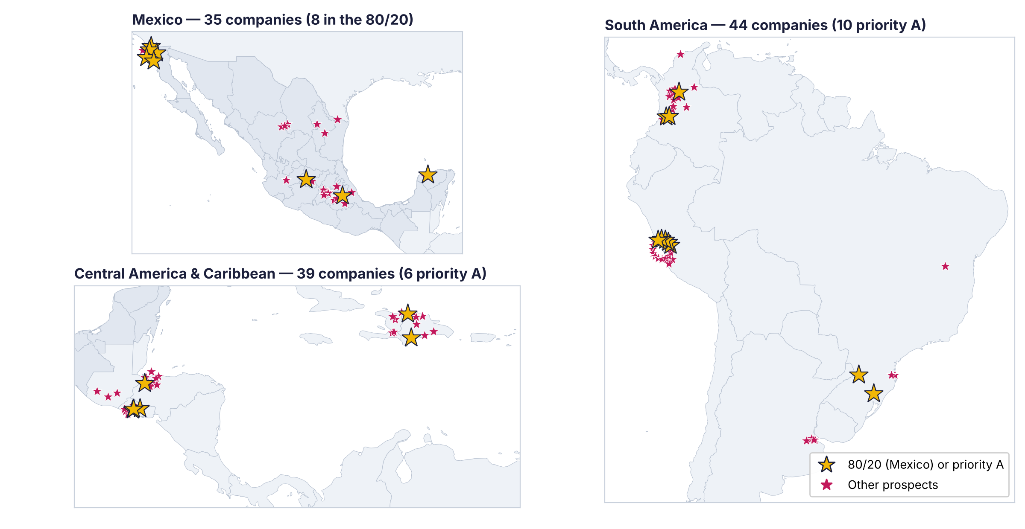
LATAM map: OEM prospects (export contract manufacturing)
Gold star: 80/20 account in Mexico or priority A elsewhere in LATAM. Numbered account list in mapas/ and in the prospects workbook.

Slide 34
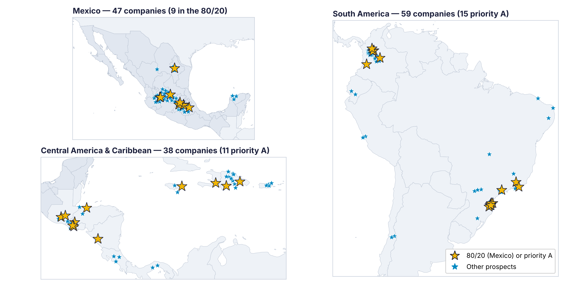
LATAM map: printers and manufacturers
Gold star: 80/20 account in Mexico or priority A elsewhere in LATAM. Numbered account list in mapas/ and in the prospects workbook.

Slide 35
Expansion path
1
Wave 1 · years 2–3
2
Wave 2 · year 3
3
Wave 3 · years 3–4
El Salvador, Honduras, Guatemala
Peru and Colombia
Dominican Rep., Haiti and others
Contractors printing for Hanes, Gildan, Tegra; sold from Mexico
Export cotton and knitwear; local agent with TID support
Free zones with screen printing (Gildan, Hansae)
U.S.: VSP Printing (California) provides local service and covers OEM headquarters; CLT already exhibits at PRINTING United.

Slide 36
Conclusions
08

Slide 37
Conclusions
1
Mexico’s industry must stand out against imports: hybrid printing answers that need.
2
The reachable market is concentrated (~1,900 firms): it is won with consultative selling to a few large accounts.
3
Nobody owns the category: no formal distributor of Chinese hybrids and no turnkey offer with local service.
4
Ink competition is premium (Avient, Matsui) or cheap (ScreenTec, local brands): CLT competes with package and service.
5
2026 tariffs and USMCA favor producing in Mexico; Central America and Peru are the next wave.

Slide 38
Recommendations and next steps
1
Formal CLT quotation to replace estimates
2
Validate consumption and prices with 10–15 shops
3
Open the demo room and work the 17 80/20 accounts
4
Confirm tariffs and HS codes with a customs broker
5
Prepare the Central America entry (year 2)

Slide 39
Thank you
Carlos Moreno — TID México · carlos.moreno@tidmexico.com.mx · +52 446 479 4420

