Slide 1
Gator App
Cristian Patino
Carlos Parlour

Slide 2
Motivations
this app will make studying on the go easier
A uSER DRIVEN ENVIRONMENT

Slide 3
Motivations
Provide additional tools for new/current CS students.
Helps students to finish UHD strong.

Slide 4
Uses
Not to be used as a source to upload Exam, Homework and Quizzes
User can request topics and upload requested material through feedback app
Items are subject to review
Not a place where users can ask questions

Slide 5
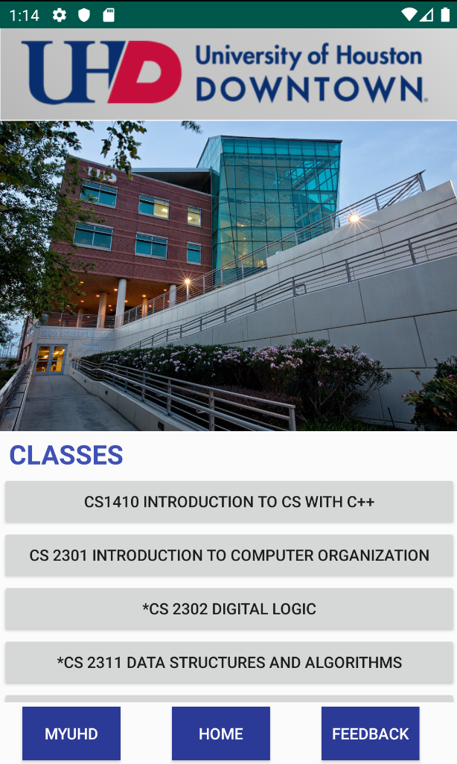
App Functions
Scroll view section with some of the Computer Science classes offered at UHD
3 fixed buttons
MYUHD
- Redirects you to MyUHD login page
Home
- Redirects you to App Home Screen
FEEDBACK
- Redirects you to Google Survey Form

Slide 6
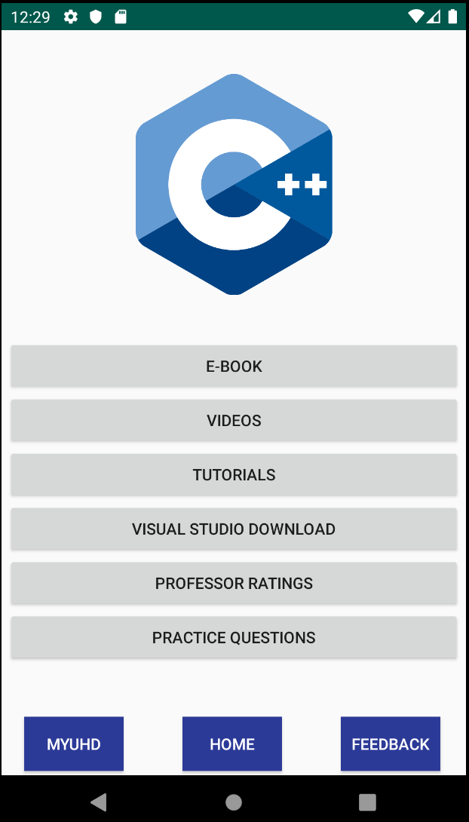
App Functions
Scroll view section with the materials we offer for this class
3 fixed buttons
MYUHD
- Redirects you to MyUHD login page
Home
- Redirects you to App Home Screen
FEEDBACK
- Redirects you to Google Survey Form

Slide 7
Potential Additions
Discussion board
Map of where students are studying
Adding more Majors and classes

Slide 8
End
Question?

