Slide 1

Gator App
Cristian Patino
Carlos Parlour

Slide 2

Motivations
Help students to finish UHD strong.
Provide additional tools for new/current CS students.
PROVIDE ADDITIONAL TOOLS FOR NEW/CURRENT CS STUDENTS

Slide 3
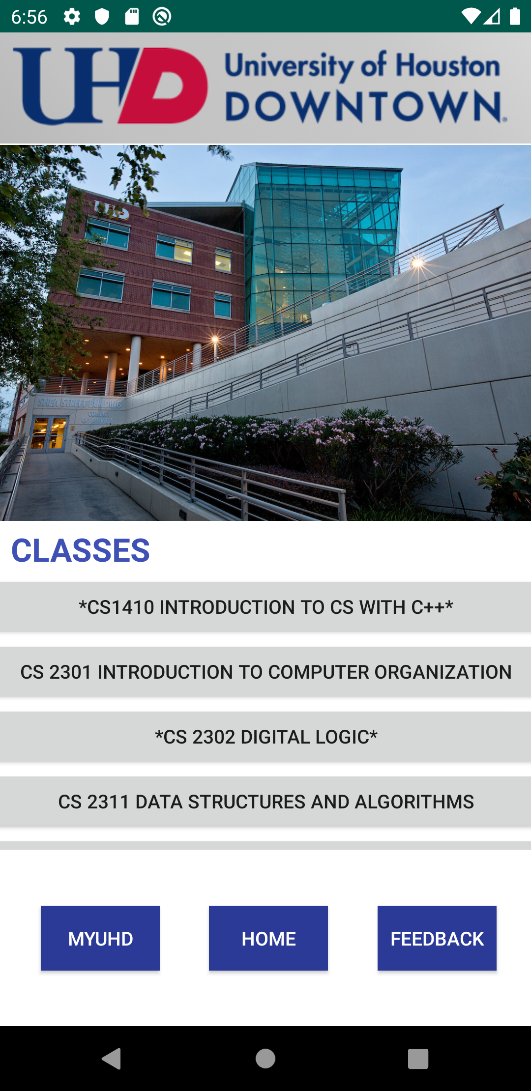
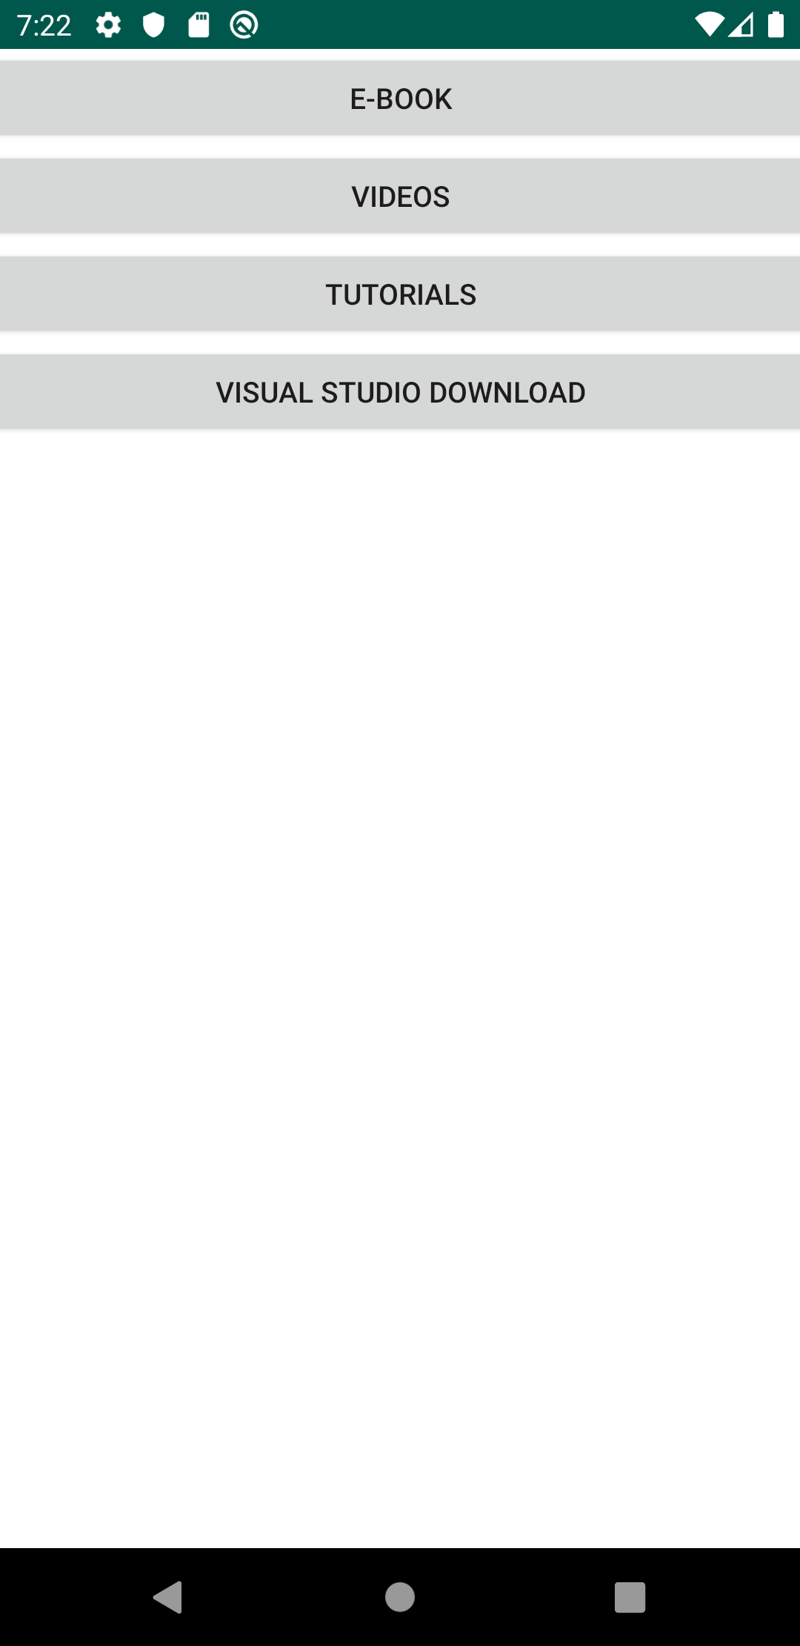
App Functions
Displays Computer Science Classes
MYUHD
HOME
*Feedback
E-Book
Videos
Tutorials
Additional material/Download Software needed.

Slide 4
Potential Additions
Feedback
Adding more major and classes, etc

