Slide 1
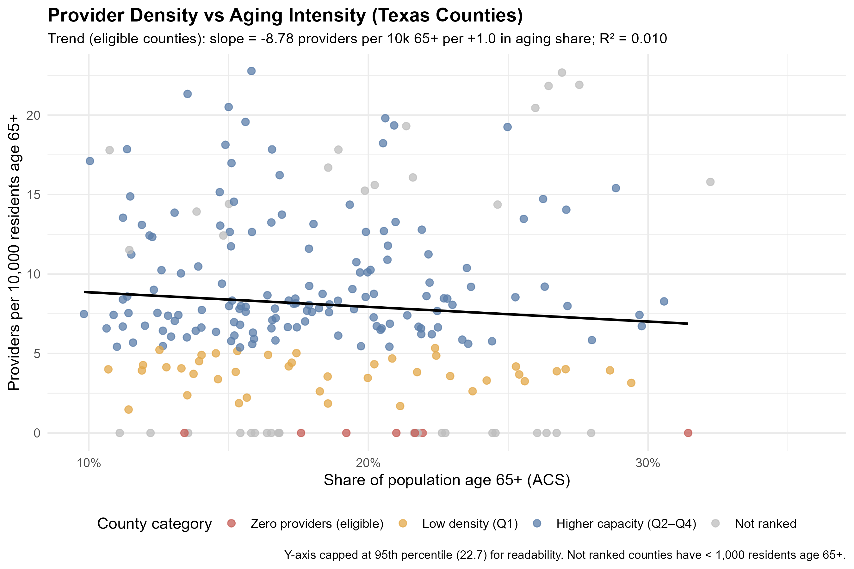
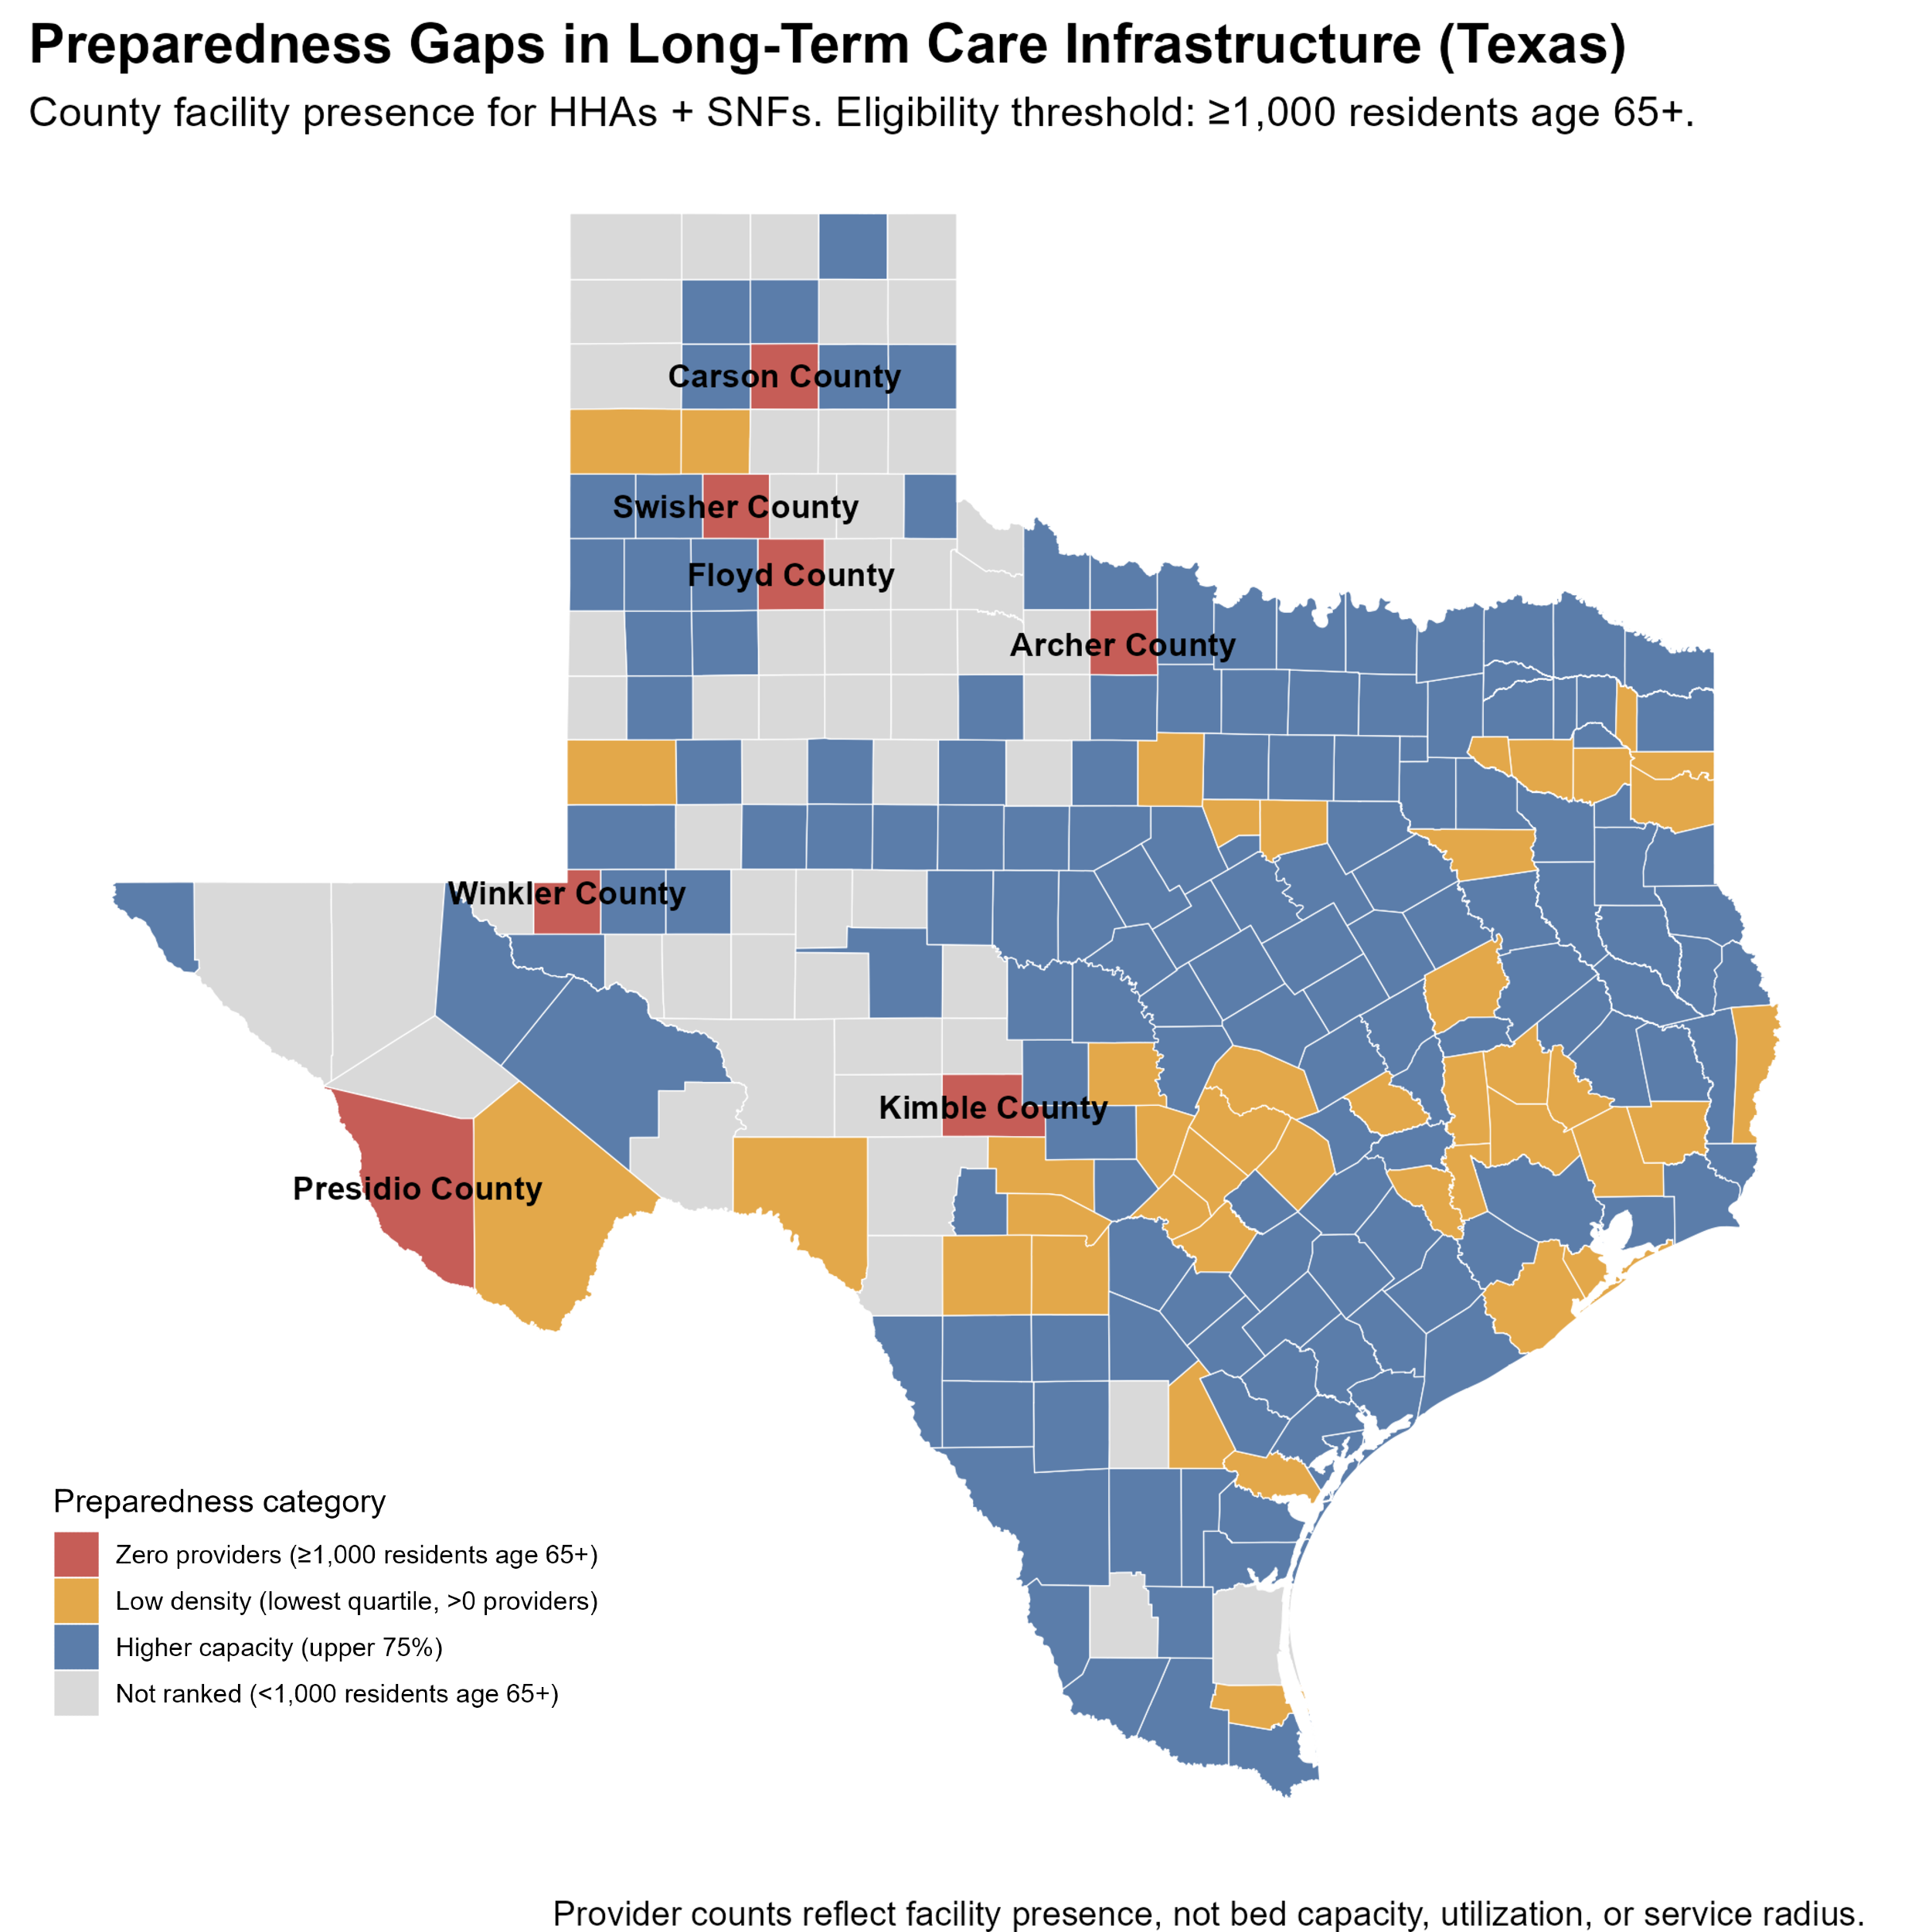

Is Texas Prepared for Its Aging Population?
Texas State
Datathon 2026
Wild Card
Suburban growth counties show lower aging-care provider density than urban cores across multiple Texas metros.
By Carlos Perez (Graduate Student - Health Information Management)
Background
Texas is experiencing rapid growth in its population age 65 and older. As communities age, local healthcare infrastructure must scale to support healthy aging and Medicare access.
This study evaluates whether county-level aging care infrastructure, including skilled nursing and home health services, aligns with demographic demand across Texas.
Research Question
Are Texas counties structurally prepared to support their aging populations, or are infrastructure gaps emerging in suburban and rural regions?
Why This Matters
Uneven infrastructure distribution may create geographic disparities in access to aging-related services.
This analysis directly aligns with the Aging Populations Wild Card by assessing community-level readiness for demographic aging.
Defining a Community Preparedness Metric
Interpretation
Infrastructure alignment varies significantly across Texas.
Preparedness gaps are not limited to small rural counties and may emerge in fast-growing suburban regions where demographic aging is accelerating.
This suggests structural readiness does not automatically scale with population growth.
Why This Matters for Aging Populations
Local infrastructure is foundational to healthy aging.
Counties with limited provider presence may experience increased travel burden, delayed post-acute care, and greater geographic disparities in Medicare-supported services.
Preparedness is defined as:
$$\text{Providers} \text{per} \text{10}\text{,}\text{000} \text{residents} \text{age} \text{65}\text{+}$$
Providers = Skilled Nursing Facilities (SNF)
Home Health Agencies (HHA)
Denominator = County-level population age 65+ (ACS 2019–2023 5-year estimate)
Counties were classified as:
• Zero providers with at least 1,000 residents age 65+
• Low density (lowest quartile among eligible counties)
• Moderate density (middle quartiles, Q2–Q3)
• Higher capacity (upper 75 percent)
This metric assesses structural infrastructure relative to aging demand. Quartiles based on providers per 10,000 residents age 65+ among eligible Texas counties (≥1,000 seniors).
Larger aging populations do not consistently correlate with higher provider density.
Identifying structural misalignment supports proactive regional planning.
Identifying counties where infrastructure lags demographic growth can inform proactive planning and more equitable resource allocation.
A County-Level Analysis of Senior Care Infrastructure
Key Findings
• Several large suburban counties fall into low preparedness tiers despite substantial aging populations.
• Seven eligible counties have zero identified providers.
• Infrastructure is concentrated in metro cores, with uneven distribution across surrounding regions.
Seven counties with over 1,000 seniors have zero providers.
Top 5 Texas Counties
by Population Age 65+
County Name | Population Age 65+ | Providers per 10,000 (65+) | Quartile
Harris County | 543,463 | 7.54 | Q3
Dallas County | 298,992 | 14.88 | Q4
Bexar County | 257,782 | 5.47 | Q2
Tarrant County | 256,473 | 6.75 | Q2
Travis County | 139,903 | 4.00 | Q1
Data Sources
• CMS Skilled Nursing Facility (SNF) Public Use File
• CMS Home Health Agency (HHA) Public Use File
• U.S. Census American Community Survey (2019–2023, 5-year)
• HUD ZIP-to-County Crosswalk
All datasets are publicly available and reproducible.
Geographic Standardization
• All records were standardized to 5-digit county GEOIDs.
• HHA ZIP codes were mapped to counties using HUD crosswalk files.
• All merges were validated using QC coverage summaries.
Methods Overview
Ingest CMS provider datasets
Standardize geographic identifiers
Map ZIP codes to counties
Retrieve aging indicators via Census API
Aggregate county-level supply
Merge supply and demand
Compute preparedness tiers
All analysis conducted using reproducible R scripts and publicly available federal datasets.
Limitations
• Provider counts reflect facility presence, not bed capacity or staffing levels.
• Assisted living and hospital-based capacity were not included.
• Cross-county utilization is not captured.
• Analysis represents a cross-sectional snapshot.
Future Extensions
• Incorporate bed capacity and occupancy data.
• Integrate Medicare utilization patterns.
• Model projected aging growth.
• Assess regional equity across metro and rural counties.
Travis County has 139,903 residents age 65+, yet falls in the lowest preparedness quartile with only 4.0 providers per 10,000 seniors.
Data Challenges the Rural–Urban Shortage Narrative
Provider shortages are not confined to rural Texas. Suburban counties surrounding major metros often show lower provider density than their urban cores.
• Houston Metro: Harris County (7.54 per 10k, Q3) vs. Montgomery County (2.37 per 10k, Q1).
Montgomery has less than one-third the provider density of Harris County.
• Austin Metro: Travis (4.00), Williamson (4.13), and Hays (3.93) all fall in the lowest statewide quartile (Q1).
• Dallas Metro: Dallas County (14.88 per 10k, Q4) exceeds Denton (6.69, Q2) and Collin (8.58, Q3). Dallas County (14.88 per 10k) has more than six times the provider density of Montgomery County (2.37 per 10k).
Preparedness gaps reflect suburban growth pressure and infrastructure lag — not rural isolation alone.
Artificial Intelligence Disclosure:
AI tools were used to assist with workflow structuring and documentation drafting. All analytical logic, metric construction, and conclusions were developed and validated by the project author.
Texas growth is increasingly suburban — and aging infrastructure is not keeping pace.

