Slide 1
What is the pH of rainwater?

Slide 2
Acids and Bases
Acid: hydrogen-bearing compound that dissociates when dissolved in water, releasing H⁺ ions (protons) and lowering the pH of the solution
Base: substance containing the OH⁻ group that dissociates when dissolved in water, releasing OH⁻ ions and thus raising the pH of the solution

Slide 3
Dissociation constants
Acid dissociation:
H_{m}A_{n} ←→ mH⁺ + nA⁻ K_{a} = (a_{H+})^{m}(a_{A-})^{n} a_{HmAn}
Base dissociation:
B_{p}OH_{q} ←→ pB⁺ + qOH⁻ K_{b} = (a_{B+})^{p}(a_{OH-})^{q}
a_{BpOHq}
Higher value of dissociation constant, greater the degree of dissociation and stronger the acid or base

Slide 4
pH of aqueous solution
pH = -log₁₀a_{H+}
H₂O = H⁺ + OH⁻
K_{w} = a_{H+}a_{OH-} = a_{H+}a_{OH-} = 10⁻¹⁴
a_{H2O}
For pure water at 298 K and 1 bar, a_{H+} = a_{OH-} = 10⁻⁷,
pH = 7 (neutral)
pH < 7 is defined as acidic
pH > 7 is defined as basic

Slide 5
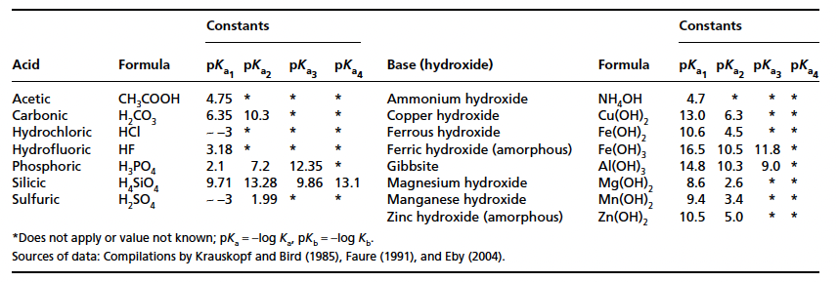

Slide 6
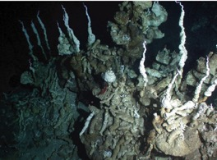
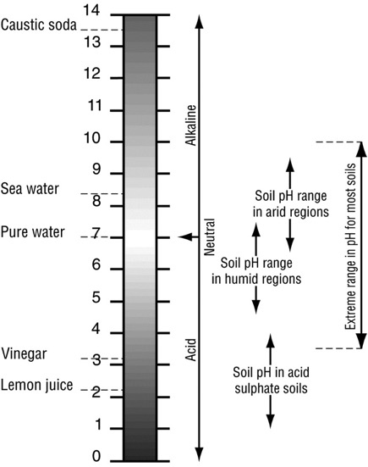
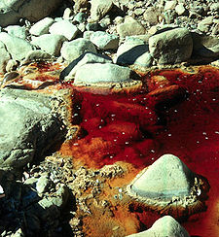
pH Range in Environment
12.6
Most basic : serpentinite mud (cold) volcanoes on the seafloor
Most acidic : acid mine drainage
-3.6
https://www.qld.gov.au/environment/land/soil/soil-properties/ph-levels/

Slide 7
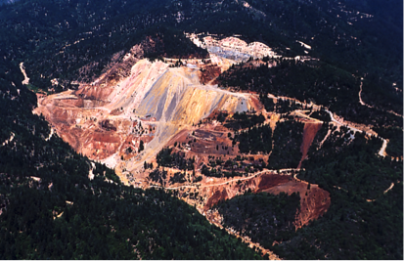
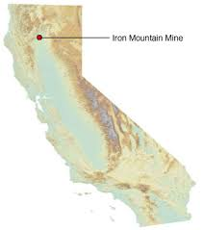
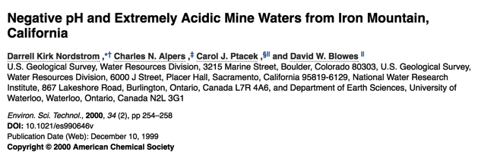
Most Acidic Waters:
Iron Mountain Mine (Richmond Mine),
Superfund Site in Northern California
Dominant sources of extreme acidity in natural ecosystems:
magmatic gases that contribute HCl, HF, H₂SO₄
oxidative weathering of pyrite (FeS₂), which produces H₂SO₄
pH as low as -3.6
a_{H+} = 10^{3.6}

Slide 8
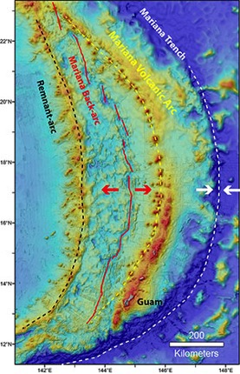
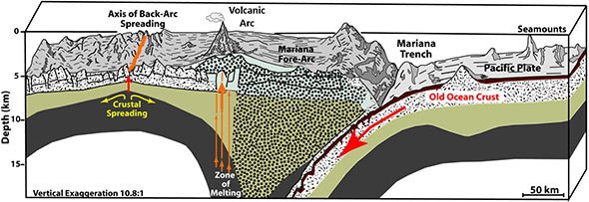
Most Basic Waters:
Serpentine Mud Volcanoes
in Mariana Trench Forearc on the seafloor
Subseafloor “weathering” of mantle olivine to serpentine and dissolution of carbonate
Low-density serpentinite rises buoyantly along intersecting fractures and extrudes at the seafloor,
“Cold” mud volcanoes, 2 km high, 50 km across
pH as high as 12.6
a_{H+} = 10^{-12.6}
https://www.geochemsoc.org/publications/geochemicalnews/gn141oct09/highestph/
http://oceanexplorer.noaa.gov/okeanos/explorations/ex1605/background/geology/welcome.html

Slide 9
Carbonic acid as polyprotic acid
H₂CO₃ (aq) = H⁺ + HCO₃⁻
K_{H2CO3} = a_{H+}a_{HCO3-} = 10^{-6.35}
a_{H2CO3}
HCO₃⁻ = H⁺ + CO₃²⁻
K_{HCO3-} = a_{H+}a_{CO32-} = 10^{-10.33}
a_{HCO3-}
H₂O = H⁺ + OH⁻
K_{w} = a_{H+}a_{OH-} = 10⁻¹⁴
a_{H2O}
Polyprotic acids:
Contain more than one H in their formula dissociate in a step-wise manner, with a different dissociation constant for each step

Slide 10
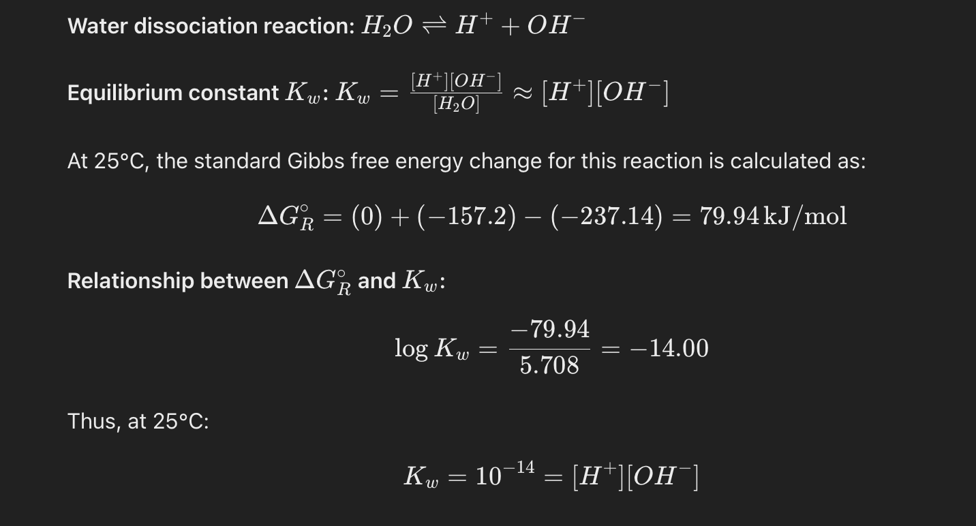
Dissociation of water and pH

Slide 11
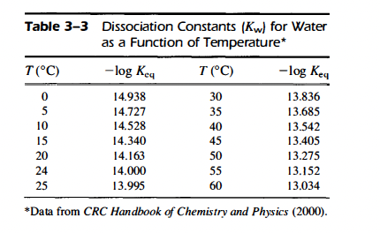

Slide 12
Common acids in nature
Strong acids:
HCl
HNO₃: acid rain due to the oxidation on NOx by combustion
H₂SO₄: acid rain, combustion of fossil fuel, release of SO₂
Weak acids:
H₂CO₃: Atmosphere due to the presence of CO2 and water
H₄SiO₄: dissolution of silicates by water vapour
CHCOOH (acetic acid): Landfill leachates and sewage
HCOOH (formic acid): due to leak of hydrocarbons mainly in ground waters

Slide 13
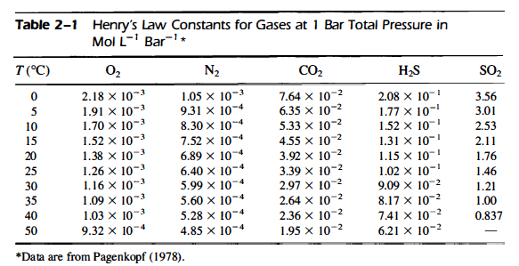
Henry’s Law of Gases
C_{i} = K*P_{i}

Slide 14
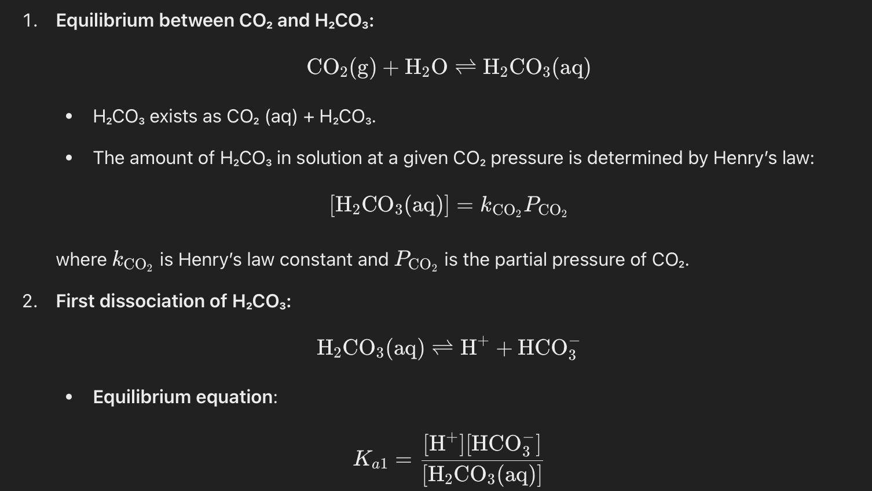
Carbonic acid I

Slide 15
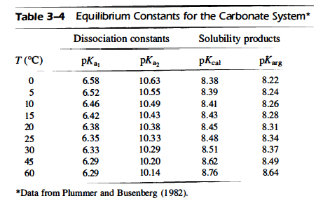

Slide 16
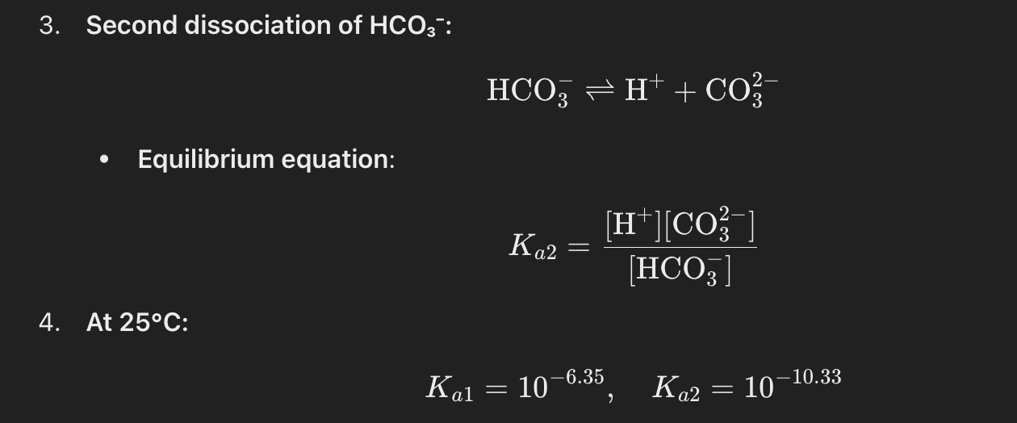
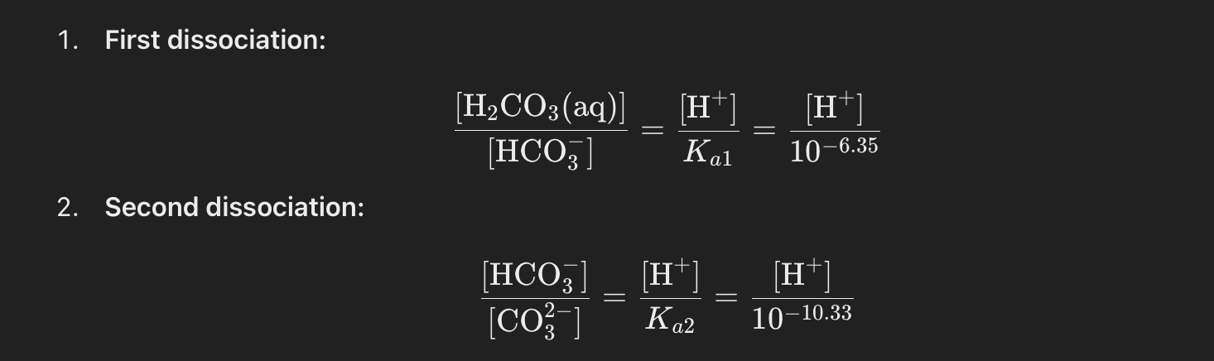
Carbonic acid II

Slide 17
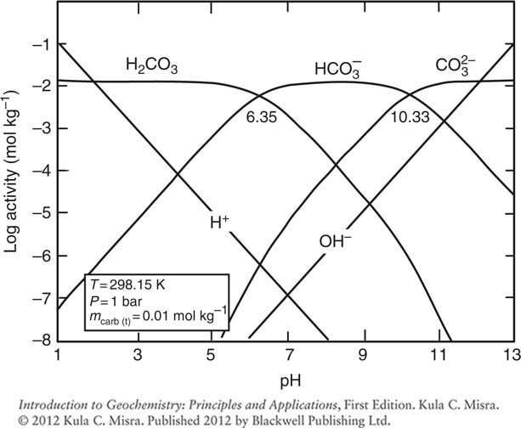
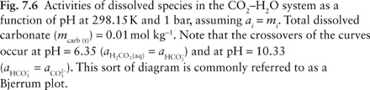
What is the major species in the CO₂-H₂O system at pH 4.2? 8? pH 2 ? pH 12?
H₂CO₃
HCO3⁻
CO₃²⁻

Slide 18
Converting ppm of gas to bars
ppm gas = parts per million of gas of interest
= mole fraction * 1,000,000
So, to get mole fraction (X_{gas}),
divide ppm of gas by 1,000,000
Then, multiply partial pressure of atmosphere in bars by mole fraction to get partial pressure of gas of interest in bars:
P_{gas} = P_{atmosphere}*X_{gas}
where P_{atmosphere} = 1 bar

Slide 19
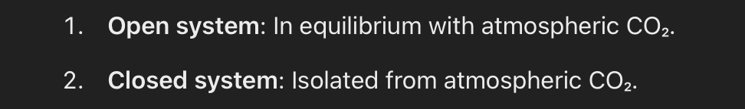
Charge balance
Sum of the positive charges in solution must equal the sum of the negative charges
Σm_{i}⁺z_{i}⁺ = Σm_{i}⁻z_{i}⁻
Σm_{i}z_{i} = 0
Charge balance for natural waters:
2m_{Ca2+} + 2m_{Mg2+} +m_{Na+} + m_{K+} + m_{H+} =
m_{Cl-} + 2m_{SO42-} + m_{HCO3-} + 2m_{CO32-} + m_{OH-} +…..
For CO₂-H₂O system:
m_{H+} = m_{HCO3-} + 2m_{CO32-} + m_{OH-}

Slide 20
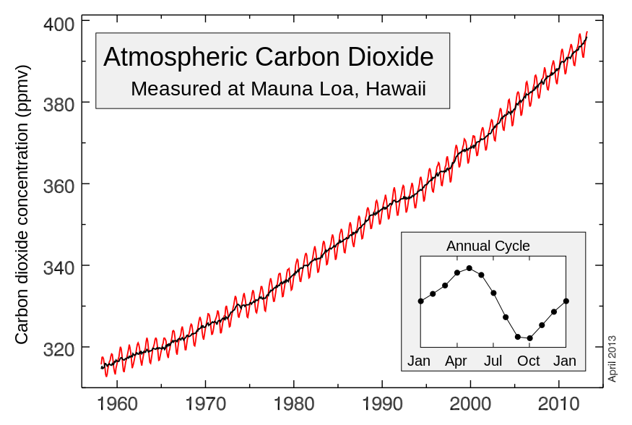
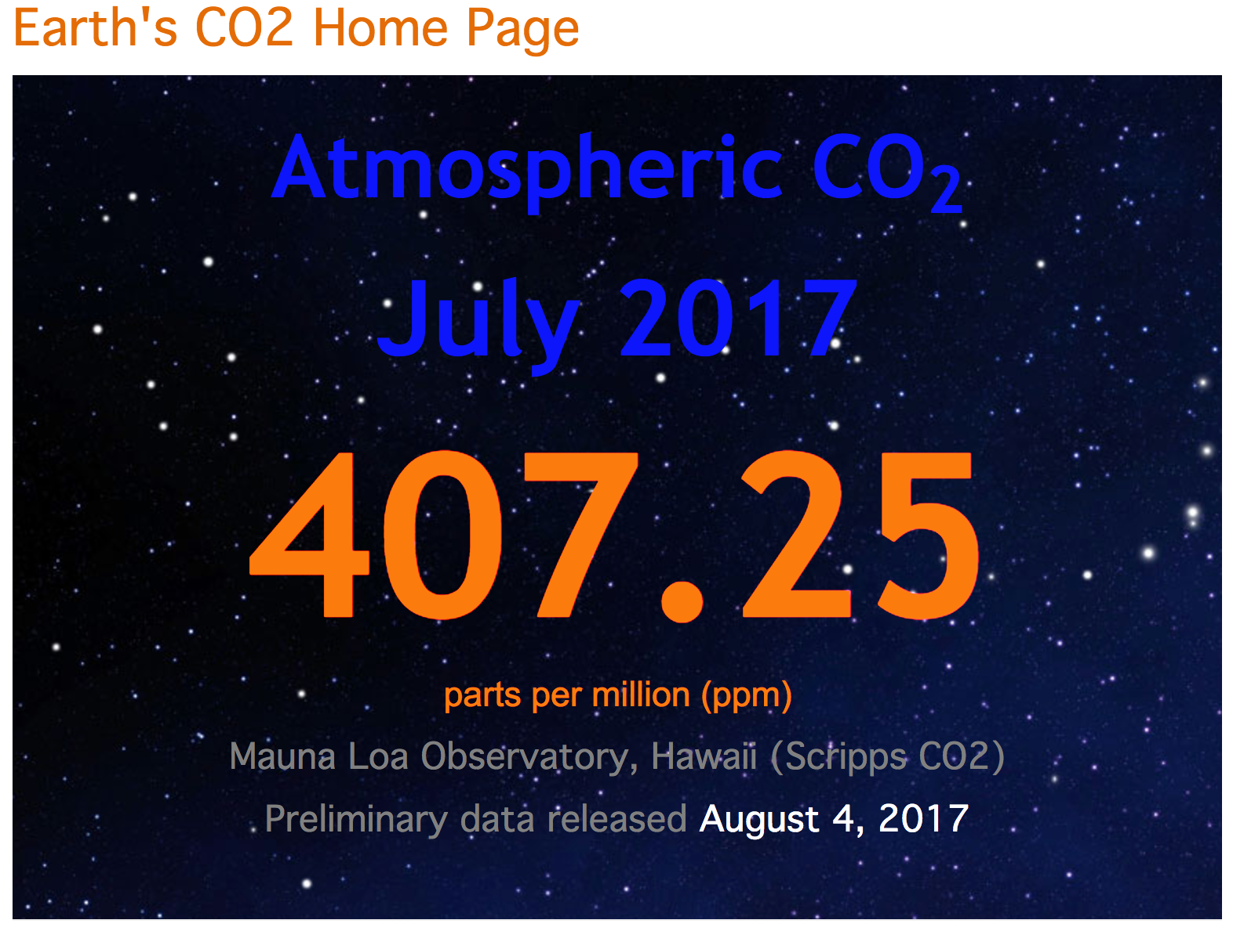
Rising atmospheric CO₂
Currently ~400 ppm
co2now.org

Slide 21
Quiz 3a. Calculate the concentration of carbonic acid in rainwater in equilibrium with 400 ppm CO₂ in the atmosphere. Quiz 3b. Calculate the pH of rainwater in equilibrium with 400 ppm CO₂ in the atmosphere.

