Slide 1
Agenda
▶ Introduction
▶ Running Python
▶ Python Programming
▶ Variables
▶ Types
▶ Arithmetic operators
▶ Boolean logic
▶ Strings
▶ Printing
▶ Exercises

Slide 2
What is python?
▶ Object oriented language
▶ Interpreted language
▶ Supports dynamic data type
▶ Independent from platforms
▶ Focused on development time
▶ Simple and easy grammar
▶ High-level internal object data types
▶ Automatic memory management
▶ It’s free (open source)!

Slide 3
Brief History of Python
▶ Invented in the Netherlands, early 90s by Guido van Rossum
▶ Named after Monty Python
▶ Open sourced from the beginning
▶ Considered a scripting language, but is much more
▶ Scalable, object oriented and functional from the beginning
▶ Used by Google from the beginning
▶ Increasingly popular

Slide 4

Python’s Benevolent Dictator
For Life
“Python is an experiment in how much freedom programmers need. Too much freedom and nobody can read another's code; too little and expressive-ness is endangered.”
- Guido van Rossum

Slide 5
Language properties
▶ Everything is an object
▶ Modules, classes, functions
▶ Exception handling
▶ Dynamic typing, polymorphism
▶ Static scoping
▶ Operator overloading
▶ Indentation for block structure

Slide 6
High-level data types
▶ Numbers: int, long, float, complex
▶ Strings: immutable
▶ Lists and dictionaries: containers
▶ Other types for e.g. binary data, regular expressions, introspection
▶ Extension modules can define new “built-in” data
types

Slide 7
Why learn python?
▶ Fun-to-use "Scripting language"
▶ Object-oriented
▶ Highly educational
▶ Very easy to learn
▶ Powerful, scalable, easy to maintain
▶ high productivity
▶ Lots of libraries
▶ Glue language
▶ Interactive front-end for FORTRAN/C/C++ code

Slide 8
Where to use python?
▶ System management (i.e., scripting)
▶ Graphic User Interface (GUI)
▶ Internet programming
▶ Database (DB) programming
▶ Text data processing
▶ Distributed processing
▶ Numerical operations
▶ Graphics
▶ And so on…

Slide 9
Why learn python? (cont.)
▶ Reduce development time
▶ Reduce code length
▶ Easy to learn and use as developers
▶ Easy to understand codes
▶ Easy to do team projects
▶ Easy to extend to other languages

Slide 10
Course Goals
▶ To understand the basic structure and syntax of Python programming language
▶ To write your own simple Python scripts.
▶ To serve as the starting point for more advanced training on Python coding

Slide 11
Agenda
▶ Introduction
▶ Running Python
▶ Python Programming
▶ Data types
▶ Control flows
▶ Classes, functions, modules
▶ Hands-on Exercises

Slide 12
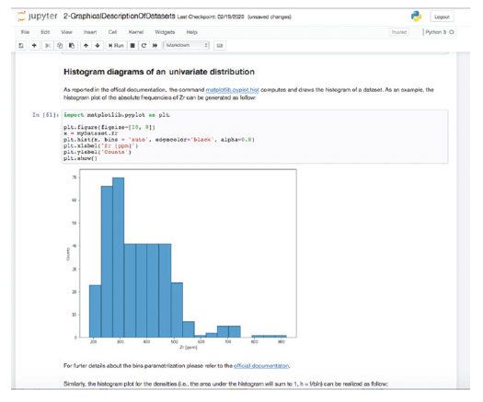
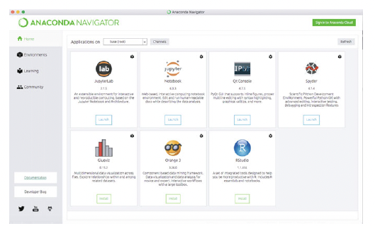
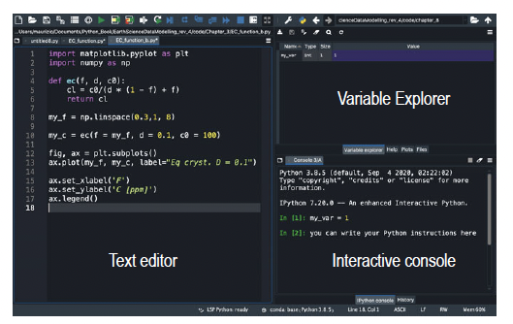
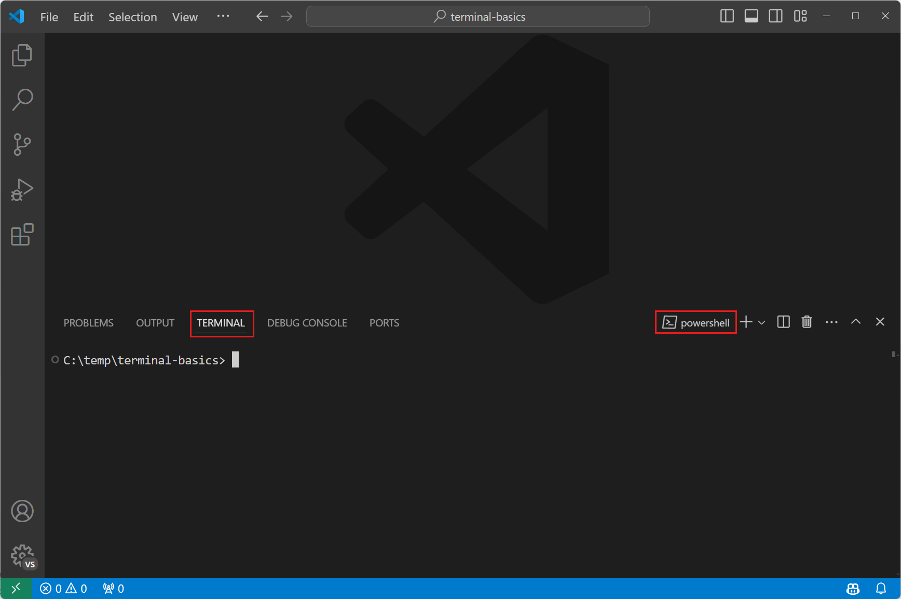
Jupyter Notebook
Spyder Console
Visual Studio

Slide 13

Python as a calculator
▶ Let us calculate the distance between Edinburgh
and London in km

Slide 14
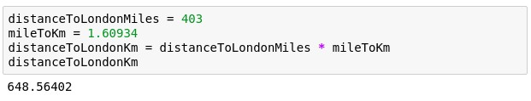
Variables
▶ Great calculator but how can we make it store
values?
▶ Do this by defining variables
▶ Can later be called by the variable name
▶ Variable names are case sensitive and unique

Slide 15

We can now reuse the variable mileToKm in the next block without
having to define it again!

Slide 16
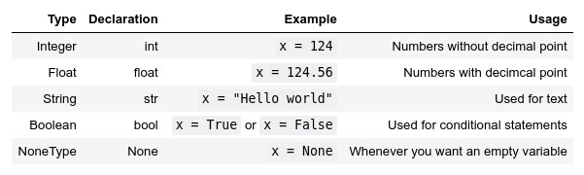
Types
Variables actually have a type, which defines the way it
is stored.
The basic types are:

Slide 17






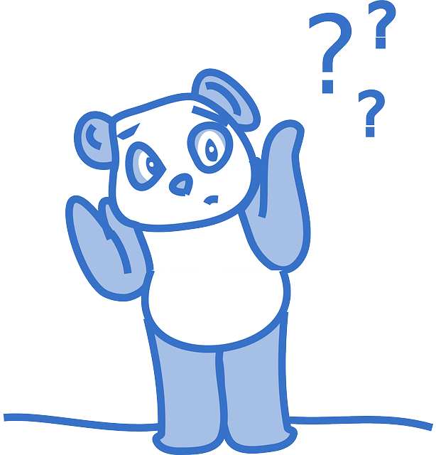

WHY SHOULD WE CARE?

Slide 18
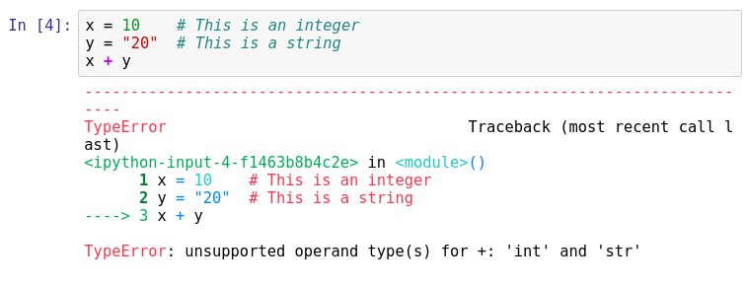
Important lesson to remember!
We can't do arithmetic operations on variables of different types. Therefore make sure that you are always aware of your variables types!
You can find the type of a variable using type(). For example type type(x).

Slide 19

Casting types
Luckily Python offers us a way of converting variables to
different types!
Casting – the operation of converting a variable to a different type
Similar methods exist for other data types: int(), float(), str()

Slide 20

Quick quiz
What will be the result?

Slide 21
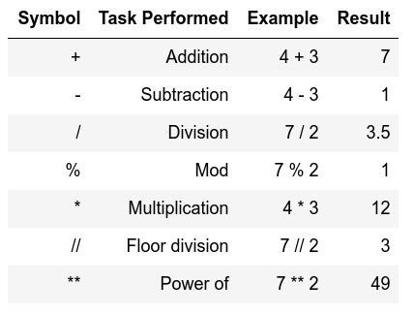
Arithmetic operations
Similar to actual Mathematics. Order of precedence is the same
as in Mathematics.
We can also use parenthesis ()

Slide 22

Order precedence example

Slide 23


Quick quiz
vs
13
49

Slide 24
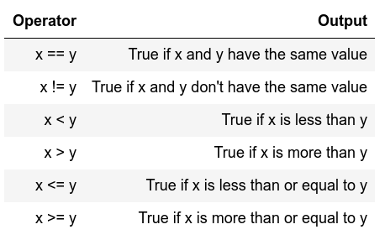
Comparison operators
▶ I.e. comparison operators
▶ Return Boolean values
(i.e. True or False)
▶ Used extensively for conditional statements

Slide 25
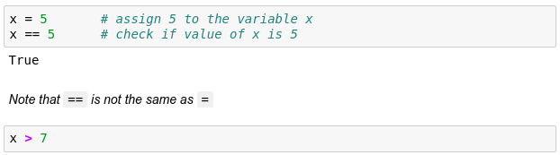
Comparison examples
False

Slide 26
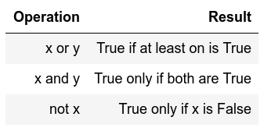
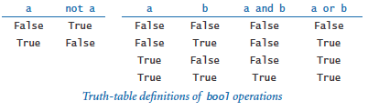
Logical operators
Allows us to extend the conditional logic
Will become essential later on

Slide 27
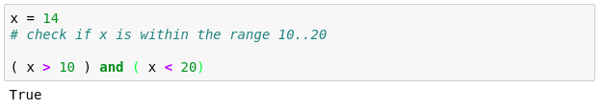
Combining both
True
True

Slide 28
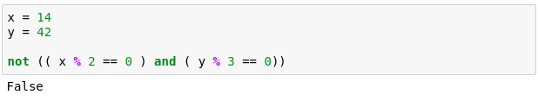
Another example
True
True True
That wasn't very easy to read was it?
Is there a way we can make it more readable?

Slide 29
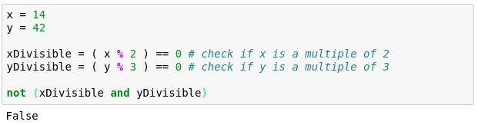

Slide 30
Strings
▶ Powerful and flexible in Python
▶ Can be added
▶ Can be multiplied
▶ Can be multiple lines

Slide 31
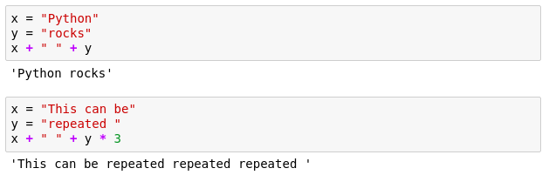
Strings

Slide 32
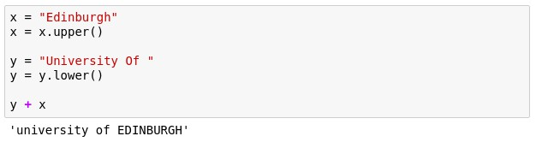
Strings
These are called methods and add extra functionality to the String.
If you want to see more methods that can be applied to a string
simply type in dir('str')

Slide 33
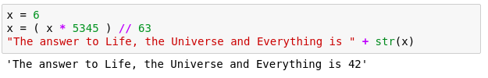
Mixing up strings and numbers
Often we would need to mix up numbers and strings. It is best to keep numbers as numbers (i.e. int or float)
and cast them to strings whenever we need them as a string.

Slide 34
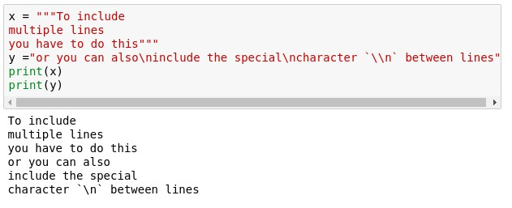
Multiline strings

Slide 35
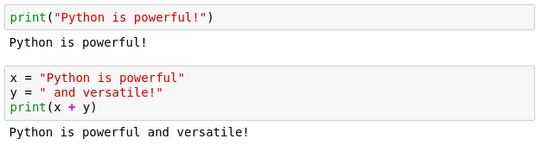
Printing
▶ When writing scripts, your outcomes aren't printed on
the terminal.
▶ Thus, you must print them yourself with the print() function.
▶ Beware to not mix up the different type of variables!

Slide 36

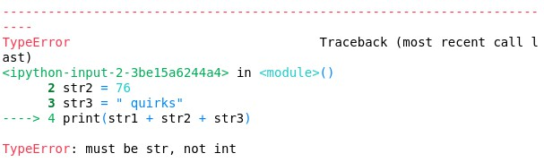
Quick quiz
Do you see anything wrong with this block?

Slide 37
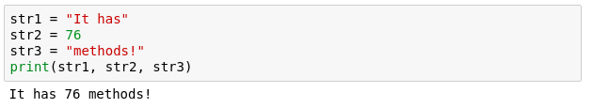
Another more generic way to fix it
If we comma separate statements in a print function we
can have different variables printing!

Slide 38
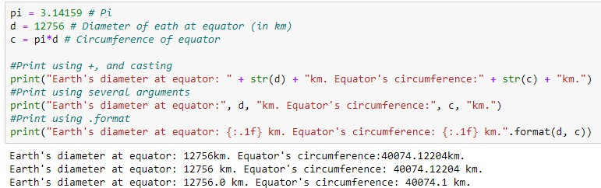
Placeholders
▶ A way to interleave numbers is
▶ Elegant and easy
▶ more in your notes

Slide 39
Commenting
▶ Useful when your code needs further explanation.
Either for your future self and anybody else.
▶ Useful when you want to remove the code from execution but not permanently
▶ Comments in Python are done with #

Slide 40
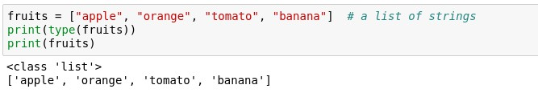
Lists
▶ One of the most useful concepts
▶ Group multiple variables together (a kind of
container!)

Slide 41


Indexing a list
Indexing – accessing items within a data structure
Indexing a list is not very intuitive...
The first element of a list has an index 0

Slide 42
Quick quiz
What will fruits[3] return?

Slide 43
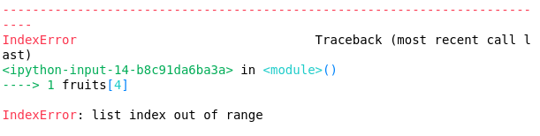
Quick quiz
What will this return?

Slide 44

Data structure sizes
Make sure you are always aware of the sizes of each
variable!
This can easily be done using the len() function. It returns the length/size of any data structure

Slide 45

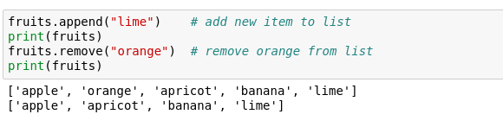
Is a tomato really a fruit?
Furthermore, we can modify lists in various ways

Slide 46
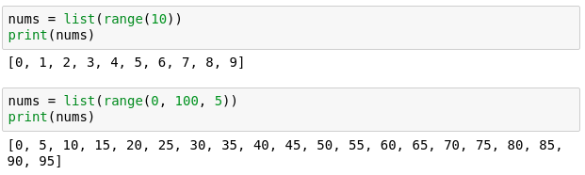
Lists with integers
range() - a function that generates a sequence of numbers as a list

Slide 47
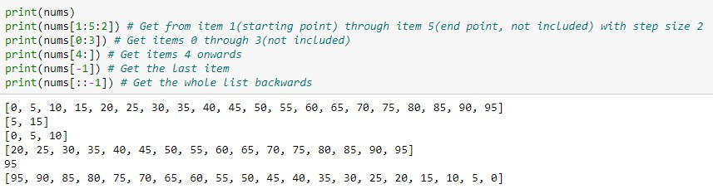
Slicing lists
Slicing – obtain a particular set of sub-elements from a data structure.
Very useful and flexible.

Slide 48
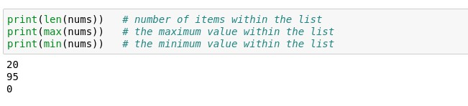
Lists – helpful functions
▶ Makes them extremely useful and versatile

Slide 49

Lists can be of different types
▶ Not very useful, but possible

Slide 50
Mutability
Mutable object – can be changed after creation.
Immutable object - can NOT be changed after creation.

Slide 51
Quick quiz
▶ Are lists mutable?

Slide 52
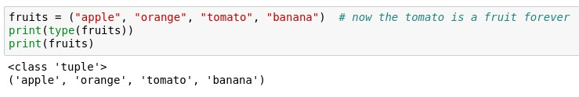
Tuples
▶ Effectively lists that are immutable (I.e. can't be
changed)

Slide 53
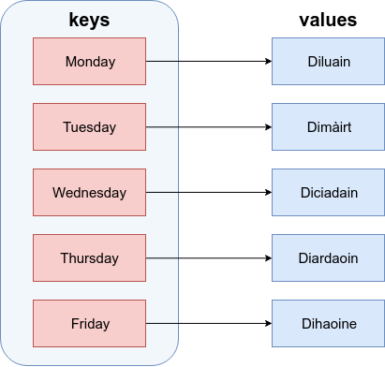
Dictionaries
Similar to actual dictionaries
They are effectively 2 lists combined – keys and values
We use the keys to access the values instead of indexing them like a list
Each value is mapped to a
unique key

Slide 54

Dictionary definition
Defined as comma separated key : value pairs:
Comma separated
Curly brackets

Slide 55
Dictionary properties
▶ Values are mapped to a key
▶ Values are accessed by their key
▶ Key are unique and are immutable
▶ Values cannot exist without a key

Slide 56
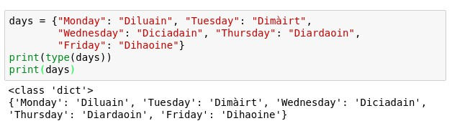
Dictionaries
Let us define the one from the previous image

Slide 57

Accessing a dictionary
Values are accessed by their keys (just like a dictionary)
Note that they can't be indexed like a list

Slide 58
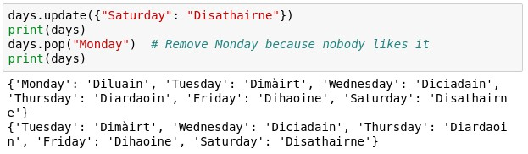
Altering a dictionary
Can be done via the dictionary methods

Slide 59
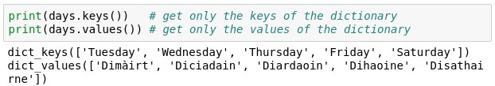
Keys and Values
It is possible to obtain only the keys or values of a
dictionary.
This is useful for iteration.

Slide 60
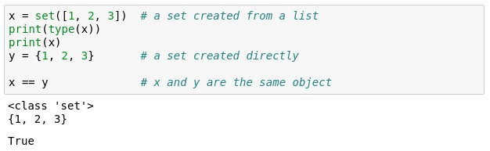
Sets
▶ Effectively lists that can't contain duplicate items
▶ Similar functionality to lists
▶ Can't be indexed or sliced
▶ Can be created with {} or you can convert a list to a set

Slide 61

If Else
▶ Fundamental building block of software
Conditional statement
Executed if answer is True
Executed if answer is False

Slide 62
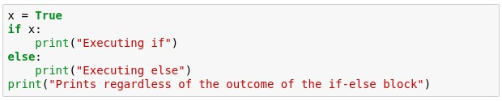
If Else example
Try running the example below. What do you get?

Slide 63
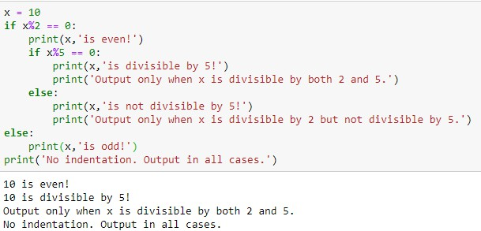
Indentation matters!
▶ Code is grouped by its indentation
▶ Indentation is the number of whitespace or tab characters before the code.
▶ If you put code in the wrong block then you will get unexpected behavior

Slide 64
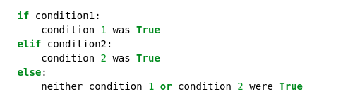
Extending if-else blocks
▶ We can add infinitely more if statements using elif
▶ elif = else + if which means that the previous statements must be false for the current one to evaluate to true

Slide 65
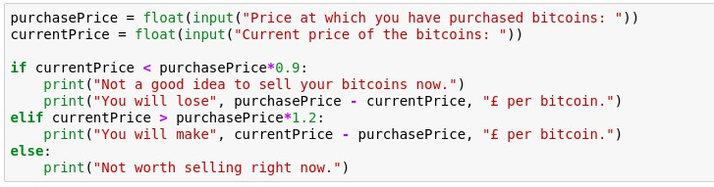
Bitcoin broker example

Slide 66
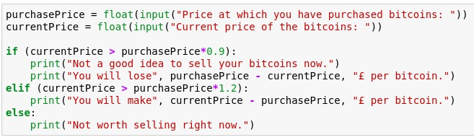

Quick quiz
▶ What would happen if both conditions are True?

Slide 67

For loop
▶ Allows us to iterate over a set amount of variables within a data structure. During that we can manipulate each item however we want
▶ Again, indentation is important here!

Slide 68
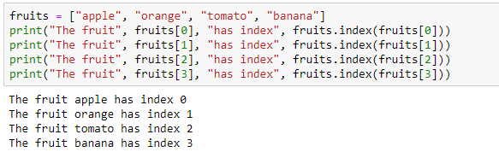
Example
▶ Say we want to go over a list and print each item
along with its index
▶ What if we have much more than 4 items in the list, say, 1000?

Slide 69
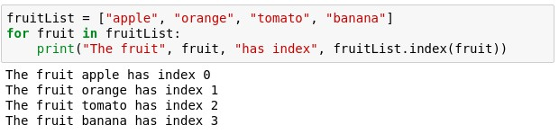
For example
Now with a for loop
Saves us writing more lines
Doesn't limit us in term of size

Slide 70
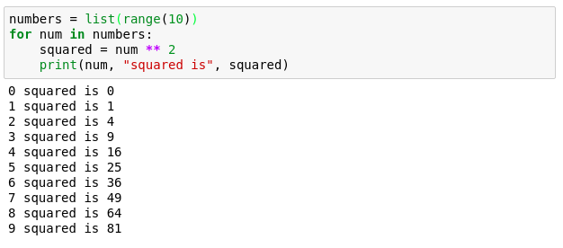
Numerical for loop

Slide 71
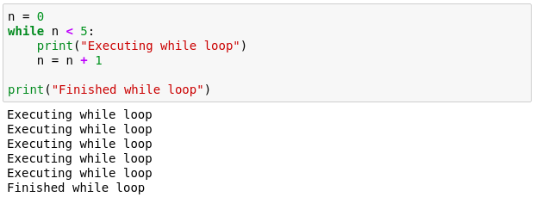
While loop
▶ Another useful loop. Similar to the for loop.
▶ A while loop doesn't run for a predefined number of iterations, like a for loop. Instead, it stops as soon as a given condition becomes true/false.

Slide 72
Break statement
▶ Allows us to go(break) out of a loop preliminary.
▶ Adds a bit of controllability to a while loop.
▶ Usually used with an if.
▶ Can also be used in a for loop.

Slide 73
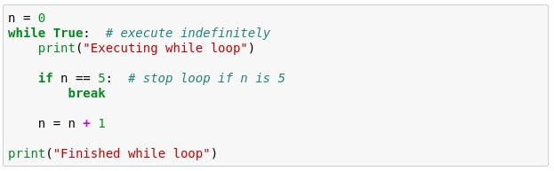
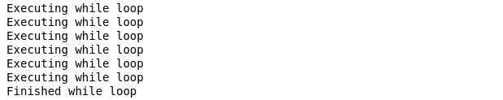
Quick quiz
How many times are we going to execute the while
loop?

Slide 74
Functions
▶ Allow us to package functionality in a nice and
readable way
▶ reuse it without writing it again
▶ Make code modular and readable
▶ Rule of thumb - if you are planning on using very similar code more than once, it may be worthwhile writing it as a reusable function.

Slide 75


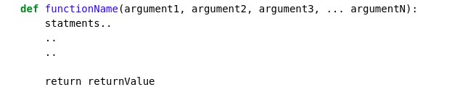
Function declaration
keyword
Any number of arguments
[Optional] Exits the function and returns some value
Functions accept arguments and execute a piece of code
Often they also return values (the result of their code)

Slide 76
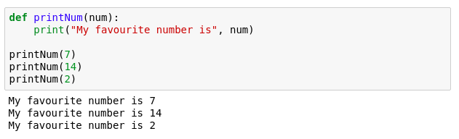
Function example

Slide 77
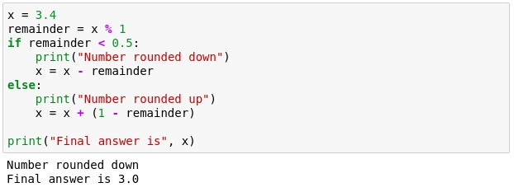
Function example 2
We want to make a program that rounds numbers up or
down.
Try to pack the following into a function.

Slide 78

Function example 2

Slide 79


Function example 3

Slide 80

Python built-in functions
To find out how they work: https://docs.python.org/3.3/library/functions.html

Slide 81
Running Python Programs Interactively
Suppose the file script.py contains the following lines:
print 'Hello world' x = [0,1,2]
Let's run this script in each of the ways described on the last slide:
▶ python
>>> import script # DO NOT add the .py suffix. Script is a module here
>>> x
Traceback (most recent call last):
File "<stdin>", line 1, in ?
NameError: name 'x' is not defined
>>> script.x # to make use of x, we need to let Python know which #module it came from, i.e. give Python its context
[0,1,2]

Slide 82
File naming conventions
▶ python files usually end with the suffix .py
▶ but executable files usually don’t have
the .py extension
▶ modules (later) should always have the .py
extension

Slide 83
References
▶ Python Homepage
http://www.python.org
▶ Python Tutorial
http://docs.python.org/tutorial/
▶ Python Documentation
http://www.python.org/doc
▶ Python Library References
▶ http://docs.python.org/release/2.5.2/lib/lib.html
▶ Python Add-on Packages:
▶ http://pypi.python.org/pypi

