Slide 1

DATA VISUALIZATION USING PYTHON
Notes from Trevor Bonjour, Purdue University

Slide 2

What will we cover today?
Motivation
Useful Python Libraries
Types of Plots
Learn by Doing

Slide 3
Visualization Objectives
Record information
Analyze data to support reasoning
Confirm hypotheses
Communicate ideas to others

Slide 4

Why Visualize
To record information

Slide 5

Why Visualize
To point out interesting things

Slide 6

Why Visualize
To point out interesting things

Slide 7
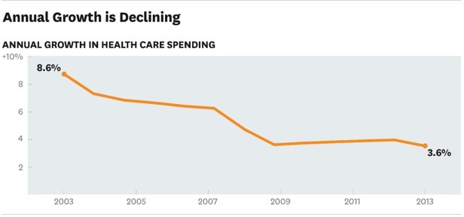
Why Visualize
To communicate information

Slide 8
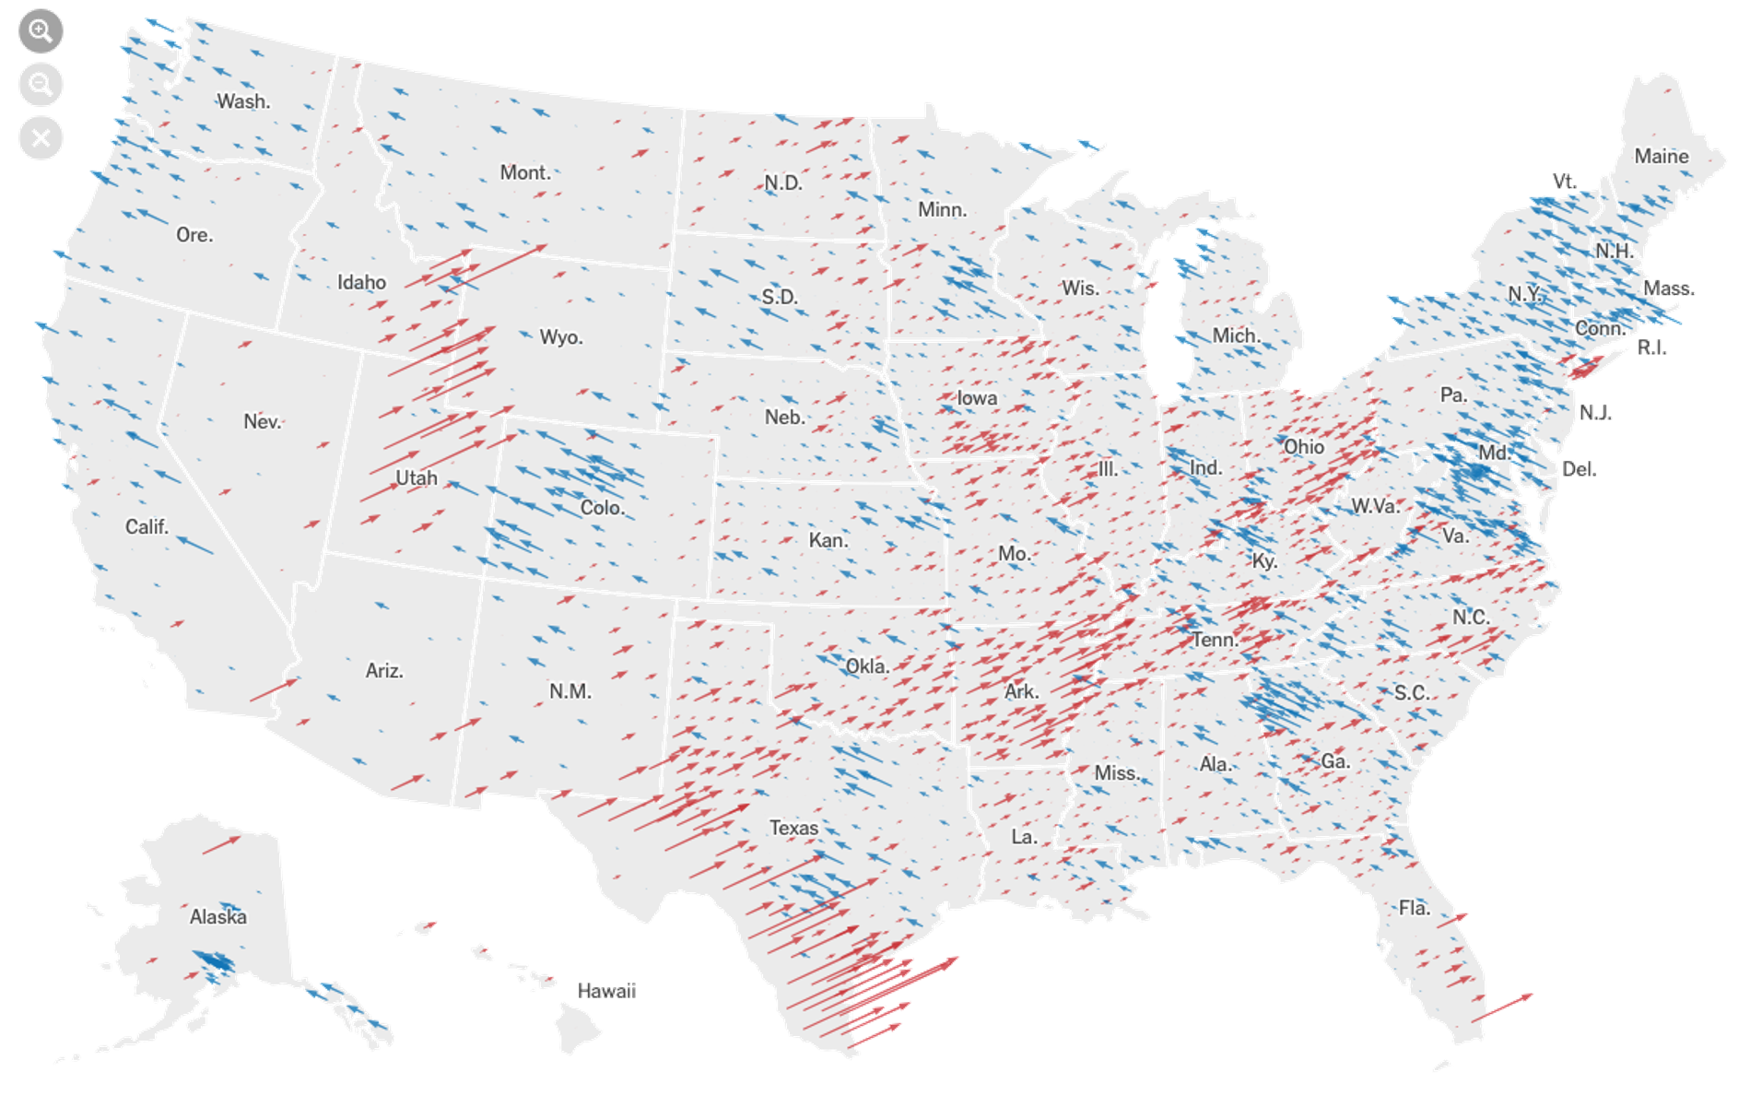
Why Visualize
To analyze data
2020 US Elections (NYTimes)

Slide 9



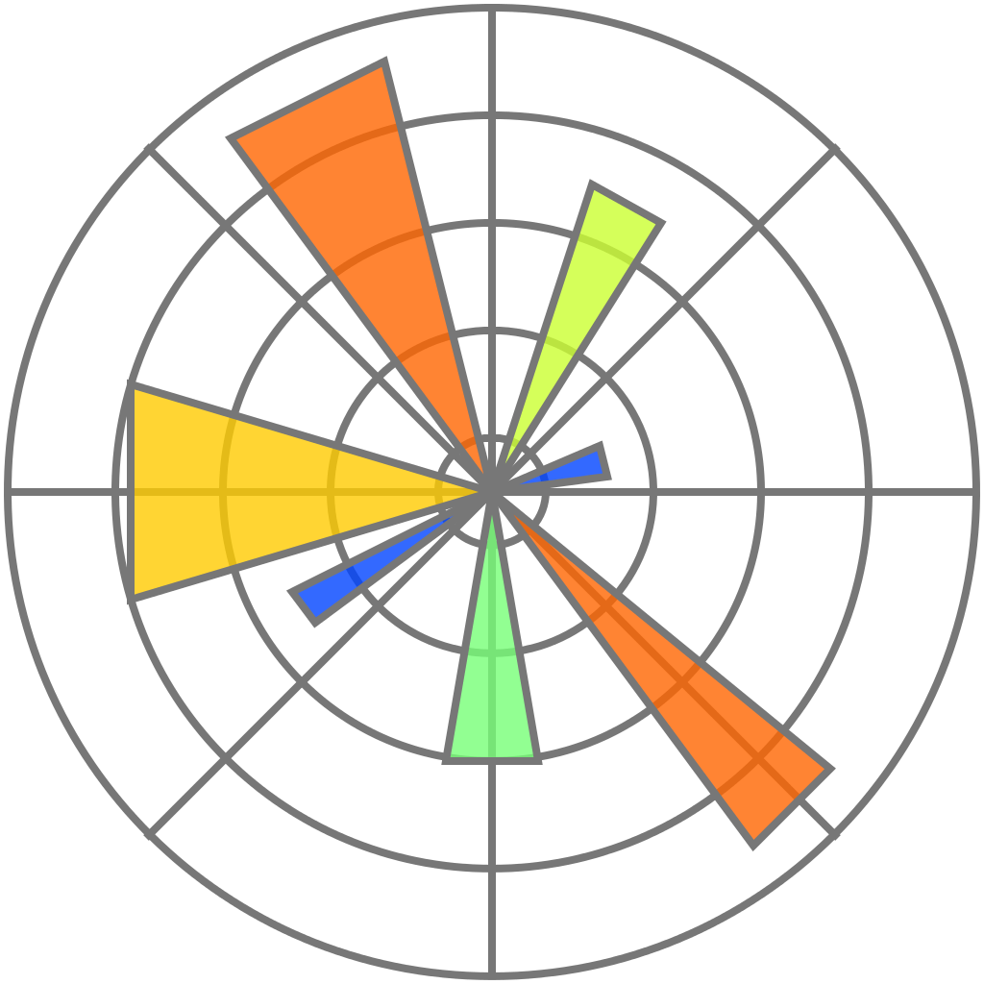

Useful Python Libraries
NumPy
pandas
matplotlib
seaborn
bokeh

Slide 10

NumPy
Fundamental package for scientific computing
Exceptionally fast – written in C
Main data structure:
ndarray : n-dimensional arrays of homogeneous data types
Data manipulation ≈ NumPy array manipulation
Used in other libraries - Matplotlib, pandas, scikit- learn
Link: NumPy for MATLAB USERS

Slide 11

Pandas
Fundamental tool for handling and analyzing input data
Particularly suited for tabular data
Implements powerful data operations
Main data structures:
DataFrame: A table with rows and columns
Series: A single column

Slide 12
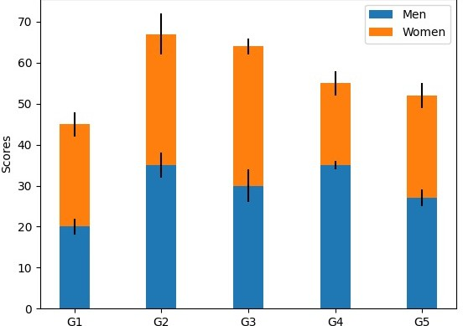
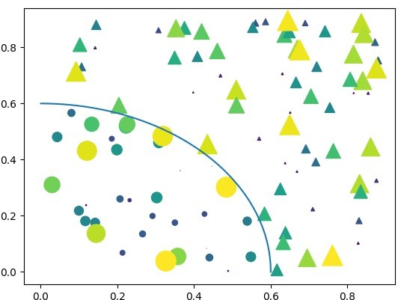
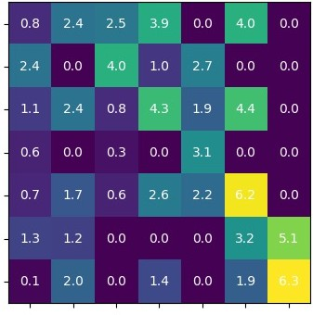
Matplotlib
Used for basic plotting
Highly customizable
Works with NumPy and pandas

Slide 13
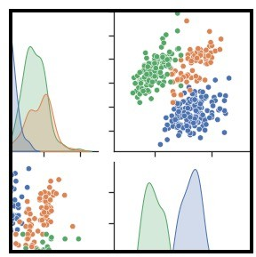
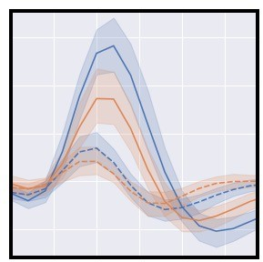
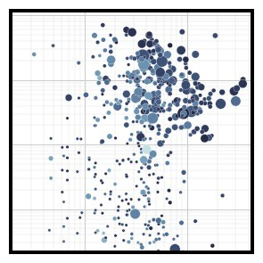
Seaborn
Used for statistical data visualization
Uses fewer syntax with good default themes
Integrated to work great with pandas data-frame
Uses Matplotlib under the hood

Slide 14
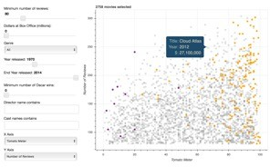
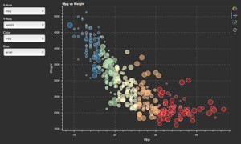
Bokeh
Used for interactive visualization
Requires modern web browsers
Integrates with JavaScript

Slide 15
Types of Plots
Line plots
Bar plots
Scatter plots
Box plots
Histograms

Slide 16
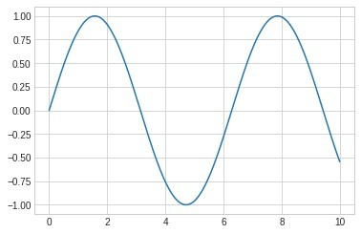
Line plots
Used for numeric data
Used to show trends
Compare two or more different variables over time
Could be used to make predictions

Slide 17
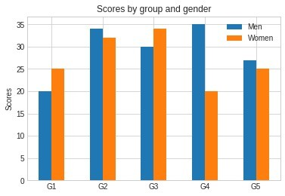
Bar plots
Used for nominal or ordinal categories
Compare data amongst different categories
Ideal for more than 3 categories
Can show large data changes over time

Slide 18
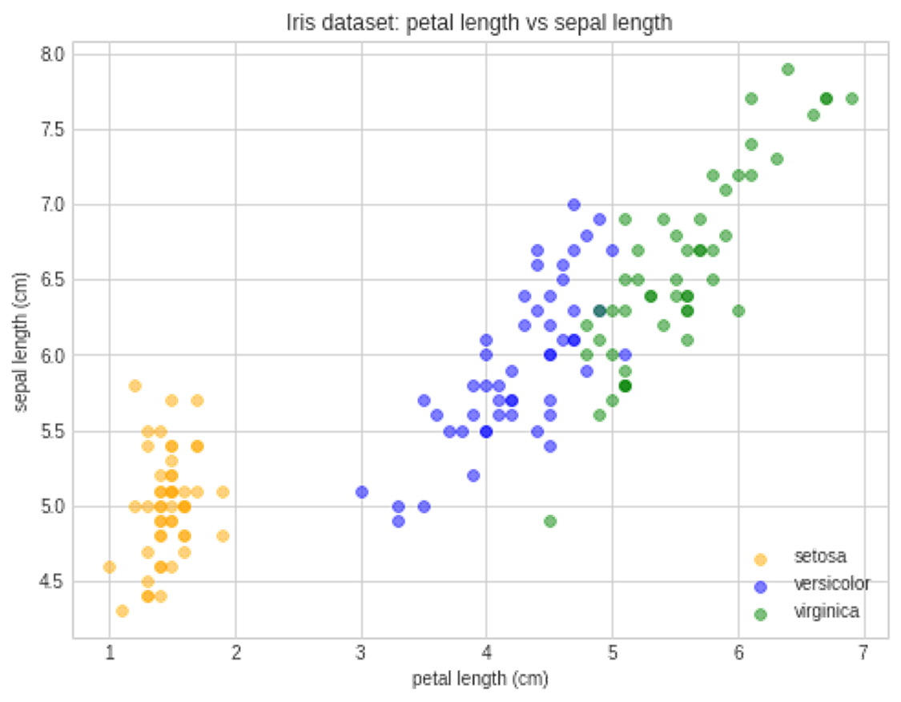
Scatter plots
Used to visualize relation between two numeric variables
Used to visualize correlation in a large data set
Predict behavior of dependent variable based on the measure of the independent variable.

Slide 19
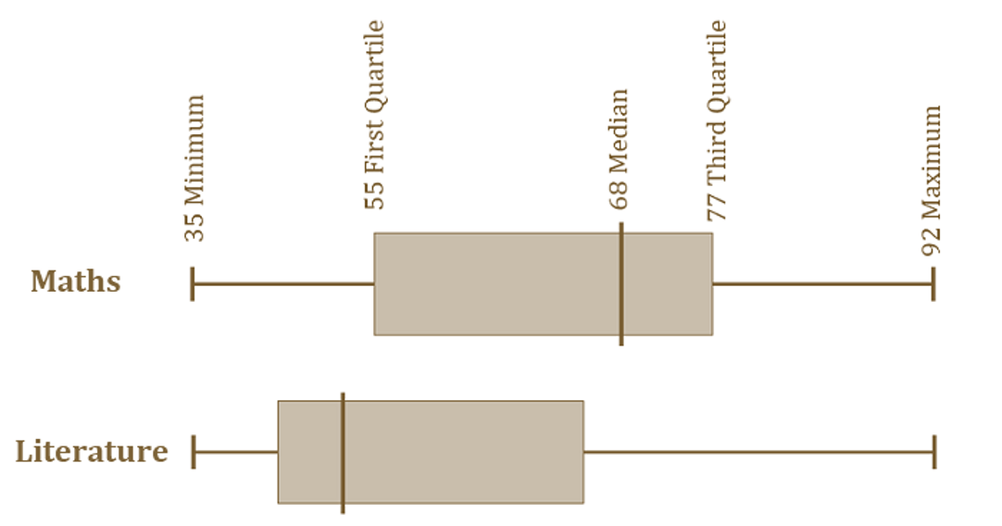
Box plots
aka whisker plot
Statistical graph used on sets of numerical data
Shows the range, spread and center
Used to compare data from different categories

Slide 20
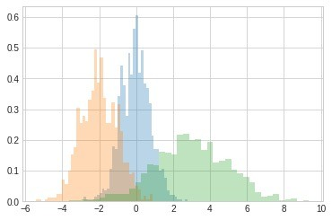
Histograms
Used for continuous data
Displays the frequency distribution (shape)
Summarize large data sets graphically
Compare multiple distributions

