Slide 1
Numerical Modelling in Geosciences

Slide 2

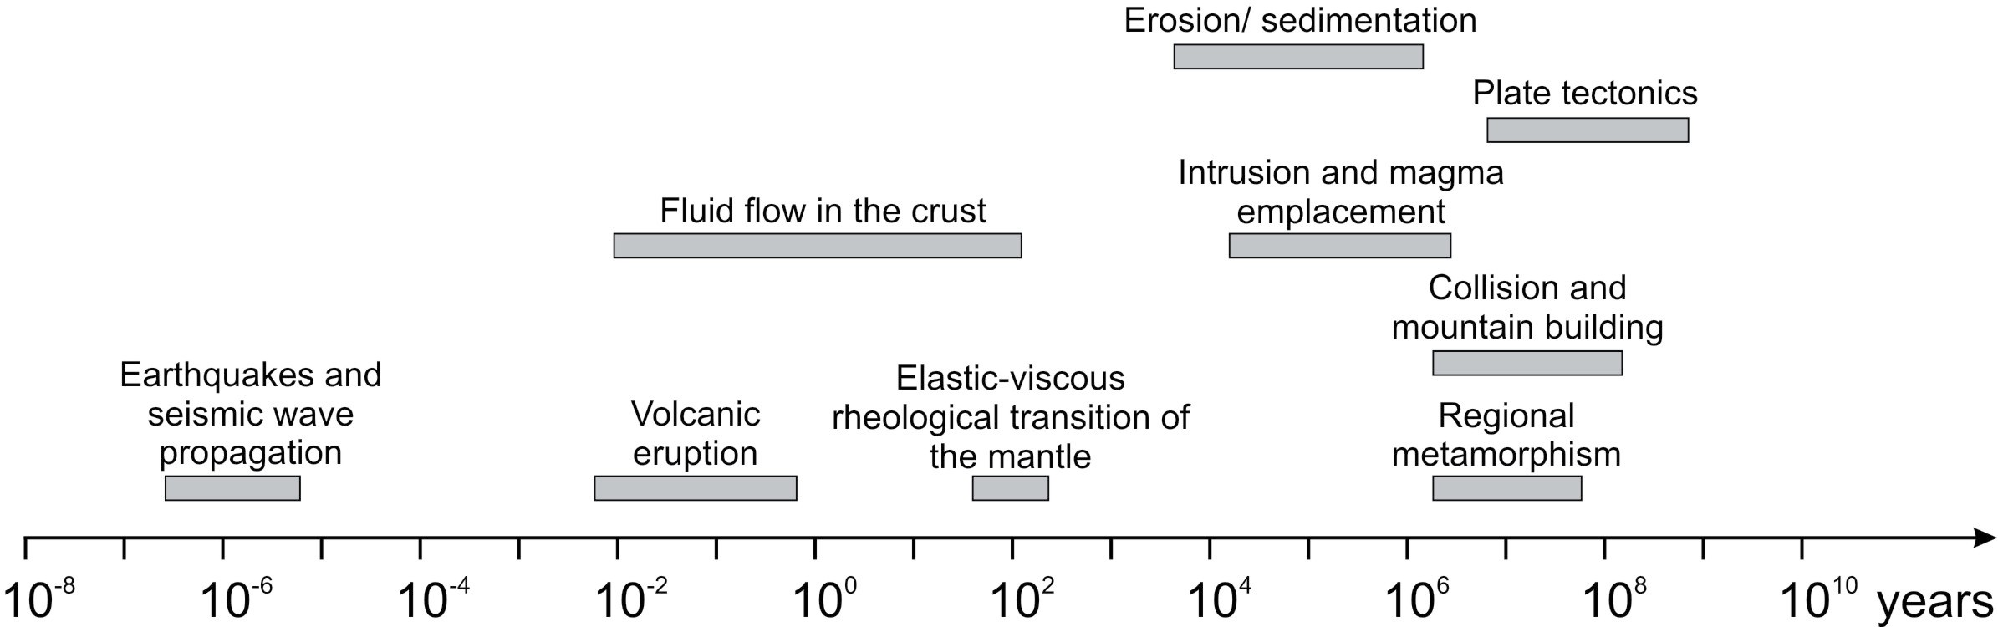
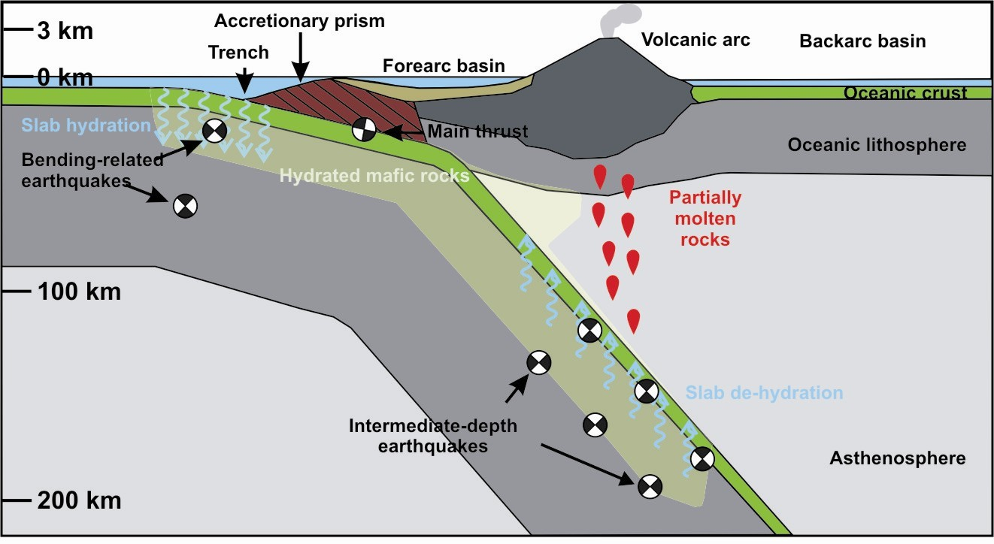
Why numerical modelling in geosciences?
1. Most of the geological processes occur at timescales and depths such that they cannot be observed directly.
Max. human timescale
Accessible by drilling (max 10 km)
Unaccessible

Slide 3
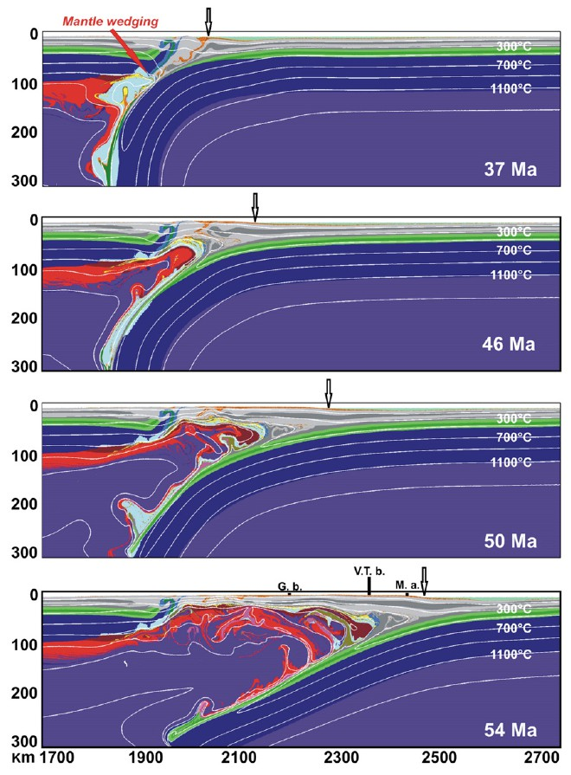
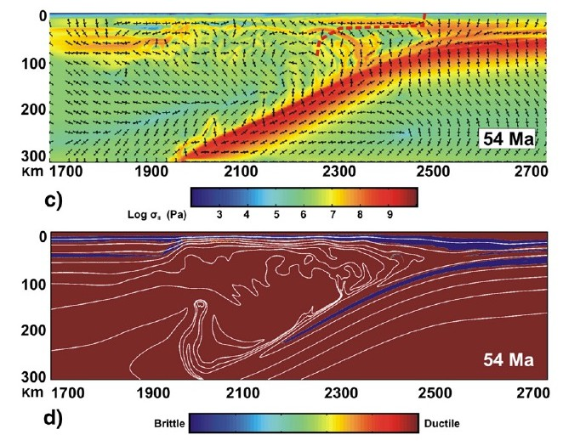
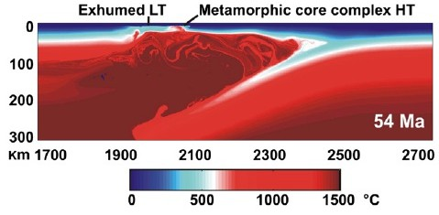
Why numerical modelling in geosciences?
2. Direct measurements of, for example, stress, deformation (strain rate), composition, temperature, pressure, etc., are limited to few rock samples. With numerical models we can know their distribution everywhere in our computational domain.

Slide 4
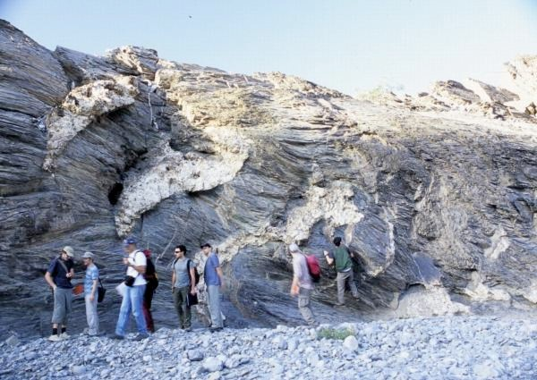
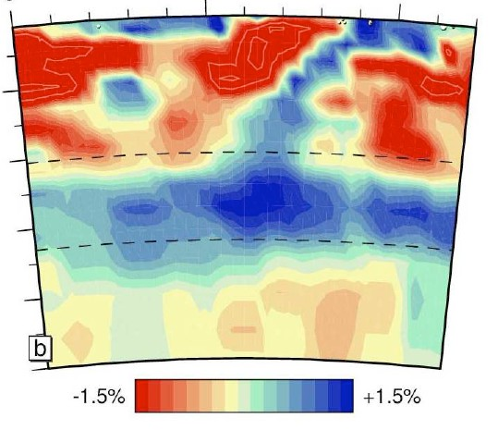






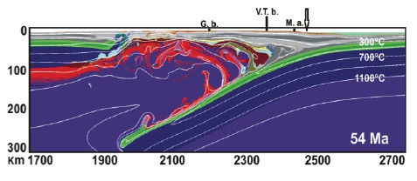
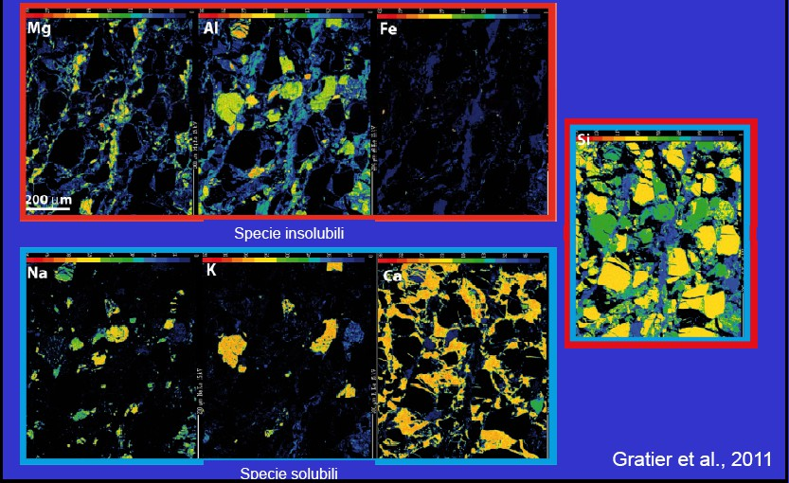
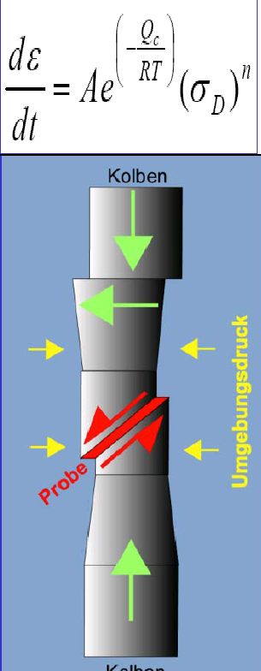


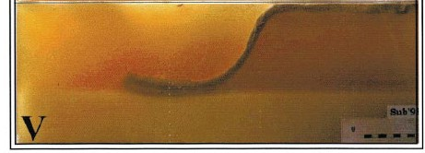
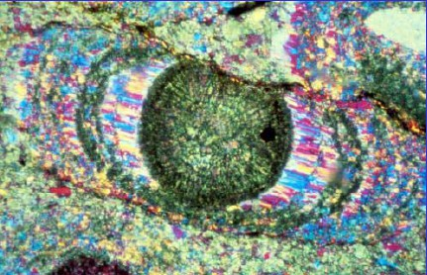

Why numerical modelling in geosciences?
3. Numerical modelling is an indispensable tool to understand the evolution of complex geological systems together with laboratory experiments (input) and field and geophysical observations (output).
Field and geophysical data
Lab. analysis/experiments and theory
Analogue/numerical modeling
Understanding geological processes

Slide 5
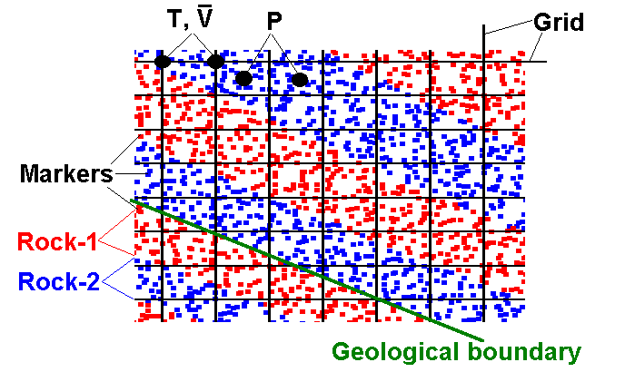
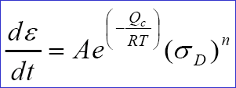
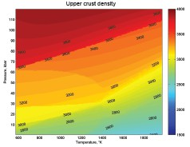
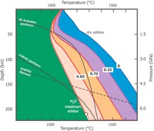
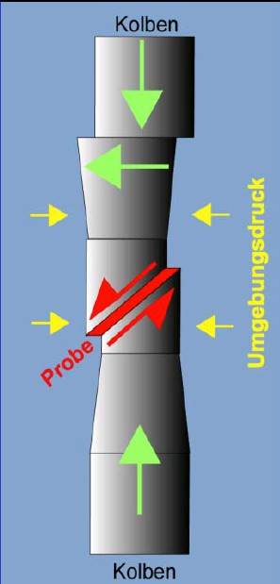
What is numerical modelling in geosciences?
Fundamental PDEs in this course
Discretization: FD,FE,FV
Eulerian+Lagrangian meshes
∇ ⋅ v = 0
Conservation of mass for incompressible media
∇ ⋅σ #− ∇P = −ρg
Conservation of momentum for slowly flowing continuous media
ρc ^{DT} = −∇ ⋅ q→ + H
Conservation of energy
P
Dt
To close the system we need rock physical properties from lab. experiments:
density
thermal conductivity, expansivity
heat capacity
rock mechanical properties
melting/metamorphic reactions

Slide 6
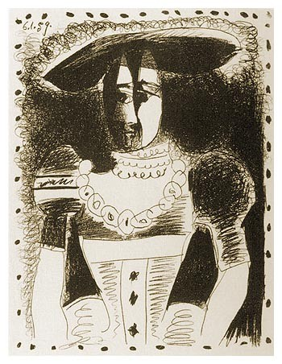
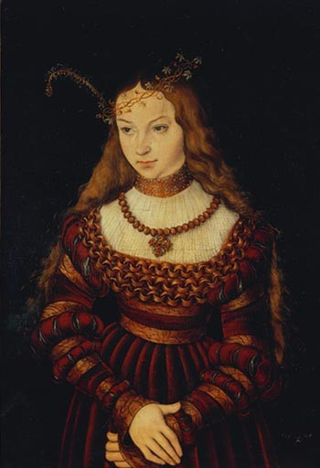
Visualization is important!
Sibylla von Cleve als Braut, Lukas Cranach d. Ä. (1472-1553)
Noble dame, 1959
© Succession Picasso / VG Bild-Kunst, Bonn 2

Slide 7

6.00E+0 | Numerical modeling without visualization |  |  |  |  |  |  |  |  |  |  |  |  | 0E+03
7.00E+0 |  |  |  |  |  |  |  |  |  |  |  |  |  | 0E+03
8.00E+0 |  |  |  |  |  |  |  |  |  |  |  |  |  | 0E+03
9.00E+0 |  |  |  |  |  |  |  |  |  |  |  |  |  | 0E+03
1.00E+04 |  | 9.00E+03 | 0.00E+00 | 1.10E-09 | -8.96E-10 | 0 | 320 | 1281 | 1.00E+19 | 3.00E-05 | 2.98E+02 | 0.00E+00 | 1.00E+03
1.10E+04 |  | 9.00E+03 | 0.00E+00 | 1.10E-09 | -6.97E-10 | 0 | 351 | 1312 | 1.00E+19 | 3.00E-05 | 3.15E+02 | 0.00E+00 | 1.00E+03
1.20E+04 |  | 9.00E+03 | 0.00E+00 | 1.10E-09 | -4.98E-10 | 0 | 382 | 1343 | 1.00E+19 | 3.01E-05 | 3.81E+02 | 0.00E+00 | 1.00E+03
1.30E+04 |  | 9.00E+03 | 0.00E+00 | 1.10E-09 | -2.99E-10 | 0 | 413 | 1374 | 1.00E+19 | 3.01E-05 | 3.98E+02 | 0.00E+00 | 1.00E+03
1.40E+04 |  | 9.00E+03 | 0.00E+00 | 1.10E-09 | -9.96E-11 | 0 | 444 | 1405 | 1.00E+19 | 3.01E-05 | 3.98E+02 | 0.00E+00 | 1.00E+03
1.50E+04 |  | 9.00E+03 | 0.00E+00 | 1.10E-09 | 9.96E-11 | 0 | 475 | 1436 | 1.00E+19 | 3.01E-05 | 3.98E+02 | 0.00E+00 | 1.00E+03
1.60E+04 |  | 9.00E+03 | 0.00E+00 | 1.10E-09 | 2.99E-10 | 0 | 506 | 1467 | 1.00E+19 | 3.01E-05 | 3.98E+02 | 0.00E+00 | 1.00E+03
1.70E+04 |  | 9.00E+03 | 0.00E+00 | 1.10E-09 | 4.98E-10 | 0 | 537 | 1498 | 1.00E+19 | 3.01E-05 | 3.98E+02 | 0.00E+00 | 1.00E+03
1.80E+04 |  | 9.00E+03 | 0.00E+00 | 1.10E-09 | 6.97E-10 | 0 | 568 | 1529 | 1.00E+19 | 3.01E-05 | 3.81E+02 | 0.00E+00 | 1.00E+03
1.90E+04 |  | 9.00E+03 | 0.00E+00 | 1.10E-09 | 8.96E-10 | 0 | 599 | 1560 | 1.00E+19 | 3.00E-05 | 3.15E+02 | 0.00E+00 | 1.00E+03
2.00E+04 |  | 9.00E+03 | 0.00E+00 | 1.10E-09 | 1.10E-09 | 0 | 630 | 1591 | 1.00E+19 | 3.00E-05 | 2.98E+02 | 0.00E+00 | 1.00E+03
2.10E+04 |  | 9.00E+03 | 0.00E+00 | 1.10E-09 | 1.29E-09 | 0 | 661 | 1622 | 1.00E+19 | 3.00E-05 | 2.98E+02 | 0.00E+00 | 1.00E+03
2.20E+04 |  | 9.00E+03 | 0.00E+00 | 1.10E-09 | 1.49E-09 | 0 | 692 | 1653 | 1.00E+19 | 3.00E-05 | 2.98E+02 | 0.00E+00 | 1.00E+03
2.30E+04 |  | 9.00E+03 | 0.00E+00 | 1.10E-09 | 1.69E-09 | 0 | 723 | 1684 | 1.00E+19 | 3.00E-05 | 2.98E+02 | 0.00E+00 | 1.00E+03
2.40E+04 |  | 9.00E+03 | 0.00E+00 | 1.10E-09 | 1.89E-09 | 0 | 754 | 1715 | 1.00E+19 | 3.00E-05 | 2.98E+02 | 0.00E+00 | 1.00E+03
2.50E+04 |  | 9.00E+03 | 0.00E+00 | 1.10E-09 | 2.09E-09 | 0 | 785 | 1746 | 1.00E+19 | 3.00E-05 | 2.98E+02 | 0.00E+00 | 1.00E+03
2.60E+04 |  | 9.00E+03 | 0.00E+00 | 1.10E-09 | 2.29E-09 | 0 | 816 | 1777 | 1.00E+19 | 3.00E-05 | 2.98E+02 | 0.00E+00 | 1.00E+03
2.70E+04 |  | 9.00E+03 | 0.00E+00 | 1.10E-09 | 2.49E-09 | 0 | 847 | 1808 | 1.00E+19 | 3.00E-05 | 2.98E+02 | 0.00E+00 | 1.00E+03
2.80E+04 |  | 9.00E+03 | 0.00E+00 | 1.10E-09 | 2.69E-09 | 0 | 878 | 1839 | 1.00E+19 | 3.00E-05 | 2.98E+02 | 0.00E+00 | 1.00E+03
2.90E+04 |  | 9.00E+03 | 0.00E+00 | 1.10E-09 | 2.89E-09 | 0 | 909 | 1870 | 1.00E+19 | 3.00E-05 | 2.98E+02 | 0.00E+00 | 1.00E+03
3.00E+04 |  | 9.00E+03 | 0.00E+00 | 1.10E-09 | 0.00E+00 | 0 | 940 | 1901 | 1.00E+19 | 3.00E-05 | 2.98E+02 | 2.02E+03 | 1.00E+03
0.00E+00 |  | 9.00E+03 | 0.00E+00 | 1.10E-09 | -2.89E-09 | 0 | 10 | 971 | 1.00E+19 | 3.00E-05 | 2.98E+02 | 1.99E+03 | 1.00E+03
1.00E+03 |  | 9.00E+03 | 0.00E+00 | 1.10E-09 | -2.69E-09 | 0 | 41 | 1002 | 1.00E+19 | 3.00E-05 | 2.98E+02 | 0.00E+00 | 1.00E+03
2.00E+03 |  | 9.00E+03 | 0.00E+00 | 1.10E-09 | -2.49E-09 | 0 | 72 | 1033 | 1.00E+19 | 3.00E-05 | 2.98E+02 | 0.00E+00 | 1.00E+03
3.00E+03 |  | 9.00E+03 | 0.00E+00 | 1.10E-09 | -2.29E-09 | 0 | 103 | 1064 | 1.00E+19 | 3.00E-05 | 2.98E+02 | 0.00E+00 | 1.00E+03
4.00E+03 |  | 9.00E+03 | 0.00E+00 | 1.10E-09 | -2.09E-09 | 0 | 134 | 1095 | 1.00E+19 | 3.00E-05 | 2.98E+02 | 0.00E+00 | 1.00E+03
5.00E+03 |  | 9.00E+03 | 0.00E+00 | 1.10E-09 | -1.89E-09 | 0 | 165 | 1126 | 1.00E+19 | 3.00E-05 | 2.98E+02 | 0.00E+00 | 1.00E+03
6.00E+03 |  | 9.00E+03 | 0.00E+00 | 1.10E-09 | -1.69E-09 | 0 | 196 | 1157 | 1.00E+19 | 3.00E-05 | 2.98E+02 | 0.00E+00 | 1.00E+03
7.00E+03 |  | 9.00E+03 | 0.00E+00 | 1.10E-09 | -1.49E-09 | 0 | 227 | 1188 | 1.00E+19 | 3.00E-05 | 2.98E+02 | 0.00E+00 | 1.00E+03
8.00E+03 |  | 9.00E+03 | 0.00E+00 | 1.10E-09 | -1.29E-09 | 0 | 258 | 1219 | 1.00E+19 | 3.00E-05 | 2.98E+02 | 0.00E+00 | 1.00E+03
9.00E+03 |  | 9.00E+03 | 0.00E+00 | 1.10E-09 | -1.10E-09 | 0 | 289 | 1250 | 1.00E+19 | 3.00E-05 | 2.98E+02 | 0.00E+00 | 1.00E+03
1.00E+04 |  | 9.00E+03 | 0.00E+00 | 1.10E-09 | -8.96E-10 | 0 | 320 | 1281 | 1.00E+19 | 3.00E-05 | 2.98E+02 | 0.00E+00 | 1.00E+03
1.10E+04 |  | 9.00E+03 | 0.00E+00 | 1.10E-09 | -6.97E-10 | 0 | 351 | 1312 | 1.00E+19 | 3.00E-05 | 3.15E+02 | 0.00E+00 | 1.00E+03
1.20E+04 |  | 9.00E+03 | 0.00E+00 | 1.10E-09 | -4.98E-10 | 0 | 382 | 1343 | 1.00E+19 | 3.01E-05 | 3.81E+02 | 0.00E+00 | 1.00E+03
1.30E+04 |  | 9.00E+03 | 0.00E+00 | 1.10E-09 | -2.99E-10 | 0 | 413 | 1374 | 1.00E+19 | 3.01E-05 | 3.98E+02 | 0.00E+00 | 1.00E+03
1.40E+04 |  | 9.00E+03 | 0.00E+00 | 1.10E-09 | -9.96E-11 | 0 | 444 | 1405 | 1.00E+19 | 3.01E-05 | 3.98E+02 | 0.00E+00 | 1.00E+03
1.50E+04 |  | 9.00E+03 | 0.00E+00 | 1.10E-09 | 9.96E-11 | 0 | 475 | 1436 | 1.00E+19 | 3.01E-05 | 3.98E+02 | 0.00E+00 | 1.00E+03
1.60E+04 |  | 9.00E+03 | 0.00E+00 | 1.10E-09 | 2.99E-10 | 0 | 506 | 1467 | 1.00E+19 | 3.01E-05 | 3.98E+02 | 0.00E+00 | 1.00E+03
1.70E+04 |  | 9.00E+03 | 0.00E+00 | 1.10E-09 | 4.98E-10 | 0 | 537 | 1498 | 1.00E+19 | 3.01E-05 | 3.98E+02 | 0.00E+00 | 1.00E+03
1.80E+04 |  | 9.00E+03 | 0.00E+00 | 1.10E-09 | 6.97E-10 | 0 | 568 | 1529 | 1.00E+19 | 3.01E-05 | 3.81E+02 | 0.00E+00 | 1.00E+03
1.90E+04 |  | 9.00E+03 | 0.00E+00 | 1.10E-09 | 8.96E-10 | 0 | 599 | 1560 | 1.00E+19 | 3.00E-05 | 3.15E+02 | 0.00E+00 | 1.00E+03
2.00E+04 |  | 9.00E+03 | 0.00E+00 | 1.10E-09 | 1.10E-09 | 0 | 630 | 1591 | 1.00E+19 | 3.00E-05 | 2.98E+02 | 0.00E+00 | 1.00E+03
3 9.00E+03 0.00E+00 1.10E-09 -1.69E-09 0 196 1157 1.00E+19 3.00E-05 2.98E+02 0.00E+00 1.0
3 9.00E+03 0.00E+00 1.10E-09 -1.49E-09 0 227 1188 1.00E+19 3.00E-05 2.98E+02 0.00E+00 1.0
3 9.00E+03 0.00E+00 1.10E-09 -1.29E-09 0 258 1219 1.00E+19 3.00E-05 2.98E+02 0.00E+00 1.0
3 9.00E+03 0.00E+00 1.10E-09 -1.10E-09 0 289 1250 1.00E+19 3.00E-05 2.98E+02 0.00E+00 1.0

Slide 8

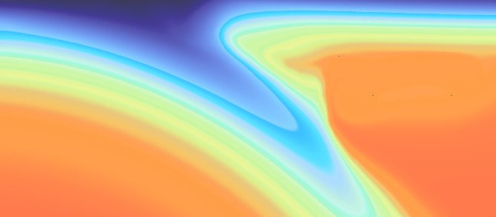
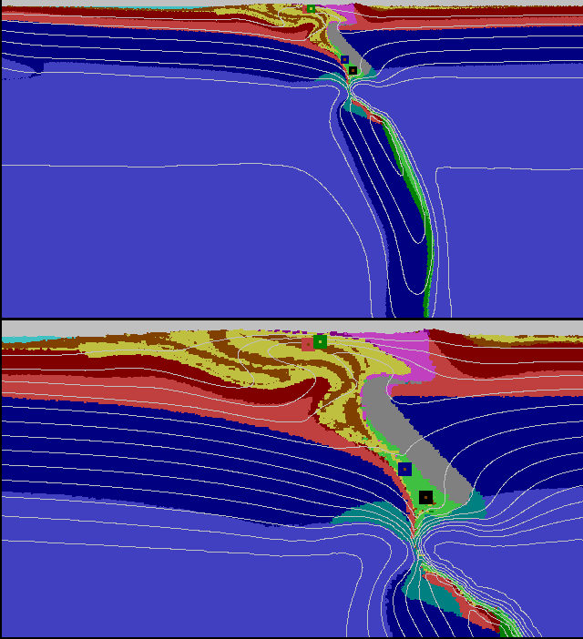
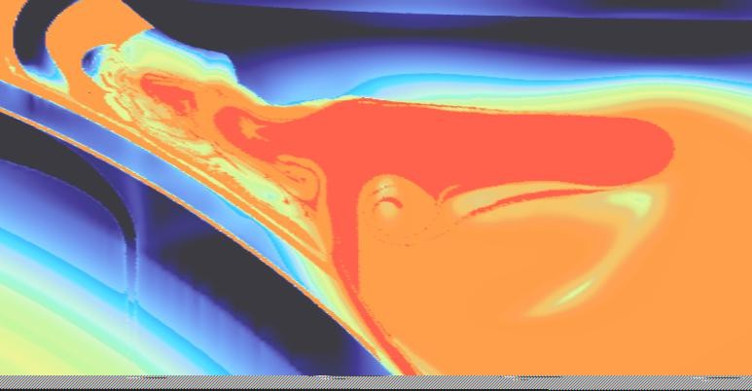
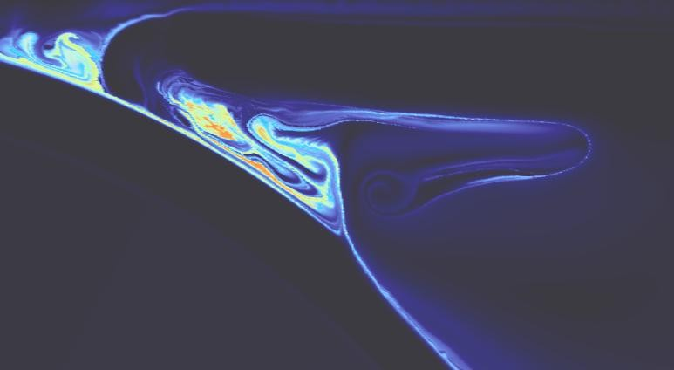
Numerical modeling with visualization
400ºC
800ºC
1200ºC
Temperature
Viscosity
200ºC
400ºC
600ºC
800ºC
1000ºC
1200ºC
Bulk Strain

Slide 9
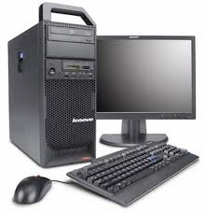
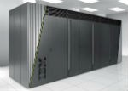
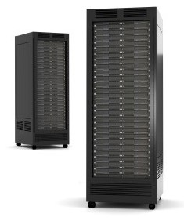
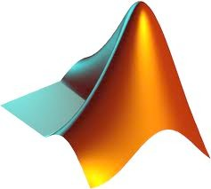


Computational resources
1D/2D models:
computation and visualization can be mostly done on local machines with moderate to high RAM and 1 to 8 CPUs (depending on the numerical resolution = problem size)(€ 1.500-4.000)
Workstation
3D models:
computation on supercomputing clusters (e.g., PLX, EURORA and FERMI at CINECA, Italy) with 100s to 1.000.000s CPUs. If many users, “problems” may arise due to long queuing times.
alternatively, with about € 100.000 it is possible to buy medium
size clusters (e.g., 384-786 CPUs) that could serve the whole department.
visualization requires powerful GPUs (€ 2.000-10.0000) and can be done on local machines or remotely using cluster’s GPUs.
FERMI at CINECA, Bologna, Italy
Programming languages:
C/C++, Fortran, MatLab (€ 500-1000 → Octave for free!)
Visualization softwares:
MatLab, Paraview, Amira,
etc.
This is not a coffee vending machine!

Slide 10
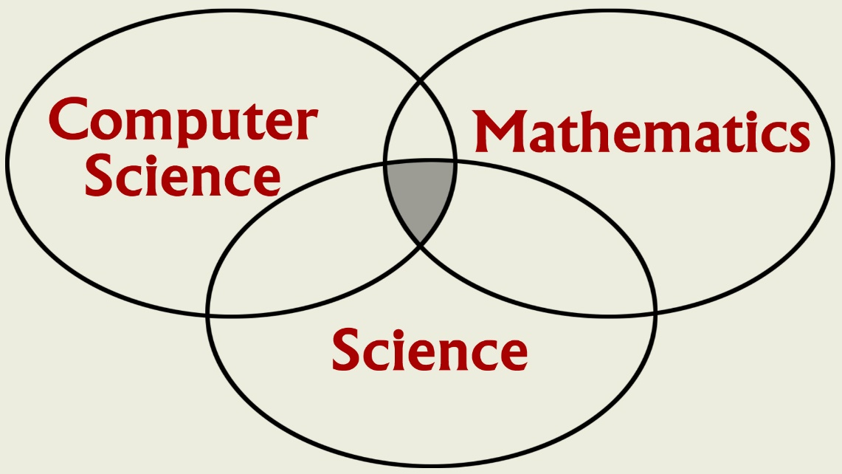
Computational Science?
Notes:
Science?
Computational Science is a multidisciplinary activity, brings together people from a variety of disciplines.

Slide 11
Computational Science
Complements, but does not replace, theory and experimentation in scientific research.
Experiment
Theory
Computation
Notes:
Validation

Slide 12
Computational Science
Has emerged as a powerful, indispensable tool for studying a variety of problems in scientific research, product and process development, and manufacturing.
Seismology
Climate modeling
Economics
Environment
Material research
Drug design
Manufacturing
Medicine
Biology
Analyze - Predict
Notes:
Seismology: oil exploration, earthquake prediction (Parallel computation reduced compute time from weeks to hours)
Global ocean/ climate modeling: global warming, weather prediction
Economics: growth of a local or national economy (Agent-based modeling), management of resources, analysis of tax strategies
Environmental: utilization of resources, population modeling, insect control
Materials research: design of new materials, smart materials; shape driven by temperature materials; materials aging issues (Stockpile stewardship)
Drug design: design of anti-cancer drugs, etc.
Manufacturing: optimization of manufacturing processes, automation
Medicine: Medical imaging, MRIs
Human genome: applications to understanding and treating disease

Slide 13
Example: Industry →
First jetliner to be digitally designed, "pre-assembled" on computer, eliminating need for costly, full-scale mockup.
Computational modeling improved the quality of work and reduced changes, errors, and rework.
www.boeing.com/commercial/
777family/index.html
Notes:
!00% digitally designed using 3D computer graphics.
Bottom line: Reduced cost/Reduced time to market.

Slide 14
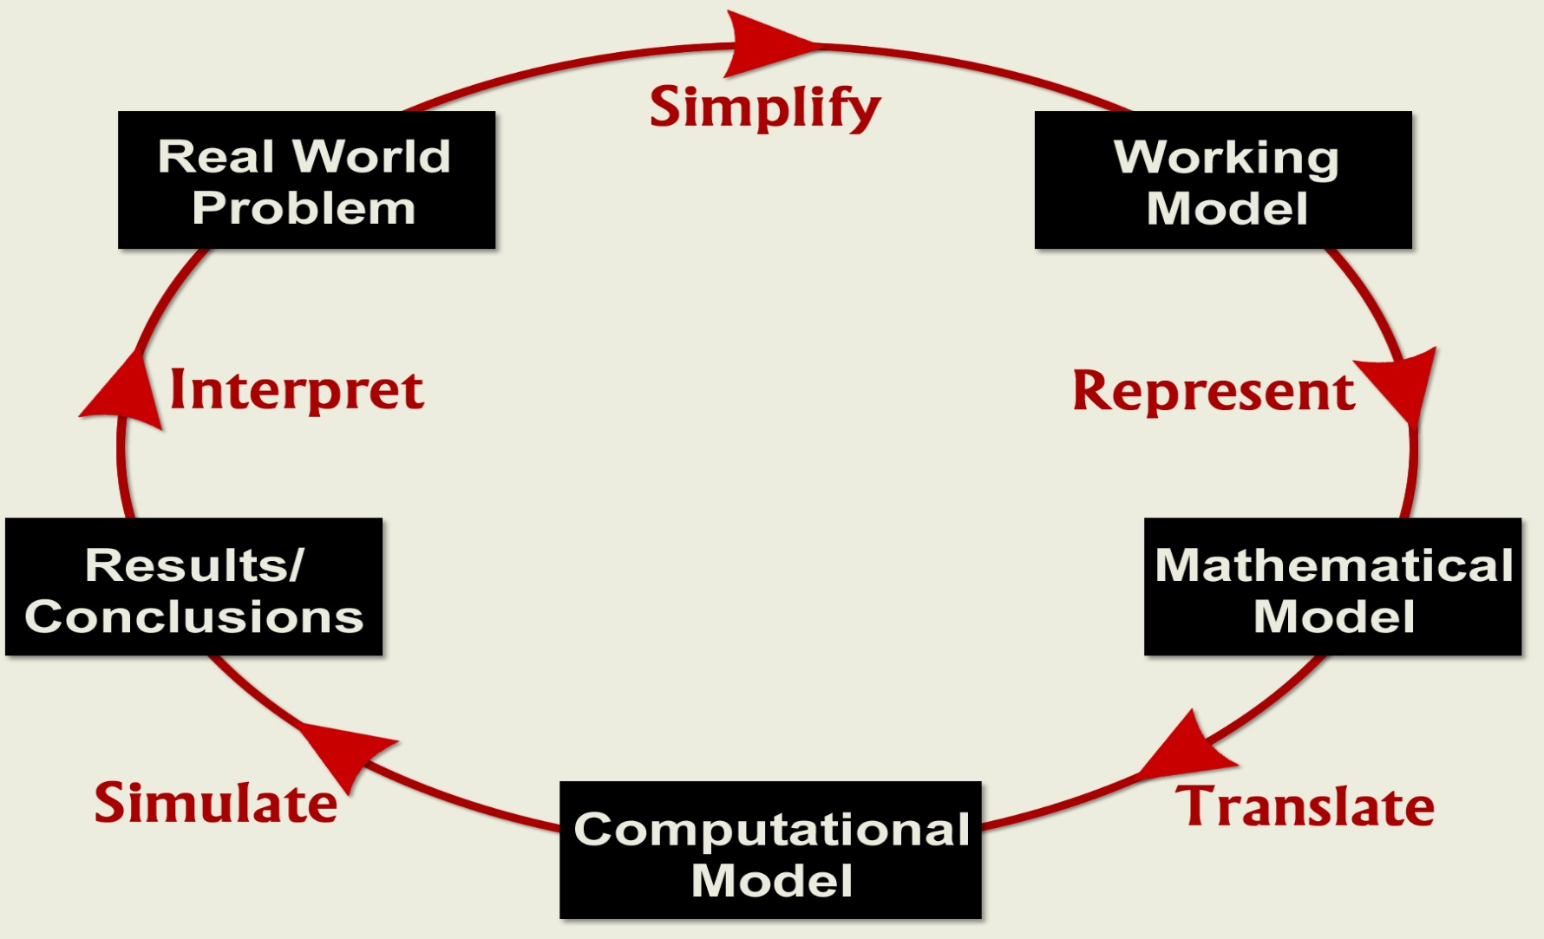
Computational Science Process

Slide 15

Mathematics
First of all: it is simple!!! First and second order derivatives.
(Very short) review of the mathematical background needed in this course to
handle partial differential equations (PDE): differential equations in which an unknown function is a function of multiple (rather than single) independent variables (space coordinates and time).
∂T ″∂²T ∂²T ∂²T ⎞
∂t
Example: 3D Heat diffusion equation →
= k
⎮
⎛
+ +
∂x ∂y² ∂z²
⎮
⎠
2
In this course we will use the finite difference method to operate differentiation and numerically solve for PDEs

Slide 16
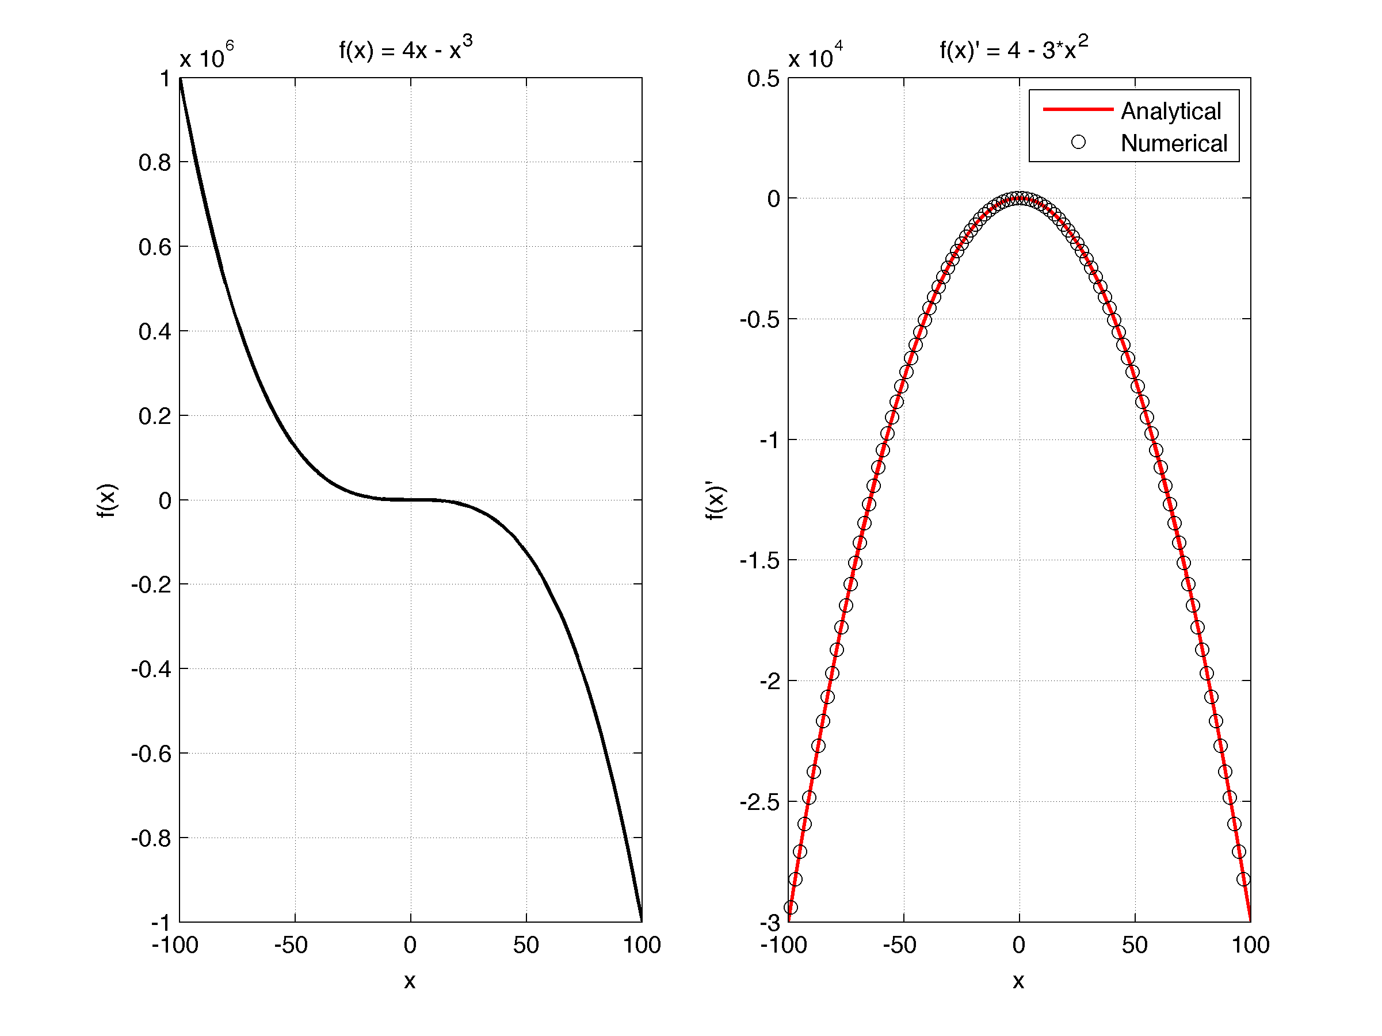
Finite difference method
First derivative of function f(x) (1D case): ∂f (x) f (x + Δx) − f (x) f !(x) = ≈ lim ∂x ^{Δx→0} (x + Δx) − (x) Analytical vs Numerical | Example: ∂T ≈ ΔT ₌ T₂ − T₁ ∂x Δx x₂ − x₁ ″∂T ⎞ _{T} ⎮ ⎮ _{T2} ₁ ⎛ ∂x ⎠ x x₁ x₂ Δx
 | The same is valid for first derivative in time: ∂T ΔT T ^{t+Δt} − T ^{t} ≈ = ∂t Δt Δt

Slide 17
Chapter Objectives
Understanding the meaning of local and global truncation errors and their relationship to step size for one-step methods for solving ODEs.
Knowing how to implement the following Runge-Kutta (RK) methods for a single ODE:
Euler
Heun
Midpoint
Fourth-Order RK
Knowing how to iterate the corrector of Heun’s method.
Knowing how to implement the following Runge-Kutta methods for systems of ODEs:
Euler
Fourth-order RK

Slide 18
Ordinary Differential Equations
Methods described here are for solving differential equations of the form:
The methods in this chapter are all one-step methods and have the general format: where φ is called an increment function, and is used to extrapolate from an old value y_{i} to a new value y_{i+1}.

Slide 19
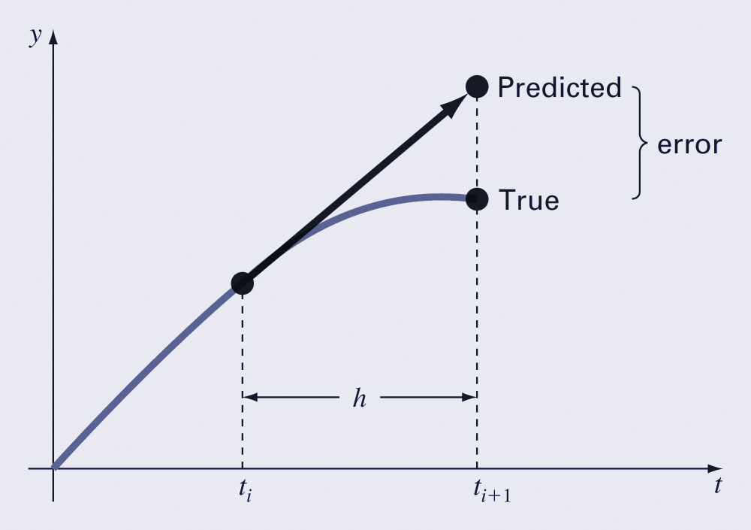
Euler’s Method
The first derivative provides a direct estimate of the slope at t_{i}: and the Euler method uses that estimate as the increment function:

Slide 20
Error Analysis for Euler’s Method
The numerical solution of ODEs involves two types of error:
Truncation errors, caused by the nature of the techniques employed
Roundoff errors, caused by the limited numbers of significant digits that can be retained
The total, or global truncation error can be further split into:
local truncation error that results from an application method in question over a single step, and
propagated truncation error that results from the approximations produced during previous steps.

Slide 21
Error Analysis for Euler’s Method
The local truncation error for Euler’s method is O(h²) and proportional to the derivative of f(t,y) while the global truncation error is O(h).
This means:
The global error can be reduced by decreasing the step size, and
Euler’s method will provide error-free predictions if the underlying function is linear.
Euler’s method is conditionally stable, depending on the size of h.

Slide 22
Runge-Kutta Methods
Runge-Kutta (RK) methods achieve the accuracy of a Taylor series approach without requiring the calculation of higher derivatives.
For RK methods, the increment function φ can be generally written as: where the a’s are constants and the k’s are
where the p’s and q’s are constants.

Slide 23
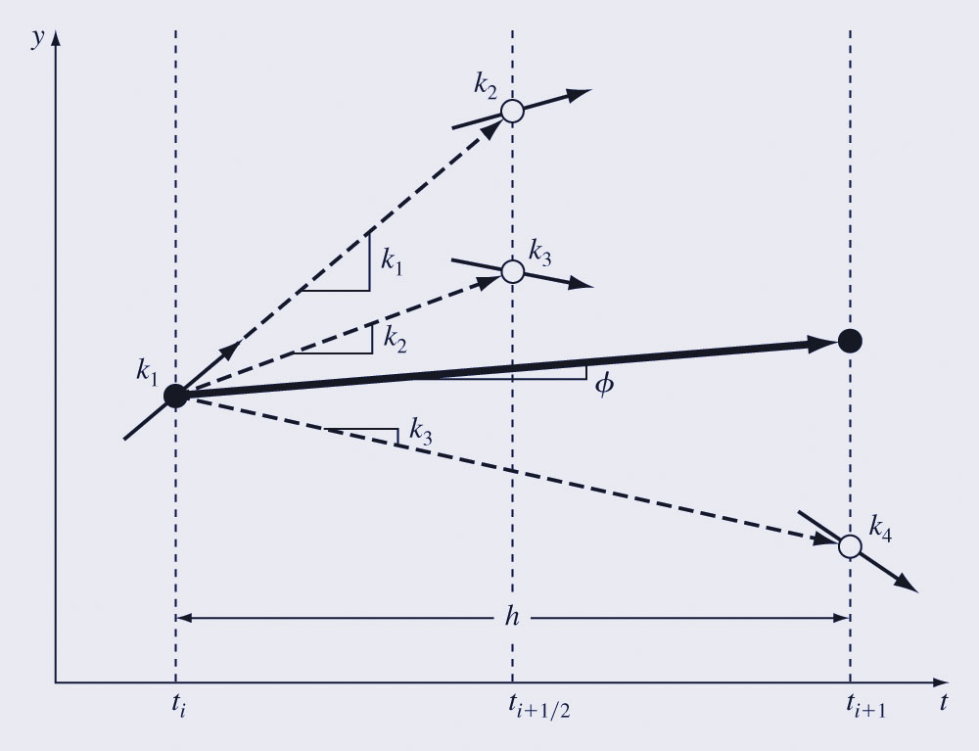
Classical Fourth-Order Runge-Kutta Method
The most popular RK methods are fourth-order, and the most commonly used form is: where:

Slide 24
Systems of Equations
Many practical problems require the solution of a system of equations:
The solution of such a system requires that n initial conditions be known at the starting value of t.

Slide 25
Solution Methods
Single-equation methods can be used to solve systems of ODE’s as well; for example, Euler’s method can be used on systems of equations - the one-step method is applied for every equation at each step before proceeding to the next step.
Fourth-order Runge-Kutta methods can also be used, but care must be taken in calculating the k’s.

Slide 26
Solving Differential Equations Numerically
Example equation:
dy/dx + 2y = 1.3 e^{-x}
Initial condition:
y(0) = 5
Rewrite:
dy/dx = 1.3 e^{-x} - 2y
Goal: compute y(x) numerically.

Slide 27
Why Numerical Methods?
Many differential equations cannot be solved analytically.
Example idea (Euler method):
y_{n+1} = y_n + h f(x_n, y_n)
But Euler can be inaccurate.
Runge–Kutta methods improve accuracy using several slope evaluations.

Slide 28
Runge–Kutta 4 Method
Compute four slopes:
k1 = f(x_n, y_n)
k2 = f(x_n + h/2, y_n + h k1/2)
k3 = f(x_n + h/2, y_n + h k2/2)
k4 = f(x_n + h, y_n + h k3)
Update:
y_{n+1} = y_n + h/6 (k1 + 2k2 + 2k3 + k4)

Slide 29
Example Step (RK4)
Equation:
f(x,y) = 1.3 e^{-x} - 2y
Initial values:
x0 = 0
y0 = 5
Step size:
h = 0.1
Compute slopes k1, k2, k3, k4.

Slide 30
Result of RK4 Step
k1 = -8.7
k2 ≈ -7.893
k3 ≈ -7.974
k4 ≈ -7.229
Update:
y1 = y0 + h/6 (k1 + 2k2 + 2k3 + k4)
Result:
y(0.1) ≈ 4.206

Slide 31
Geometric Interpretation
RK4 evaluates slopes at:
• start of the interval
• middle (twice)
• end of the interval
Weighted average of slopes:
k1 + 2k2 + 2k3 + k4
This gives a much more accurate estimate than Euler's method.

