Slide 1

Introduction to Linux
(Part 2/2)
Carlos Pinilla
Physics and Geosciences Dept.
2026-10

Slide 2
Course Agenda
Part 2: Introduction to more advanced topics in Linux
Linux Essential Commands (Part 2)
Text Editors in Linux
Linux Environment Variables
Basic Bash Scripting in Linux

Slide 3
Review
Command | Description
pwd | Prints Current Working Directory
ls | Lists the contents of a directory
cd | Change the current path to the destination directory
mkdir | Makes a new directory
rmdir | Removes an empty directory
cp | Copy file or directory
mv | Move/Rename file or directory
rm | Delete file or directory
cat | Concatenates and prints the contents a file

Slide 4
Review
Command | Description
echo | Write arguments to the standard output
wc | word, line, character, and byte count
man | Search and open the manual page of a Linux command
more | Paging through text one screenful at a time
less | Improved version of more allows backward/forward movement
head | Display first lines of a file
tail | Display last lines of a file
grep | Print lines in a file matching a pattern
history | See the commands you have typed so far

Slide 5
Linux Essential Commands
(Part 2)

Slide 6


Linux Essential Commands 2
Define the file type:
Unlike Windows, files extensions rarely define the type of a file in Linux.
  For example: “file.txt” many not be a TEXT file.
file command displays the file type along with a brief summary of the file contents.
quanah:$ file myfile
myfile: ASCII text
quanah:$ file /home/mahmadia/program.py
/home/mahmadia/program.py: Python script, ASCII text executable quanah:$ file test.tar.gz
test.tar.gz : gzip compressed data, from Unix, last modified: Wed Sep 4 14:04:10 2019

Slide 7


Linux Essential Commands 2
CRLF Line Terminator:
Windows text editors such as notepad add a Carriage Return Line Feed (CRLF) character at the end of each line of the text which causes problems with many Linux applications.
dos2unix command fixes the CRLF issue in text files from Windows.
quanah:$ file windows.txt
windows.txt: ASCII text, with CRLF line terminators quanah:$ dos2unix windows.txt
dos2unix: converting file windows.txt to Unix format ... quanah:$ file windows.txt
windows.txt : ASCII text

Slide 8


Linux Essential Commands 2
Compression and File Packaging:
zip command packages and compresses files and directories
  zip [OPTIONS] zip_file file_dir1 file_dir2 …
  -r : Add the directories and subdirectories contents into the zip file
quanah:$ ls mydir test1.txt
quanah:$ zip -r archive.zip ./* adding: ./test1.txt (deflated 62%) adding: ./mydir/ (deflated 0%) quanah:$ ls
archive.zip mydir test1.txt

Slide 9

Linux Essential Commands 2
Compression and File Packaging:
unzip command lists and extracts the contents of a zipped file
  -l : Lists the contents of a zipped file
quanah:$ ls archive.zip
quanah:$ unzip archive.zip quanah:$ ls
archive.zip mydir test1.txt

Slide 10
Linux Essential Commands 2
Compression and File Packaging:
Other compression commands available in Linux
Command | Description | Decompression | File Ext.
zip | Packages and compresses files and directories | unzip | .zip
gzip | A GNU tool for compressing or expanding files/directories | gunzip gzip -d | .gz
bzip2 | Compresses files using the Burrows- Wheeler block sorting text compression algorithm. | bunzip2 bzip2 -d | .bz, .bz2
xz | Similar to gzip and bzip2 | unxz | .xz

Slide 11
Linux Essential Commands 2
Archiving:
tar command saves many files and directories into a single “archive” file
  tar OPTIONS dest_file src1 src2 …
  -f define the archive file path/name
  -c Create a new archive
  -a Append to the existing archive file
  -x Extract the contents of an archive file
  -z Compress archive file with gzip
  -j Compress archive file with bzip2
  -v verbosely list files processed

Slide 12


Linux Essential Commands 2
Archiving:
tar command examples:
quanah:$ ls mydir test1.txt
quanah:$ tar -cf myarchive.tar ./* quanah:$ ls
myarchive.tar mydir test1.txt quanah:$ tar -xvf myarchive.tar test1.txt
mydir/
quanah:$ tar -czf docs.tar.gz /home/mahmadia/docs quanah:$ ls
Docs.tar.gz myarchive.tar mydir test1.txt quanah:$ tar -xzf docs.tar.gz

Slide 13

Linux Essential Commands 2
Download files from internet:
wget command downloads files from internet
  -O : (capital O) defined the name of the destination file on your system
quanah:$ wget “https://repo.anaconda.com/miniconda/Miniconda3- latest-Linux-x86_64.sh” -O miniconda3.sh

Slide 14
Exercise #4
Go to your home directory
Create a new directory and name it “exercise4”
Go to the “exercise4” directory
Choose a small directory from your home directory
Try to archive and compress the directory by tar and save it under the “exercise4” directory.
Now try to decompress the tar file that you just created
Check the type of the file
Now try to untar the file

Slide 15
Linux Essential Commands 2
Access Control List (ACL):
Second level of discretionary permissions that override the standard ugo/rwx
better granularity in setting access to a file or a directory
Recommended on HPCC cluster environments
getfacl shows the file/directory Access Control List
  getfacl <File | Directory>
setfacl modify/remove the ACL permissions
  setfacl -m [u|g]:<username>:rwx <File|Directory>
  setfacl -x [u|g]:<username> <File|Directory>

Slide 16


Linux Essential Commands 2
quanah:$ getfacl test.txt # file: test.txt
# owner: mahmadia # group: CS user::rw-
group::r--
other::r--
quanah:$ setfacl -m u:user1:rw test.txt quanah:$ getfacl test.txt
# file: test.txt # owner: mahmadia # group: CS user::rw- user:user1:rw- group::r--
mask::rw-
other::r--

Slide 17
Text Editors in Linux

Slide 18
Text Editors in Linux
How to edit text files in Linux?
There are many text editors available on Linux
  nano is a small, simple and friendly editor
  vi/vim is a powerful text editor which can be used to edit all kinds of text
  emacs is part of the GNU project written by Richard Stallman
In this training course we will cover nano and vi/vim
Let’s look into nano (Demo)

Slide 19
Text Editors in Linux
How does vi/vim work?
vi/vim is a very popular text editor among programmers and system administrators
It supports many programming and scripting languages
Suitable for more advanced file editing
vi/vim has two modes:
  Text mode: which can be enabled by typing i (insert) or a (append)
  Command mode: which will be enabled by pressing the Esc key on keyboard.

Slide 20
Text Editors in Linux
Some useful vi/vim commands:
command | description |  | command | description
! | Forces the action |  | i | insert
:q | quit |  | a | append
:q! | Force quit |  | x | Delete a character
:w | write |  | y[count]y | Yank (copy) [count] lines
:wq | Write and quit |  | d[count]d | Cut (Delete) [count] lines
:x | Write and quit |  | p | Paste after the current line
Let’s look into vim (Demo)

Slide 21
Exercise #5
Go to your home directory
Create a new directory and name it “exercise5”
Go to the “exercise5” directory
Open a new text file with the editor of your choice and type the lines below:
Exercise #5
This is a Linux text editor exercise We finally made it!
Save the file and exit
Try to display the contents of the file on your screen
Change the permission of the file as below:
  Set read/write permission for the owner
  Set read-only permission to your group
  Give a read-only permission to user mahmadia and then remove it.

Slide 22
Environment Variables in Linux

Slide 23


Linux Environment Variables
What is the environment variable?
Environment Variables stores any user-defined or system-defined information that can be accessed within the shell.
Environment Variables are useful for passing data to programs or being used in shell scripts.
Defining a variable is very simple (do not put spaces around = symbol)
quanah:$ VAR_NAME=“This is a variable”
When referencing a variable place a ($) before the variable name
quanah:$ echo $VAR_NAME This is a variable

Slide 24
Linux Environment Variables
Common Linux Environment Variables
HOME | Pathname of the current user’s home directory
PATH | Colon separated list of directories where commands can be found
SHELL | Name of the current Shell program
PWD | Print current working directory
USER | Print current username
TERM | The type of the terminal
HOSTNAME | Displays computer’s hostname

Slide 25


Linux Environment Variables
PATH Environment Variable
Shell uses the PATH environment variable to locate commands
The PATH variable is colon (:) separated, and can be displayed with echo
quanah:$ echo $PATH
/usr/local/bin:/usr/bin:/usr/local/sbin:/usr/sbin
You can add a directory into the PATH variable of your own environment
quanah:$ export PATH="/home/username/bin:$PATH"
/home/username/bin:/usr/local/bin:/usr/bin:/usr/local/sbin:/usr/sbin
export command promotes a shell variable to an environment variable

Slide 26

Linux Environment Variables
Set Environment Variables at login time
~/.bashrc : Commands for environment variables that you want to set up at login time should be included in your ~/.bashrc file.
  For HPCC users we highly recommend using modules instead of modifying the ~/.bashrc file. (Modules are covered in HPCC New User Training)
quanah:$ vim ~/.bashrc
export WORK=/lustre/work/mahmadia export SCRATCH=/lustre/scratch/mahmadia export PATH=“$PATH:$WORK/bin”

Slide 27
Basic Bash Scripting In Linux

Slide 28


Basic Bash Scripting in Linux
What is Bash Script?
Bash script is an executable file contains Bash shell commands which could be used to automate and simplify things.
  Shell script is a text file starts with (#!) followed by the path to the shell interpreter (i.e. /bin/bash)
quanah:$ vim myscript.sh #!/bin/bash
echo “Hello World!”
quanah:$ chmod +x myscript.sh quanah:$ ./myscript.sh
Hello World!

Slide 29
Basic Bash Scripting in Linux
Control flows
The syntax of the if-then-else clause is as following:
if [ … | $var -eq 1 |  |  | ]; then
elif | [ | $var | -ne | 1 | ]; | then
…
elif | [ | $var | -gt | 1 | ]; | then
…
elif | [ | $var | -lt | 1 | ]; | then
…
fi

Slide 30
Basic Bash Scripting in Linux
Loops
The syntax of the for…in loop is as following:
for VARIABLE in 1 2 3 … N; do
… done
for VARIABLE in file1 file2 file3; do
… done
For VARIABLE in `Linux command`; do
… done

Slide 31
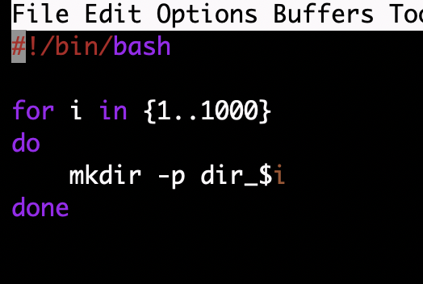
Use of the if and for
Cree una version similar para borrar estos directorios

Slide 32
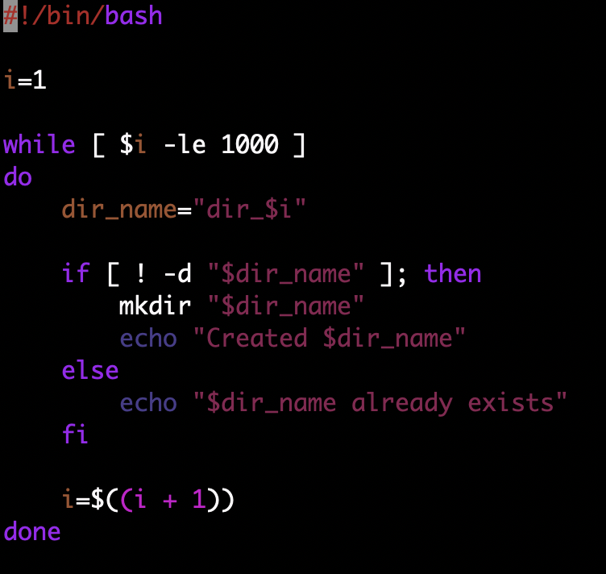
Cycle while and if

Slide 33
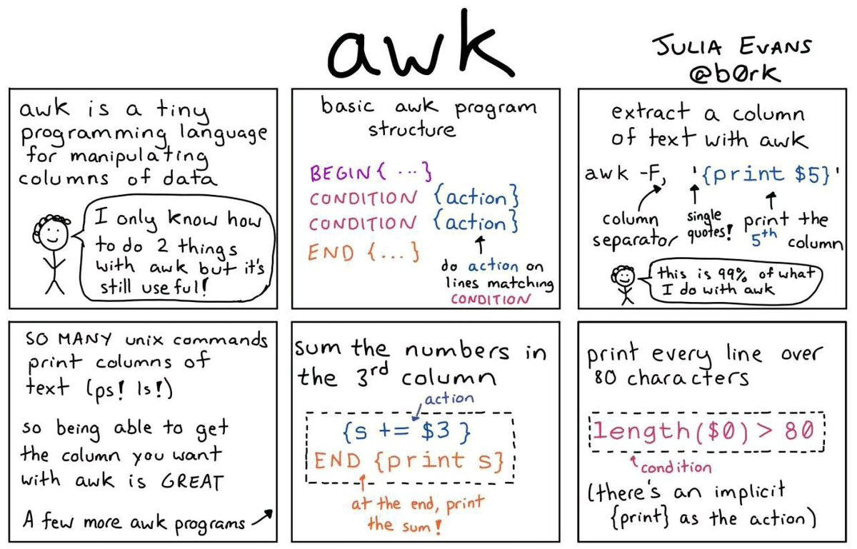

Slide 34
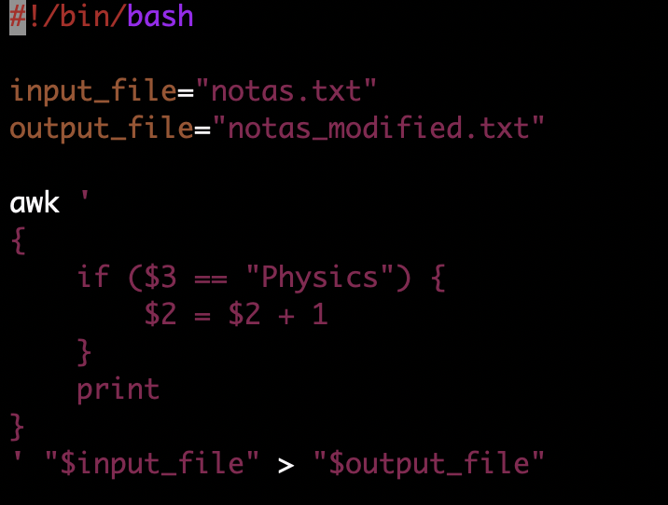
Awk and files modification

Slide 35
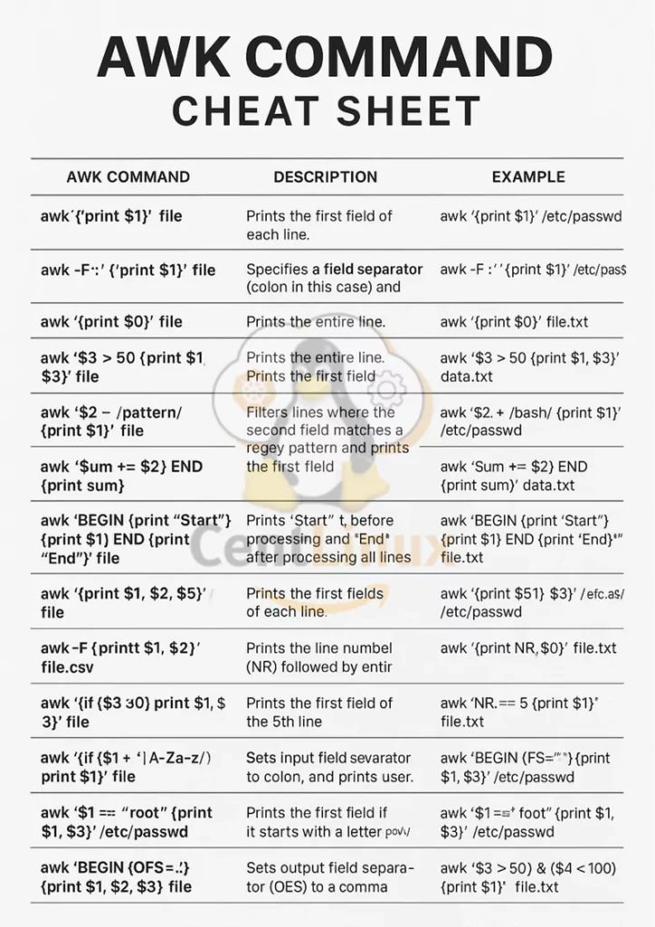
awk -F',' '{ print $1, $2 }' file.csv
awk 'BEGIN { OFS="," } { print $1, $2 }' file.txt

Slide 36
Exercise #6
Go to your home directory
Create a new directory and name it “exercise6”
Go to the “exercise6” directory
Create a script file and name it “show_dirs.sh”
Program the “show_dirs.sh” to go over all the directories under your home directory and print the following message for each directory:
/home/username contains --> the_directory_name
then print the following line for “exercise6” directory
This is the last directory --> excercise6
Make your script file executable and run it.

