Slide 1
Crowd simulation based on emergent behaviours

Slide 2
Agent

Slide 3
Individual behaviour: Brain

Slide 4
Collective behaviour: Flock

Slide 5
Global behaviour: Crowd

Slide 6
Emergent behaviour
Individual
Behaviour
Emergent
Behaviour
Collective
Behaviour

Slide 7
Data flow for an agent
Environment data
Agents
Terrain
...
Agent data
Position
Velocity
State
Flock
...
Flocking data
Neighbours
...
Brain
script
Agent
Crowd Simulator

Slide 8
Pipeline
Brain
script
3D package
Crowd Simulator
C++ standalone
Simulation
script
3D package
NGL
OpenGL

Slide 9
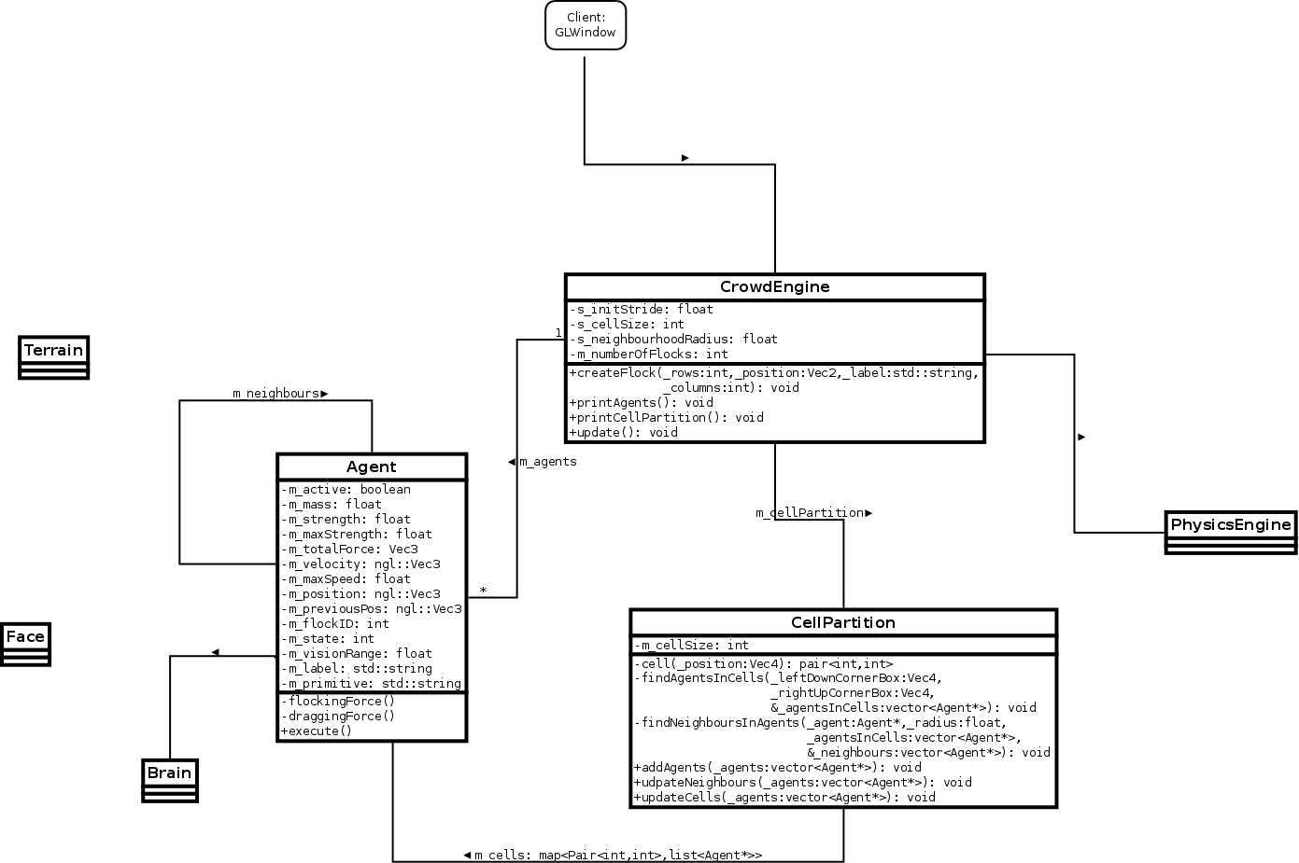
Class Diagram (so far)

