Slide 1
MongoDB
NoSQL Database
www.mongodb.com

Slide 2
What is MongoDB?
A Document-Oriented Database
A Document is a JSON content
In SQL Databases ->
we save text content in Structured Tables
In MongoDB ->
we save Structured JSON

Slide 3
NoSQL vs SQL: The Major Differences
SQL
NoSQL
Individual records are stored as rows and tables
Structured and data types are fixed in advance.
To store information about a new data ítem, the entire database must be altered
Document databases do away with the table-and-row model altogether, storing all relevant data together in a single “document”
Records can add new information on the fly, and unlike SQL table rows, dissimilar can be stored together as necessary

Slide 4

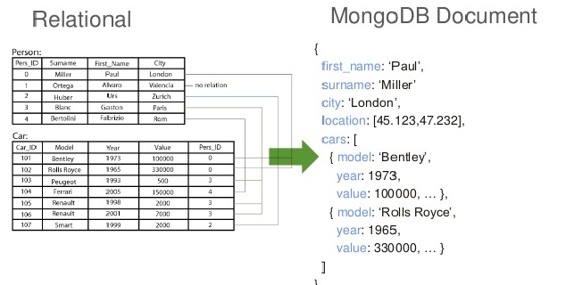
Data Models: Relational to Document

Slide 5
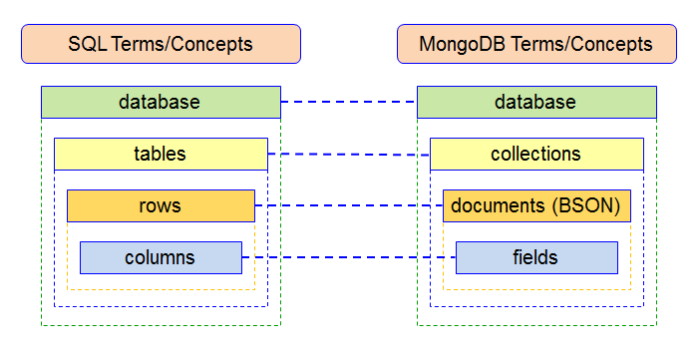

Slide 6
Who Uses MongoDB
Google
Facebook
Adobe
NBCUniversal
Verizon
Forbes
Department of Veteran Affairs
And Much More. See: https://www.mongodb.com/who-uses-mongodb

Slide 7
carlosrafaelcolon.com

