Slide 1
Implementation Reference for Responsys WebServices 6.x using Java in Windows

Slide 2
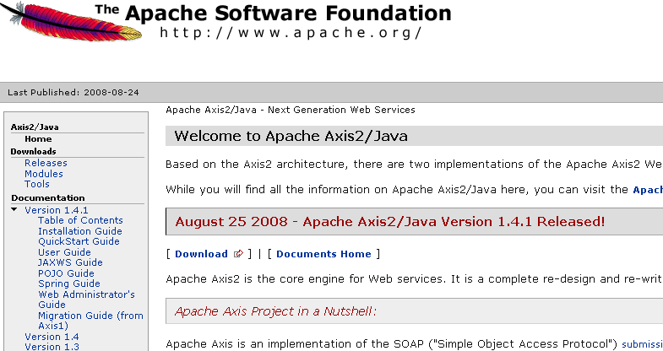
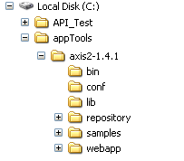
Getting Started with Java
Download and install Apache Axis distribution
Unzip files into a directory in your local system

Slide 3
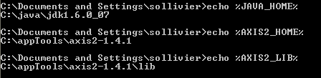
Getting Started with Java
Set environment variables
JAVA_HOME = C:\path\to\java\jdk
AXIS2_HOME = C:\path\to\axis2-1.4
AXIS2_LIB = %AXIS2_HOME%\lib
Example:

Slide 4
Get WSDL URLS after API enabled for Account
Responsys Interact POD | Web Service API URLS
Interact 2 | WSDL: https://ws2.responsys.net/webservices/wsdl/ResponsysWS_Level1.wsdl Endpoint: https://ws2.responsys.net/webservices/services/ResponsysWSService
Interact 5 | WSDL: https://ws5.responsys.net/webservices/wsdl/ResponsysWS_Level1.wsdl Endpoint: https://ws5.responsys.net/webservices/services/ResponsysWSService

Slide 5

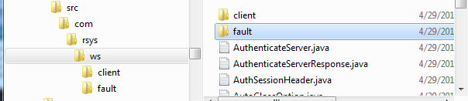
Getting Started with Java
Generate Web service stub classes from Responsys WSDL
Interact 2 WSDL:
https://ws2.responsys.net/webservices/wsdl/ResponsysWS_Level1.wsdl
Interact 5 WSDL:
https://ws5.responsys.net/webservices/wsdl/ResponsysWS_Level1.wsdl
Execute WSDL2Java utility using WSDL url:
%AXIS2_HOME%\bin\WSDL2Java -uri https://ws2.responsys.net/webservices/services/ResponsysWSService?wsdl -u -d adb -s -p com.rsys.ws.client

Slide 6
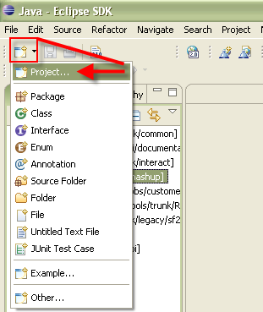
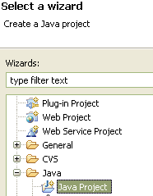
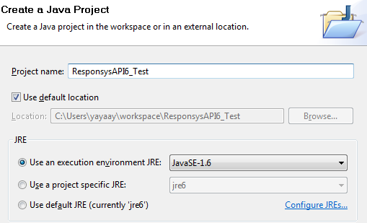
Getting Started with Java
Create a Java project in Eclipse

Slide 7
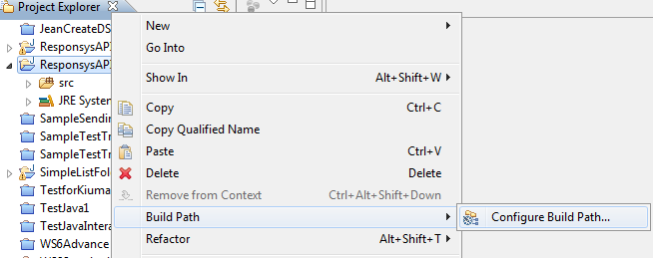

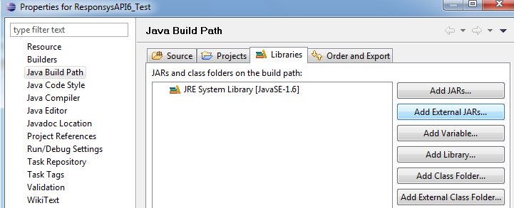
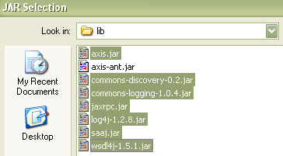
Getting Started with Java
Add Axis libraries to your Java Project
Right Click the project and select Build Path|Configure Build Path
Click Add External JARs
Select the JARs in your axis\lib folder:

Slide 8
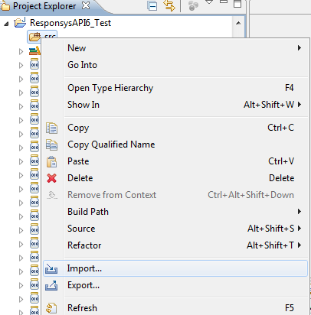
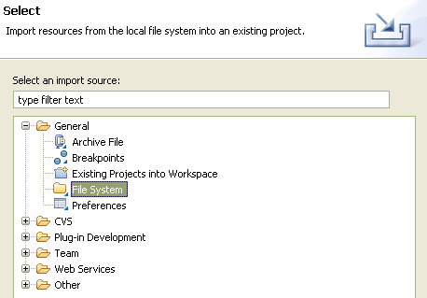
Getting Started with Java
Import your stub classes
Right click the “src” folder and select the “Import” menu item and then select “File System”
Note: screens may differ somewhat depending on whether you’re using standard Eclipse versus MyEclipse.

Slide 9
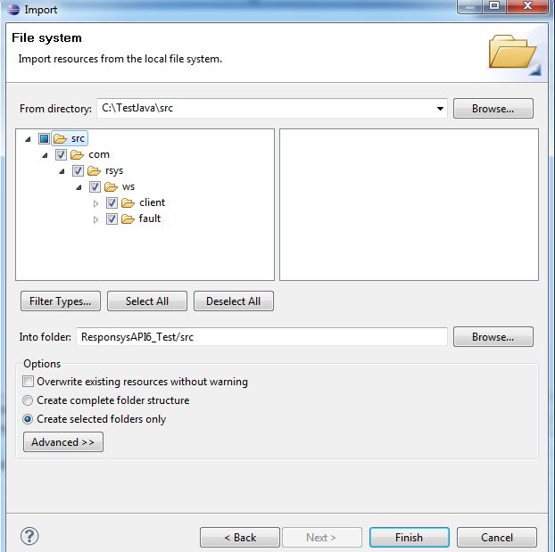

Getting Started with Java
Select the folder where you generated you stub classes with the WSDL2Java utility and the responsys.ws.client package will be created under the “src” folder.

Slide 10
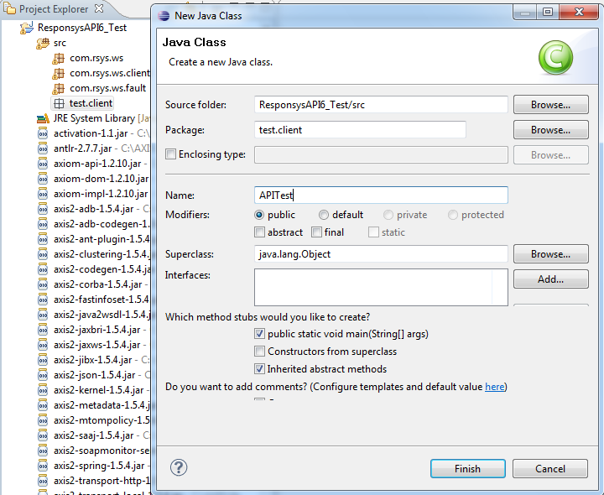
Getting Started with Java
Create a package for your client code: “test.client”
Create a Java Class for your project
Use package name from above: “test.client”
Give class a name: “APITest”
For this simple example, include a main() method

Slide 11
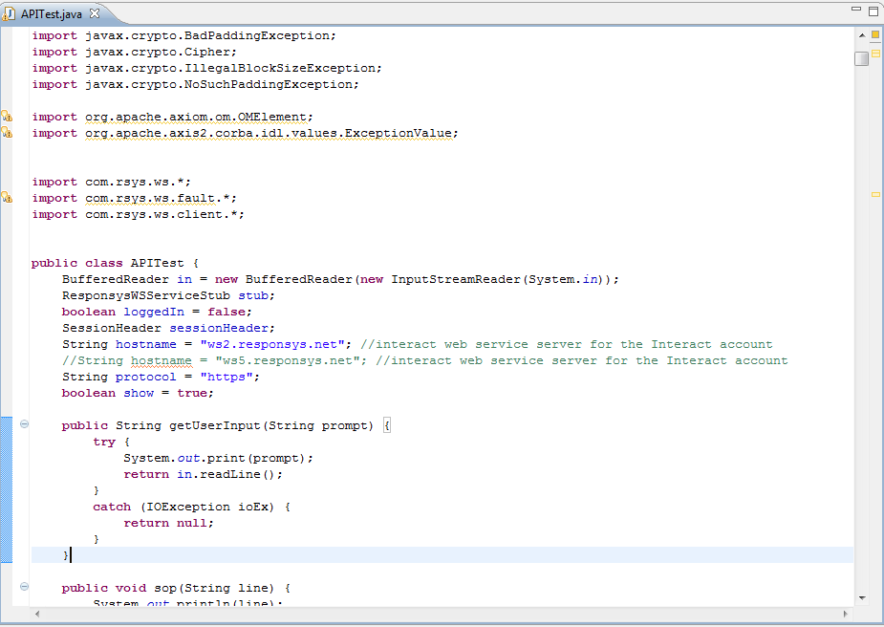
Getting Started with Java
Copy content of the java client sample code (APITest.java) into the content of the java class
Getting Started with Java

Slide 12
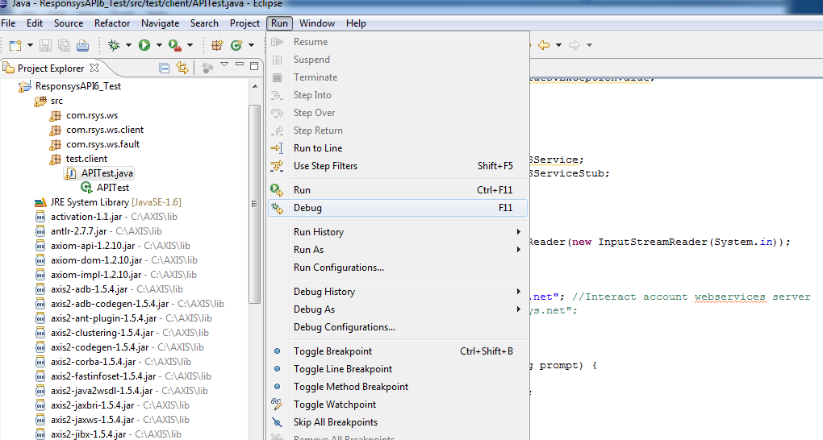
Getting Started with Java
Test by running code with IDE (select Debug or Run)
For debugging, insert breakpoints

