Slide 1

RepRap
Manufacturing for the Masses
Adrian Bowyer
University of Bath, U.K.
FOSDEM, 7 February 2010

Slide 2
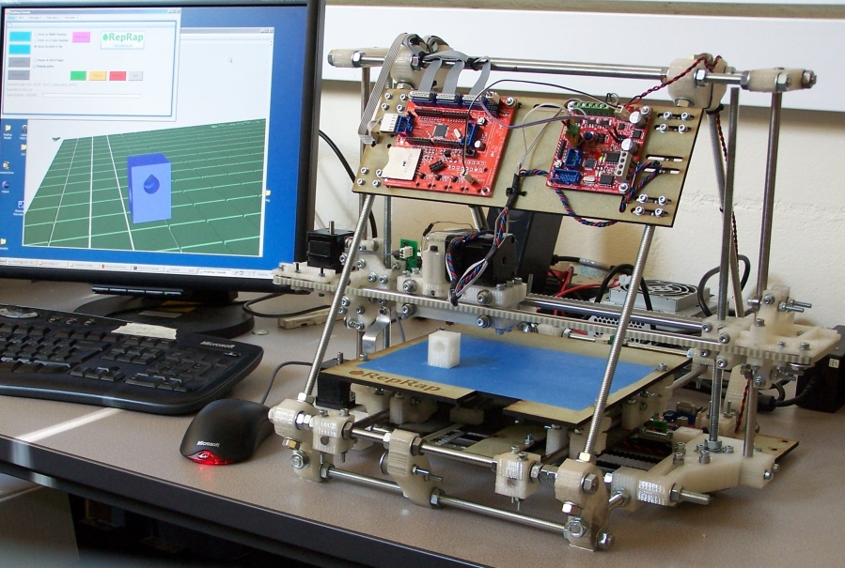
What is RepRap?
RepRap is a replicating 3D printer

Slide 3
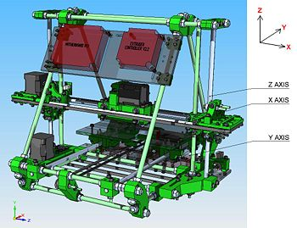
RepRap Facts
RepRap can copy about half its own parts.
The other half: hardware shops or online.
Cost of all the materials €350.
Working volume: 200 x 200 x 140 mm³.
Material: most plastics.
Print rate: 19 ml/hour (2.5 days to replicate).
Licence: GPL.

Slide 4
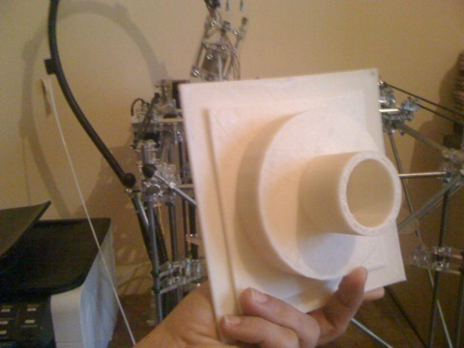
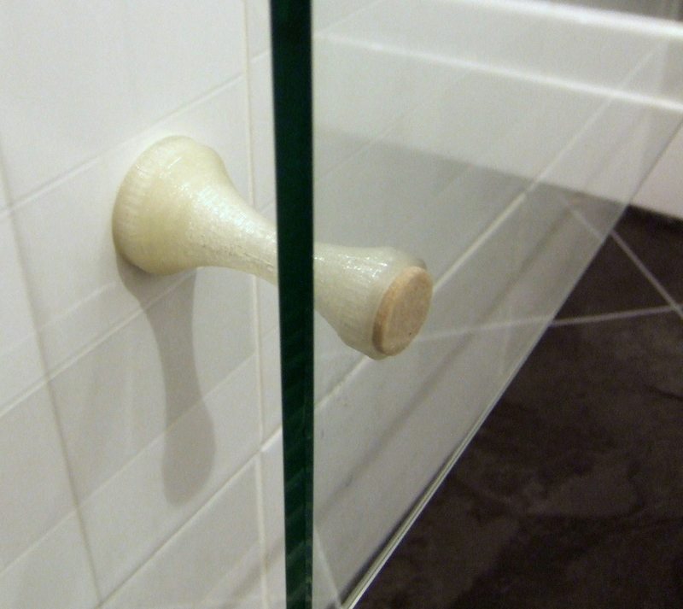
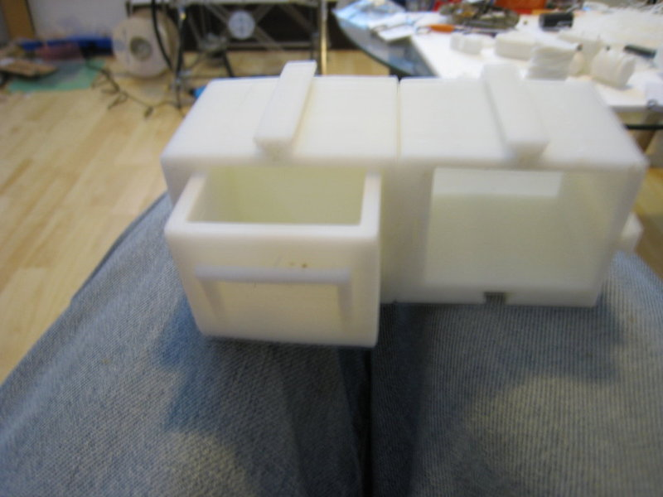
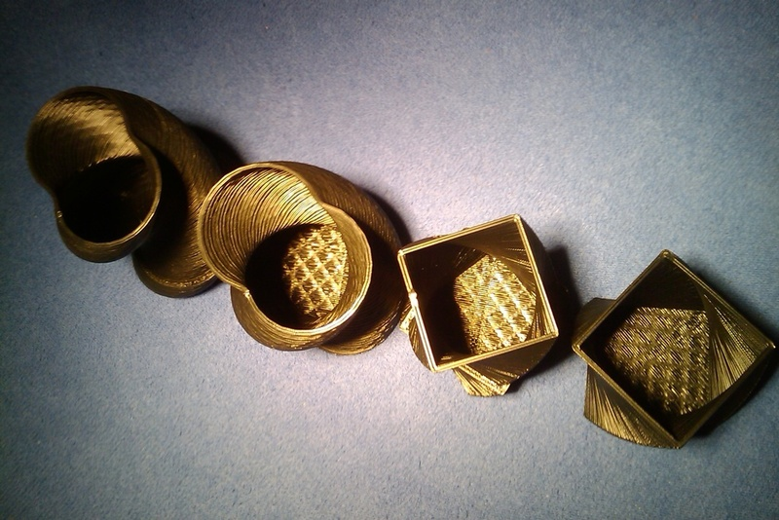
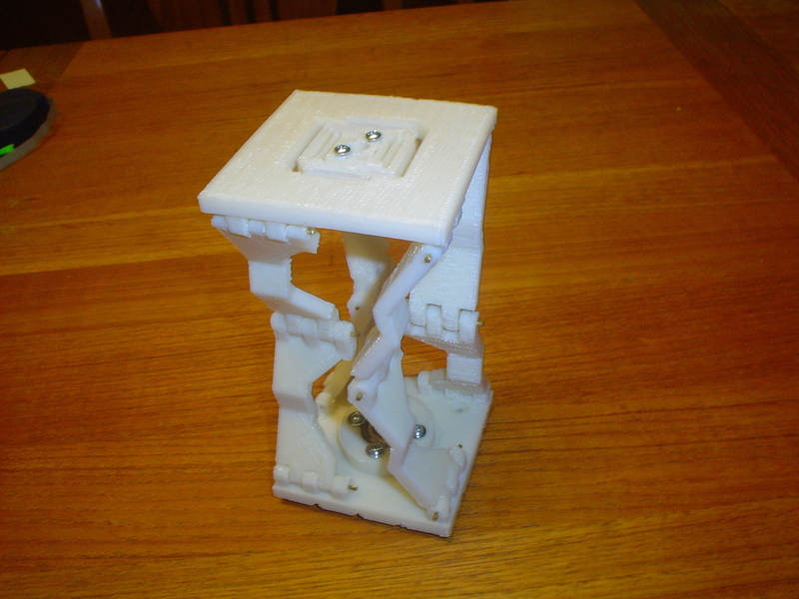
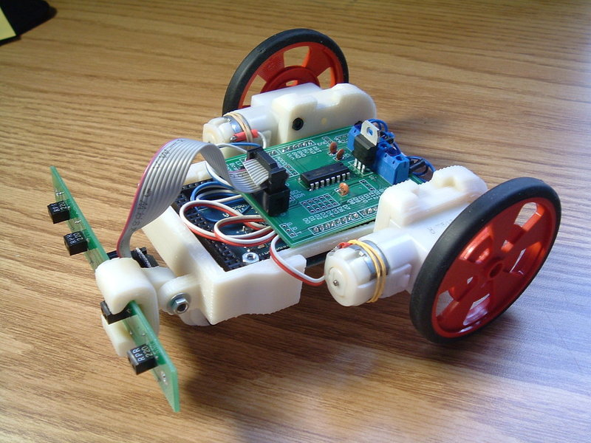
RepRap Makes
http://thingiverse.com

Slide 5
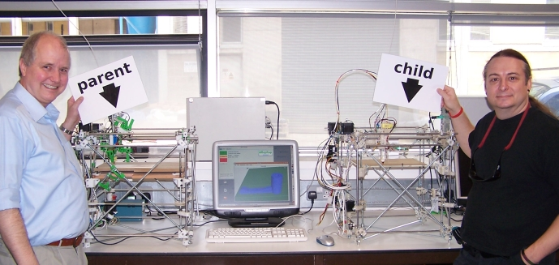
Anyone with a RepRap can make another RepRap for a friend
29 May 2008

Slide 6
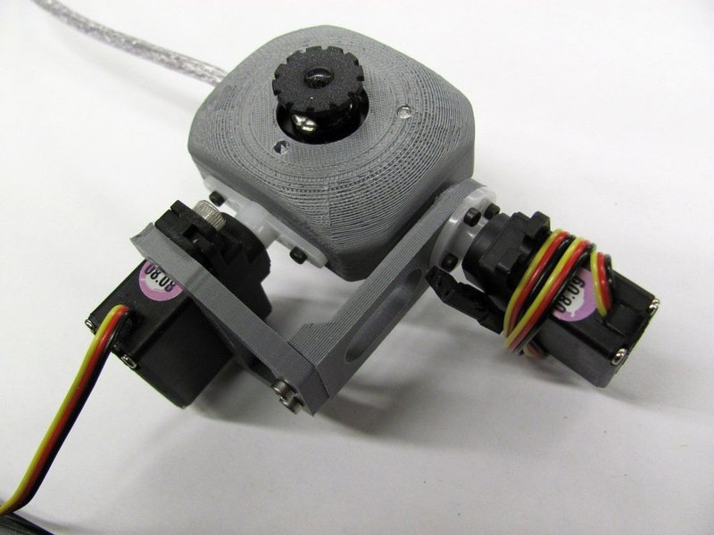
It's like MP3 music sharing, but for real solid stuff...
...ultimately any stuff

Slide 7


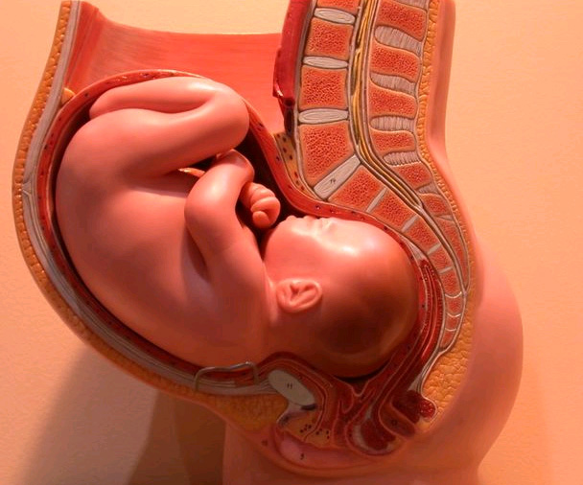
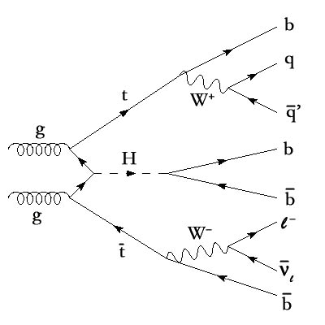
People are constrained by
Rules
Economics
Biology
Physics

Slide 8
Rules
Registered and Unregistered rights
Copyright (unregistered)
Patent (registered)
Unregistered and registered design
Passing off

Slide 9
Economics
Making manufacturing like agriculture
Developing communities
Economies of scale
Distribution
Recycling

Slide 10
Biology

Slide 11
Physics

Slide 12
http//reprap.org

