Slide 1
Wealth without money - self-replicating production
Adrian Bowyer
Bath University
Pop!Tech 2007

Slide 2
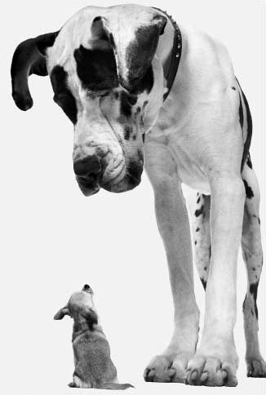
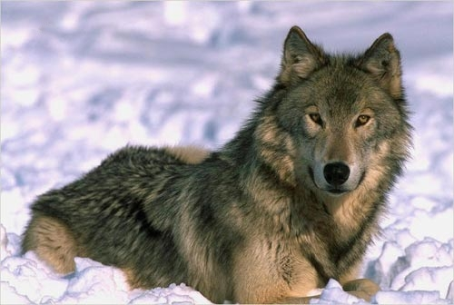

Breeding

Slide 3
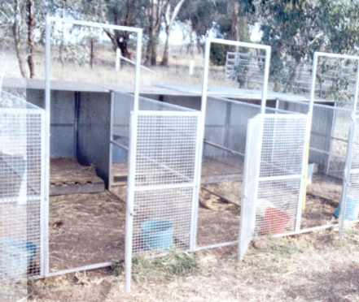
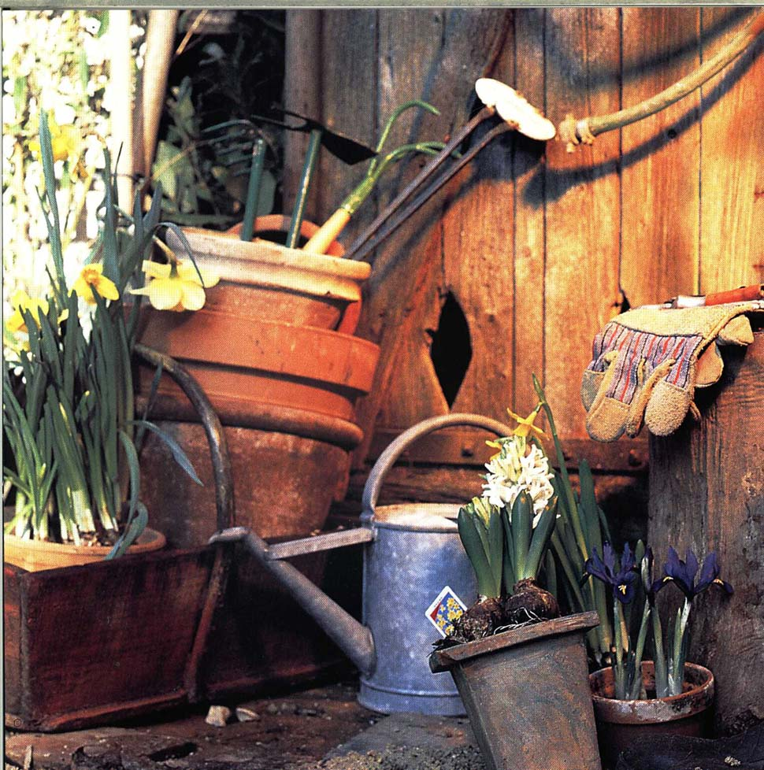
Advanced genetic engineering equipment

Slide 4
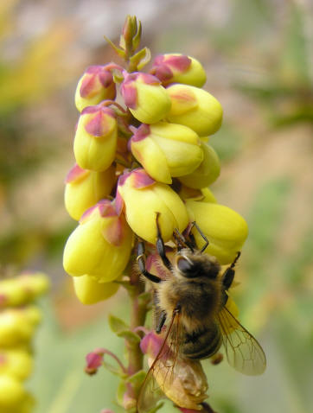
Symbiosis
nectar <> reproduction

Slide 5
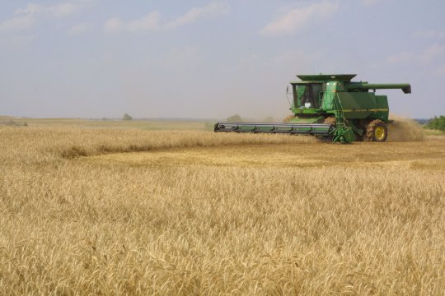
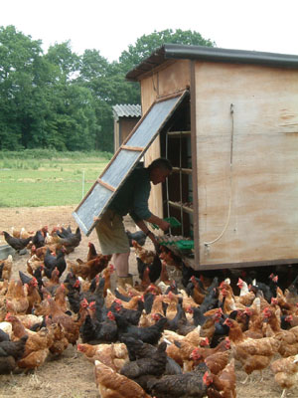
Symbiosis
nectar <> reproduction

Slide 6
Symbiosis
nectar <> reproduction cake <> reproduction

Slide 7
Suppose we made a machine that:
Self-replicated almost all its parts
Existed symbiotically with people, giving them goods in return for being helped to replicate (like flowers)...
RepRap - The Replicating Rapid Prototyper Project

Slide 8
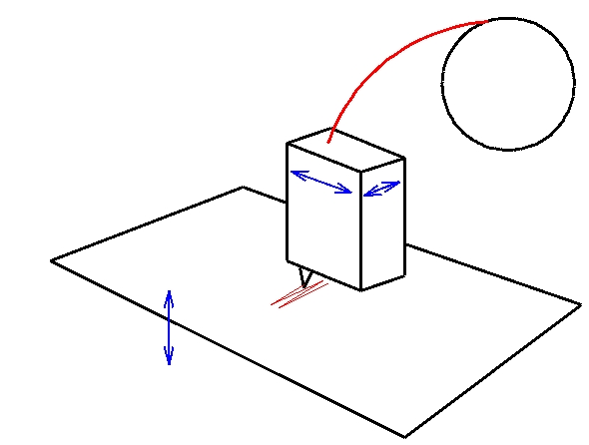
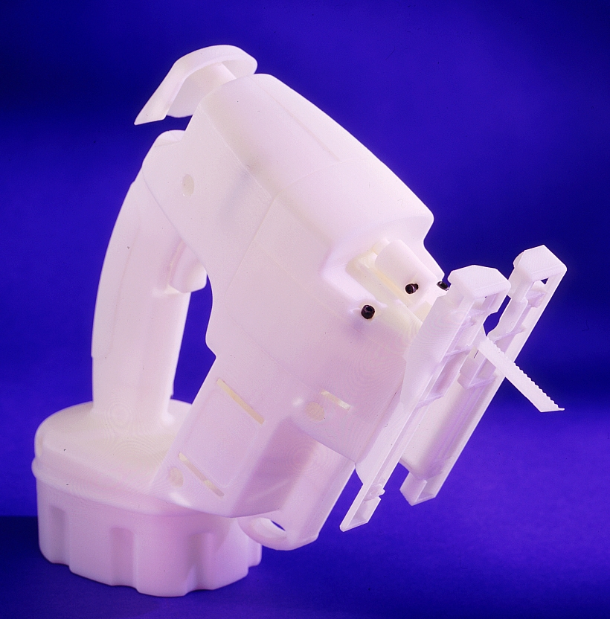
FDM rapid prototyping
Fused Deposition Modelling

Slide 9
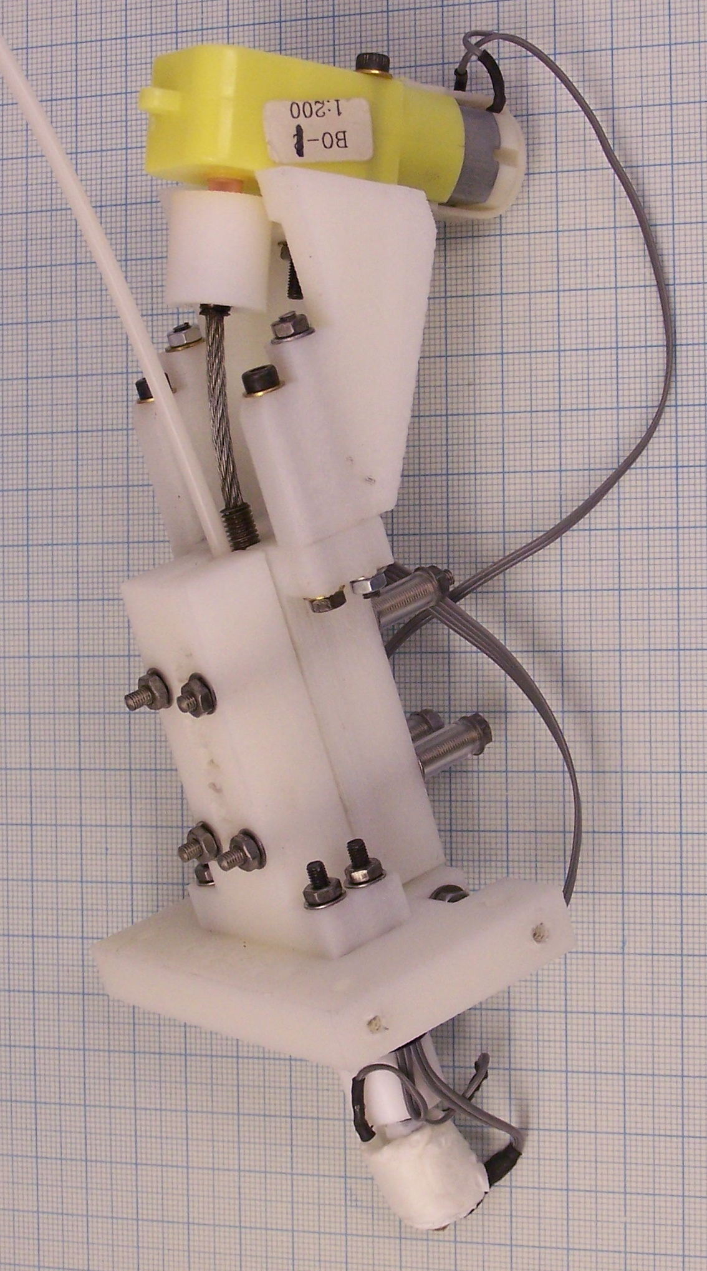
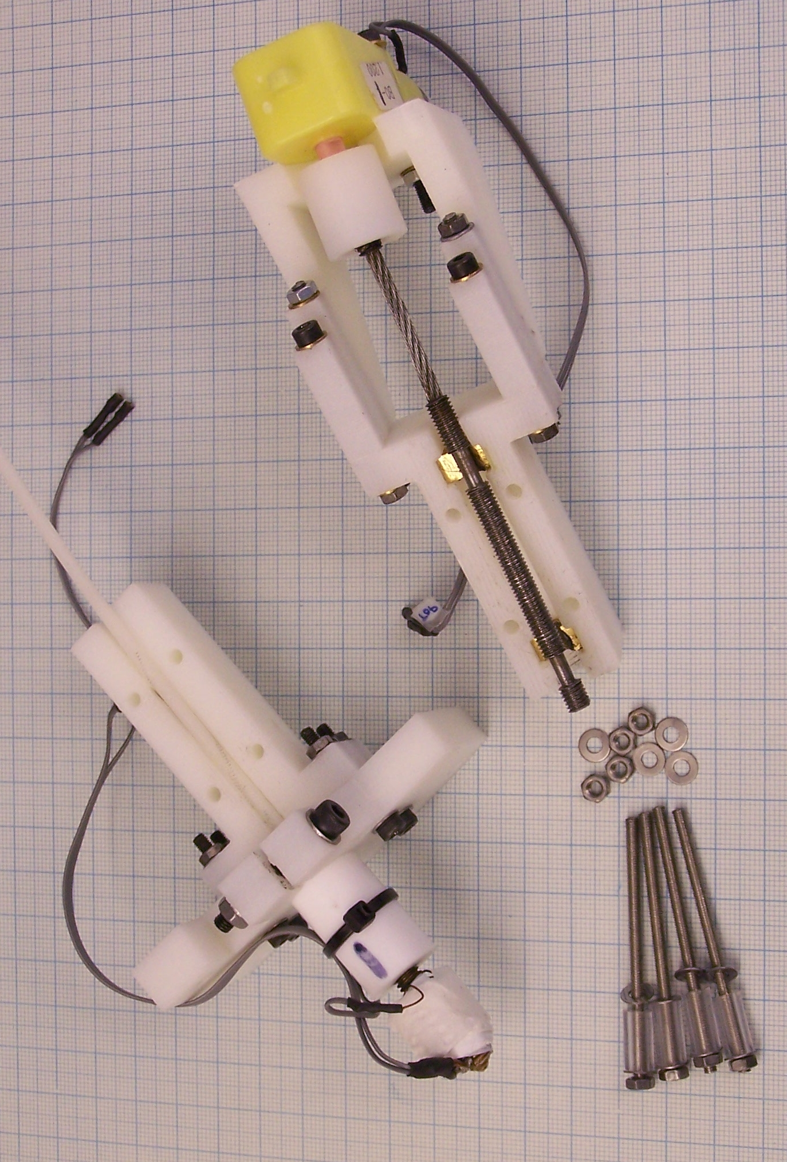
Rapid-prototyped write-head

Slide 10
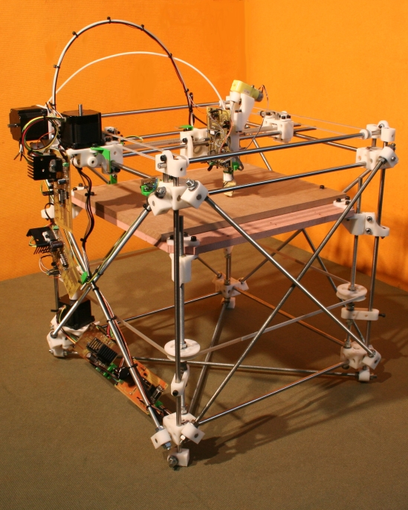
Rapid-prototyped X, Y, Z robot

Slide 11
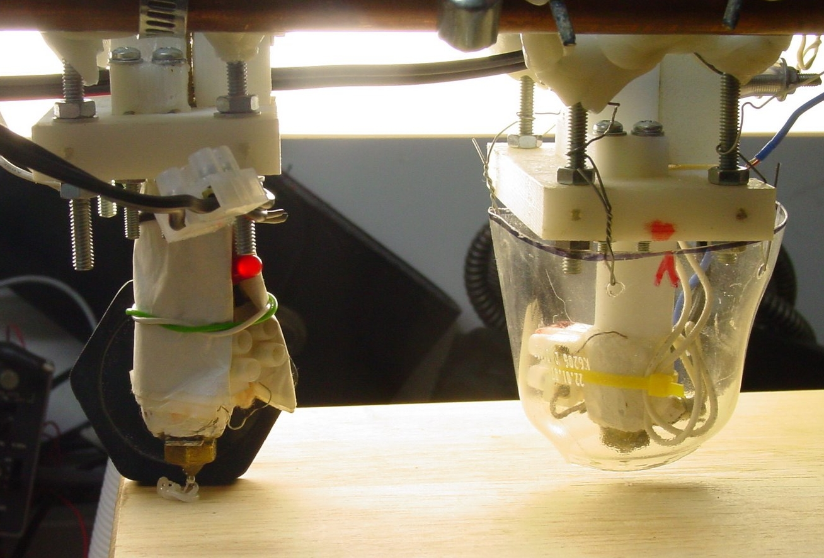
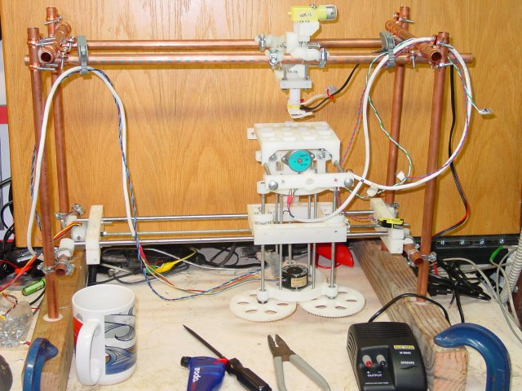
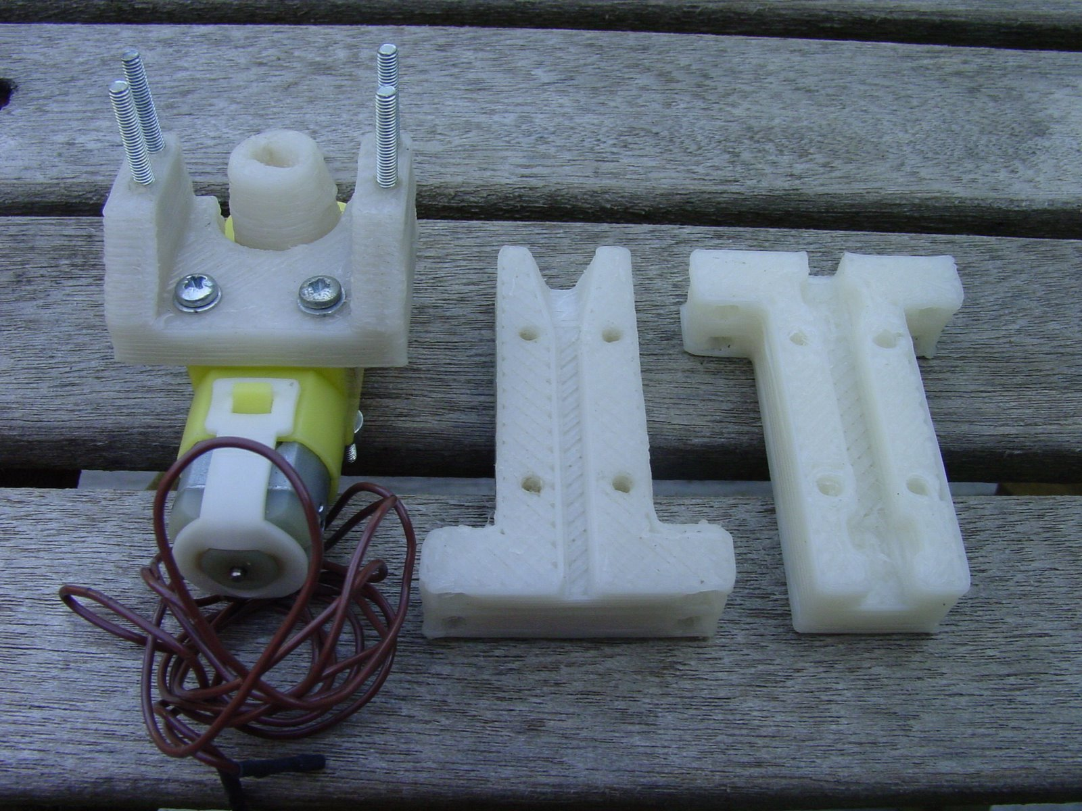
Does it work?
Testbed machine

Slide 12
Hubris
What will happen if RepRap takes off?

Slide 13



Start by making RepRap open-source
Linux

Slide 14
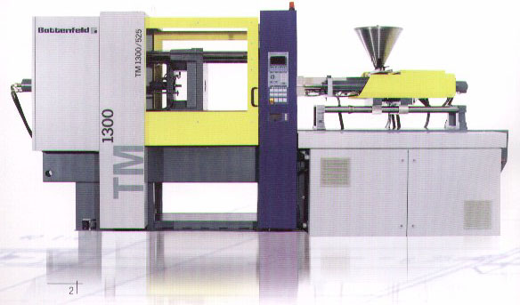
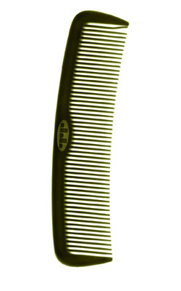
Exponential growth
10,000 per hour
Say the RepRap machine takes one day to copy itself, and to make one comb...

Slide 15
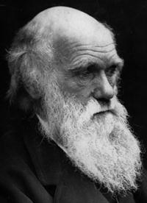
Evolution
The design files (genotype) have to be available with the RepRap machine (phenotype) for it to be able to copy itself.
People will improve the design.
Some improvements will be posted back on the Web.
Old machines can make new designs.
Artificial selection – speed, simplicity, accuracy, fewer added parts...

Slide 16

Economics
It doesn't matter how much the first RepRap
machine costs, all the rest will cost:
raw-materials + assembly-time.
Once you have one, you can have any number.
No one can make money by selling RepRap.
Target cost of raw materials, motors, chips etc:
$400

Slide 17
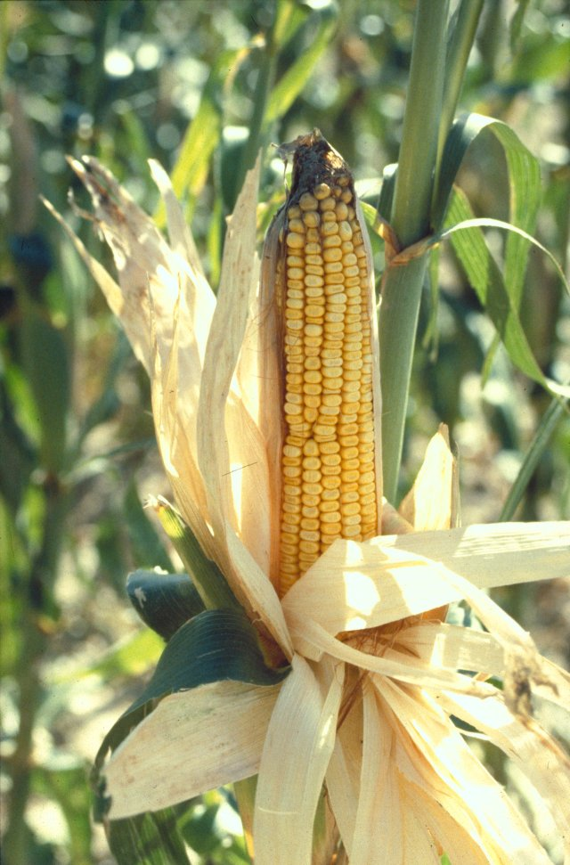
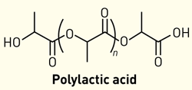
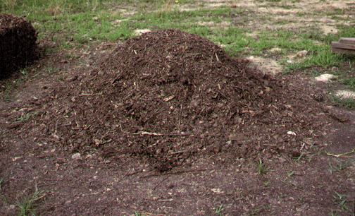
Environment
Material supply - biomass.
Bringing manufacturing to the poorest people.
Making manufacturing like agriculture.
Recycling.

Slide 18
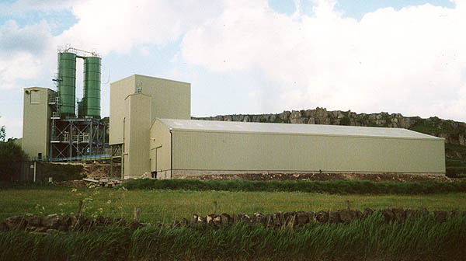
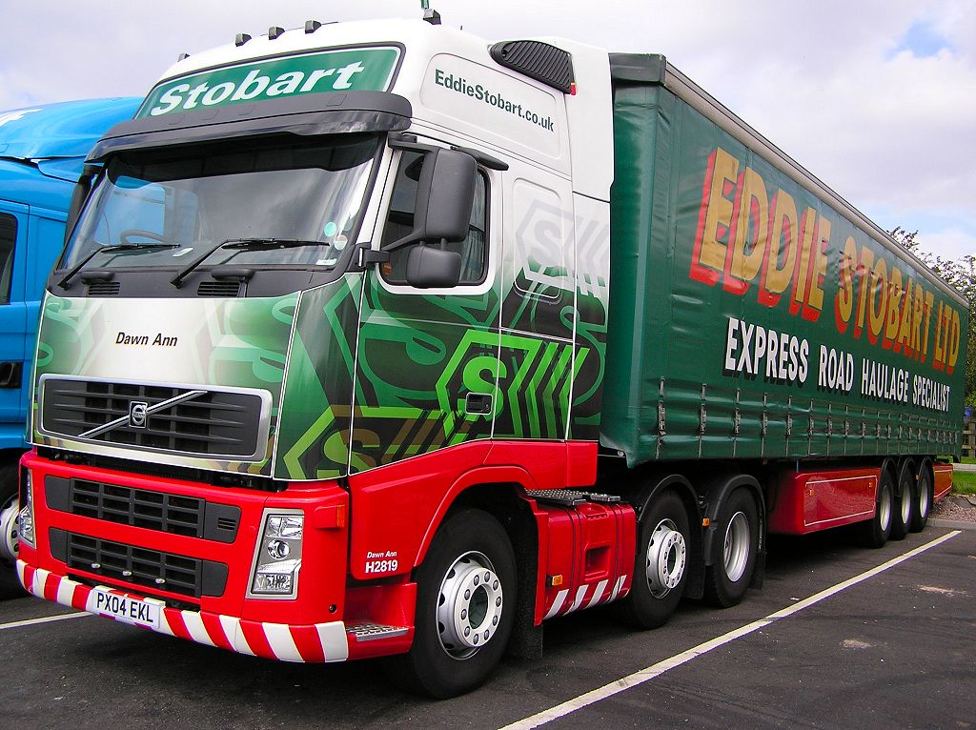
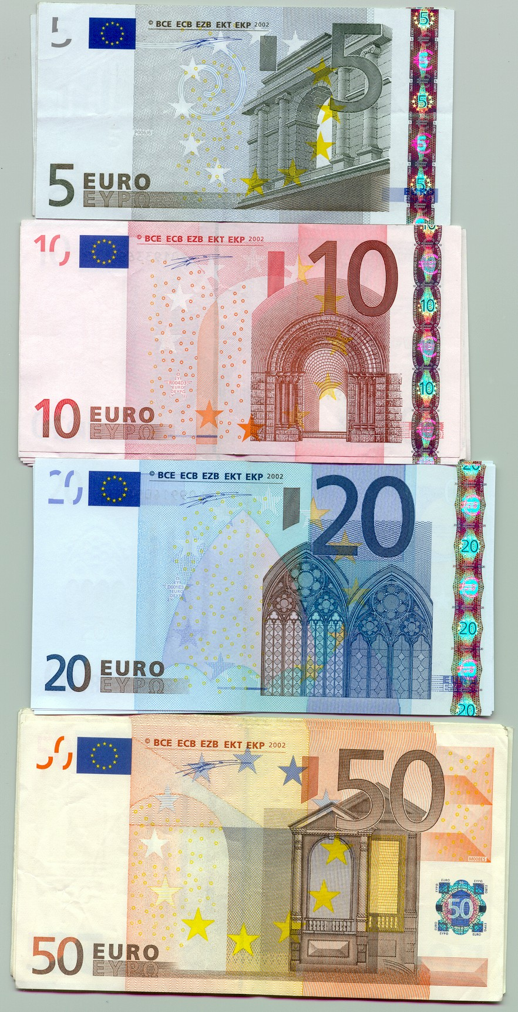
The Future?
A tenth-generation replicator in every home?
Fewer factories?
Less goods transport?
Less need for money?

Slide 19
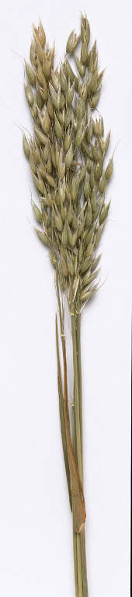
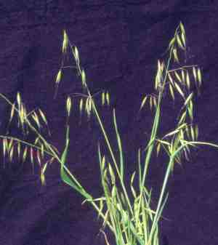
Self-replication allows:
Exponential growth,
Customizability by selective breeding,
And very low cost.

Slide 20
Project website:
"Money is a sign of poverty."
- Iain M. Banks, 1987.
http://reprap.org

Slide 21
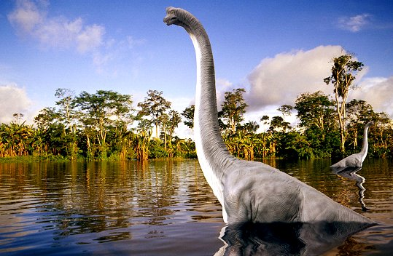
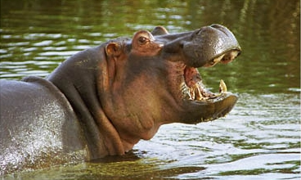
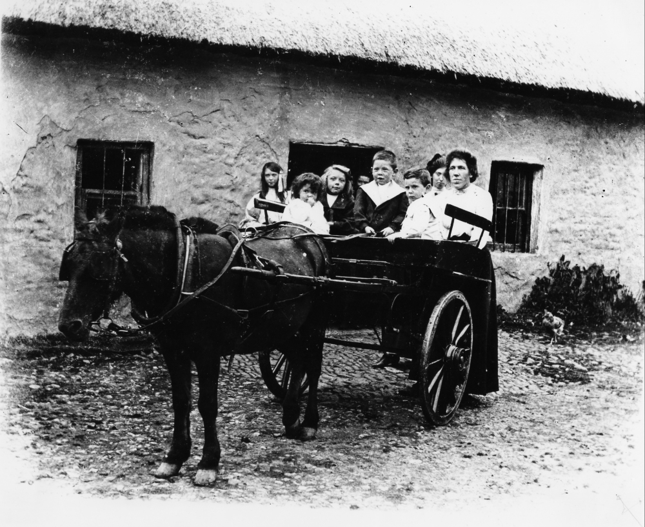
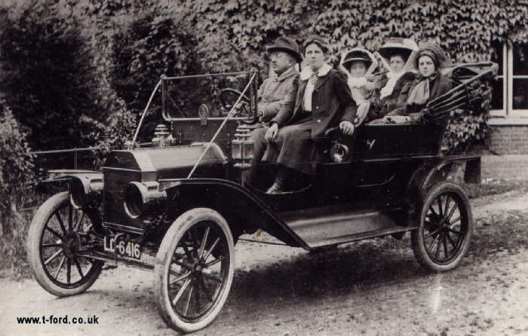
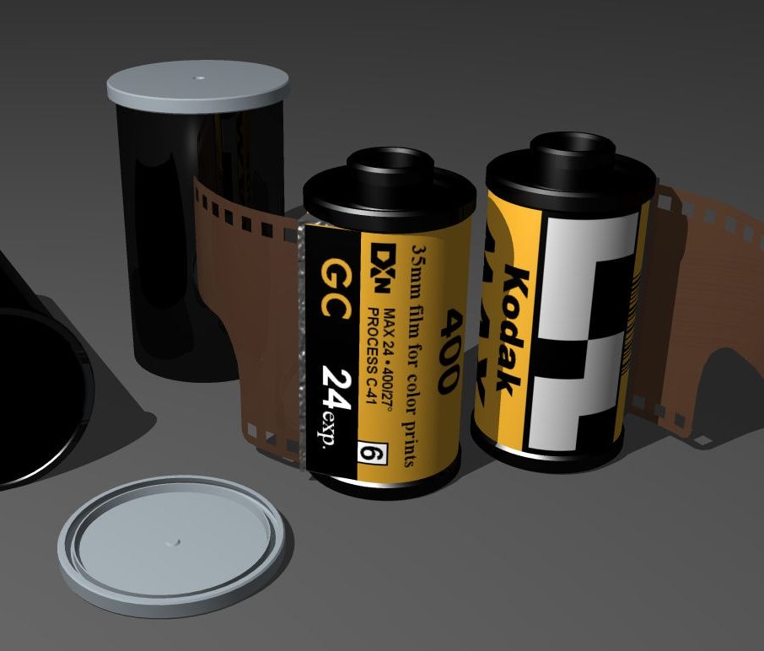
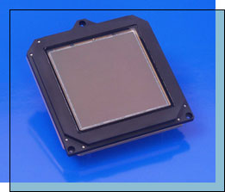
These are one-way processes:

Slide 22
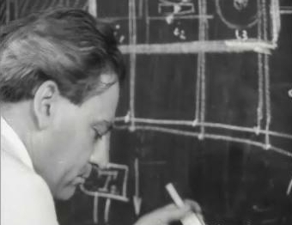
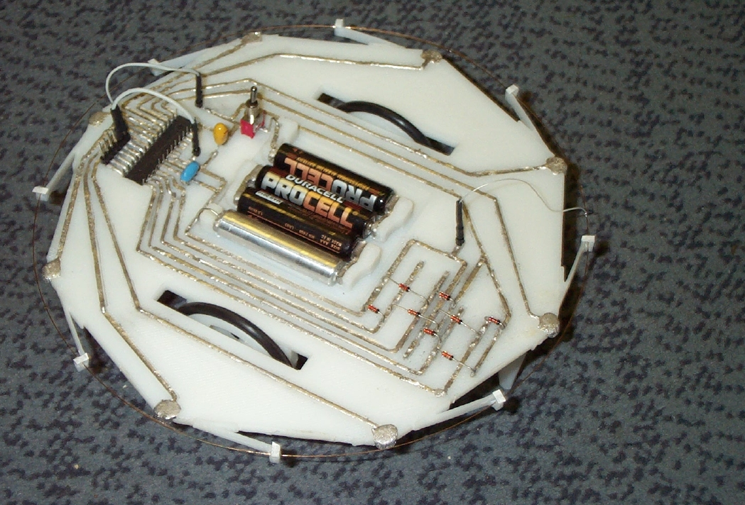
Rapid-prototyped electric circuits
John Sargrove

Slide 23
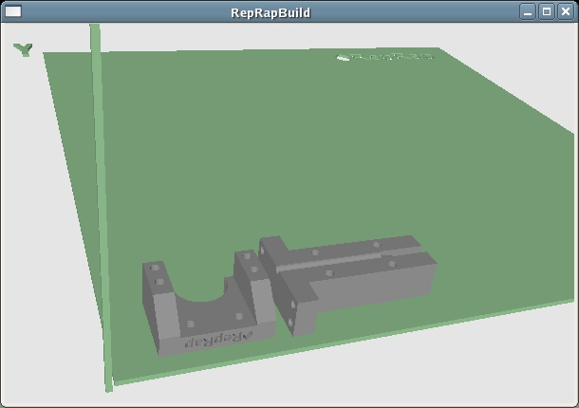
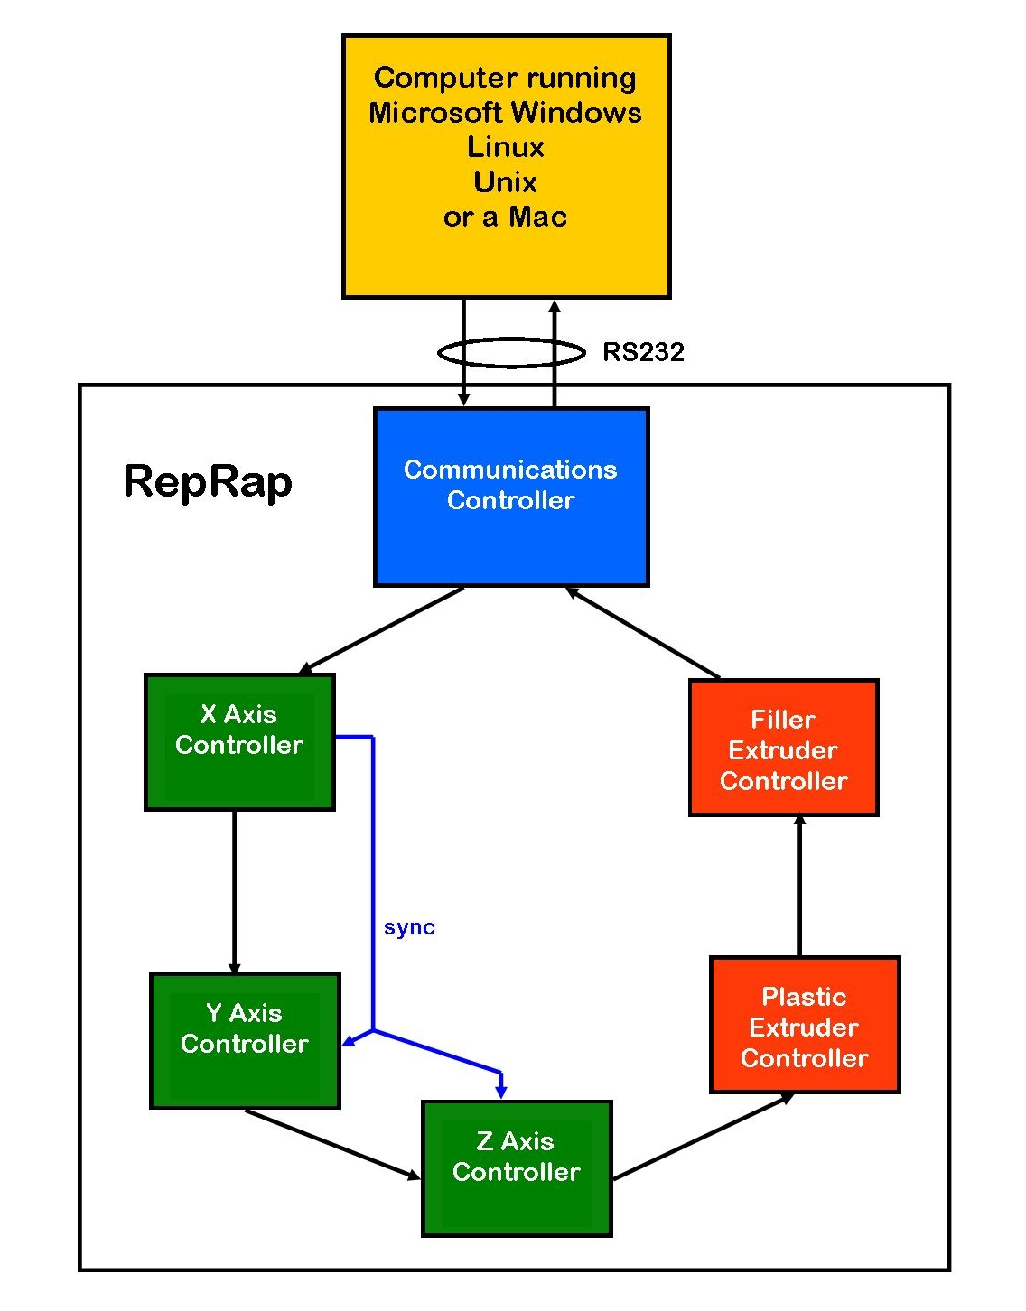
Software and communications
PC : Java
Microcontrollers : C

Slide 24
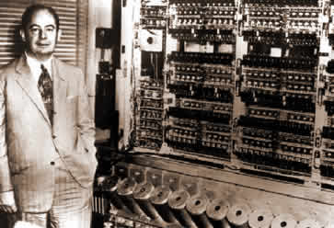
Artificial self replicators & assemblers
John von Neumann:
Universal Constructor (1950s)
A Universal Constructor would be a computer linked to a manufacturing robot.
The combination would be able to copy themselves.
John von Neumann with ENIAC

Slide 25
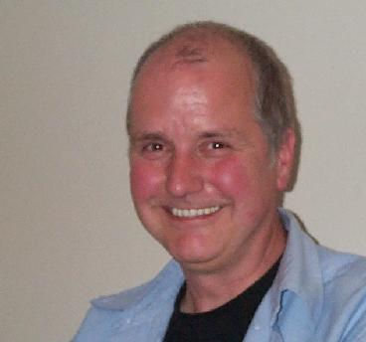
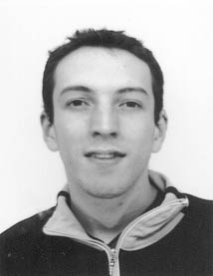

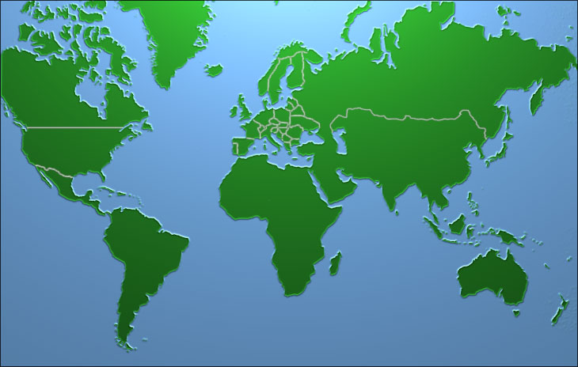
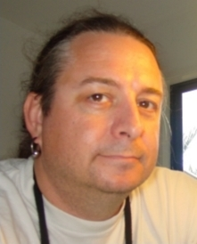

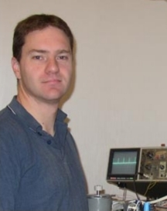
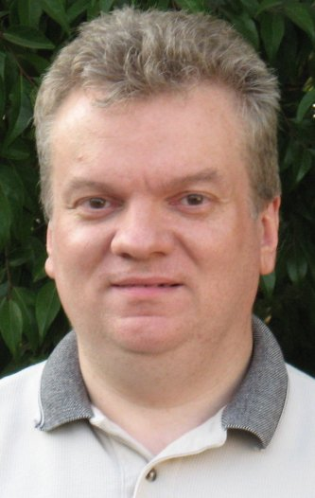
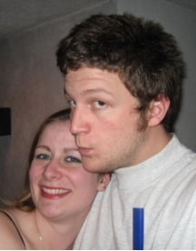
Acknowledgments & The Team
Nuffield Foundation
EPSRC
Bath University IdMRC
Pop!Tech

Slide 26
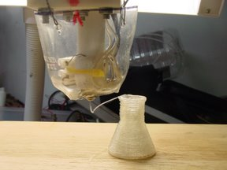
Polylactic acid

Slide 27
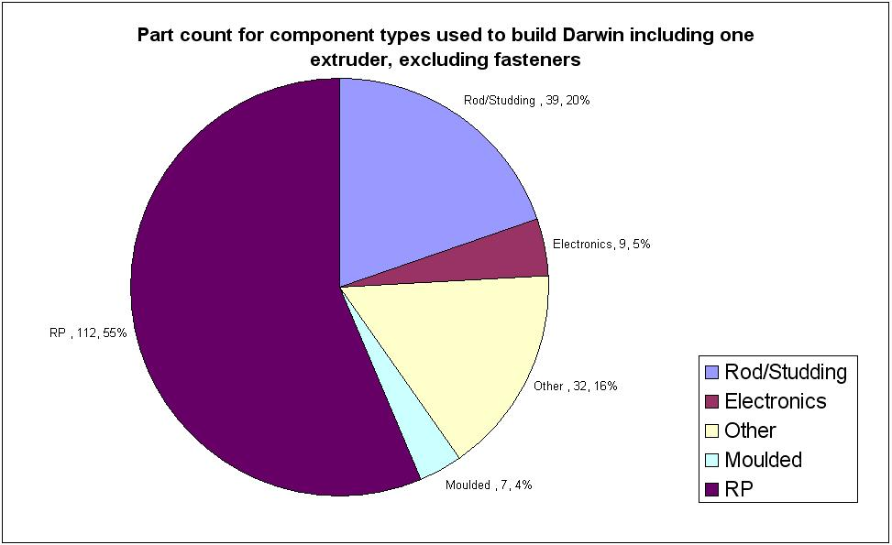
RepRap part count

Slide 28
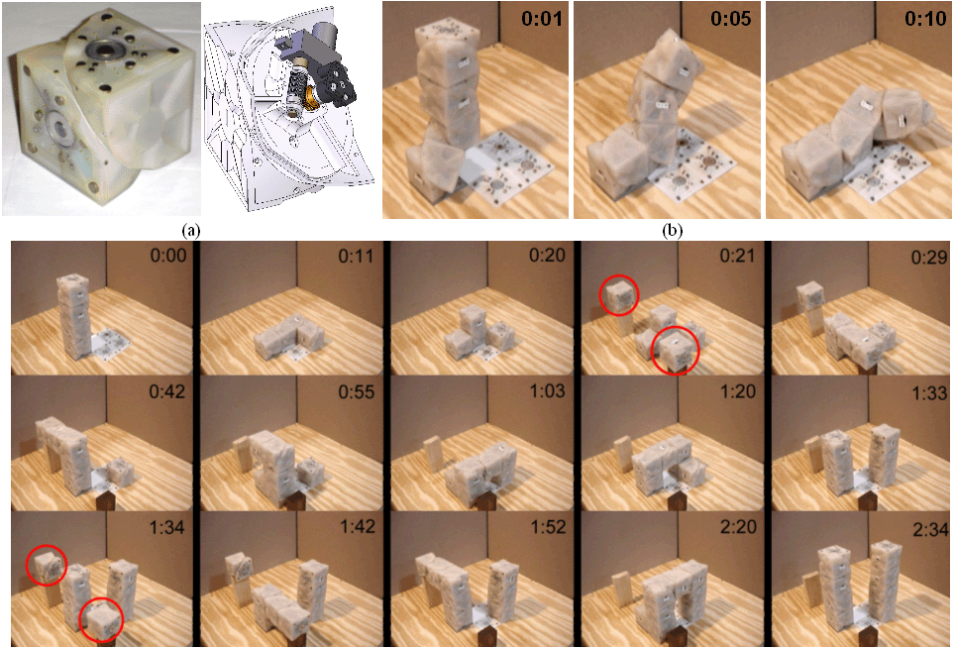
Artificial self replicators & assemblers
Viktor Zykov, Hod Lipson et al. (2005)

Slide 29
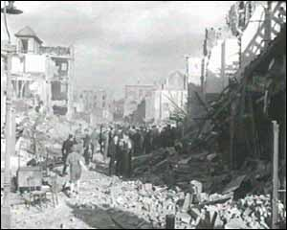
How to destroy things
London 1943

Slide 30
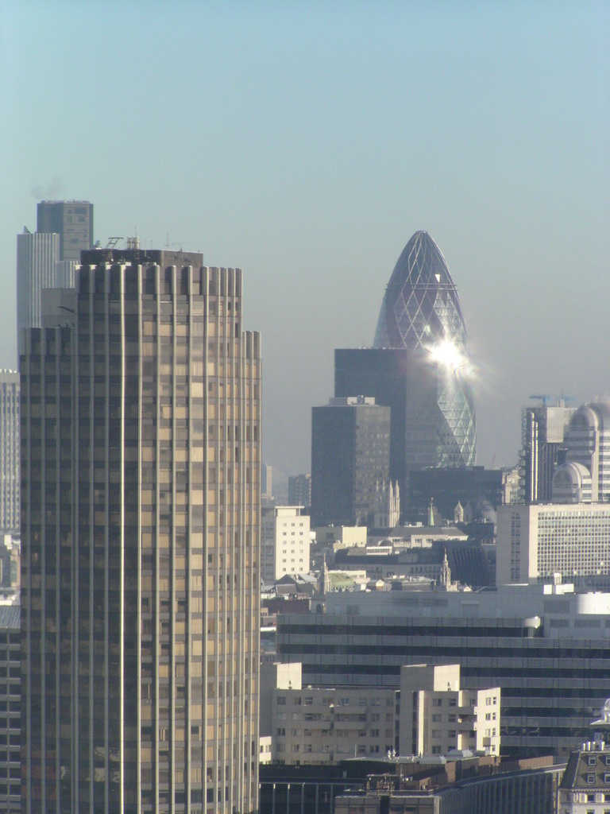
That one never works
London 2007

Slide 31
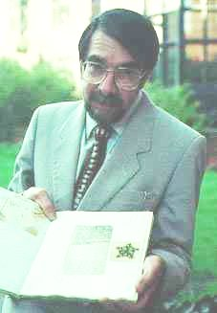


Rapid Prototyping
David Jones -
“Daedalus” - 1974
Wyn Kelly Swainson patent
published in 1977.
Now many different technologies.

Slide 32

Artificial self replicators & assemblers
Eerewhon (1872)
“...how few of the machines are there which have not been produced systematically by other machines? But it is man that makes them do so. Yes; but is it not insects that make many of the plants reproductive, and would not whole families of plants die out if their fertilization was not effected by a class of agents utterly foreign to themselves? Does anyone say that the red clover has no reproductive system because the humble bee (and the humble bee only) must aid and abet it before it can reproduce? No one. The humble bee is a part of the reproductive system of the clover.”
Samuel Butler

Slide 33


Two Potential RepRap products
Many more on the RepRap website contributed by the public.

Slide 34
The Open Phone
TUX phone
Free open design on the web
Each phone is also a base station
Game theory:
Attenuate signal with proximity
Relay signals from neighbours
Check new connections – only relay if 1 & 2 satisfied

Slide 35

Open Pharma
Year’s supply of a new drug: £20,000 and rising
Cost of a desktop synthesiser: £100,000 and falling
People can make patented things themselves
Have RepRap make the synthesiser
Open-source drug design, development, and testing

Slide 36




The two most important phenomena in biology
Self Replication Self Assembly

Slide 37


Simple replicators get complicated replicators to do the assembly.
Rhinovirus H. sapiens

Slide 38
Darwinian Engineering
19th century: steam power
20th century: electric data
21st century: Darwinian engineering
History doesn’t happen in centuries...
Darwinian engineering is the design of self-replicating machines and and their extended phenotypes so that they collectively exhibit an evolutionarily stable strategy.

Slide 39






Self-replicating machines
Bacteria, archaea, eukarya
Artificial replicators

Slide 40



Extended phenotype (Dawkins)
Phenotype
Extended phenotype

Slide 41


Evolutionarily Stable Strategy (Maynard-Smith)
An ESS is a (set of) phenotype(s) that cannot be invaded by a mutation.
Hawk Dove
Hawk -25 +50
Dove 0 +15
ESS:
Hawk : Dove = 3 : 2
Every ESS is a Nash equilibrium.
Not every Nash equilibrium is an ESS.

Slide 42
Darwinian Engineering
The design of self-replicating machines and and their extended phenotypes so that they collectively exhibit an Evolutionarily Stable Strategy.
RepRap is an example.
Self-replicating machines: People, RepRap
Phenotype behaviour: helping to copy; making useful stuff
ESS: Symbiosis, like the insects and the flowers

