Slide 1

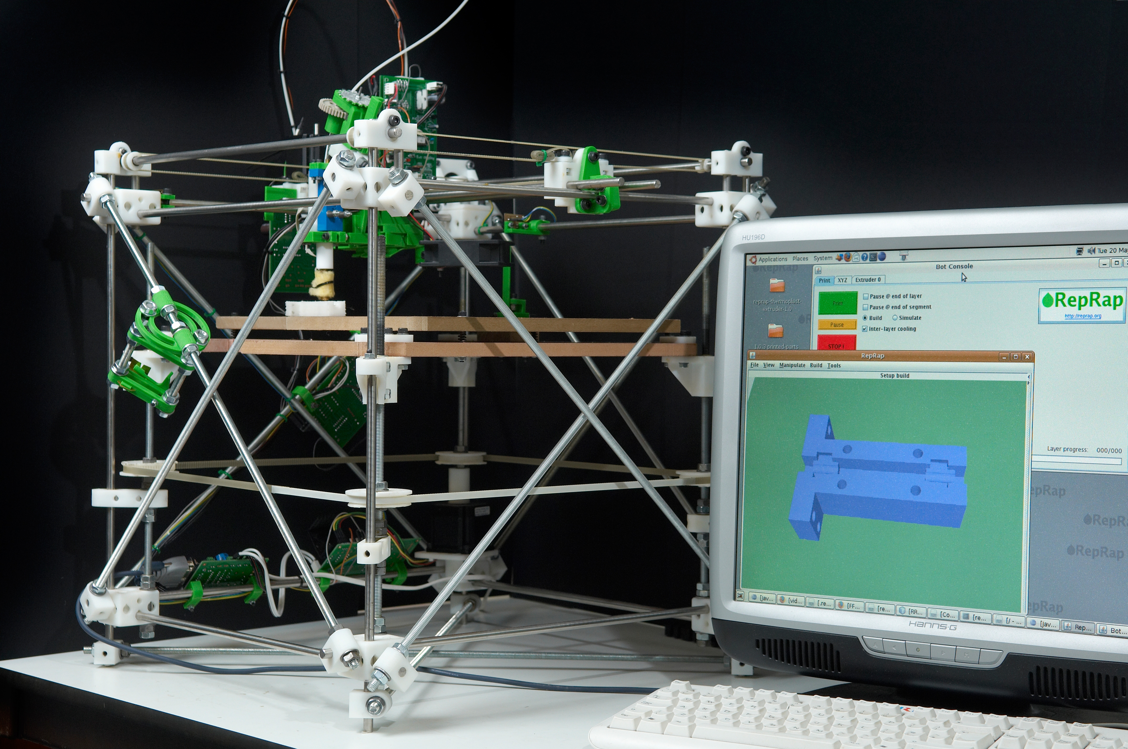
Smart Ideas (si)
and
Dumb Mistakes (dm)
Adrian Bowyer
Bath University, UK

Slide 2

Start with: Social/Economic/Political Specification (si)
Aim: to allow anyone to make what they want for themselves, including the machine that does the making.
Free hardware/open-source (si)
Distributed at no charge over the net (si)
Legal: design copyright under the GPL (si/dm ?)

Slide 3
Then: Engineering Specification
Working volume: adjustable (si); nominally 300mm x 300mm x 300mm (dm)
Working materials: Polycaprolactone and a filler/support (si → dm)
Configuration: 3-axis Cartesian drive using stepper motors (si)
Line and space: 0.5mm and about 0.2mm (si)
Feature size: about 2mm (si)
Positioning accuracy: 0.1 mm (si)
Layer thickness: adjustable, but nominally 0.4mm (si)
Computer interface: RS232 (dm → USB)
Material handling: Two fixed material extruders, user exchangeable (si)
Power supply needed: 6A max, 3A continuous at 12V DC (si)
Driving computer: Microsoft Windows, Linux, Unix, or Mac (si)
Dimensions: adjustable; nominally 600 mm x 520 mm x 650 mm high (si)
Weight: about 15 Kg (si)

Slide 4
How easy is it to change things as you go along?
Software - easy
Electronics – not too difficult
Mechanics - difficult
So: early on, think hardest abut the mechanics, and get them as good as you can. (si)

Slide 5
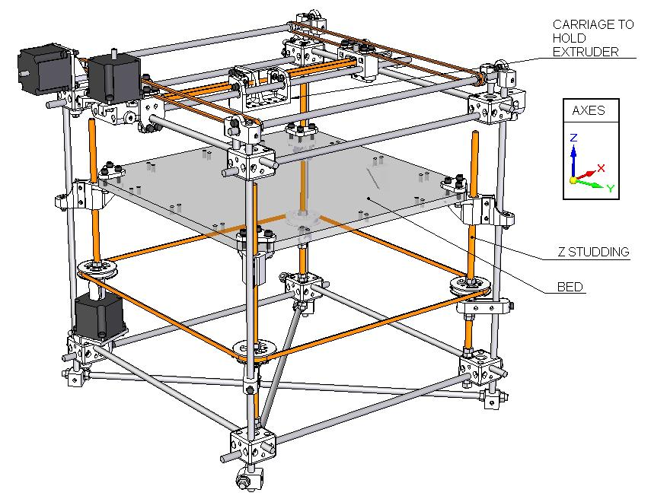
Mechanics
Cross braces omitted for clarity
Note corner blocks

Slide 6
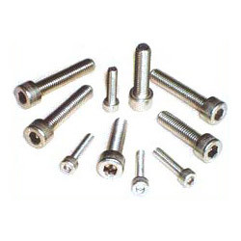
Mechanics
Metric, not English (si)
Standardise (si)
Check global availability (si)
Hardware shop materials (si)
Threads: M8, M5, M3 (si)
8 mm threaded rod (si)
8 mm smooth rod (dm)
Don't dismiss wood (especially MDF) (si)
Make jigs (si)

Slide 7
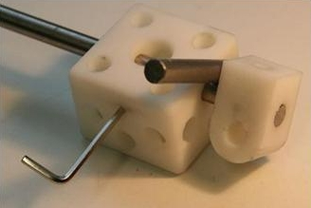
Mechanics
Design Frame of Mind:
If you can, make each part solve lots of problems (si)

Slide 8
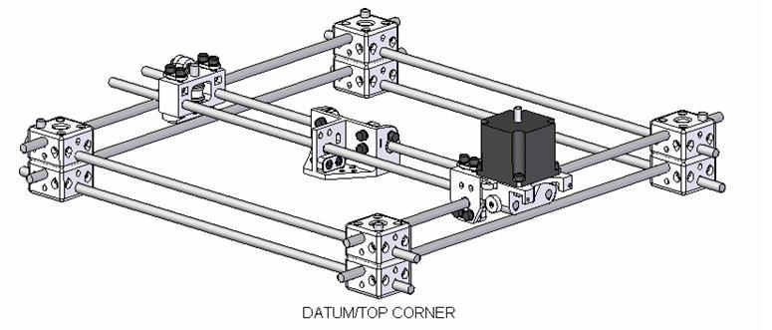
Mechanics
Design Frame of Mind:
Remember that you have to put it together and to take it apart... Lots of times... (si)

Slide 9
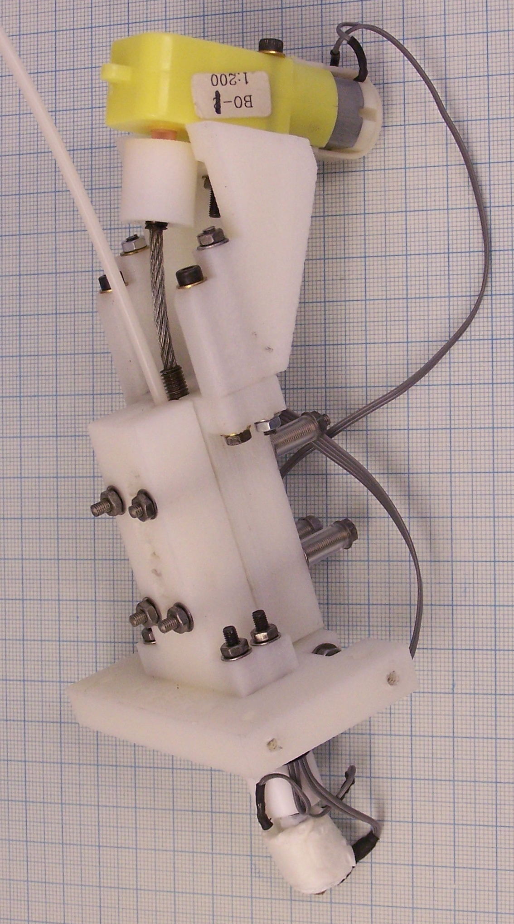
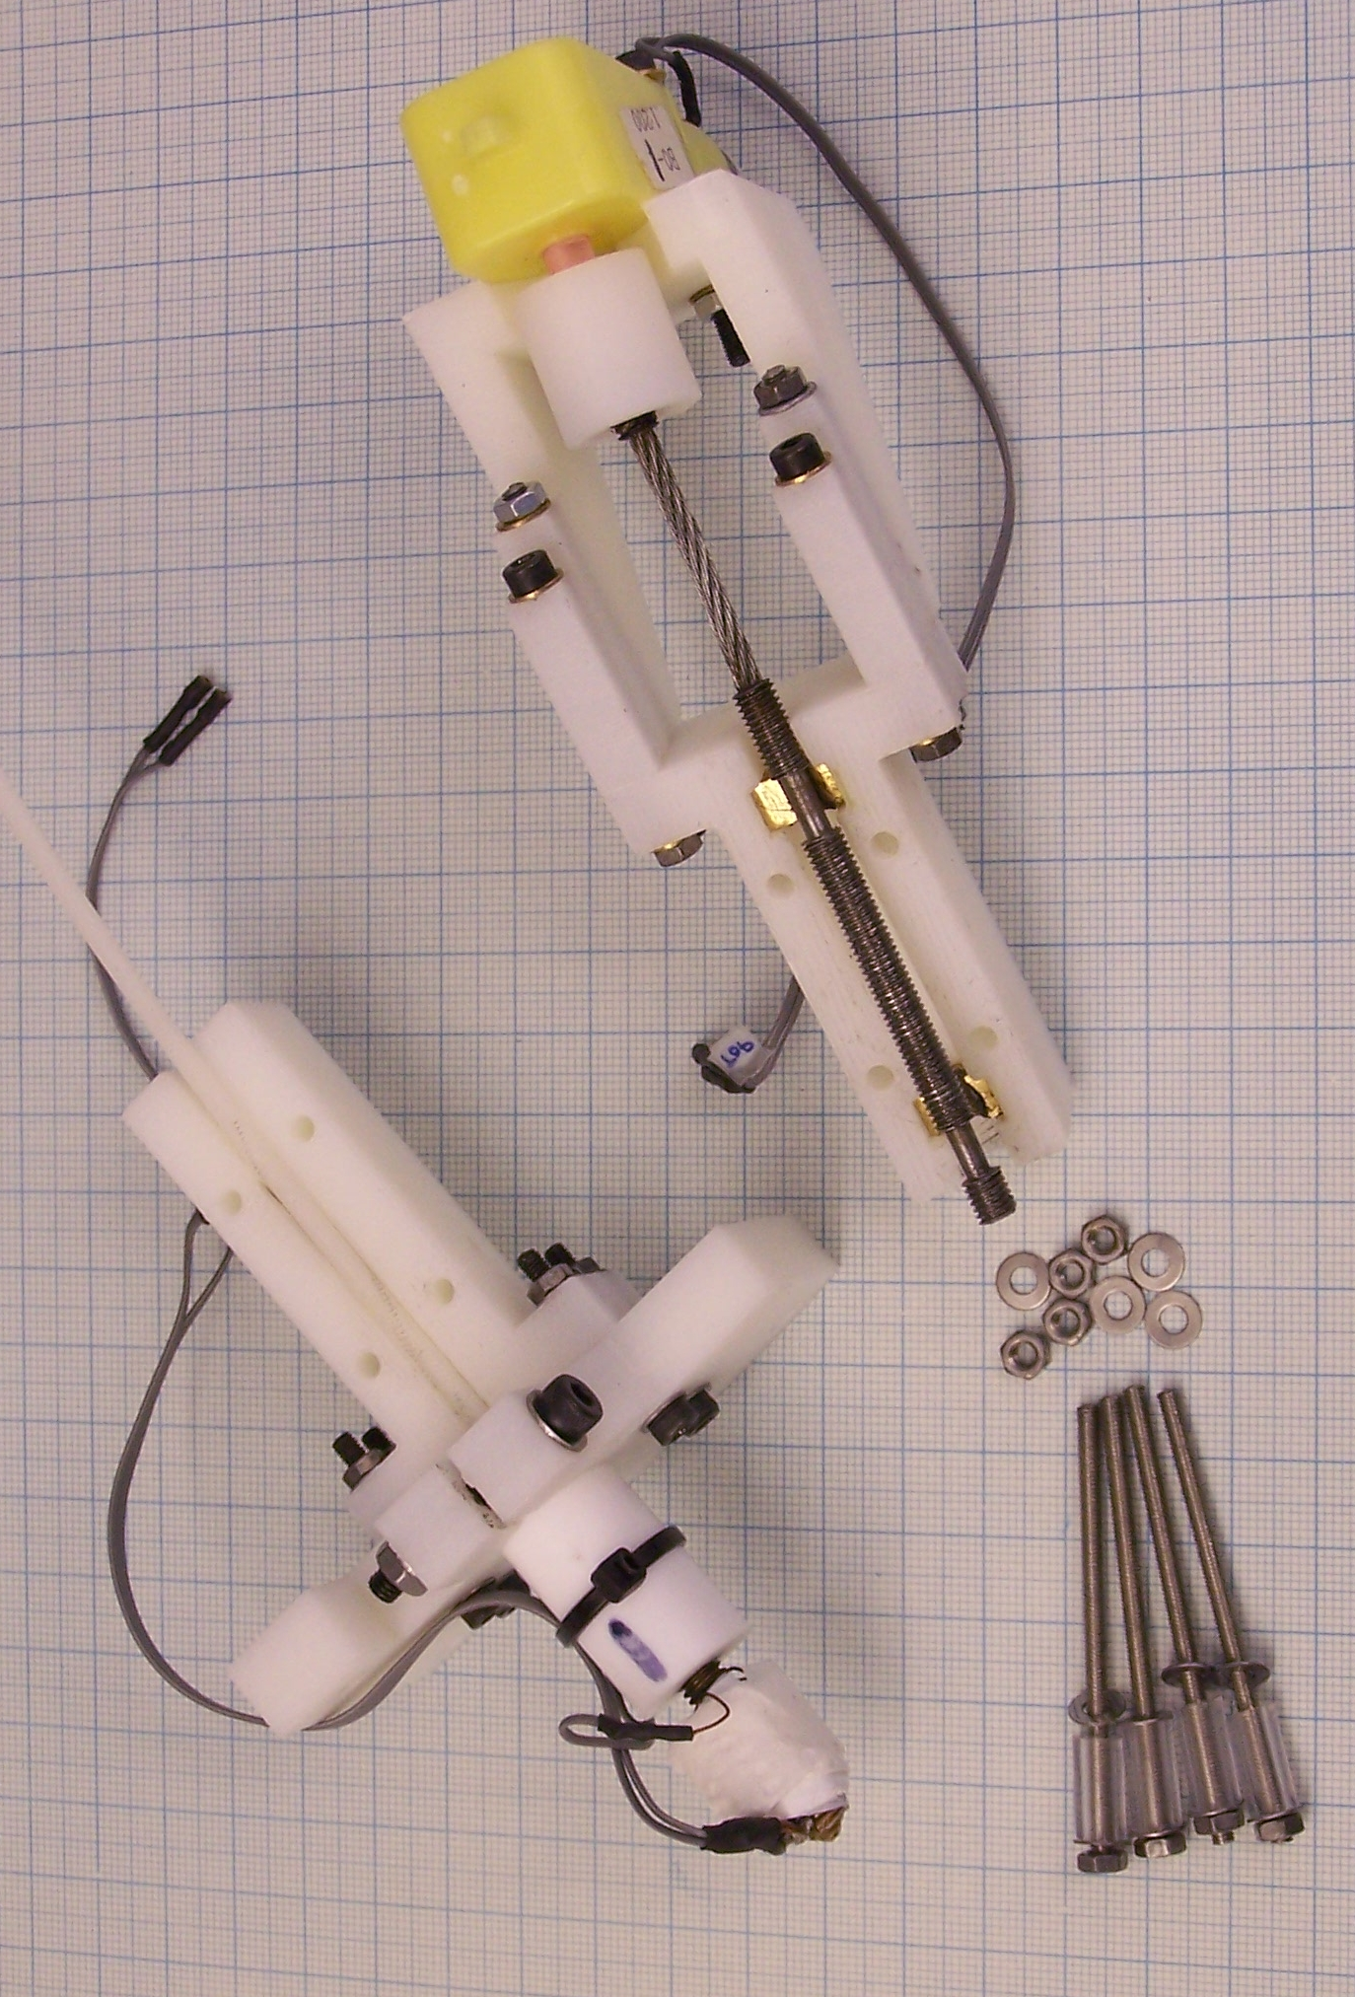
Mechanics
The Version 1 Extruder
Screw drive (si)
Geared DC motor (dm)
PTFE insulation (si)
Brass barrel (si)
Nichrome heater (si)
Thermistor (si/dm)
Flexible drive (dm)

Slide 10
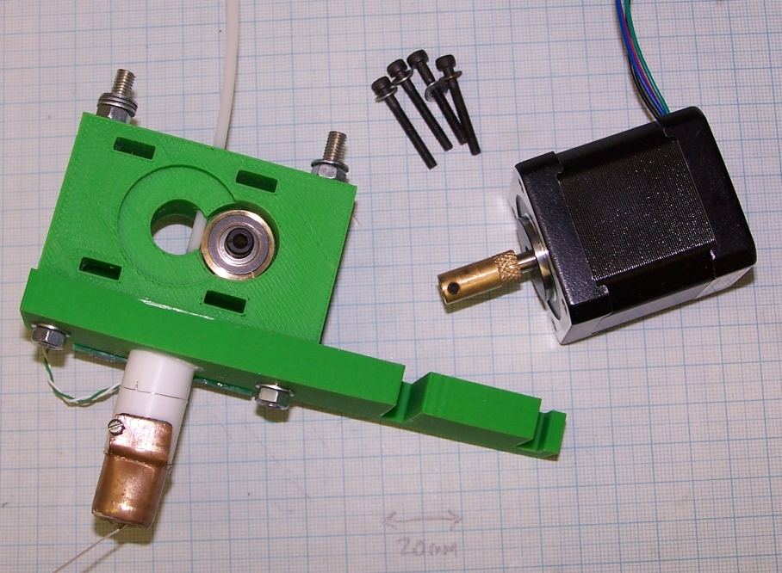
Mechanics
The Version 2 Extruder
Direct drive (si)
Stepper motor (si)
Same head (si)
Fewer parts (si)
More controllable (si)
Easy set-up (si)
Thermocouple (si/dm)

Slide 11
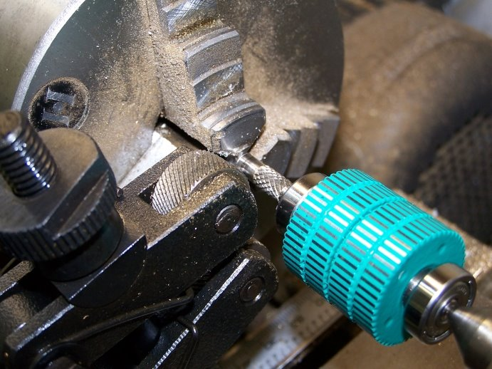
Mechanics
Knurl the stepper shaft directly

Slide 12
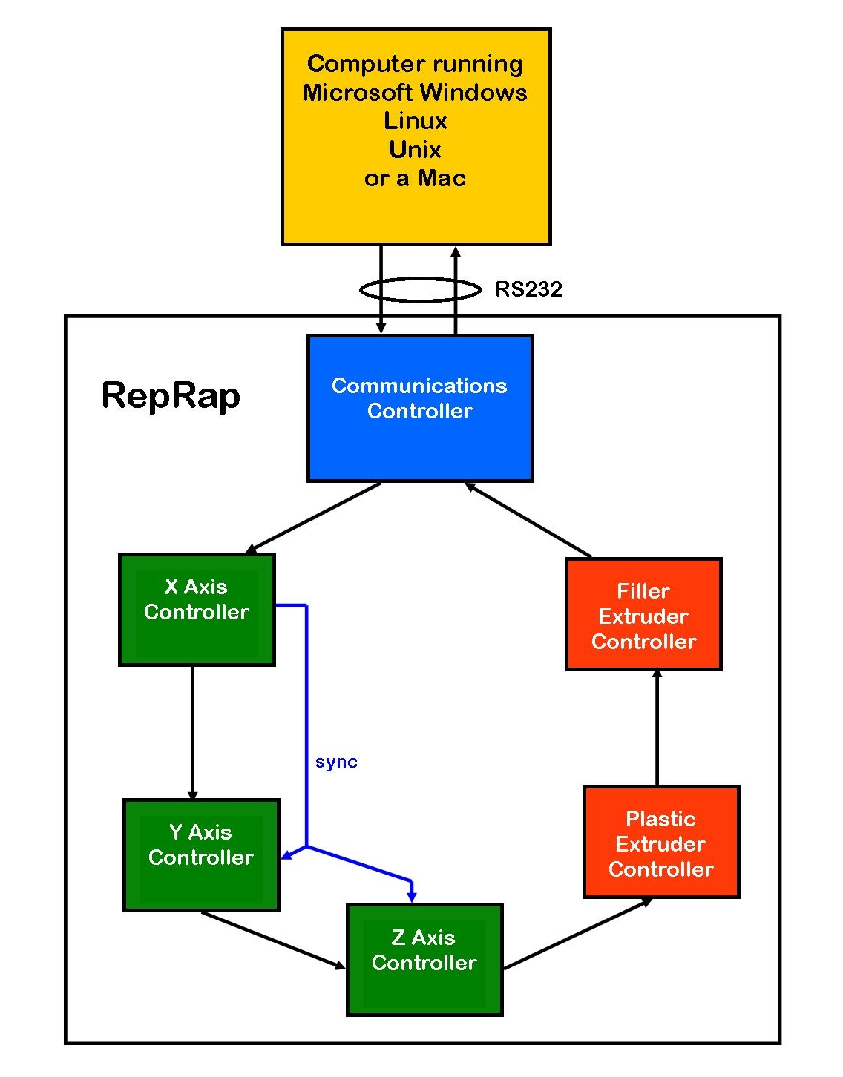
Electronics
Generation 1
Internal network (si)
RS232 (dm)
Universal PCB (si)
PIC 16F648A (dm)
SDCC (dm)
Single 12V supply (si)
XYZ: steppers (si)
Extruder: DC servo (dm)

Slide 13
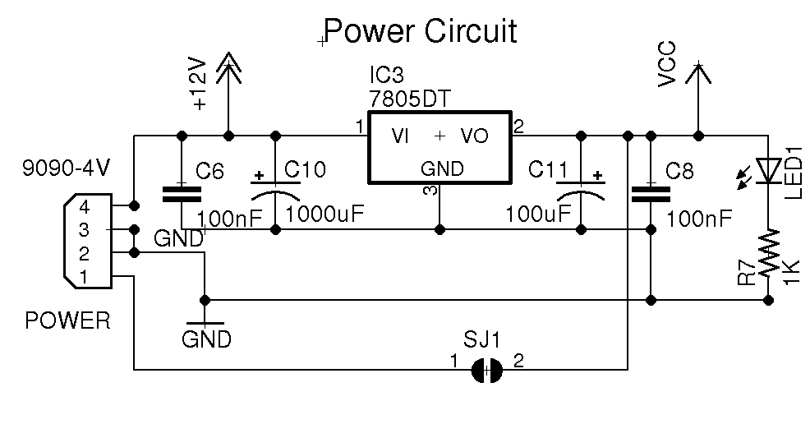
Electronics

Slide 14
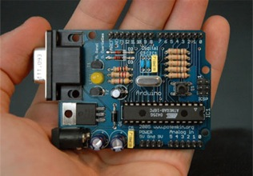
Electronics
Generation 2.1
Arduino
Rock solid compiler (si)
Someone else does the work (si)
ATMEGA168 (si)
Only just enough pins (dm)
Only just enough memory (dm)
No internal network (dm)
G-codes from host (si)

Slide 15
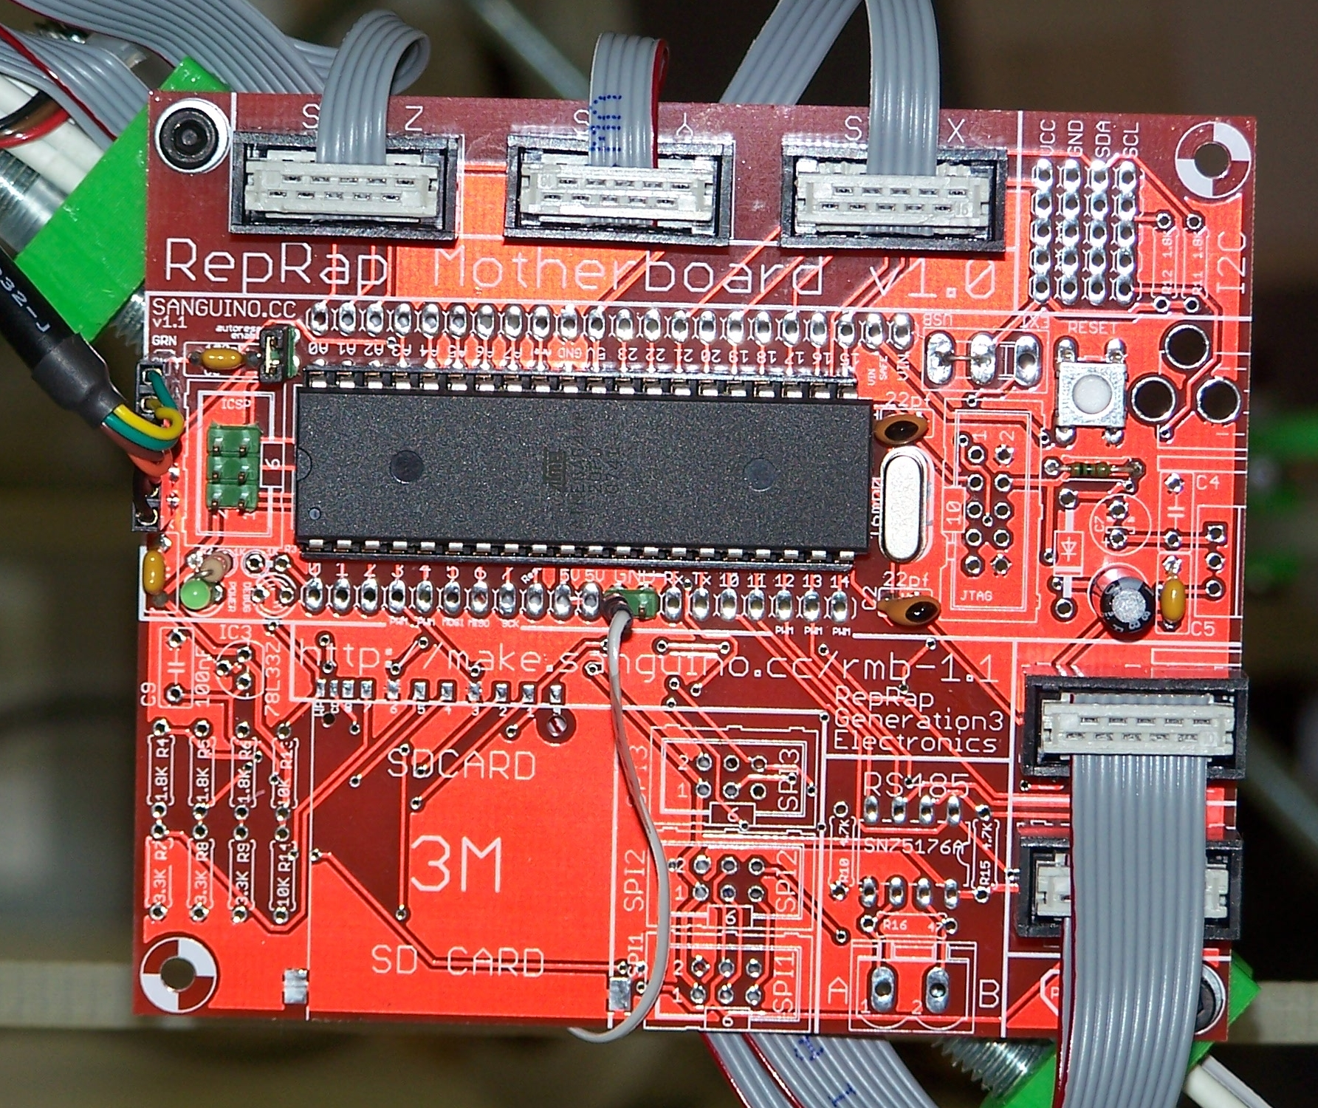
Electronics
Generation 2.2
Sanguino
Arduino development environment (si)
ATMEGA644P (si)
Plenty of pins; plenty of memory (si)
No internal network (dm)

Slide 16
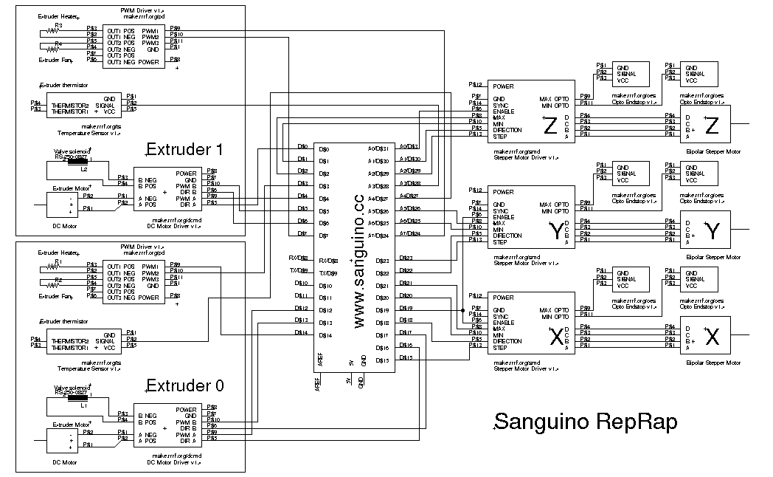
Electronics

Slide 17
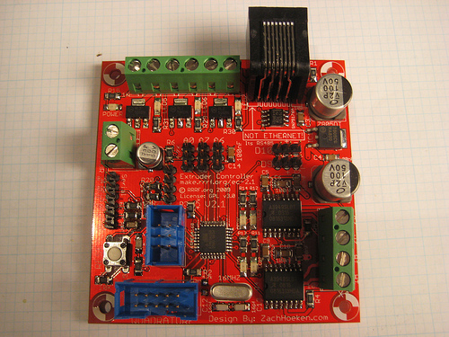
Electronics
Generation 3 (near future)
Sanguino
Plus RS485 network
Extruder 1
Extruder 3
Extruder 2

Slide 18
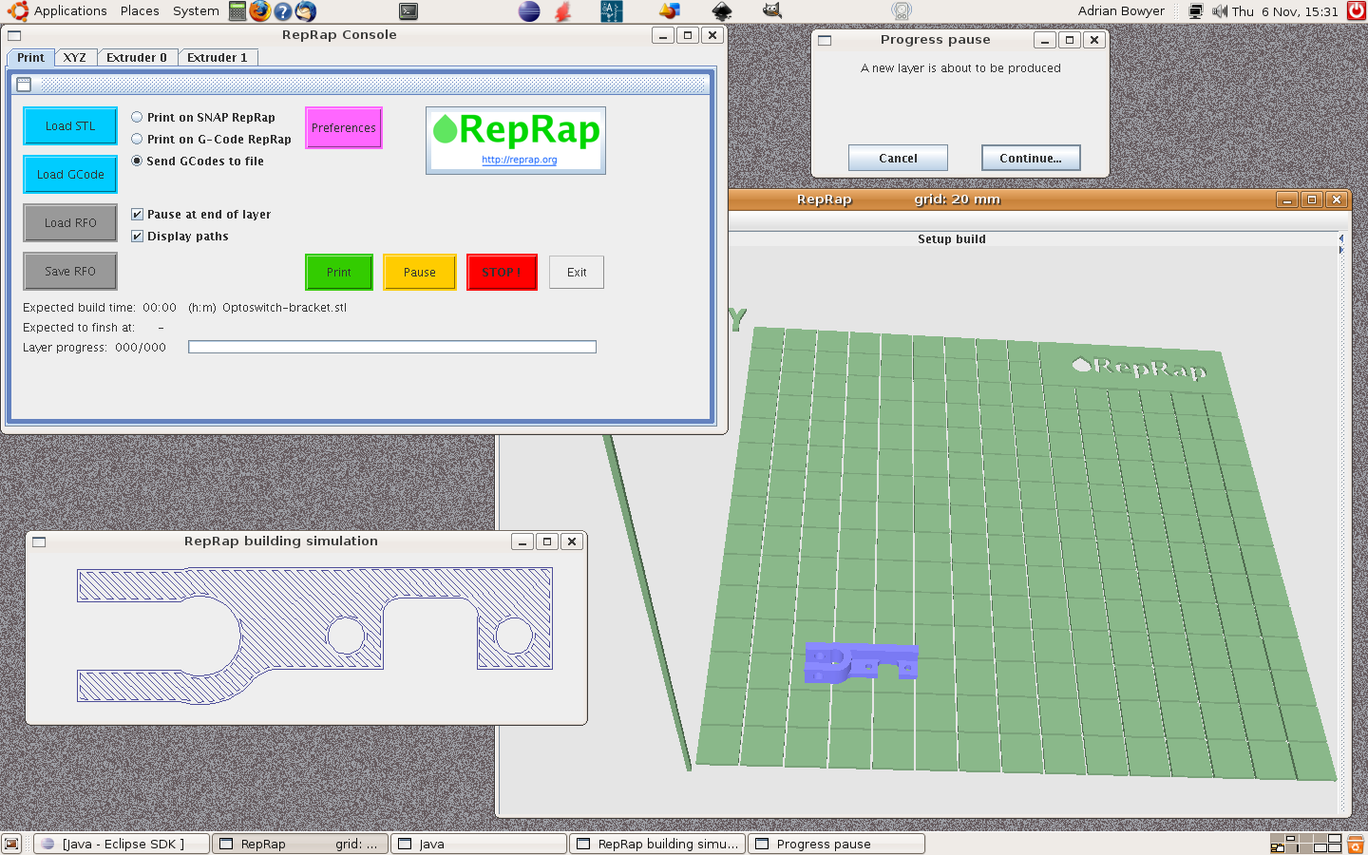
Software
On the host: Java

Slide 19
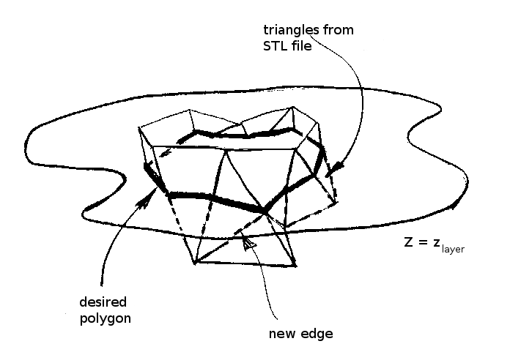
Software
Input data: STL files

Slide 20
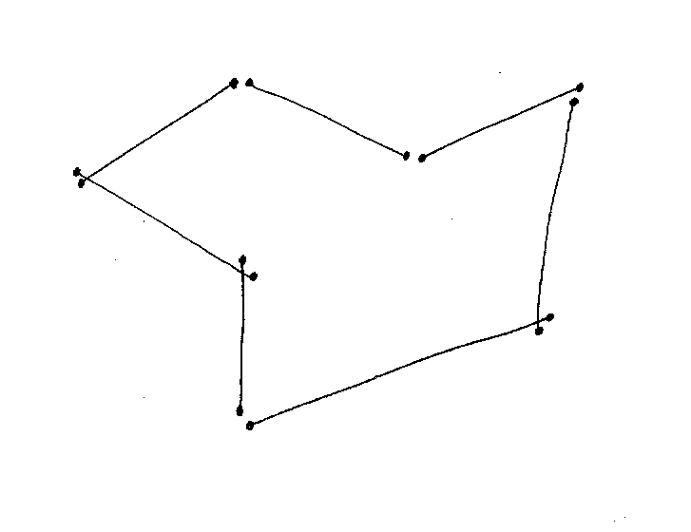
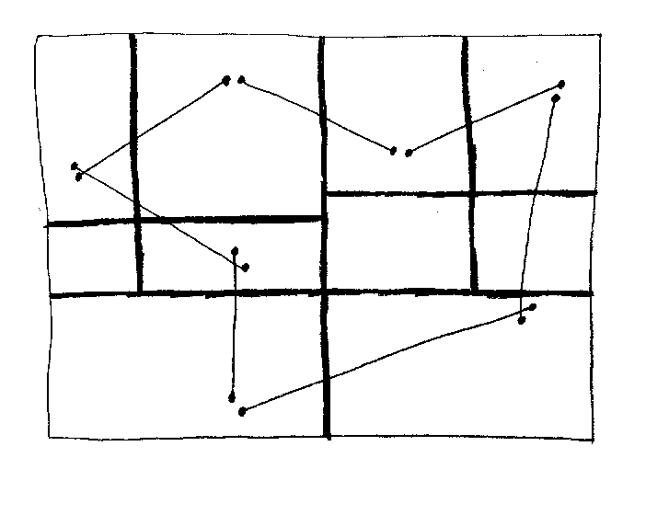
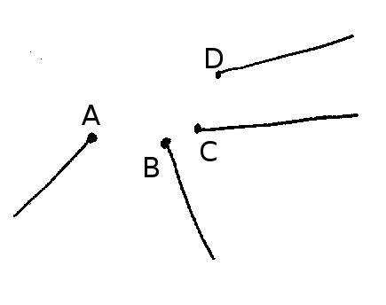
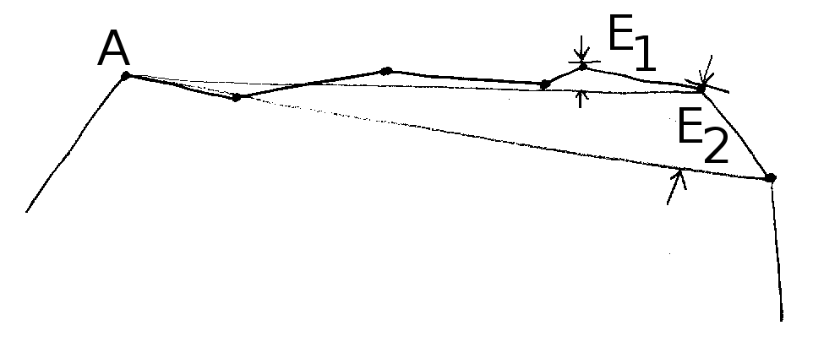
Software
Turning slices into sense
1
3
Easy – join the dots
Make a global problem local
2
4
But...
Filter STL triangle profligacy

Slide 21
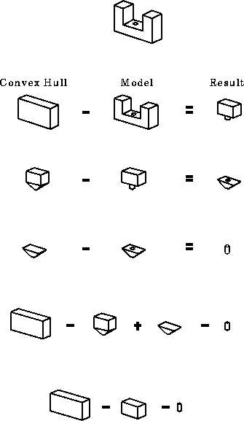
Software
Convert to CSG
Tony Woo's Alternating Sum of
Volumes Algorithm
(but in 2D, obviously)

Slide 22
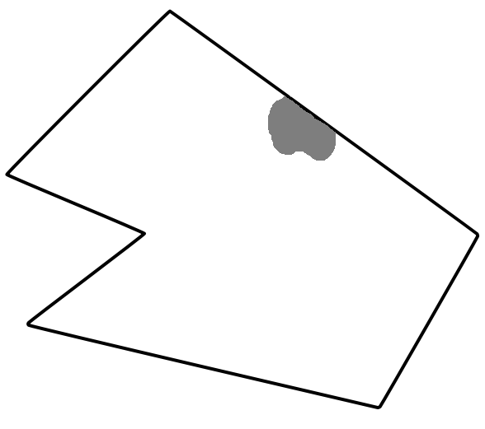
Software
CSG Polygons
Shape:
(L1 ^ L2 ^ L3 ^ L4) ^ (L5 U L6)
Li: aix + biy + ci ≤ 0
Always valid (si)
Offsets trivial (si)
Combinations trivial (si)
Line intersection trivial (si)
Simplification hard (dm)
Non-local (dm)

Slide 23
Conclusion
We did some smart things (si)
We did a few dumb things (dm)
It works... (si)

