Slide 1

RepRap the open-source self-copying 3D printer
Adrian Bowyer
Bath University, U.K.
Go Open Oslo, 9 April 2008

Slide 2
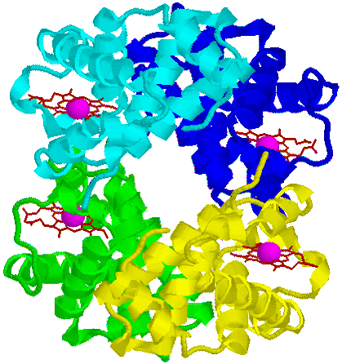
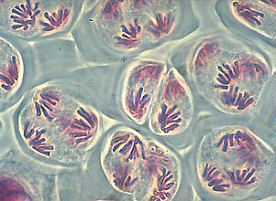
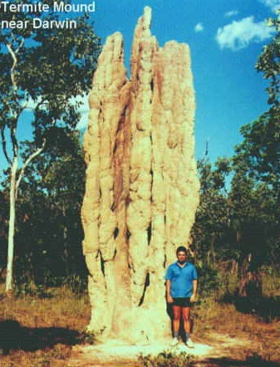
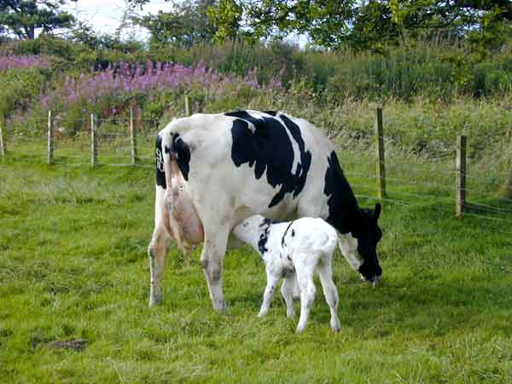
The two key biological phenomena
Self Replication Self Assembly

Slide 3
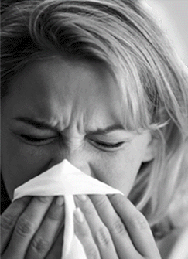
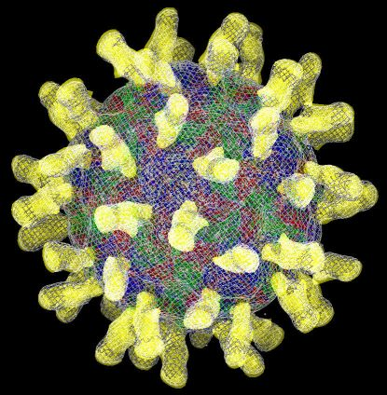
Simple replicators get complicated replicators to do the assembly.
Rhinovirus H. sapiens

Slide 4
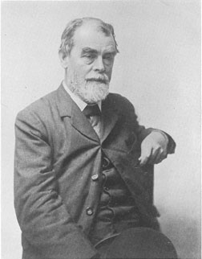
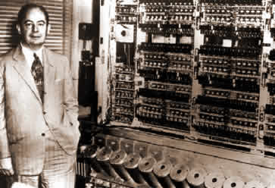
Artificial self replicators & assemblers
Samuel Butler (1870s) John von Neumann(1950s)

Slide 5
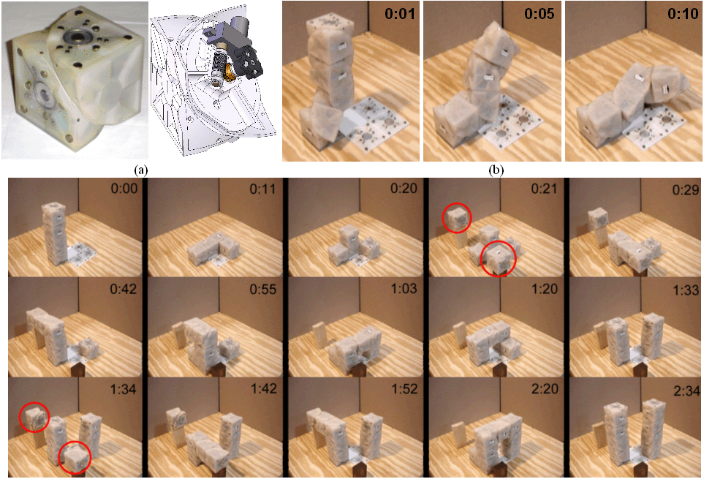
Artificial self replicators & assemblers
Viktor Zykov, Hod Lipson et al. (2005)

Slide 6
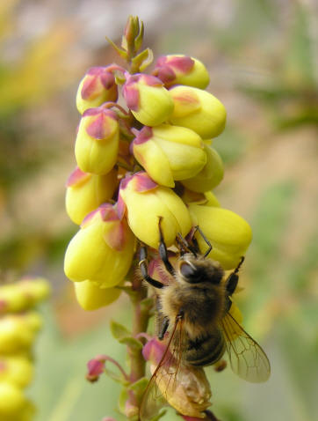
Symbiosis
nectar <> reproduction

Slide 7
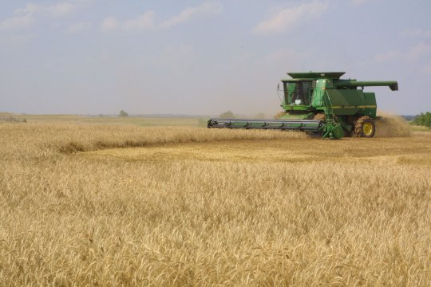
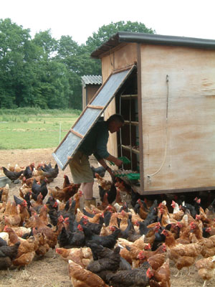
Symbiosis
nectar <> reproduction

Slide 8
Symbiosis
nectar <> reproduction cake <> reproduction

Slide 9
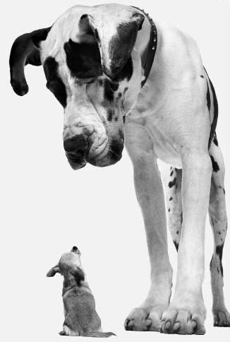
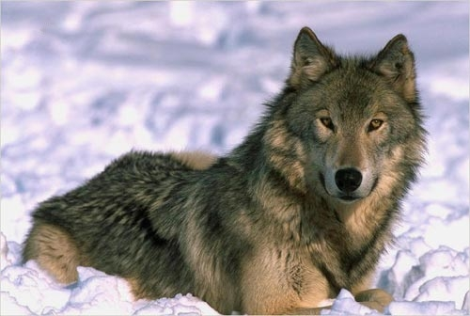
Humanity's most advanced technology

Slide 10
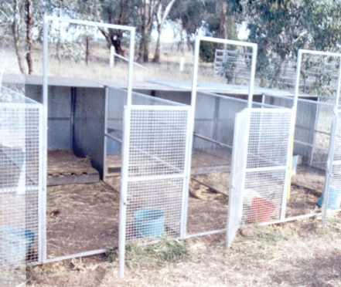
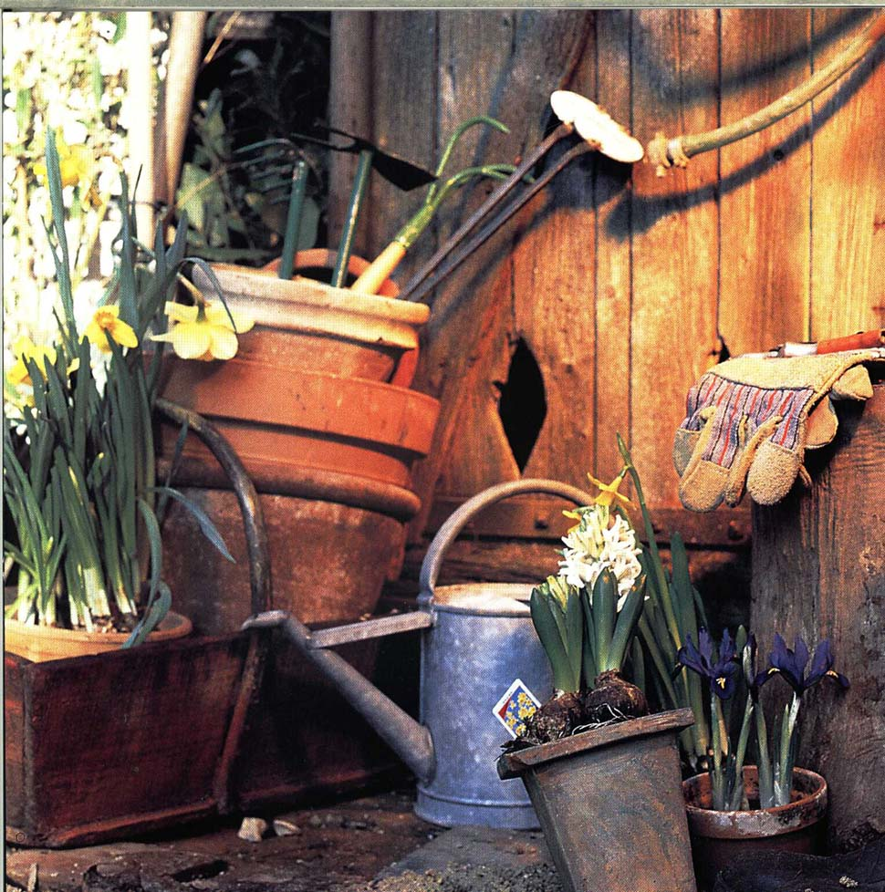
Genetic engineering equipment

Slide 11
Suppose we made a machine that:
Self-replicated almost all its parts
Existed symbiotically with people, giving them goods in return for being helped to replicate (like flowers)...
Evolved by breeding

Slide 12
Suppose we made a machine that:
Self-replicated almost all its parts
Existed symbiotically with people, giving them goods in return for being helped to replicate (like flowers)...
Evolved by breeding
RepRap - The Replicating Rapid Prototyper

Slide 13
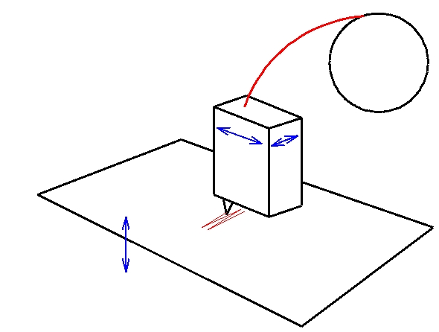
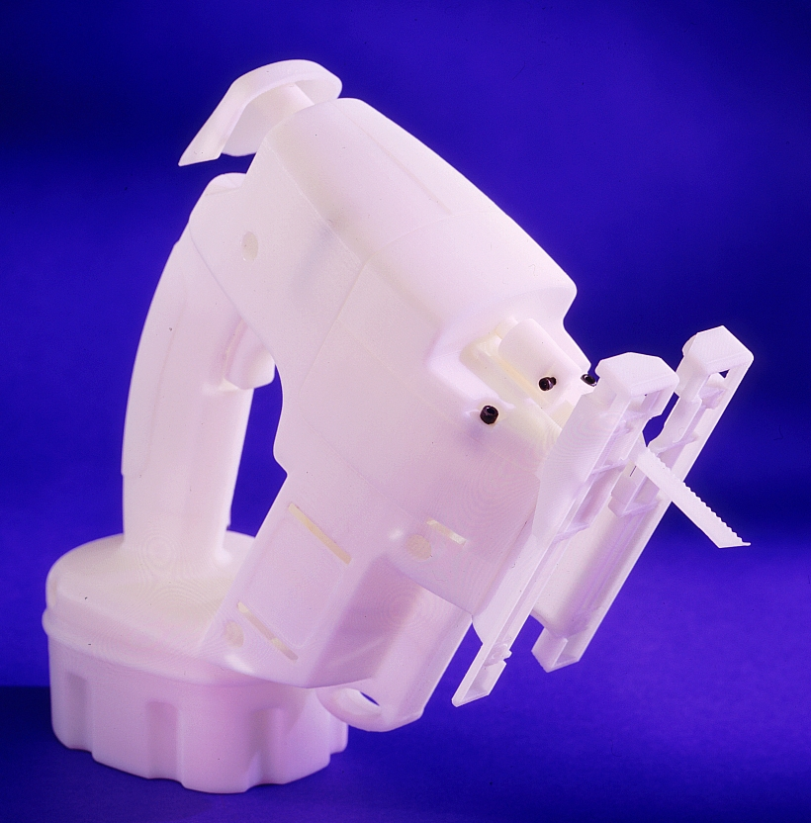
FFF rapid prototyping
Fused Filament Fabrication

Slide 14
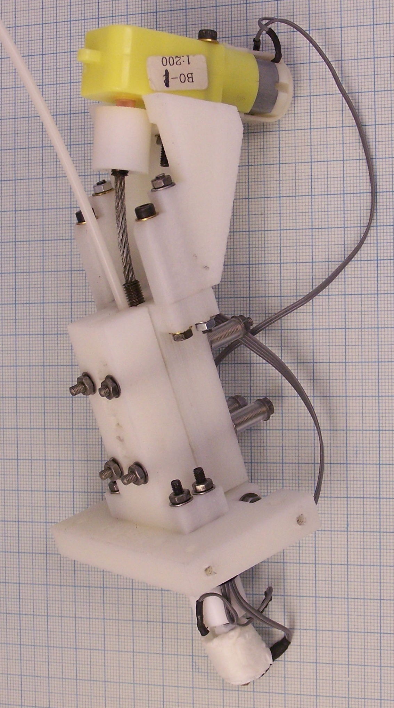
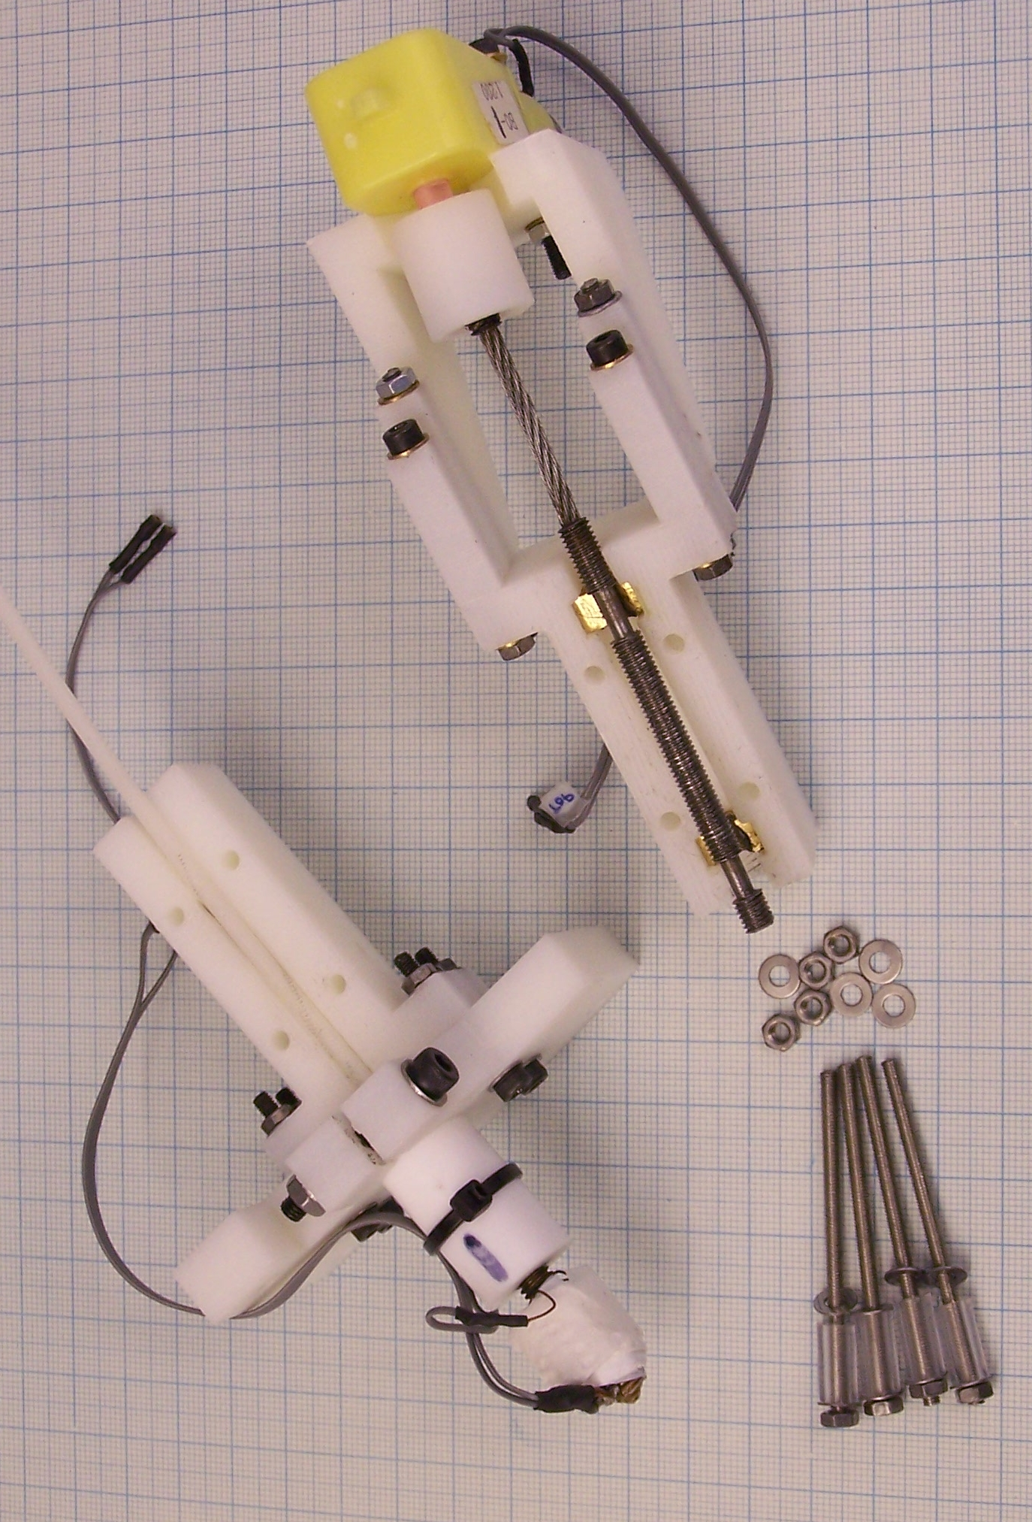
Rapid-prototyped write-head

Slide 15
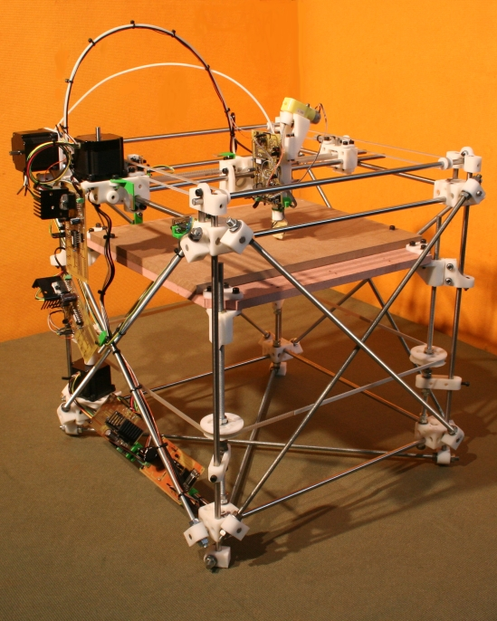
Rapid-prototyped X, Y, Z robot

Slide 16
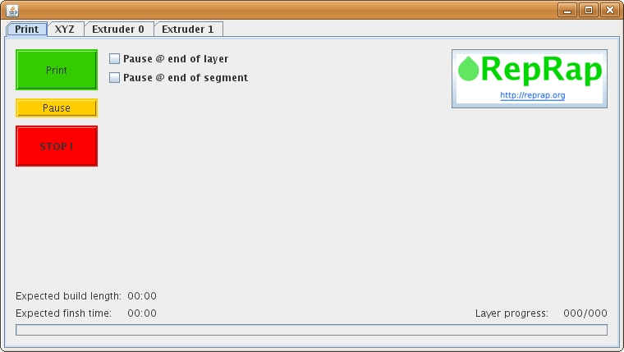
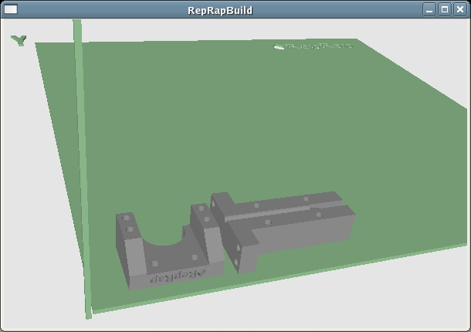
Software
PC : Java
Microcontrollers : C

Slide 17
Does it work?

Slide 18
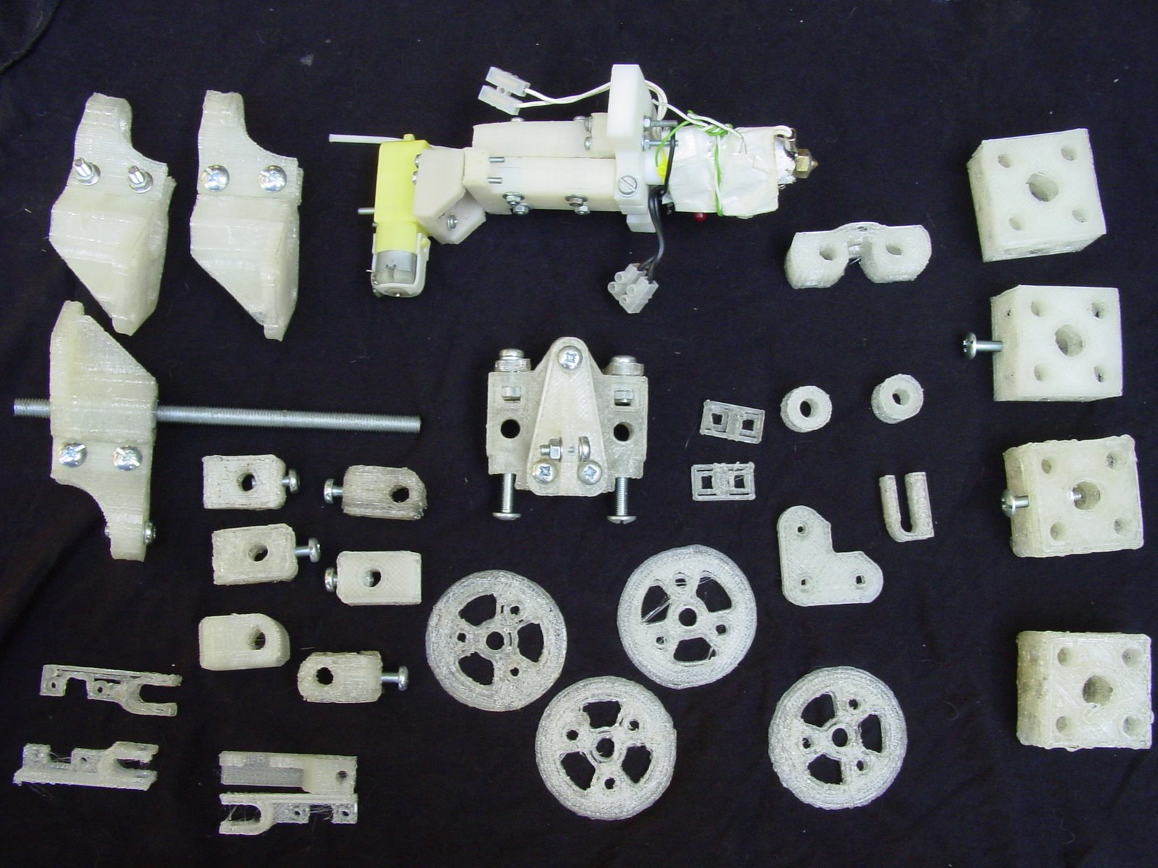
Parts reproduced at 5 Feb 2008
35%

Slide 19
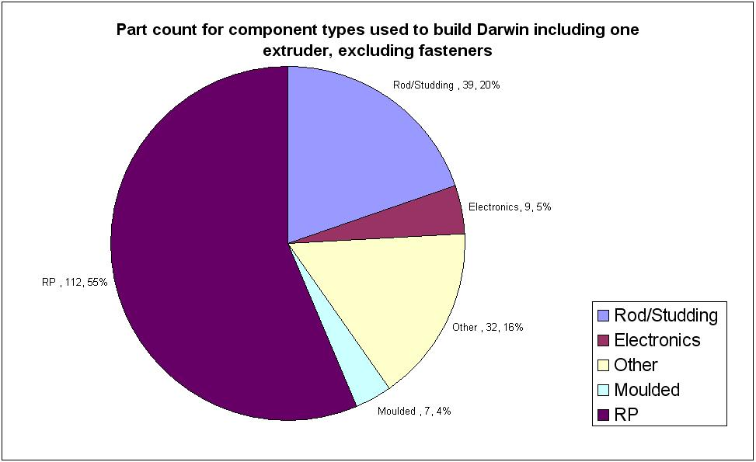
RepRap part count

Slide 20
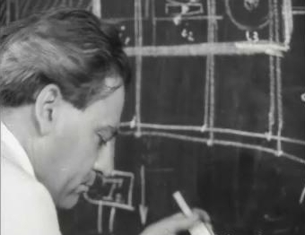
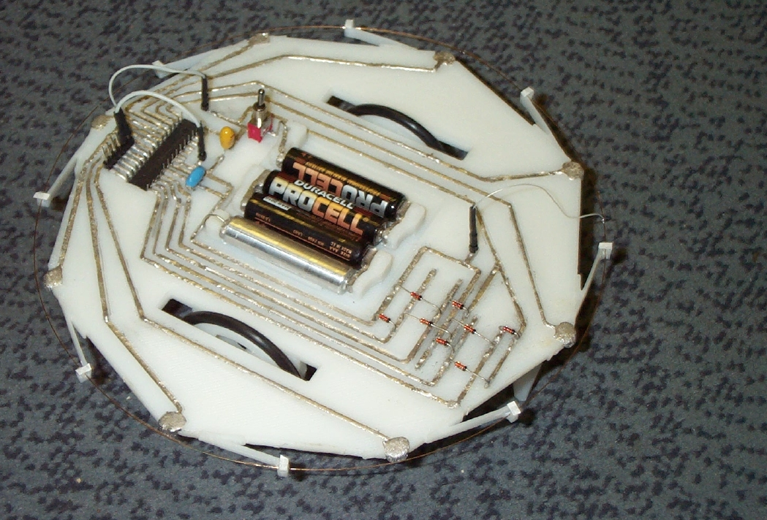
Rapid-prototyped electric circuits
John Sargrove

Slide 21
Hubris
What will happen if RepRap is successful?

Slide 22



Start by making RepRap free hardware
Linux

Slide 23
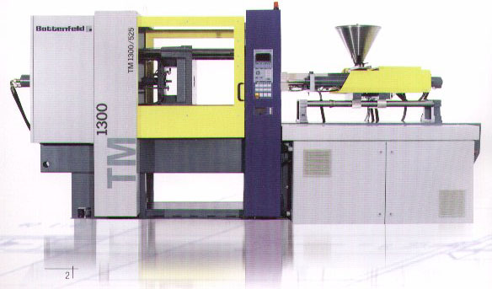
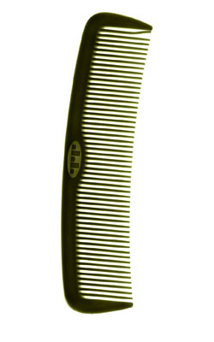
Exponential growth
10,000 per hour
Say the RepRap machine takes one day to copy itself, and to make one comb...

Slide 24
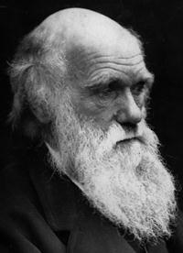
Evolution
People will improve the design.
Some improvements will be posted back on the Web.
Old machines can make new designs.
Artificial selection – speed, simplicity, accuracy, fewer added parts...

Slide 25

Economics
It doesn't matter how much the first RepRap
machine costs, all the rest will cost:
raw-materials + assembly-time.
Once you have one, you can have any number.
No one can make money by selling RepRap.
Cost of raw materials, motors, chips etc:
NOK 3000

Slide 26
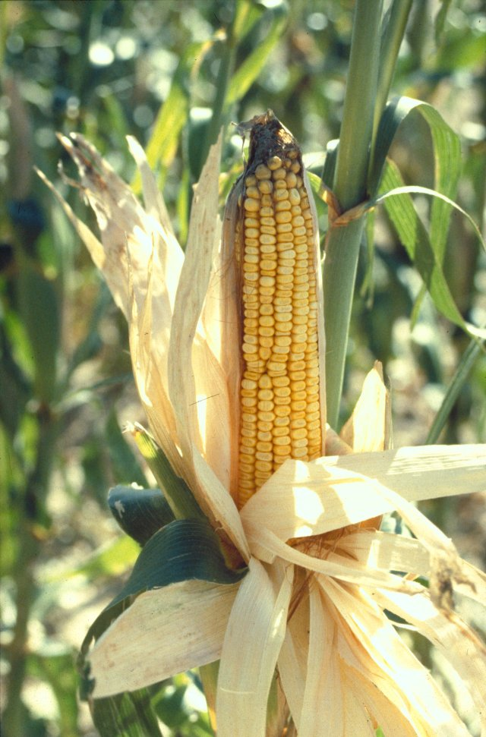
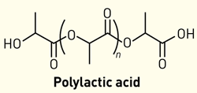
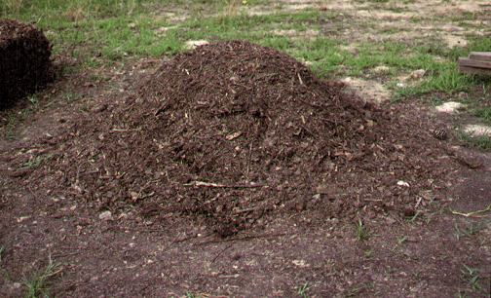
Environment
Material supply - biomass.
Bringing manufacturing to the poorest people.
Making manufacturing like agriculture.
Recycling.

Slide 27
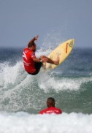
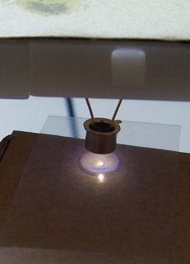
Environment
Sustainable Composites Ltd.
Plant-sourced UV resin.
Parts NON-bio-degradable.

Slide 28
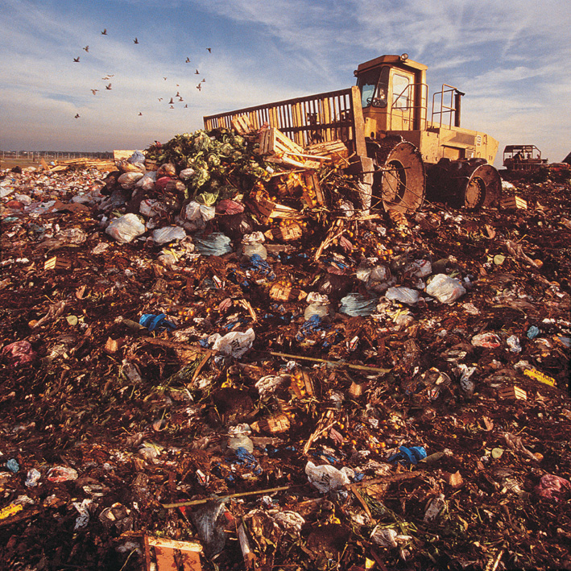
Environment
Sustainable Composites Ltd.
Plant-sourced UV resin.
Parts NON-bio-degradable.

Slide 29
Environment
Sustainable Composites Ltd.
Plant-sourced UV resin.
Parts NON-bio-degradable.
Locks up CO2 for
geological time.

Slide 30

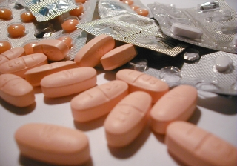
Two Potential RepRap products
Many more on the RepRap website contributed by the public.

Slide 31
The Open Phone
TUX phone
Free open design on the web
Each phone is also a base station
Game theory:
Attenuate signal with proximity
Relay signals from neighbours
Check new connections – only relay if 1 & 2 satisfied

Slide 32
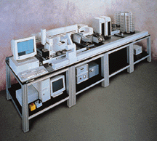
Open Pharma
Year’s supply of a new drug: NOK 200,000 and rising
Cost of a desktop synthesiser: NOK 1,000,000 and falling
People can make patented things for themselves
Have RepRap make the synthesiser
Open-source drug design, development, and testing

Slide 33
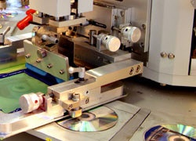
The Future?
Almost everyone in the developed world runs their own:
CD pressing plant

Slide 34
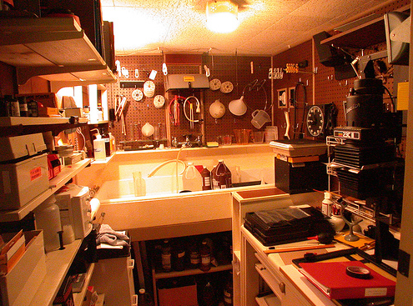
The Future?
Almost everyone in the developed world runs their own:
CD pressing plant
Photographic laboratory

Slide 35
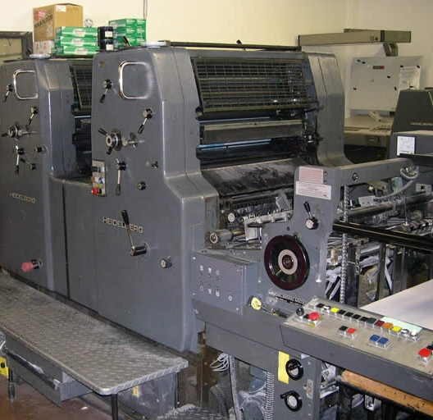
The Future?
Almost everyone in the developed world runs their own:
CD pressing plant
Photographic laboratory
Printing press

Slide 36
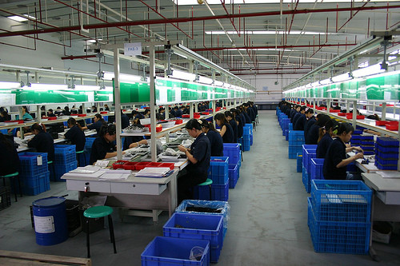
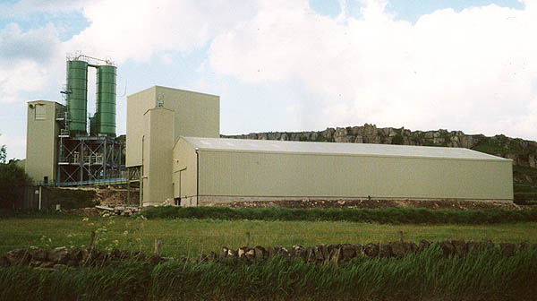
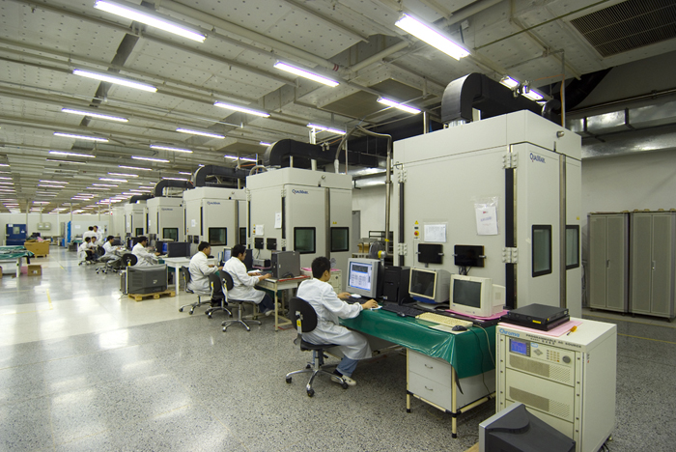
Why not their own factories?

Slide 37
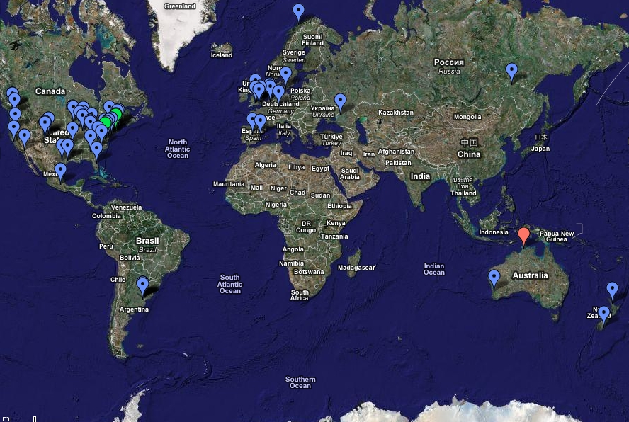
Reprappers

Slide 38
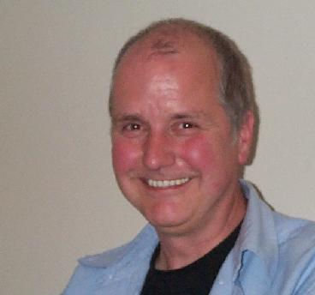
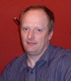
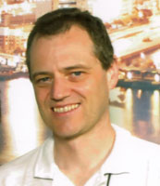
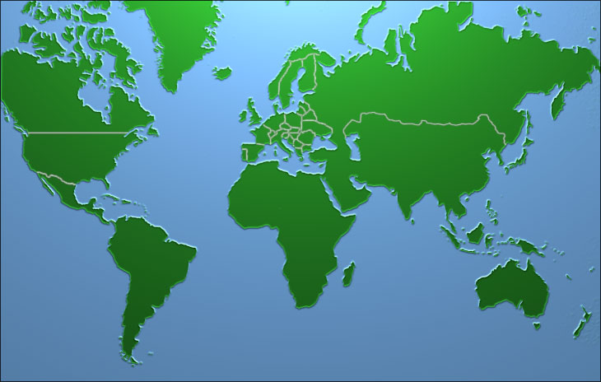
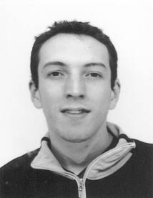






Acknowledgments & The Core Team
Nuffield Foundation
EPSRC
Bath University IdMRC

Slide 39
Project website:
http://reprap.org

Slide 40

Destruction
London 1943

Slide 41

That never works:
London 2008

Slide 42






This always works:

Slide 43

Design and manufacture are neutral
They reflect human nature

Slide 44

Design and manufacture are neutral
They reflect human nature

Slide 45
Design and manufacture are neutral
They reflect human nature
Is open design and manufacture likely to be better?

Slide 46


The Future?
A tenth-generation replicator in every home?
Fewer factories?
Less goods transport?
Less need for money?

Slide 47



Rapid Prototyping
David Jones -
“Daedalus” - 1974
Wyn Kelly Swainson patent
published in 1977.
Now many different technologies.

Slide 48
Artificial self replicators & assemblers
Eerewhon (1872)
“...how few of the machines are there which have not been produced systematically by other machines? But it is man that makes them do so. Yes; but is it not insects that make many of the plants reproductive, and would not whole families of plants die out if their fertilization was not effected by a class of agents utterly foreign to themselves? Does anyone say that the red clover has no reproductive system because the humble bee (and the humble bee only) must aid and abet it before it can reproduce? No one. The humble bee is a part of the reproductive system of the clover.”
Samuel Butler

Slide 49
Darwinian Engineering
19th century: steam power
20th century: electric data
21st century: Darwinian engineering
History doesn’t happen in centuries...
Darwinian engineering is the design of self-replicating machines and and their extended phenotypes so that they collectively exhibit an evolutionarily stable strategy.

Slide 50






Self-replicating machines
Bacteria, archaea, eukarya
Artificial replicators

Slide 51



Extended phenotype (Dawkins)
Phenotype
Extended phenotype

Slide 52


Evolutionarily Stable Strategy (Maynard-Smith)
An ESS is a (set of) phenotype(s) that cannot be invaded by a mutation.
Hawk Dove
Hawk -25 +50
Dove 0 +15
ESS:
Hawk : Dove = 3 : 2
Every ESS is a Nash equilibrium.
Not every Nash equilibrium is an ESS.

Slide 53
Darwinian Engineering
The design of self-replicating machines and and their extended phenotypes so that they collectively exhibit an Evolutionarily Stable Strategy.
RepRap is an example.
Self-replicating machines: People, RepRap
Phenotype behaviour: helping to copy; making useful stuff
ESS: Symbiosis, like the insects and the flowers

