Slide 1


Combines the performance of plastics with environmental sustainability.

Slide 2
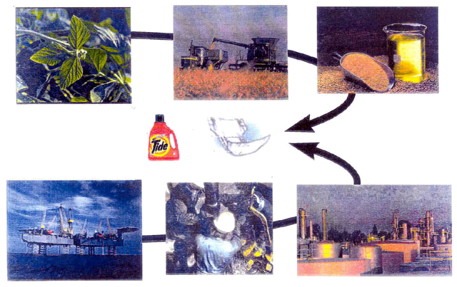
P&G’s Nodax™
Biodegradable thermoplastics from renewable resources

Slide 3
NodaxTM Project
Overall Objective
Produce a novel and functional polymer from a renewable resource that is competitive with conventional petroleum-based polymers in price, and offers improved end-use properties.
Approach
Thermoplastic aliphatic polyester (NodaxTM) production in microorganisms or agricultural crops to achieve price and volume objectives.
Commercialization
Broadly license and transfer R&D for production of neat polymer, resins and forms.
Create demand by internal use and broad licensing of other end users.
Cooperate and collaborate with other companies to capitalize on synergies with other bioplastics to grow entire market.

Slide 4
NodaxTM - P&G Bioplastics
Materials Properties
    Comparable to high-grade polyethylene
      Strength, flexibility, toughness
    Additional beneficial characteristics of polyesters
      Dyeability, printability, compatibility, etc.
    Gas Barrier properties combined with heat sealability
    Hard springy elasticity upon stretching
    Chemically digestibility in hot alkaline solutions
Additional Features
    Produced from renewable resources
    Fully biodegradable and compostable
    Novel and proprietary materials
Estimated Cost
    $ 1.00 - $ 2.50/kg. (Target)
    Competitive with high-end commodity plastics

Slide 5
Historical Background
Issues
    P&G’s detergent phosphate experience 1970 ~
    Increasing solid Waste concerns 1980 ~
      Are we running out of landfills?
      Plastic packages, diapers and other disposable products
Technical Approach
    Biodegradable/compostable plastics 1990 ~
      Disintegration to pieces
      Mineralization to CO₂, CH₄, and H₂O
Specific Actions
    Quick fix with available materials
      Starch-based resins
      Cellulose derivatives
    Long-term solution
      Next generation degradable polymers
      Major technical discontinuity

Slide 6
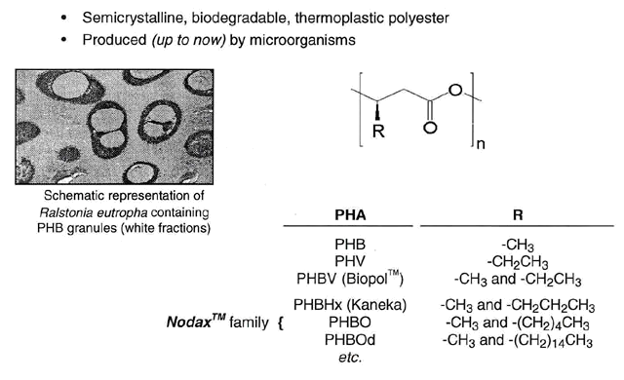
Polyhydroxyalkanoates (PHAs)

Slide 7
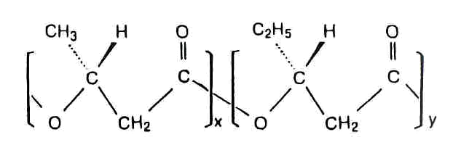
Properties of Conventional PHAs
Biopol™
Commercial PHA from Metabolix
Bacterial fermentation of sugar
Advantages
Produced from renewable resources
Biodegradable (compostable)
Thermoplastic
Moisture resistant
Limitations
Cost $5 ~ $8/lb?
Supply Limited production scale
Pollution Biomass disposal
End-use properties Hard, brittle, weak, unstable
Processability High Tm, poor thermal stability
Low extensional viscosity
Slow crystallization rate

Slide 8
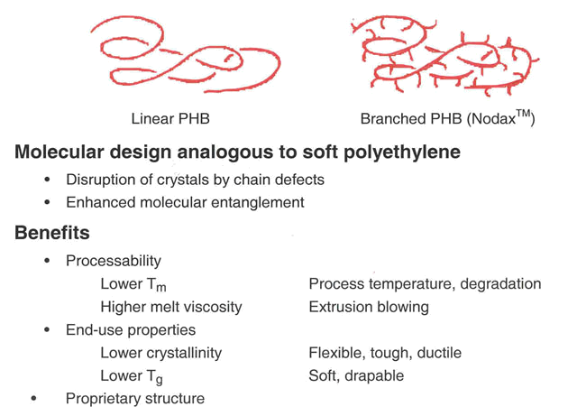
Branched PHAs (Nodax™)

Slide 9
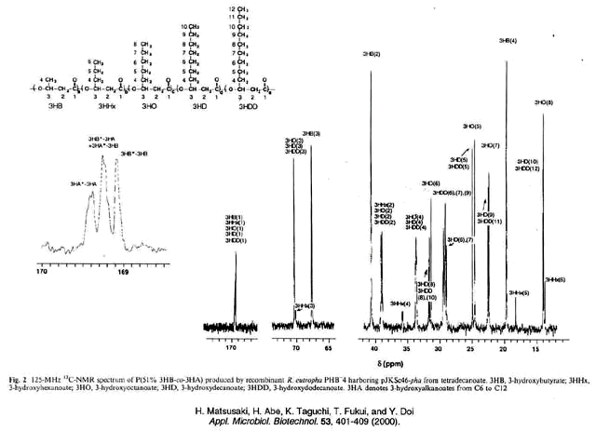
NMR Spectrum of Nodax™ Produced by Pseudomonas sp. 61-3

Slide 10
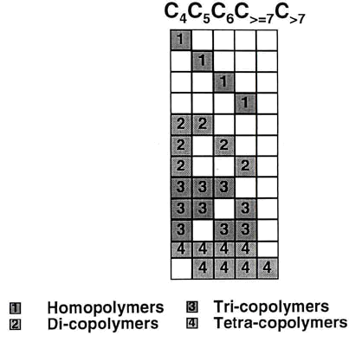
PHA Copolymer Compositions
Literature
Metabolix
Literature
Literature
Metabolix
Kaneka
P&G
P&G
P&G
P&G
P&G
P&G
P&G claimed the use of C4C6
in films, fibers, nonwovens, hygiene products, etc.
C4’s level is at least 50%
P&G also claimed
all PHA opolymers with 5 components and above

Slide 11
Properties of NodaxTM
Biological Properties
    To be made from renewable resources
    Biodegradable - aerobic, anaerobic
Thermo-mechanical Properties
    Similar to polyethylene, polypropylene
    Versatility - films, fiber, elastomers, etc.
    Exhibit hard (springy) elasticity
Physico-chemical Properties
    Affinity/compatibility with certain materials
    Higher surface energy - printing, adhesion
    Hot alkali digestibility
    Barrier properties
    UV resistance, high density, etc.

Slide 12
Biodegradable Summary
Aerobically Degradable: Compost, surface exposure
    78% / 45 days via intensive aerobic compost simulation.
Anaerobically Degradable: Septic, sediment, marine
    Good in simulated landfill conditions. Same rate or better than reference materials like yard waste, various papers.
    Good in septic systems. Disintegration in 7 days in model system.
    Slower in marine conditions. 40% / 40 days. Reference material was 55% / 15 days.

Slide 13
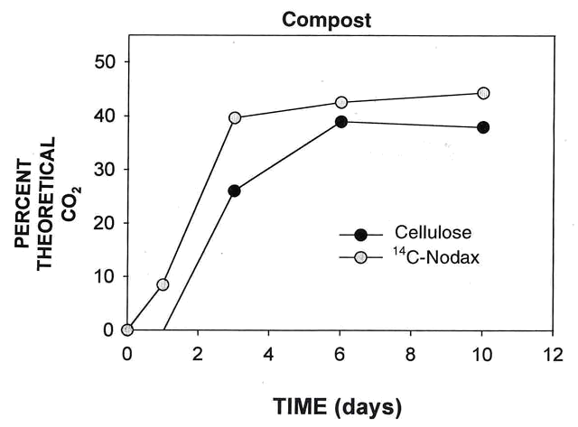
Mineralization of NodaxTM

Slide 14
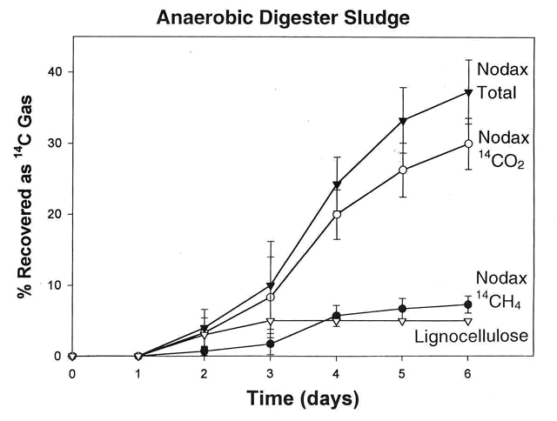
Mineralization of NodaxTM

Slide 15
Thermal Properties
Melting
    C₂ branches (PHBV) do not affect T_{m} much
    C_{≥3} branches (NodaxTM) depresses T_{m}
    Branch size above C_{≥3} has less effect on T_{m} lowering efficacy
Crystallinity
    C₂ branches has little effect on total crystallinity
    NodaxTM has the same crystal structure as PHB
    C_{≥3} branches depresses crystallinity
    Larger branches depresses crystallinity
    Higher branch content slows down crystallization rate
Glass Transition
    Higher branch content depresses T_{g}
    Larger branches depresses T_{g}

Slide 16
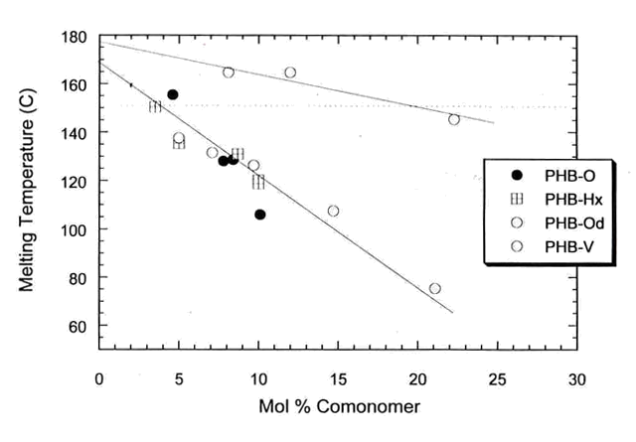
Melt Temperature

Slide 17
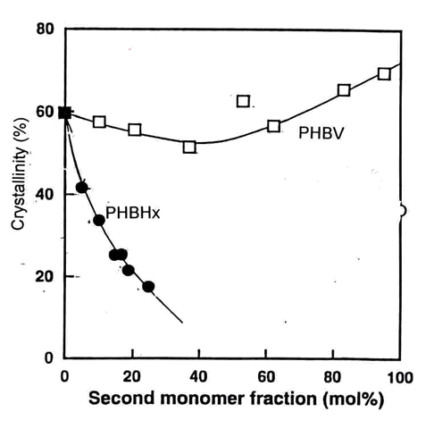
Crystallinity

Slide 18
Mechanical Properties
Young’s Modulus (Stiffness)
    Content and size of branches reduce modulus
    Between HDPE and LDPE
    Molecular weight has little effect
    Aging slightly increases modulus
Yield Stress
    Content and size of branches reduce yield stress
    Between HDPE and LDPE
    Molecular weight has little effect
Toughness and Ultimate Elongation
    Molecular weight has profound effect (preferably > 600K)
    Size of branches improves both
Comparable to high-grade PE

Slide 19
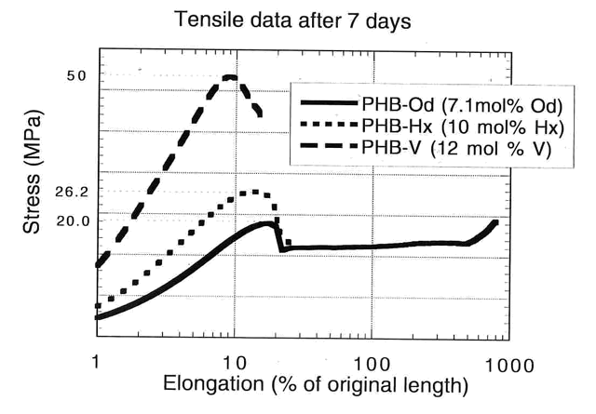
Tensile Properties

Slide 20
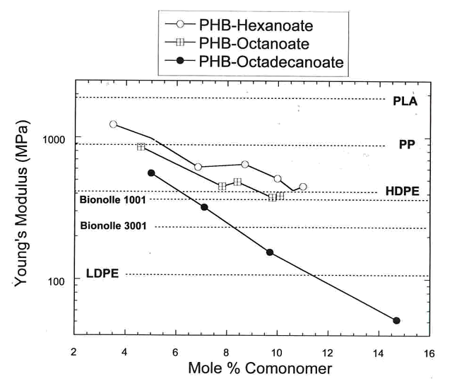
Tensile Properties

Slide 21
Interactions with Other Materials
Bulk Phase Properties
    Solubility – “green” non-CFC solvents (acetone, ethyl acetate, etc.)
    Compatibility – plasticizers, antioxidants, processing aids
    Blendability, miscibility
    Dyeability
    Moisture and grease resistance
    Barrier – O₂, CO₂, odor
Surface Properties
    Adhesion
    Dispersibility
    Wettability
    Printability

Slide 22
PLA vs. PHA (NodaxTM)
Polylactic acid
Physical Properties
Often amorphous
Transparent
Brittle, hard, and stiff
Use temperature < 60° C
Degradation Mechanisms
Hydrolytic attack
Not directly biodegradable
Temperature, pH, and moisture effect
Spontaneous degradation
Processability
Quick quench
Fiber spinning
Polyhydroxyalkanoates
Semicrystalline
Tough, ductile and drapable
Usually opaque
Use temperature < 120º C
Enzymatic digestion
Rapid biotic degradation
Aerobic or anaerobic conditions
Relatively stable in ambient
Slow crystallization
Films, fibers

Slide 23
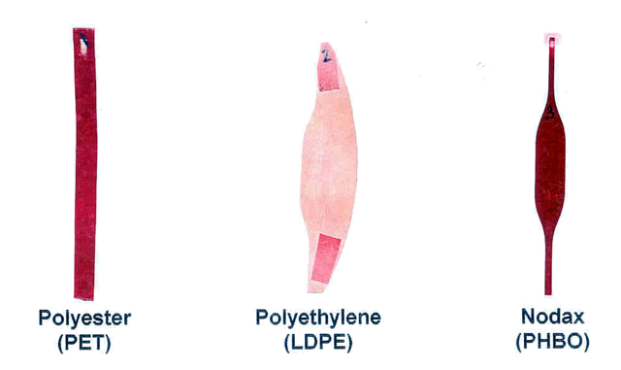
Dyeability
Dyeability test
  Immersion of films in aqueous dispersion of nonionic dye
  Similar to commercial polyester fiber dyeing process

Slide 24
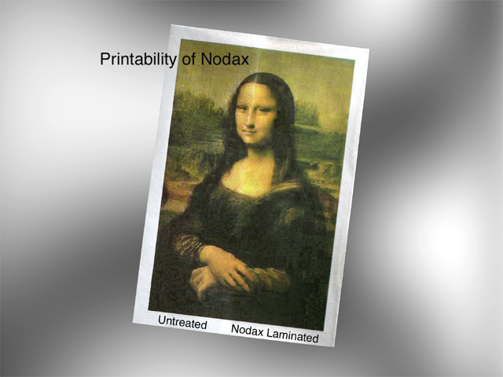

Slide 25
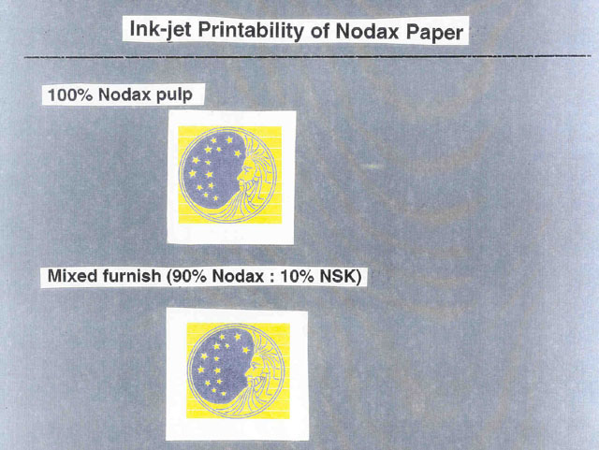

Slide 26
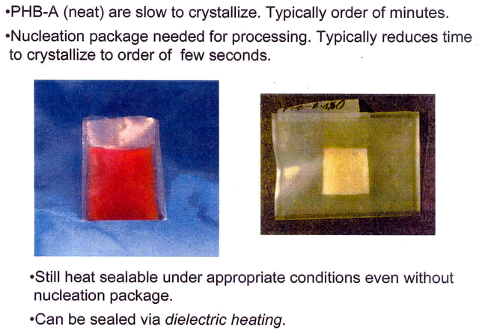
Heat Sealability

Slide 27
Gas Permeability of Films
Transmission Rate
Polymer Moisture O₂
Saran 1 10
NodaxTM 90 40
PET 50 60
Polypropylene 10 2300
Polyethylene 20 7000
Bionolle 300
Natural rubber 1000 24000
Cellulose acetate 3000 1000
Margin of error 0.5x - 2x
For most polymers, CO₂ permeability is ~ 5x O₂ permeability

Slide 28
Chemical Digestibility
Alkaline DIgestion
    Hot alkaline solutions attack bioplastics
      Caustic solution, e.g., Cascade
    Rapid disintegration to particulate
    Degradation to water-solubles (monomer, oligomer)
    Full biodegradation of digested products
Implications
    Flushable after digestion
    Household digestion possible
    Institutional uses:
      Fast-food restaurants, hospitals, marine transportation, military use
    Specialty uses:
      Electronic circuit board, mold release, etc.

Slide 29
Key Attributes of NodaxTM
Excellent barrier for odor, oxygen, CO2, and moisture
Impervious to grease, water, and other liquids
Heat-sealable, thermally processable
Good PE-like mechanical properties
Alkali digestible (e.g., with Cascade solution)
Dyeable and printable
Compatible with various additives and fillers
Made into laminated paper, layered plastic sheets, nonwovens, etc.
Blendable with many other polymers
Low cost, when made by crop plants
Available from renewable resources
Biodegradable, compostable

Slide 30
Conversion to Formed Articles
Films and sheets
Molded articles
Fibers
Elastics
Laminates and coated articles
Nonwoven fabrics
Synthetic paper products
Foams

Slide 31
High MW (700M)
Blown Films
(Garbage Bags)
Elastomeric
Film (Gloves)
High MW (1MM+)
Blow Molding
(Rigid Packaging)
Thermoforming
Functional Fiber
(Melt Spun)
Cast or
Tintered Films
(e.g., breathable)
Tie-Layer
Foam
(cups)
Spun-bond NW
Coating/Lamination
(Melt Resin)
(e.g., coated paper, NW)
Synthetic Paper
Adhesives
Melt Blown NW
Injection Mold
Low MW (500M)
5%
10%
15%
Stiff/Brittle
Flexible/Ductile
Soft/Elastic
Composition (Comonomer Content)

Slide 32
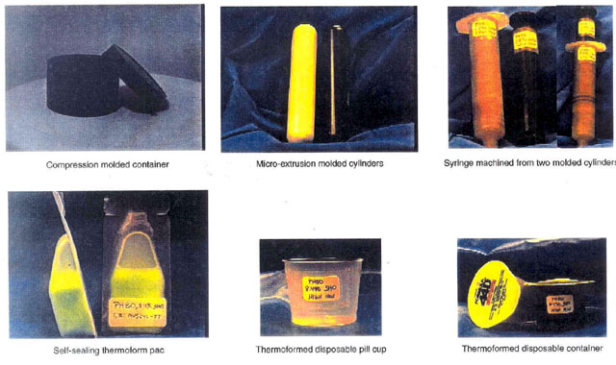
Protoypes of NodaxTM Products

Slide 33
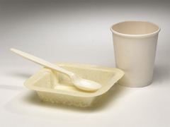
Paper Laminates/Coatings
Shows good adhesion to paper,
cellulosics
Water/grease barrier
Heat sealable
More flexible and crack resistant
than PHB/PHBV
Repulpable
Navy Drinking Cup Application:
Heat sealing rate sufficient for drinking cups to be processed at production speeds
Extrusion coating rheology is acceptable
Crystallization rate of neat material needs to be adjusted

Slide 34
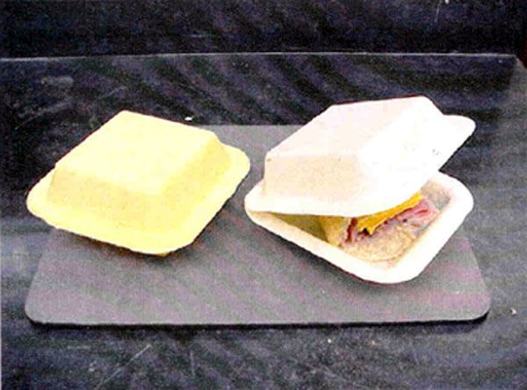
NodaxTM Foam
Clam-shell containers made of NodaxTM foam

Slide 35
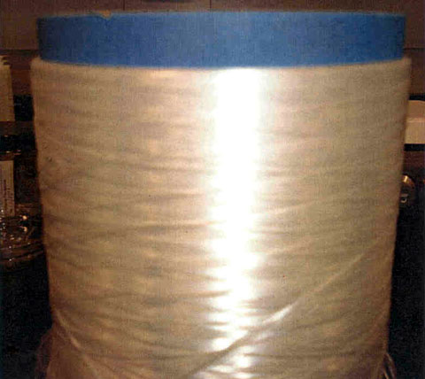
NodaxTM Fiber
Nodax bicomponent fiber

Slide 36
Combines the performance of plastics with environmental sustainability.

