Slide 1
MACHINE LEARNING · PROJECT DEFENCE
Predicting Irrigation Need
Multiclass classification of plot-level irrigation demand, and what the models revealed about the data
Carlo Stasi VR543606
Master's Degree in Artificial Intelligence · University of Verona
Academic Year 2025/2026

Slide 2
THE PROBLEM
Three irrigation levels, and one of them is rare
Predict Irrigation_Need — Low, Medium or High — for an agricultural plot from soil, climate and crop attributes.
630,000 labelled records, 19 attributes, from the Kaggle Playground Series S6E4 (synthetic, generated from a real irrigation dataset).
Low
58.72% (369,917 rows)
Medium
37.95% (239,074 rows)
High
3.33% (21,009 rows)
Class distribution of the 630,000 labelled records
17.6 : 1
Low-to-High imbalance
21,009 High rows against 369,917 Low
3.33%
of records are High
the class every downstream decision turns on
Asymmetric
cost of the two errors
a missed drought costs a harvest; a needless watering costs water
Predicting Irrigation Need · Carlo Stasi · A.Y. 2025/2026
2 / 13

Slide 3
METHODOLOGY
Two training arenas, one common test set
630,000 rows
load, drop id
+3 agronomic indices
Thermal impact, Soil Health, Water Deficit
38 encoded dims
14 standardized + 24 one-hot
80 / 20 split
stratified, random_state=42
Arena A — balanced
50,421 training rows, 1:1:1
random undersampling of Low and Medium; the whole of High is kept
Arena B — full data
504,000 training rows, natural distribution
class weights / sample weights instead of resampling
One common test set: 126,000 rows, natural distribution — identical in both arenas
Six models per arena: two un-tuned baselines (majority class, single decision tree) and four tuned estimators — K-NN, SVM, Random Forest, XGBoost, each by GridSearchCV, cv = 3, scoring = f1_macro.
Balancing is applied to the training partition only, after the split, so the test set keeps the distribution the field would actually present.
Predicting Irrigation Need · Carlo Stasi · A.Y. 2025/2026
3 / 13

Slide 4
THE MEASURING STICK
We tuned on macro F1, but Kaggle scored balanced accuracy
Macro F1 mean of the three per-class F1 scores
F1 blends precision and recall, so every false alarm is charged for.
What the grid search optimised: scoring = 'f1_macro'
Balanced accuracy mean of the three per-class recalls
Asks only: of the real droughts, how many did we catch? It never looks at false alarms.
What Kaggle scores — and the Recall column this pipeline always wrote
On the rare class High | Recall | Droughts caught | Fields flagged | False alarms
Decision Tree (d=8) | 0.9074 | 3,813 of 4,202 | 3,966 | 153
XGBoost | 0.9412 | 3,955 of 4,202 | 4,568 | 613
Same trade, two prices: XGBoost catches +142 droughts and raises +460 false alarms.
0.9560 vs 0.9682
macro F1 — XGBoost is LAST
it is charged for the 460 extra false alarms
0.9671 vs 0.9595
balanced accuracy — XGBoost is FIRST
it is never charged for them; it only gets credit for the 142 extra droughts
Predicting Irrigation Need · Carlo Stasi · A.Y. 2025/2026
4 / 13

Slide 5
RESULTS · FULL-DATA ARENA
An un-tuned baseline ties the tuned forest
Model | Macro F1 | Balanced acc. | Recall on High | Precision on High
Majority baseline | 0.2466 | 0.3333 | 0.0000 | 0.0000
Decision Tree (d=8) | 0.9682 | 0.9595 | 0.9074 | 0.9614
K-NN | 0.7514 | 0.7071 | 0.3755 | 0.8539
Linear SVM | 0.7536 | 0.7156 | 0.3705 | 0.7968
Random Forest | 0.9682 | 0.9601 | 0.9093 | 0.9586
XGBoost | 0.9560 | 0.9671 | 0.9412 | 0.8658
Balanced accuracy is the macro average of per-class recall. Highlighted: the two rows that tie.
0.9682 = 0.9682
Decision tree and Random Forest
221 leaves against 300 trees, equal to four decimals
0.2466
Majority-class floor
58.7% accurate, and never predicts High at all
0.9560
XGBoost — last here, first on balanced accuracy
exactly the disagreement the previous slide explained
Predicting Irrigation Need · Carlo Stasi · A.Y. 2025/2026
5 / 13

Slide 6
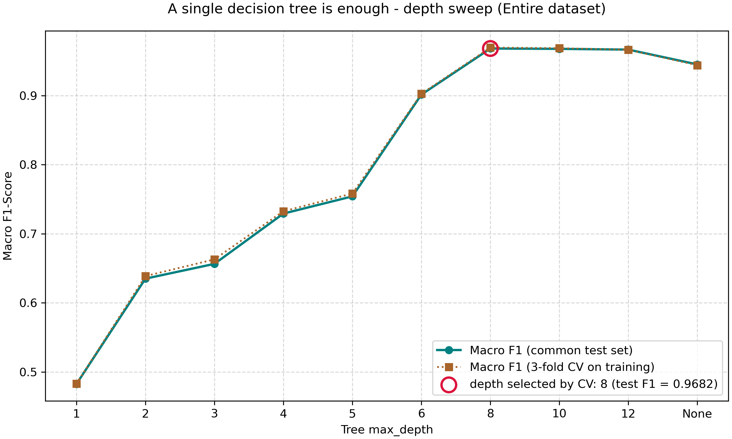
THE EXPLANATION
The target is a near-deterministic threshold rule
More capacity makes it worse, not better.
221 leaves score 0.9682. Unbounded, 9,866 leaves score 0.9452.
THE SPLITS THE TREE RECOVERS
Soil_Moisture 25
Temperature_C 30
Wind_Speed_km/h 10
Depth sweep, full-data arena. Cross-validated macro F1 peaks and then decays.
De-standardized, the learned split points are 24.99, 29.98 and 9.99. The generator wrote the labels with round numbers, and the tree found them.
Predicting Irrigation Need · Carlo Stasi · A.Y. 2025/2026
6 / 13

Slide 7
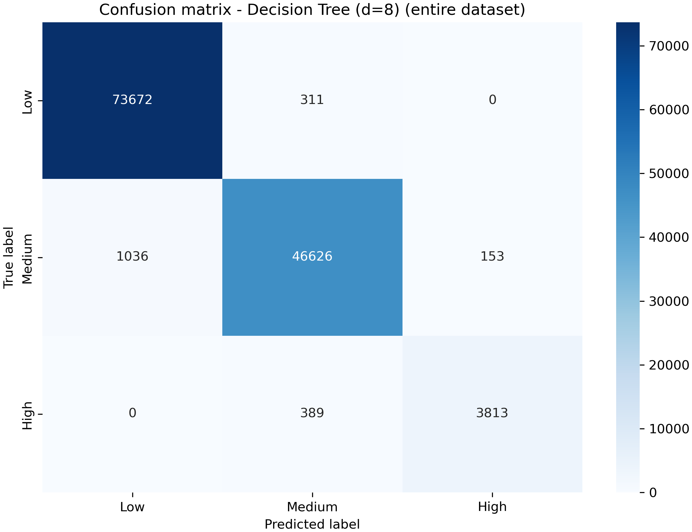

CONSEQUENCE 1
The ensembles buy nothing
1 tree, 221 leaves, 39 KB
300 trees, 2,784,223 leaves, 494 MB
12,300x
more disk for the same score
both at 0.9682 macro F1; the forest takes 4.8 s to score the test set, the tree is too fast to measure
-0.0001
difference between them
95% interval [-0.0011, +0.0009] -- the only comparison in the study that contains zero
99.84%
identical labels, unseen data
on 270,000 held-out competition rows they disagree 428 times, never between Low and High
Predicting Irrigation Need · Carlo Stasi · A.Y. 2025/2026
7 / 13

Slide 8
CONSEQUENCE 2
Balancing is a trade-off, not a free lunch
Precision and recall on High, same estimator, same grid, same test set — only the training arena changes.
K-NN
Linear SVM
recall 0.934
recall 0.924
0.854
0.797
0.376
0.370
precision 0.230
precision 0.278
balanced
50,421 rows
full data
504,000 rows
balanced
50,421 rows
full data
504,000 rows
Two unrelated families mirror each other: balancing buys recall on the rare class and pays for it in precision. Cross-validation even rediscovers the prior shift on its own — K is tuned to 31 balanced and 11 on the full data, because a large K makes each vote regress towards the global distribution, which a 3.3% class cannot survive.
Predicting Irrigation Need · Carlo Stasi · A.Y. 2025/2026
8 / 13

Slide 9
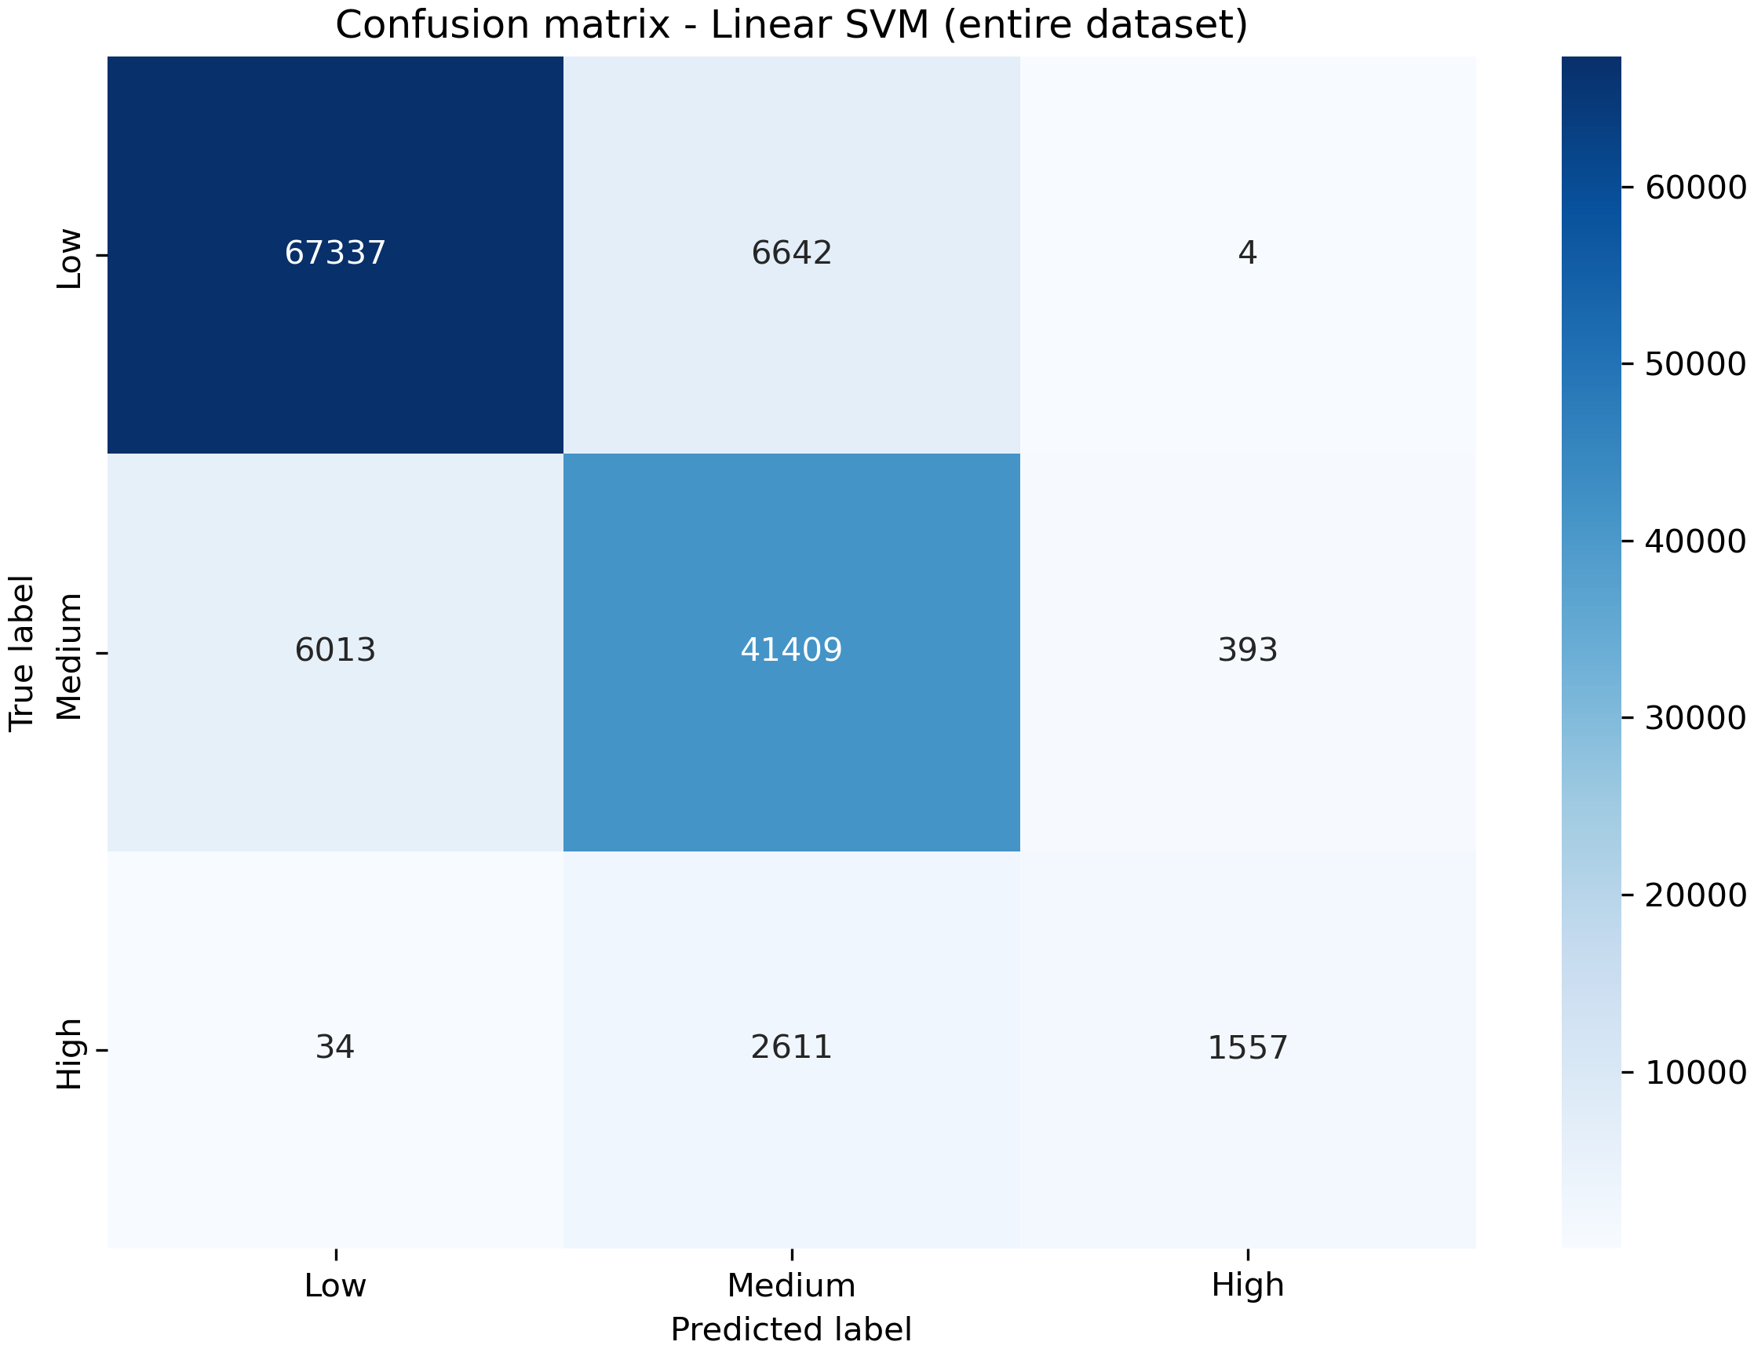
CONSEQUENCE 3
A macro average can hide an operational failure
0.7536
Linear SVM macro F1, full data
comfortably above balanced-arena K-NN at 0.6452 — so on the aggregate it looks like the better model
62.95%
of real droughts missed
recall on High = 0.3705; it recovers 1,557 of the 4,202 droughts and files most of the rest under Medium
Linear SVM, full training partition, common test set
The aggregate was never wrong — it was answering a different question.
Slide 4 showed two aggregates disagreeing about the winner. This is the sharper version: one aggregate can look healthy while the class the whole problem is about is being missed. Which is why every model here carries per-class precision and recall.
Predicting Irrigation Need · Carlo Stasi · A.Y. 2025/2026
9 / 13

Slide 10
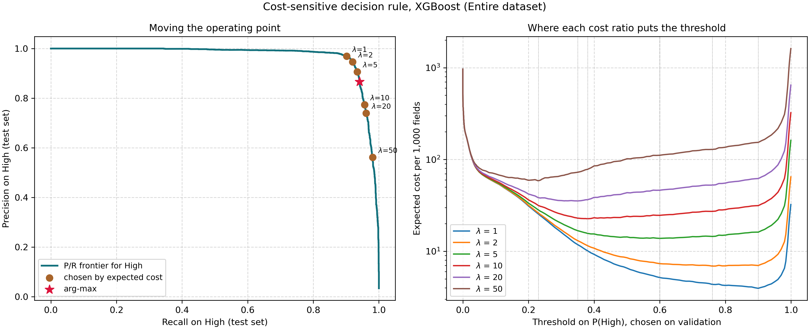
CONSEQUENCE 4
Fix the decision rule, not the model
The ROC tells us the information is already there: one-vs-rest AUC on High is 0.9981. The ranking is near-perfect. What limits recall is where we put the threshold.
Left: the precision-recall frontier for High, with arg-max marked. Right: expected cost per 1,000 fields against the threshold, one curve per cost ratio, chosen on training-side validation.
t = 0.90
cost-optimal threshold at lambda = 1
λ = 5 means «I prefer water 10 fields rather than lose 1 drought
not the 0.5-like boundary that arg-max applies
0.9560 → 0.9679
XGBoost macro F1, arg-max vs cost rule
almost the whole gap to the decision tree was the decision rule
0.9807
recall on High at lambda = 50
at precision 0.5615 — about 10 needless waterings per recovered drought
Predicting Irrigation Need · Carlo Stasi · A.Y. 2025/2026
10 / 13

Slide 11
EXTERNAL VALIDATION
Someone else's scoring code, on rows we never saw
Three submissions to the Kaggle Playground S6E4 holdout — 270,000 rows whose labels only Kaggle has.
Kaggle splits those rows into two disjoint random halves. Public is scored live during the competition and everyone sees it; private stays hidden until it closes and decides the final ranking — so nobody can tune a model against it.
For us, submitting late and unranked, that split is worth more than the ranking: it is two independent measurements of the same model.
Model | Internal (our test set) | Kaggle private | Kaggle public | Largest gap
Decision Tree (d=8) | 0.9595 | 0.96073 | 0.95973 | 0.0012
Random Forest | 0.9601 | 0.96257 | 0.95916 | 0.0025
XGBoost | 0.9671 | 0.96785 | 0.96630 | 0.0008
A prediction made before the fact
1 Internally XGBoost is last on macro F1, first on balanced accuracy.
2 Kaggle scores balanced accuracy, so it should win here.
3 Written down before submitting: 0.9671
4 Scored 0.96785 and 0.96630 — off by 0.0008 on each half.
A difference that is not a difference
The two halves disagree about tree versus forest: the forest leads by 0.00184 on the private half and trails by 0.00057 on the public one. A gap whose sign depends on how the rows were dealt is not a gap — and this time the split was not ours to choose. XGBoost, by contrast, leads on both.
Predicting Irrigation Need · Carlo Stasi · A.Y. 2025/2026
11 / 13

Slide 12
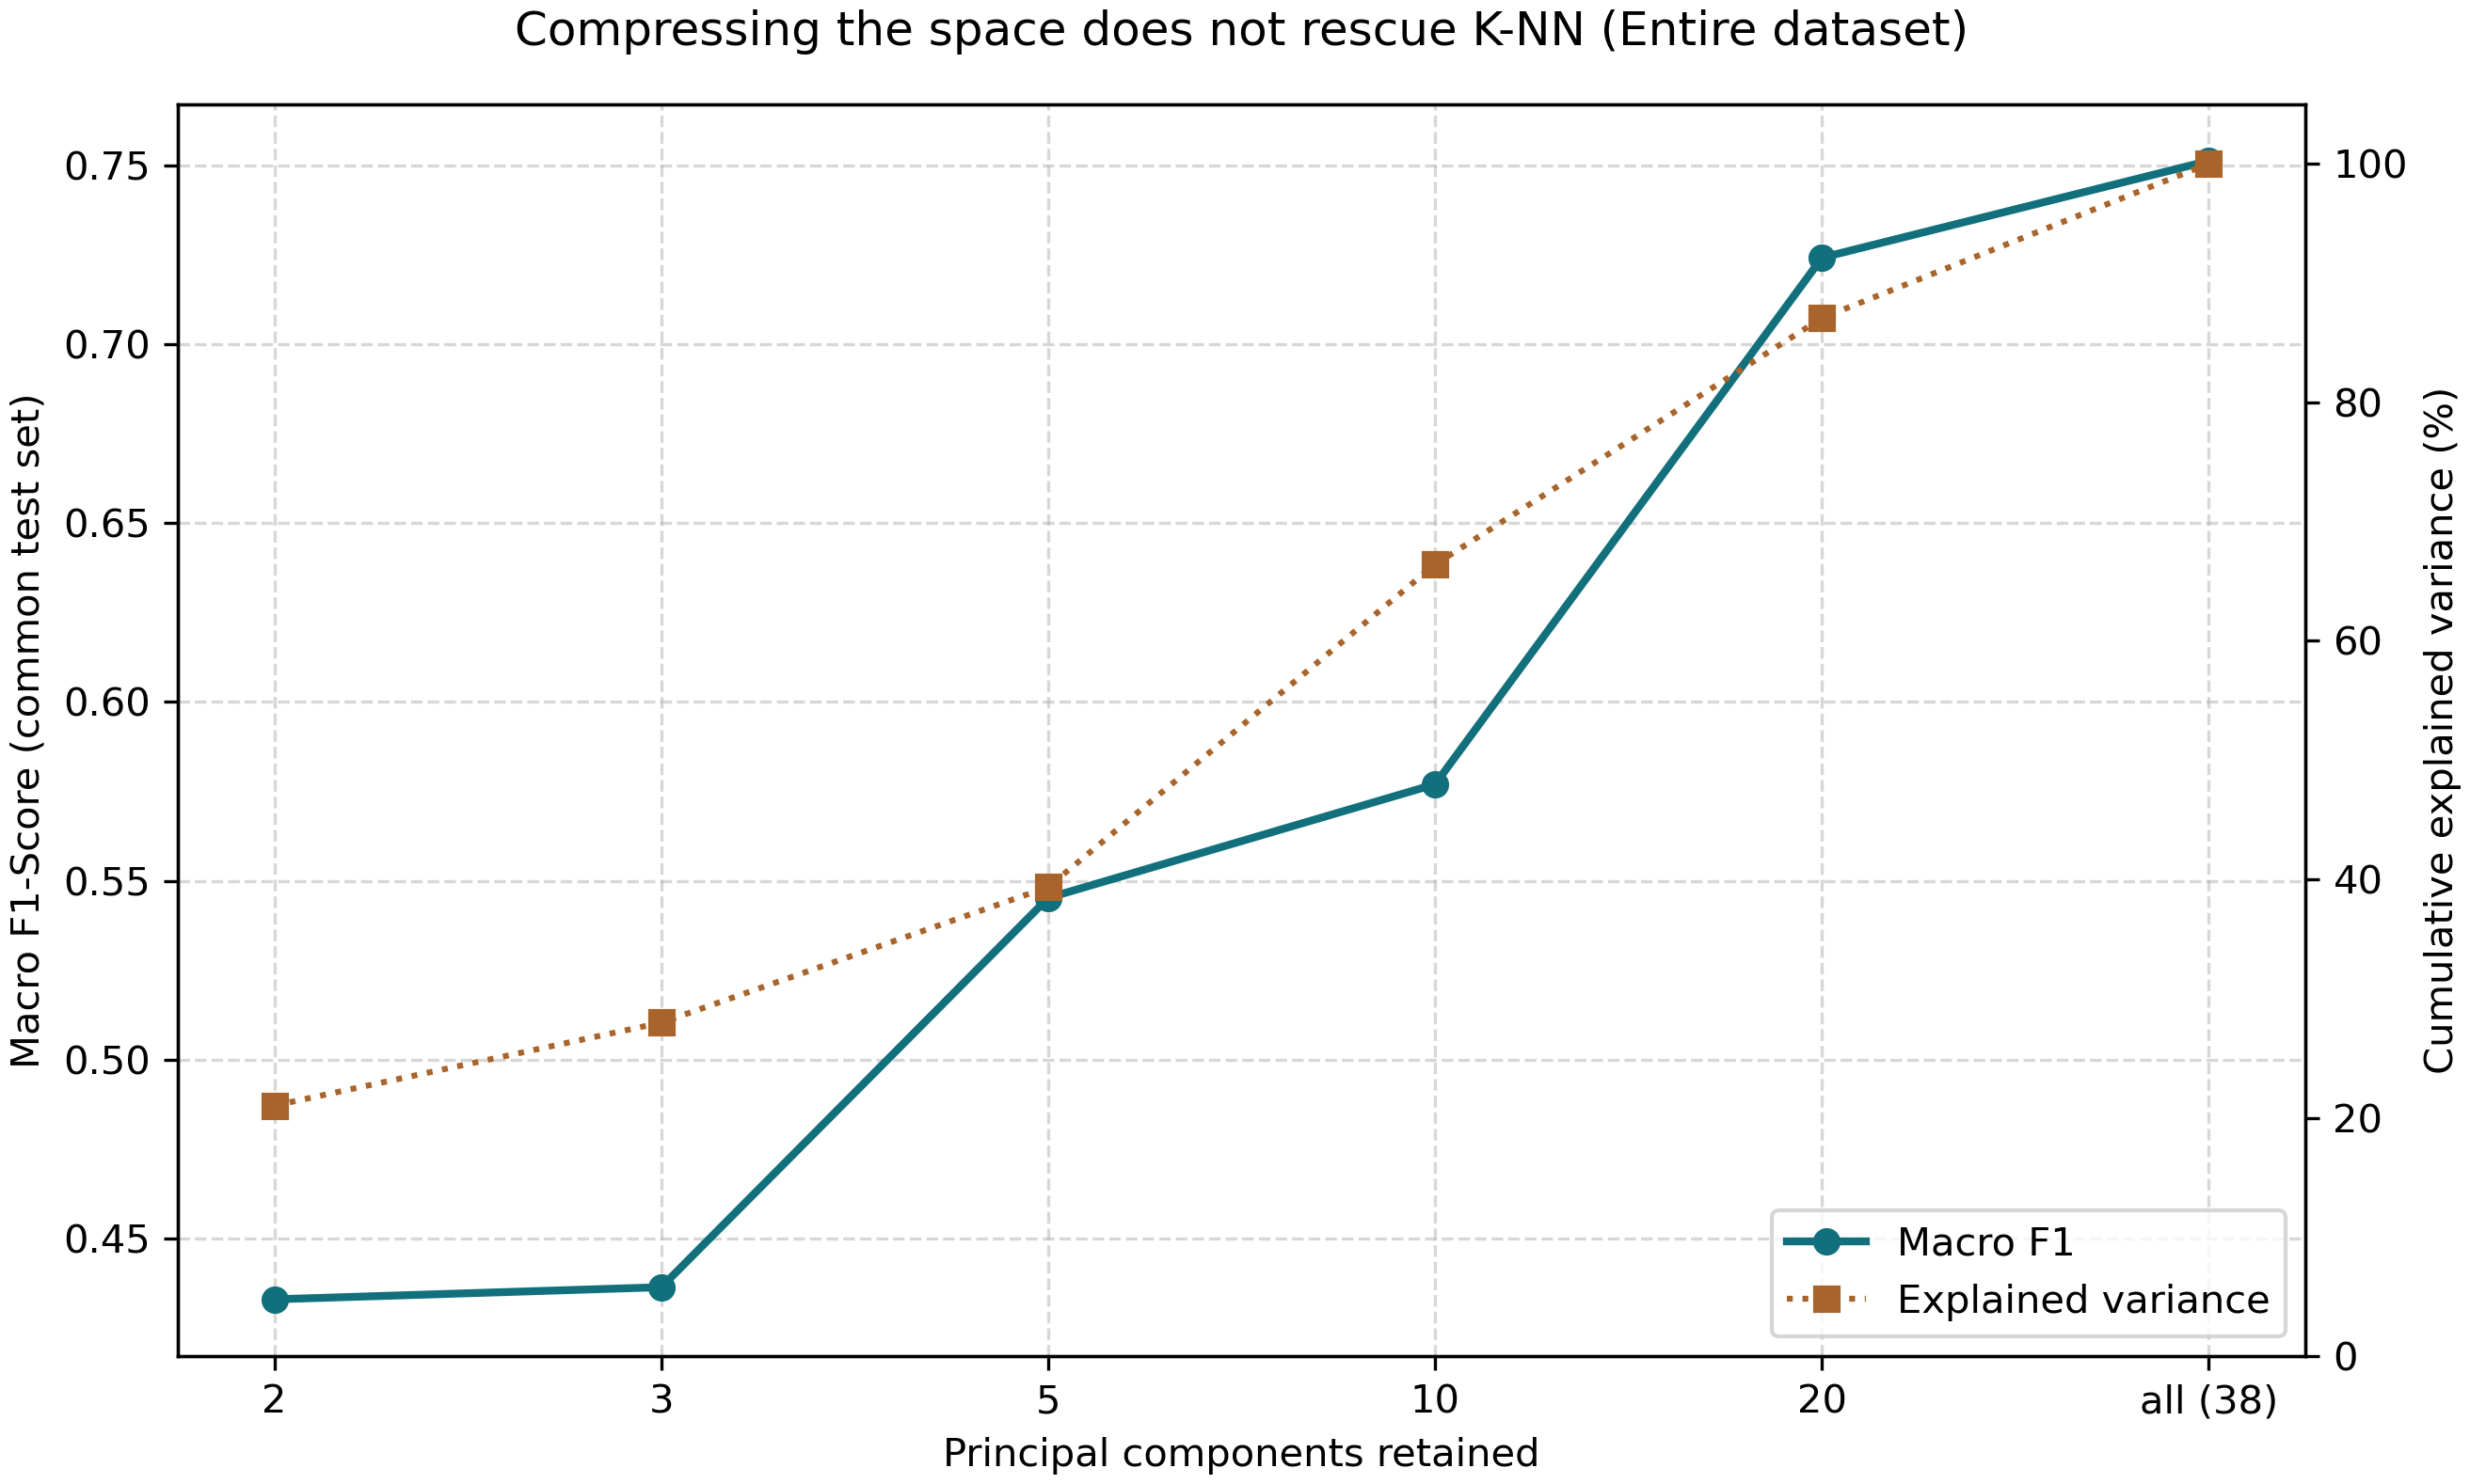
WHAT DID NOT WORK
Two things I expected to help, and did not
0.0083
recall on High at 2 principal components
down from 0.3755 uncompressed — fewer than 50 of the 4,202 droughts found. The loss is monotone; there is no knee to trade on.
0.9682
decision-tree macro F1 in all six ablation rows
identical whichever engineered features are removed — a tree rebuilds a ratio by splitting on its parts, so it cannot measure them
PCA + K-NN, full-data arena: macro F1 against retained components
Both are corroboration, not disappointment. PCA rotates towards directions of maximum variance, which have no reason to align with the axes a threshold rule is written on, so compression destroys exactly the structure the classifier needs.
Predicting Irrigation Need · Carlo Stasi · A.Y. 2025/2026
12 / 13

Slide 13
CONCLUSIONS
What the models revealed about the data
The data is governed by a threshold rule.
It explains the whole results landscape — reporting 97% without it would imply the problem needed an expensive model.
Aggregate metrics can mask operational failures.
A higher macro F1 hid a model missing 63% of droughts. Per-class recall caught it.
Balancing is a trade-off, not a free lunch.
Two unrelated estimators mirrored each other; confining it to the training partition is what let us measure the cost honestly.
External validation confirmed the internal reading.
The tie held on 270,000 unseen rows, and the predicted reversal happened.
Engineered features must justify their complexity.
Two of three were worth nothing; the third only helped a model that could not rebuild it, and only when data was scarce.
Limitations: the dataset is synthetic, so the threshold behaviour is an artefact of the generator; the cost analysis uses uncalibrated probabilities; several selected hyperparameters sit at a grid edge.
Predicting Irrigation Need · Carlo Stasi · A.Y. 2025/2026
13 / 13

