Slide 1


Texas Mortgage Issues Assessment
Presented by:
Jodee Harris
Eze Odimegwu
Carlos Valenciano
Ana Gutierrez
Last Updated: 08/17/2023

Slide 2
References:
The project’s data set is located on Kaggle.
Financial Product and Services Customer Complaints (https://www.kaggle.com/datasets/taeefnajib/bank-customer-complaints)

Slide 3




Table of Contents
Project Description (Slide 4)
Hypotheses (Slide 5)
Frequent Issues with Texas Mortgages between 2011-2019? (Slide 7-8)
Do consumer complaints display a trend in company responses? (Slide 6)
Which top 3 companies had the most closed responses? (Slide 9-10)
Analysis (Slide 11)

Slide 4

Project Description
Project Focus - Texas customer mortgage public or nonpublic responses to complaints resulting in a variety of closed complaints between 2011 to 2019.
Audience – Texas consumers with options to choose a loan mortgage company in Texas.
Motivation - Consumer awareness about companies with high trending issues in the state of Texas involved with mortgages.
Objective - The breakdown of various issues associated which top companies that provide mortgage loans proving or disproving, public responses had any effect on the outcome of closed issues.

Slide 5


Hypotheses
Our hypothesis suggests the primary challenges associated with Texas mortgages that banks addressed, had more customer complaints that were effectively closed with public responses.
Our null hypothesis suggests the primary challenges associated with Texas mortgages that banks addressed, had little to no differences in the effect of public responses in customer complaints

Slide 6
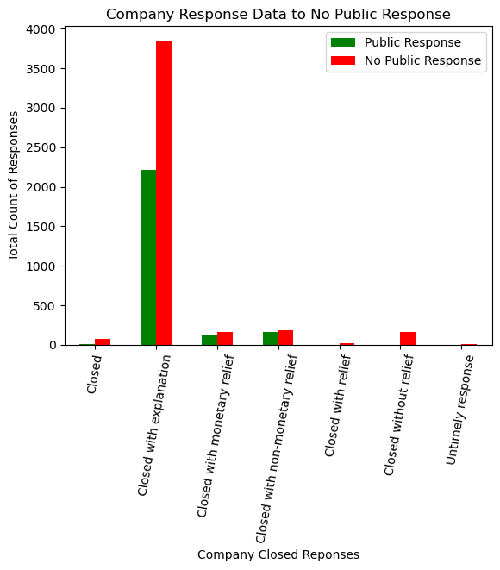
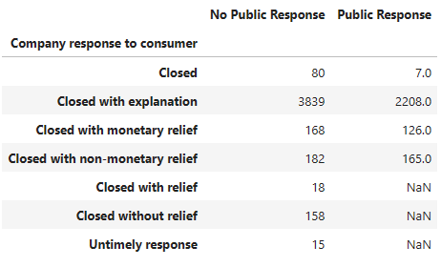
Do consumer complaints display a trend in company responses?
The distribution of different company responses ("Closed," "Closed with explanation," etc.) for “Public Response” and “No Public Response” provides an initial understanding of how companies are addressing consumer complaints.
The trend displayed here is that regardless of type of closed response “No Public Response” tallied higher than “Public Responses”.

Slide 7

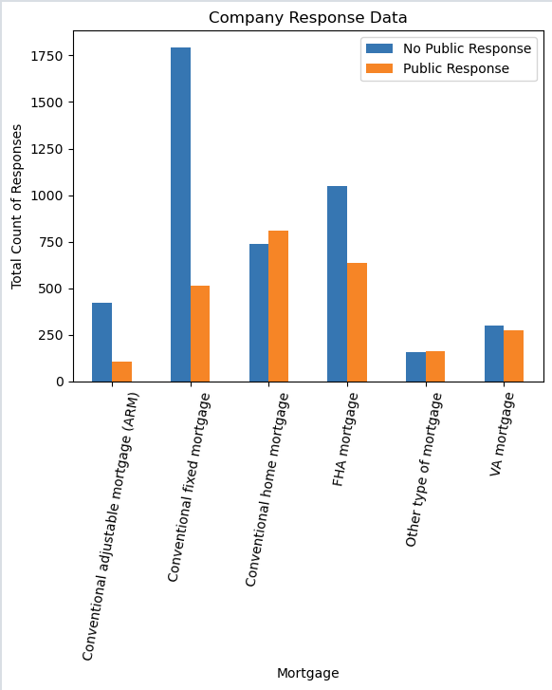
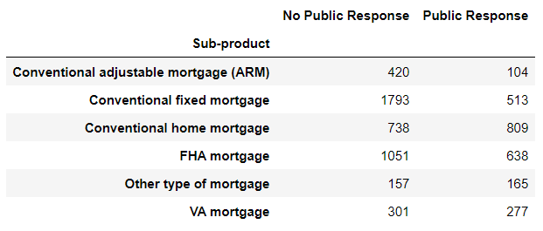
Frequent Issues with Texas Mortgages between 2011-2019?
The separation of mortgage loan types into those with public and non-public company responses.
Companies show to have mixed results to handling complaints based on the type of loan consumers obtained.

Slide 8
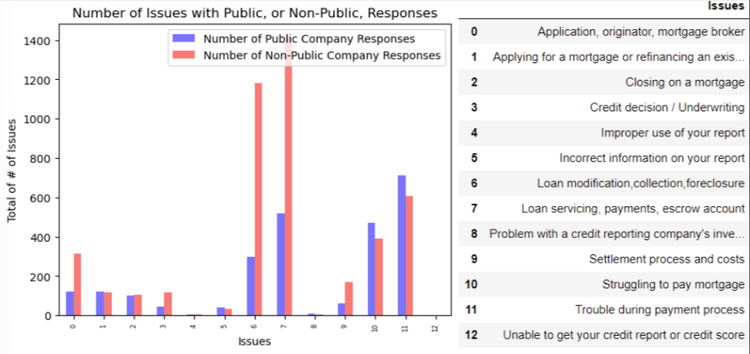
Displayed is the count of each type of issue, separated by public and non-public company responses.
Top 3 issues: “Loan servicing, payment, escrow accounts”, “Loan modification, collection, foreclosure”, and “Trouble during payment process”.
Hypothesis or Null Hypothesis based on Public or Non-Public Responses?

Slide 9
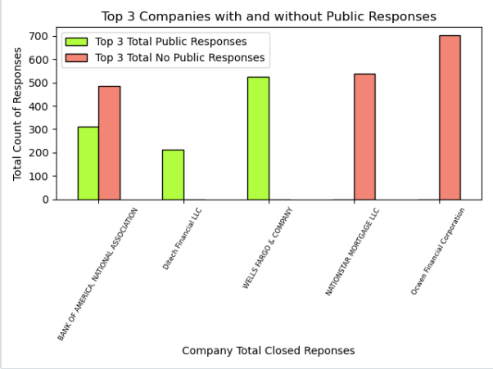
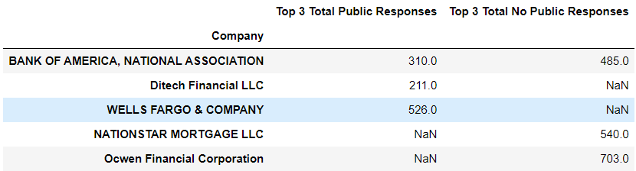
Which top 3 companies had the most closed responses?
Top 3 “Public Responses” companies: “Bank of America”, “Ditech Financial”, and Wells Fargo.
Top 3 “No Public Responses” companies: “Bank of America”, “Nationstar Mortgage” and “Ocwen Financial” .

Slide 10
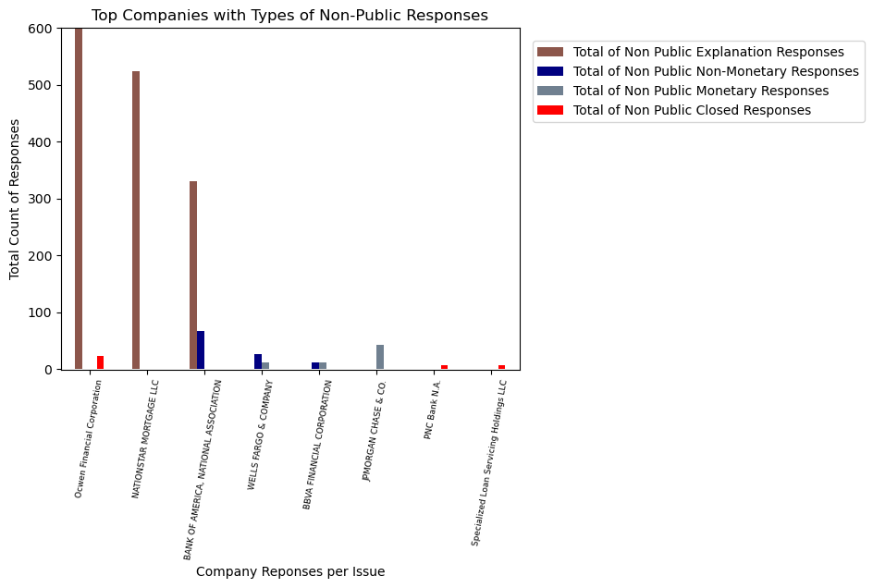
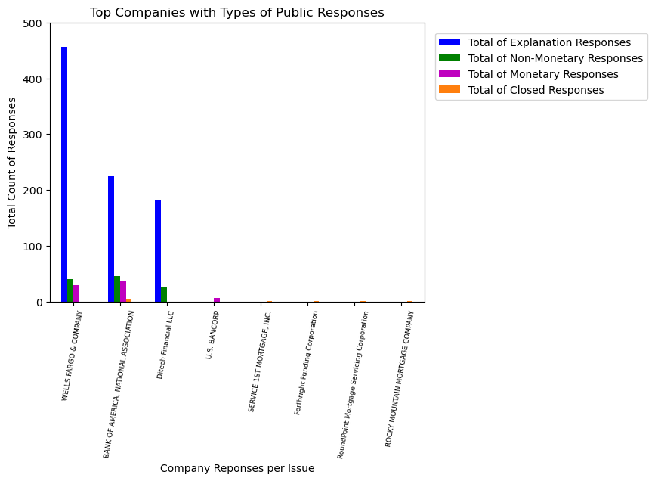
The data displays “Closed with explanation” as the most response to consumers on both public and Non-public for the top 3 companies responding to consumers.

Slide 11
Analysis
Our analysis is that consumer complaints saw very little to no effect from a company's public response. Many of the top issues consumers faced were overwhelmingly closed with a non-public response ( a letter in the mail, email, phone call).
From the data presented, the issues most frequent with Texas mortgages between 2011 to 2019 were: loan servicing, payments and escrow accounts, and we saw that most companies show to have mixed results to handling complaints based on the type of loan consumers obtained.
Many of the response's companies gave were closed with an explanation which just means companies like Bank of America, Nation Star, and Ocwen Financial gave brief summaries to why or why not a request was approved. Fortunately, enough for consumers according to the Consumer Financial Protection Bureau, companies provided a timely response to 99% of the approximate 800,000 complaints.

