Slide 1

Computer Security Fundamentals
by Chuck Easttom
Chapter 2 Networks and the Internet

Slide 2
Chapter 2 Objectives
Describe the OSI model
Explain the use of MAC addresses
Identify each of the major protocols used on network communication
Understand the various connection methods and speeds used in networks
Compare and contrast a hub and a switch
© 2016 Pearson, Inc. Chapter 2 Networks and the Internet
Notes:
Describe the OSI model of network communication.
Explain the use of MAC addresses.
Identify each of the major protocols used in network communication (for example, FTP and Telnet) and what use you can make of each.
Understand the various connection methods and speeds used on networks.
Compare and contrast a hub and a switch.

Slide 3
Chapter 2 Objectives (cont.)
Identify what a router is
Understand how data is transmitted
Explain how the Internet works
Use network utilities
Explain the use of firewalls and proxy servers
© 2016 Pearson, Inc. Chapter 2 Networks and the Internet
Notes:
Identify what a router is and its use.
Understand how data is transmitted over a network.
Explain how the Internet works and the use of IP address and URLs.
Use network utilities such as these: ping, ipconfig, and tracert.
Explain the use of firewalls and proxy servers.
You will find that understanding this chapter will be crucial to your success with the rest of the book.

Slide 4
OSI Model
Open Systems Interconnect model
Seven-layer model created to enable problem isolation
Diagnostic and troubleshooting tool
Each layer supports the layer above and performs a specific function
© 2016 Pearson, Inc. Chapter 2 Networks and the Internet
Notes:
MEMORIZE THE OSI MODEL. It is on all the certification exams.
A mnemonic device: Please, Do Not Throw Sausage Pizza Away.

Slide 5
Network Basics
A network is two or more connected computers
Connected via a Network Interface Card (NIC)
NIC operates on the physical layer
Uses a RJ 45 connector
Allows the host to connect to the network
© 2016 Pearson, Inc. Chapter 2 Networks and the Internet
Notes:
The part of the NIC that is external to the computer has an opening that looks like a telephone jack but larger. The cable plugs in there and connects to the network.
Wireless networks also use a NIC but connect via infrared signals rather than a slot and cable.

Slide 6
Network Basics (cont.)
Media Access Control (MAC) addresses
Physical address, as opposed to the IP address
Burned on the NIC in hexadecimal
It is the layer 2 address used for identification within the network
© 2016 Pearson, Inc. Chapter 2 Networks and the Internet
Notes:
This is the physical address of the computer.
It never changes; as opposed to the IP address, which is a virtual address that may change as often as the network admin allows.
It is represented by a 6-byte hexadecimal number.
The first three octets identify the manufacturer and the last three are randomly generated numbers.

Slide 7

Network Basics (cont.)
DNS Servers – Domain Name Server
Translates domain name (URL) to IP address
www.explain.com or 198.203.167.9?
URL – Universal Resource Locator
© 2016 Pearson, Inc. Chapter 2 Networks and the Internet
Notes:
Which would you rather remember?
A DNS server resolves URLs, the global address of documents, and other resources on the World Wide Web.
The first part of the address indicates what protocol to use, and the second part specifies the IP address or the domain name where the resource is located. When you type in the URL, the DNS server translates it to the appropriate IP address.
There are DNS servers all over the globe. They keep each other current with zone transfers–mass transfers of all their new data.

Slide 8
Network Basics – Cabling
10BASE5 – Thick Ethernet or Thicknet
10BASE2 – Thin Ethernet, Thinnet
10BASE-T
10BASE-F
© 2016 Pearson, Inc. Chapter 2 Networks and the Internet
Notes:
10BASE5—Thick Ethernet or Thicknet is the original Institute of Electronic and Electrical Engineers (IEEE) 802.3 Ethernet.
10BASE2—Thin Ethernet, Thinnet, or Cheapernet – Resembles 10BASE5; was introduced to reduce the cost and complexity of installation and became popular for replacing Thick Ethernet as an office-cabling solution.
10BASE-T – A completely new physical layer; is IEEE 802.3i and uses two pairs of unshielded twisted-pair (UTP) telephone-type cable: one to transmit and the other to receive.
10BASE-F – Refers to three different fiber-optic specifications:
10BASE-FL (Fiber Link) replaces the 1987 Fiber Optic Inter-Repeater Link (FOIRL) specification and is backward compatible with existing FOIRL devices. It is the most popular 10-Mbps fiber standard.
10BASE-FP and 10BASE-FB are dead. P means passive; B means backbone.

Slide 9
Network Basics – Cabling (cont.)
Fast Ethernet 100BASE-T
Gigabit or 1000-Mb Ethernet
© 2016 Pearson, Inc. Chapter 2 Networks and the Internet
Notes:
Fast Ethernet 100BASE-T is 10BASE-T with the original Ethernet Media Access Controller (MAC) at 10 times the speed. It allows three physical layer implementations, all part of IEEE 802.3u:
100BASE-TX, which has two pairs of category 5 UTP or type 1 STP cabling and is most popular for horizontal connections;
100BASE-FX, which has two strands of multimode fiber and is most popular for vertical or backbone connections;
100BASE-T4, which has four pairs of category 3 or better cabling and is not common.
Gigabit or 1000-Mb Ethernet is the 1998 IEEE 802.3z standard that includes the Gigabit Ethernet MAC and three physical layers. Gigabit uses 8B/10B encoding and encompasses three physical standards:
1000BASE-SX Fiber (horizontal fiber)
1000BASE-LX Fiber (vertical or campus backbone)
1000BASE-CX Copper (Copper-Twinax cabling)
1000BASE-T

Slide 10
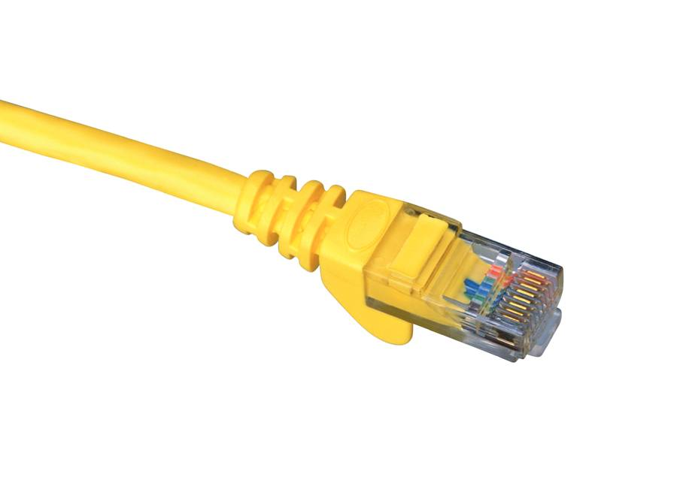
Network Basics (cont.)
RJ 45 connects computer to patch panel
A phone jack uses an RJ 11 connection
RJ 45 looks like a phone jack, but larger
RJ 45 connector
© 2016 Pearson, Inc. Chapter 2 Networks and the Internet
Notes:
Computers with hard-wired NICs are connected using cables with RJ 45 jacks.
Phone line jacks have four wires, whereas RJ 45 jacks have eight.

Slide 11
Network Basics (cont.)
The hub is the simplest connection device
  Creates a simple network
  Sends traffic out all ports (no routing or switching)
  A layer 1 device
© 2016 Pearson, Inc. Chapter 2 Networks and the Internet
Notes:
The hub is the simplest connection device.
It has four or more ports; usually RJ 45 jacks.
It creates a simple network that must remain small. It does NO filtering.
Any more than 10 ports cause too much congestion on the network.
It is a layer 1 device.
The problem with a hub is that it is an indiscriminate gossip. It tells everybody everything. Therefore, there is a lot of traffic on the hubbed network.

Slide 12
Network Basics (cont.)
The switch is a smart hub
  Sends packets only to the intended host
  A layer 2 device
© 2016 Pearson, Inc. Chapter 2 Networks and the Internet
Notes:
The switch sends packets only to the intended host, limiting traffic and freeing up bandwidth.
It can have up to 24 ports.
It is a layer 2 device.
Traffic is limited to only local traffic. No traffic that is not going to the host is allowed on the wire.

Slide 13
Network Basics (cont.)
The router is more sophisticated
Limits traffic to the intended network
A layer 3 device
© 2016 Pearson, Inc. Chapter 2 Networks and the Internet
Notes:
The router is a far more sophisticated device.
It limits traffic to the intended network.
As it connects networks, it utilizes fewer ports.
It is a layer 3 device.
The router separates networks and makes complex decisions. It is also the location for security devices such as Access Control lists, firewalls, and so forth.

Slide 14
Network Basics (cont.)
The Internet connection
Uses transmission media such as
  DSO
  ISDN
  T1 and T3
  OC3, OC12, and OC48
© 2016 Pearson, Inc. Chapter 2 Networks and the Internet
Notes:
An Internet Service Provider (ISP) uses other transmission media, such as
T1 – Most common in business and education; often shared, as in a partial T1
1.54 mbs
OC3 – Optical, fast and expensive; common in telecommunications
155 mbs

Slide 15
Network Basics (cont.)
How is data actually transmitted?
  A packet is sent.
  The packet, or datagram, consists of bytes.
  Packet is divided into header and body.
© 2016 Pearson, Inc. Chapter 2 Networks and the Internet
Notes:
How is data actually transmitted?
The OSI model calls the data and how it is handled at each layer by various names.
The packet, or datagram, is composed of changes in electrical power or levels of light or sine waves. These changes are measured and calculated to be either a 1 or a 0.
These binary digits carry information that is collected into packets.

Slide 16
Network Basics (cont.)
Packet headers tell where the packet is going.
Network devices read the headers to determine where the packet should be sent.
© 2016 Pearson, Inc. Chapter 2 Networks and the Internet
Notes:
The packets have headers that tell the various devices it meets in its travels across the network exactly where it came from and where it wants to go.
The devices, switches, routers, and NICs read the headers and make decisions based on the information in the headers.
These decisions may include NOT letting the packet through.

Slide 17
Network Basics (cont.)
Protocols
  Rules that control network and Internet communication.
  Internet Engineering Task Force (IETF) controls these rules.
  Different rules for different purposes.
© 2016 Pearson, Inc. Chapter 2 Networks and the Internet
Notes:
Protocols
The rules that control network and Internet communication.
IETF – The Internet Engineering Task Force controls these rules.
Different rules for different purposes.
The concept is similar to the various communication rules in your life. You do not communicate with your friends the same way you communicate with your parents. Different circumstances call for different behavior.

Slide 18
Network Basics (cont.)
Protocols
  Transmission Control Protocol (TCP) is connection-oriented.
  Internet Protocol (IP) is connectionless.
    Together, they guarantee a successful delivery across the Internet.
© 2016 Pearson, Inc. Chapter 2 Networks and the Internet
Notes:
TCP is the workhorse. It works hard to make a connection and guarantees error-free data.
IP just puts the address on the envelope and drops it in the mailbox.

Slide 19
Network Basics (cont.)
Protocols
  User Datagram Protocol (UDP) is connectionless.
  Internet Control Message Protocol (ICMP) is used to notify devices of trouble on the network.
© 2016 Pearson, Inc. Chapter 2 Networks and the Internet
Notes:
UDP is connectionless. UDP is great for RIP updates, clock setting, and so forth. If you miss one, there’s another coming along.
ICMP – PING, tracert, source quench, and so forth. It is used to notify devices of trouble on the network.
See Table 2.4 in the text.

Slide 20
Network Basics (cont.)
Port
  A connection point
  Not physical ports on a computer
  Used by protocols to communicate
© 2016 Pearson, Inc. Chapter 2 Networks and the Internet
Notes:
In this case, we are talking about virtual ports; not referring to serial or parallel ports or RJ 45 ports on a computer.
A port is a numeric designation for a communication pathway.
See Table 2.4 in the text. Telnet is 23, FTP is 20 and 21, DNS is 53, and so on.

Slide 21
Internet
To connect to the Internet, you log on to your Internet Service Provider (ISP).
The ISP connects to another ISP or a backbone provider.
One backbone provider connects to another at a Network Access Point (NAP).
© 2016 Pearson, Inc. Chapter 2 Networks and the Internet
Notes:
When you connect to the Internet, your computer logs on to your Internet Service Provider (ISP).
The ISP connects to another ISP or a backbone provider.
The backbone provider connects to another backbone provider at a Network Access Point (NAP).

Slide 22
Internet (cont.)
IP (Internet Protocol) Addresses
  Necessary to navigate the Internet
  It is a unique identifier, like a Social Security number
  Usually in binary form
  Consists of four octets separated by decimals
© 2016 Pearson, Inc. Chapter 2 Networks and the Internet
Notes:
Without IP addresses, no one would find their way around the Internet.
The IP address is a unique identifier, like a Social Security number.
Usually in binary form, it consists of four octets separated by decimals.
It will be helpful for you to review your knowledge of the binary number system.

Slide 23
Internet (cont.)
Public versus Private IP Addresses
  Public addresses are routable on the Internet.
  Must be leased from an ISP.
  Private addresses are not routable on the Internet.
© 2016 Pearson, Inc. Chapter 2 Networks and the Internet
Notes:
Public versus Private Internet Protocol Addresses:
Public addresses are routable on the Internet.
They must be leased from an ISP, which leases them from one of four regional Internet registries.
Private addresses are not routable on the Internet; use them only inside your private network.

Slide 24
Internet (cont.)
Network Classes
  Each octet in an IP address means something specific.
  The first octet defines the class to which the IP belongs.
© 2016 Pearson, Inc. Chapter 2 Networks and the Internet
Notes:
See Table 2.5 in the text.

Slide 25
Internet (cont.)
Availability of IP addresses
  IP addresses are not infinite.
  IPv4 will be replaced by IPv6.
  A subnet is a portion of a network that shares the same subnet address.
  Subnet masks describe what subnet the address belongs to.
  Classless Inter Domain Routing (CIDR) is a way to describe the subnet with the IP address.
© 2016 Pearson, Inc. Chapter 2 Networks and the Internet
Notes:
Availability of IP addresses:
IP addresses are not infinite; they will soon run out.
IPv4, the current addressing scheme, will be replaced by IPv6. IP addresses will be four times as long – 128 bit instead of 32 bit.
Subnetting allows for the division of a leased network address into more subnetwork addresses.
Subnet masks are used to determine to which subnet the IP address belongs.

Slide 26
Internet (cont.)
IP V6
  128-bit address
  Supports DHCP
© 2016 Pearson, Inc. Chapter 2 Networks and the Internet

Slide 27
Internet (cont.)
Uniform Resource Locators (URLs)
  The easy way to remember a Web site
  Translated by the Domain Name Server (DNS)
  Error messages can be sent by the web server
© 2016 Pearson, Inc. Chapter 2 Networks and the Internet

Slide 28
Internet (cont.)
  Error Messages
    100 series messages are informational.
    200s are not seen because they indicate success.
    300s are redirects.
    400s are client errors.
    500s are server errors.
© 2016 Pearson, Inc. Chapter 2 Networks and the Internet
Notes:
Error messages that appear when connecting to an Internet site:
100 series messages are informational.
200s are not seen because they indicate success.
300s are redirects; the site has moved and your browser is directed to the new location.
400s are client errors, or an error on your side. You may have mistyped the address, or typed an address that does not exist.
500s are server errors, or an error on the server side.

Slide 29
Basic Network Utilities
  IPConfig
  Ping
  Tracert
  Netstat
  NSLookup
© 2016 Pearson, Inc. Chapter 2 Networks and the Internet
Notes:
These are some of the basic troubleshooting and diagnostic tools used by technicians to solve network connectivity problems from the command prompt (CLI).
IPConfig
Ping
Tracert

Slide 30
Basic Network Utilities (cont.)
IPConfig can give you information about your system.
    Open the Start menu.
    Select Run.
    Enter cmd and click OK.
    At the CLI prompt, enter ipconfig.
    The output looks like Figure 2.4 (next slide).
© 2016 Pearson, Inc. Chapter 2 Networks and the Internet

Slide 31
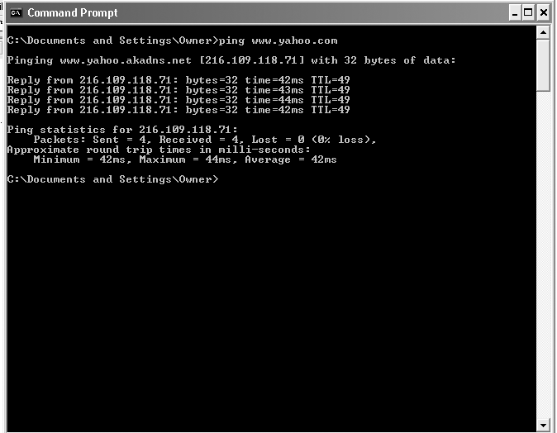
Basic Network Utilities (cont.)
IPConfig results
© 2016 Pearson, Inc. Chapter 2 Networks and the Internet

Slide 32
Basic Network Utilities (cont.)
IPConfig shows your system’s
    IP address
    Subnet mask
    Default gateway
© 2016 Pearson, Inc. Chapter 2 Networks and the Internet
Notes:
Disconnect your computer from the network, then try this again. What do you see?

Slide 33
Basic Network Utilities (cont.)
IPConfig
  Other commands to use
    Type ipconfig -?
    Other options appear.
    The most common is ipconfig/all.
© 2016 Pearson, Inc. Chapter 2 Networks and the Internet
Notes:
Try these commands. What do you see?

Slide 34
Basic Network Utilities (cont.)
Ping tells if a system is connected to the network.
  It also tells how long it takes for an “echo request” packet to arrive at the destination host.
© 2016 Pearson, Inc. Chapter 2 Networks and the Internet
Notes:
Ping will tell you whether a system is “alive” or connected to the network. Ping is used by network technicians to determine connectivity.
It is used by hackers to determine who is available.
It also tells you how long it takes for a 32-byte “echo request” packet to arrive at the destination host.
That information is carried by a 32-byte “echo reply” packet.

Slide 35
Basic Network Utilities (cont.)
Tracert
  “Ping deluxe.”
  Uses the same syntax as ping.
  Shows every “hop” between host and destination address.
  Useful tool for technicians and hackers alike.
  See Figure 2.8 on the next slide.
© 2016 Pearson, Inc. Chapter 2 Networks and the Internet
Notes:
Tracert
This command uses the same syntax as ping. It shows you every “hop” or router between your host and the destination address.
This a useful tool for technicians and hackers alike.
Each of these utilities is, in one sense, like a gun. In the hands of the police, guns are used for good. In the hands of a criminal, they are used for evil. These tools are used for information gathering by network technicians and by hackers.

Slide 36
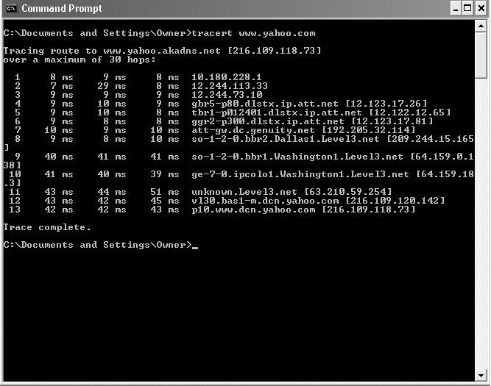
Basic Network Utilities (cont.)
Tracert
© 2016 Pearson, Inc. Chapter 2 Networks and the Internet

Slide 37
Basic Network Utilities (cont.)
Netstat
  Network status
  Shows active connections
© 2016 Pearson, Inc. Chapter 2 Networks and the Internet

Slide 38
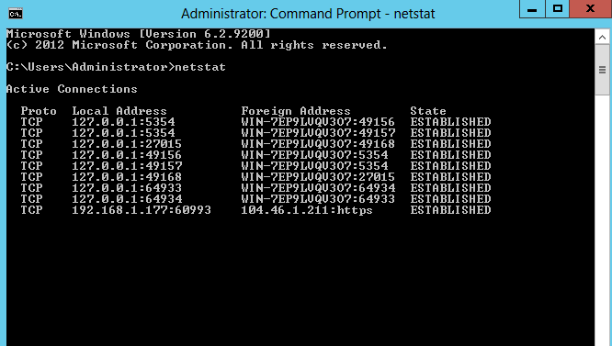
Basic Network Utilities (cont.)
netstat
© 2016 Pearson, Inc. Chapter 2 Networks and the Internet

Slide 39
Basic Network Utilities (cont.)
NsLookup
  Connect to NSServer
  Execute dns related commands
© 2016 Pearson, Inc. Chapter 2 Networks and the Internet

Slide 40
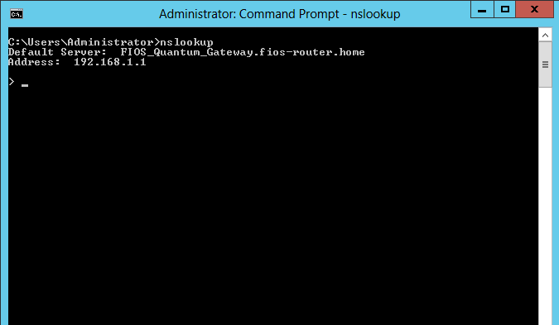
Basic Network Utilities (cont.)
nslookup
© 2016 Pearson, Inc. Chapter 2 Networks and the Internet

Slide 41
Other Network Devices
Firewalls
  Hardware or software
  Filter packets as they enter the network
  Deny unacceptable packets
Proxy servers
  Disguise the network
  Substitute their IP address for that of hosts accessing the Internet
© 2016 Pearson, Inc. Chapter 2 Networks and the Internet
Notes:
Firewalls can use different techniques to protect the network, but packet filtering is the most common.
A proxy server and a firewall are basic network security devices. It would be negligent to run a network without them.

Slide 42
Summary
You should now understand
  The structure of networks and the Internet
  How networks work
  The uses of some network utilities and devices
This chapter is a basic tour of networks; review it before continuing if the material is new to you.
© 2016 Pearson, Inc. Chapter 2 Networks and the Internet

