Slide 1
Systems Analysis and Design 10th Edition
Chapter 10 – System Architecture

Slide 2
Chapter Objectives
Provide a checklist of issues to consider when selecting a system architecture
Trace the evolution of system architecture from mainframes to current designs
Explain client/server architecture, including tiers, cost-benefit issues, and performance
Compare in-house e-commerce development with packaged

Slide 3
Chapter Objectives (Cont.)
Discuss the impact of cloud computing and Web 2.0
Define network topology, including hierarchical, bus, ring, star, and mesh models
Describe wireless networking, including wireless standards, topologies, and trends
Describe the system design specification

Slide 4
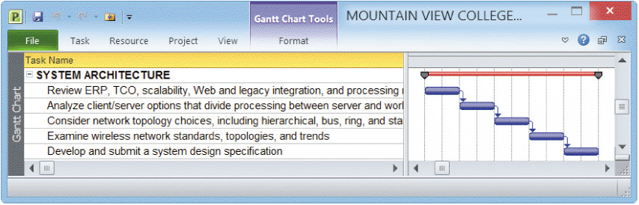
Architecture Checklist
Corporate organization and culture
Enterprise resource planning (ERP)
Initial and total cost of ownership (TCO)
Scalability
Web integration
Legacy system interface requirements
Processing options
Security issues
Corporate portals
FIGURE 10-1 Typical system architecture tasks

Slide 5
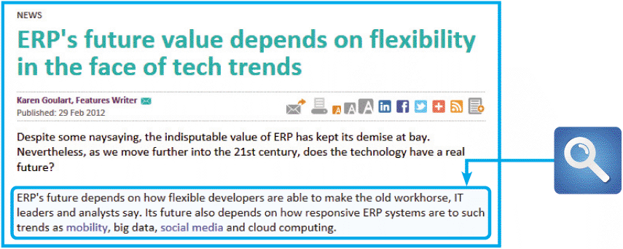
Architecture Checklist (Cont.)
Corporate organization and culture
An information system must perform well in a company’s organization and culture
Enterprise resource planning (ERP)
Establish a company-wide strategy for using IT that includes a specific architecture, standards for data, processing, network, and user interface design
FIGURE 10-2 Is ERP outdated, or will it still be around? Author Karen Goulart says that ERP’s future success depends on integrating new technology, such as mobility and cloud computing

Slide 6
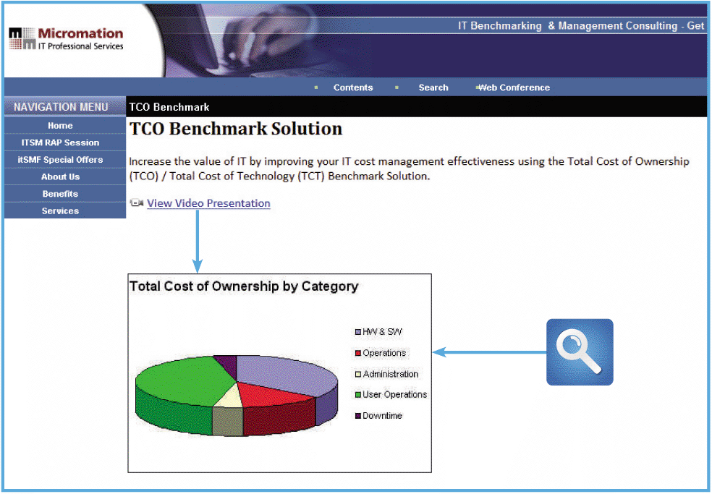
Architecture Checklist (Cont.)
Initial Cost and TCO
TCO includes tangible purchases, fees, and contracts called hard costs
FIGURE 10-4 The Micromation site suggests that soft costs are very significant, but are more difficult to measure

Slide 7
Architecture Checklist (Cont.)
Scalability
A system’s ability to expand, change, or downsize easily to meet the changing needs of a business enterprise
Web Integration
Will the application be part of an e-commerce strategy and what is the degree of integration with other Web-based components
Legacy Systems
A new system might have to interface with one or more legacy systems, which are older systems that use outdated technology, but still are functional

Slide 8
Architecture Checklist (Cont.)
Processing Options
Will the system process data online or in batches?
Security Issues
Security threats and defenses are a major concern to a systems analyst
Corporate Portals
Provide access for customers, employees, suppliers, and the public
A well-designed portal can integrate with various other systems and provide a consistent look and feel

Slide 9
System Architecture: Then and Now
Every business information system must carry out three main functions:
Manage applications that perform the processing logic
Handle data storage and access.
Provide an interface that allows users to interact with the system

Slide 10
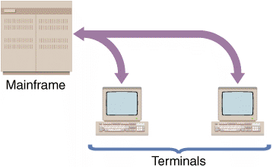
System Architecture: Then and Now (Cont.)
Mainframe Architecture
A server is a computer that supplies data, processing services, or other support to one or more computers, called clients
The earliest servers were mainframe computers, and a system design where the server performs all the processing sometimes is described as mainframe architecture
FIGURE 10-6 In a centralized design, the remote user’s keystrokes are transmitted to
the mainframe, which responds by sending screen output back to the user’s screen

Slide 11
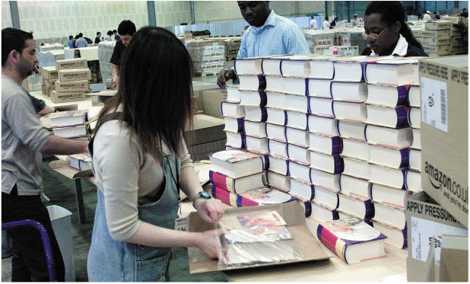
System Architecture: Then and Now (Cont.)
Impact of the Personal Computer
Stand-alone computing: Users can run their own word processing, spreadsheet, and database applications without assistance from the IT group
Companies then linked the stand-alone computers into networks that enabled the user clients to exchange data and perform local processing
FIGURE 10-7 Internet-based retail operations such as Amazon.com use customer service centers to fulfill online sales

Slide 12
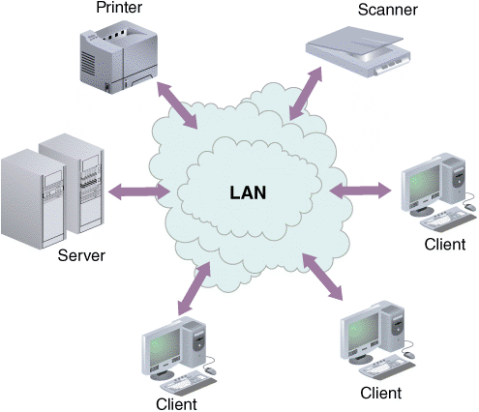
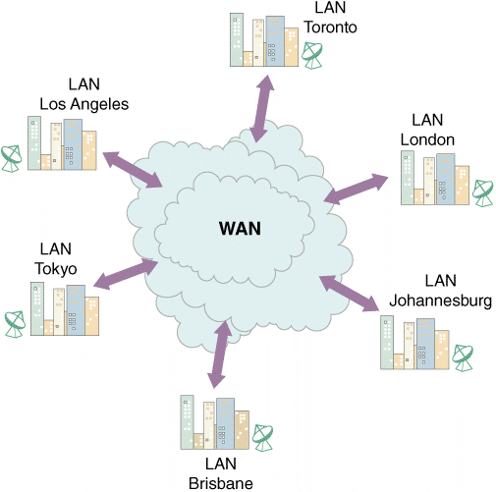
System Architecture: Then and Now (Cont.)
Network Evolution
A local area network (LAN) allows sharing of data and hardware resources
A wide area network (WAN) spans long distances and can connect LANs that are continents apart
FIGURE 10-8 A LAN allows sharing of data and hardware,
such as printers and scanners
FIGURE 10-9 A WAN can connect many LANs and link users who are continents apart

Slide 13
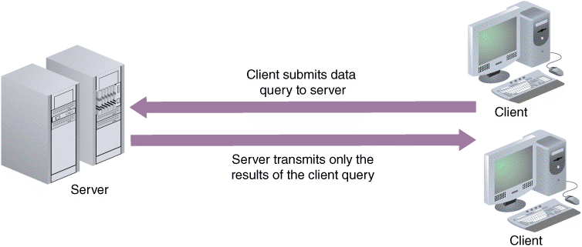
Client/Server Designs
Client/server architecture generally refers to systems that divide processing between one or more networked clients and a central server
The client handles the entire user interface, including data entry, data query, and screen presentation logic
The server stores the data and provides data access and database management functions
FIGURE 10-10 In a client/server design, data is stored and usually processed on the server

Slide 14
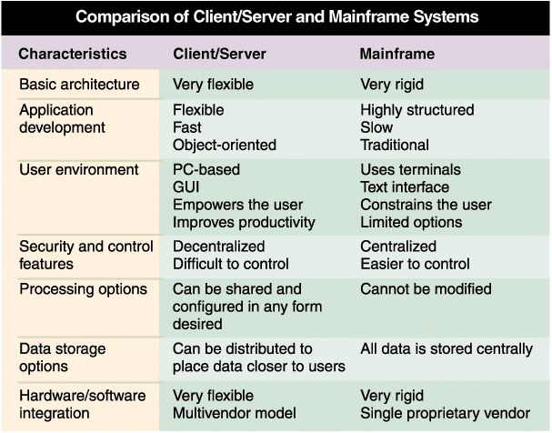
Client/Server Designs (Cont.)
FIGURE 10-11 Comparison of the characteristics of client/server and mainframe systems

Slide 15
Client/Server Designs (Cont.)
The Client’s Role
Client/server relationship must specify how the processing will be divided between the client and the server
A fat client, also called a thick client, design locates all or most of the application processing logic at the client
A thin client design locates all or most of the processing logic at the server
Thin client designs provide better performance because program code resides on the server, near the data
A fat client handles more of the processing and must access and update the data more often

Slide 16
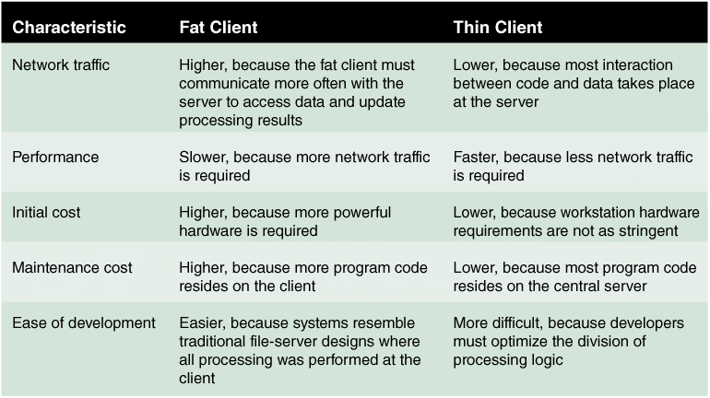
Client/Server Designs (Cont.)
FIGURE 10-12 Characteristics of fat and thin clients

Slide 17
Client/Server Designs (Cont.)
Client/Server Tiers
In a two-tier design, the user interface resides on the client, all data resides on the server, and the application logic can run either on the server or on the client, or be divided between the client and the server
In a three-tier design, the user interface runs on the client and the data is stored on the server but a middle layer between the client and server processes the client requests and translates them into data access commands that can be understood and carried out by the server

Slide 18
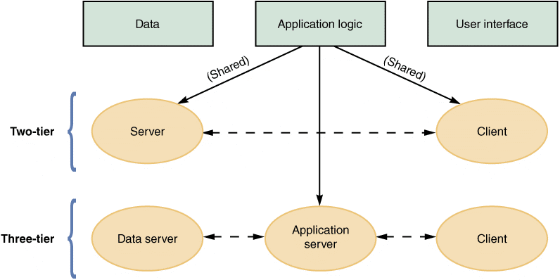
Client/Server Designs (Cont.)
FIGURE 10-13 Characteristics of two-tier versus three-tier client/server design

Slide 19
Client/Server Designs (Cont.)
Middleware
Middleware offers an interface to connect software and hardware
Middleware can integrate legacy systems and Web-based applications
Middleware is like glue that holds different applications together
Middleware represents the slash in the term client/server.
Middleware resembles the plumbing system in your home: it connects important objects in a way that requires little or attention

Slide 20
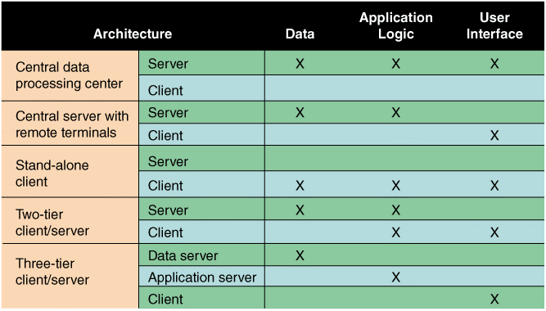
Client/Server Designs (Cont.)
FIGURE 10-14 The location of the data, the application logic, and the user interface depend on the type of architecture

Slide 21
Client/Server Designs (Cont.)
Cost-Benefit Issues
To support business requirements, information systems need to be scalable, powerful, and flexible
For most companies, client/server systems offer the best combination of features to meet those needs
Performance Issues
IBM states that the performance characteristics of a client/server system are not the same as a centralized processing environment
Client/server response times increase gradually as more requests are made, but then rise dramatically when the system nears its capacity - called the knee of the curve, because it marks a sharp decline in the system’s speed and efficiency

Slide 22
The Impact of the Internet
In an Internet-based architecture, in addition to data and application logic, the entire user interface is provided by the Web server in the form of HTML documents that are displayed by the client’s browser
Shifting the responsibility for the interface from the client to the server simplifies data transmission and results in lower hardware cost and complexity

Slide 23
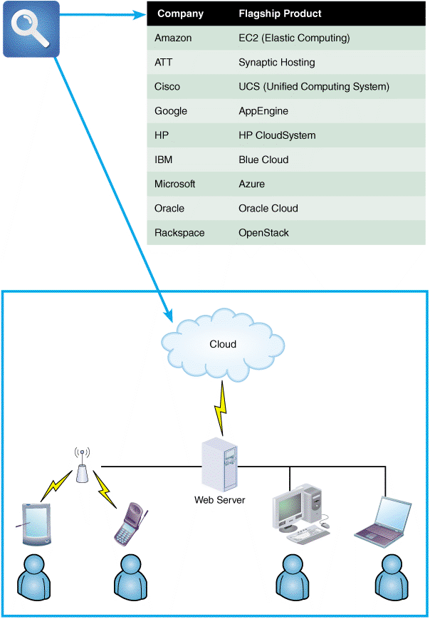
The Impact of the Internet (Cont.)
Cloud Computing
Cloud computing refers to the cloud symbol that often is used to represent the Internet
The cloud computing concept envisions a cloud of remote computers that provide a total online software and data environment that is hosted by third parties
Cloud computing requires significantly more bandwidth (the amount of data that can be transferred in a fixed time period) than traditional client/server networks
FIGURE 10-16 The explosive growth of cloud computing has attracted many firms that fight hard for market share

Slide 24
The Impact of the Internet (Cont.)
Web 2.0
Not a reference to a more technically advanced version of the current Web
Envisions a second generation of the Web that will enable people to collaborate, interact, and share information more dynamically
Applications will deliver software as a continuous service with no limitations on the number of users that can connect or how users can consume, modify, and exchange data
Goal is to enhance creativity, interaction, and shared ideas

Slide 25
E-Commerce Architecture
In-House Solutions
A unique Web site, with a look and feel consistent with the company’s other marketing efforts
Complete control over the organization of the site, the number of pages, and the size of the files
A scalable structure to handle increases in sales and product offerings in the future
More flexibility to modify and manage the site as the company changes
The opportunity to integrate the firm’s Web-based business systems with its other information systems, creating the potential for more savings and better customer service

Slide 26
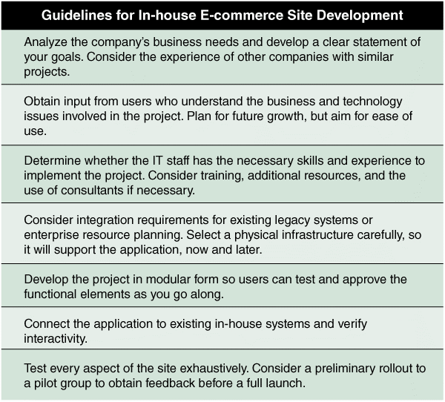
E-Commerce Architecture (Cont.)
FIGURE 10-17 Guidelines for companies developing e-commerce strategies

Slide 27
E-Commerce Architecture (Cont.)
Packaged Solutions
Many vendors, including Microsoft and Intershop, offer turnkey systems for companies that want to get an e-business up and running quickly
Service Providers
Many ASPs offer full-scale Internet business services for companies that decide to outsource those functions

Slide 28
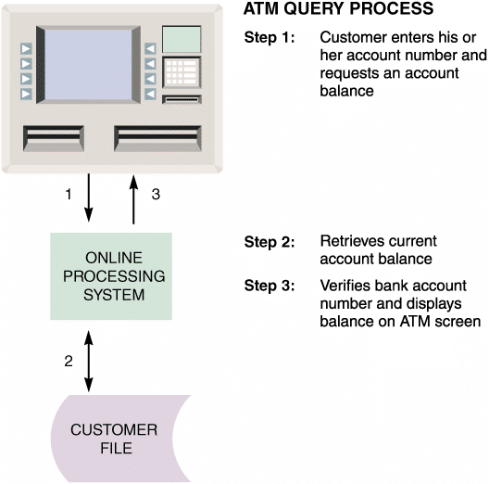
Processing Methods (Cont.)
FIGURE 10-20 When a customer requests a balance, the ATM
system verifies the account number, submits the query, retrieves the
current balance, and displays the balance on the ATM screen

Slide 29
Processing Methods (Cont.)
Batch Processing: Still With Us After All These Years
Batch processing means that data is managed in groups, or batches
An acceptable choice in the 1960s, and for most firms, it was the only choice
Tasks can be planned and run on a predetermined schedule, without user involvement
Batch programs that require major network resources can run at times when costs, and impact on other traffic, will be lowest
A batch method is well-suited to address security, audit, and privacy concerns, because it runs in a relatively controlled environment

Slide 30
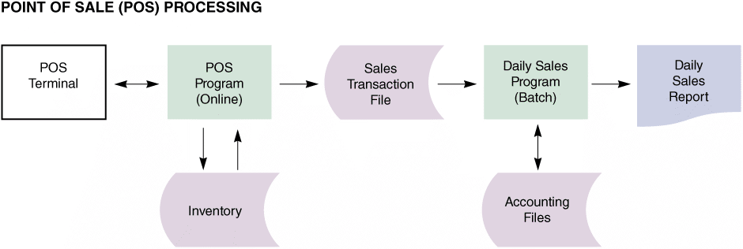
Processing Methods (Cont.)
Real-World Examples
Point of Sale (POS) Terminals
FIGURE 10-22 Many retailers use a combination of online and batch processing. When a salesperson enters the sale on the POS terminal, the online system retrieves data from the item file, updates the quantity in stock, and produces a sales transaction record. At the end of the day, a batch processing program produces a daily sales report and updates the
accounting system

Slide 31
Network Models
The OSI Model
Open Systems Interconnection (OSI) model describes how data moves from an application on one computer to an application on another networked computer
Provides physical design standards that assure seamless network connectivity, regardless of the specific hardware environment

Slide 32
Network Models (Cont.)
Network Topology
Topology can refer to a physical or a logical view of the network
Physical topology describes the actual network cabling and connections
Logical topology describes the way the components interact
Hierarchical Network
Departmental servers control lower levels of processing and network devices
Bus Network
A single communication path connects the central server, departmental servers, workstations, and peripheral devices
Information is transmitted in either direction between networked devices, and all messages travel over the same central bus

Slide 33
Network Models (Cont.)
Ring Network
Still exist but somewhat outdated
Resembles a circle where the data flows in only one direction from one device to the next
Star Network
By far the most popular LAN topology today
Has a central networking device called a switch, which manages the network and acts as a communications conduit for all network traffic
Mesh Network
Each node connects to every other node
Extremely reliable but very expensive to install and maintain

Slide 34
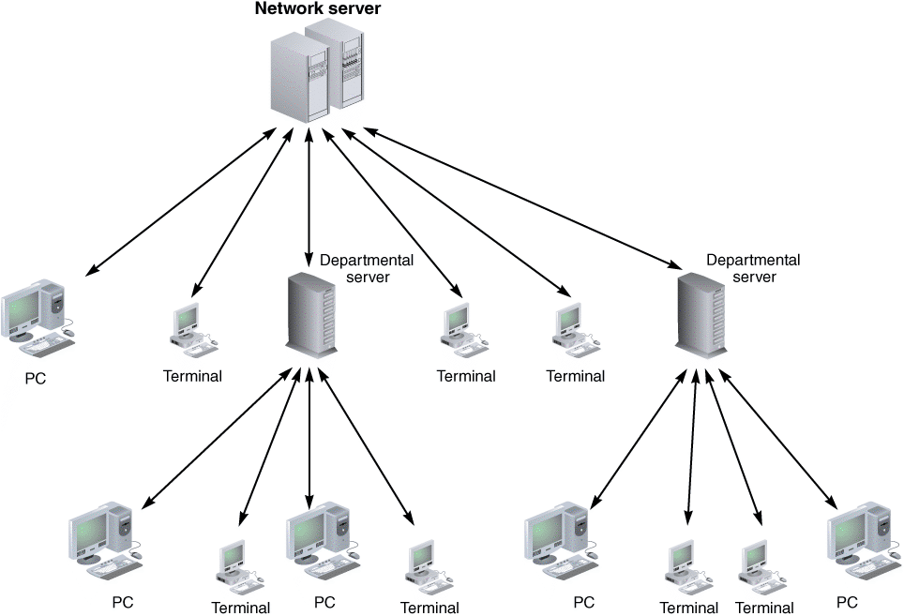
Network Models (Cont.)
FIGURE 10-24 A hierarchical network with a single server that controls the network

Slide 35
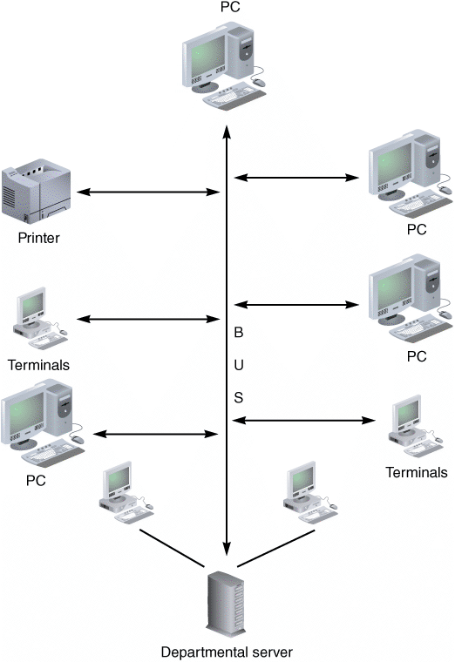
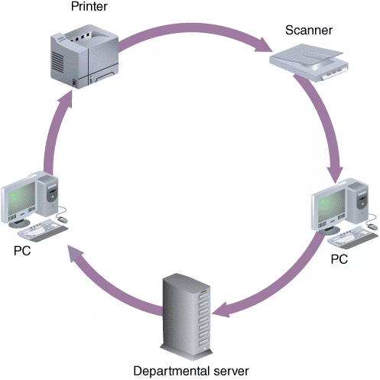
Network Models (Cont.)
FIGURE 10-25 A bus network with all devices connected to a single communication path
FIGURE 10-26 A ring network with a set of computers that send and receive data flowing in one direction

Slide 36
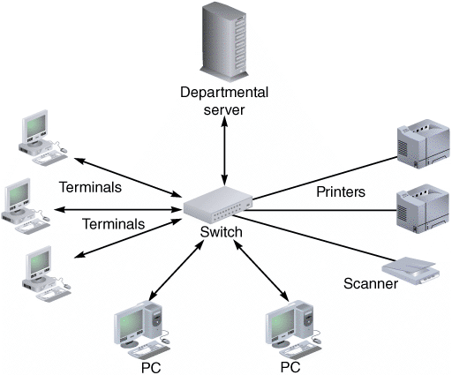
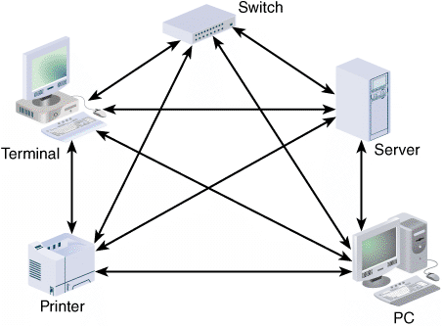
Network Models (Cont.)
FIGURE 10-27 A typical star network with a switch, departmental server, and connected workstations
FIGURE 10-28 Mesh networks are used in situations where a high degree of redundancy is needed, such as military applications. The redundant design provides alternate data paths, but is expensive to install and maintain

Slide 37
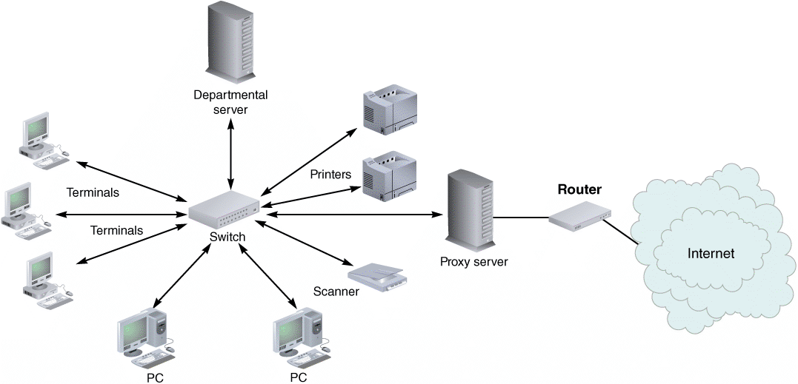
Network Models (Cont.)
FIGURE 10-29 Routers can be used to connect LANs and WANs to other networks, such as the Internet

Slide 38
Network Models (Cont.)
Network Devices
Networks such as LANs or WANs can be interconnected using devices called routers
A router is a device that connects network segments, determines the most efficient data path, and guides the flow of data
Modeling Tools
Microsoft Visio, which is a multipurpose drawing tool, is used to represent the physical structure and network components
Visio offers a wide variety of drawing types, styles, and downloadable templates

Slide 39
Wireless Networks
Wireless Network Standards
Most popular is IEEE 802.11 - a family of standards developed by the Institute of Electrical and Electronics Engineers (IEEE) for wireless LANs
802.11g offered increased bandwidth and was widely accepted by the IT industry
802.11n uses multiple input/multiple output (MIMO) technology to boost performance
MIMO relies on multiple data paths, also called multipath design, to increase and width and range
Latest proposed standards, 802.11ac and 802.11ad, are currently being tested

Slide 40
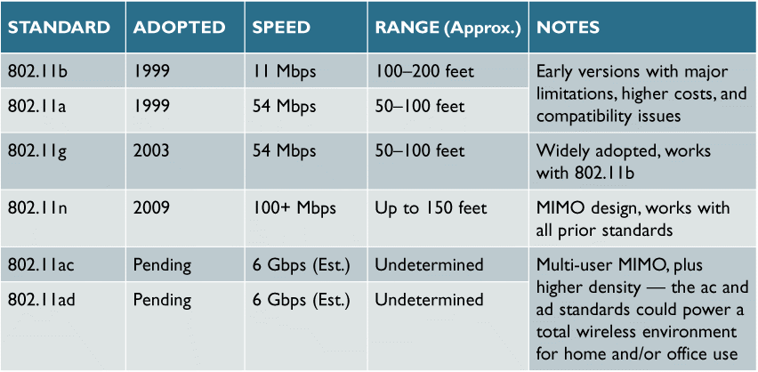
Wireless Networks(Cont.)
FIGURE 10-31 IEEE Wi-Fi standards and characteristics

Slide 41
Wireless Networks (Cont.)
Wireless Network Topologies
Two most common network topologies available for IEEE 802.11 WLANs are the Basic Service Set and the Extended Service Set
The Basic Service Set (BSS), also called the infrastructure mode has a central wireless device called an access point or wireless access point (WAP) to serve all wireless clients
The Extended Service Set (ESS) is made up of two or more Basic Service Set networks
Using an ESS topology, wireless access can be expanded over a larger area

Slide 42
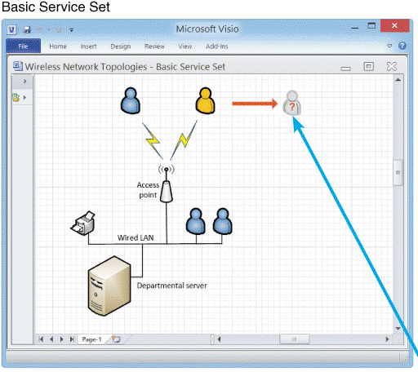
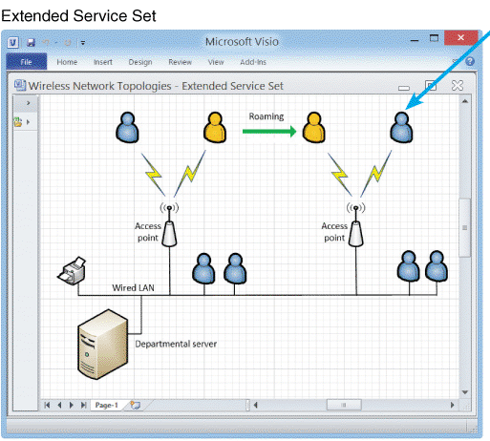
Wireless Networks(Cont.)
FIGURE 10-22 Notice that the user in the left screen has moved out of the BSS coverage area, and cannot communicate. In the right screen, the user roams into another ESS coverage area, and the transition is seamless

Slide 43
System Design Completion
System architecture marks the end of the systems design phase of the SDLC
Final activities in the systems design phase are:
Preparing a system design specification
Obtaining user approval
Delivering a presentation to management

Slide 44
System Design Completion (Cont.)
System Design Specification
A document that presents the complete design for the new information system, along with detailed costs, staffing, and scheduling for completing the next SDLC phase — systems implementation
A typical system design specification typically includes the following sections

Slide 45
System Design Completion (Cont.)
1. Management Summary
A brief overview of the project for company managers and executives
Outlines the development efforts to date, provides a current status report, summarizes project costs, reviews the benefits of the new system, presents the systems implementation schedule, and highlights any issues that management will need to address
2. System Components
Contains the complete design for the new system, including the user interface, outputs, inputs, files, databases, and network specifications.
Includes source documents, report and screen layouts, DFDs, and all other relevant documentation.
Also includes the requirements for backup and recovery, start-up processing, and file retention and any interface information required between the package and the system being developed
3. System Environment
Describes the constraints, or conditions, affecting the system, including any requirements that involve operations, hardware, systems software, or security

Slide 46
System Design Completion (Cont.)
4. Implementation Requirements
Specifies start-up processing, initial data entry or acquisition, user training requirements, and software test plans
5. Time and Cost Estimates
Provides detailed schedules, cost estimates, and staffing requirements for the systems development phase and revised projections for the remainder of the SDLC as well as total costs-to-date for the project and compare those costs with your prior estimates
6. Additional Material
Other material can be included at the end of the system design specification such as documents from earlier phases if they would be helpful to readers

Slide 47
System Design Completion (Cont.)
User Approval
Users must review and approve the interface design, report and menu designs, data entry screens, source documents, and other areas of the system that affect them
Ensures that you do not have a major task of obtaining approvals at the end
Keeps the users involved with the system’s development
Gives you feedback about whether or not you are on target

Slide 48
System Design Completion (Cont.)
Presentations
Give you an opportunity to explain the system, answer questions, consider comments, and secure final approval
The first presentation is technically oriented - to the systems analysts, programmers, and technical support staff members who will be involved in future project phases or operational support for the system
Next presentation is to department managers and users from departments affected by the system
Final presentation is delivered to management

Slide 49
Chapter Summary
An information system combines hardware, software, data, procedures, and people into a system architecture
Before selecting an architecture, the analyst must consider enterprise resource planning, initial cost and TCO, scalability, Web integration, legacy interface requirements, processing options, security issues, and corporate portals

Slide 50
Chapter Summary (Cont.)
Enterprise resource planning (ERP) establishes an enterprise-wide strategy for IT resources and specific standards for data, processing, network, and user interface design
An architecture requires servers and clients. Servers are computers that supply data, processing services, or other support to one or more computers called clients
Client/server architecture divides processing between one or more clients and a central server

Slide 51
Chapter Summary (Cont.)
A fat, or thick, client design places all or most of the application processing logic at the client
A thin client design places all or most of the processing logic at the server
Client/server designs can be two-tier or three-tier
The Internet has had an enormous impact on system architecture

Slide 52
Chapter Summary (Cont.)
The most prevalent processing method today is online processing
Networks allow the sharing of hardware, software, and data resources in order to reduce expenses and provide more capability to users
The way a network is configured is called the network topology
The system design specification presents the complete systems design for an information system and is the basis for the presentations that complete the systems design phase

