Slide 1
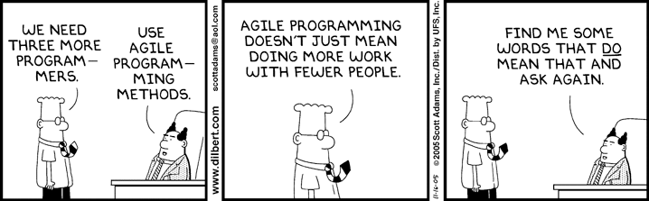
Systems Analysis and Design 10th Edition
Chapter 11 – Managing Systems Implementation

Slide 2
Chapter Objectives
Explain the importance of software quality assurance and software engineering
Describe application development using structured, object-oriented, and agile methods
Draw a structure chart showing top-down design, modular design, cohesion, and coupling
Explain the coding process
Explain unit, integration, and system testing
Differentiate between program, system, operations, and user documentation

Slide 3
Chapter Objectives (Cont.)
List the main steps in system installation and evaluation
Develop training plans for various user groups, compare in-house and vendor training options, and describe effective training techniques
Describe data conversion and changeover methods
Explain post-implementation evaluation and the final report to management

Slide 4
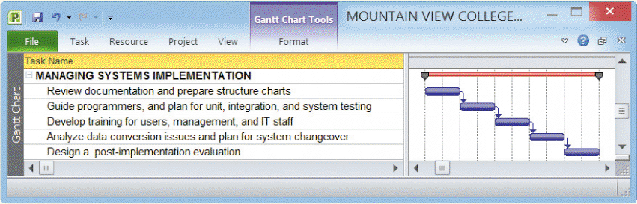
Software Quality Assurance
Companies are intensely concerned with the quality of their products and services
Main objective of quality assurance is to avoid problems or to identify them as soon as possible
Poor quality can result from inaccurate requirements, design problems, coding errors, faulty documentation, and ineffective testing
FIGURE 11-1 Typical systems implementation task list

Slide 5
Software Quality Assurance (Cont.)
Software Engineering
A software development process that stresses solid design, accurate documentation, and careful testing
Software Engineering Institute (SEI) at Carnegie Melon University
Designed software development standards used successfully by thousands of organizations around the globe
The Capability Maturity Model (CMM)® improves software quality, reduces development time, and cuts costs
New model integrates software and systems development into a much larger framework called process improvement
Capability Maturity Model Integration (CMMI®)

Slide 6
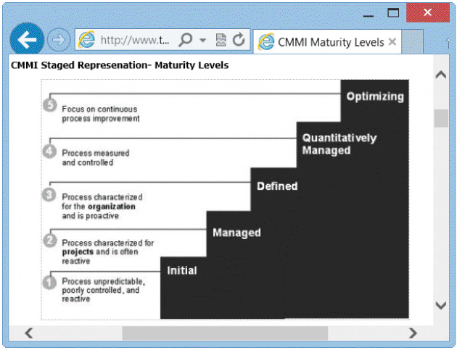
Software Quality Assurance (Cont.)
CMMI
The CMMI® tracks an organization’s processes, using five maturity levels, from Level 1, which is referred to as unpredictable, poorly controlled, and reactive, to Level 5, in which the optimal result is process improvement
FIGURE 11-3 The CMMI® includes five maturity levels, from Level 1, which is referred to as unpredictable, poorly controlled, and reactive, to Level 5, in which the optimal result is process improvement

Slide 7
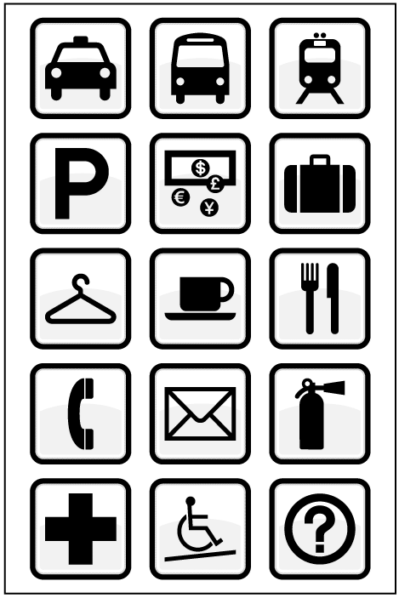
Software Quality Assurance (Cont.)
International Organization for Standardization (ISO)
A worldwide body that establishes quality standards for products and services
ISO standards include everything from internationally recognized symbols to the ISBN numbering system that identifies this textbook
FIGURE 11-5 ISO standards include internationally recognized symbols

Slide 8
Overview of Application Development
Application development is the process of constructing the programs and code modules that serve as the building blocks of the information system
Structured analysis, object-oriented (O-O) analysis, and agile methods are three popular development options
The objective is to translate the design into program and code modules that will function properly

Slide 9
Overview of Application Development (Cont.)
Review the System Design
Requirements modeling
Functional decomposition diagrams (FDDs)
Structured data and process modeling
Data flow diagrams (DFDs)
Case diagrams
Class diagrams
Sequence diagrams
State transition diagrams
Activity diagrams
Development strategy
User interface
Entity-relationship diagrams (ERDs)
Overall system architecture

Slide 10
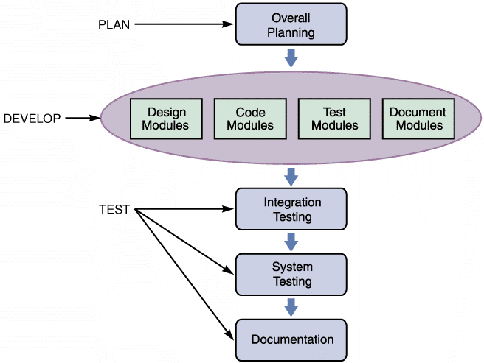
Overview of Application Development (Cont.)
Application Development Tasks
Traditional Method is to develop an overall strategy design, code and test and document individual modules
A module consists of related program code organized into small units that are easy to understand and maintain
FIGURE 11-6 The main steps in application development

Slide 11
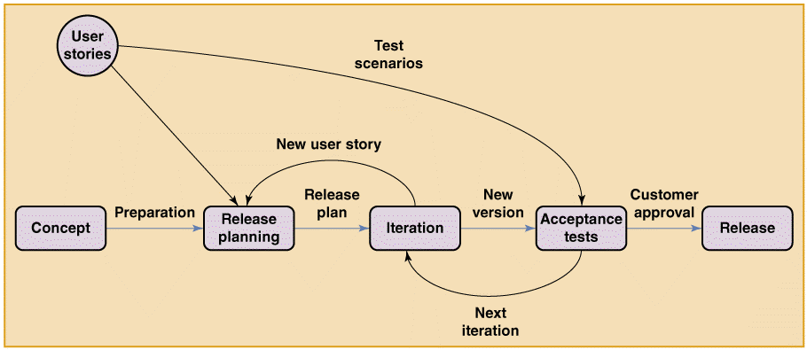
Overview of Application Development (Cont.)
Application Development Tasks (Cont.)
Agile Method creates a system through an iterative process of planning, designing, coding, and testing
Examples include the Spiral model and the Extreme Programming(XP) model
FIGURE 11-7 Simplified model of an Extreme Programming (XP) project. Note the emphasis on iteration and testing

Slide 12
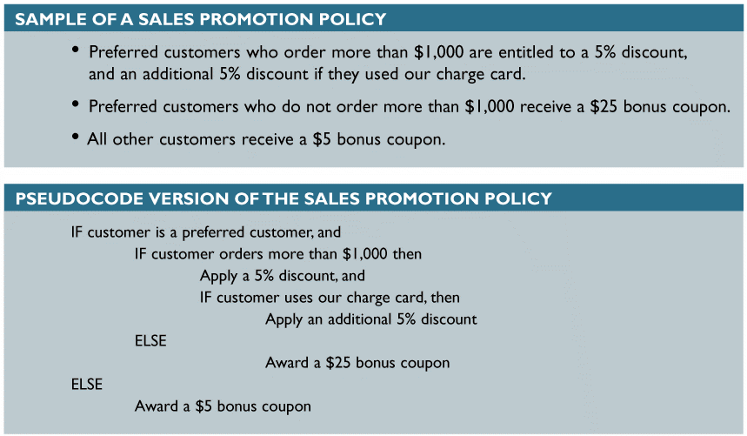
Overview of Application Development (Cont.)
System Development Tools
ENTITY-RELATIONSHIP DIAGRAMS
Shows the interaction among system entities and objects
FLOWCHARTS
Logical rules and interaction graphically, using a series of symbols connected by arrows
PSEUDOCODE
Combination of English and computer code
FIGURE 11-8 Sample of a sales promotion policy with logical rules, and a pseudocode version of the policy. Notice the alignment and indentation of the logic statements

Slide 13
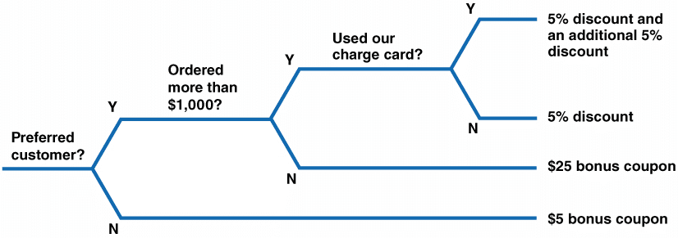
Overview of Application Development (Cont.)
System Development Tools (Cont.)
DECISION TABLES AND DECISION TREES
Used to model business logic for an information system
Project Management
Structured development techniques and tools are used along with object-oriented and agile development methods
FIGURE 11-9 Sample decision tree that reflects the sales promotion policy in Figure 11-8. Like a decision table, a decision tree shows the action to be taken based on certain conditions

Slide 14
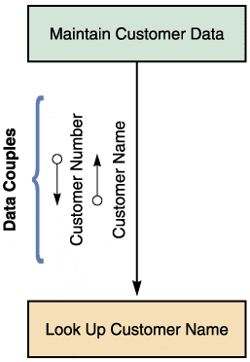
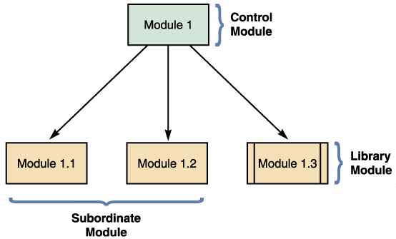
Structured Application Development
Structure Charts
Structure charts show the program modules and the relationships among them
FIGURE 11-10 An example of structure chart modules
FIGURE 11-11 An example of a structure chart data

Slide 15
Structured Application Development (Cont.)
MODULE
A rectangle represents a module
Vertical lines at the edges of a rectangle indicate that a module is a library module - reusable code and can be invoked from more than one point in the chart
DATA COUPLE
An arrow with an empty circle represents a data couple which shows data that one module passes to another
CONTROL COUPLE
An arrow with a filled circle represents a control couple which shows a message, also called a status flag, which one module sends to another

Slide 16
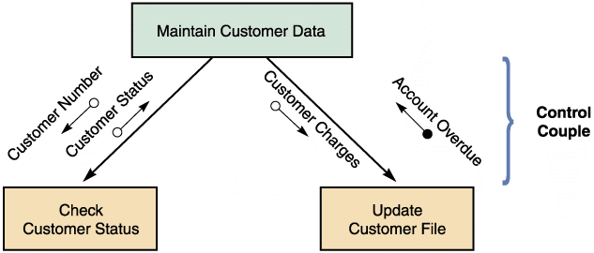
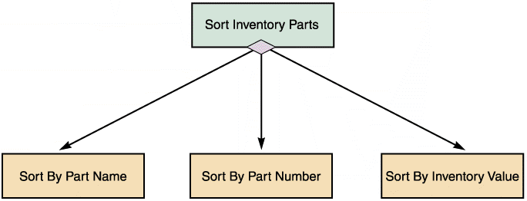
Structured Application Development (Cont.)
CONDITION
A line with a diamond on one end represents a condition which indicates that a control module determines which subordinate modules will be invoked, depending on a specific condition
FIGURE 11-12 An example of a structure chart control couple
FIGURE 11-13 The diagram shows a control module that triggers three subordinate modules

Slide 17
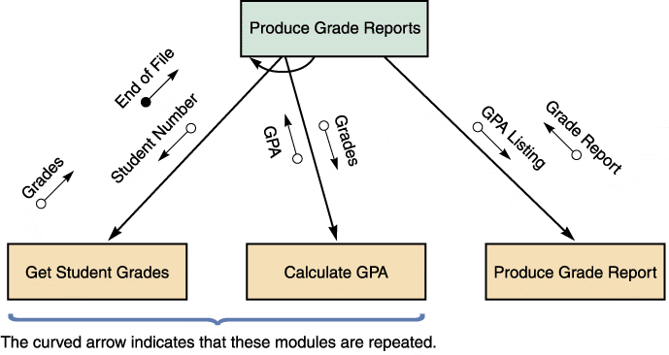
Structured Application Development (Cont.)
LOOP
A curved arrow represents a loop which indicates that one or more modules are repeated
FIGURE 11-13 The diagram shows a control module that triggers three subordinate modules

Slide 18
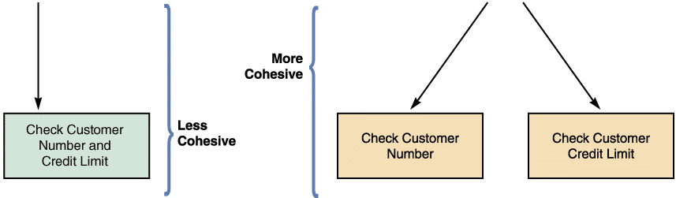
Structured Application Development (Cont.)
Cohesion and Coupling
Cohesion measures a module’s scope and processing characteristics
A module that performs a single function or task has a high degree of cohesion, which is desirable because it focuses on a single task and is much easier to code and reuse
FIGURE 11-15 Two examples of cohesion. Notice that the single module on the left is less cohesive than the two modules on the right

Slide 19
Structured Application Development (Cont.)
Cohesion and Coupling
Coupling describes the degree of interdependence among modules
Modules that are independent are loosely coupled, which is desirable
Loosely coupled modules are easier to maintain and modify, because the logic in one module does not affect other modules
Tightly coupled modules have one module linked to internal logic contained in another module

Slide 20
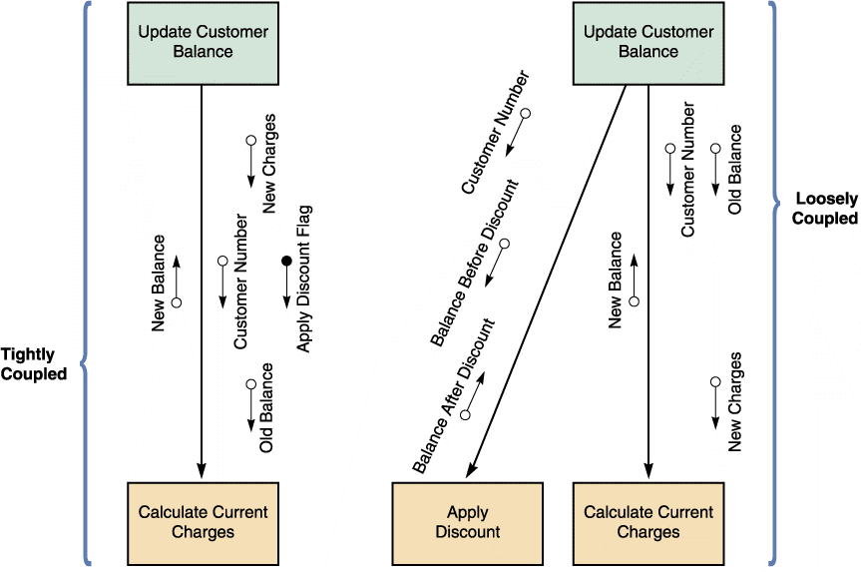
Structured Application Development (Cont.)
FIGURE 11-16 An example of tightly coupled and loosely coupled structure charts

Slide 21
Structured Application Development (Cont.)
Drawing a Structure Chart
Follow four steps when to create a structure chart
Review DFDs to identify the processes and methods
Identify the program modules and determine control-subordinate relationships
Add symbols for couples and loops
Analyze the structure chart and Data Dictionary to ensure that it is consistent with your system documentation

Slide 22
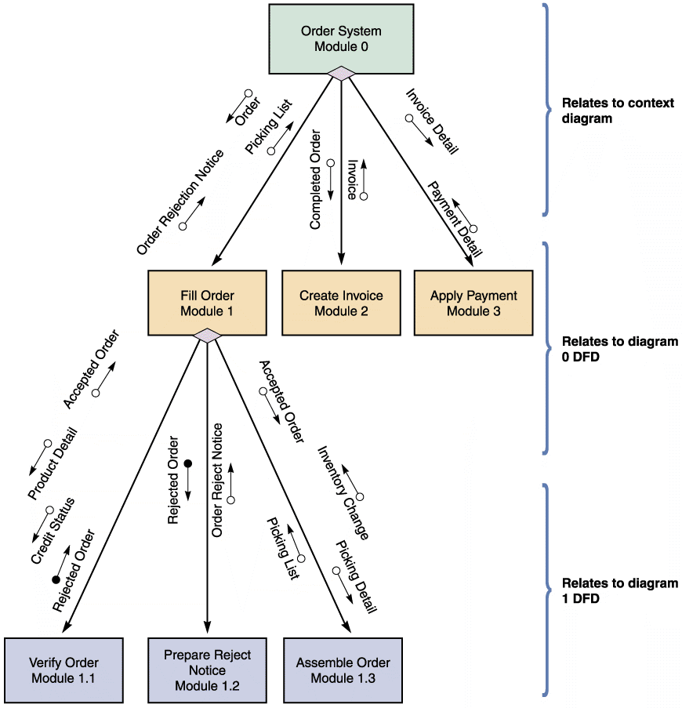
Structured Application Development (Cont.)
FIGURE 11-17 A structure chart based on the order system DFDs on pages 196–198. The three-level structure chart relates to the three DFD levels

Slide 23
Object-Oriented Application Development
Characteristics of Object-Oriented Application Development
Individual object instances belong to classes of objects with similar characteristics
The relationship and interaction among classes are described using a class diagram
Class diagrams describe the characteristics of objects in the class, and the methods, which represent program logic

Slide 24
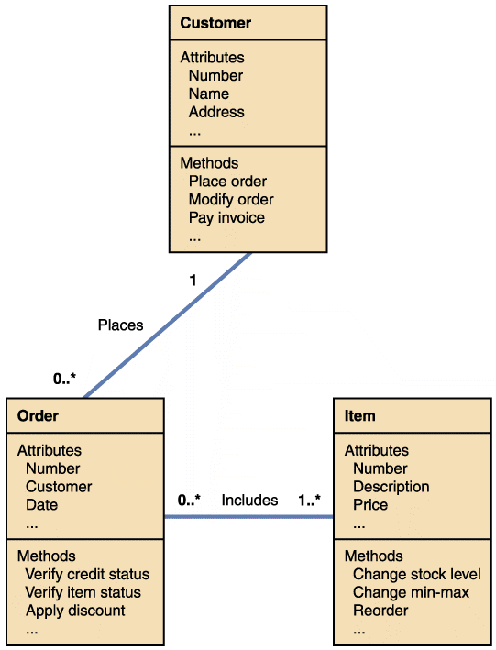
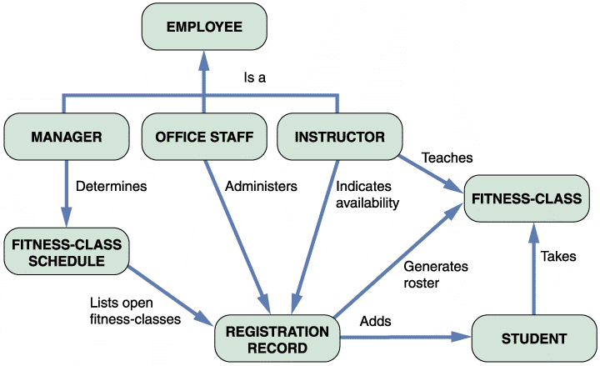
Object-Oriented Application Development(Cont.)
FIGURE 11-19 An object-relationship diagram for a fitness center
FIGURE 11-18 A simplified class diagram for a customer order processing system

Slide 25
Object-Oriented Application Development(Cont.)
Implementation of Object-Oriented Designs
Main objective is to translate object methods into program code modules and determine what event or message will trigger the execution of each module
Programmers analyze sequence diagrams and state transition diagrams that show the events and messages that trigger changes to an object
Object-Oriented Cohesion and Coupling
Classes should be as loosely coupled (independent of other classes) as possible
An object’s methods also should be loosely coupled (independent of other methods) and highly cohesive (perform closely related actions)

Slide 26
Agile Application Development
Uses a highly iterative process
Development team is in constant communication with the primary user, shaping and forming the system to match specifications
Agile development is aptly named because it is
based on a quick and nimble development process that easily adapts to change
Agile development focuses on small teams, intense communication, and rapid development iterations

Slide 27
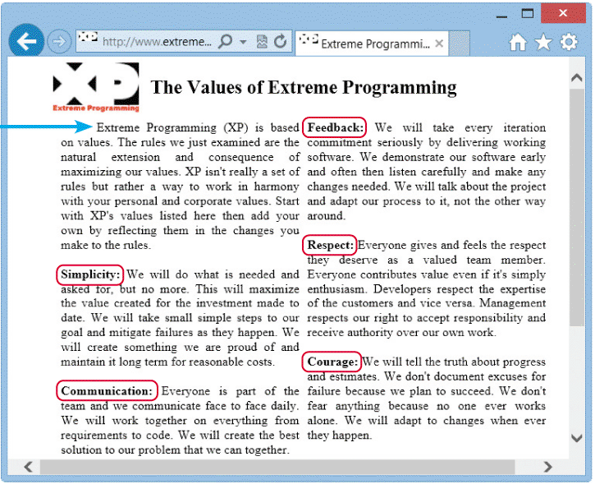
Agile Application Development (Cont.)
FIGURE 11-21 Extreme programming relies on the core values shown here. Notice that users are invited to start with these values, and add their own

Slide 28
Agile Application Development (Cont.)
An Extreme Programming (XP) Example
The first step in the XP process, like any other development method, would be to define the system requirements
The customer begins by meeting with programmers and providing user stories (short, simple requirements definition)
Programmers review user stories to determine the project’s requirements, priorities, and scope
User stories do not deal with technical details and are so short that they are often written on index cards

Slide 29
Agile Application Development (Cont.)
An Extreme Programming (XP) Example (Cont.)
Programming team regularly meets with the customer, who tests prototype releases as they become available
Extreme Programming uses parallel programming where two programmers work on the same task on the same computer
One drives (programs) while the other navigates (watches)
The onlooker examines the code strategically to see the forest while the driver is concerned with the individual trees immediately in front of him or her

Slide 30
Agile Application Development (Cont.)
The Future of Agile Development
Agile methodology is becoming very popular for software projects
Supporters boast that it speeds up software development and delivers precisely what the customer wants, when the customer wants it, while fostering teamwork and empowering employees
Critics claim it lacks discipline and produces systems of questionable quality and may not work as well for larger projects because of their complexity and the lack of focus on a well-defined end product

Slide 31
Coding
Programming Environments
Visual Basic, Python, Ruby, and SQL are examples of commonly used programming languages
Internet-based applications use HTML/XML, Java, and other Web-centric languages
An integrated development environment (IDE) makes it easier to program interactive software products by providing built-in tools and advanced features, such as real-time error detection, syntax hints, highlighted code, class browsers, and version control
Generating Code
Application generators, report writers, screen generators, and fourth-generation languages exist

Slide 32
Testing The System
Each program must tested to make sure it functions correctly
Desk checking
Groups of three to five IT staff members participate in code review
Objective is to have a peer group identify errors, apply quality standards, and verify that the program meets the requirements of the system design specification

Slide 33
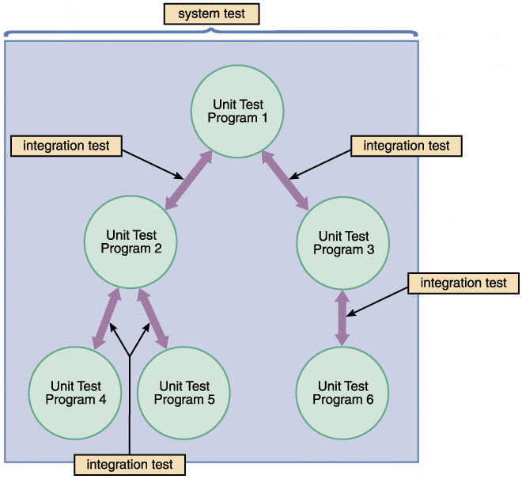
Testing The System(Cont.)
Unit Testing
The testing of an individual program or module
Objective is to identify and eliminate execution errors that could cause the program to terminate abnormally, and logic errors that could have been missed during desk checking
FIGURE 11-22 The first step in testing is unit testing, followed by integration testing, and then system testing

Slide 34
Testing The System(Cont.)
Unit Testing (Cont.)
Test data should contain both correct data and erroneous data and should test all possible situations that could occur
Programs that interact with other programs and files are tested individually, before they are integrated into the system
Someone other than the programmer who wrote the program usually creates the test data and reviews the results
Integration Testing
Testing two or more programs that depend on each other to make sure that the programs work together properly

Slide 35
Testing The System(Cont.)
System Testing
Perform a final test of all programs
Verify that the system will handle valid and invalid data properly
Ensure that the IT staff has the documentation and instructions needed to operate the system properly and that backup and restart capabilities of the system are adequate Demonstrate that users can interact with the system successfully
Verify that all system components are integrated properly and that actual processing situations will be handled correctly
Confirm that the information system can handle predicted volumes of data in a timely and efficient manner

Slide 36
Documentation
Program Documentation
Program documentation describes the inputs, outputs, and processing logic for all program modules
Process starts in the systems analysis phase and continues during systems implementation
Systems analysts prepare overall documentation, such as process descriptions and report layouts, early in the SDLC
This documentation guides programmers, who construct modules that are well supported by internal and external comments and descriptions that can be understood and maintained easily

Slide 37
Documentation (Cont.)
System Documentation
Describes the system’s functions and how they are implemented
Includes data dictionary entries, data flow diagrams, object models, screen layouts, source documents, and the systems request that initiated the project
Operations Documentation
Operations documentation contains all the information needed for processing and distributing online and printed output
User Documentation
Consists of instructions and information to users who will interact with the system and includes user manuals, Help screens, and tutorials

Slide 38
Documentation (Cont.)
User Documentation (Cont.)
A system overview that clearly describes all major system features, capabilities, and limitations
Description of source document content, preparation, processing, and samples
Overview of menu and data entry screen options, contents, and processing instructions
Examples of reports that are produced regularly or available at the user’s request, including samples
Security and audit trail information
Explanation of responsibility for specific input, output, or processing requirements
Procedures for requesting changes and reporting problems
Examples of exceptions and error situations
Frequently asked questions (FAQs)
Explanation of how to get help and procedures for updating the user manual

Slide 39
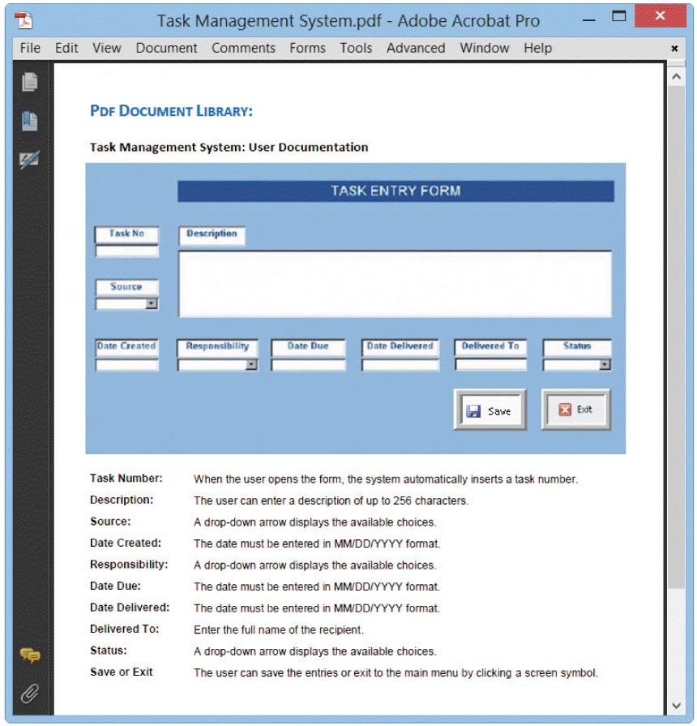
Documentation (Cont.)
FIGURE 11-27 A sample page from a user manual. The instructions explain how to add a new task to the system

Slide 40
Management Approval
After system testing is complete, you present the results to management
You should describe the test results, update the status of all required documentation, and summarize input from users who participated in system testing
You also must provide detailed time schedules, cost estimates, and staffing requirements for making the system fully operational

Slide 41
System Installation and Evaluation
Prepare a separate operational and test environment
Provide training for users, managers, and IT staff
Perform data conversion and system changeover
Carry out a post-implementation evaluation of the system
Present a final report to management

Slide 42
Operational and Test Environments
The environment for the actual system operation is called the operational environment or production environment
The environment that analysts and programmers use to develop and maintain programs is called the test environment
A separate test environment is necessary to maintain system security and integrity and protect the operational environment

Slide 43
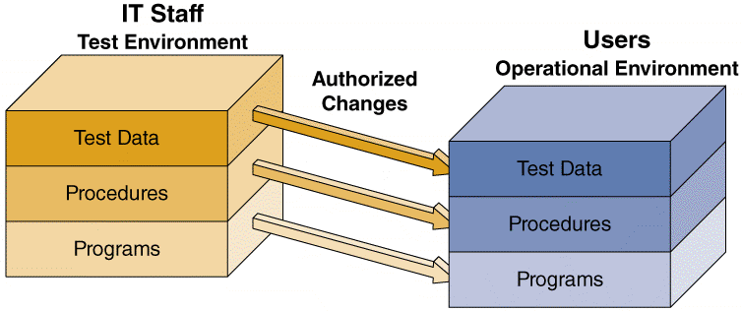
Operational and Test Environments (Cont.)
Access to the operational environment is limited to users and must strictly be
controlled
FIGURE 11-28 The test environment versus the operational environment. Notice that access to the test environment is limited to IT staff, while the operational environment is
restricted to users

Slide 44
Training
Training Plan
Essential to provide the right training for the right people at the right time
The first step is to identify who should receive training and what training is needed
Look carefully at the organization, how the system will support business operations, and who will be involved or affected

Slide 45
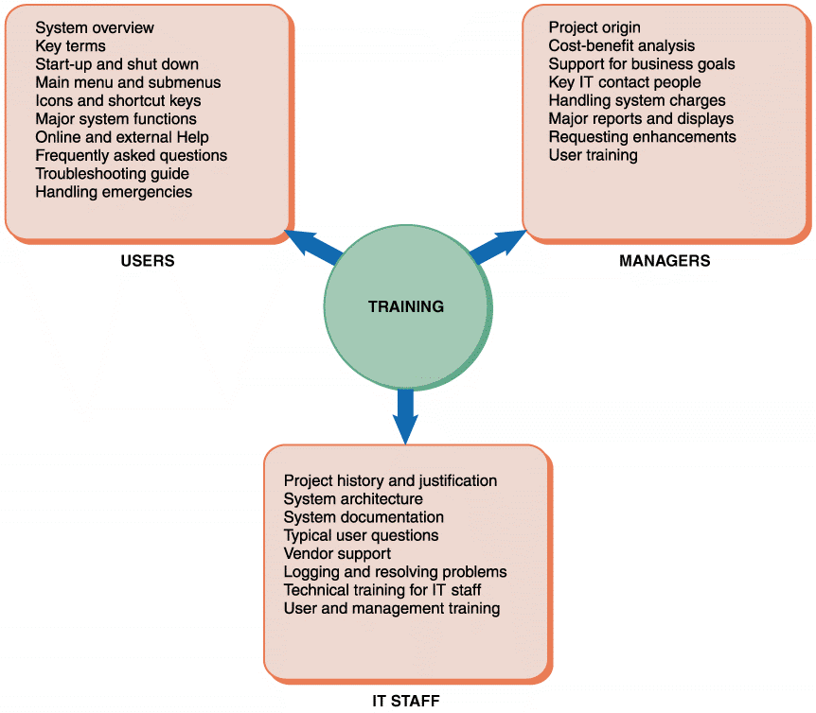
Training ( Cont.)
FIGURE 11-30 Examples of training topics for three different groups. Users, managers, and IT staff members have different training needs

Slide 46
Training (Cont.)
Vendor Training
If the system includes the purchase of software or hardware, then vendor-supplied training is one of the features you should include in the RFPs (requests for proposal) and RFQs (requests for quotation) that you send to potential vendors
Webinars, Podcasts, and Tutorials
Many vendors offer Web-based training options, including Webinars, podcasts, and tutorials
A Webinar (web and seminar) is an Internet-based training session that provides an interactive experience
A pre-recorded Webinar can be delivered as a Webcast – a one-way transmission, whenever a user wants support
Outside Training
Many training consultants, institutes, and firms are available that provide either standardized or customized training packages

Slide 47
Training (Cont.)
Training Tips
The IT staff and user departments often share responsibility for developing and conducting training programs
Train people in groups, with separate training programs for distinct groups
Select the most effective place to conduct the training.
Provide for learning by hearing, seeing, and doing
Rely on previous trainees
Interactive Training
Most people prefer hands-on training
Less-expensive methods can be used, including training manuals, printed handouts, and online materials

Slide 48
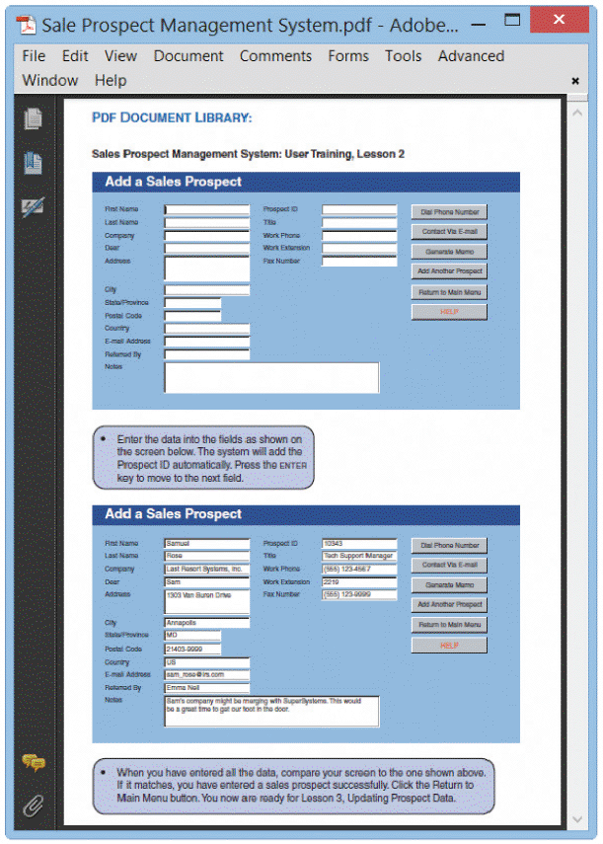
Training (Cont.)
ONLINE TRAINING
Regardless of the instructional method, training lessons should include step-by-step instructions for using the features of the information system
Training materials should resemble actual screens, and tasks should be typical of a user’s daily work — the more realistic, the better
FIGURE 11-33 A sample lesson in an online tutorial

Slide 49
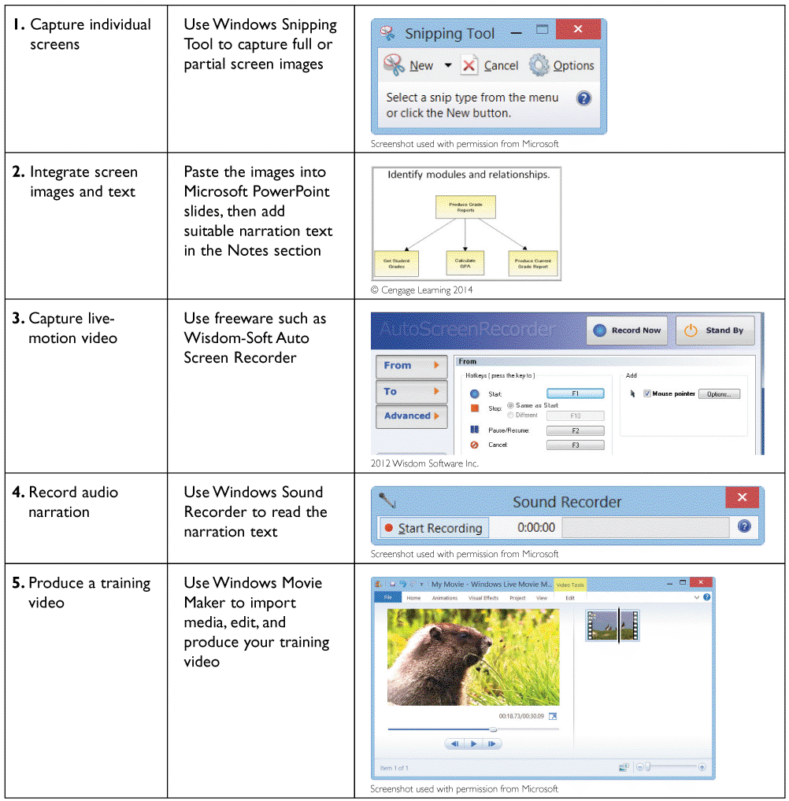
Training (Cont.)
VIDEO TUTORIALS
The Video Learning Sessions for this textbook were initially created as classroom teaching tools
Later, they were polished, edited, and transformed into streaming videos
FIGURE 11-34 You can use free software such as Windows Snipping Tool for image capture, Wisdom-Soft Auto Screen Recorder for live-motion video, and Windows Sound Recorder for audio narration. After you create the media, you can import the material into Windows Live Movie Maker

Slide 50
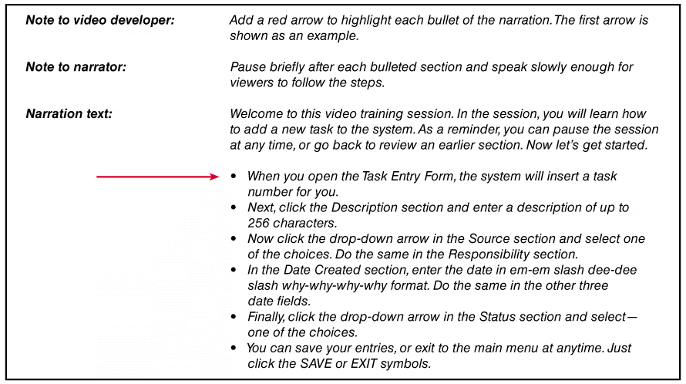
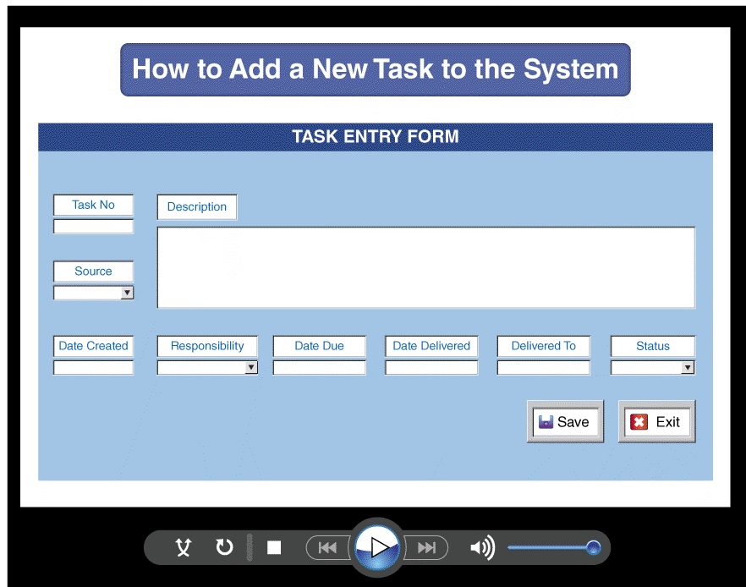
Training (Cont.)
FIGURE 11-35 A sample video tutorial might include images, narration text, and notes to the video developer and narrator

Slide 51
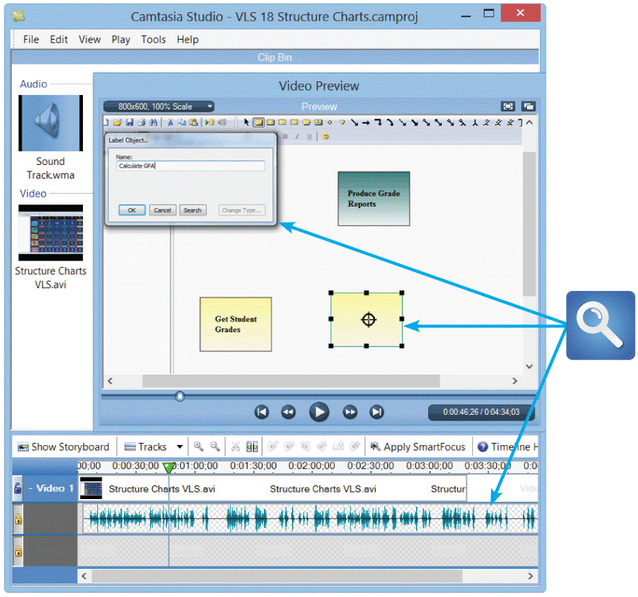
Training (Cont.)
FIGURE 11-36 Camtasia is a moderately-priced video editing tool that can produce professional-quality
training videos. In this example, a live video clip explains how to create a structure chart using the Visible Analyst® CASE tool. Notice the narration track at the bottom, which shows the sound waves that were recorded

Slide 52
Data Conversion
Data Conversion Strategies
When a new system replaces an existing system, you should automate the data conversion process
The old system might be capable of exporting data in an acceptable format for the new system r
ODBC. ODBC (Open Database Connectivity) is an industry-standard protocol that allows DBMSs from various vendors to interact and exchange data
Middleware connects dissimilar applications and enables them to communicate

Slide 53
Data Conversion (Cont.)
Data Conversion Security and Controls
Maintain strict input controls during the conversion process
Ensure that all system control measures are in place and operational to protect data from unauthorized access and to help prevent erroneous input

Slide 54
System Changeover
System changeover is the process of putting the new information system online and retiring the old system
Changeover can be rapid or slow, depending on the method
The four changeover methods are:
Direct cutover
Parallel operation
Pilot operation
Phased operation

Slide 55
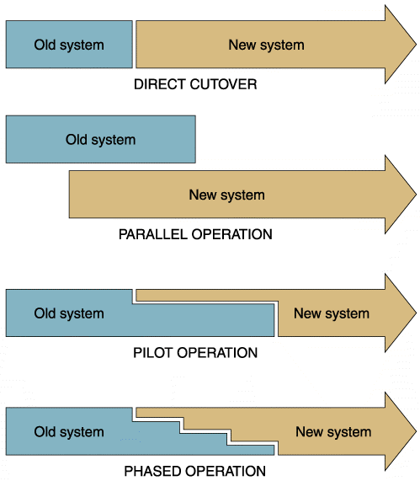
System Changeover (Cont.)
Direct Cutover
Causes the changeover from the old system to the new system to occur immediately when the new system becomes operational
Usually is the least expensive changeover method because the IT group has to operate and maintain only one system at a time
FIGURE 11-37 The four system changeover methods

Slide 56
System Changeover (Cont.)
Parallel Operation
Requires that both the old and the new information systems operate fully for a specified period
Obvious advantage of parallel operation is lower risk
Company can use the old system as a backup
Most costly changeover method
FIGURE 11-37 The four system changeover methods

Slide 57
System Changeover (Cont.)
Pilot Operation
Implementing the complete new system at a selected location of the company
The old system continues to operate for the entire organization, including the pilot site
Restricting the implementation to a pilot site reduces the risk of system failure
Less expensive than a parallel operation for the entire company
FIGURE 11-37 The four system changeover methods

Slide 58
System Changeover (Cont.)
Phased Operation
Implement the new system in stages, or modules
Combines direct cutover and parallel operation to reduce risks and costs
Give a part of the system to all users, while pilot operation
provides the entire system, but to only some users
Risk of errors or failures is limited to the implemented module only
Less expensive than full parallel operation because you have to work with only one part of the system at a time
FIGURE 11-37 The four system changeover methods

Slide 59
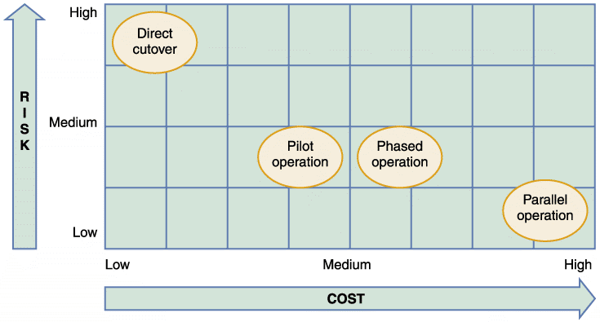
System Changeover (Cont.)
FIGURE 11-38 Relative risk and cost characteristics of the four changeover methods

Slide 60
Post Implementation Tasks
Post-Implementation Evaluation
A post-implementation evaluation assesses the overall quality of the information system
Accuracy, completeness, and timeliness of information system output
User satisfaction
System reliability and maintainability
Adequacy of system controls and security measures
Hardware efficiency and platform performance
Effectiveness of database implementation
Performance of the IT team
Completeness and quality of documentation

Slide 61
Post Implementation Tasks (Cont.)
Quality and effectiveness of training
Accuracy of cost-benefit estimates and development schedules
When evaluating a system, you should:
Interview members of management and key users
Observe users and computer operations personnel actually working with the new information system
Read all documentation and training materials
Examine all source documents, output reports, and screen displays
Use questionnaires to gather information and opinions from a large number of users
Analyze maintenance and help desk logs

Slide 62
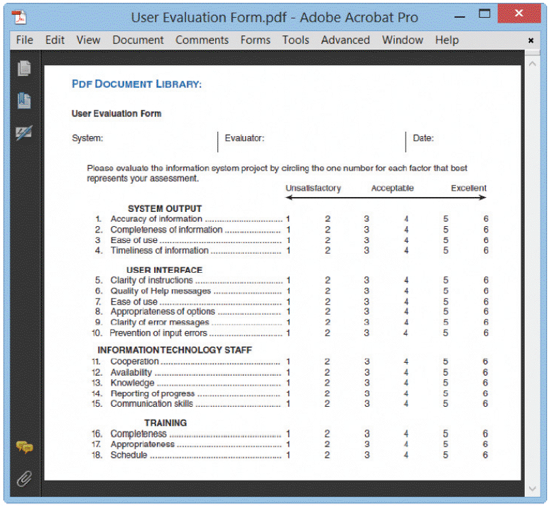
Post Implementation Tasks (Cont.)
FIGURE 11-39 Sample user evaluation form. The numerical scale allows easy tabulation of
results. Following this section, the form provides space for open-ended comments and suggestions

Slide 63
System Design Completion (Cont.)
Final Report to Management
At the end of each SDLC phase, you submit a report to management
This report should include the following:
Final versions of all system documentation
Planned modifications and enhancements to the system that have been identified
Recap of all systems development costs and schedules
Comparison of actual costs and schedules to the original estimates
Post-implementation evaluation, if it has been performed

Slide 64
Chapter Summary
The systems implementation phase consists of application development, testing, installation, and evaluation of the new system
Structured development relies heavily on DFDs and structure charts
System developers also can use more generic tools to help them translate the system logic into properly functioning program modules
These tools include entity-relationship diagrams, flowcharts, pseudocode, decision tables, and decision trees

Slide 65
Chapter Summary (Cont.)
In agile development the customer creates user stories describing required features and priority levels
Cohesion measures a module’s scope and processing characteristics
Coupling measures relationships and interdependence among modules
The four steps to creating a structure chart are review DFDs and object models to identify the processes and methods, identify the program modules and determine control-subordinate relationships, add symbols for couples and loops, and analyze the structure chart

Slide 66
Chapter Summary (Cont.)
Programmers perform desk checking, code review, and unit testing tasks during application development
In addition to system documentation, analysts and technical writers also prepare operations documentation and user documentation
During the installation process, you establish an operational, or production, environment for the new information system that is completely separate from the test environment

Slide 67
Chapter Summary (Cont.)
Everyone who interacts with the new information system should receive training appropriate to his or her role and skills
Data conversion often is necessary when installing a new information system
System changeover is the process of putting the new system into operation. Four changeover methods exist: direct cutover, parallel operation, pilot operation, and phased operation

Slide 68
Chapter Summary (Cont.)
A post-implementation evaluation assesses and reports on the quality of the new system and the work done by the project team
The final report to management includes the final system documentation, describes any future system enhancements that already have been identified, and details the project costs

