Slide 1
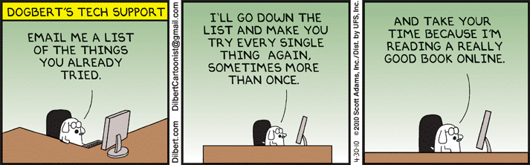
Systems Analysis and Design 10th Edition
Chapter 12 – Managing Systems Support and Security

Slide 2
Chapter Objectives
Explain the systems support and security phase
Describe user support activities, including user training and service desks
Define the four types of maintenance
Explain various techniques for managing systems maintenance and support
Describe techniques for measuring, managing, and planning system performance
Explain risk management concepts

Slide 3
Chapter Objectives (Cont.)
Assess system security at six levels: physical security, network security, application security, file security, user security, and procedural security
Describe backup and disaster recovery
List factors indicating that a system has reached the end of its useful life
Assess future challenges and opportunities for IT professionals
Develop a strategic plan for career advancement and strong IT credentials

Slide 4
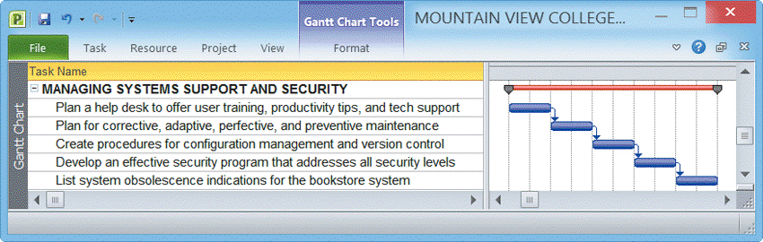
Overview
The systems support and security phase begins when a system becomes operational and continues until the system reaches the end of its useful life
After delivering the system, the IT team focuses on support and maintenance tasks
FIGURE 12-1 Typical systems support and security task list

Slide 5
User Support
User Training
New employees must be trained on the company’s information systems
IT Department may develop a user training package
Training users about system changes is similar to initial training
Objective is to show users how the system can help them perform their jobs

Slide 6
User Support (Cont.)
Service Desks (Help Desk)
Enhance productivity and improve utilization of a company’s information resources
The help desk is a central contact point for all IT maintenance activities
Three main objectives:
Show people how to use system resources more effectively
Provide answers to technical or operational questions
Make users more productive by teaching them how to meet their own information needs

Slide 7

User Support (Cont.)
Service Desks (Cont.)
Show a user how to create a query or report
Resolve network access or password problems
Demonstrate an advanced feature of a system
Help a user recover damaged data
Offer tips for better operation
Explain an undocumented software feature
Show a user how to use Web conferencing
Explain how to access the company’s intranet
Assist a user in developing a simple database
Answer questions about software licensing and upgrades
FIGURE 12-3 A service desk, also called a help desk or an information
center, provides support to system users, so that users hopefully will not have
the experience shown in the Dilbert® example on page 503

Slide 8
User Support (Cont.)
Service Desks (Cont.)
Provide information about system specifications and the cost of new hardware or software
Recommend a system solution that integrates data from different locations to solve a business problem
Provide hardware support by installing or reconfiguring devices such as scanners, printers, network cards, wireless devices, optical drives, backup devices, and multimedia systems
Show users how to maintain data consistency and integrity among a desktop computer, a notebook computer, and a handheld computer or smartphone
Troubleshoot software issues via remote control utilities

Slide 9
User Support (Cont.)
Outsourcing Issues
Offshore call centers can trim expenses and free up valuable human resources for product development
Critical factors might include phone wait times, support staff performance, and online support tools

Slide 10
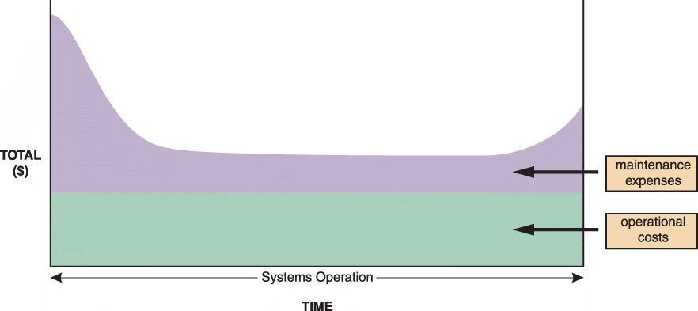
Maintenance Tasks
FIGURE 12-4 The total cost of operating an information system includes operational and maintenance costs. Operational costs (green) are relatively constant, while maintenance costs (purple) vary over time

Slide 11
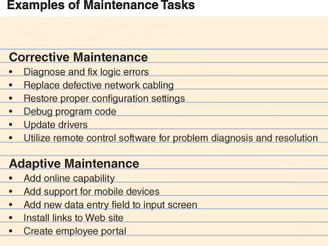
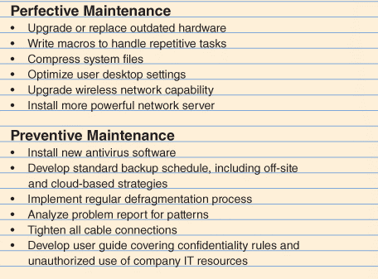
Maintenance Tasks (Cont.)
FIGURE 12-5 Corrective maintenance fixes errors and problems. Adaptive maintenance provides enhancements to a system. Perfective maintenance improves a system’s efficiency, reliability, or maintainability. Preventive maintenance avoids future problems

Slide 12
Maintenance Tasks (Cont.)
Corrective Maintenance
Diagnoses and corrects errors in an operational system
Respond to errors in various ways, depending on nature
Worst-case situation is a system failure
When the system is operational again, the maintenance team determines the cause, analyzes the problem, and designs a permanent solution

Slide 13
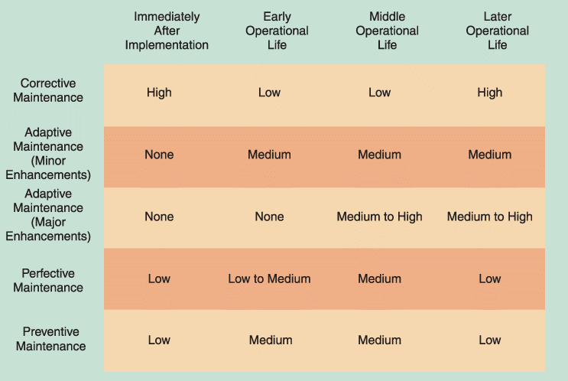
Maintenance Tasks (Cont.)
FIGURE 12-6 Information systems maintenance depends on the type of maintenance and the age of the system

Slide 14
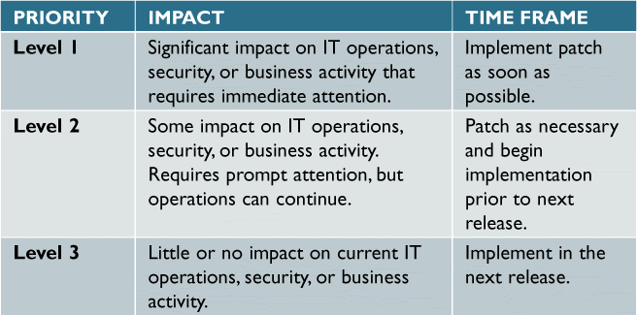
Maintenance Tasks (Cont.)
Adaptive Maintenance
Adds enhancements to an operational system and makes the system easier to use
The procedure for minor adaptive maintenance is similar to routine corrective maintenance
Can be more difficult than new systems development because the enhancements must work within the constraints of an existing system
FIGURE 12-7 This three-level ranking framework for IT support considers potential impact and response urgency

Slide 15
Maintenance Tasks (Cont.)
Perfective Maintenance
Involves changing an operational system to make it more efficient, reliable and maintainable
Cost-effective during the middle of the system’s operational life
Programs that need a large number of maintenance changes usually are good candidates for reengineering
The more a program changes, the more likely it is to become inefficient and difficult to maintain

Slide 16
Maintenance Tasks (Cont.)
Preventive Maintenance
Requires analysis of areas where trouble is likely to occur
IT department normally initiates preventive maintenance
Often results in increased user satisfaction, decreased downtime, and reduced TCO
Sometimes does not receive the high priority that it deserves

Slide 17
Maintenance Management
The Maintenance Team
System administrator
Manages computer and network systems
Systems analysts
Investigate and rapidly locate the source of a problem by using analysis and synthesis skills
Programmers
Applications programmers work on new systems development and maintenance
Systems programmers concentrate on operating system software and utilities
Database programmers focus on creating and supporting large-scale database systems
Organizational issues
Maintenance team vs. new systems development team

Slide 18
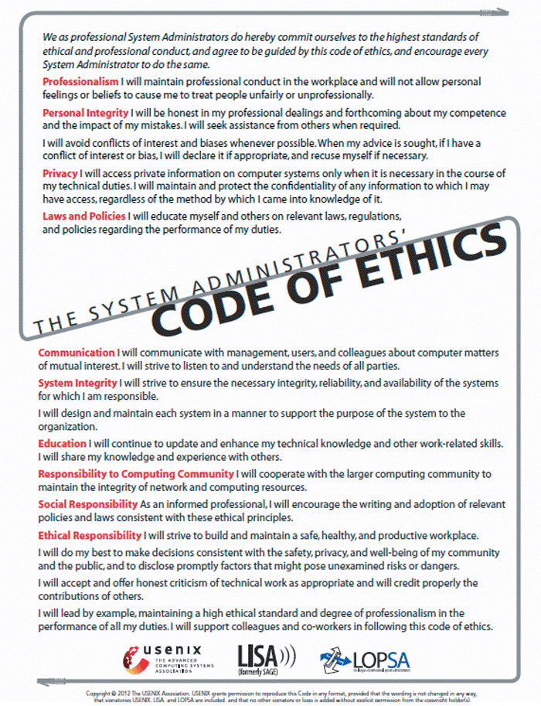
Maintenance Management (Cont.)
FIGURE 12-9 SAGE seeks to establish standards of professional excellence, improve the technical skills of its members, and promote a comprehensive code of ethics

Slide 19
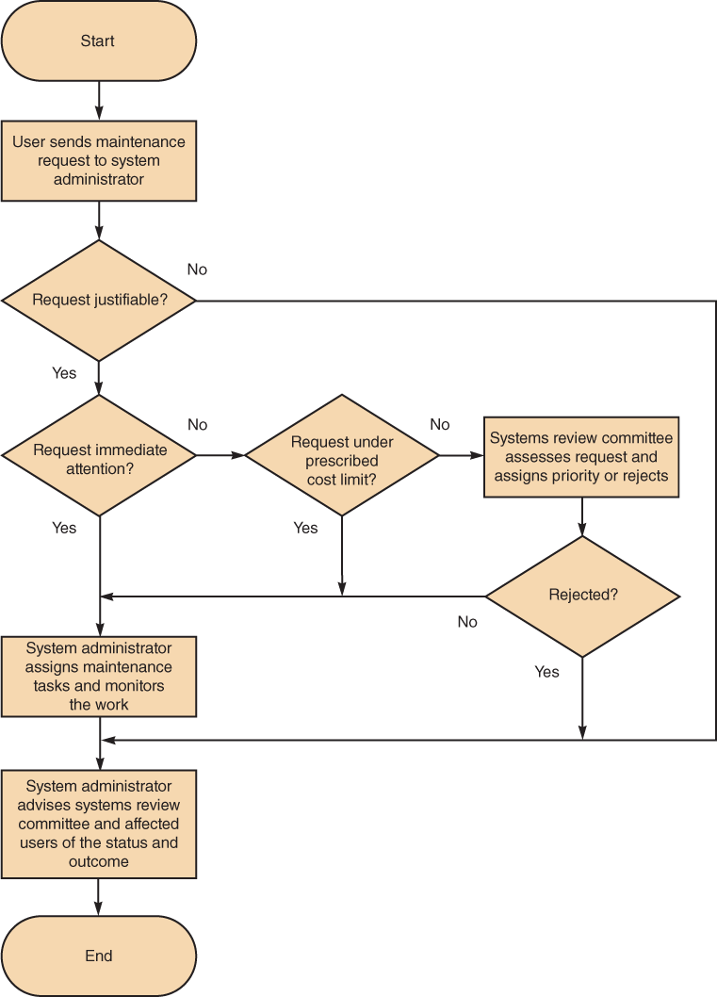
Maintenance Management (Cont.)
Maintenance Requests
Involve a series of steps
All work must be covered by a specific request
Initial determination
The systems review committee
Task completion
User notification
FIGURE 12-10 Although the procedure varies from company to company,
the chart shows a typical process for handling maintenance requests

Slide 20
Maintenance Management (Cont.)
Initial Determination
System administrator makes the initial determination if are justifiable
The System Review Committee
Either approves the request and assigns a priority to it, or rejects it
Task Completion
System administrator usually assigns tasks to individuals or to a maintenance team
User Notification
Users who initiate maintenance requests expect a prompt response, especially if the situation directly affects their work

Slide 21
Maintenance Management (Cont.)
Establishing Priorities
In many companies, systems review committee separates maintenance requests from new systems development requests
Some IT managers believe that evaluating all projects together leads to the best possible decisions
Object is to have a procedure that balances new development and necessary maintenance work

Slide 22
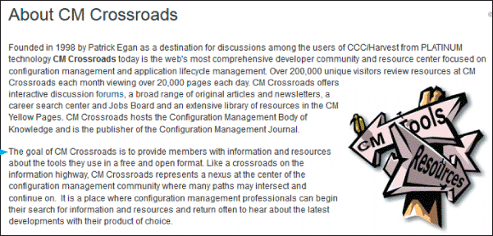
Maintenance Management (Cont.)
Configuration Management
As enterprise-wide information systems grow more complex, configuration management becomes critical
Also helps to organize and handle documentation
FIGURE 12-11 CM Crossroads provides a source of information and resources for
configuration management professionals

Slide 23
Maintenance Management (Cont.)
Maintenance Releases
A numbering pattern distinguishes the different releases
Reduces the documentation burden
Service packs
Version Control
Archived
Essential part of system documentation
Baselines
Systems analysts use baselines as yardsticks to document features and performance
Functional baseline
Allocated baseline
Product baseline

Slide 24
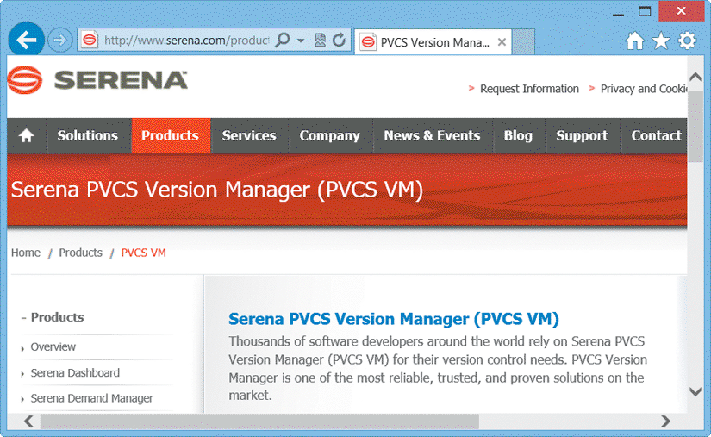
Maintenance Management (Cont.)
FIGURE 12-13 The more complex the system, the more important the task of version control. Commercial software packages, such as this example from Serena Software, can help companies maintain controls and reduce costs

Slide 25
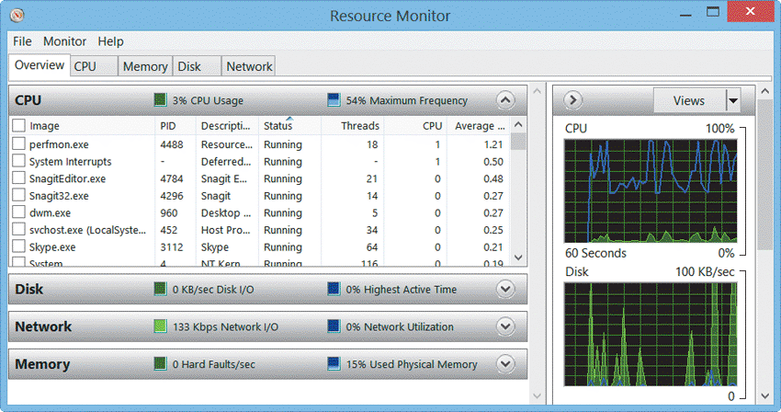
System Performance Management
Fault Management
The more complex the system, the more difficult it can be to analyze symptoms and isolate a cause
The best strategy is to prevent problems by monitoring system performance and workload
FIGURE 12-14 Windows Resource Monitor displays CPU, memory, disk, and network activity in real time

Slide 26
System Performance Management (Cont.)
Performance and Workload Measurement
Benchmark testing
Metrics
Response time
Bandwidth and throughput
Kbps (kilobits per second)
Mbps (megabits per second)
Gbps (gigabits per second)

Slide 27
System Performance Management (Cont.)
Performance Metrics include
Arrivals — The number of items that appear on a device during a given observation time
Busy — The time that a given resource is unavailable
Completions — The number of arrivals that are processed during a given observation period
Queue length — The number of requests pending for a service
Service time — The time it takes to process a given task once it reaches the front of the queue
Think time — The time it takes an application user to issue another request
Utilization — How much of a given resource was required to complete a task
Wait time — The time that requests must wait for a resource to become available

Slide 28
System Performance Management (Cont.)
Performance and Workload Measurement (Cont.)
Turnaround time
The IT department often measures response time, bandwidth, throughput, and turnaround time to evaluate system performance both before and after changes to the system or business information requirements
Management uses current performance and workload data as input for the capacity planning process

Slide 29
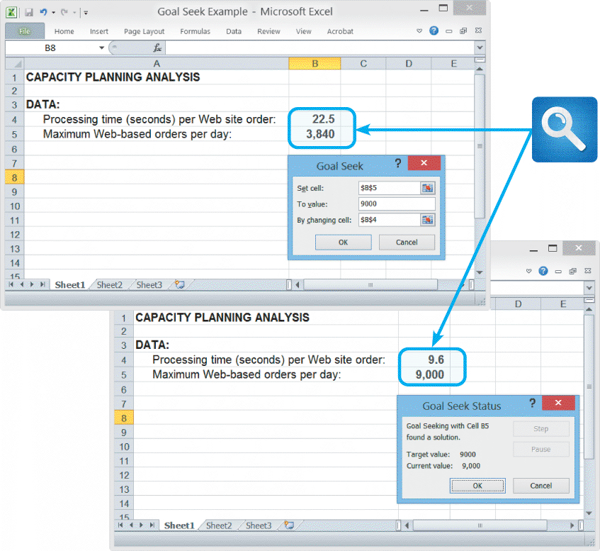
System Performance Management (Cont.)
Capacity Planning
What-if analysis
Need detailed information
Need an accurate forecast of future business activities
Should develop contingency plans based on input from users and management
FIGURE 12-16 In this Goal Seek example, the user wants to know the effect on processing time if the number
of daily transactions increases from 3,840 to 9,000

Slide 30
System Performance Management (Cont.)
System Maintenance Tools
Many CASE tools include system evaluation and maintenance features
In addition to CASE tools, you also can use spreadsheet and presentation software to calculate trends, perform what-if analyses, and create attractive charts and graphs to display the results

Slide 31
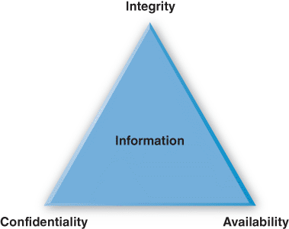
System Security Overview
Security is a vital part of every computer system
System Security Concepts
CIA triangle
Integrity
Availability
Security policy
FIGURE 12-18 A System security must
provide information confidentiality, integrity, and availability

Slide 32
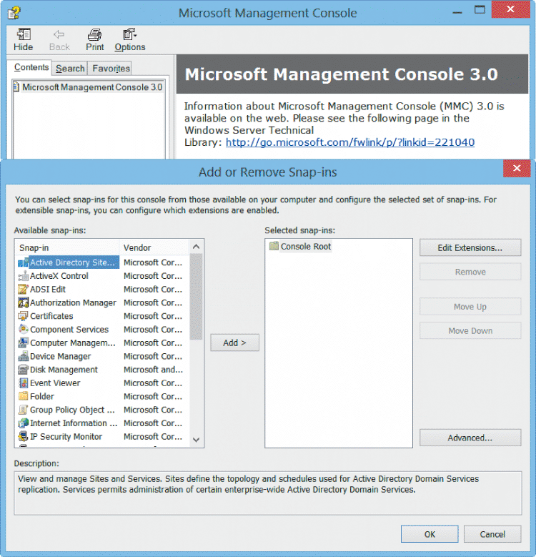
System Security Overview (Cont.)
Risk Management
Absolute security is not a realistic goal
Risk Identification
List and clarify business assets
Risk Assessment –
Risk of an attack is multiplied by the likelihood of a vulnerability being exploited
Risk control
Avoidance, mitigation, transference, acceptance
FIGURE 12-19 The Microsoft Management Console (MMC) includes built-in security tools, such as password and lock-out policies, audit policies, user rights, and security configurations, among others

Slide 33
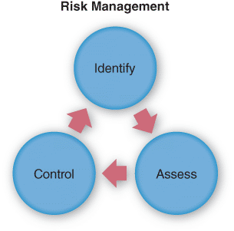
System Security Overview (Cont.)
Attacker Profiles and Attacks
An attack might be launched by a disgruntled employee, or a hacker who is 10,000 miles away
Attackers break into a system to cause damage, steal information, or gain recognition, among other reasons
FIGURE 12-20 Risk management requires continuous risk identification, assessment, and control

Slide 34
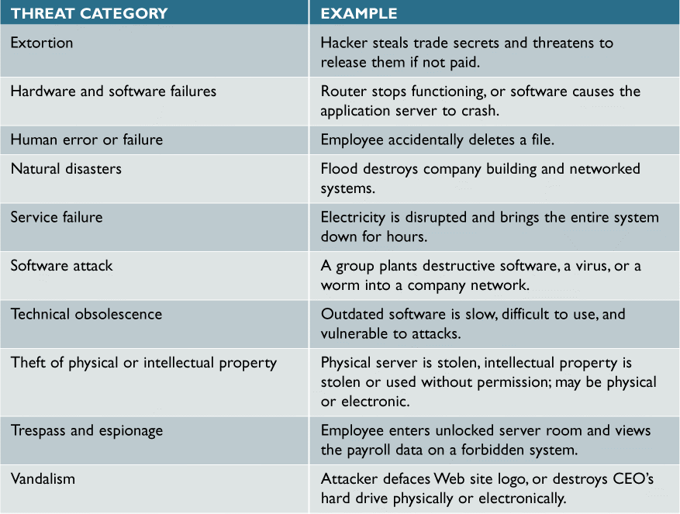
System Security Overview (Cont.)
FIGURE 12-21 System threats can be grouped into several broad categories. Note the examples provided for each category

Slide 35
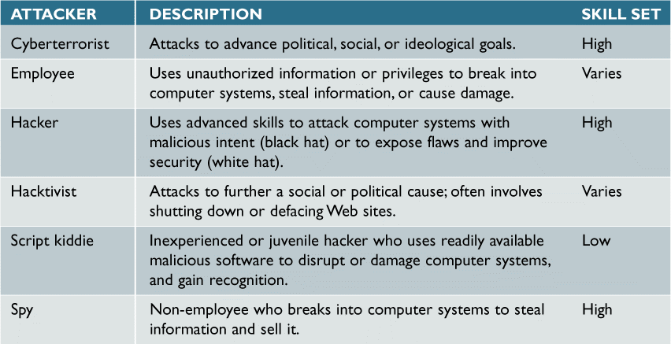
Security Levels
FIGURE 12-22 IT security professionals have coined labels for various types of attackers

Slide 36
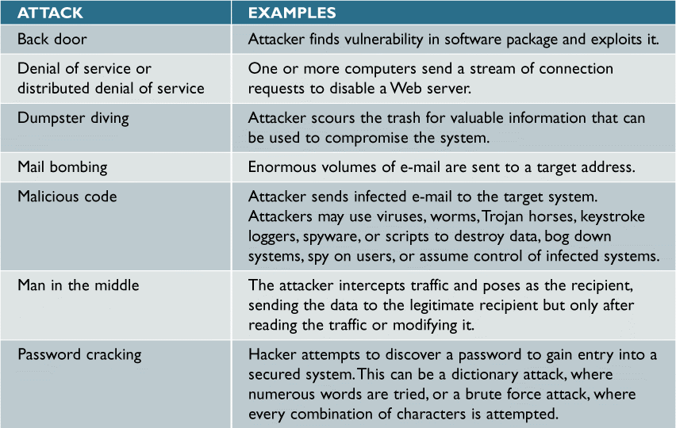
Security Levels (Cont.)
FIGURE 12-22 Attacks can take many forms, as this table shows. IT security managers must be able to detect these attacks and respond with suitable countermeasures (Continues)

Slide 37
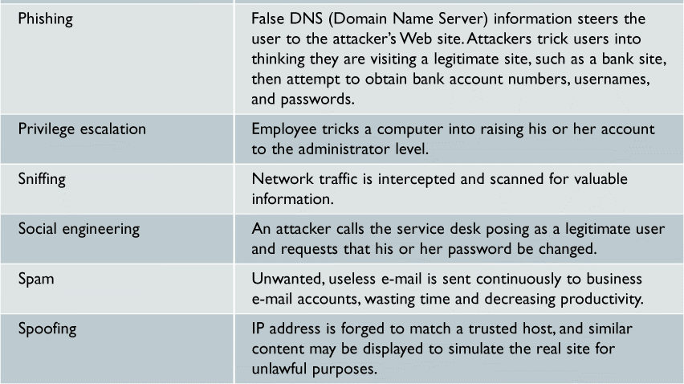
Security Levels (Cont.)
FIGURE 12-22 Attacks can take many forms, as this table shows. IT security managers must be able to detect these attacks and respond with suitable countermeasures

Slide 38
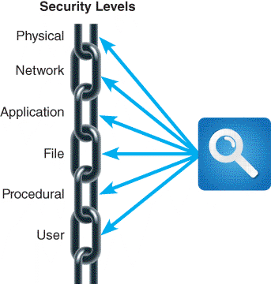
Security Levels (Cont.)
Must consider six separate but interrelated levels
Physical Security
First level of security concerns the physical environment
Physical access to a computer represents an entry point into the system and must be controlled and protected
FIGURE 12-24 Each security link has a
specific focus, and the overall chain is only as strong as the weakest link

Slide 39
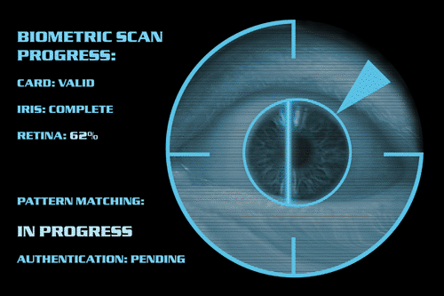
Security Levels (Cont.)
Physical Security
Operations center security
Servers and desktop computers
Portable computers
Network Security
Encrypting network traffic
Wireless Networks
Private networks
FIGURE 12-25 Companies use biometric scanning to
analyze the features of the eye’s iris, which has more than 200 points that can be measured and used for comparison

Slide 40
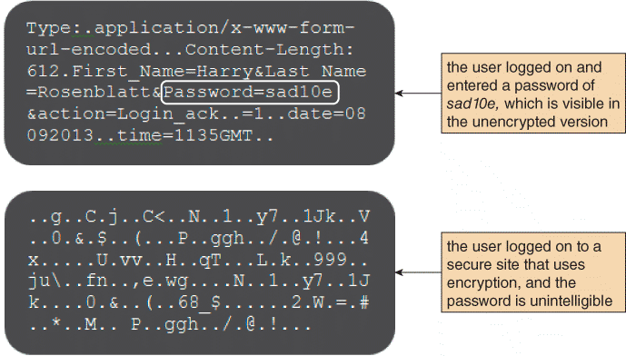
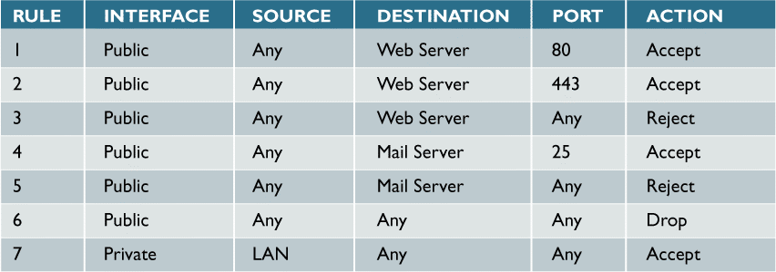
Security Levels (Cont.)
Network Security (Cont.)
Virtual Private Networks
Ports and Services
Firewalls
Network Intrusion Detection
FIGURE 12-28 The upper screen shows an example of unencrypted text, which contains a visible password. In the lower screen, the encrypted text cannot be read
FIGURE 12-31 Examples of rules that determine whether the firewall will allow traffic to pass.

Slide 41
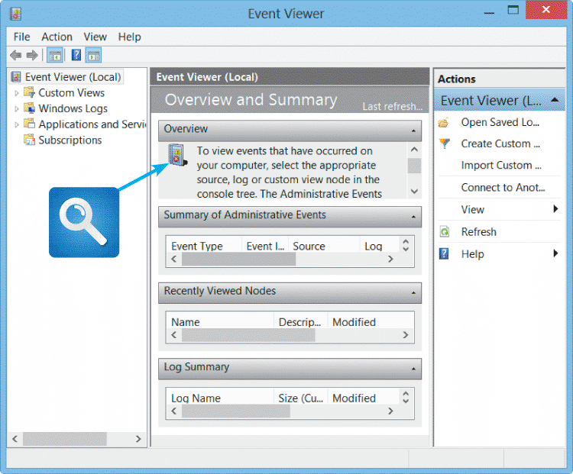
Security Levels (Cont.)
Application Security
Services
Hardening
Application Permissions
Input validation
Patches and Updates
Software logs
File Security
Encryption
Permissions
User groups
FIGURE 12-32 Windows Event Viewer can log application usage, security settings, and system changes

Slide 42
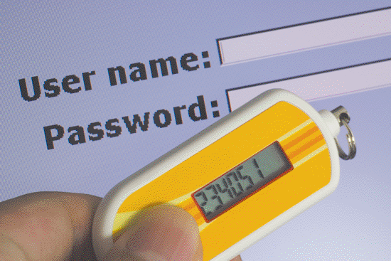
Security Levels (Cont.)
User Security
Privilege escalation attack
Identity management
Password protection
Social engineering
User Resistance
New Technologies
FIGURE 12-34 Security tokens, which come in various forms, can provide an additional level of security

Slide 43
Security Levels (Cont.)
Procedural Security
Also called Operational security
Users must log out
Dumpster diving attacks
Paper shredders
Need-to-know concept

Slide 44
Backup and Recovery
Backup Policies
Backup Media
Includes tape, hard drives optical and online storage
Rotation schedule
Cloud-based storage
Backup Types
Full, differential, incremental, continuous
Retention periods
Can be months or years

Slide 45
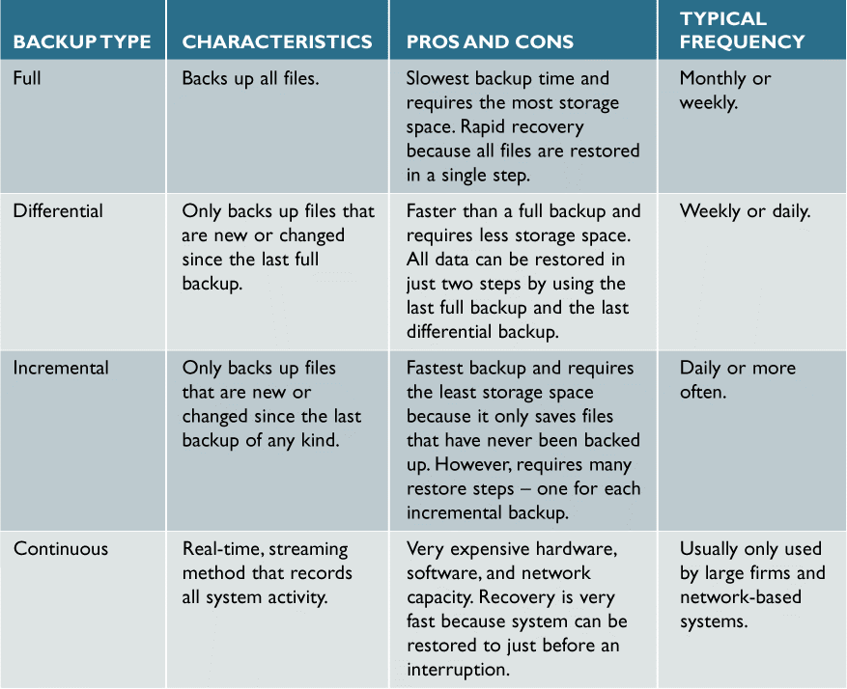
Backup and Recovery(Cont.)
FIGURE 12-35 Comparison of full, differential, incremental, and continuous backup methods.

Slide 46
Backup and Recovery(Cont.)
Business Continuity Issues
Test plan
Business continuity plan (BCP)
Hot site
Data replication

Slide 47
System Obsolescence
The system’s maintenance history indicates that adaptive and corrective maintenance are increasing steadily
Operational costs or execution times are increasing rapidly, and routine perfective maintenance does not reverse or slow the trend
A software package is available that provides the same or additional services faster, better, and less expensively than the current system
New technology offers a way to perform the same or additional functions more efficiently
Maintenance changes or additions are difficult and expensive to perform
Users request significant new features to support business requirements

Slide 48
Future Challenges and Opportunities
Trends and Predictions
The financial impact of cybercrime will grow at a compound rate of 10 percent per year
Mobile application development using smartphones and tablets will outnumber PC-based software by a four-to-one ratio
The prices for most cloud services will include a global energy surcharge
One of every two e-mail users will rely primarily on a browser, tablet or mobile client, instead of a desktop client
Half of all companies will make proof of independent security testing a precondition for using any type of cloud service
Twenty percent of Asia-sourced hardware consumed in the U.S. will shift to the Americas

Slide 49
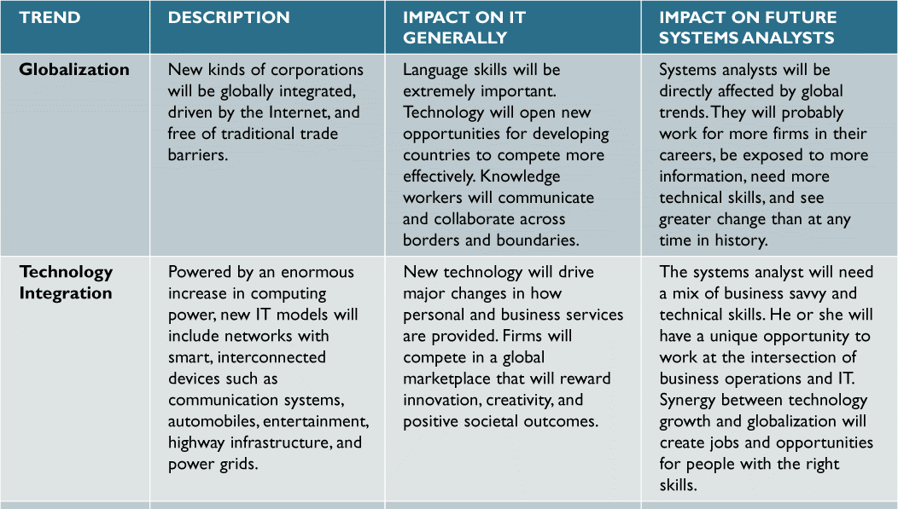
Future Challenges and Opportunities (Cont.)
Strategic Planning for IT Professionals
FIGURE 12-36 Major trends and their impact on IT generally and on future systems analysts (Continues)

Slide 50
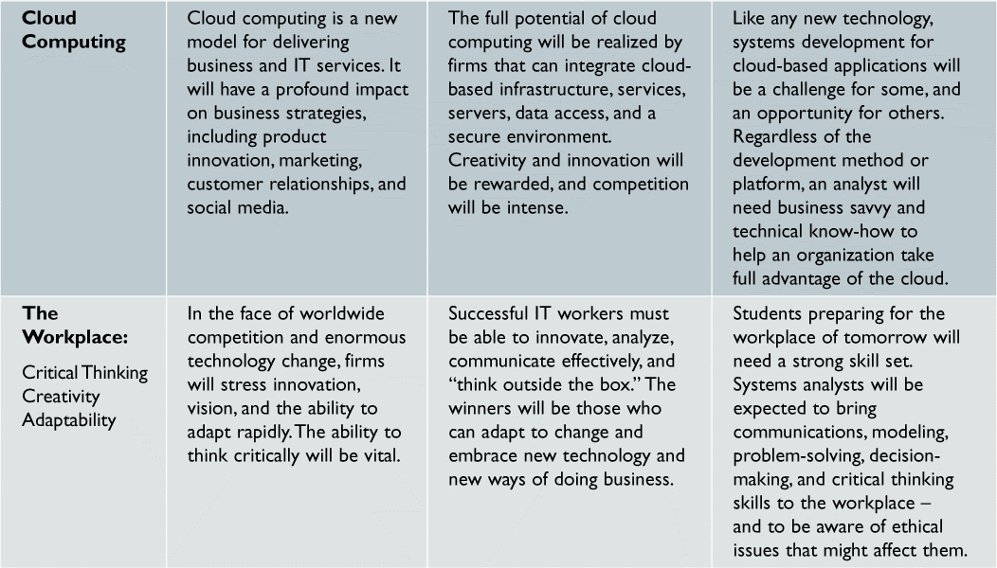
Future Challenges and Opportunities (Cont.)
Strategic Planning for IT Professionals (Cont.)
FIGURE 12-36 Major trends and their impact on IT generally and on future systems analysts

Slide 51
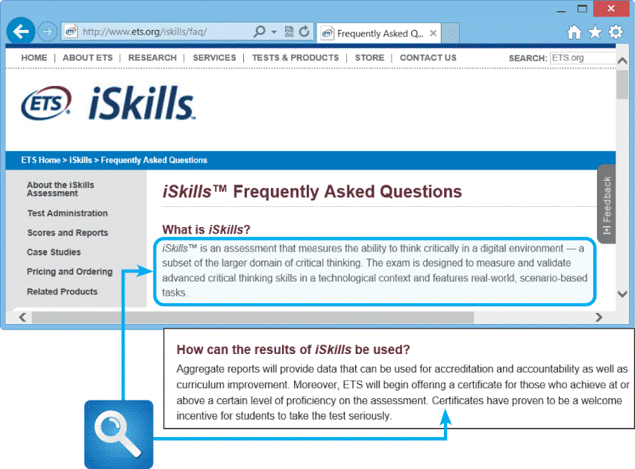
Future Challenges and Opportunities (Cont.)
IT Credentials and Certification
CompTIA, Microsoft, Cisco, Novell, Oracle, and Sun Microsystems
Critical Thinking Skills
Soft Skills
Data Mining
FIGURE 12-38 Employers like to hire people who can think logically and effectively. The Educational Testing Service (ETS) measures critical thinking skills using an interactive test with realistic scenarios, and will provide certificates to students who are proficient

Slide 52
Chapter Summary
Systems support and security covers the entire period from the implementation of an information system until the system no longer is used
Corrective, Adaptive, Perfective and Preventative are types of system maintenance
A maintenance team consists of systems analysts and programmers
Configuration management is necessary and system performance measurements are needed
Security is a vital part of every computer system

Slide 53
Chapter Summary (Cont.)
Risk management identifies, analyzes, anticipates and reduces risk to an acceptable level
Data back and recovers plans are necessary
All information systems eventually become obsolete
Intense competition is predicted for the future
IT professionals should have a strategic career plan that includes long-term goals and intermediate milestones

