Slide 1



Criminal Database: TJPD
Argel Torres
Carlos Villarreal
Daniel Blancas

Slide 2
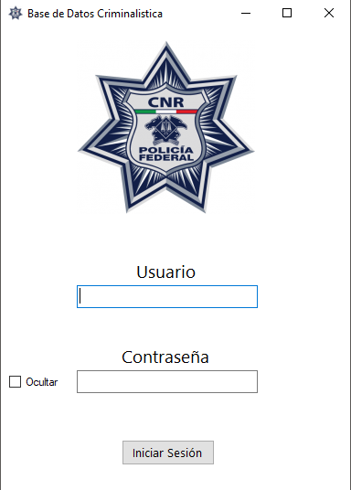
Objetivo
Implementación de una base de datos de giro criminalista.

Slide 3


Aplicaciones
Procedures
Cursors
Sequences
Constraints
Functions

Slide 4
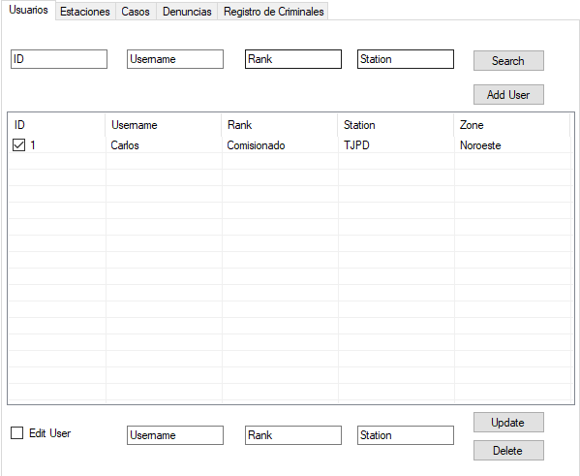
Acciones Principales
Add
Delete
Edit
Search
Update

Slide 5
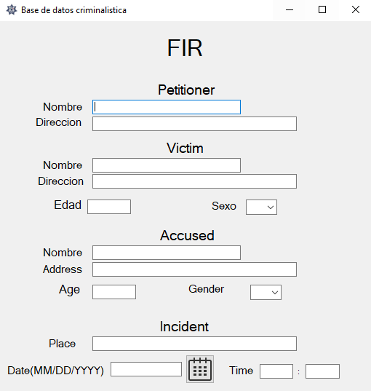
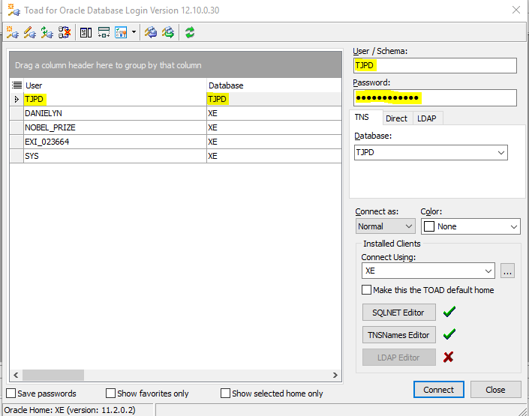
FIR LOG IN

Slide 6
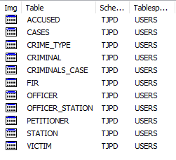
Tablas
Accused
Cases
Crime_Type
Criminal
Criminals_Case
FIR
Officer
Officer_Station
Petitioner
Station
Victim

Slide 7
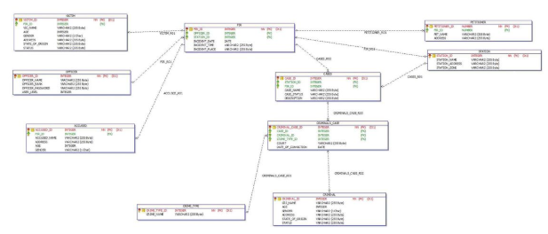
Diagrama General

