Slide 1
King County
House Price Analysis
Predicting sale prices · King County, WA · May 2014 – May 2015
21,613 records · 21 features · ML regression models

Slide 2
Dataset Overview
King County, WA — May 2014 to May 2015
21,613
21
$540K
$450K
Total house sales
Feature columns
Mean sale price
Median sale price
id / date
price
bedrooms/baths
sqft_living/lot
Unique ID & sale date
Sale price — TARGET
Rooms configuration
Living & lot size (sqft)
floors/waterfront
grade/condition
yr_built/renovated
lat/long/zipcode
Levels & waterfront flag
KC grading system
Construction & reno year
Geographic coordinates

Slide 3
Price Distribution
Right-skewed distribution — log transform improves model fit
Key Statistics
Min
$75,000
Max
$7,700,000
Mean
$540,088
Median
$450,000
< 200K
200-300K
300-400K
400-500K
500-600K
600-800K
> 800K
Std Dev
$367,127
Price Distribution (simulated)
Note: Distribution is right-skewed — log(price) used in linear models

Slide 4
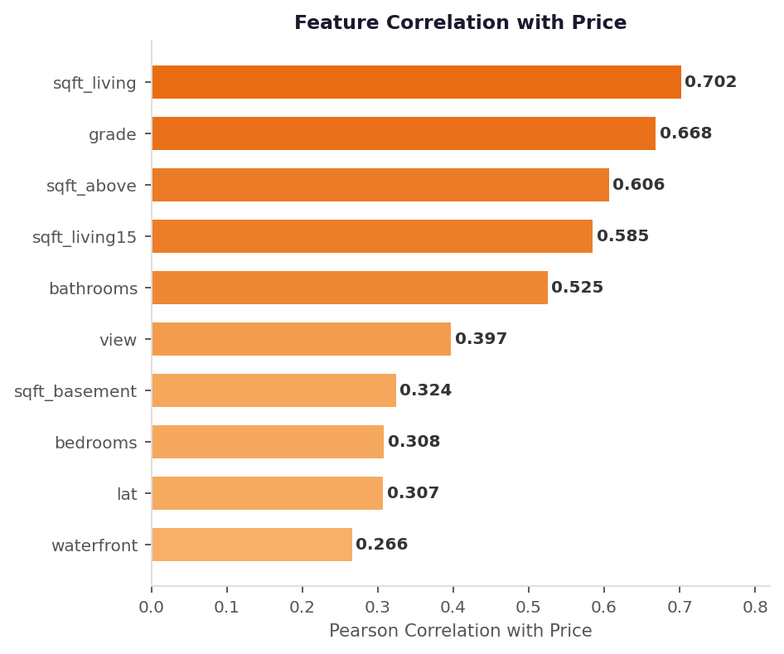
Top Features Impacting Price
Pearson correlation with sale price — generated from real dataset
sqft_living r=0.70
Largest single predictor
grade r=0.67
KC quality grading system
bathrooms r=0.53
Proxy for luxury level
view r=0.40
Times viewed / view quality

Slide 5
Premium Properties
Houses priced at $650,000 and above
24.2%
Metric
Standard (<$650K)
Premium (≥$650K)
Avg. Grade
6.9
9.2
of all transactions
Avg. Sqft
1,710
3,150
Waterfront
0.4%
4.1%
Avg. Price
$317K
$1.08M
Key Insights
Higher grade = exponentially higher price
Premium homes are ~2x larger (sqft)
10x more likely to have waterfront access
Concentrated in Seattle & Bellevue areas

Slide 6
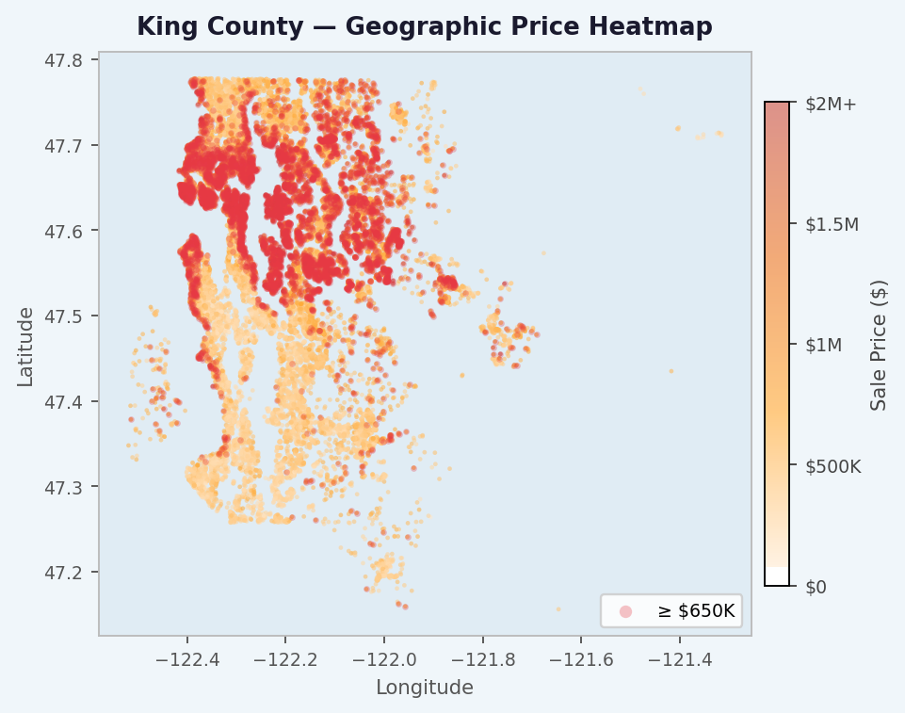
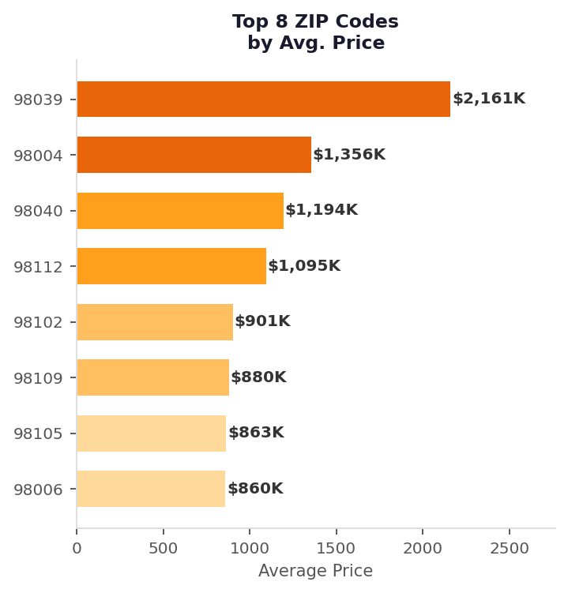
Geographic Insights
Location is one of the strongest price predictors

Slide 7
Feature Engineering
Transformations applied before training
house_age
was_renovated
Sale year − year built
Binary flag (1 if yr_renovated > 0)
years_since_renovation
has_basement
Years since last reno (or house_age)
Binary: sqft_basement > 0
living_space_ratio
sale_month
sqft_living ÷ sqft_living15 (vs neighbors)
Month extracted from sale date

Slide 8
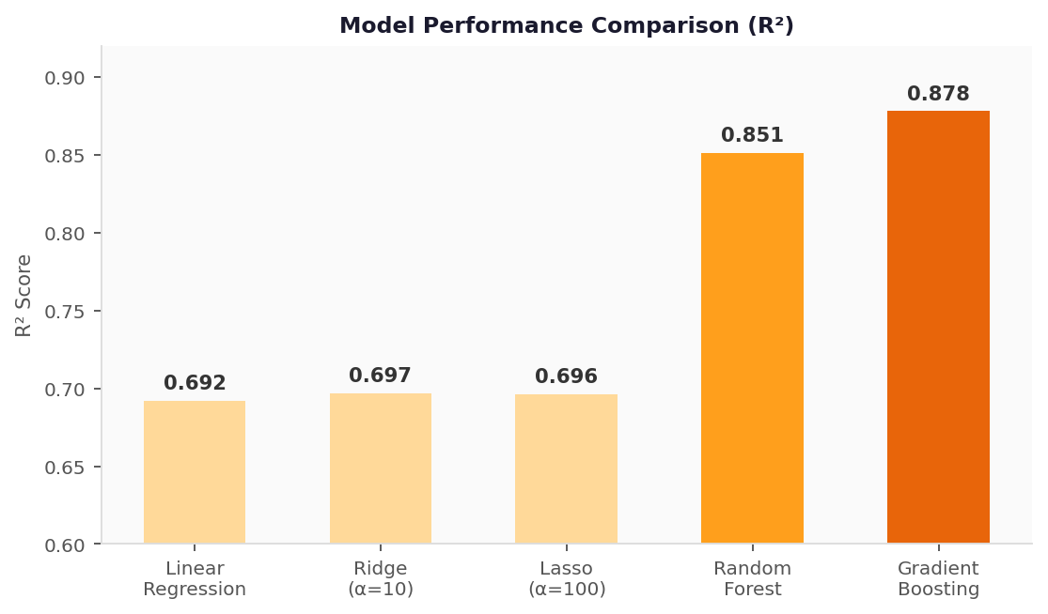
Models Comparison
5 models evaluated on 20% hold-out test set
Model
RMSE
R²
Linear Reg.
$211K
0.692
Ridge
$209K
0.697
Lasso
$210K
0.696
Random Forest
$145K
0.851
Grad. Boost.
$132K
0.878
Winner: Gradient Boosting

Slide 9
Best Model: Gradient Boosting
200 estimators · learning_rate = 0.1 · 5-fold cross-validation
R² = 0.878
$132K RMSE
$82K MAE
Variance explained
Root Mean Squared Error
Mean Absolute Error
Top 6 Most Important Features
sqft_living
22%
grade
19%
lat
15%
sqft_living15
10%
long
8%
sqft_above
7%

Slide 10
Key Takeaways
Size & Grade dominate
sqft_living and grade are the #1 and #2 predictors of price.
Location is critical
Latitude, longitude, and zip code explain significant price variance.
Premium segment is distinct
24% of homes (≥$650K) show starkly different grade, size, and waterfront rates.
Tree models outperform linear
Gradient Boosting achieves R² = 0.878 vs 0.697 for Ridge regression.
Feature engineering adds value
house_age, was_renovated, and living_space_ratio improved model accuracy.
Gradient Boosting · R² = 0.878 · RMSE $132K · MAE $82K

