Slide 1


HIST-DAILY
A Dataset of Daily and Sub-Daily European Weather Observations before 1900
Carlota Corbella^{1,2,*}, Conall E. Ruth^{1,2}, Yuri Brugnara^{1,2,3}, Mariano Barriendos⁴, Carla Mateus⁵, Rajmund Przybylak⁶, Dario Camuffo^{7,8}, Antonio della Valle^{7,8}, Francesca Becherini^{7,9}, Richard C. Cornes¹⁰, Olesya Skrynyk^{11,12}, Vladyslav Sidenko¹², Stefan Brönnimann^{1,2}
Oeschger Centre for Climate Change Research, University of Bern, Bern, Switzerland
Institute of Geography, University of Bern, Bern, Switzerland
GeoSphere Austria, Vienna, Austria
IDAEA-CSIC, Barcelona, Spain
ICARUS Climate Research Centre, Department of Geography, Maynooth University, Maynooth, Ireland
Department of Meteorology and Climatology, Faculty of Earth Sciences and Spatial Management, and Centre for Climate Change Research, Nicolaus Copernicus University, Toruń, Poland
Italian National Research Council
Institute of Atmospheric Sciences & Climate, Italy
Institute of Polar Sciences, Italy
National Oceanography Centre, Southampton, UK
National University of Life and Environmental Sciences of Ukraine, Kyiv, Ukraine
Ukrainian Hydrometeorological Institute, Kyiv, Ukraine
*Corresponding author: Carlota Corbella (carlota.corbellaalcantara@unibe.ch)
Notes:
Hello my name is Carlota Corbella and I am a phd student at the university of Bern. Today I am going to present a dataset that I’ve been working on for almost the past year, and which unifies daily and subdaily weather observations across Europe before the 20th century.
As you've been hearing throughout this session, these observations exist, but they're scattered across archives, national services, and old publications. HIST-DAILY hopefully brings them together into a single standardized dataset, building on exactly the kind of rescue work many of you are presenting today.

Slide 2
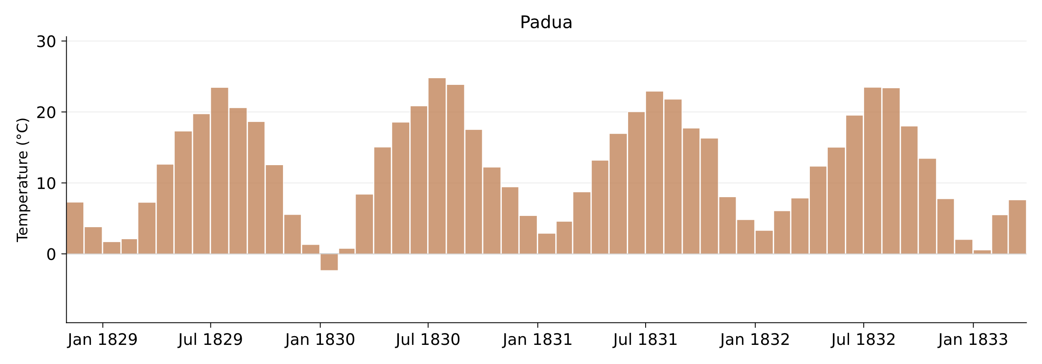
HIST-DAILY
Why daily data?
Monthly data
Camuffo, D., & Jones, P. (2002). Improved Understanding of Past Climatic Variability from Early Daily European Instrumental Sources: Guest Editorial. In Improved Understanding of Past Climatic Variability from Early Daily European Instrumental Sources (pp. 1-4). Dordrecht: Springer Netherlands.
Notes:
First, why do we need daily data if Monthly databases already give us a lot? I’ll go over this quickly, as many of you don’t need convincing. But let me show you what monthly data alone can miss. Here’s the temperature of Padua through the 1830s.

Slide 3
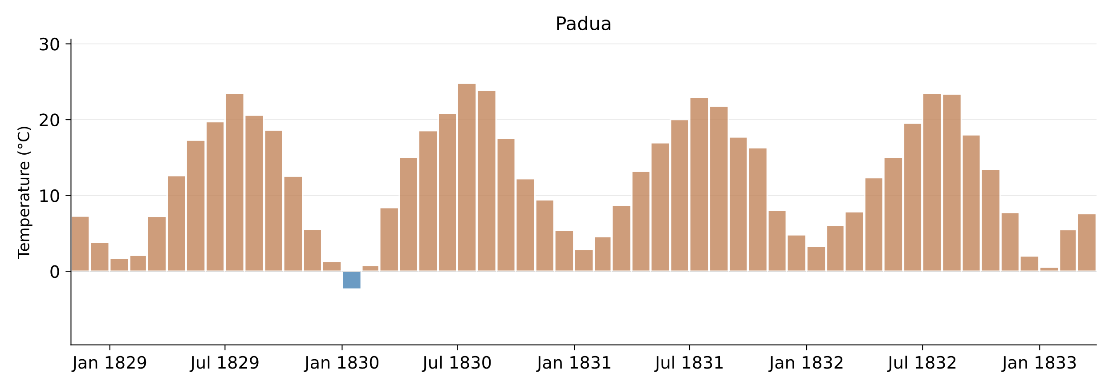
HIST-DAILY
Why daily data?
Monthly data
1 month < 0°C
Camuffo, D., & Jones, P. (2002). Improved Understanding of Past Climatic Variability from Early Daily European Instrumental Sources: Guest Editorial. In Improved Understanding of Past Climatic Variability from Early Daily European Instrumental Sources (pp. 1-4). Dordrecht: Springer Netherlands.
Notes:
Only once, in January 1830, did the monthly mean temperature drop below freezing.

Slide 4
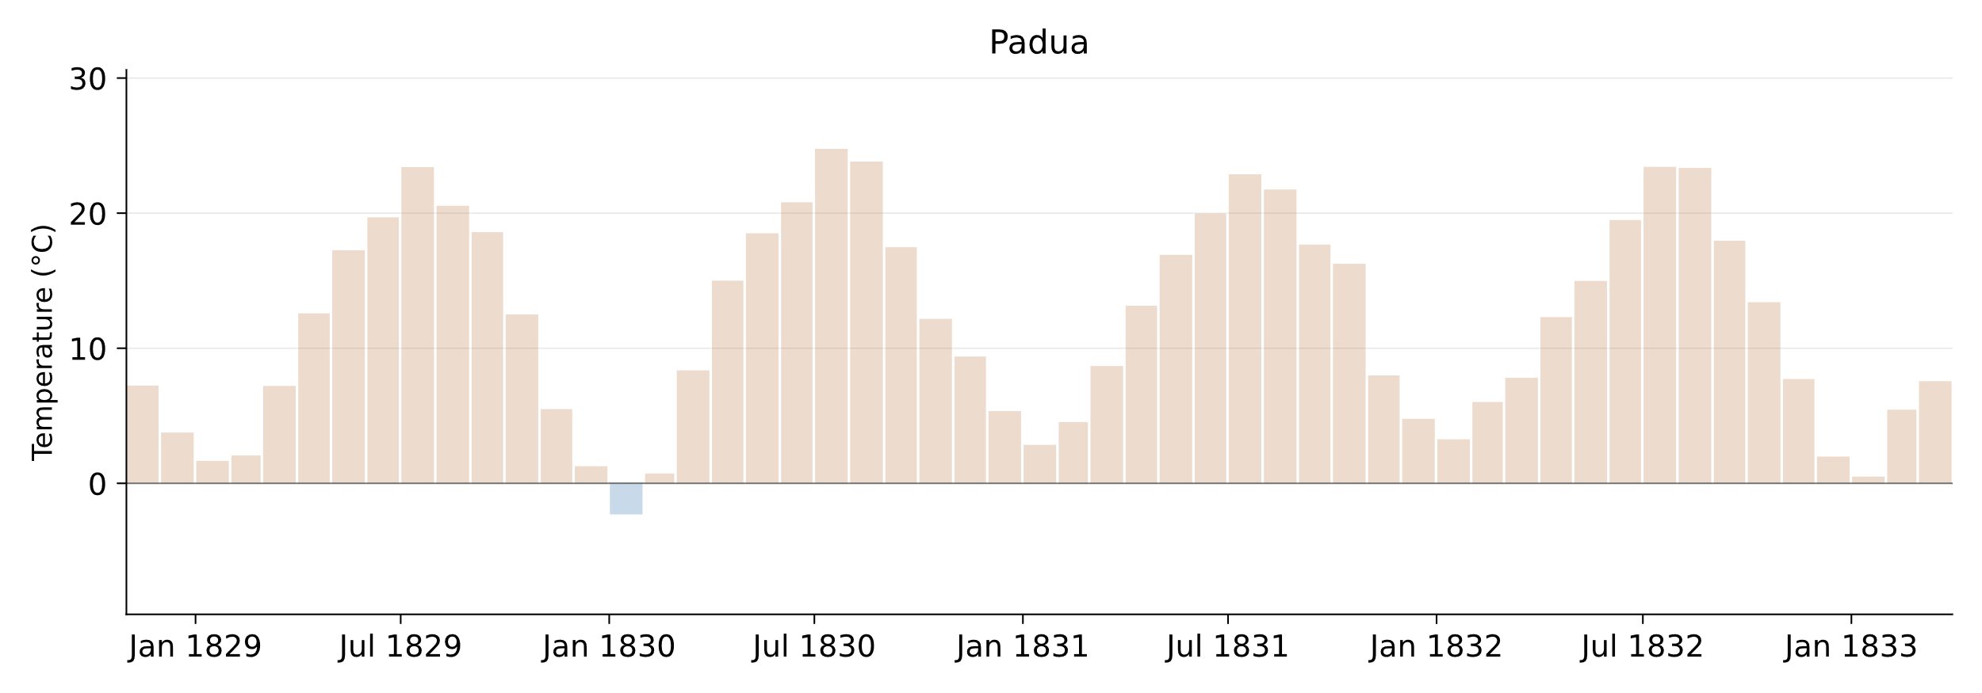
HIST-DAILY
Why daily data?
Daily means
Camuffo, D., & Jones, P. (2002). Improved Understanding of Past Climatic Variability from Early Daily European Instrumental Sources: Guest Editorial. In Improved Understanding of Past Climatic Variability from Early Daily European Instrumental Sources (pp. 1-4). Dordrecht: Springer Netherlands.
Notes:
That single cold month stands out. But at monthly resolution, that’s all we see: one cold dot.

Slide 5
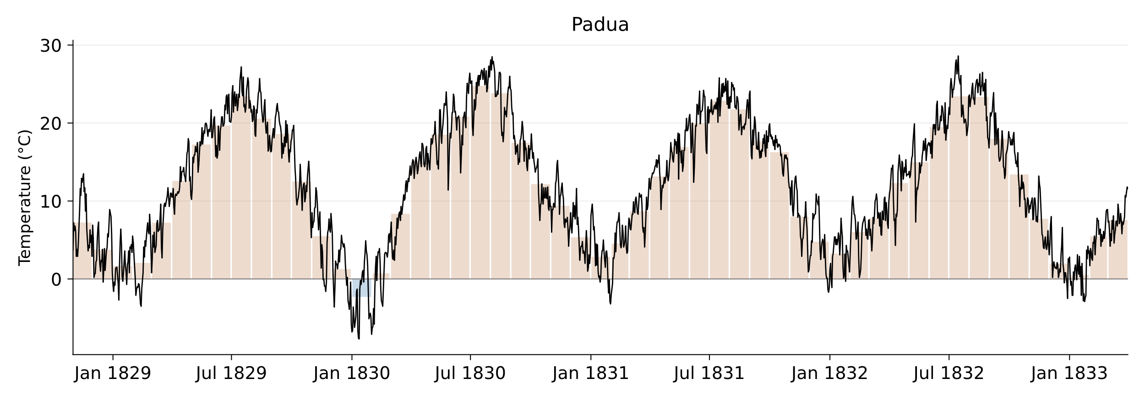
HIST-DAILY
Why daily data?
Daily means
Camuffo, D., & Jones, P. (2002). Improved Understanding of Past Climatic Variability from Early Daily European Instrumental Sources: Guest Editorial. In Improved Understanding of Past Climatic Variability from Early Daily European Instrumental Sources (pp. 1-4). Dordrecht: Springer Netherlands.
Notes:
When we superimpose the daily data, we see a different story, with days that swing well above or below the monthly mean.

Slide 6
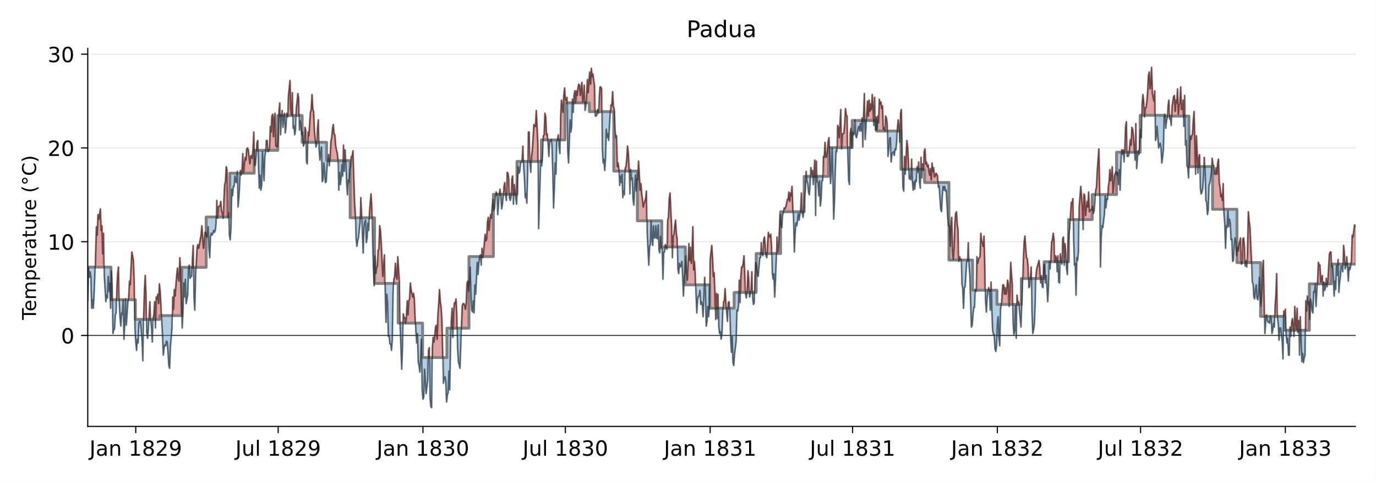
HIST-DAILY
Why daily data?
Daily means
Camuffo, D., & Jones, P. (2002). Improved Understanding of Past Climatic Variability from Early Daily European Instrumental Sources: Guest Editorial. In Improved Understanding of Past Climatic Variability from Early Daily European Instrumental Sources (pp. 1-4). Dordrecht: Springer Netherlands.
Notes:
Daily departures from the monthly mean can reach up to 8 degrees. And this is just for temperature, for precipitation for example the effect is more dramatic, since a single flood day is nothing like continuous light rain, even if the monthly totals match.
But HIST-DAILY doesn’t only provide daily data, more than half of our series are subdaily. Let’s take the cold winter of 1829/1830 for example.

Slide 7
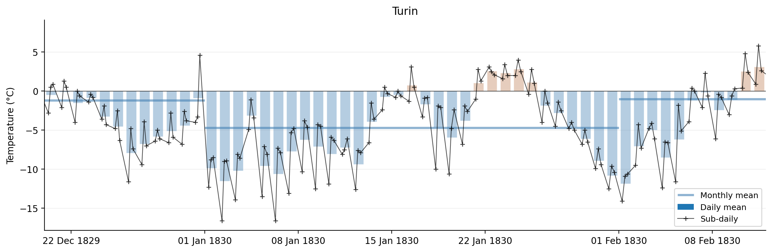
HIST-DAILY
Why sub-daily data?
Notes:
In this graph the daily means are shown as bars, and the sub-daily observations as the line. Looking at the data, January wasn't simply a cold month, we can see what appears to be two pronounced cold spells separated by a brief recovery. The sub-daily observations reveal the within-day structure. Temperatures dropped to -16°C but the dirunal cycle was preserved. This kind of structure is invisible at monthly resolution, so without daily data we would never know whether the cold was sustained, episodic, or how the events were separated in time.

Slide 8
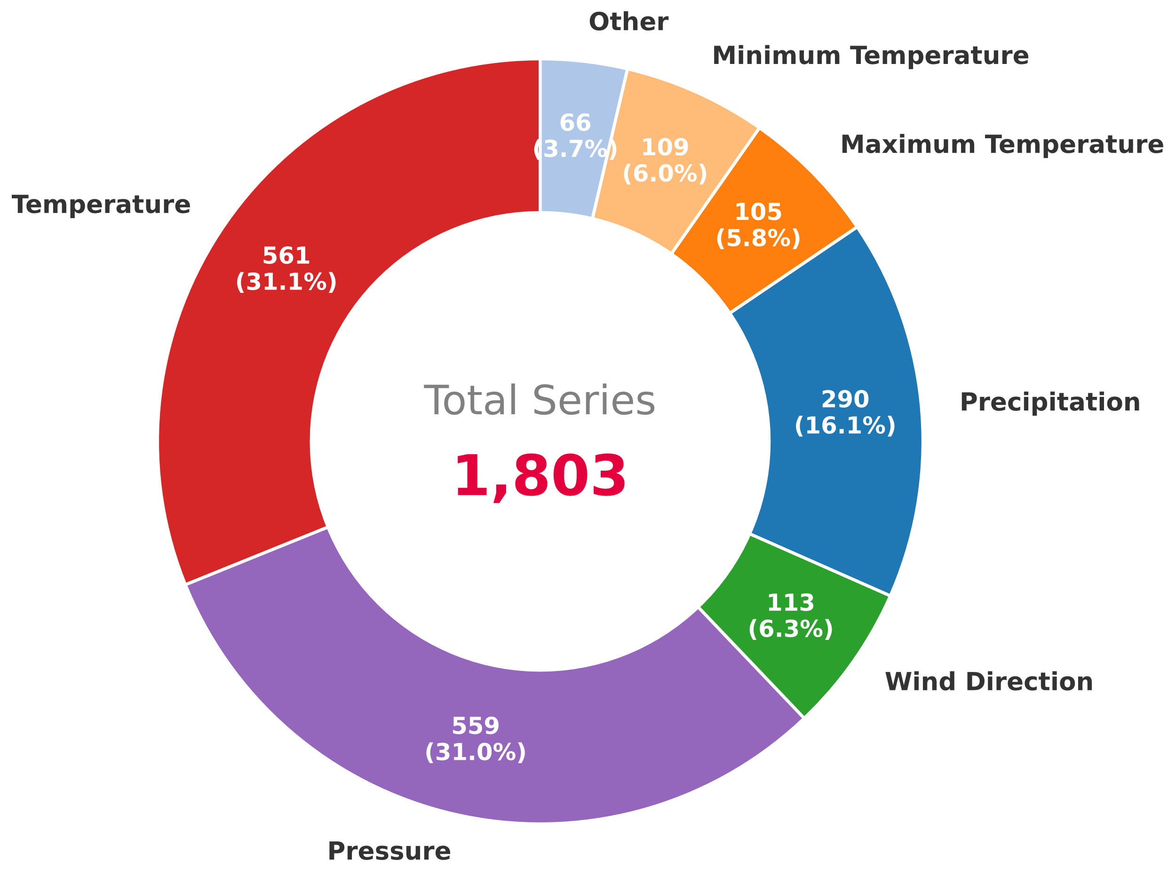
HIST-DAILY
The Dataset
88 independent sources
Online databases (CDS, ECA&D, GHCNd, ISPD…)
Journals, papers
Collaborations
Digitized manuscripts at the University of Bern (23.3% of total series)
Notes:
So let me show you what’s in HIST-DAILY first, and then walk through how we built the database.
We collected data from 88 sources, both already published and not yet published. In total, more than 1800 series.

Slide 9
HIST-DAILY
The Dataset
88 independent sources
Online databases (CDS, ECA&D, GHCNd, ISPD…)
Journals, papers
Collaborations
Digitized manuscripts at the University of Bern (23.3% of total series)
Notes:
The focus has been on pressure and temperature, the most widely recorded variables. But we’ve also included non-instrumental observations such as wind direction. A key strength of HIST-DAILY is that for many sites we provide multiple variables together, which enables studies of compound events and the synoptic dynamics behind them.
These are 420 series from UniBern + 42 series from collaborators → total of 26% series published here for the first time.
→ 88 distinct sources feed into HIST-DAILY.
Of these:
- 33 sources contribute 5+ series each — these are the large institutional/project
providers (PALAEO-RA, DWR_UKMO, GHCN-D, CHIMES, GCOS, KNMI, UA-UHMI, ECA&D, CRU,
WeaR, EMULATE, DigiHom, DWD, IMPROVE, SMI, etc.) plus a handful of substantial
individually-contributed datasets (Mateus et al. 2020 for Ireland, Vaquero et al.
2020 PANGAEA, Cornes figshare, the Walter Lenke 1708/09 study, etc.)
- 55 sources contribute fewer than 5 series each — almost all
individually-contributed literature citations, historical newspapers/archives (e.g.
several digitized Cádiz/Sevilla/Granada periodicals), or single-station personal
contributions.

Slide 10
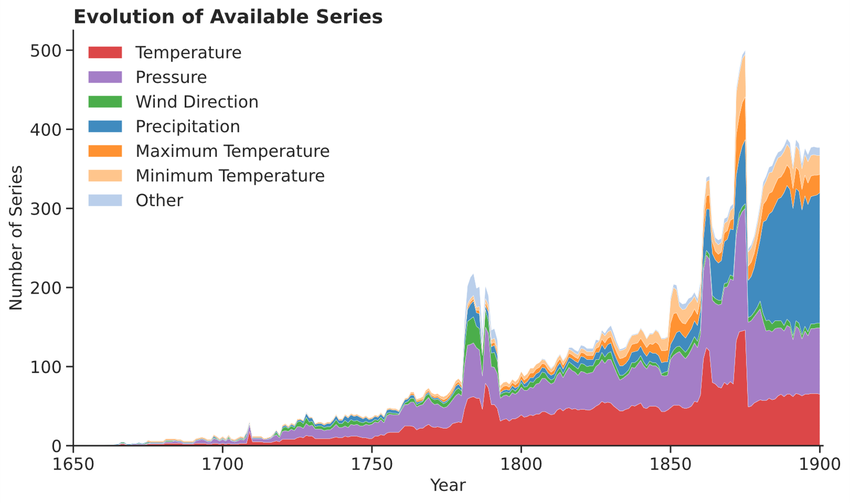
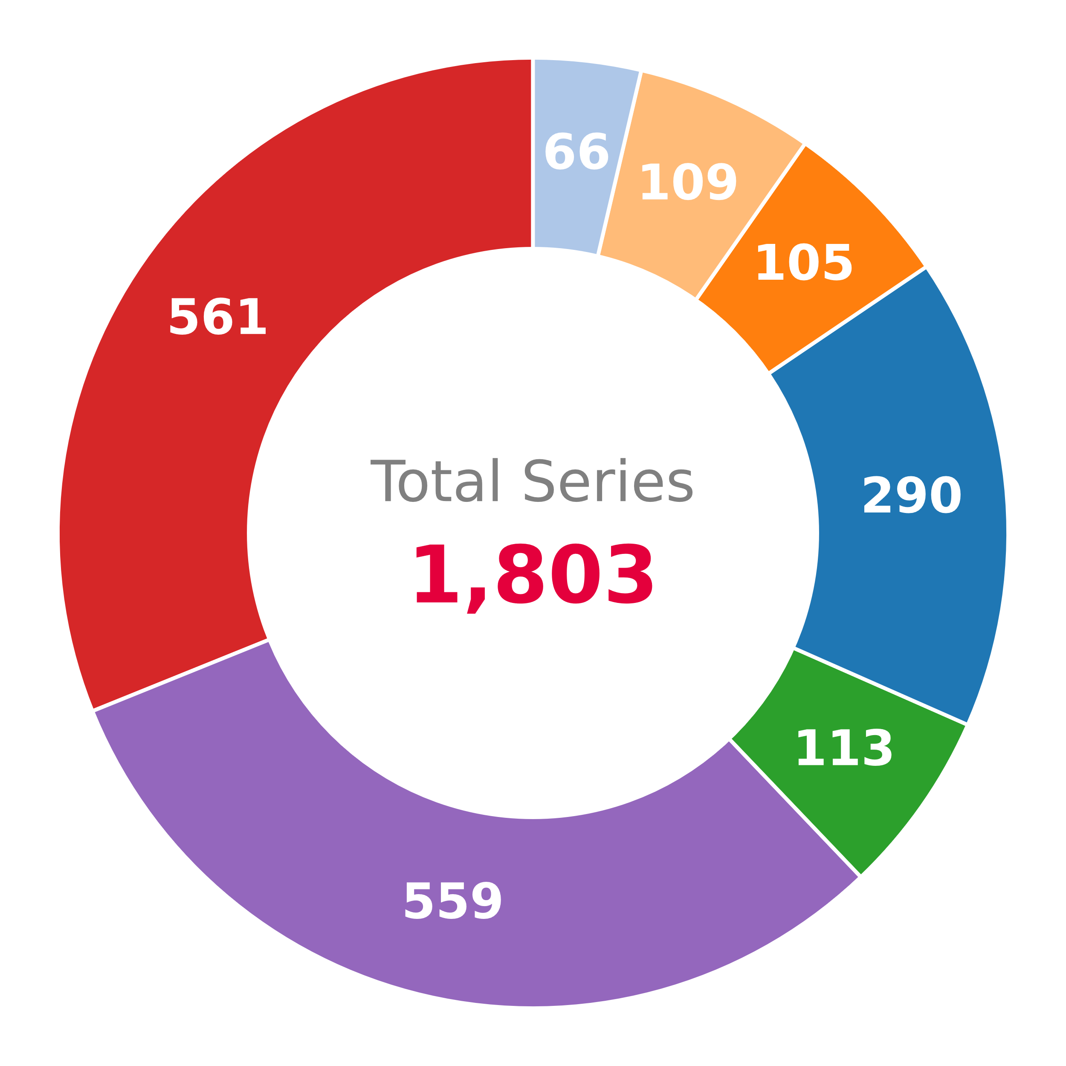
HIST-DAILY
Establishment of national meteorological services
The Dataset
Palatine Society
Notes:
This figure shows how the available network evolves over time. Keep in mind that this is what has been digitized and collected, and many more records exist in archives that haven’t yet been rescued. A few features stand out. First, the peak in the 1780s is from the Palatine Society, a coordinated European observing network with standardized instruments. Then a long gap through much of the early 19th century. From the mid-19th century onward, national meteorological services began to be established, and the network grows steadily.
##
NO: Spike in Palatine Society → except for 1780, when funding was cut and only 1/obs per day or simply missing obs during that time. This effort is digitized by unibern within the PALAEO-RA and WeaR projects.
Spike 1860s that only last for this time (pressure, temperature): DWR_UKMO (i.e. WRDv2-2 from Ed Hawkins), UA-UHMI, EMOSSv2 (Early Meteorological Observations from Southern Spain). ECA&D, MEDARE (the Mediterranean climate Data Rescue), EMULATE (metofficeUK), CRU (climate research unit) last for longer.
Spike 1870s
Precipitation is GHCN-D, DWR_UKMO,
Tx, Tn is ILMMT

Slide 11
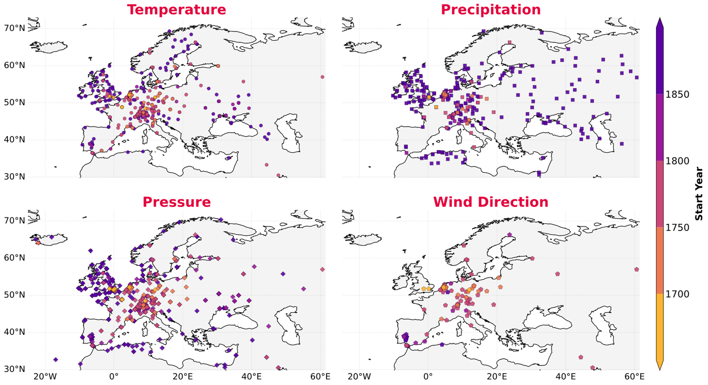
HIST-DAILY
The Dataset
Notes:
As for the spatial extent, temperature and pressure offer the broadest coverage, from the Iberian Peninsula to Scandinavia and into Russia., Precipitation clusters in the Britain and Ireland and the Alpine area, and wind direction is concentrated in central Europe. Coverage is thinner in sourtheastern Europe and across much of Scandinavia before the mid-19th century.

Slide 12
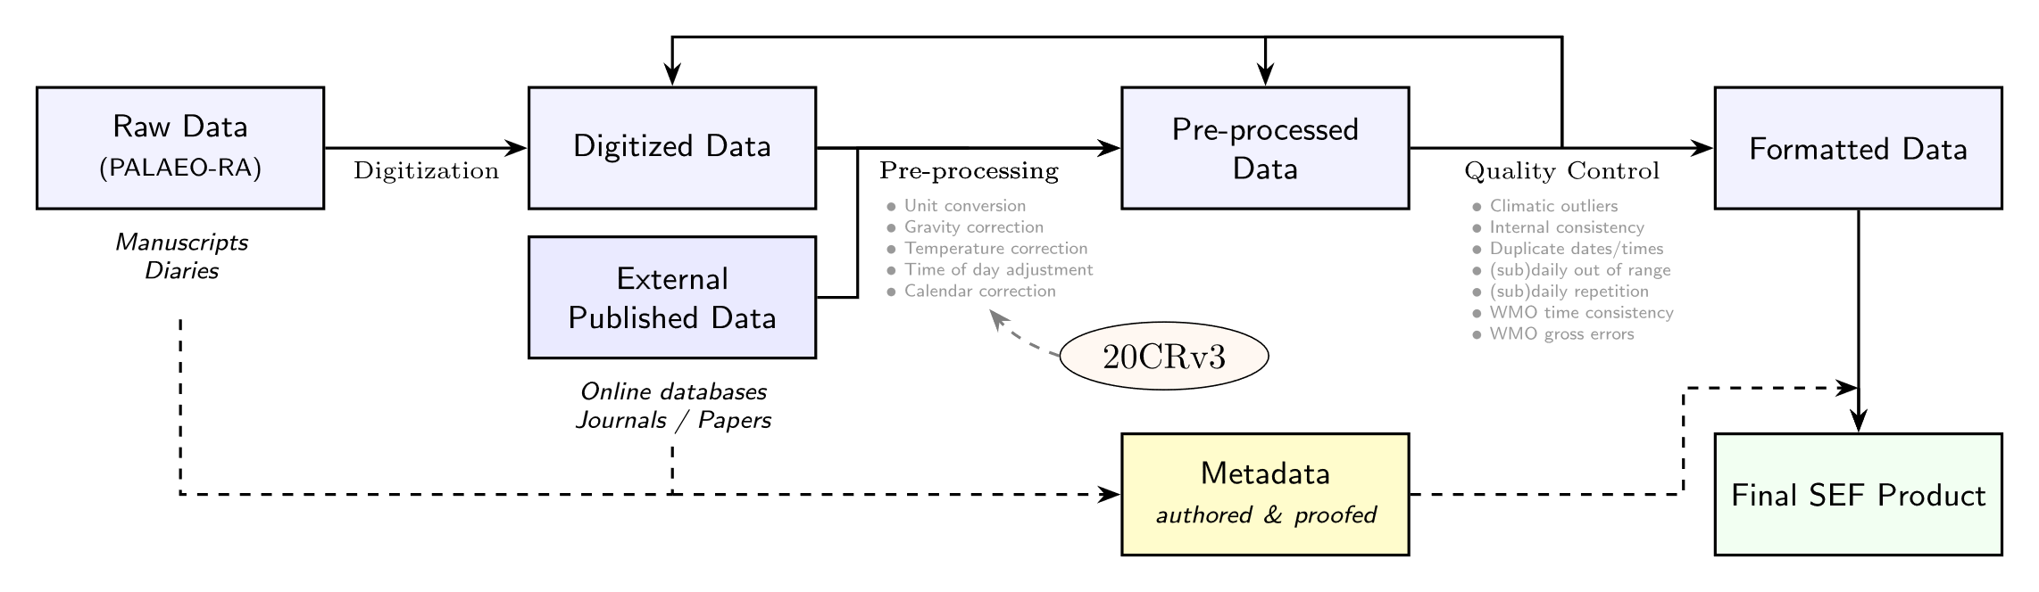
HIST-DAILY
Data Processing
Notes:
Now let me walk you through how we built the dataset. We started with two streams of input data.

Slide 13
HIST-DAILY
Data Processing
Notes:
The pre-processing step includes unit conversion from historical scales to the international system, time-of-day adjustment and, most crucially for the daily scale, calendar harmonization, as many sources adopted the Gregorian calendar at different points in history.

Slide 14
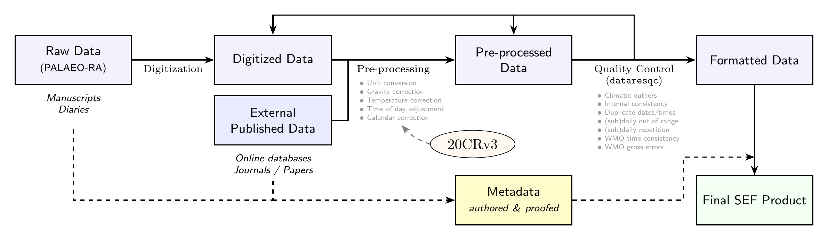
HIST-DAILY
Data Processing
Notes:
Afterwards, the data were submitted to various quality control steps. When QC tests flagged values, we went back to the original sources, where possible, to distinguish digitization errors from real extremes. Clear errors were corrected, and the process was repeated. Values that couldn’t be verified were flagged but not deleted, thus preserving traceability.

Slide 15
HIST-DAILY
Data Processing
Notes:
Then, together with rigorous metadata, the final file is produced in the Station Exchange Format, or SEF.

Slide 16
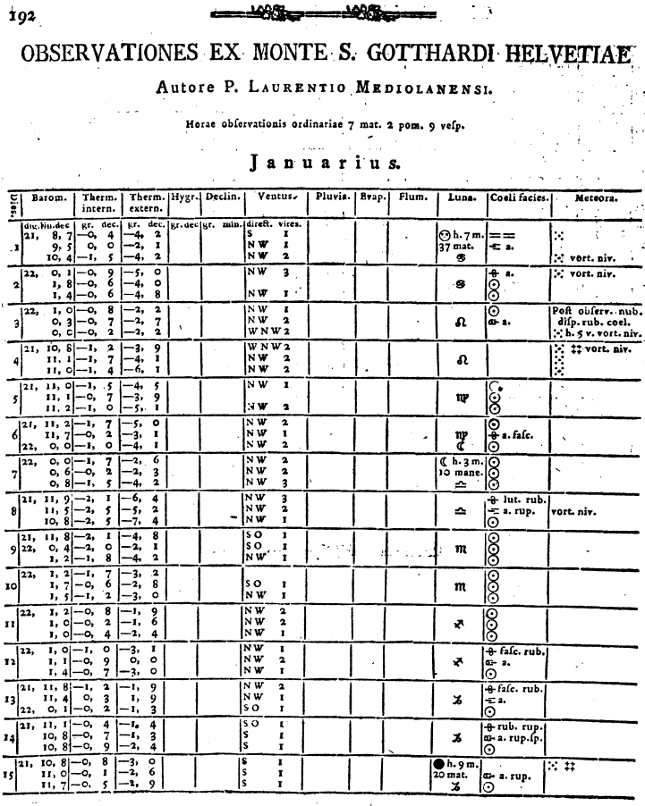
HIST-DAILY
Raw Data
January 2nd, 1790, 07:00
Pressure: 22 inches, 0 lines, 1 decimal
Temperature indoor: – 0 degrees, 9 decimals
Temperature outdoor: – 5 degrees, 0 decimals
Wind direction: NW
Wind intensity: 3
Societas Meteorologica Palatina, Ephemerides Societatis Meteorologicae Palatinae, Annus 1790 (Mannheim, 1783), p. 197. Digitized by the Bayerische Staatsbibliothek.
Notes:
These were observed by capuchin fraires 3 times a day.

Slide 17
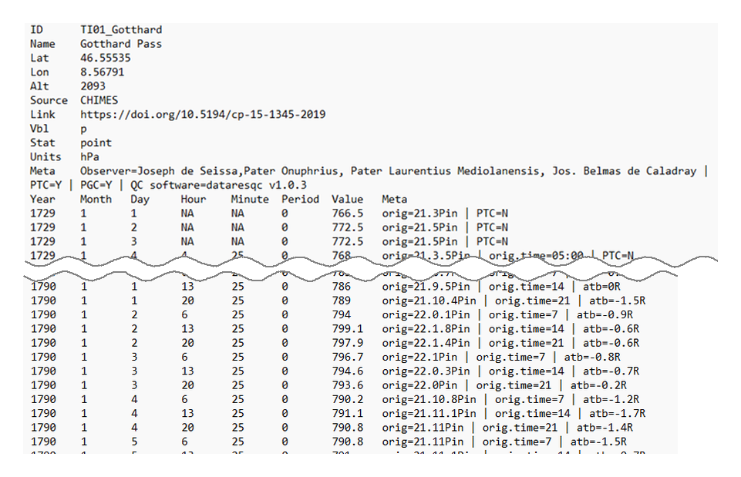
HIST-DAILY
Processed Data
Machine-readable, tabular-separated values
Notes:
The SEF files are a tab-separated text format, and it looks like this. A minimal header carries all station metadata, and each row corresponds to one observation with its original value and any corrections documented in the metadata column. The idea is that the dataset will be easy to integrate into reanalysis pipelines and other rescue efforts.

Slide 18
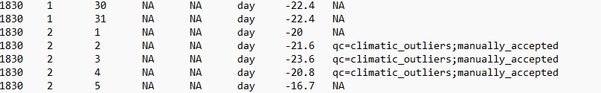

HIST-DAILY
Problematic Data
29th of February in non-leap years (Valencia)
(31st of September are quite popular too)
Manually approved climatic outliers (Jena)
Later adoption of Gregorian calendar (Odesa)

Slide 19
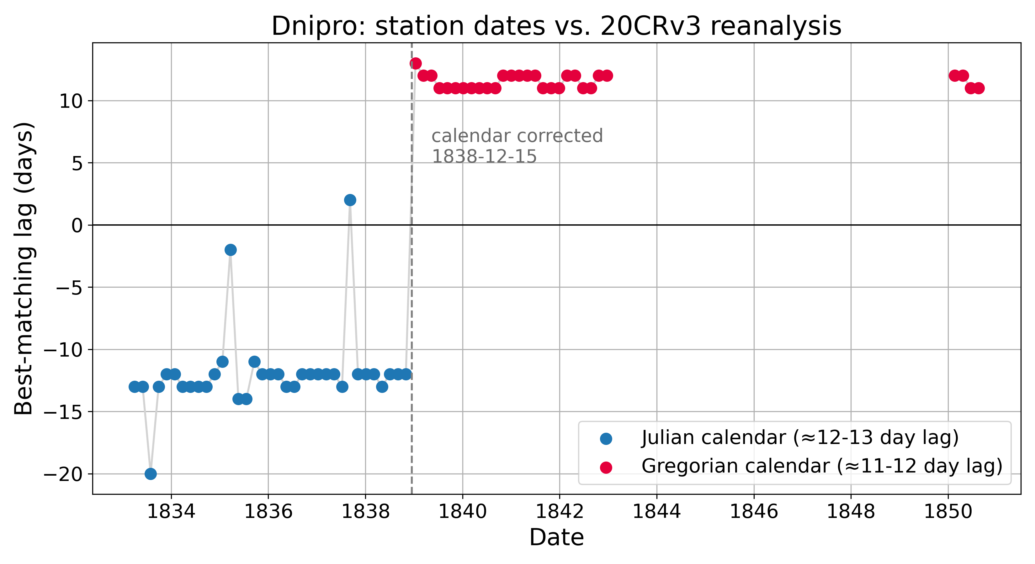
HIST-DAILY
Problematic Data
Skrynyk, O., Luterbacher, J., Allan, R., Sidenko, V., Saloid, K., Xoplaki, E., ... & Osadchyi, V. (2026). Early Instrumental Weather Observations From Ukraine: The ClimUAsd‐Stn. v2 Dataset, 1808–1880. Geoscience Data Journal, 13(1), e70050.

Slide 20
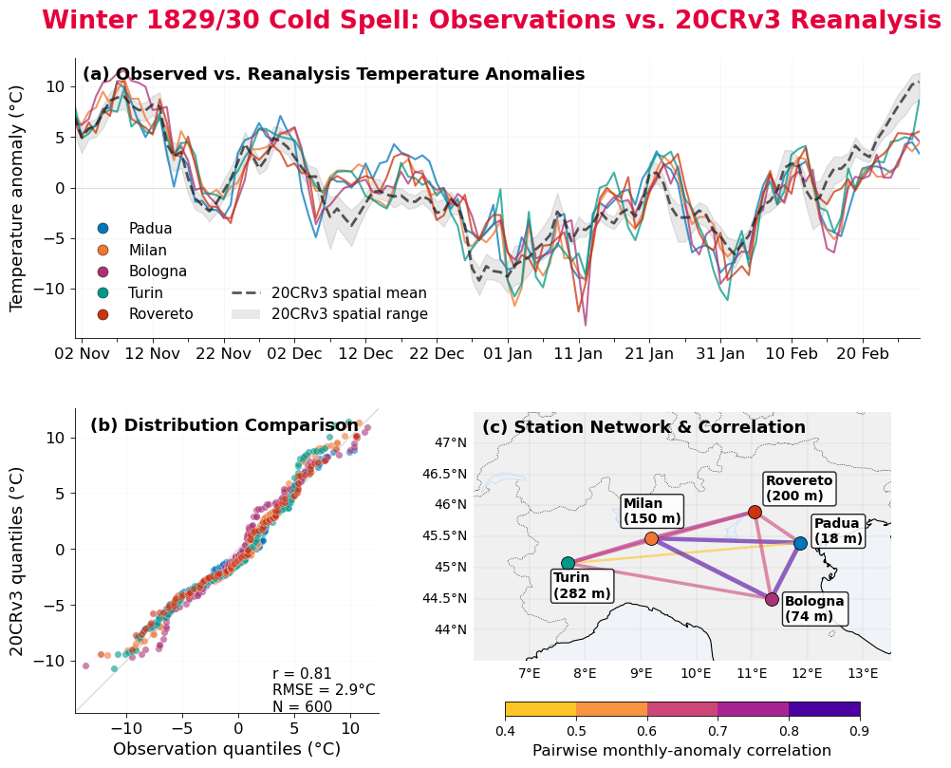
HIST-DAILY
Case Study
Notes:
Now let’s go for a validation example, the cold winter of 1829/30, one of the coldest winters on record in Europe, that’s the one I showed at the beginning. The top panel shows daily temperature anomalies from five northern Italian stations, compared to the 20th century reanalysis ensemble mean and spread for the corresponding cells. Two things stand out. First, the 5 stations agree remarkably well with each other, which gives us confidence that our quality control preserves real climate signals. Second, the reanalysis follows the observations closely in timing but consistently underestimates the depth of the cold extremes. The bottom panels show this quantitatively, as the observed distribution has heavier cold tails than 20CR reproduces. The panel on the bottom right shows pairwise correlations between the stations, confirming internal consistency across independent records.
This case study shows that HIST-DAILY can capture extremes that current reanalyses underestimate, with the kind of information needed to improve them.
##
NO The pressure field for the cold winter 1829/30 indicates a
strong blocking of the westerlies connected with a cold temperature pattern. A cold anticyclone with strong
northeasterly airflow prevailed over northeastern Europe, connected with advection of cold air masses to
Central Europe. The SLP anomalies (dotted lines, 1901–2000 reference period) indicate that the pressure
tendency over the Alps was similar to twentieth-century conditions. The highest positive pressure anomalies
(more than 10 hPa) are found over Scandinavia.

Slide 21
HIST-DAILY
Outlook
1803 series of daily & sub-daily European observations before 1900
Multi-variable: temperature, pressure, precipitation, wind direction
Rigorous quality control
Ready to assimilate into historical reanalyses
The data will be available in the PANGAEA® Data Publisher once approved.
https://www.pangaea.de/
Carlota Corbella | carlota.corbellaalcantara@unibe.ch
Notes:
To summarize: HIST-DAILY brings together more than 1,800 daily and sub-daily series from across Europe before 1900 standardized in SEF format. It combines multiple variables at the same locations, enabling studies of past extreme events and synoptic dynamics that monthly data cannot resolve. Ongoing work focuses on assimilating these observations into reanalysis models to improve our picture of historical weather. The dataset will be available through the BORIS portal at the University of Bern. Thank you — I'm happy to take questions.

