Slide 1
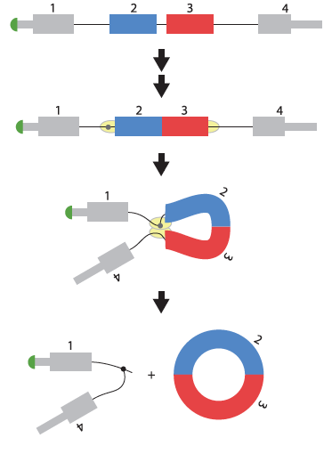
1: Biogenesis and function of exonic circular RNAs
Abundance
Conservation
Function
Salzman et al., PLoS ONE 7(2): e30733.

Slide 2
2: Viral translation strategies
IRES (e.g. poliovirus, hepatitis C virus)
Specialized ribosomes
Cap snatching (e.g. influenza virus)
WIREs RNA 2014. doi: 10.1002/wrna.1246

Slide 3
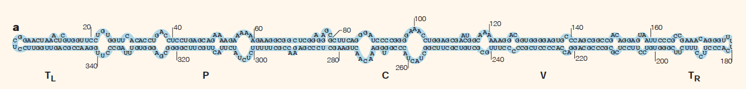
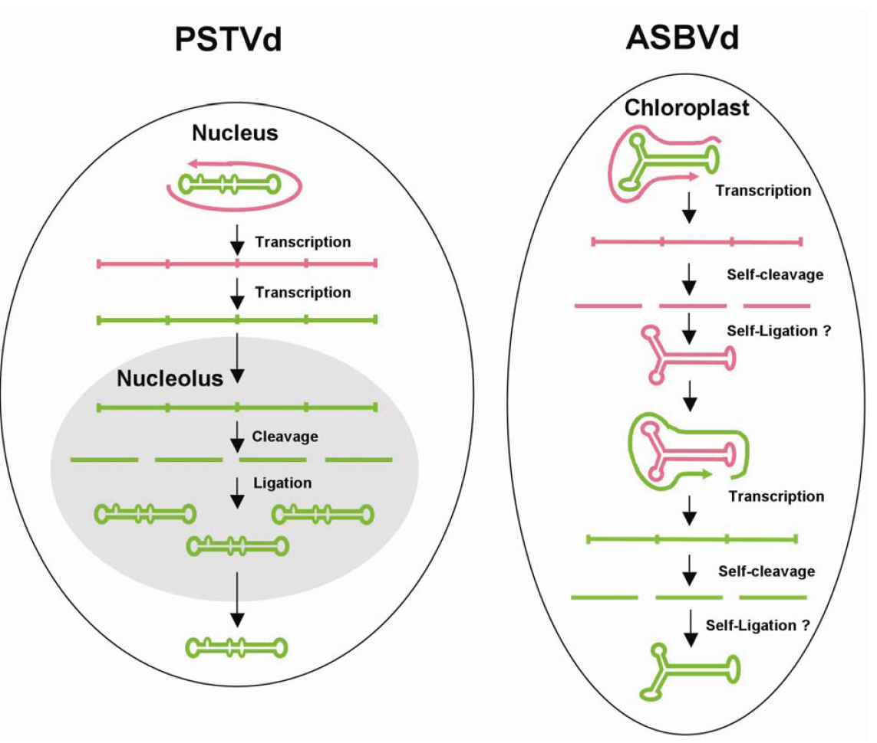
3:Viroids: autonomously replicating, pathogenic non-coding RNA

Slide 4
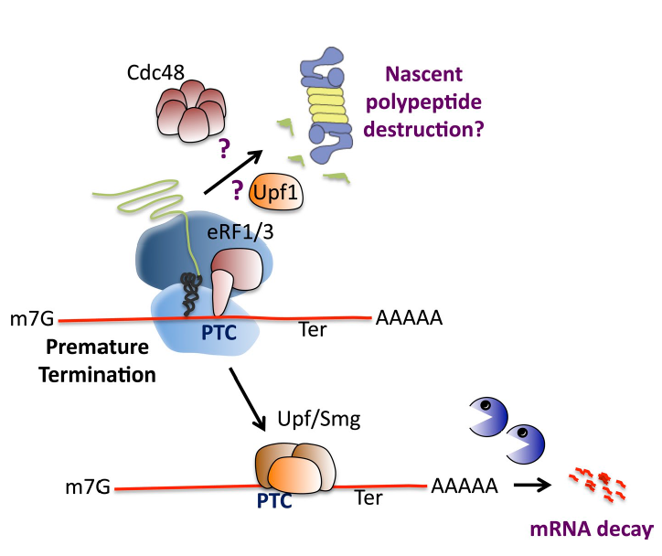
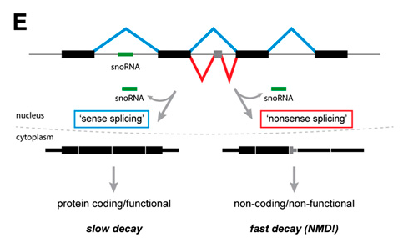
4: Non-sense mediated decay – from quality control to gene regulation
Lykke-Andersen J J Cell Biol (14)
Lykke-Andersen S Genes and Development (14)

Slide 5
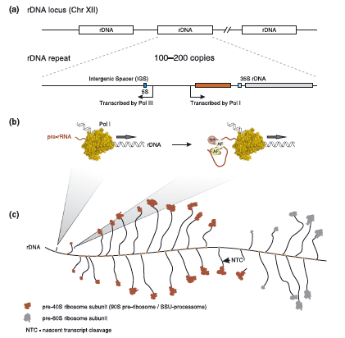
5: Ribosome biogenesis
Turowski WIRES RNA (15)

Slide 6
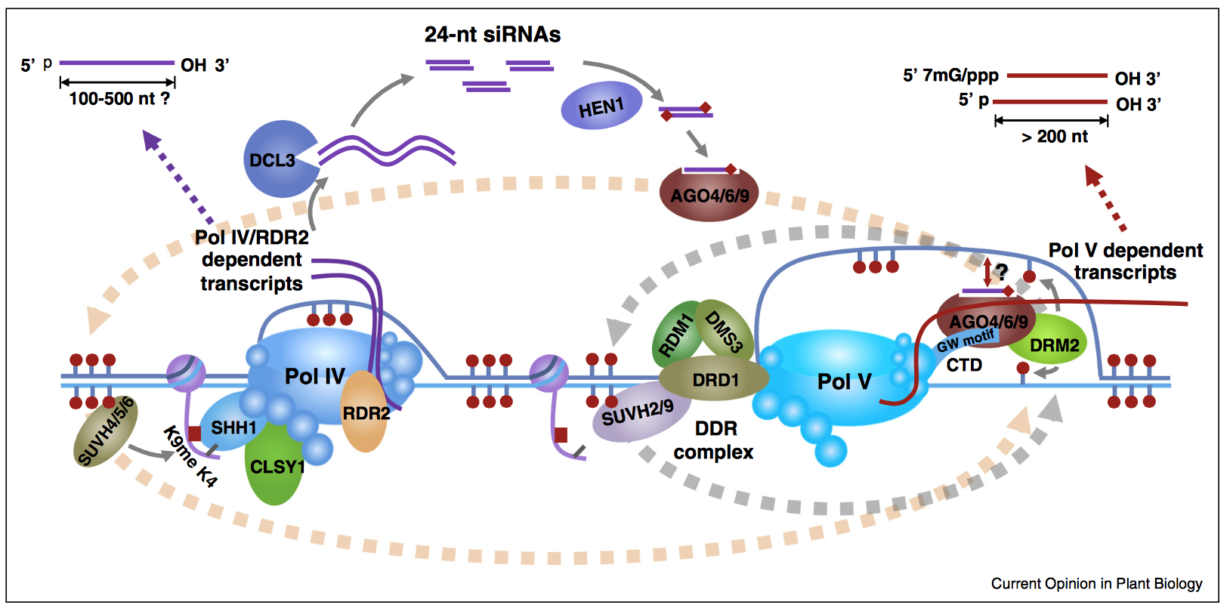
6: RNA Polymerases IV and V: evolution and function

Slide 7
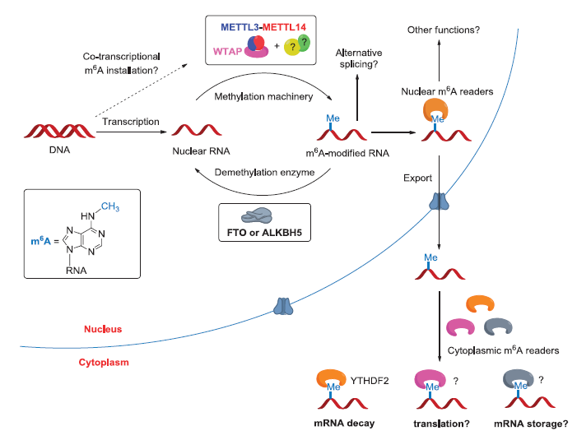
7: Functional consequences of adenine methylation in mRNA
Yue Genes and Development (15)

Slide 8
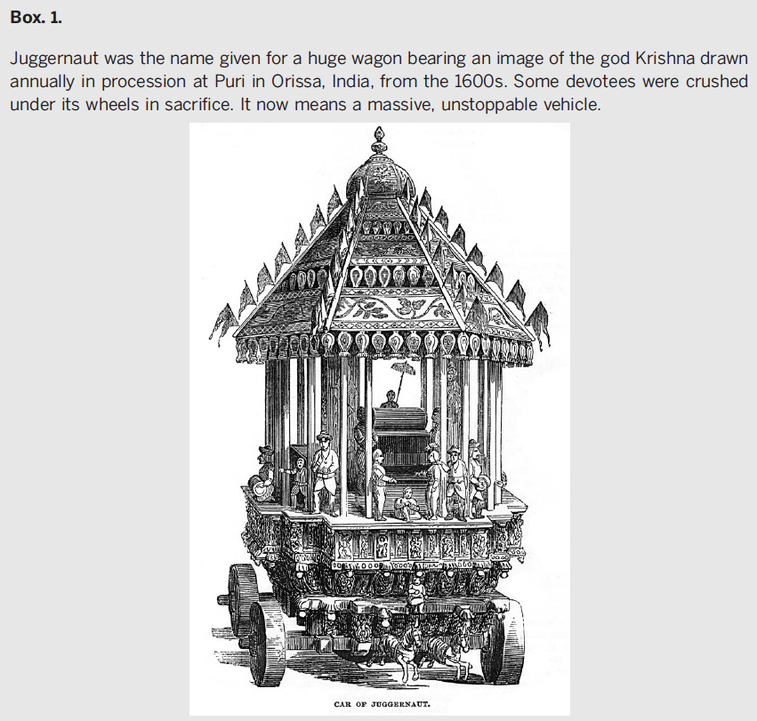
8: Molecular mechanisms underlying RNA Polymerase II termination
“Stopping the RNA polymerase II juggernaut”

Slide 9
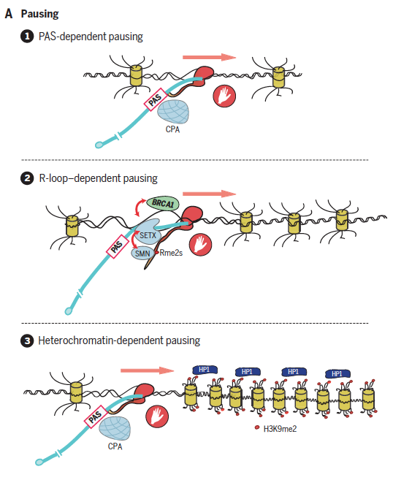
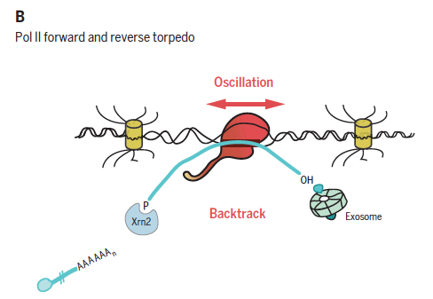
8: Molecular mechanisms underlying RNA Polymerase II termination

Slide 10
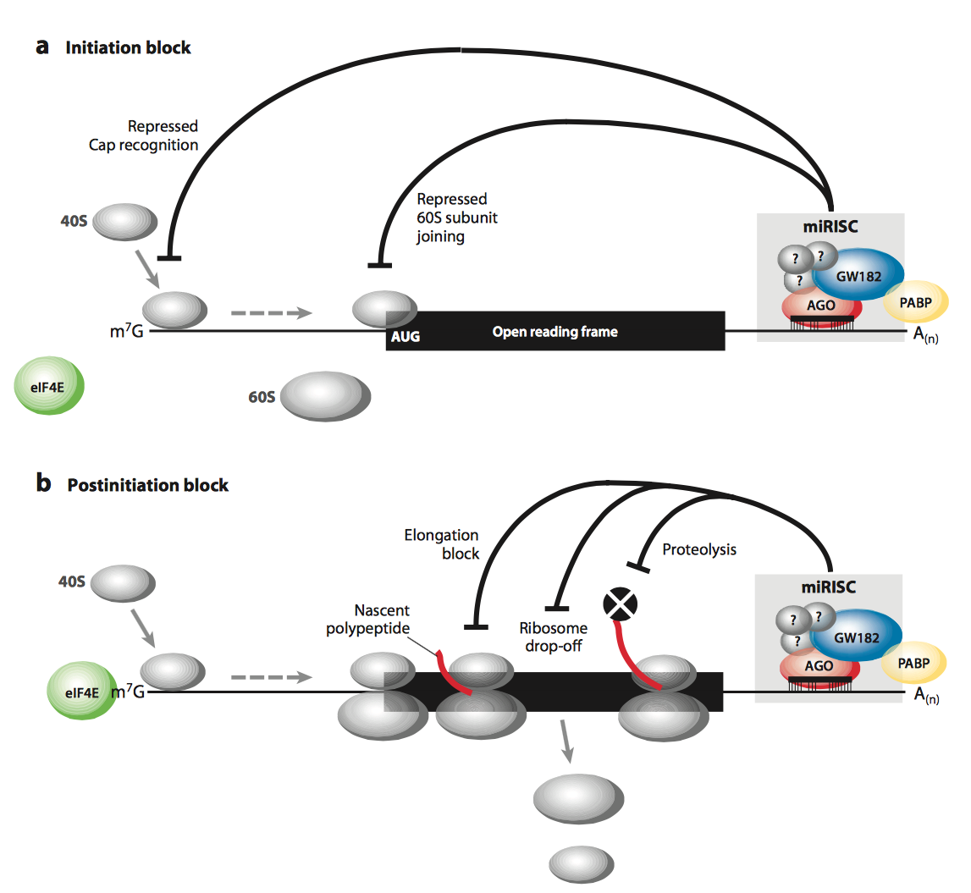
9: Mechanism of miRNA-guided translational repression

Slide 11
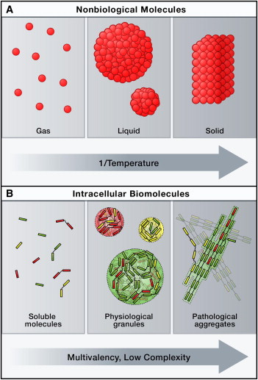
10: RNA binding proteins and formation of membrane-less bodies
Cell 149, 1188-1191 (2012)

Slide 12
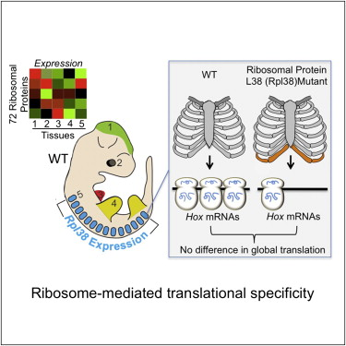
11: Implication of the ribosome in regulation of specific genes
Cell 145, 383–397 (2011)

Slide 13
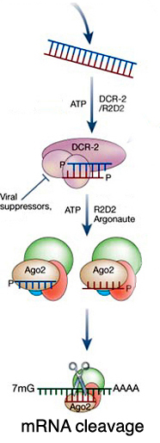
12: RNA-dependent RNA Polymerases
DICER
sRNA
Sequence-specificity
RdRP
RISC
[Argonaute]
Effector
Example of effect

Slide 14
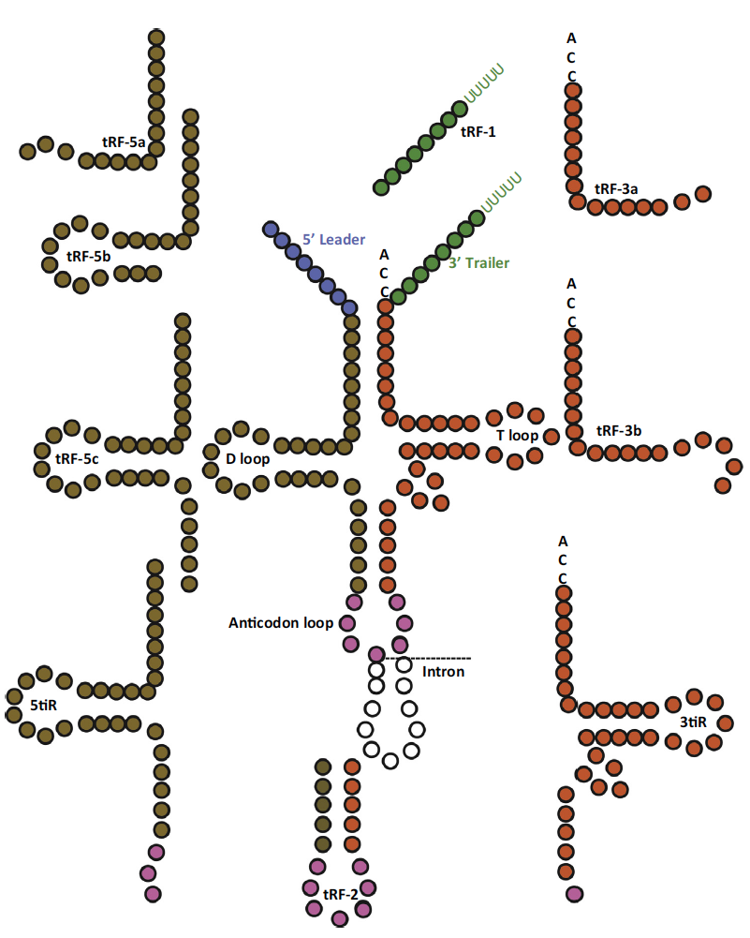
13: Biogenesis and function of tRNA fragments

Slide 15
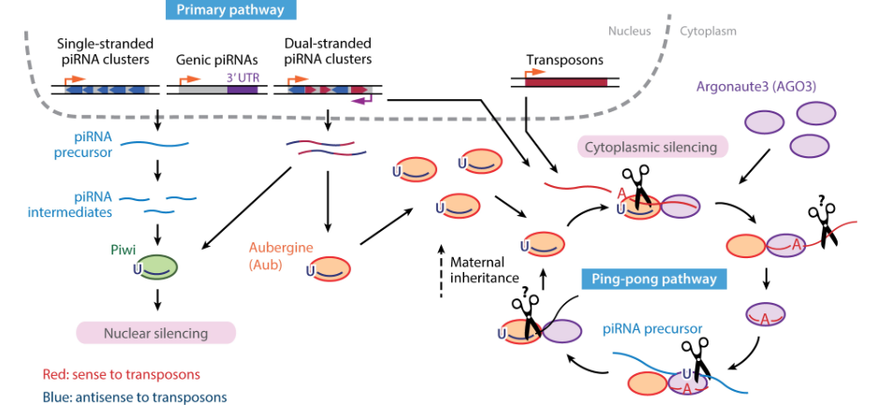
14: piRNA-guided silencing of transposable elements

Slide 16
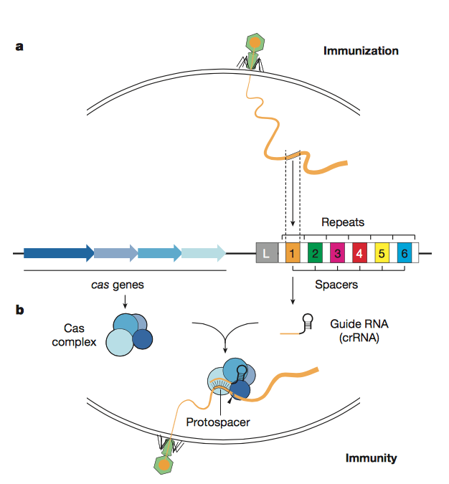
15: Antiviral defence via CRISPR-Cas systems

Slide 17
Topics
1: Circular RNAs: occurrence and function in gene regulation
2: Viral translation strategies
3: Viroids: autonomously replicating, pathogenic non-coding RNA
4: Non-sense mediated decay – from quality control to gene regulation
5: Ribosome biogenesis
6: RNA Polymerases IV and V: evolution and function
7: Functional consequences of adenine methylation in mRNA
8: Molecular mechanisms underlying RNA Polymerase II termination
9: Mechanism of miRNA-guided translational repression
10: RNA binding proteins and formation of membrane-less bodies
11: Implication of the ribosome in regulation of specific genes
12: RNA-dependent RNA Polymerases
13: Biogenesis and function of tRNA fragments
14: piRNA-guided silencing of transposable elements
15: Antiviral defence via CRISPR-Cas systems

