Slide 1


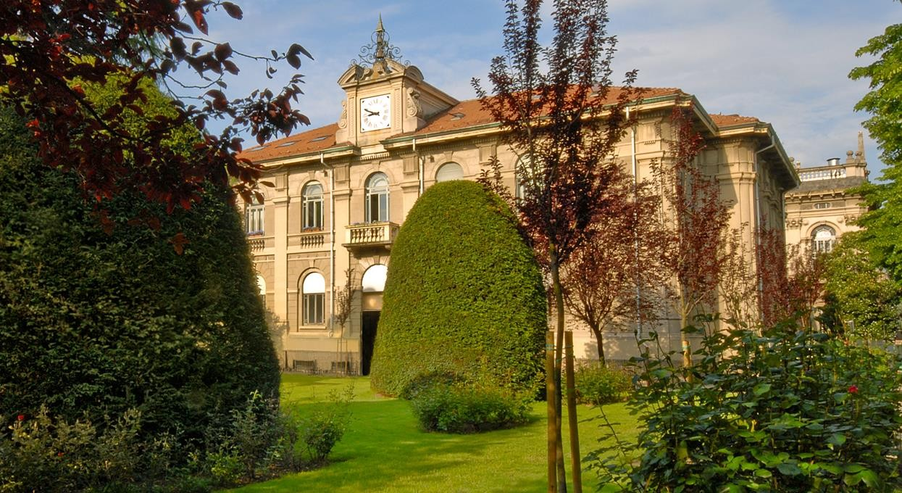

Geoinformatics Engineering
Virtual Support Vector Machine
with Active Learning Method
for Multispectral Image Classification
Lorenzo Carlassara
2023/2024

Slide 2
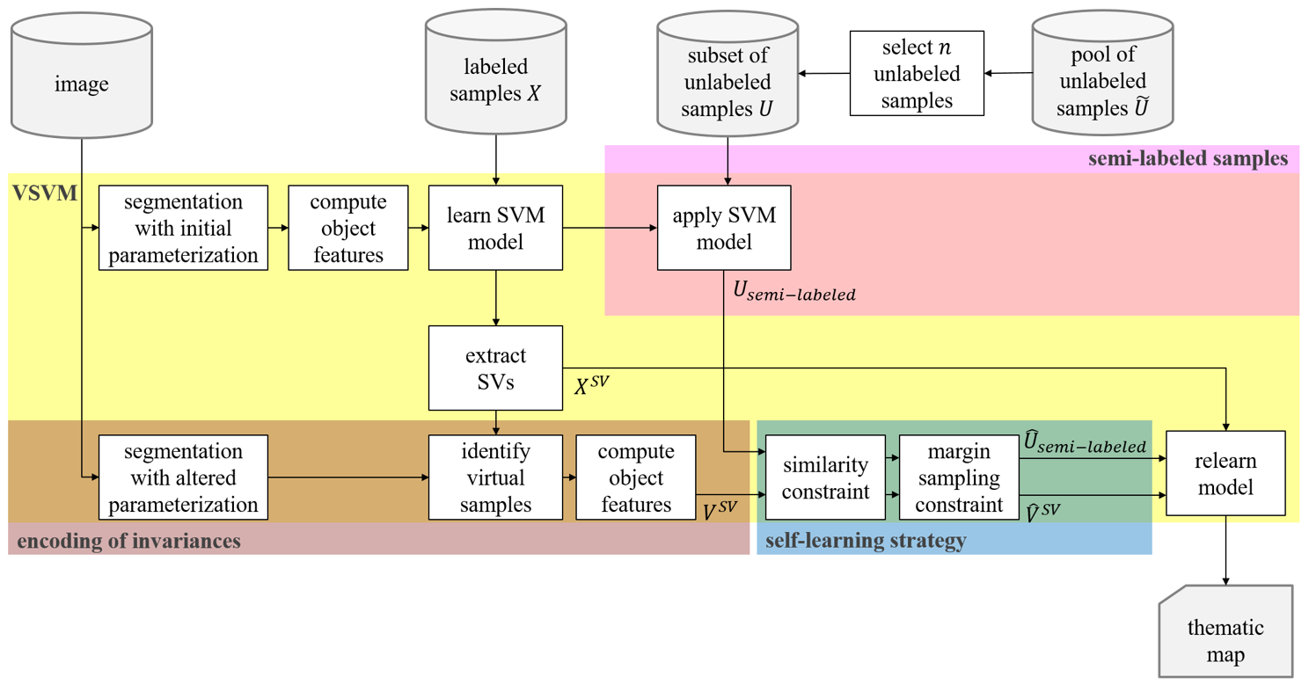

Previous block scheme
Virtual Support Vector Machines with self-learning strategy for classification of multispectral remote sensing imagery
Semi-Supervised Learning with Constrained Virtual Support Vector Machines for Classification of Remote Sensing Image Data (Geiss)
Semi-Supervised Virtual Support Vector Machines with Self-Learning Constraint for Remote Sensing Image Classification (Ozan)
Lorenzo Carlassara

Slide 3
VSVM background
Lorenzo Carlassara

Slide 4

Datasets & Models collection
Cologne, Germany
Hadagera, Kenya
SVM: Support Vector Machine
SVM-MS: include all multilevel segmentations
VSVM: enconding invariance wrt the SVs
VSVM-SL: Self-learning strategy
remove VSVs:
over a certain distance wrt the original SVs
outside radius threshold on margin distance
SVM-SL-UNL
VSVM-SL-UNL
VSVM-SL-virtual-UNL
VSVM-SL + Active Learning distance function
Invariances of shape: base level + 8 level
Invariances of scale: L4 base level + 9 level
Binary classification
Multiclass classification with 5/6 classes
Unlabeled Sampling
Execution order of the import section
New Train set after VSVM
Lorenzo Carlassara

Slide 5

Script review
Script understanding
Identify structure
Find the sections to extend
R documentation
Dataset Preprocessing
generalDataPool
normalizedDataPoolAllLev
data
normalized_data
Script customization
Improve code readability
Optimize performance
trainDataCur
trainFeat (sub)
trainDataPoolAllLev
trainLabels
testDataAllLev
testFeatsub
testLabels
validateDataAllLev
validateFeatsub
validateLabels
Uncertainty function
Single level VS multi level
Variable dependencies inside the script
Sequence/Order of SVM model implementation
Lorenzo Carlassara

Slide 6

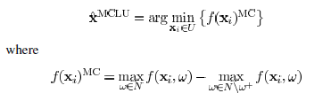
Implemented steps
Multiplecores for parallel computing -> foreach & doParallel libraries
Save trained models
Added class probability
From euclidean distance to kernel distance function
RBF kernel function implementation
Adapt pred_one function to different class label distances
Marging sampling (MULTICORE)
MCLU sampling (MULTICORE)
Uncertainty distance (MULTICORE)
MCLP sampling (MULTICORE)
Lorenzo Carlassara

Slide 7



Current progress
Active Learning framework
A Survey of Active Learning Algorithms for Supervised Remote Sensing Image Classification
Active Learning Methods for Remote Sensing Image Classification
Large-Margin-Based Active Learning
Margin Sampling MS
Multiclass Level Uncertainty MCLU
Significance Space Construnction SSC
Most Ambiguous and orthogonal MAO
Multiclass level uncertainty-angle-based diversity MCLU-ABD
Multiclass level uncertainty-enhanced cluster based diversity MCLU-ECBD
Posterior Probability-Based Active Learning
Kullbach–Leibler divergence KL
Breaking Ties (BT)
Multiclass Level Probability MCLP
Execute code on a different machine
Qiskit python library for VSVM
Lorenzo Carlassara

Slide 8
1. DONE try without indexTrain
3. DONE split alter_samples in multiple iterations
4. DONE check if in the multiclas setting the random / balanced unlabeled samples actually change
5. DONE implement only_probability_distance + check different implementation of mclu (see paper)
6. DONE check if NDVI feature is actually useful
7. DONE boundClass1 issue related to implementation error -> values inside variables
8. DONE implement binary + multiclass in the same script
9. DONE tune alter_label hyperparameter: how many label need to be relabeled?
10. DONE overall hyperparameters optimization e.g. "boundMargin" and "bound"
11. DONE descriptive stats of the dataset/data visualization
12. DONE Kappa-score coefficient definition: change the metric from "kappa" to "accuracy"
15. DONE multiclass script is implemented differently from the binary one -> got different accuracies
17. DONE add shape scripts
18. DONE add hadagera scripts
19. DONE check if it is sufficient to run registerDoParallel(num_cores) just once inside the script
20. DONE either balanced the datapool at the beginning or the each train/test/validate/unlabeled set
21. DONE pick one new sample at time OR pick multiple from different regions/classes
22. DONE plots for different model accuracies with different training data size and unlabeled samples
24. DONE implement VSVM-SL + VIRTUAL Unlabeled Samples on new_tunedVSVM IT
25. DONE use the kernel_function from the base_svm
29. DONE compare VSVM / VSVM_SL / VSVM_SL Unl / VSVM_SL V Unl as base model for ITerative AL
30. DONE check why SVM as an Accuracy of 90% just with 3 samples
31. DONE check sampleSize = sampleSizePor[sample_size] - sampleSizePor[sample_size-1]
32. DONE compare VSVM_SL_Un_it trained on SVM/VSVM with VSVM_SL_Un_b/VSVM_SL_vUn_b
36. DONE try MS with one sample per iteration
39. DONE consider all the levels for the uncertainty distance
41. DONE check warnings in AL binary hagadera -> na due to ncol(samplesRemaining) in UD FUNCS

Slide 9
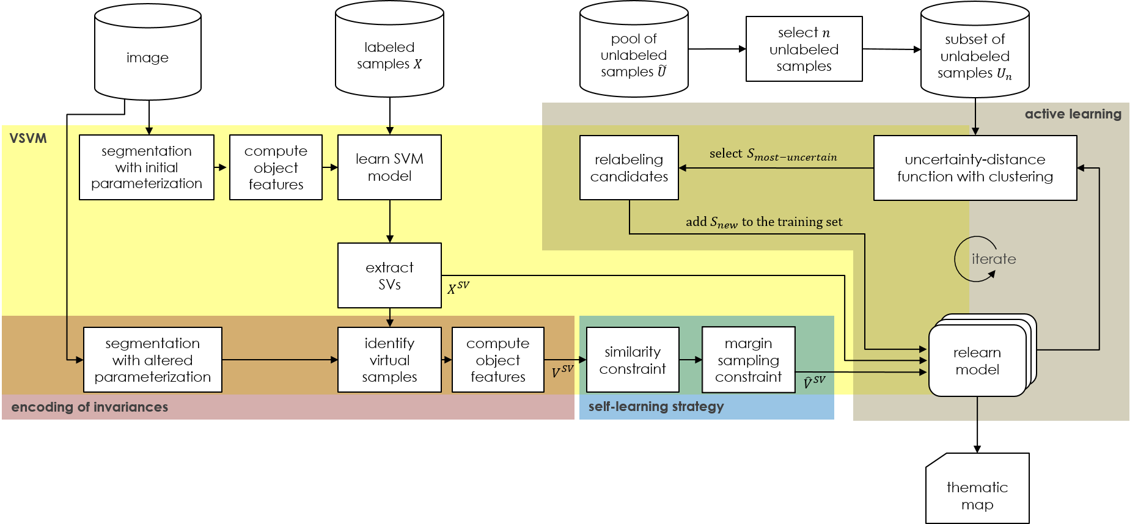
Active learning method for Virtual Support Vector Machine with self-learning constraints
Lorenzo Carlassara

Slide 10
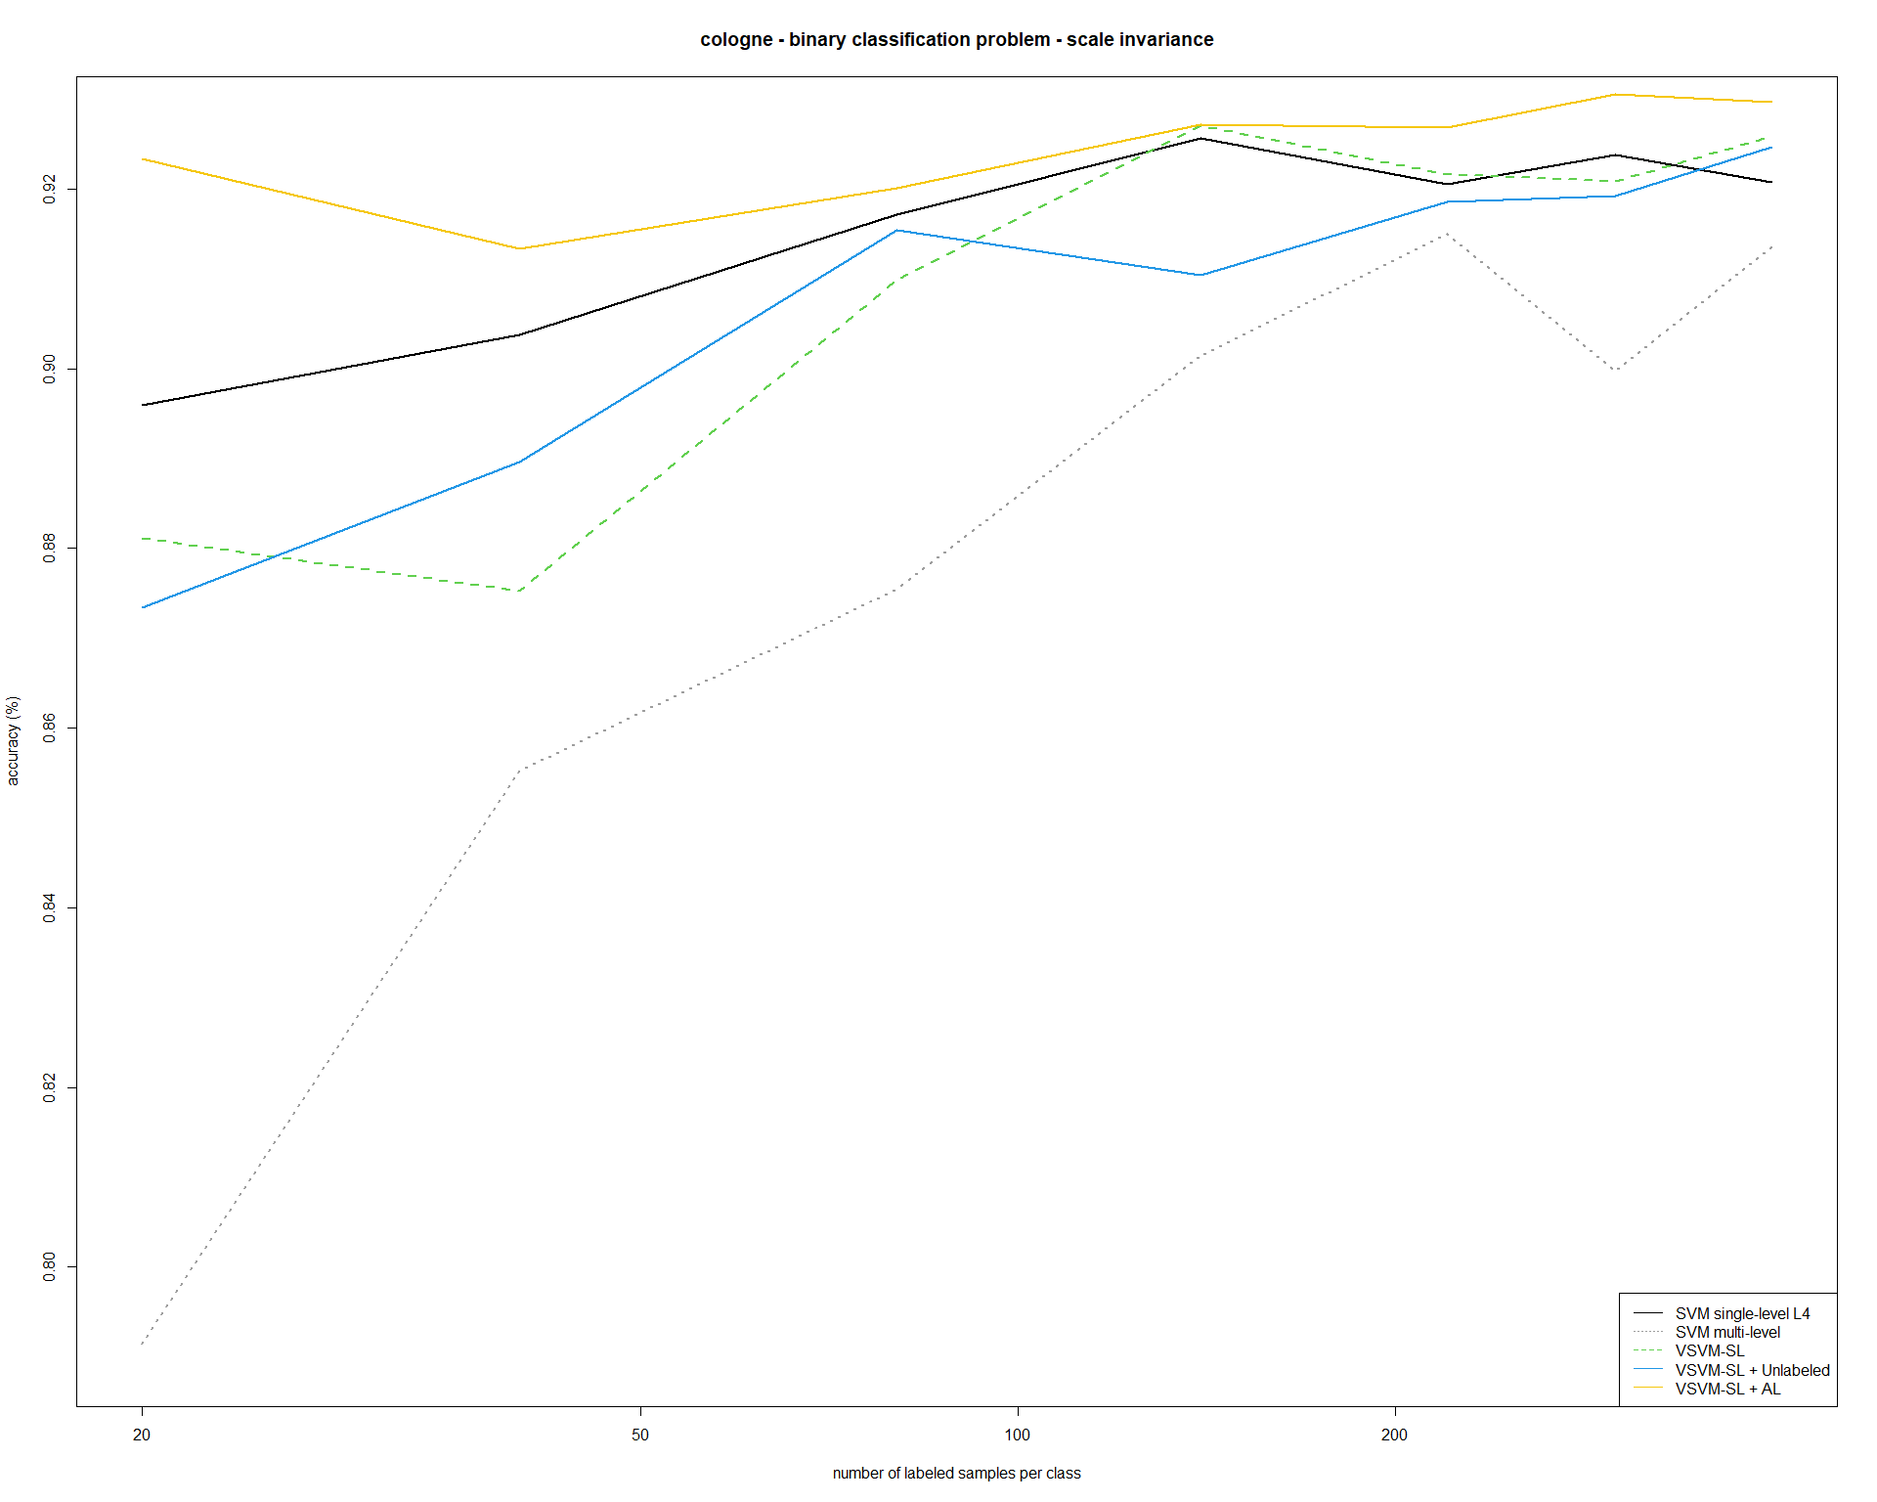
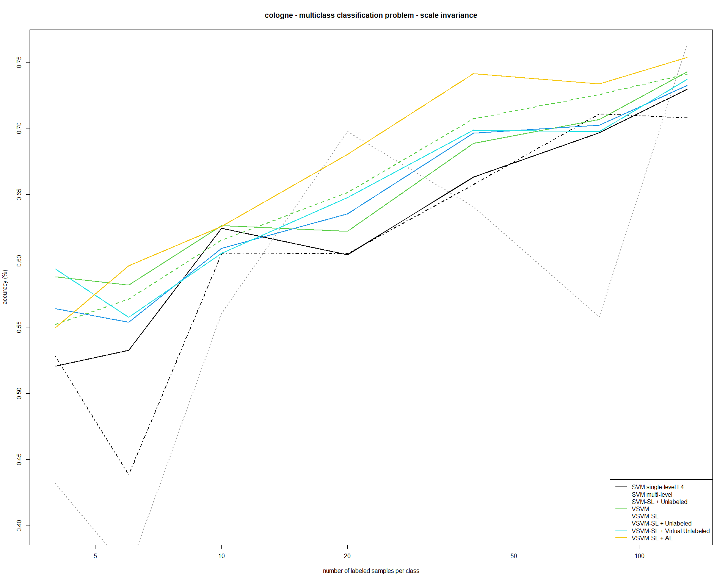
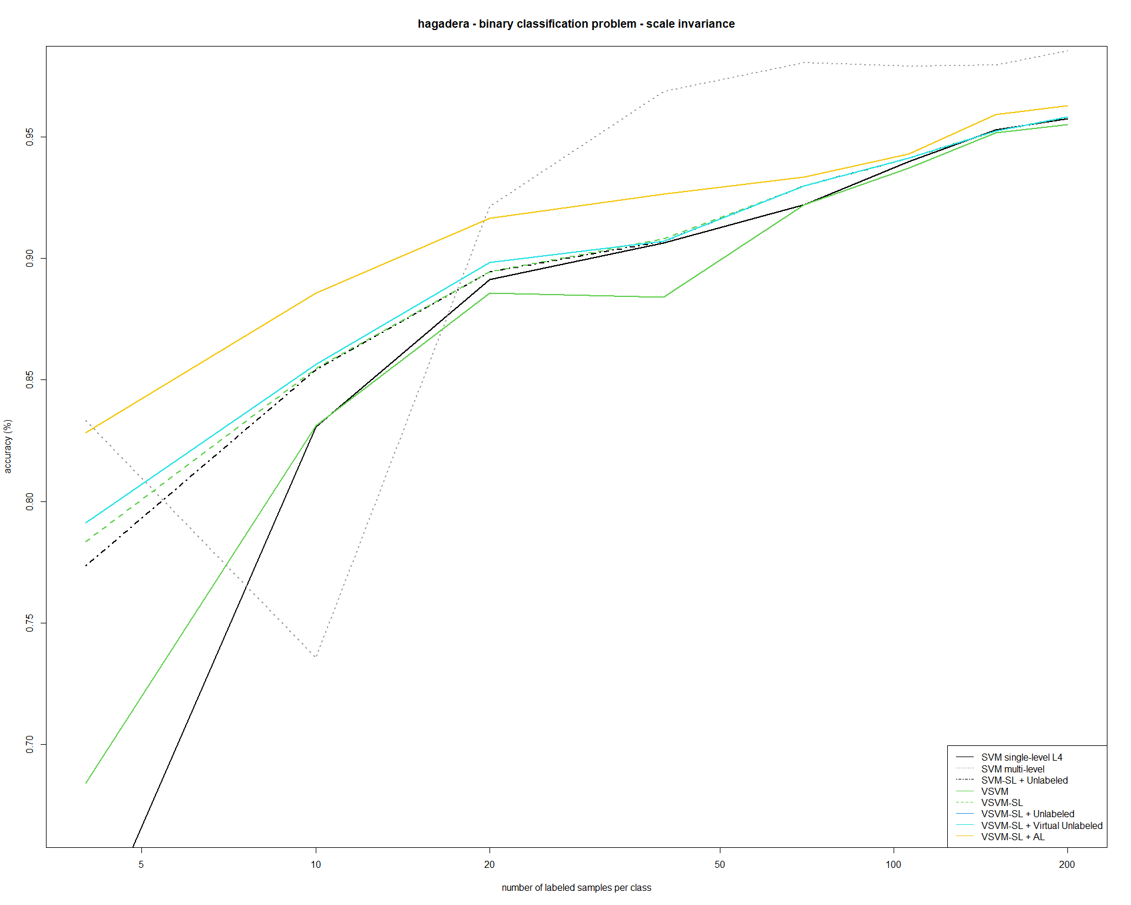
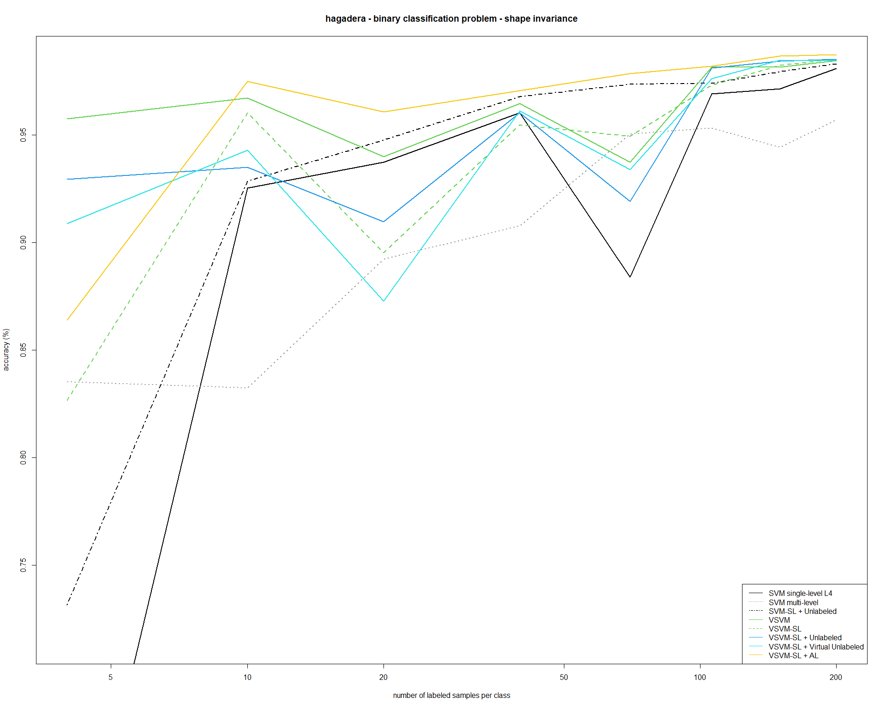

Slide 11
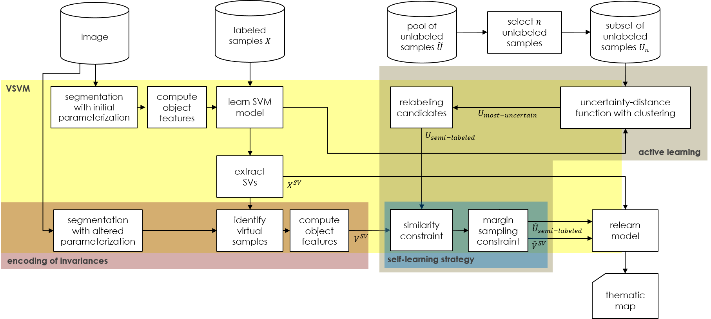
Active learning method for Virtual Support Vector Machine with self-learning constraints
Lorenzo Carlassara

Slide 12
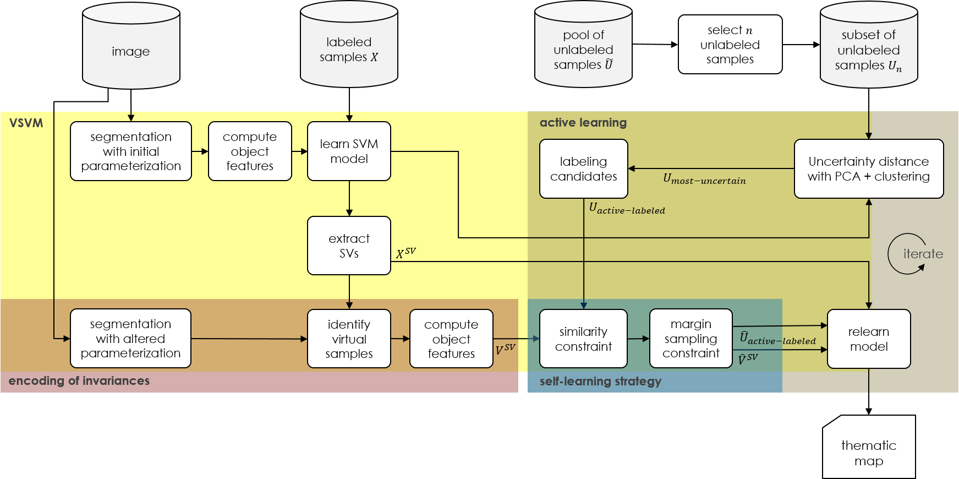
Active learning method for Virtual Support Vector Machine with self-learning constraints
Lorenzo Carlassara

Slide 13
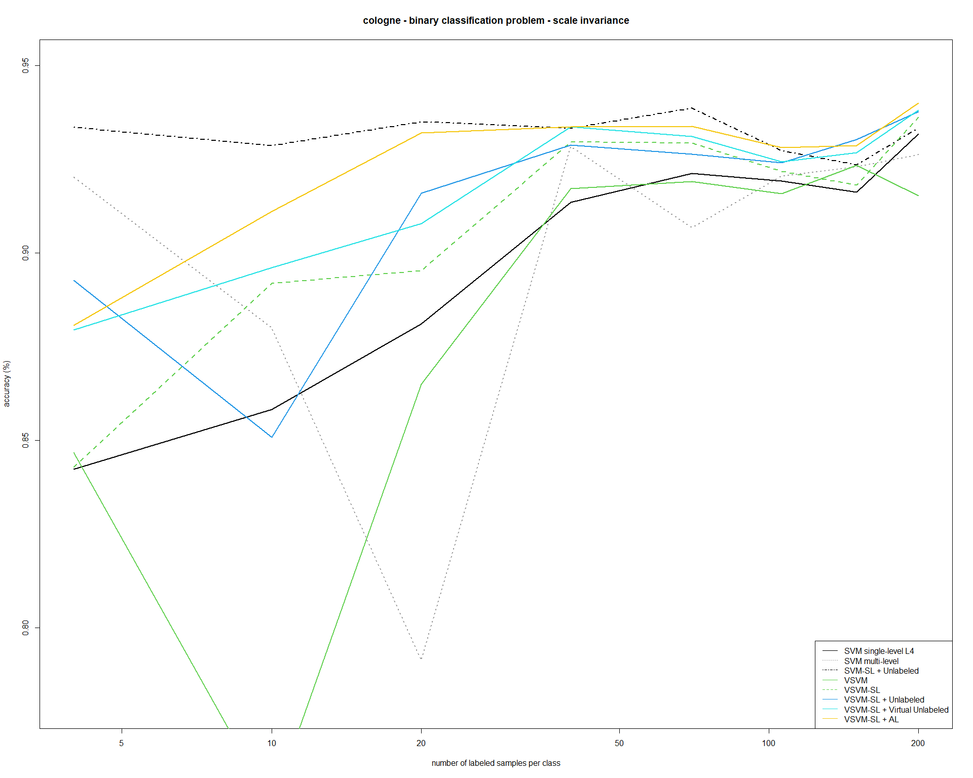
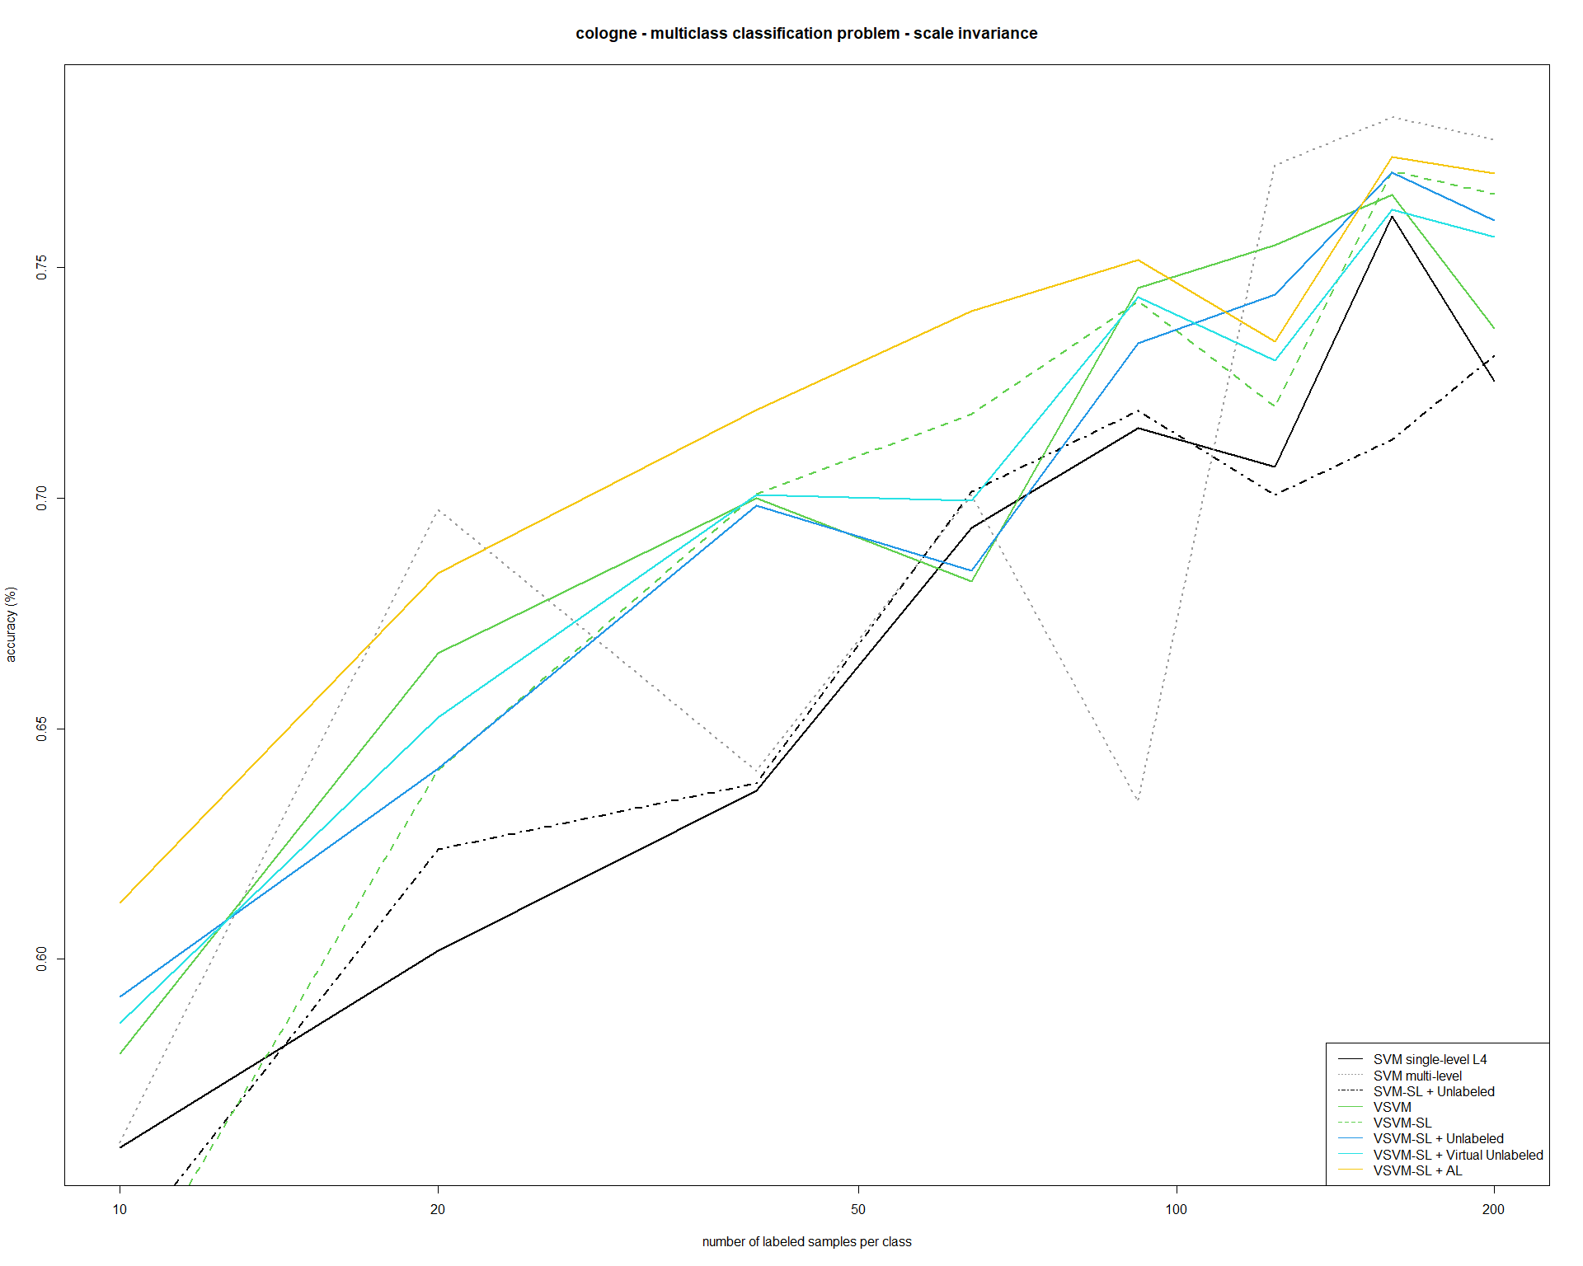

Slide 14
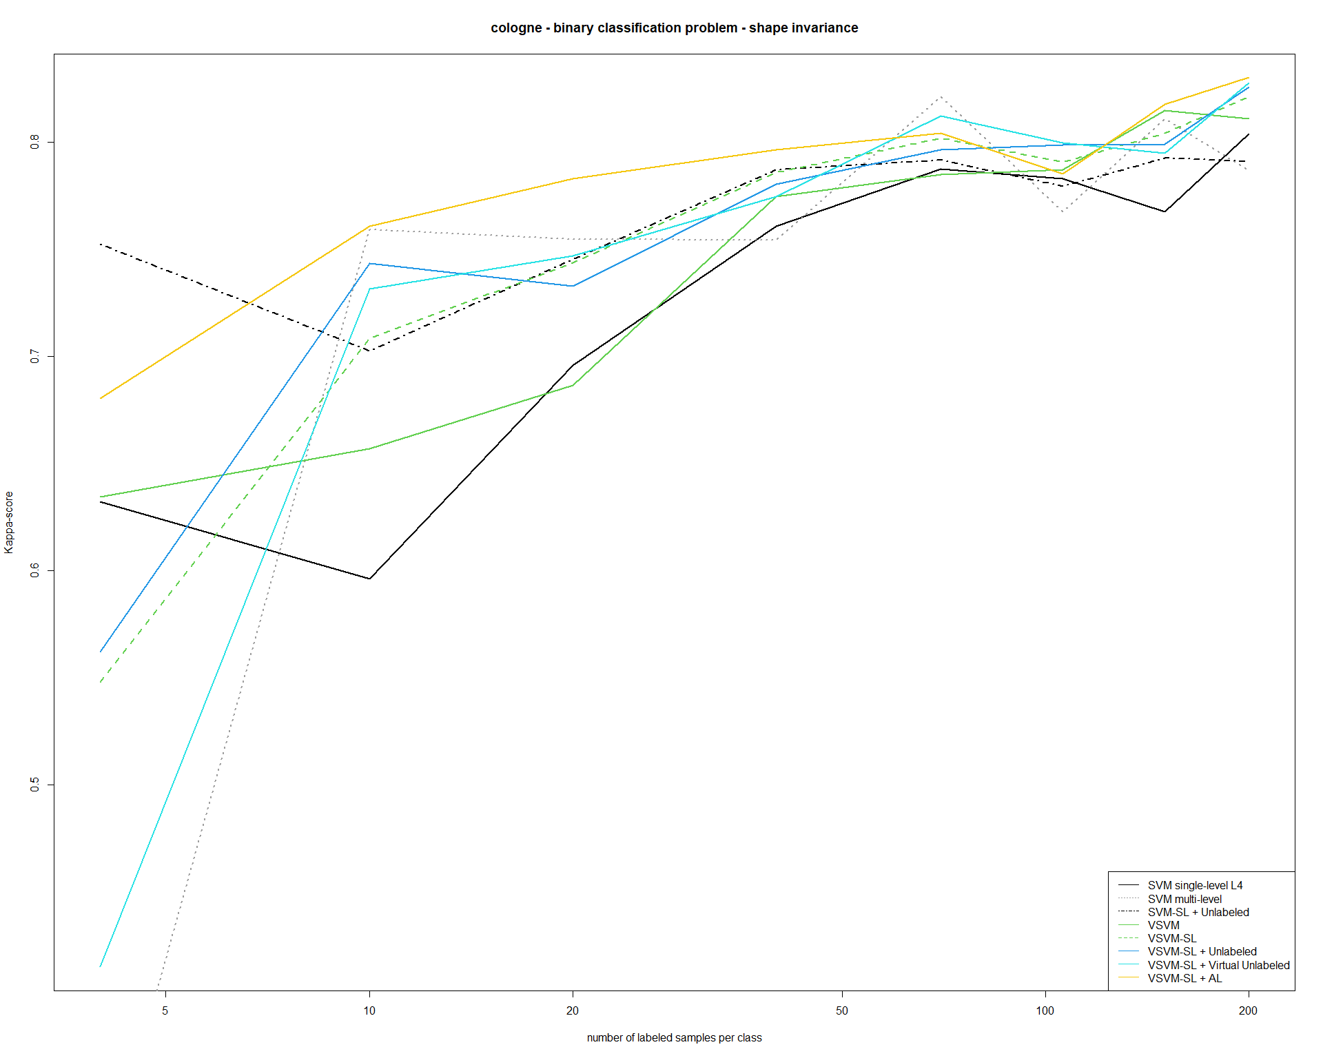
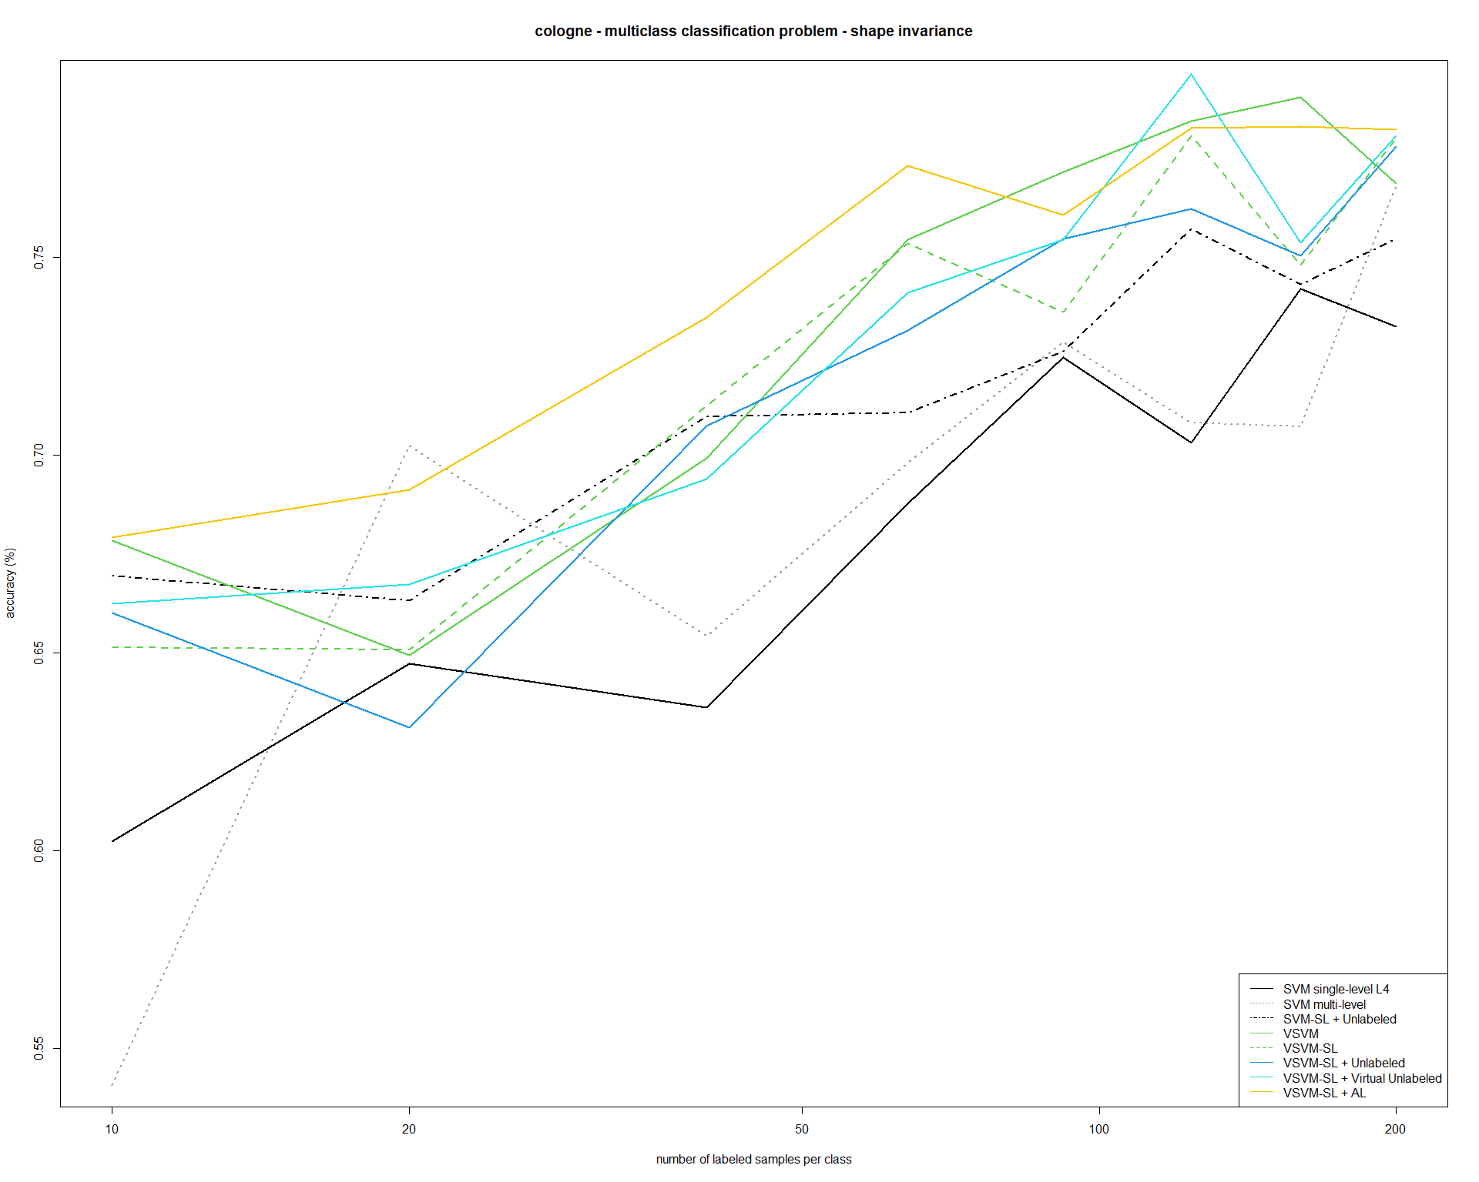

Slide 15
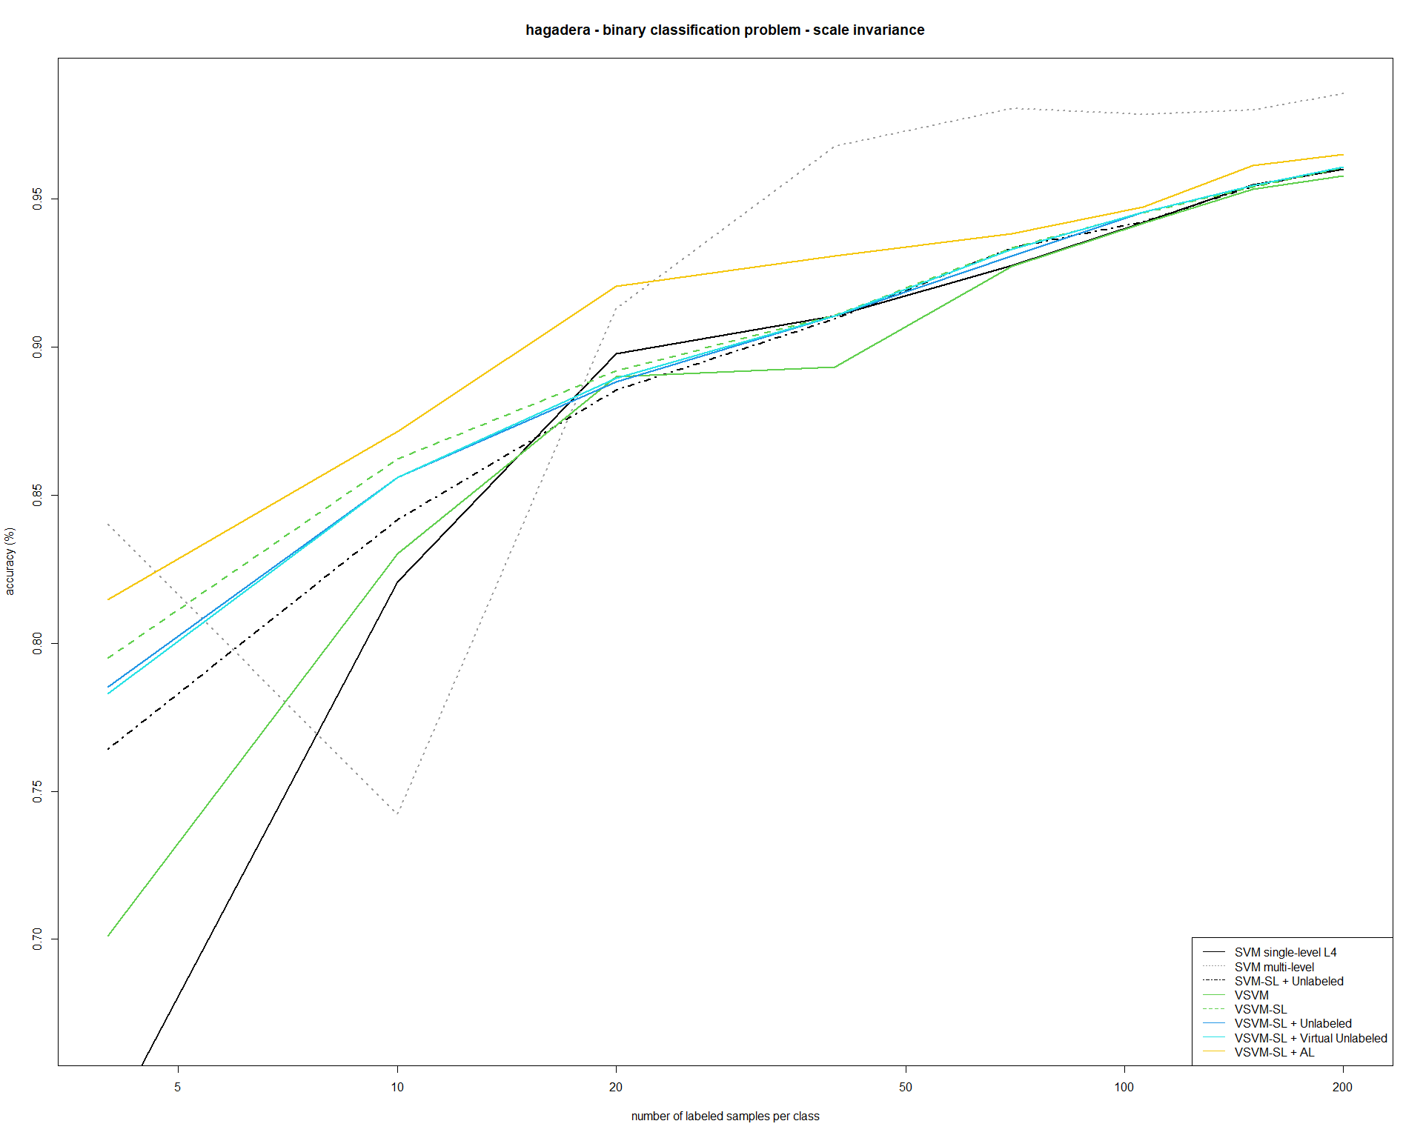
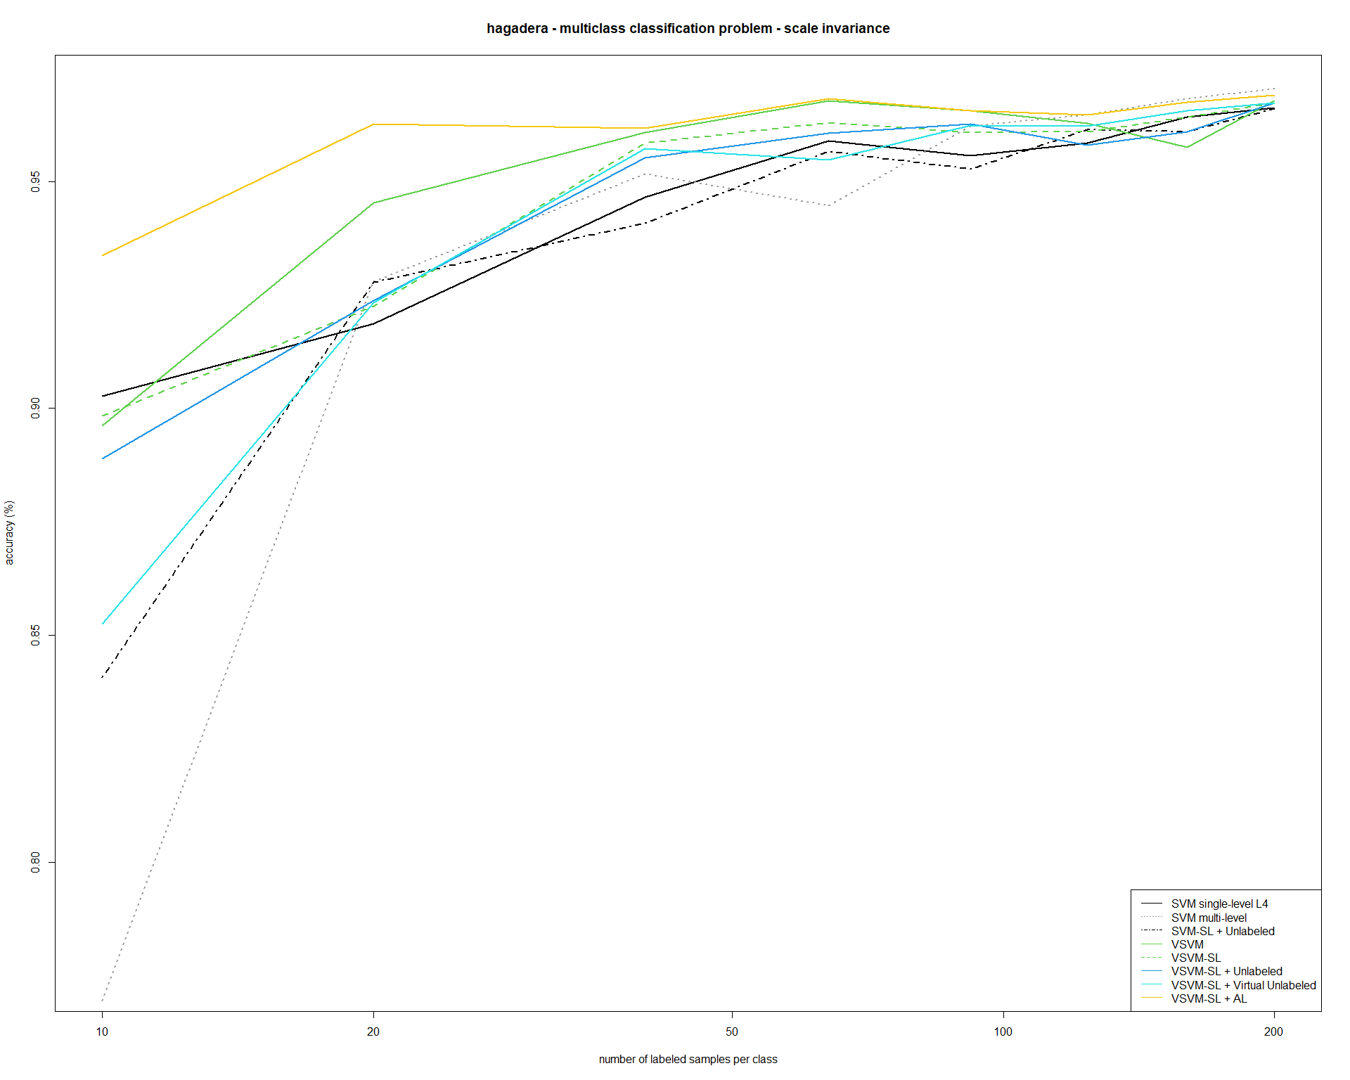

Slide 16
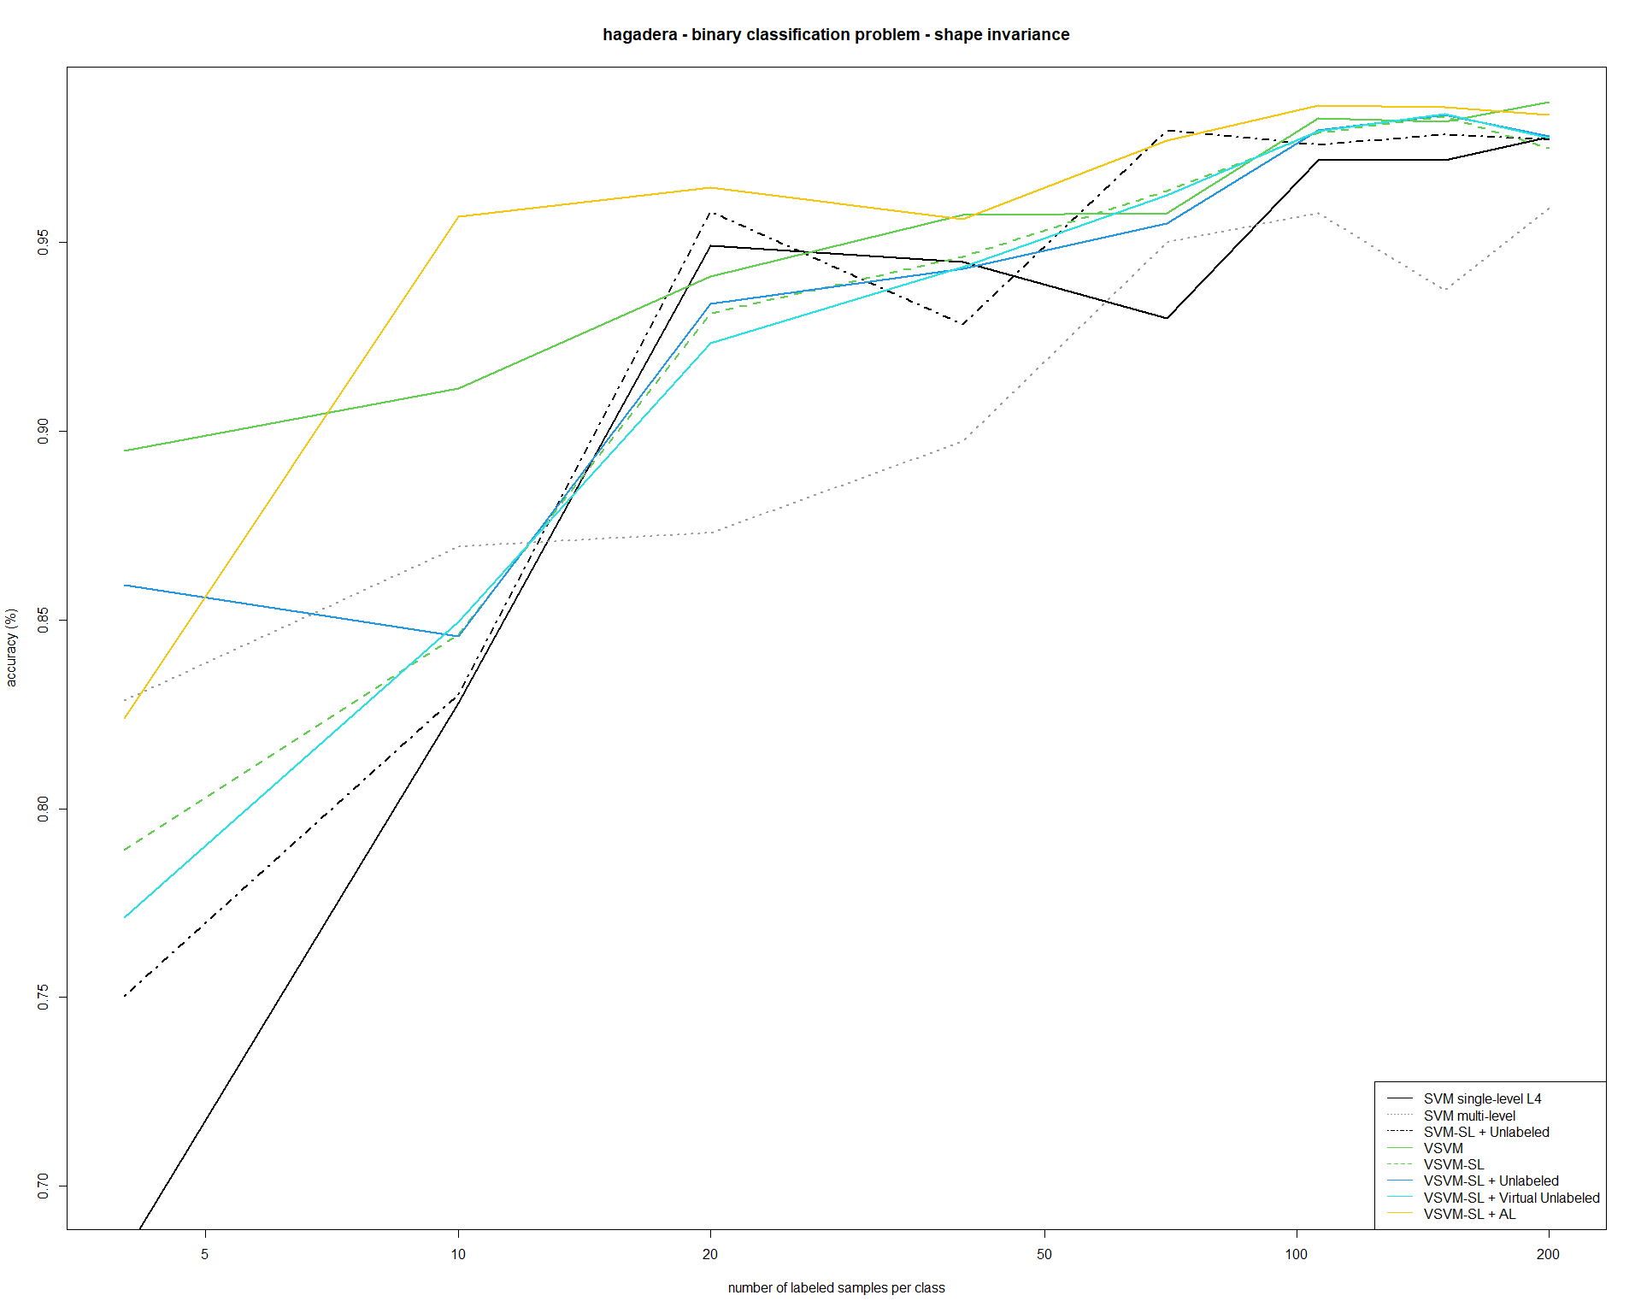
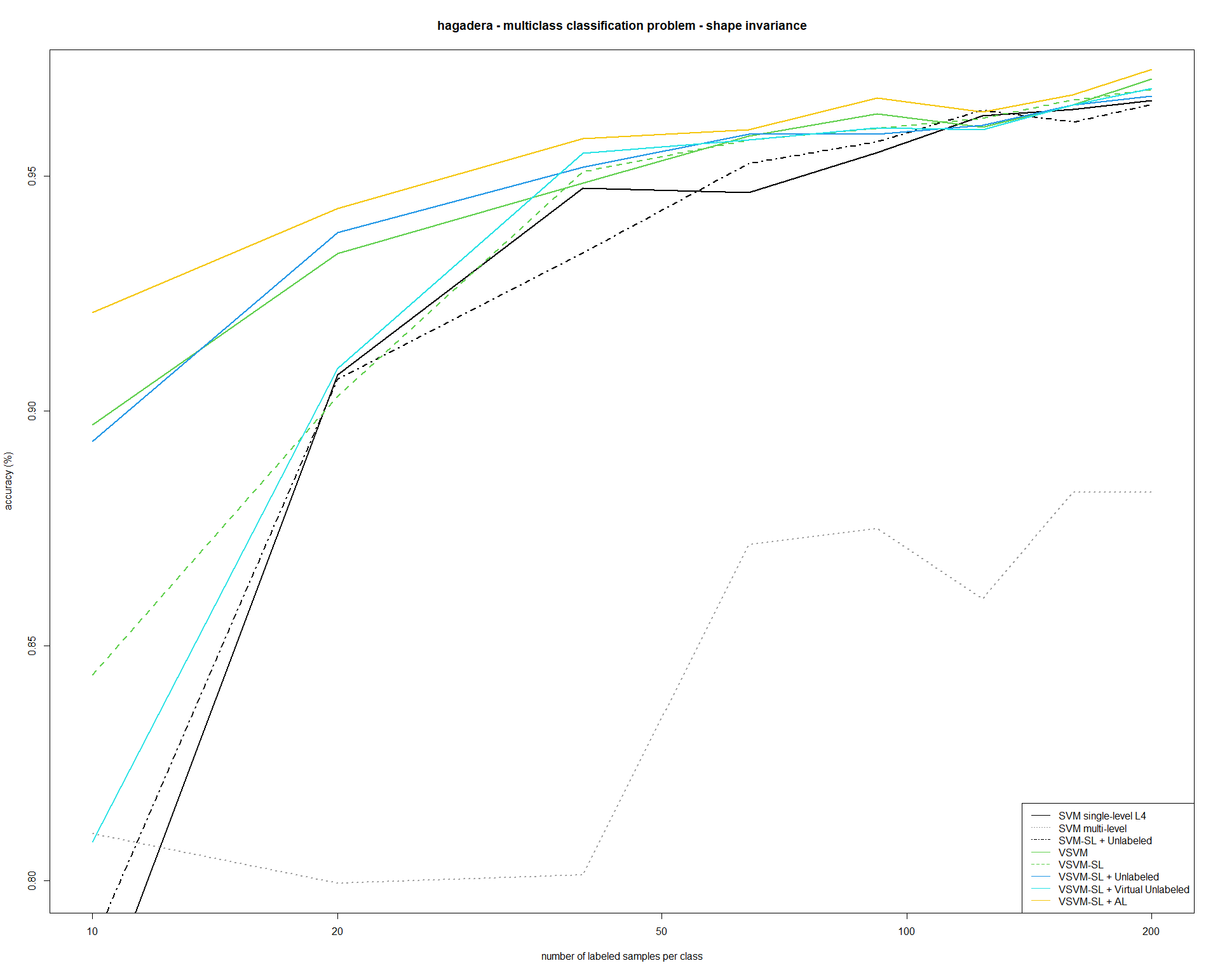

Slide 17
Thanks
lorenzo.carlassara@mail.polimi.it
All materials in this presentation are from the public literature and internet. Use herein of copyrighted material is purely for academic purposes.

