Slide 1


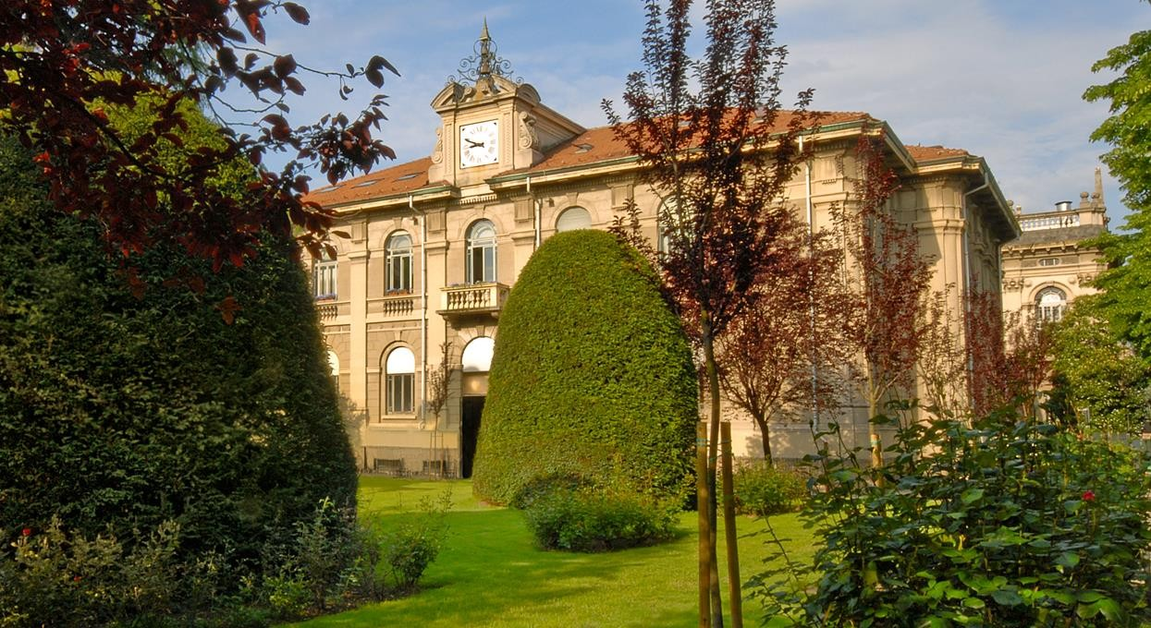

Thesis – work in progress
Virtual Support Vector Machines
with Active Learning Algorithm for Remote Sensing Image Classification
Lorenzo Carlassara 10601118
2023/2024

Slide 2

Paper review
Virtual Support Vector Machines with self-learning strategy for classification of multispectral remote sensing imagery
Semi-Supervised Learning with Constrained Virtual Support Vector Machines for Classification of Remote Sensing Image Data (Geiss)
Semi-Supervised Virtual Support Vector Machines with Self-Learning Constraint for Remote Sensing Image Classification (Ozan)

Slide 4
Code review
Cologne, Germany
Hadagera, Kenia
SVM: Support Vector Machine
SVM-MS: multilevel segmentation
VSVM: enconding invariance
VSVM-SL: Self-learning strategy
Margin Sampling constraint
SVM-MS-SL-semi-labeled
VSVM-SL-semi-labeled
VSVM-SL-virtual-semi-labeled
Invariances of shape: base level + 8 level
Invariances of scale: L4 base level + 9 level
Binary classification : ‘bushes/trees’ vs other
Multiclass classification with 6 classes: ‘bushes/trees’, ‘facade’, meadow’, ’impervious surface’, ’roofs’, ’shadow’
Execution order of the import section
New Train set after VSVM
Unlabeled Sampling
Random
Balanced

Slide 5
generalDataPool
Script understanding
Identify structure
Locate the sections to extend
R documentation
REF
data
normalizedDataPoolAllLev
normalized_data_MS
normalizedDataPool_MS
normalized_data
Script customization
Improve readability of the code
Optimize computational performance
trainDataPoolAllLev
trainDataPoolAllLevMS
testDataAllLev
testDataAllLevMS
validateDataAllLev
validateDataAllLevMS
Uncertainty function
Single level VS multi level
Variable dependencies inside the script
Sequence/Order of SVM model implementation

Slide 6

Next steps
Active Learning framework
A Survey of Active Learning Algorithms for Supervised Remote Sensing Image Classification
Active Learning Methods for Remote Sensing Image Classification
Large-Margin-Based Active Learning
Margin Sampling MS
Multiclass Level Uncertainty MCLU
Significance Space Construnction SSC
Most Ambiguous and orthogonal MAO
Multiclass level uncertainty-angle-based diversity MCLU-ABD
Multiclass level uncertainty-enhanced cluster based diversity MCLU-ECBD
Posterior Probability-Based Active Learning
Kullbach–Leibler divergence KL
Breaking Ties (BT)
Widen papers background
Test code on a different machine
Qiskit python library for VSVM

Slide 7
Thanks!
lorenzo.carlassara@mail.polimi.it
Geoinformatics Engineering
All materials in this presentation are from the public literature and internet. Use herein of copyrighted material is purely for academic purposes.

