Slide 1


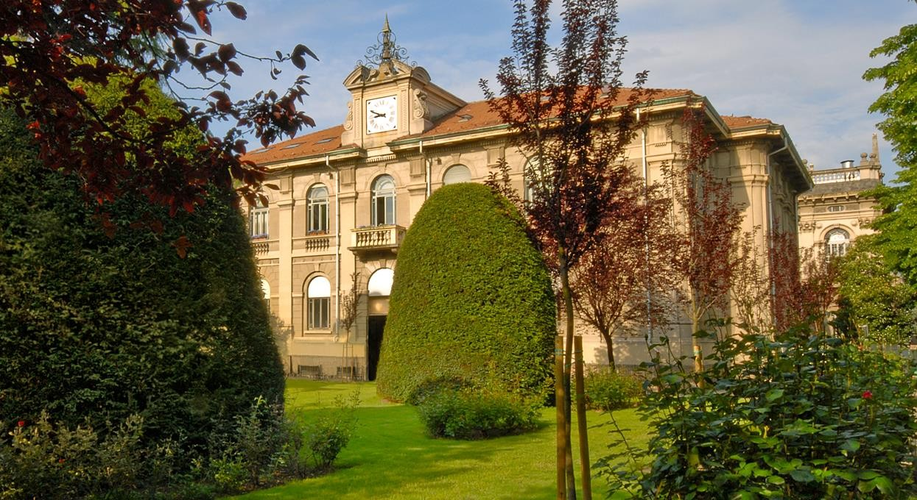

Thesis – work in progress
Virtual Support Vector Machines
with Active Learning Algorithm for Remote Sensing Image Classification
Lorenzo Carlassara 10601118
2023/2024

Slide 2

Paper review
Virtual Support Vector Machines with self-learning strategy for classification of multispectral remote sensing imagery
Semi-Supervised Learning with Constrained Virtual Support Vector Machines for Classification of Remote Sensing Image Data (Geiss)
Semi-Supervised Virtual Support Vector Machines with Self-Learning Constraint for Remote Sensing Image Classification (Ozan)

Slide 3
Code review
VSVM background
Virtual Support Vector Machines with self-learning strategy for classification of multispectral remote sensing imagery
Semi-Supervised Learning with Constrained Virtual Support Vector Machines for Classification of Remote Sensing Image Data
Script understanding
Identify structure
Locate the sections to extend
R documentation
SVM: Support Vector Machine
SVM-M: multilevel segmentation
Script customization
Add more user-readability
Improve computational efficiency
VSVM: enconding invariance
Invariances of shape (8 dataset)
Invariances of scale (9 dataset)
VSVM-SL: Self-learning strategy
Margin sampling constraint
Binary classification problem (‘bushes_trees’ vs other)
Multiclass classification problem (6 classes: ‘bushes_trees’, ‘facade’, meadow’, ’other_impervious_surface’, ’roofs’, ’shadow’)
SVM-M-semi-labeled
VSVM-SL-semi-labeled
VSVM-SL-virtual-semi-labeled

Slide 4

Future steps
Active Learning framework
A Survey of Active Learning Algorithms for Supervised Remote Sensing Image Classification
Active Learning Methods for Remote Sensing Image Classification
Widen papers background
Test project code on a different machine
Quantum Computing library fo SVM

Slide 6
Thanks!
lorenzo.carlassara@mail.polimi.it
Geoinformatics Engineering
All materials in this presentation are from the public literature and internet. Use herein of copyrighted material is purely for academic purposes.

