Slide 1


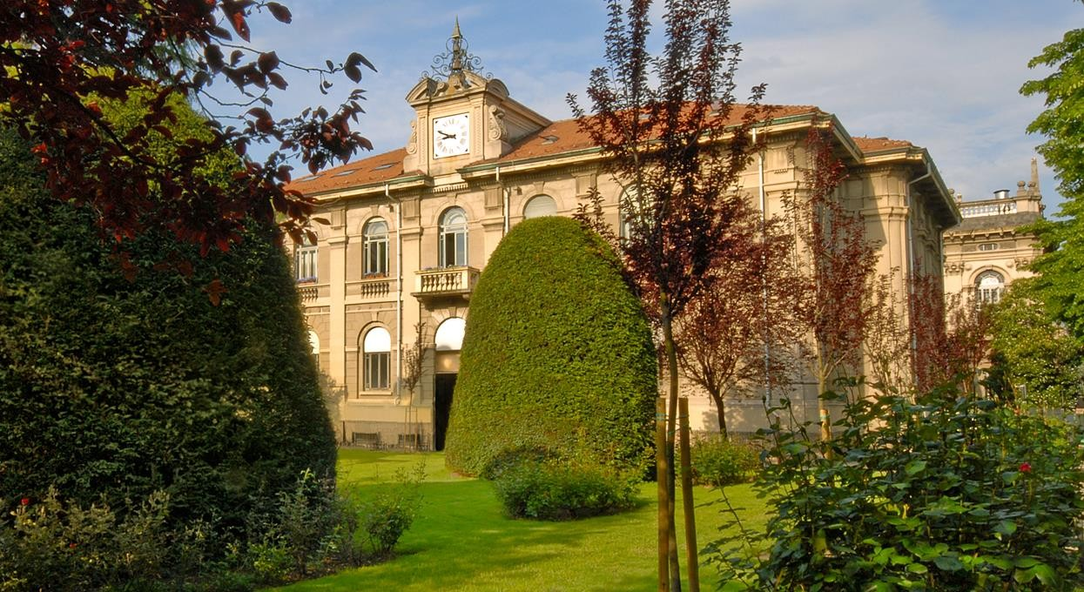

Thesis – work in progress
Virtual Support Vector Machines
with Active Learning Algorithm for Remote Sensing Image Classification
Lorenzo Carlassara 10601118
2023/2024

Slide 2

Paper review
Virtual Support Vector Machines with self-learning strategy for classification of multispectral remote sensing imagery
Semi-Supervised Learning with Constrained Virtual Support Vector Machines for Classification of Remote Sensing Image Data (Geiss)
Semi-Supervised Virtual Support Vector Machines with Self-Learning Constraint for Remote Sensing Image Classification (Ozan)

Slide 4

Model collection
Cologne, Germany
Hadagera, Kenya
SVM: Support Vector Machine
SVM-MS: include all multilevel segmentations
VSVM: enconding invariance wrt/into SVs
VSVM-SL: Self-learning strategy
remove VSVs:
not located within certain distance to original SVs
outside radius threshold on margin distance
SVM-MS-SL-UNL
VSVM-SL-UNL
VSVM-SL-virtual-UNL
Invariances of shape: base level + 8 level
Invariances of scale: L4 base level + 9 level
Binary classification : ‘bushes/trees’ vs other
Multiclass classification with 6 classes: ‘bushes/trees’, ‘facade’, meadow’, ’impervious surface’, ’roofs’, ’shadow’
VSVM-SL-UNL + uncertainty function for relabeling
Unlabeled Sampling
Random
Balanced
Execution order of the import section
New Train set after VSVM

Slide 5
Script review
Script understanding
Identify structure
Locate the sections to extend
R documentation
generalDataPool
REF
data
normalizedDataPoolAllLev
normalized_data_MS
normalizedDataPool_MS
normalized_data
Script customization
Improve readability of the code
Optimize performance
trainDataPoolAllLev
trainDataPoolAllLevMS
testDataAllLev
testDataAllLevMS
validateDataAllLev
validateDataAllLevMS
Uncertainty function
Single level VS multi level
Variable dependencies inside the script
Sequence/Order of SVM model implementation

Slide 6


Next steps
Active Learning framework
A Survey of Active Learning Algorithms for Supervised Remote Sensing Image Classification
Active Learning Methods for Remote Sensing Image Classification
Large-Margin-Based Active Learning
Margin Sampling MS
Multiclass Level Uncertainty MCLU
Significance Space Construnction SSC
Most Ambiguous and orthogonal MAO
Multiclass level uncertainty-angle-based diversity MCLU-ABD
Multiclass level uncertainty-enhanced cluster based diversity MCLU-ECBD
Posterior Probability-Based Active Learning
Kullbach–Leibler divergence KL
Breaking Ties (BT)
Multiclass Level Probabbility MCLP
Widen papers background
Test code on a different machine
Qiskit python library for VSVM

Slide 7
Next steps
Multiple cores for parallel computing -> foreach & doParallel libraries
Save trained models
Add class probability
From euclidean distance to kernel distance function
RBF kernel function implementation
Adapt pred_one function to different class label distance
Marging sampling (MULTICORE)
MCLU sampling (MULTICORE)
Uncertainty distance (MULTICORE)
MCLP sampling (MULTICORE)

Slide 8
Thanks!
lorenzo.carlassara@mail.polimi.it
Geoinformatics Engineering
All materials in this presentation are from the public literature and internet. Use herein of copyrighted material is purely for academic purposes.

