Slide 1


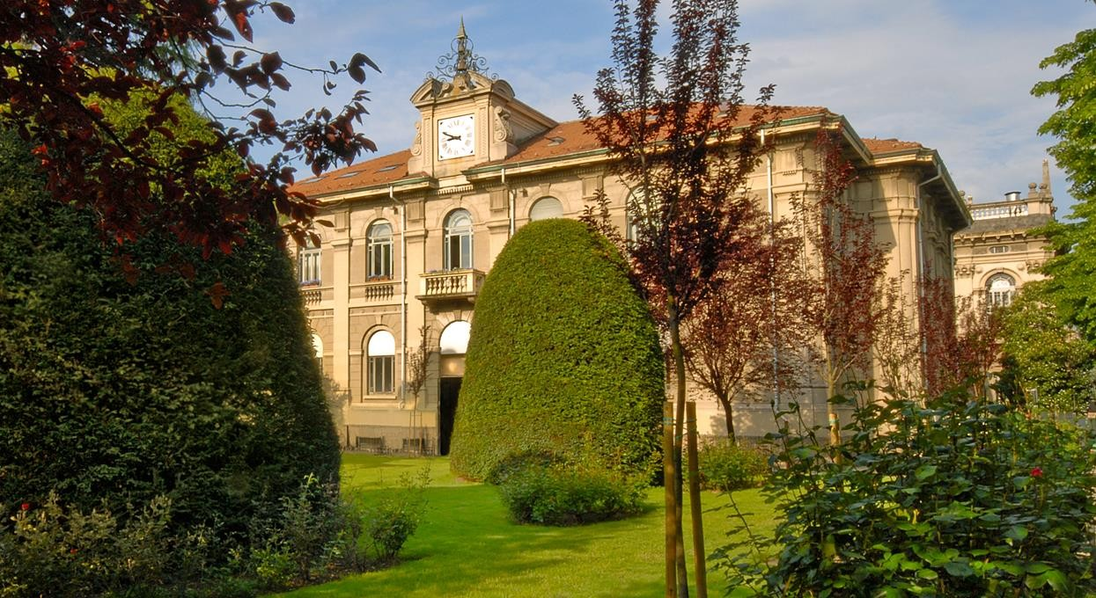

Thesis – work in progress
Virtual Support Vector Machines
with Active Learning Algorithm for Remote Sensing Image Classification
Lorenzo Carlassara 10601118
2023/2024

Slide 2

Pipeline
Virtual Support Vector Machines with self-learning strategy for classification of multispectral remote sensing imagery
Semi-Supervised Learning with Constrained Virtual Support Vector Machines for Classification of Remote Sensing Image Data (Geiss)
Semi-Supervised Virtual Support Vector Machines with Self-Learning Constraint for Remote Sensing Image Classification (Ozan)

Slide 3
Functionality

Slide 4

Model collection
Cologne, Germany
Hadagera, Kenya
SVM: Support Vector Machine
SVM-MS: include all multilevel segmentations
VSVM: enconding invariance wrt/into SVs
VSVM-SL: Self-learning strategy
remove VSVs:
not located within certain distance to original SVs
outside radius threshold on margin distance
SVM-MS-SL-UNL
VSVM-SL-UNL
VSVM-SL-virtual-UNL
Invariances of shape: base level + 8 level
Invariances of scale: L4 base level + 9 level
Binary classification : ‘bushes/trees’ vs other
Multiclass classification with 6 classes: ‘bushes/trees’, ‘facade’, meadow’, ’impervious surface’, ’roofs’, ’shadow’
VSVM-SL-UNL + uncertainty function for relabeling
Unlabeled Sampling
Random
Balanced
Execution order of the import section
New Train set after VSVM

Slide 5
Script review
generalDataPool
Script understanding
Identify structure
Locate the sections to extend
R documentation
data
normalizedDataPoolAllLev
normalized_data
trainFeat (sub)
trainDataPoolAllLev
trainDataCur
trainLabels
Script customization
Improve readability of the code
Optimize performance
testFeatsub
testDataAllLev
testLabels
validateDataAllLev
validateFeatsub
validateLabels
Uncertainty function
Single level VS multi level
Variable dependencies inside the script
Sequence/Order of SVM model implementation

Slide 6

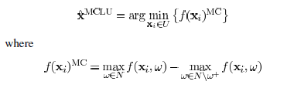

Implemented steps
Multiplecores for parallel computing -> foreach & doParallel libraries
Save trained models
Added class probability
From euclidean distance to kernel distance function
RBF kernel function implementation
Adapt pred_one function to different class label distances
Marging sampling (MULTICORE)
MCLU sampling (MULTICORE)
Uncertainty distance (MULTICORE)
MCLP sampling (MULTICORE)

Slide 7

Current progress
Active Learning framework
A Survey of Active Learning Algorithms for Supervised Remote Sensing Image Classification
Active Learning Methods for Remote Sensing Image Classification
Large-Margin-Based Active Learning
Margin Sampling MS
Multiclass Level Uncertainty MCLU
Significance Space Construnction SSC
Most Ambiguous and orthogonal MAO
Multiclass level uncertainty-angle-based diversity MCLU-ABD
Multiclass level uncertainty-enhanced cluster based diversity MCLU-ECBD
Posterior Probability-Based Active Learning
Kullbach–Leibler divergence KL
Breaking Ties (BT)
Multiclass Level Probabbility MCLP
Test code on a different machine
Qiskit python library for VSVM

Slide 8
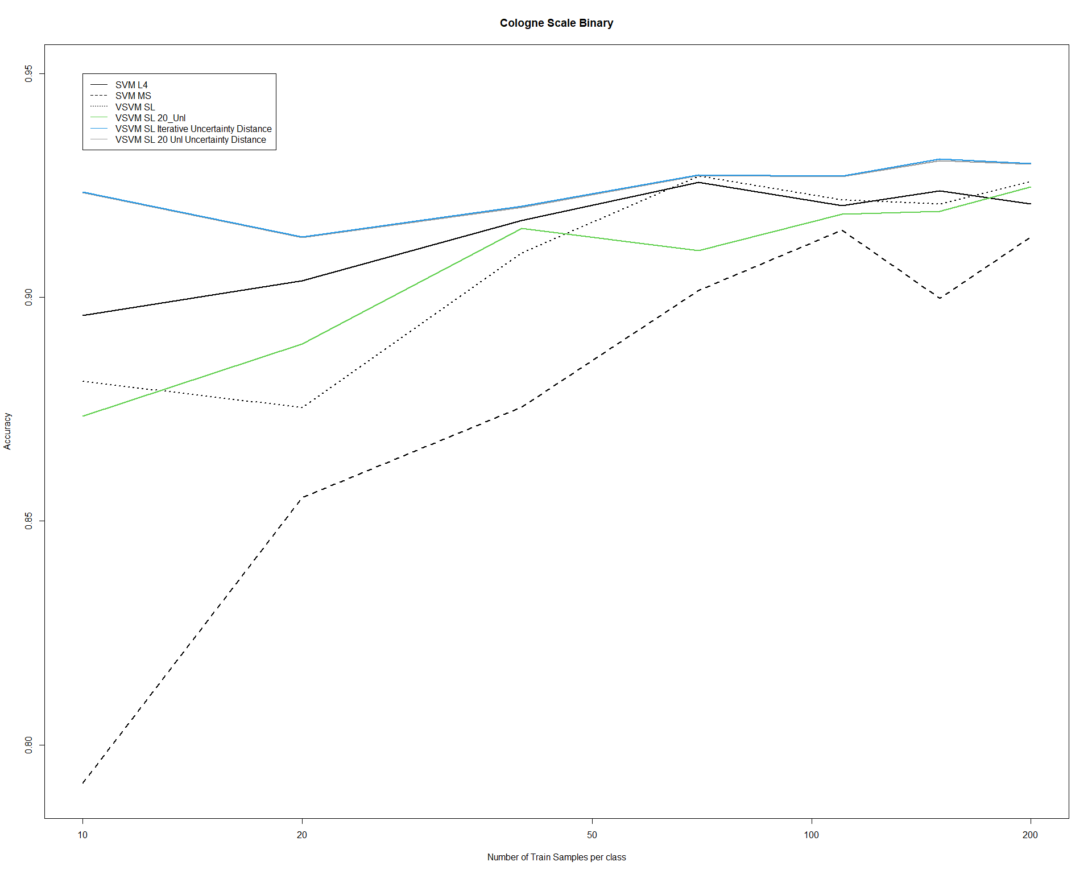

Slide 9
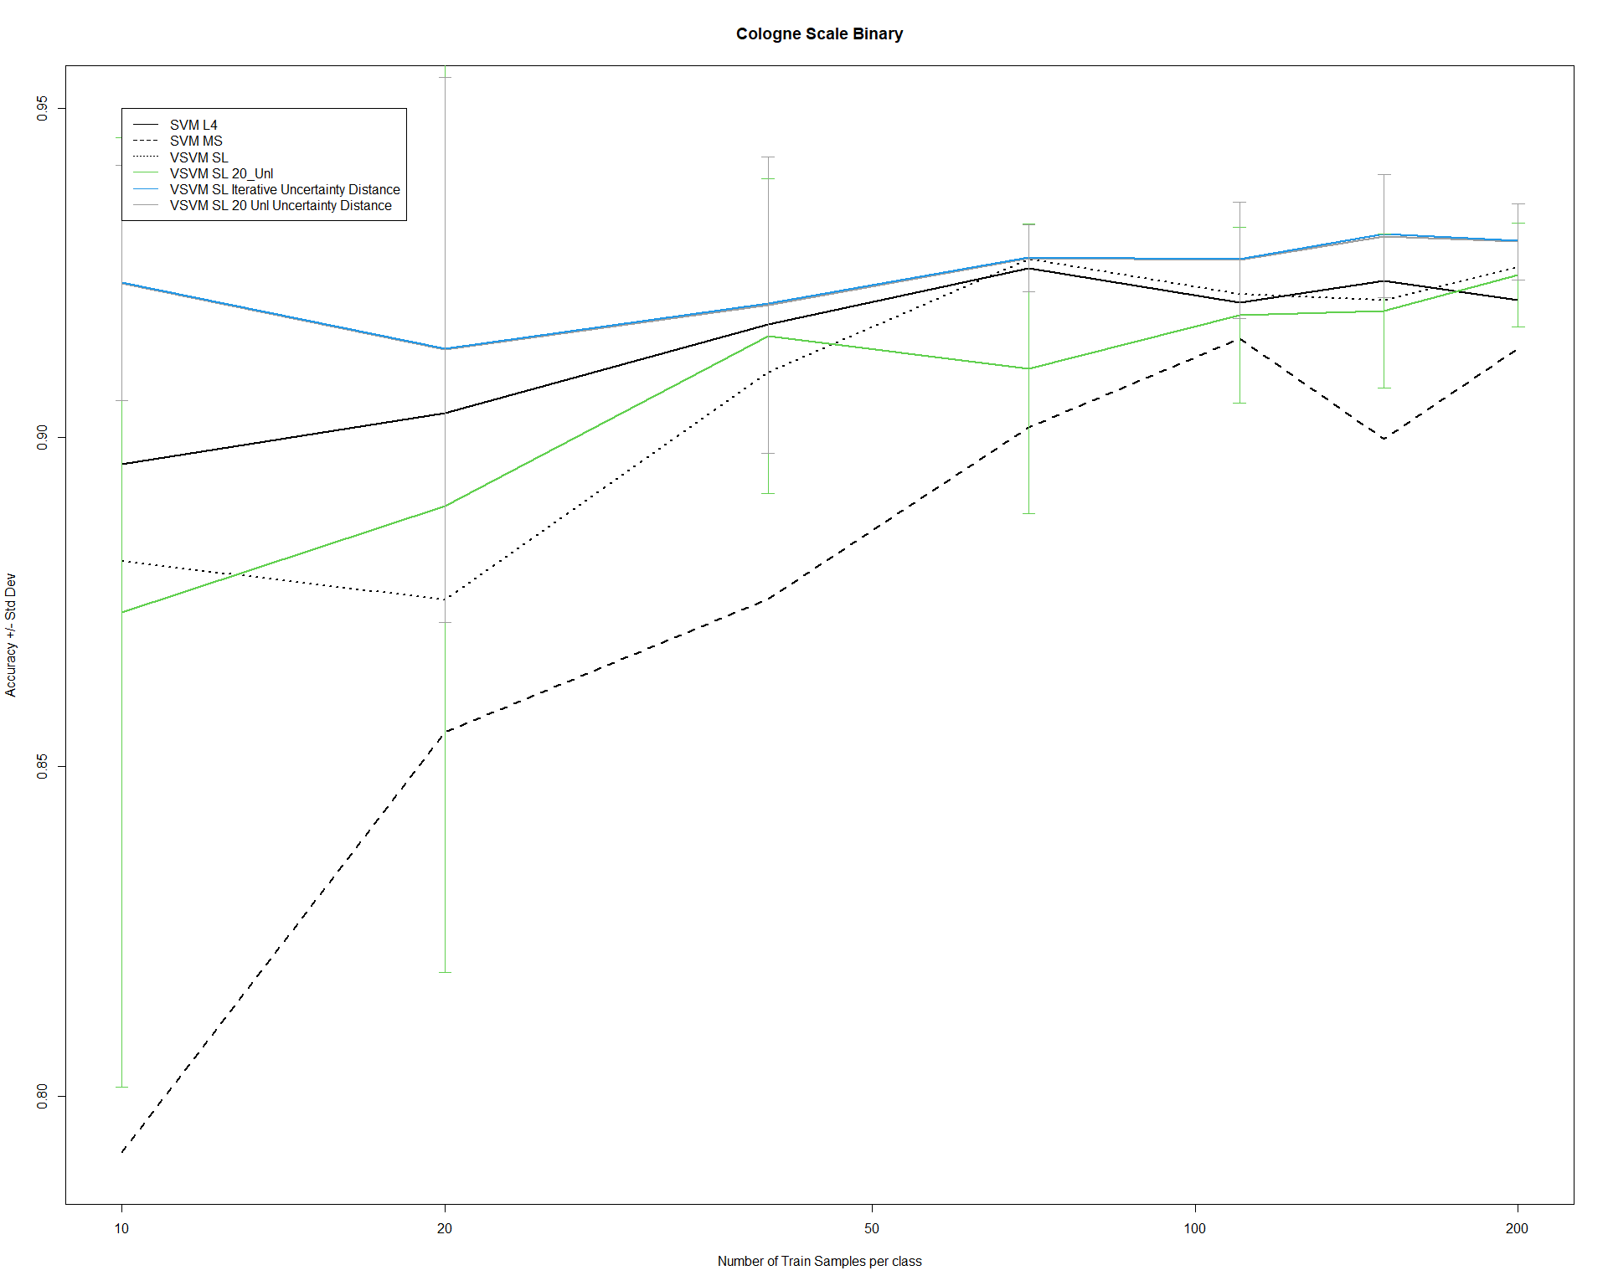

Slide 10


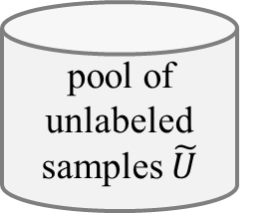




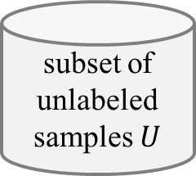
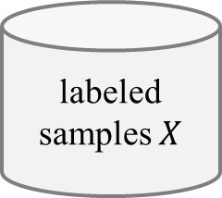


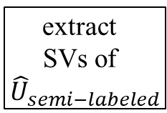



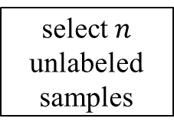


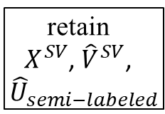
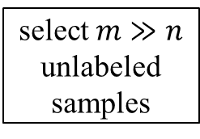
(a) Virtual Support Vector Machine with self-learning constraints and semi-labeled samples
image
labeled samples $X$
subset of unlabeled samples $U$
pool of unlabeled samples $\tilde{U}$
select $n$ unlabeled samples
select $m≫n$ unlabeled samples
semi-labeled samples
VSVM
segmentation with initial parameterization
compute
object features
learn SVM model
apply SVM model
pool of unlabeled samples $\tilde{U}$
$$U_{semi−labeled}$$
extract
SVs
$$X^{SV}$$
$${\hat{U}}_{semi−labeled}$$
relearn model
segmentation with altered parameterization
identify virtual samples
compute
object
features
similarity constraint
margin sampling constraint
$$V^{SV}$$
$${\hat{V}}^{SV}$$
encoding of invariances
self-learning strategy
thematic map
(b) Virtual Support Vector Machine with self-learning constraints and virtual semi-labeled samples
$$X^{SV}$$
$${\hat{U}}_{semi−labeled}$$
relearn model
pool of unlabeled samples $\tilde{U}$
$${\hat{V}}^{SV}$$
virtual semi-labeled samples
$${\hat{U}}_{semi−labeled}^{SV}$$
extract
SVs of ${\hat{U}}_{semi−labeled}$
retain
$X^{SV}$, ${\hat{V}}^{SV}$,
${\hat{U}}_{semi−labeled}$
identify virtual semi- labeled samples
compute
object
features
similarity constraint
margin sampling constraint
relearn model
$$V_{semi−labeled}^{U}$$
$${\hat{V}}_{semi−labeled}^{U}$$
encoding of invariances
self-learning strategy
thematic map

Slide 11
Thanks!
lorenzo.carlassara@mail.polimi.it
Geoinformatics Engineering
All materials in this presentation are from the public literature and internet. Use herein of copyrighted material is purely for academic purposes.

