Slide 1

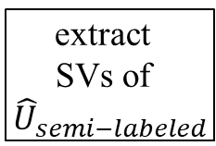
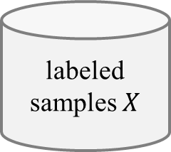

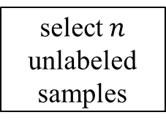


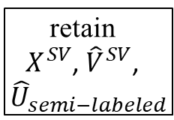
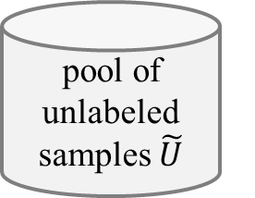




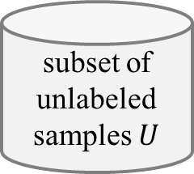



(a) Virtual Support Vector Machine with self-learning constraints and semi-labeled samples
image
labeled samples $X$
subset of unlabeled samples $U$
pool of unlabeled samples $\tilde{U}$
select $n$ unlabeled samples
semi-labeled samples
VSVM
segmentation with initial parameterization
compute
object features
learn SVM model
apply SVM model
$$U_{semi−labeled}$$
extract
SVs
$$X^{SV}$$
$${\hat{U}}_{semi−labeled}$$
relearn model
segmentation with altered parameterization
identify virtual samples
compute
object
features
similarity constraint
margin sampling constraint
$$V^{SV}$$
$${\hat{V}}^{SV}$$
encoding of invariances
self-learning strategy
thematic map
(b) Virtual Support Vector Machine with self-learning constraints and virtual semi-labeled samples
$$X^{SV}$$
$${\hat{U}}_{semi−labeled}$$
relearn model
$${\hat{V}}^{SV}$$
virtual semi-labeled samples
$${\hat{U}}_{semi−labeled}^{SV}$$
extract
SVs of ${\hat{U}}_{semi−labeled}$
retain
$X^{SV}$, ${\hat{V}}^{SV}$,
${\hat{U}}_{semi−labeled}$
identify virtual semi- labeled samples
compute
object
features
similarity constraint
margin sampling constraint
relearn model
$$V_{semi−labeled}^{U}$$
$${\hat{V}}_{semi−labeled}^{U}$$
encoding of invariances
self-learning strategy
thematic map

Slide 2
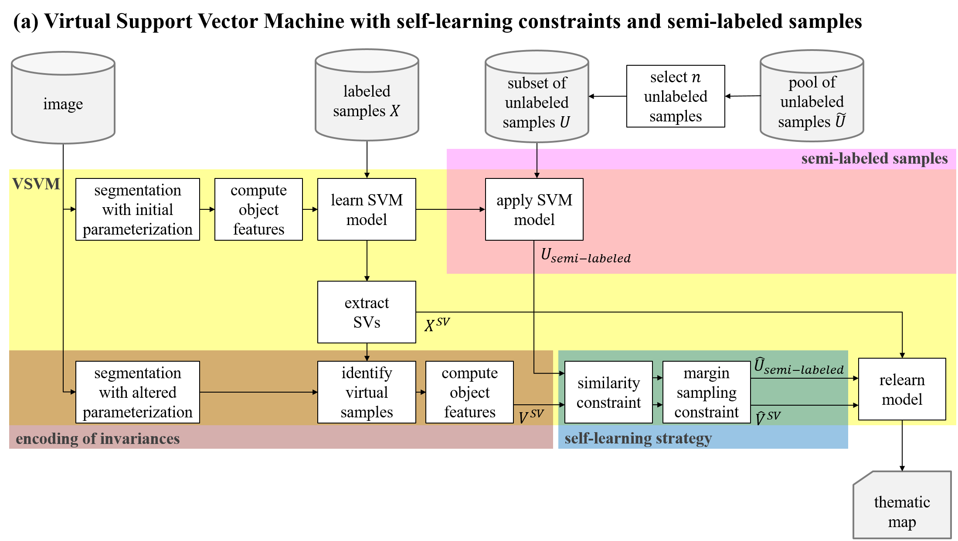



Slide 3
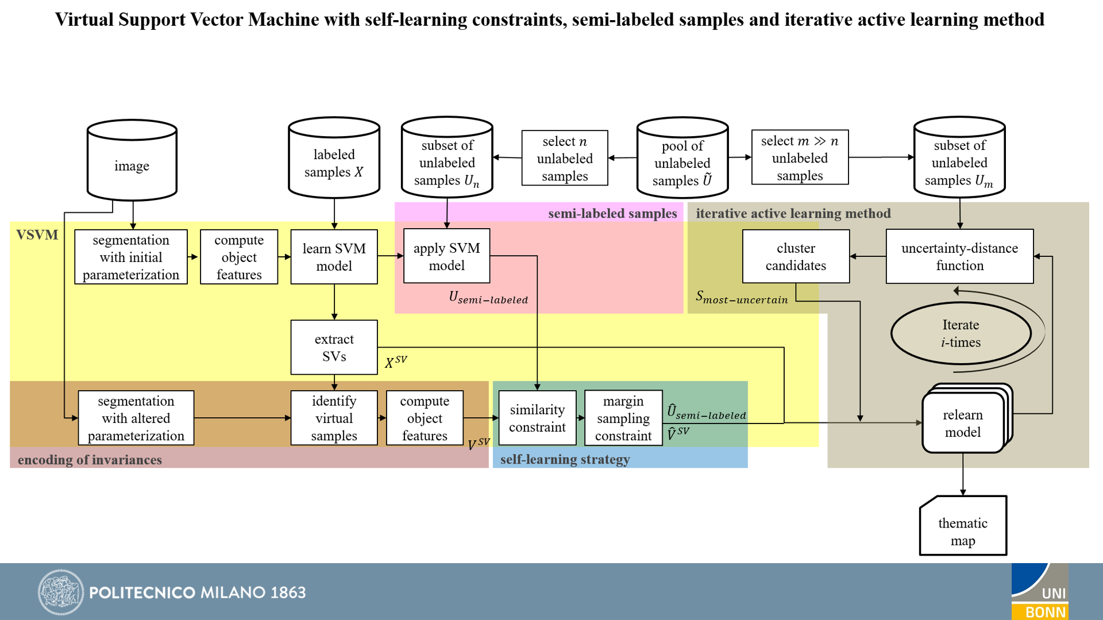

Slide 4
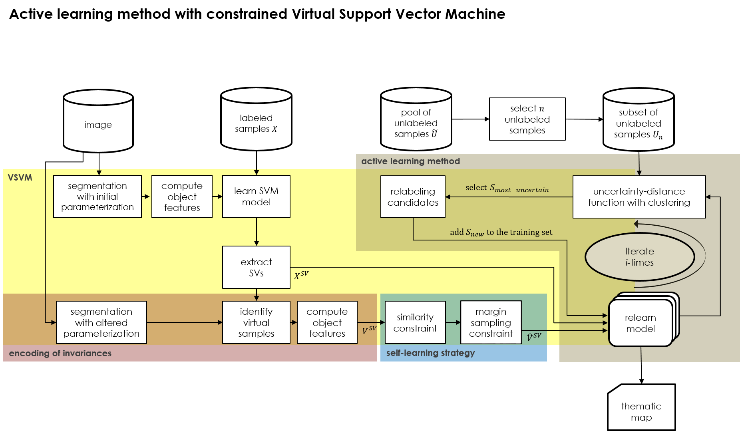

Slide 5
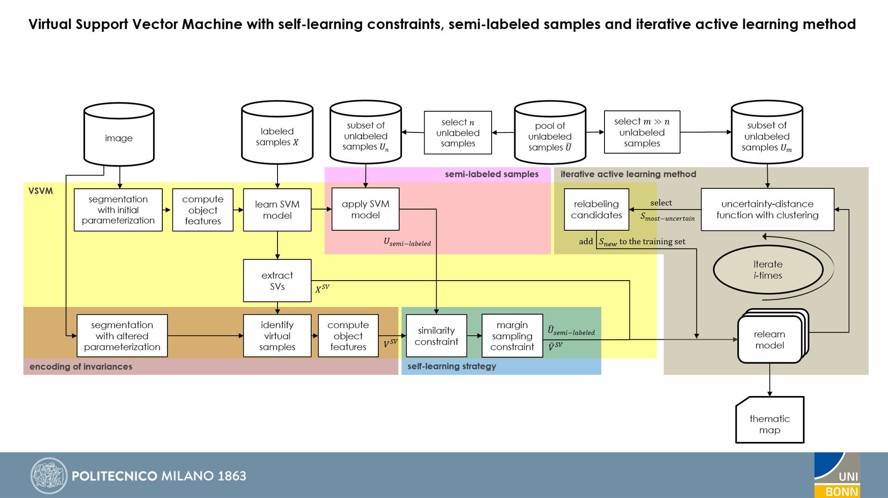

Slide 6


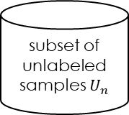
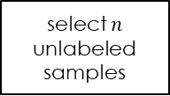

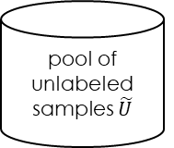
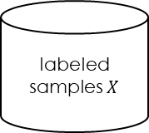


Active learning method with constrained Virtual Support Vector Machine
image
labeled samples $X$
pool of unlabeled samples $\tilde{U}$
subset of unlabeled samples $U_{n}$
select $n$ unlabeled samples
active learning
VSVM
segmentation with initial parameterization
compute
object features
learn SVM model
relabeling
candidates
$select$ $S_{most−uncertain}$
uncertainty-distance
function with clustering
$$add{ S}_{new} to the training set$$
extract
SVs
iterate
$$X^{SV}$$
segmentation with altered parameterization
identify virtual samples
compute
object
features
similarity constraint
margin sampling constraint
relearn model
$$V^{SV}$$
$${\hat{V}}^{SV}$$
encoding of invariances
self-learning strategy
thematic map

Slide 7


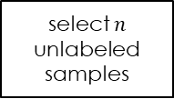


Active learning method with constrained Virtual Support Vector Machine
image
labeled samples $X$
pool of unlabeled samples $\tilde{U}$
subset of unlabeled samples $U_{n}$
select $n$ unlabeled samples
VSVM
segmentation with initial parameterization
compute
object features
learn SVM model
relabeling
candidates
uncertainty-distance
function with clustering
$$U_{most−uncertain}$$
$$U_{semi−labeled}$$
active learning
extract
SVs
$$X^{SV}$$
segmentation with altered parameterization
identify virtual samples
compute
object
features
similarity constraint
margin sampling constraint
relearn model
$${\hat{U}}_{semi−labeled}$$
$$V^{SV}$$
$${\hat{V}}^{SV}$$
encoding of invariances
self-learning strategy
thematic map

Slide 8


Active learning method with constrained Virtual Support Vector Machine
image
labeled samples $X$
pool of unlabeled samples $\tilde{U}$
subset of unlabeled samples $U_{n}$
select $n$ unlabeled samples
VSVM
segmentation with initial parameterization
compute
object features
learn SVM model
active learning
labeling
candidates
Uncertainty distance
with PCA + clustering
$$U_{most−uncertain}$$
$$U_{active−labeled}$$
extract
SVs
iterate
$$X^{SV}$$
segmentation with altered parameterization
identify virtual samples
compute
object
features
similarity constraint
margin sampling constraint
relearn model
$${\hat{U}}_{active−labeled}$$
$$V^{SV}$$
$${\hat{V}}^{SV}$$
encoding of invariances
self-learning strategy
thematic map

Slide 9

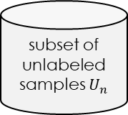
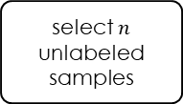
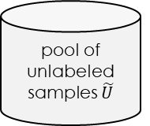

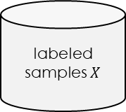


Active learning method for Virtual Support Vector Machine with self-learning constraints
Active learning method with constrained Virtual Support Vector Machine
image
labeled samples $X$
pool of unlabeled samples $\tilde{U}$
subset of unlabeled samples $U_{n}$
select $n$ unlabeled samples
VSVM
segmentation with initial parameterization
compute
object
features
learn SVM model
active learning
labeling
candidates
Uncertainty distance
with PCA + clustering
$$U_{most−uncertain}$$
$$U_{active−labeled}$$
extract
SVs
$$X^{SV}$$
iterate
segmentation with altered parameterization
identify virtual samples
compute
object
features
similarity constraint
margin sampling constraint
relearn model
$${\hat{U}}_{active−labeled}$$
$$V^{SV}$$
$${\hat{V}}^{SV}$$
encoding of invariances
self-learning strategy
thematic map

