Slide 1


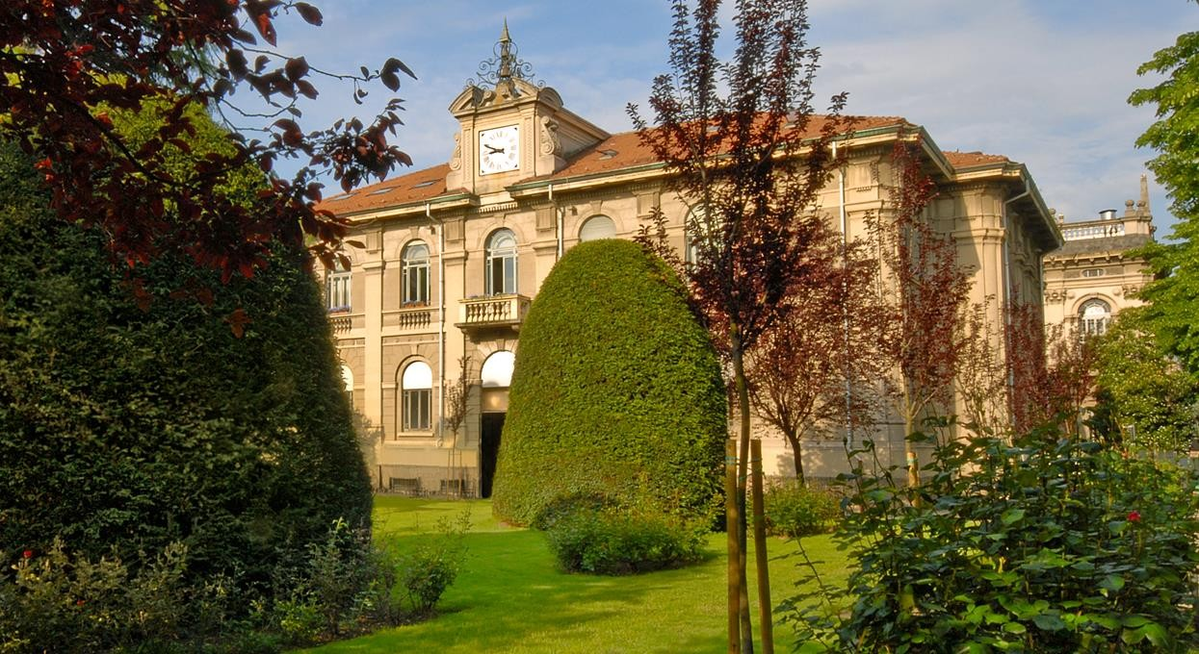

Geoinformatics Engineering
Virtual Support Vector Machines with
Iterative Active Learning Method for
Multispectral Satellite Image Classification
Lorenzo Carlassara
2023/2024

Slide 2
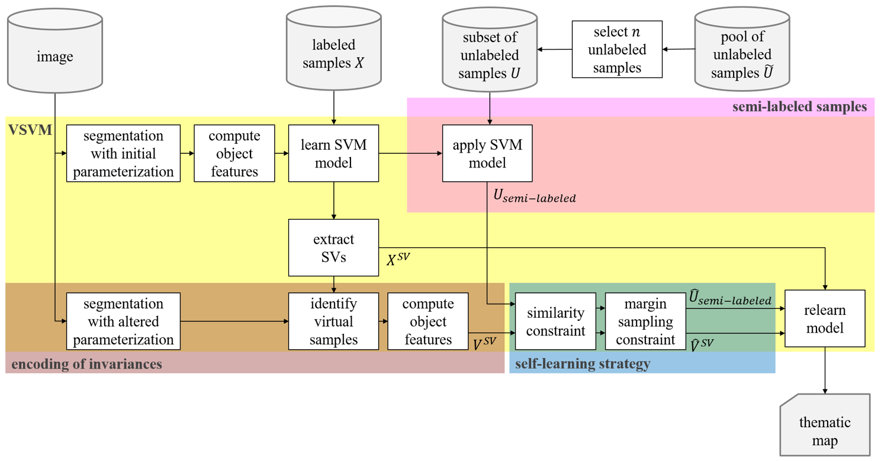

Block scheme
Virtual Support Vector Machines with self-learning strategy for classification of multispectral remote sensing imagery
Semi-Supervised Learning with Constrained Virtual Support Vector Machines for Classification of Remote Sensing Image Data (Geiss)
Semi-Supervised Virtual Support Vector Machines with Self-Learning Constraint for Remote Sensing Image Classification (Ozan)

Slide 3
VSVM background

Slide 4

Model collection
Cologne, Germany
Hadagera, Kenya
SVM: Support Vector Machine
SVM-MS: include all multilevel segmentations
VSVM: enconding invariance wrt/into SVs
VSVM-SL: Self-learning strategy
remove VSVs:
not located within certain distance to original SVs
outside radius threshold on margin distance
SVM-MS-SL-UNL
VSVM-SL-UNL
VSVM-SL-virtual-UNL
VSVM-SL-UNL + uncertainty function for relabeling
Invariances of shape: base level + 8 level
Invariances of scale: L4 base level + 9 level
Binary classification : ‘bushes/trees’ vs other
Multiclass classification with 6 classes: ‘bushes/trees’, ‘facade’, meadow’, ’impervious surface’, ’roofs’, ’shadow’
Unlabeled Sampling
Balanced
(Random)
Execution order of the import section
New Train set after VSVM

Slide 5
Script review
Script understanding
Identify structure
Find the sections to extend
R documentation
generalDataPool
data
normalizedDataPoolAllLev
normalized_data
Script customization
Improve code readability
Optimize performance
trainFeat (sub)
trainDataPoolAllLev
trainDataCur
trainLabels
testDataAllLev
testFeatsub
testLabels
validateDataAllLev
validateFeatsub
validateLabels
Uncertainty function
Single level VS multi level
Variable dependencies inside the script
Sequence/Order of SVM model implementation

Slide 6

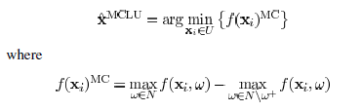
Implemented steps
Multiplecores for parallel computing -> foreach & doParallel libraries
Save trained models
Added class probability
From euclidean distance to kernel distance function
RBF kernel function implementation
Adapt pred_one function to different class label distances
Marging sampling (MULTICORE)
MCLU sampling (MULTICORE)
Uncertainty distance (MULTICORE)
MCLP sampling (MULTICORE)

Slide 7


Current progress
Active Learning framework
A Survey of Active Learning Algorithms for Supervised Remote Sensing Image Classification
Active Learning Methods for Remote Sensing Image Classification
Large-Margin-Based Active Learning
Margin Sampling MS
Multiclass Level Uncertainty MCLU
Significance Space Construnction SSC
Most Ambiguous and orthogonal MAO
Multiclass level uncertainty-angle-based diversity MCLU-ABD
Multiclass level uncertainty-enhanced cluster based diversity MCLU-ECBD
Posterior Probability-Based Active Learning
Kullbach–Leibler divergence KL
Breaking Ties (BT)
Multiclass Level Probabbility MCLP
Test code on a different machine
Qiskit python library for VSVM

Slide 8
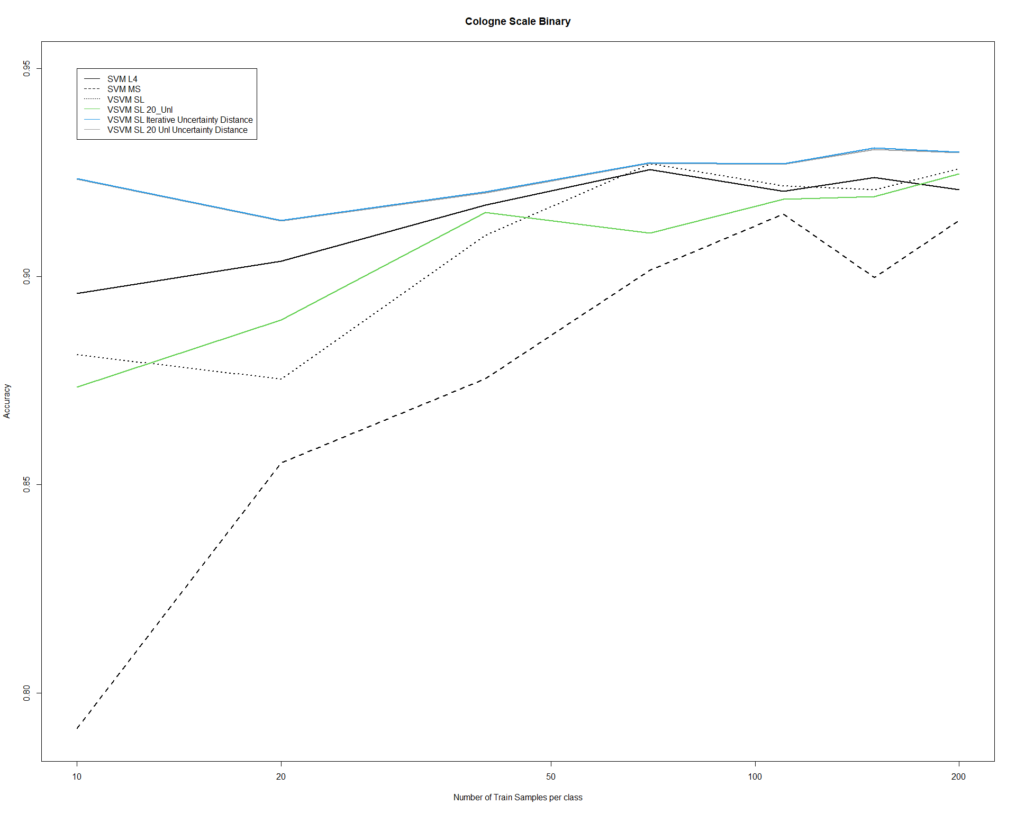

Slide 9
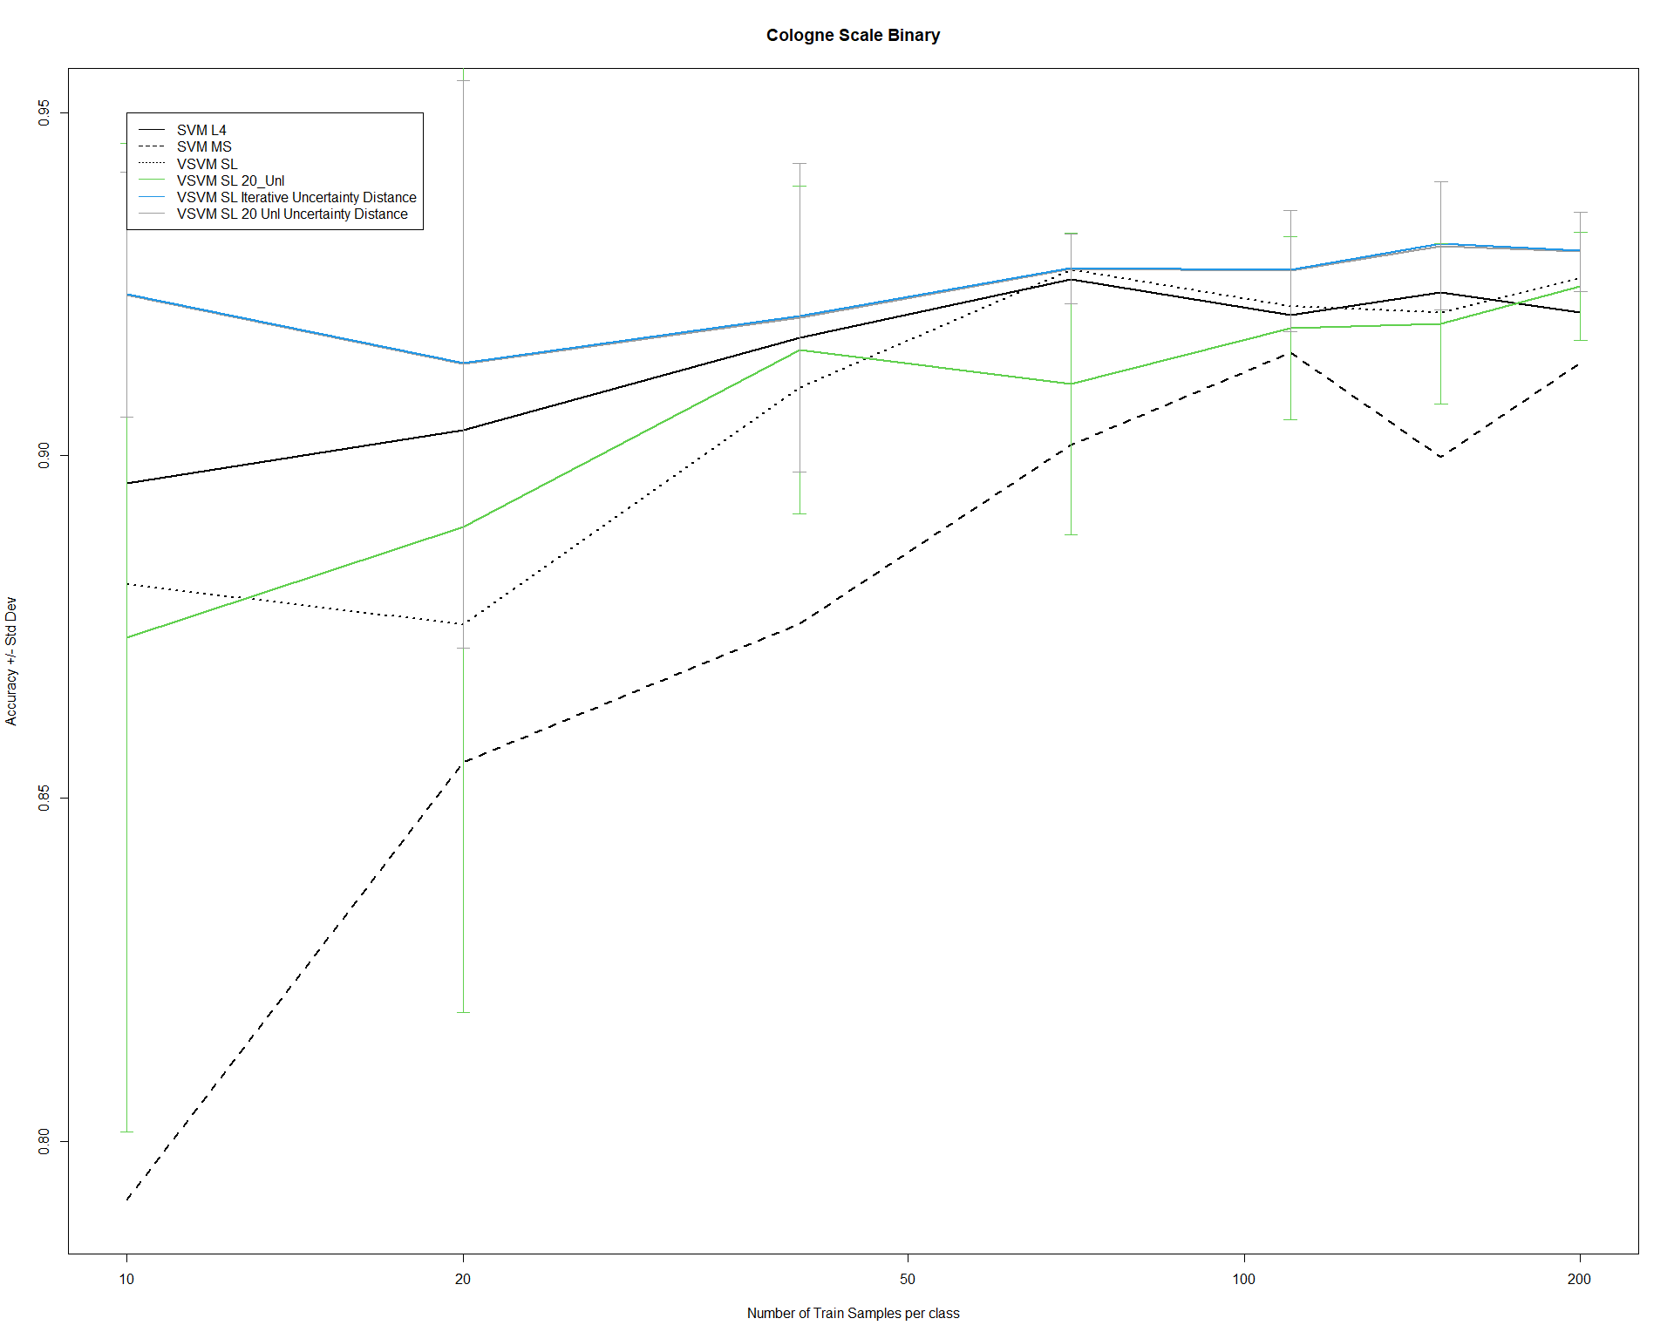

Slide 10
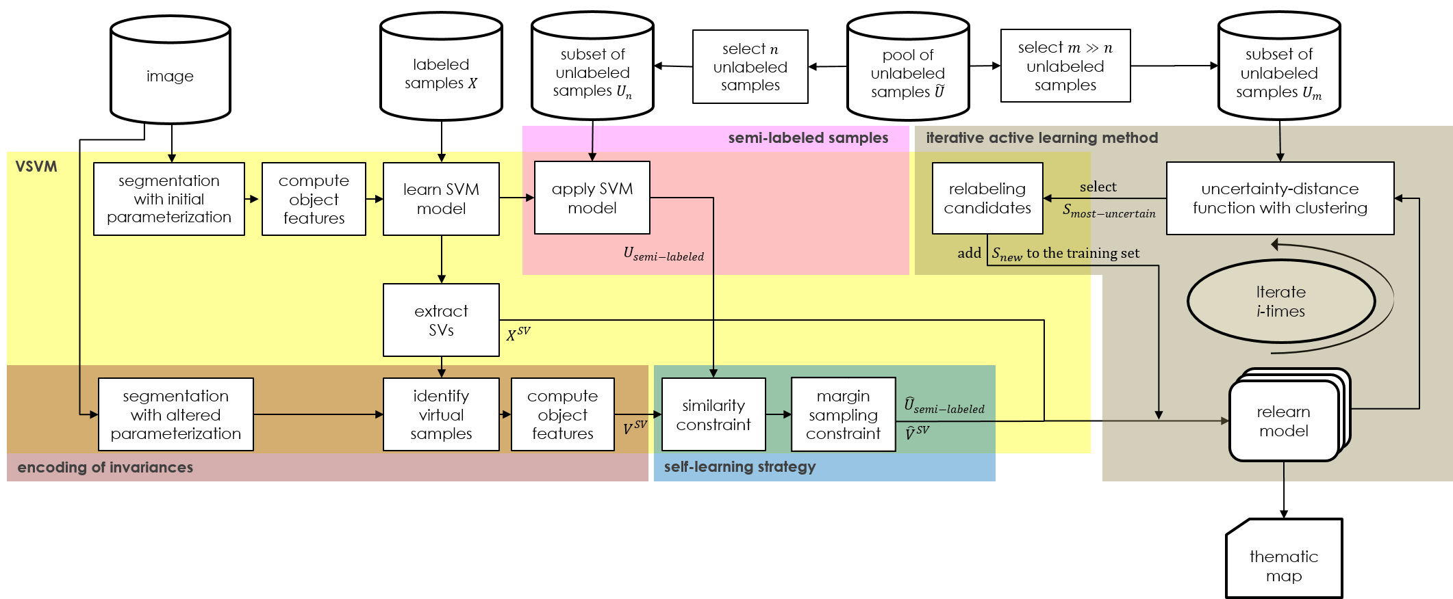
Virtual Support Vector Machine with self-learning constraints, semi-labeled samples and iterative active learning method
Lorenzo Carlassara

Slide 11
Thanks
lorenzo.carlassara@mail.polimi.it
All materials in this presentation are from the public literature and internet. Use herein of copyrighted material is purely for academic purposes.

