Slide 1




Geoinformatics Project
A Multi-fidelity Bayesian Method for Complex Model Optimization:
An Industrial Case Study
Lorenzo Carlassara
ID: 10601118
2022/2023

Slide 2

Dataset
Train set
Test set
Build
surrogate model
1
Multi-fidelity
Bayesian optimization
High-fidelity
Low-fidelity
Add new point
to set of observed
data points
4
Objective function
Neural network
Gaussian process
Maximize Acquisition function
2
Sample next
point objective
UCB
PI
EI
qEI
qNEI
qKG
3
List

Slide 3
MFBO iteration steps:
Initialize the surrogate model using a Gaussian Process which will provide low-fidelity data
1
Maximize the acquisition functions on the surrogate model in order to get the optimal point
2
Sample the objective of the optimal point using the high-fidelity model provided by the Neural Network
3
Add the sampled optimal point to the data set
4
Repeat the procedure from 1 to 4 iteratevely
5

Slide 4

Full results – categorized by Conv flag
Dataset
Train set
Test set
The not converged solutions are associated with low (negative) angles stall

Slide 5
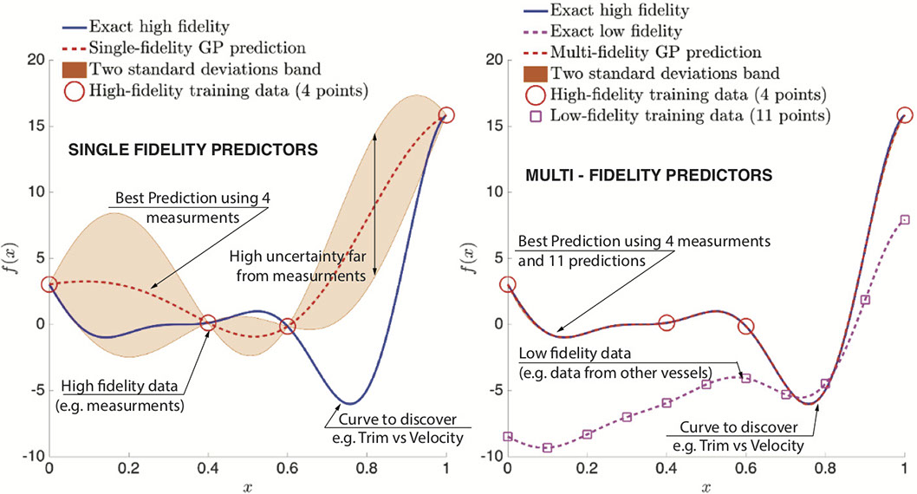
Multi-fidelity
High-fidelity
Low-fidelity
Neural network
Gaussian process
Image: L. Bonfiglio. Optimization and performance predictions using machine learning and stochastic multi-fidelity modeling, 2018. URL https://web.mit.edu/~bonfi/www/multi-fidelity.html

Slide 6
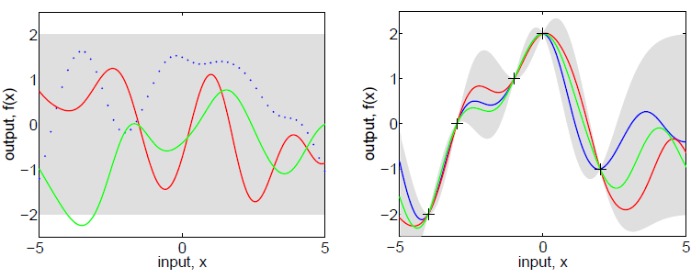
Sample points
Gray uncertainty area
Surrogate model
Gaussian process
Prior
Posterior
Random mean function
Image: C. E. Rasmussen & C. K. I. Williams, Gaussian Processes for Machine Learning, the MIT Press, 2006, ISBN 026218253X. c 2006 MIT. www.GaussianProcess.org/gpml

Slide 7
Bayesian optimization
Objective function
Next optimal point
Acquisition function
UCB
PI
EI
qEI
qNEI
qKG
List
Image: Peter I. Frazier, A Tutorial on Bayesian Optimization arXiv:1807.02811v1 [stat.ML] 8 Jul 2018

Slide 8
Hidden layer
(ReLu)
Hidden layer
(sigmoid)
Input layer
1
1
1
2
2
Output layer
Neural network
2
3
127
127
4
128
128

Slide 9
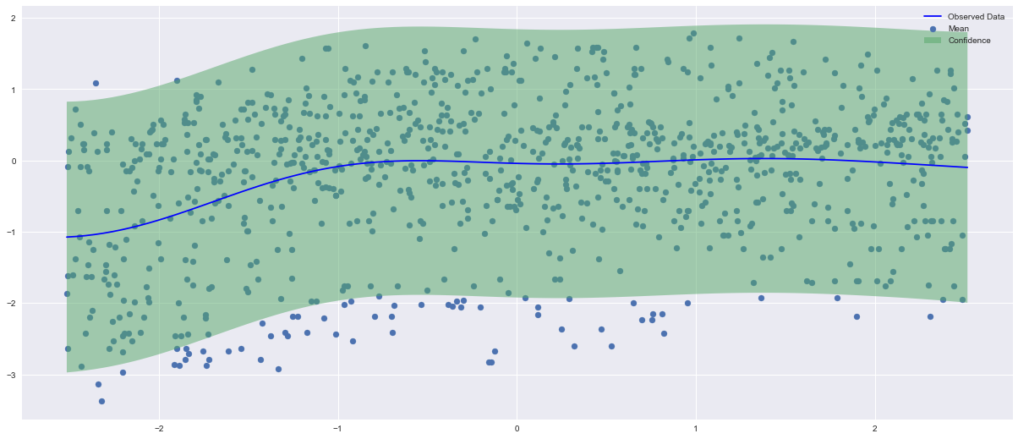
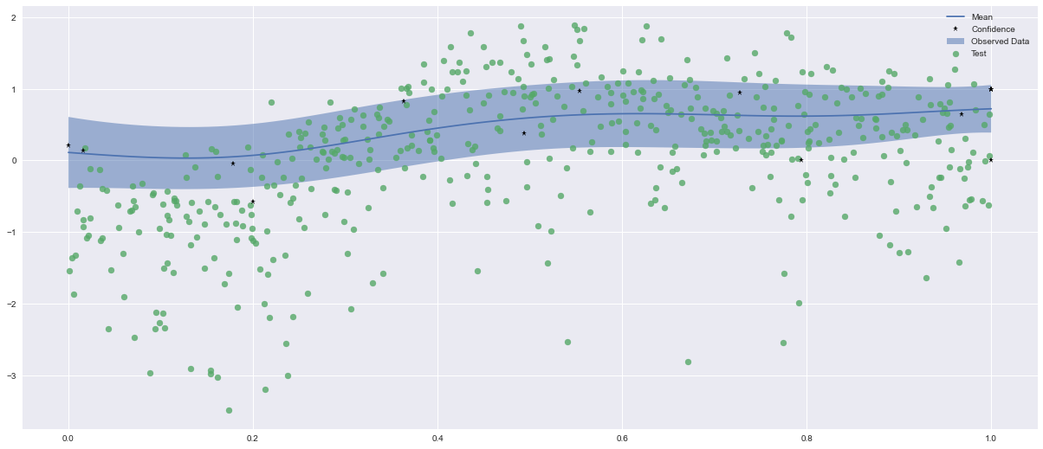
Results
Initial uncertainty level described
by GP confidence region in green
Uncertainty level provided
by EI acqf on one input only

Slide 10
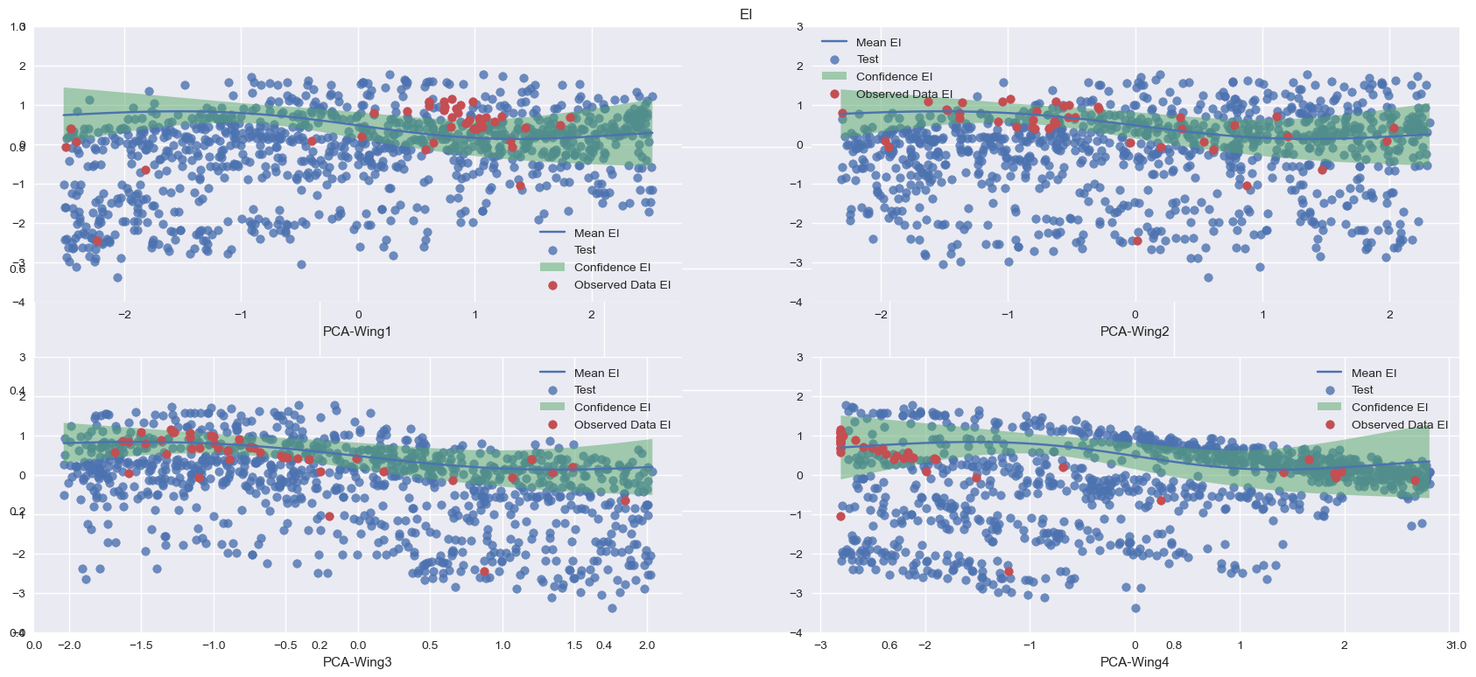
Uncertainty level provided by EI acquisition function extended on all the input cargo-wings

Slide 11
Thanks for your attention!
lorenzo.carlassara@mail.polimi.it
All materials in this presentation are from the public literature and internet. Use herein of copyrighted material is purely for academic purposes.

