Slide 1
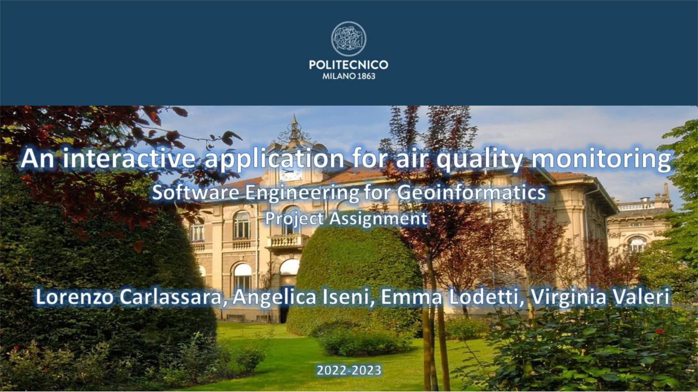

Slide 2
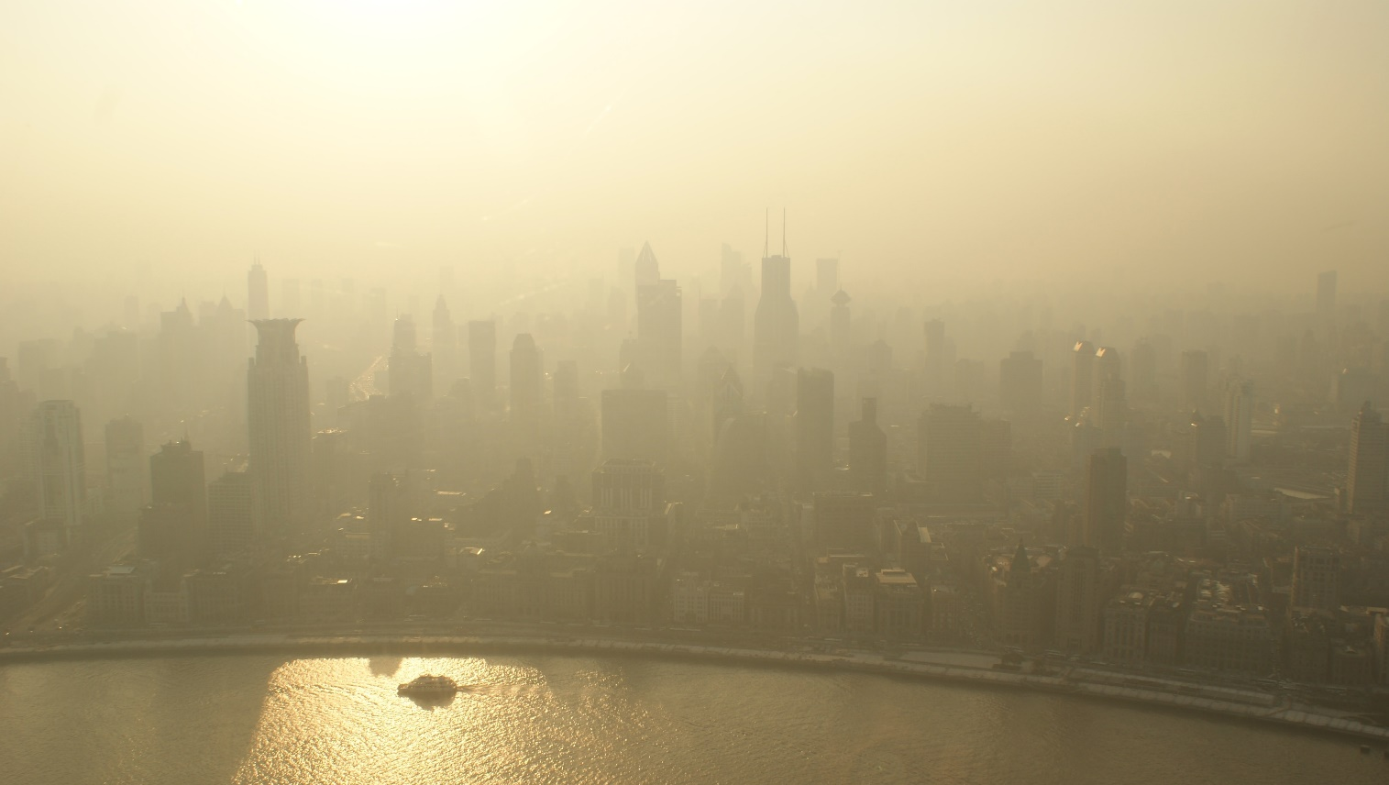

interactive Application for Air Pollution Monitoring
iAPP4P

Slide 3
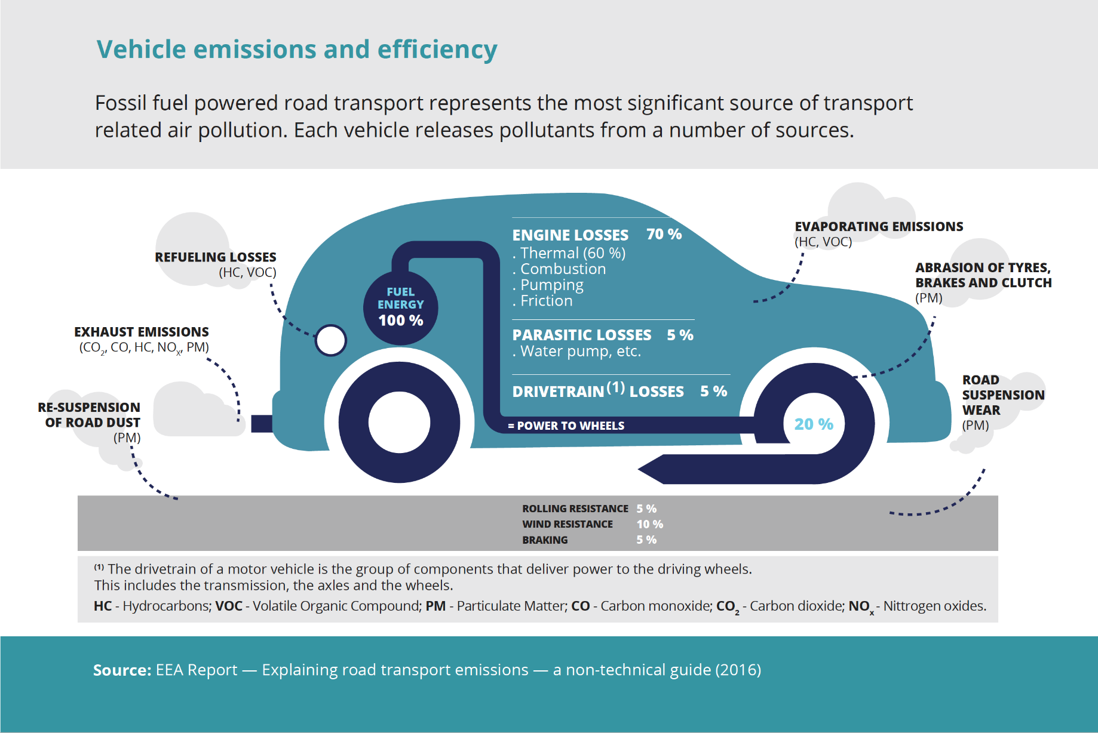
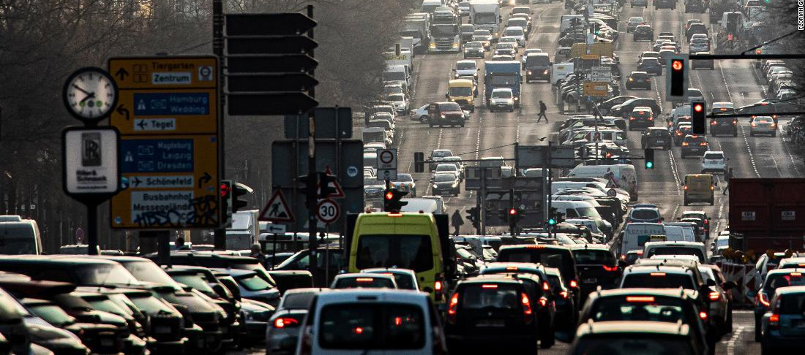
iAPP4P
Providing Clear Scientific Insights into Air Pollutants’ impact on health
Collaborative Open-Source Platform
iAPP4P

Slide 4
Pollutants
Pollutant | Description
PM10 | Particulate matter 10 Tiny particles with a diameter of 10 micron or less Dust from construction sites, landfills and agriculture, wildfires and brush burning, industrial sources, wind-blown dust from open lands
SO2 | Sulfur Dioxide Heavy, colorless, and poisonous gas composed of sulfur and oxygen From the burning of fossil fuels(coal and oil) and the smelting of mineral ores
NOx | Nitrogen Monoxide and Dioxide Gaseous air pollutant composed of nitrogen and oxygen Forms when fossil fuels (coal, oil, gas, diesel) are burned at high temperatures
CO | Carbon Monoxide Colorless, odorless gas that can be harmful when inhaled in large amounts From cars, trucks and other vehicles or machinery that burn fossil fuels.
PM2.5 | Particulate Matter 2.5 Tiny particles or droplets in the air that are two and one half micron or less in width From combustion of gasoline, oil, diesel fuel or wood produce much ofthe PM2.5 pollution
Some pollutants particularly harmful to life on the planet detected in several European capitals, mainly produced by cars, will be considered in the development of the application.
iAPP4P

Slide 5
Requirements
Functional Requirements
Data Handling
Data Processing
Secure Data Management
User-Friendly Access
Non-Functional Requirements
Language
Accessible Data
Technical Requirements
Python Backend Development
iAPP4P

Slide 6
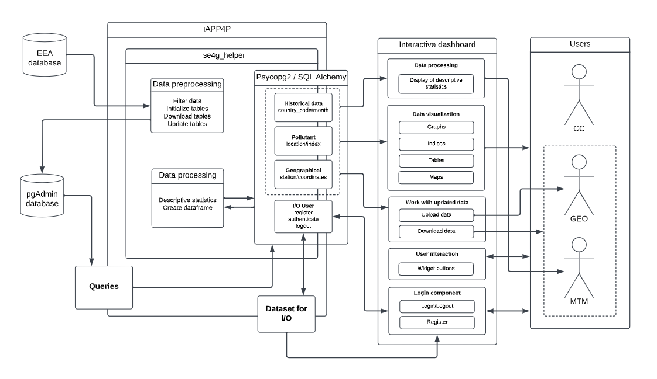
Architectural components diagram
Visual representation of the different components of iAPP4P
iAPP4P

Slide 7



Helper functions
DATA MANAGEMENT
Download
Create
Insert
Update
Table helper
1. DB transition
2. DB from CSV
3. CSV
USER LOGIN & REGISTRATION
iAPP4P

Slide 8




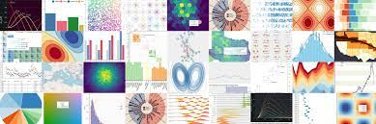

DASHBOARD CREATION & VISUALIZATION
All the tasks are grouped
into 4 main classes
iAPP4P

Slide 9
Jupyter Dashboard
1. Import from se4g_helper
2. Login/register of the user
3. Descriptive statistics
4. Display pollutant maps
5. Download Data & Update Data
6. Display Interactive Time Series
iAPP4P

Slide 10

Thanks for your attention!
lorenzo.carlassara@mail.polimi.it
angelica.iseni@mail.polimi.it
emma.lodetti@mail.poolimi.it
virginia.valeria@mail.polimi.it
All materials in this presentation are from the public literature and internet. Use herein of copyrighted material is purely for academic purposes.

