Slide 1

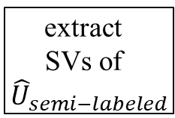
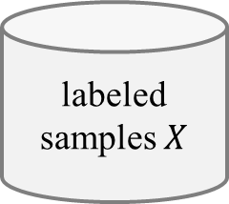

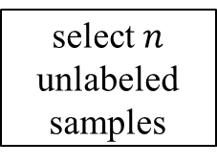


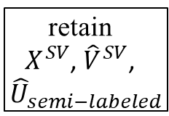
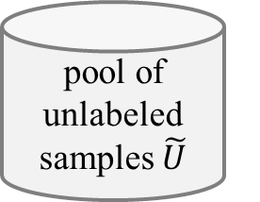




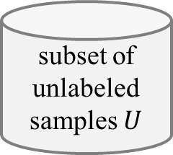



(a) Virtual Support Vector Machine with self-learning constraints and semi-labeled samples
image
labeled samples $X$
subset of unlabeled samples $U$
pool of unlabeled samples $\tilde{U}$
select $n$ unlabeled samples
semi-labeled samples
VSVM
segmentation with initial parameterization
compute
object features
learn SVM model
apply SVM model
$$U_{semi−labeled}$$
extract
SVs
$$X^{SV}$$
$${\hat{U}}_{semi−labeled}$$
relearn model
segmentation with altered parameterization
identify virtual samples
compute
object
features
similarity constraint
margin sampling constraint
$$V^{SV}$$
$${\hat{V}}^{SV}$$
encoding of invariances
self-learning strategy
thematic map
(b) Virtual Support Vector Machine with self-learning constraints and virtual semi-labeled samples
$$X^{SV}$$
$${\hat{U}}_{semi−labeled}$$
relearn model
$${\hat{V}}^{SV}$$
virtual semi-labeled samples
$${\hat{U}}_{semi−labeled}^{SV}$$
extract
SVs of ${\hat{U}}_{semi−labeled}$
retain
$X^{SV}$, ${\hat{V}}^{SV}$,
${\hat{U}}_{semi−labeled}$
identify virtual semi- labeled samples
compute
object
features
similarity constraint
margin sampling constraint
relearn model
$$V_{semi−labeled}^{U}$$
$${\hat{V}}_{semi−labeled}^{U}$$
encoding of invariances
self-learning strategy
thematic map

Slide 2



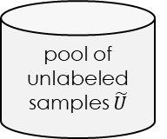
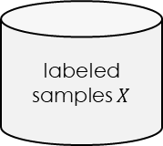


Active learning method with constrained Virtual Support Vector Machine v1
image
labeled samples $X$
pool of unlabeled samples $\tilde{U}$
VSVM
segmentation with initial parameterization
compute
object features
learn SVM model
relabeling
candidates
active learning
uncertainty-distance
function with clustering
$$U_{most−uncertain}$$
$$U_{active−labeled}$$
extract
SVs
iterate
$$X^{SV}$$
segmentation with altered parameterization
identify virtual samples
compute
object
features
similarity constraint
margin sampling constraint
relearn model
$$V^{SV}$$
$${\hat{V}}^{SV}$$
encoding of invariances
self-learning strategy
thematic map

Slide 3




Active learning method with constrained Virtual Support Vector Machine v2
image
labeled samples $X$
pool of unlabeled samples $\tilde{U}$
VSVM
segmentation with initial parameterization
compute
object features
learn SVM model
relabeling
candidates
active learning
uncertainty-distance
function with clustering
$$U_{most−uncertain}$$
$$U_{active−labeled}$$
extract
SVs
$$X^{SV}$$
segmentation with altered parameterization
identify virtual samples
compute
object
features
similarity constraint
margin sampling constraint
relearn model
$${\hat{U}}_{active−labeled}$$
$$V^{SV}$$
$${\hat{V}}^{SV}$$
encoding of invariances
self-learning strategy
thematic map

Slide 4



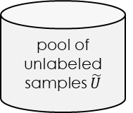

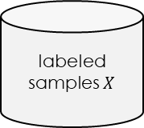


Active learning method for Virtual Support Vector Machine with self-learning constraints
Active learning method with constrained Virtual Support Vector Machine
image
labeled samples $X$
pool of unlabeled samples $\tilde{U}$
VSVM
active learning
segmentation with initial parameterization
compute
object
features
learn SVM model
labeling
candidates
Uncertainty distance
with PCA + clustering
$$U_{most−uncertain}$$
$$U_{active−labeled}$$
iterate
extract
SVs
$$X^{SV}$$
segmentation with altered parameterization
identify virtual samples
compute
object
features
similarity constraint
margin sampling constraint
relearn model
$${\hat{U}}_{active−labeled}$$
$$V^{SV}$$
$${\hat{V}}^{SV}$$
encoding of invariances
self-learning strategy
thematic map

Slide 5
Active learning method with constrained Virtual Support Vector Machine VARIANT
image
labeled samples $X$
pool of unlabeled samples $\tilde{U}$
VSVM
segmentation with initial parameterization
compute
object
features
learn SVM model
labeling
candidates
active learning
Uncertainty distance
with PCA + clustering
$$U_{active−labeled}$$
$$U_{most−uncertain}$$
iterate
extract
SVs
$$X^{SV}$$
segmentation with altered parameterization
identify virtual samples
compute
object
features
similarity constraint
margin sampling constraint
relearn model
$${\hat{U}}_{active−labeled}$$
$$V^{SV}$$
$${\hat{V}}^{SV}$$
encoding of invariances
self-learning strategy
thematic map

Slide 6

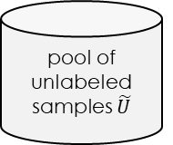

Active learning method with constrained Virtual Support Vector Machine + SEMI
image
labeled samples $X$
pool of unlabeled samples $\tilde{U}$
VSVM
segmentation with initial parameterization
compute
object
features
learn SVM model
labeling
candidates
active learning
Uncertainty distance
with tSNE + clustering
$$U_{active−labeled}$$
$$U_{most−uncertain}$$
iterate
extract
SVs
semi supervised
remaining
candidates
$$X^{SV}$$
$$U_{semi−labeled}$$
segmentation with altered parameterization
identify virtual samples
compute
object
features
similarity constraint
margin sampling constraint
$${\hat{V}}^{SV}$$
relearn model
$$V^{SV}$$
$${\hat{U}}_{active−labeled}$$
$${\hat{U}}_{semi−labeled}$$
encoding of invariances
self-learning strategy
thematic map

Slide 7



SL AL method with constrained Virtual Support Vector Machine + SEMI
image
labeled samples $X$
pool of unlabeled samples $\tilde{U}$
$$U_{active−labeled}$$
VSVM
segmentation with initial parameterization
compute
object
features
learn SVM model
active learning
labeling
candidates
margin sampling distance
$$U_{most−uncertain}$$
iterate
extract
SVs
remaining
candidates
semi labeled samples
$$X^{SV}$$
$$U_{semi−labeled}$$
segmentation with altered parameterization
identify virtual samples
compute
object
features
similarity constraint
margin sampling constraint
relearn model
$${\hat{U}}_{active−labeled}$$
$$V^{SV}$$
$${\hat{V}}^{SV}$$
encoding of invariances
self-learning strategy
thematic map

Slide 8
SL AL method with constrained Virtual Support Vector Machine
image
labeled samples $X$
pool of unlabeled samples $\tilde{U}$
VSVM
segmentation with initial parameterization
compute
object
features
learn SVM model
labeling
candidates
margin sampling distance
multiclass level uncertainty
$$U_{most−uncertain}$$
iterate
with t-SNE + k-means
extract
SVs
$$X^{SV}$$
active learning
$$U_{active−labeled}$$
segmentation with altered parameterization
identify virtual samples
compute
object
features
similarity constraint
margin sampling constraint
relearn model
$${\hat{U}}_{active−labeled}$$
$$V^{SV}$$
$${\hat{V}}^{SV}$$
encoding of invariances
self-learning strategy
thematic map

Slide 9





SL AL method with constrained Virtual Support Vector Machine + SEMI
image
labeled samples $X$
pool of unlabeled samples $\tilde{U}$
$$U_{AL}$$
VSVM
active learning
segmentation with initial parameterization
compute
object
features
learn SVM model
labeling
candidates
$$U_{most−uncertain}$$
margin sampling distance
with clustering
$$V_{AL}$$
iterate
extract
SVs
remaining
candidates
semi labeled samples
$$X^{SV}$$
$$U_{semi−AL}$$
segmentation with altered parameterization
identify virtual samples
compute
object
features
similarity constraint
margin sampling constraint
relearn model
$${\hat{V}}_{AL}$$
$$V^{SV}$$
$${\hat{V}}^{SV}$$
encoding of invariances
self-learning strategy
thematic map

Slide 10



SL AL method with constrained Virtual Support Vector Machine
image
labeled samples $X$
pool of unlabeled samples $\tilde{U}$
VSVM
segmentation with initial parameterization
compute
object
features
learn SVM model
labeling
candidates
margin sampling distance
multiclass level uncertainty
$$U_{most−uncertain}$$
$$V_{AL}$$
$$U_{AL}$$
iterate
With t-SNE + k-means
extract
SVs
$$X^{SV}$$
active learning
segmentation with altered parameterization
identify virtual samples
compute
object
features
similarity constraint
margin sampling constraint
relearn model
$${\hat{V}}_{active−labeled}$$
$$V^{SV}$$
$${\hat{V}}^{SV}$$
encoding of invariances
self-learning strategy
thematic map

Slide 11
AQ-S3VSVM

Slide 12
for the “semi-supervised” versions one would integrate randomly drawn samples (and not the most certain (as you did it?) nor the most uncertain (as I explained) (especially when aiming to prune them with the self-learning strategy) – because with semi-supervised learning one would want to model the distribution of the unlabeled data actually in a safe way (so pruning them also with the self-learning constraint)
the appropriate next step would be to prepare a list of all N consistently named model variants for each of the two frameworks: AL samples 4 2nd iteration, and AL samples 4 2nd iteration paired with consistently named pseudo-algorithms, respectively. The model variants of the two frameworks should thereby consider identical the methodological components (VSVs, active learning heuristics, clustering, dimensionality reduction, etc.); their only difference lies in where the actively labeled samples are added.
This list could then serve as the basis for our next meeting, where we can consolidate a (hopefully) final list of experiments for the paper.

Slide 13






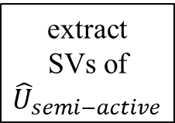










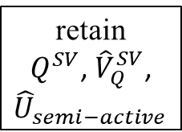
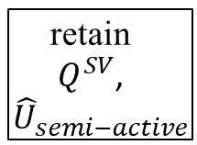













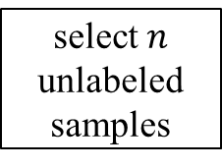























(a) Virtual Support Vector Machine with self-learning constraints and semi-labeled samples
(c) Active Learning with self-learning constrains and semi-supervised Virtual Support Vector Machines
$$U_{active−label}$$
image
labeled samples $X$
subset of unlabeled samples $U$
pool of unlabeled samples $\tilde{U}$
select $n$ unlabeled samples
$$X$$
$$\tilde{U}$$
relearn model
$$\tilde{U}$$
$$X^{SV}$$
$${\hat{V}}^{SV}$$
update
labeled samples
$${\hat{U}}_{semi−labeled}$$
$${\hat{V}}_{semi−labeled}^{U}$$
$$X$$
semi-labeled samples
margin sampling distance
with clustering
$$U_{most−uncertain}$$
labeling m candidates
$$U_{active−label}$$
VSVM
margin sampling distance
with clustering
$$U_{most−uncertain}$$
labeling candidates
$$U_{active−label}$$
$$X$$
segmentation with initial parameterization
compute
object features
learn SVM model
apply SVM model
thematic map
update
labeled samples
semi-labeled samples
$$Q$$
$$U_{semi−labeled}$$
select $n$ unlabeled samples
apply SVM model
relearn model
extract
SVs
$$X^{SV}$$
$$Q$$
$$U_{semi−active}$$
$${\hat{U}}_{semi−labeled}$$
relearn model
extract
separating
hyperplane
relearn model
$${\hat{U}}_{semi−active}$$
retain
$Q^{SV}$,
${\hat{U}}_{semi−active}$
$$U_{active−label}$$
segmentation with altered parameterization
identify virtual samples
compute
object
features
similarity constraint
margin sampling constraint
best model
best model
extract
separating
hyperplane
similarity constraint
margin sampling constraint
active learning
active learning
$$V^{SV}$$
$${\hat{V}}^{SV}$$
encoding of invariances
self-learning strategy
self-learning strategy
$$X^{SV}$$
relearn model
$${\hat{V}}^{SV}$$
thematic map
relearn model
$${\hat{U}}_{semi−labeled}$$
$${\hat{V}}_{semi−labeled}^{U}$$
thematic map
thematic map
thematic map
(b) Virtual Support Vector Machine with self-learning constraints and virtual semi-labeled samples
$$X^{SV}$$
$$Q^{SV}$$
$${\hat{U}}_{semi−labeled}$$
$$\tilde{U}$$
$${\hat{V}}_{Q}^{SV}$$
relearn model
relearn model
$$U_{active−label}$$
$${\hat{V}}^{SV}$$
multiclass level uncertainty distance
with clustering
$$U_{most−uncertain}$$
labeling candidates
$${\hat{U}}_{semi−active}$$
$$U_{active−label}$$
$$X$$
virtual semi-labeled samples
virtual semi-active samples
$${\hat{U}}_{semi−labeled}^{SV}$$
extract
SVs of ${\hat{U}}_{semi−labeled}$
retain
$X^{SV}$, ${\hat{V}}^{SV}$,
${\hat{U}}_{semi−labeled}$
update
labeled samples
$${\hat{U}}_{semi−active}^{SV}$$
extract
SVs of ${\hat{U}}_{semi−active}$
retain
$Q^{SV}$, ${\hat{V}}_{Q}^{SV}$,
${\hat{U}}_{semi−active}$
$$X^{SV}$$
relearn model
$${\hat{V}}^{SV}$$
$${\hat{U}}_{semi−labeled}$$
$${\hat{V}}_{semi−labeled}^{U}$$
identify virtual semi- labeled samples
compute
object
features
similarity constraint
margin sampling constraint
identify virtual active samples
compute
object
features
similarity constraint
margin sampling constraint
relearn model
$$Q$$
relearn model
$$V_{semi−labeled}^{U}$$
$${\hat{V}}_{semi−labeled}^{U}$$
$$V_{semi−active}^{U}$$
$${\hat{V}}_{semi−active}^{U}$$
thematic map
extract
separating
hyperplane
relearn model
best model
encoding of invariances
self-learning strategy
active learning
encoding of invariances
self-learning strategy
thematic map
thematic map
thematic map
$$X^{SV}$$
$$U_{active−label}$$
$$\tilde{U}$$
relearn model
$${\hat{V}}^{SV}$$
$${\hat{U}}_{semi−labeled}$$
$${\hat{V}}_{semi−labeled}^{U}$$
margin sampling distance
with clustering
$$U_{most−uncertain}$$
labeling candidates
$$U_{active−label}$$
$$X$$
$${\hat{U}}_{semi−active}$$
$${\hat{V}}_{active−label}^{U}$$
thematic map
$${\hat{V}}_{semi−active}^{U}$$
update
labeled samples
$$Q$$
best model
extract
separating
hyperplane
relearn model
active learning
thematic map

Slide 14

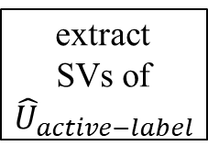




$$Q^{SV}$$
relearn model
virtual active samples
$${\hat{U}}_{active−label}^{SV}$$
extract
SVs of ${\hat{U}}_{active−label}$
retain
$X^{SV}$, ${\hat{V}}^{SV}$,
${\hat{U}}_{semi−labeled}$
identify virtual active samples
compute
object
features
similarity constraint
margin sampling constraint
relearn model
$$V_{active−label}^{SV}$$
$${\hat{V}}_{active−label}^{SL}$$
encoding of invariances
self-learning strategy
thematic map

