Slide 1
AQ-S³VSVM: Active queries on semi-supervised Virtual Support Vector Machines for classification of EO data
ESA Living Planet Symposium 2025
D.02.08 Explainable AI for Earth Observation and Earth Science - PART 1 – Hall G1, June 27th, session: 8:30-10 a.m., talk: 8:30-8:45 a.m.
Christian Geiß^{*,1,2}, Lorenzo Carlassara^{2,3}, Ludovico Giorgio Aldo Biagi³, Hannes Taubenböck^{1,4}, and Patrick Aravena Pelizari¹
¹ German Aerospace Center (DLR), German Remote Sensing Data Center (DFD), Münchener Straße 20, 82234 Weßling, Germany
² University of Bonn, Department of Geography, Meckenheimer Allee 166, 53115 Bonn, Germany
³ Department of Civil and Environmental Engineering, Politecnico di Milano, Italy.
⁴ University of Würzburg, Institute of Geography and Geology, Chair of Remote Sensing, Am Hubland, 97074 Würzburg, Germany

Slide 2
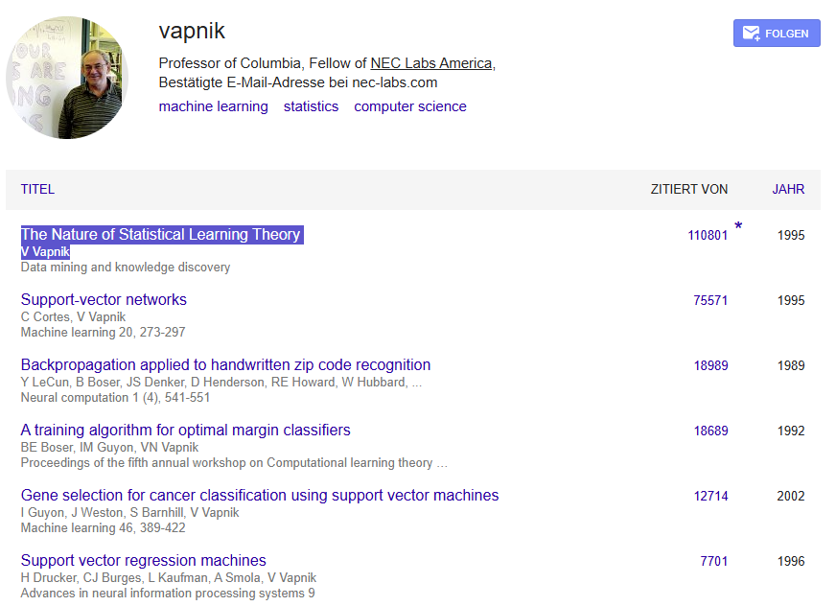
Introduction – Support Vector Machines
1963: Vapnik and Chervonenkis introduced the concept of the maximum-margin hyperplane for linear classification.
1990s: SVMs were further popularized and extended to handle non-linear classification using the kernel trick by Vapnik and collaborators (notably Corinna Cortes), especially in their 1995 paper "Support-Vector Networks".
Screenshot Google Scholar, June 23rd, 2025

Slide 3
Objective – algorithm properties
1. Maximum Margin Principle
Definition: SVM finds the hyperplane that maximizes the margin between the two classes.
Why it matters: A larger margin tends to improve generalization on unseen data.
Mathematical property: Solves a convex quadratic optimization problem.
2. Support Vectors
Definition: Only a subset of the training samples (called support vectors) determine the decision boundary.
Why it matters: These samples are critical to the model — all others do not affect the decision surface.
Consequence: Model complexity depends on the number of support vectors, not the total dataset size.
our goal:
→ equip invariant SVMs with active learning for very robust and efficient sampling and model learning

Slide 4
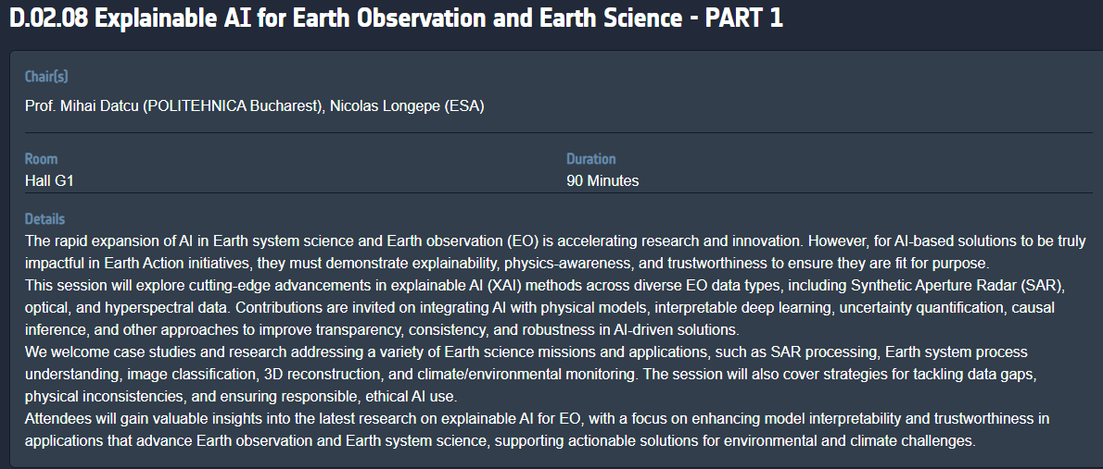
Objective
Why in this session?
efficiency

Slide 5
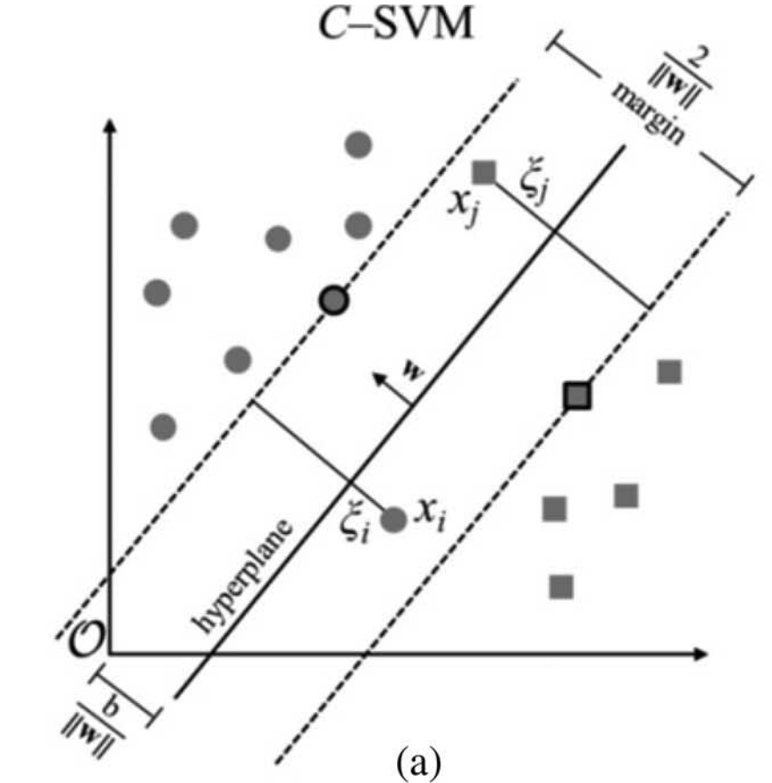
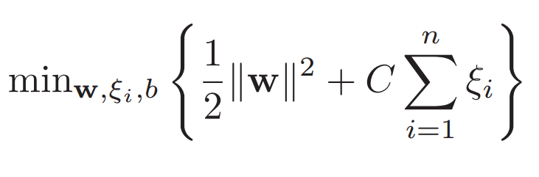
The foundation: Support Vector Machines
minimization objective
feature space

Slide 6
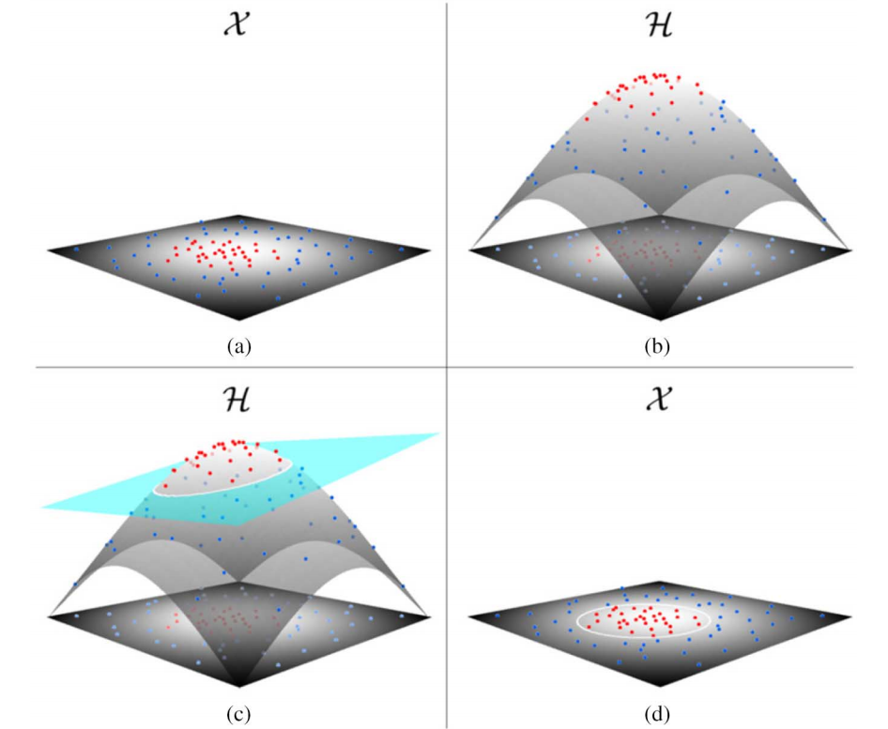
The foundation: Support Vector Machines – non-linear
Geiß, C., Jilge, M., Lakes, T., and Taubenböck, H. (2016): Estimation of Seismic Vulnerability Levels of Urban Structures With Multisensor Remote Sensing. IEEE Journal of Selected Topics in Applied Earth Observation and Remote Sensing, 9, 5, 1913–1936.

Slide 7
The foundation: Support Vector Machines
minimization objective
feature space

Slide 8
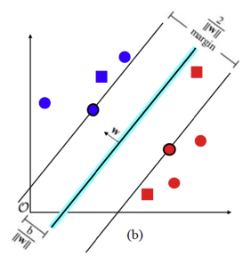
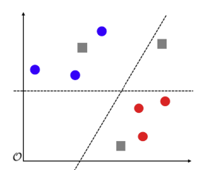
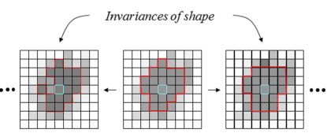
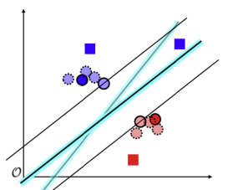
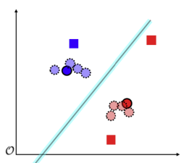
Virtual Support Vector Machines, i.e., invariant SVMs
feature space
image space
virtual sample
sample
virtual sample
1) encoded as sample and not feature
2) targeted data augmentation
Geiß, C., Aravena Pelizari, P., Blickensdörfer, L., and Taubenböck, H. (2019): Virtual Support Vector Machines with Self-Learning Strategy for Classification of Multispectral Remote Sensing Imagery. ISPRS Journal of Photogrammetry and Remote Sensing, 151, 42–58.

Slide 9
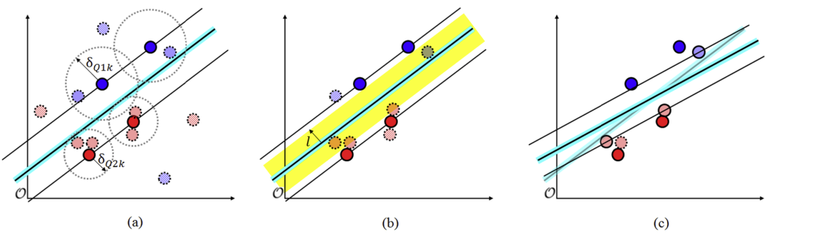
constrained, i.e., robust, Virtual Support Vector Machines
eventually prune virtual samples
criteria 1: similarity constraint
criteria 2: margin constraint
final model
Geiß, C., Aravena Pelizari, P., Blickensdörfer, L., and Taubenböck, H. (2019): Virtual Support Vector Machines with Self-Learning Strategy for Classification of Multispectral Remote Sensing Imagery. ISPRS Journal of Photogrammetry and Remote Sensing, 151, 42–58.

Slide 10
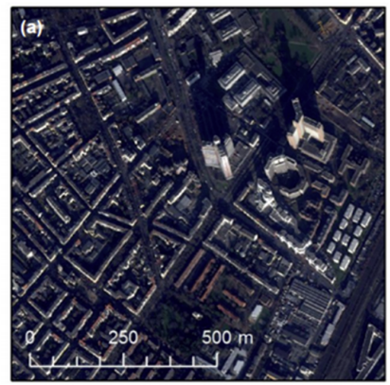
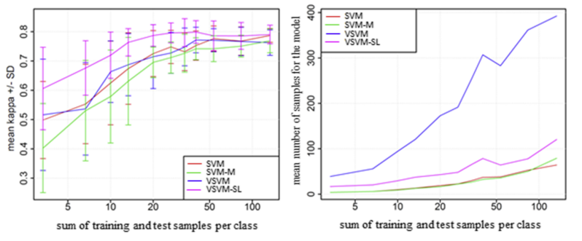
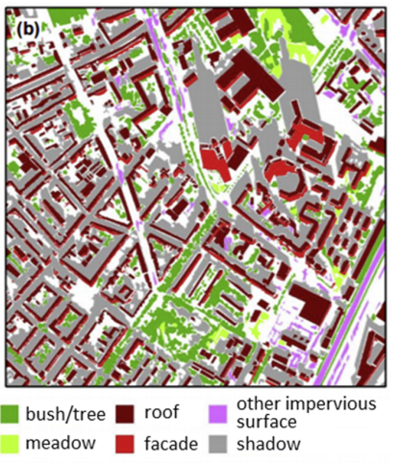
experimental setup – multispectral imagery
Geiß, C., Aravena Pelizari, P., Blickensdörfer, L., and Taubenböck, H. (2019): Virtual Support Vector Machines with Self-Learning Strategy for Classification of Multispectral Remote Sensing Imagery. ISPRS Journal of Photogrammetry and Remote Sensing, 151, 42–58.

Slide 11
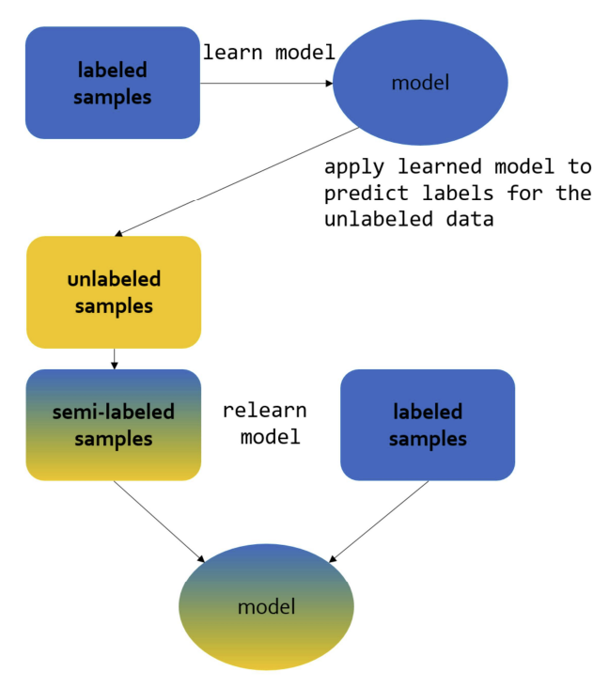
semi-supervised Virtual Support Vector Machines
Semi-supervised learning paradigm
challenge: how to not encode information that leads to model divergence?

Slide 12
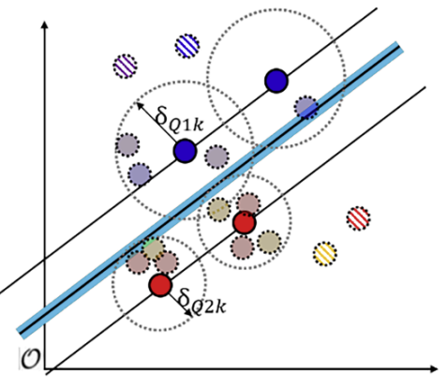
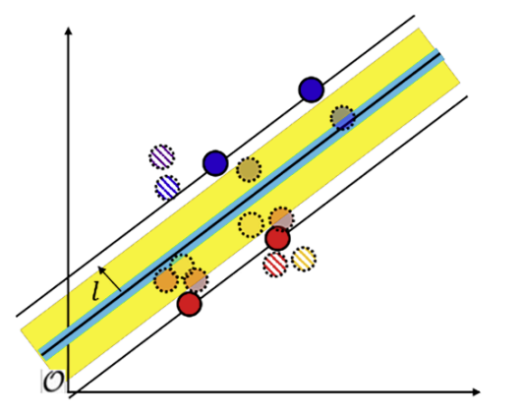
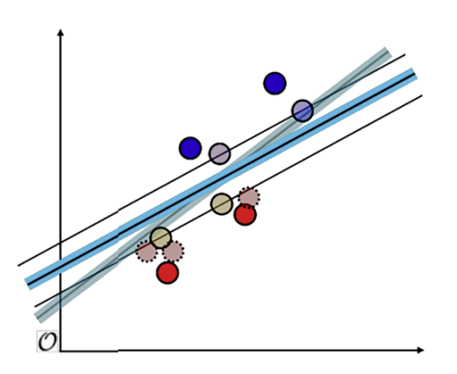
constrained, i.e., robust, Virtual Support Vector Machines
eventually prune semi-labeled (virtual) samples
criteria 1: similarity constraint
criteria 2: margin constraint
final model
Geiß, C., Aravena Pelizari, P., Tuncbilek, O., and Taubenböck, H. (2023) Semi-supervised Learning with Constrained Virtual Support Vector Machines for Classification of Remote Sensing Image Data. International Journal of Applied Earth Observation and Geoinformation, 125, 103571.

Slide 13
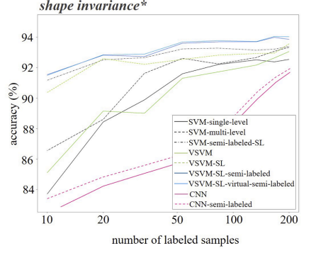
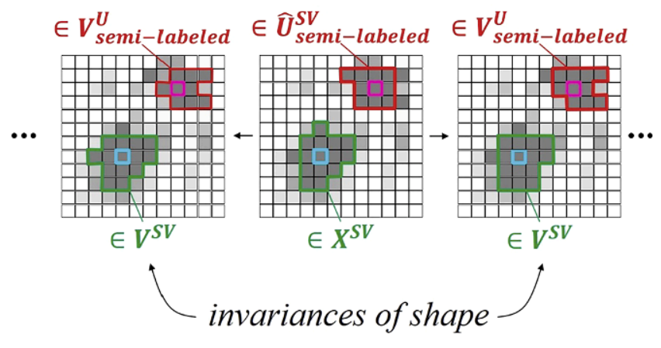
semi-supervised Virtual Support Vector Machines
Geiß, C., Aravena Pelizari, P., Tuncbilek, O., and Taubenböck, H. (2023) Semi-supervised Learning with Constrained Virtual Support Vector Machines for Classification of Remote Sensing Image Data. International Journal of Applied Earth Observation and Geoinformation, 125, 103571.

Slide 14
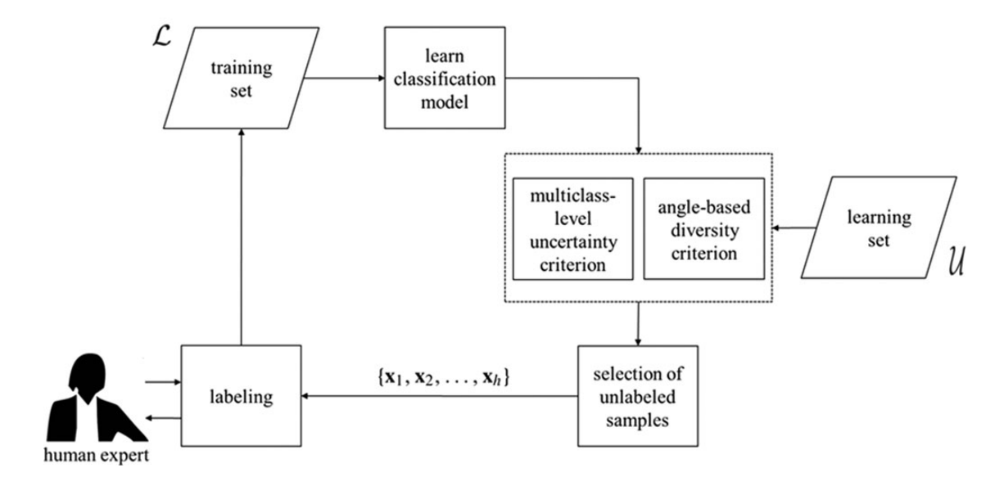
AQ-S³VSVM: Active queries on semi-supervised Virtual Support Vector Machines for classification of EO data
Active learning paradigm
selection heuristic(s)

Slide 15
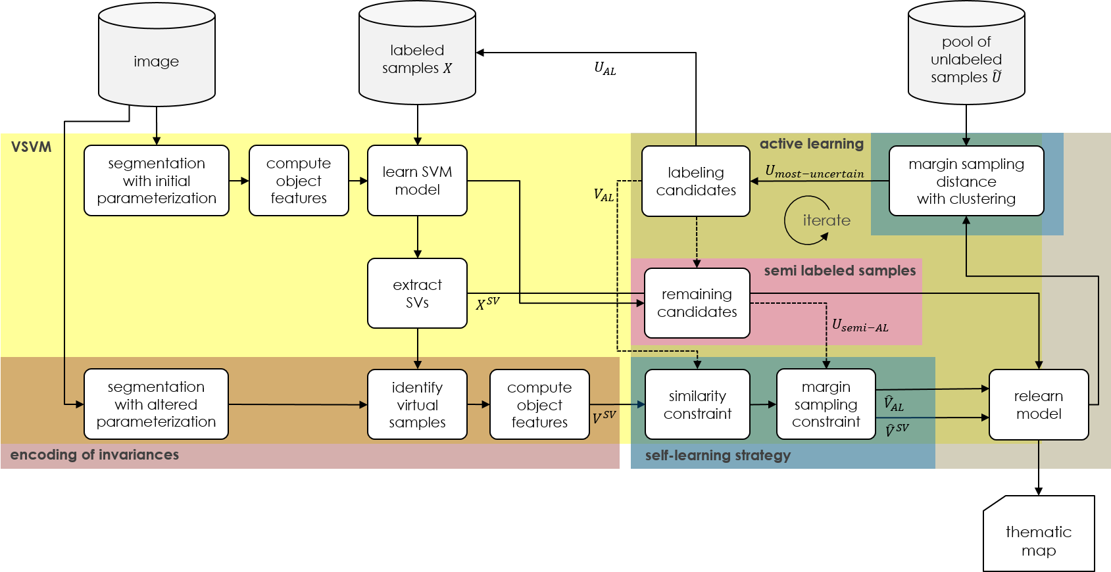
AQ-S³VSVM: Active queries on semi-supervised Virtual Support Vector Machines for classification of EO data
Active learning paradigm

Slide 16
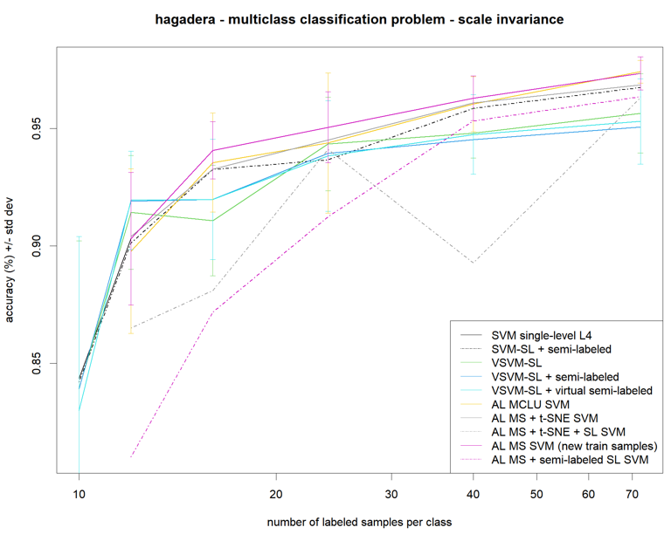
AQ-S³VSVM - preliminary results

Slide 17
Conclusion and Outlook
efficient framework for image classification with little prior knowledge (and no previously (unlabeled) encoded prior knowledge (e.g., foundation models))
model-agnostic objectives
establish invariance encoding based on representation learning approach
adapt some principles for DL models, e.g., tailored data augmentation
deploy for Quantum Machine Learning algorithms
number of qubits strongly limited –> encoding additional information as virtual samples

Slide 18
AQ-S³VSVM: Active queries on semi-supervised Virtual Support Vector Machines for classification of EO data
ESA Living Planet Symposium 2025
D.02.08 Explainable AI for Earth Observation and Earth Science - PART 1 – Hall G1, June 27th, session: 8:30-10 a.m., talk: 8:30-8:45 a.m.
Christian Geiß^{*,1,2}, Lorenzo Carlassara^{2,3}, Ludovico Giorgio Aldo Biagi³, Hannes Taubenböck^{1,4}, and Patrick Aravena Pelizari¹
¹ German Aerospace Center (DLR), German Remote Sensing Data Center (DFD), Münchener Straße 20, 82234 Weßling, Germany
² University of Bonn, Department of Geography, Meckenheimer Allee 166, 53115 Bonn, Germany
³ Department of Civil and Environmental Engineering, Politecnico di Milano, Italy.
⁴ University of Würzburg, Institute of Geography and Geology, Chair of Remote Sensing, Am Hubland, 97074 Würzburg, Germany
christian.geiss@dlr.de

