Slide 1

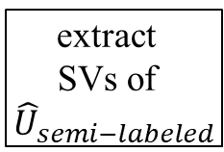
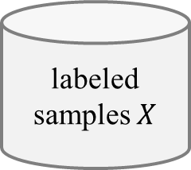

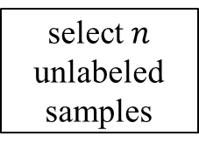


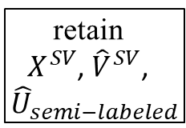
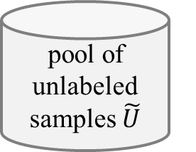




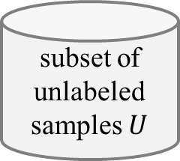



(a) Virtual Support Vector Machine with self-learning constraints and semi-labeled samples
image
labeled samples $X$
subset of unlabeled samples $U$
pool of unlabeled samples $\tilde{U}$
select $n$ unlabeled samples
semi-labeled samples
VSVM
segmentation with initial parameterization
compute
object features
learn SVM model
apply SVM model
$$U_{semi−labeled}$$
extract
SVs
$$X^{SV}$$
$${\hat{U}}_{semi−labeled}$$
relearn model
segmentation with altered parameterization
identify virtual samples
compute
object
features
similarity constraint
margin sampling constraint
$$V^{SV}$$
$${\hat{V}}^{SV}$$
encoding of invariances
self-learning strategy
thematic map
(b) Virtual Support Vector Machine with self-learning constraints and virtual semi-labeled samples
$$X^{SV}$$
$${\hat{U}}_{semi−labeled}$$
relearn model
$${\hat{V}}^{SV}$$
virtual semi-labeled samples
$${\hat{U}}_{semi−labeled}^{SV}$$
extract
SVs of ${\hat{U}}_{semi−labeled}$
retain
$X^{SV}$, ${\hat{V}}^{SV}$,
${\hat{U}}_{semi−labeled}$
identify virtual semi- labeled samples
compute
object
features
similarity constraint
margin sampling constraint
relearn model
$$V_{semi−labeled}^{U}$$
$${\hat{V}}_{semi−labeled}^{U}$$
encoding of invariances
self-learning strategy
thematic map

Slide 2



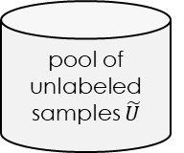
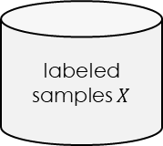


Active learning method with constrained Virtual Support Vector Machine v1
image
labeled samples $X$
pool of unlabeled samples $\tilde{U}$
VSVM
segmentation with initial parameterization
compute
object features
learn SVM model
relabeling
candidates
active learning
uncertainty-distance
function with clustering
$$U_{most−uncertain}$$
$$U_{active−labeled}$$
extract
SVs
iterate
$$X^{SV}$$
segmentation with altered parameterization
identify virtual samples
compute
object
features
similarity constraint
margin sampling constraint
relearn model
$$V^{SV}$$
$${\hat{V}}^{SV}$$
encoding of invariances
self-learning strategy
thematic map

Slide 3




Active learning method with constrained Virtual Support Vector Machine v2
image
labeled samples $X$
pool of unlabeled samples $\tilde{U}$
VSVM
segmentation with initial parameterization
compute
object features
learn SVM model
relabeling
candidates
active learning
uncertainty-distance
function with clustering
$$U_{most−uncertain}$$
$$U_{active−labeled}$$
extract
SVs
$$X^{SV}$$
segmentation with altered parameterization
identify virtual samples
compute
object
features
similarity constraint
margin sampling constraint
relearn model
$${\hat{U}}_{active−labeled}$$
$$V^{SV}$$
$${\hat{V}}^{SV}$$
encoding of invariances
self-learning strategy
thematic map

Slide 4



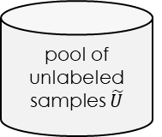

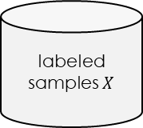


Active learning method for Virtual Support Vector Machine with self-learning constraints
Active learning method with constrained Virtual Support Vector Machine
image
labeled samples $X$
pool of unlabeled samples $\tilde{U}$
VSVM
active learning
segmentation with initial parameterization
compute
object
features
learn SVM model
labeling
candidates
Uncertainty distance
with PCA + clustering
$$U_{most−uncertain}$$
$$U_{active−labeled}$$
iterate
extract
SVs
$$X^{SV}$$
segmentation with altered parameterization
identify virtual samples
compute
object
features
similarity constraint
margin sampling constraint
relearn model
$${\hat{U}}_{active−labeled}$$
$$V^{SV}$$
$${\hat{V}}^{SV}$$
encoding of invariances
self-learning strategy
thematic map

Slide 5
Active learning method with constrained Virtual Support Vector Machine VARIANT
image
labeled samples $X$
pool of unlabeled samples $\tilde{U}$
VSVM
segmentation with initial parameterization
compute
object
features
learn SVM model
labeling
candidates
active learning
Uncertainty distance
with PCA + clustering
$$U_{active−labeled}$$
$$U_{most−uncertain}$$
iterate
extract
SVs
$$X^{SV}$$
segmentation with altered parameterization
identify virtual samples
compute
object
features
similarity constraint
margin sampling constraint
relearn model
$${\hat{U}}_{active−labeled}$$
$$V^{SV}$$
$${\hat{V}}^{SV}$$
encoding of invariances
self-learning strategy
thematic map

Slide 6


Active learning method with constrained Virtual Support Vector Machine random
image
labeled samples $X$
pool of unlabeled samples $\tilde{U}$
VSVM
active
learning
segmentation with initial parameterization
compute
object
features
learn SVM model
$$U_{random}$$
labeling
candidates
extract
SVs
$$U_{active−labeled}$$
$$X^{SV}$$
iterate
segmentation with altered parameterization
identify virtual samples
compute
object
features
similarity constraint
margin sampling constraint
relearn model
$${\hat{U}}_{active−labeled}$$
$$V^{SV}$$
$${\hat{V}}^{SV}$$
encoding of invariances
self-learning strategy
thematic map

Slide 7

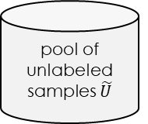

Active learning method with constrained Virtual Support Vector Machine + SEMI
image
labeled samples $X$
pool of unlabeled samples $\tilde{U}$
VSVM
segmentation with initial parameterization
compute
object
features
learn SVM model
labeling
candidates
active learning
Uncertainty distance
with PCA + clustering
$$U_{active−labeled}$$
$$U_{most−uncertain}$$
iterate
extract
SVs
semi supervised
remaining
candidates
$$X^{SV}$$
$$U_{semi−labeled}$$
segmentation with altered parameterization
identify virtual samples
compute
object
features
similarity constraint
margin sampling constraint
$${\hat{V}}^{SV}$$
relearn model
$$V^{SV}$$
$${\hat{U}}_{active−labeled}$$
$${\hat{U}}_{semi−labeled}$$
encoding of invariances
self-learning strategy
thematic map

Slide 8
Active learning method with constrained Virtual Support Vector Machine + SEMI
image
labeled samples $X$
pool of unlabeled samples $\tilde{U}$
VSVM
segmentation with initial parameterization
compute
object
features
learn SVM model
labeling
candidates
active learning
Uncertainty distance
with tSNE + clustering
$$U_{active−labeled}$$
$$U_{most−uncertain}$$
iterate
extract
SVs
semi supervised
remaining
candidates
$$X^{SV}$$
$$U_{semi−labeled}$$
segmentation with altered parameterization
identify virtual samples
compute
object
features
similarity constraint
margin sampling constraint
$${\hat{V}}^{SV}$$
relearn model
$$V^{SV}$$
$${\hat{U}}_{active−labeled}$$
$${\hat{U}}_{semi−labeled}$$
encoding of invariances
self-learning strategy
thematic map

Slide 9

SL AL method with constrained Virtual Support Vector Machine
image
labeled samples $X$
pool of unlabeled samples $\tilde{U}$
VSVM
segmentation with initial parameterization
compute
object
features
learn SVM model
labeling
candidates
multiclass level uncertainty
with t-SNE + k-means
$$U_{most−uncertain}$$
iterate
extract
SVs
$$X^{SV}$$
active learning
segmentation with altered parameterization
identify virtual samples
compute
object
features
similarity constraint
margin sampling constraint
relearn model
$${\hat{U}}_{active−labeled}$$
$$V^{SV}$$
$${\hat{V}}^{SV}$$
encoding of invariances
self-learning strategy
thematic map

Slide 10



SL AL method with constrained Virtual Support Vector Machine + SEMI
image
labeled samples $X$
pool of unlabeled samples $\tilde{U}$
$$U_{active−labeled}$$
VSVM
segmentation with initial parameterization
compute
object
features
learn SVM model
active learning
labeling
candidates
margin sampling distance
$$U_{most−uncertain}$$
iterate
extract
SVs
remaining
candidates
semi labeled samples
$$X^{SV}$$
$$U_{semi−labeled}$$
segmentation with altered parameterization
identify virtual samples
compute
object
features
similarity constraint
margin sampling constraint
relearn model
$${\hat{U}}_{active−labeled}$$
$$V^{SV}$$
$${\hat{V}}^{SV}$$
encoding of invariances
self-learning strategy
thematic map

Slide 11
SL AL method with constrained Virtual Support Vector Machine
image
labeled samples $X$
pool of unlabeled samples $\tilde{U}$
VSVM
segmentation with initial parameterization
compute
object
features
learn SVM model
labeling
candidates
margin sampling distance
multiclass level uncertainty
$$U_{most−uncertain}$$
iterate
with t-SNE + k-means
extract
SVs
$$X^{SV}$$
active learning
$$U_{active−labeled}$$
segmentation with altered parameterization
identify virtual samples
compute
object
features
similarity constraint
margin sampling constraint
relearn model
$${\hat{U}}_{active−labeled}$$
$$V^{SV}$$
$${\hat{V}}^{SV}$$
encoding of invariances
self-learning strategy
thematic map

Slide 12





SL AL method with constrained Virtual Support Vector Machine + SEMI
image
labeled samples $X$
pool of unlabeled samples $\tilde{U}$
$$U_{AL}$$
VSVM
active learning
segmentation with initial parameterization
compute
object
features
learn SVM model
labeling
candidates
$$U_{most−uncertain}$$
margin sampling distance
with clustering
$$V_{AL}$$
iterate
extract
SVs
remaining
candidates
semi labeled samples
$$X^{SV}$$
$$U_{semi−AL}$$
segmentation with altered parameterization
identify virtual samples
compute
object
features
similarity constraint
margin sampling constraint
relearn model
$${\hat{V}}_{AL}$$
$$V^{SV}$$
$${\hat{V}}^{SV}$$
encoding of invariances
self-learning strategy
thematic map

Slide 13



SL AL method with constrained Virtual Support Vector Machine
image
labeled samples $X$
pool of unlabeled samples $\tilde{U}$
VSVM
segmentation with initial parameterization
compute
object
features
learn SVM model
labeling
candidates
margin sampling distance
multiclass level uncertainty
$$U_{most−uncertain}$$
$$V_{AL}$$
$$U_{AL}$$
iterate
with PCA / t-SNE + k-means
extract
SVs
$$X^{SV}$$
active learning
segmentation with altered parameterization
identify virtual samples
compute
object
features
similarity constraint
margin sampling constraint
relearn model
$${\hat{V}}_{active−labeled}$$
$$V^{SV}$$
$${\hat{V}}^{SV}$$
encoding of invariances
self-learning strategy
thematic map

