Slide 1
AQ-S³VSVM

Slide 2
SVM-single-level
SVM-semi-labeled-SL
VSVM-SL
VSVM-SL-semi-labeled
VSVM-SL-virtual-semi-labeled
AQ^{MS}-SVM -> provide the AL samples
AQ^{MS}-SVM-semi-active-labeled
AQ-S³VSVM
AQ SVM-single-level -> equal to 6.
AQ SVM-semi-labeled-SL -> equal to 7.
AQ VSVM-SL
AQ VSVM-SL-semi-labeled
AQ VSVM-SL-virtual-semi-labeled
SVM
SVM-SL
VSVM-SL
VSVM-SL-Un
VSVM-SL-vUn
AQ-MS-SVM
AQ-MS-SVM-SL
AQ-S³VSVM
AQ SVM
AQ SVM-SL
AQ VSVM-SL
AQ VSVM-SL-Un
AQ VSVM-SL-vUn
train-set composition:
all initial samples -> 1. 2. 3. 4. 5.
vs
2/3 initial samples + 1/3 AL samples -> 6. 7. 11. 12. 13.
2 iterations of AL
20 realizations

Slide 3
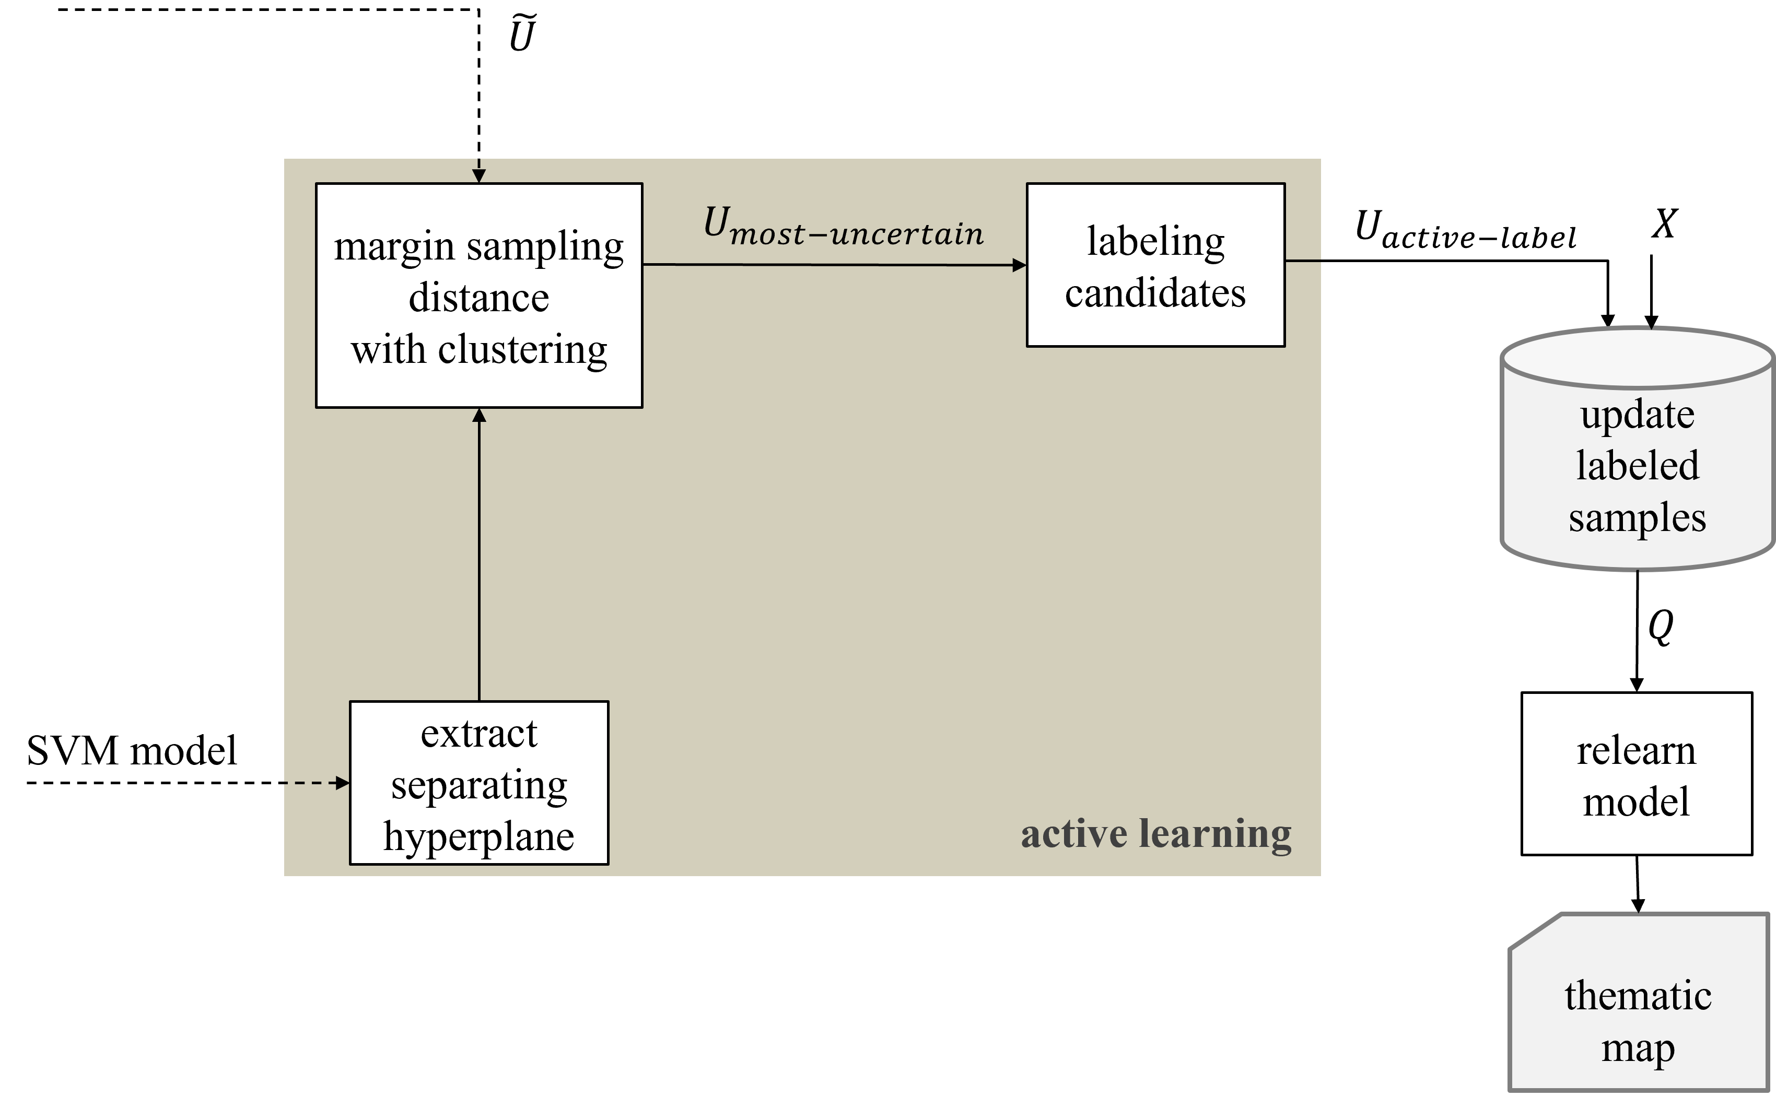
AQ^{MS}-SVM

Slide 4
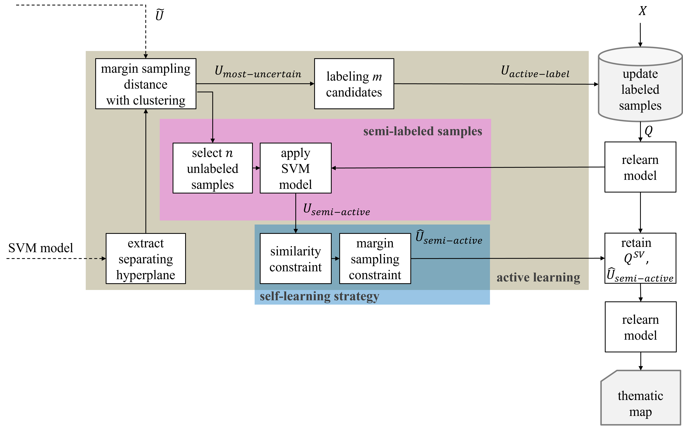
AQ^{MS}-SVM-semi-active-labeled

Slide 5
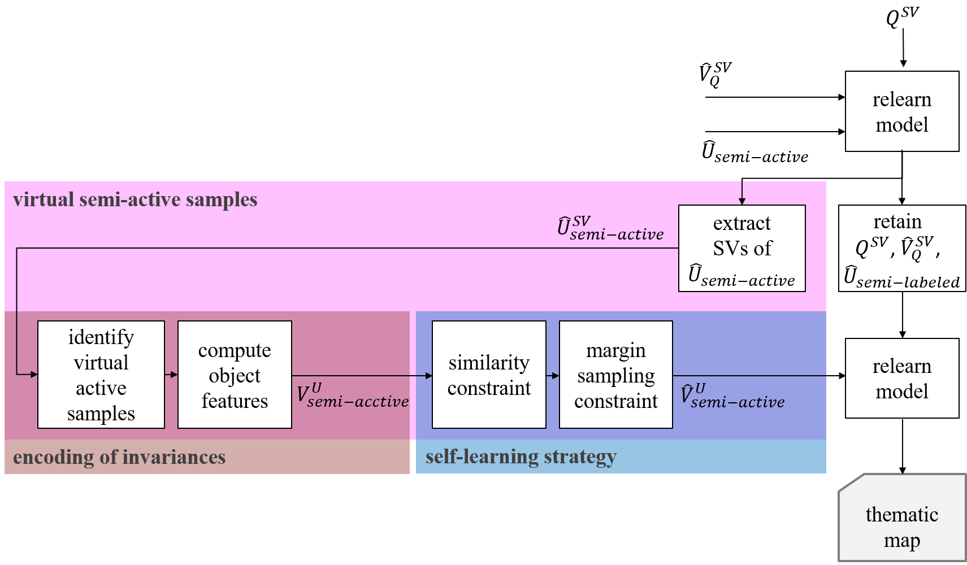
AQ-S³VSVM

Slide 6
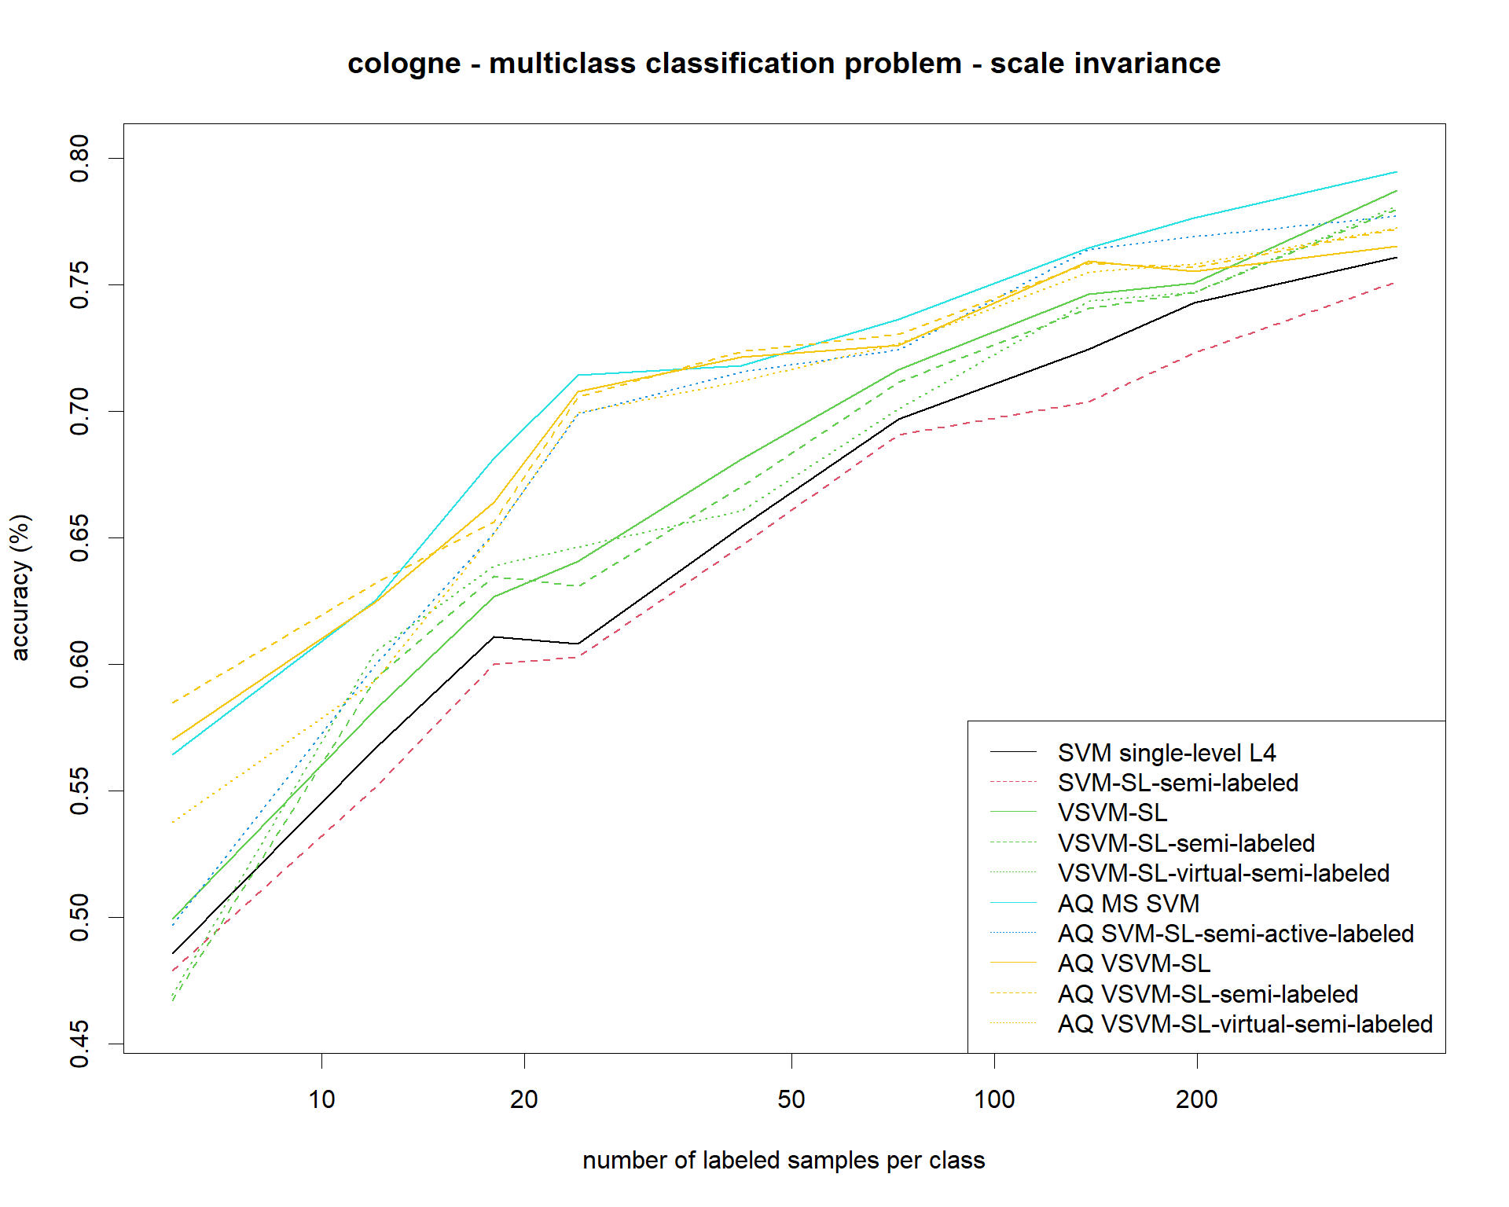

Slide 7
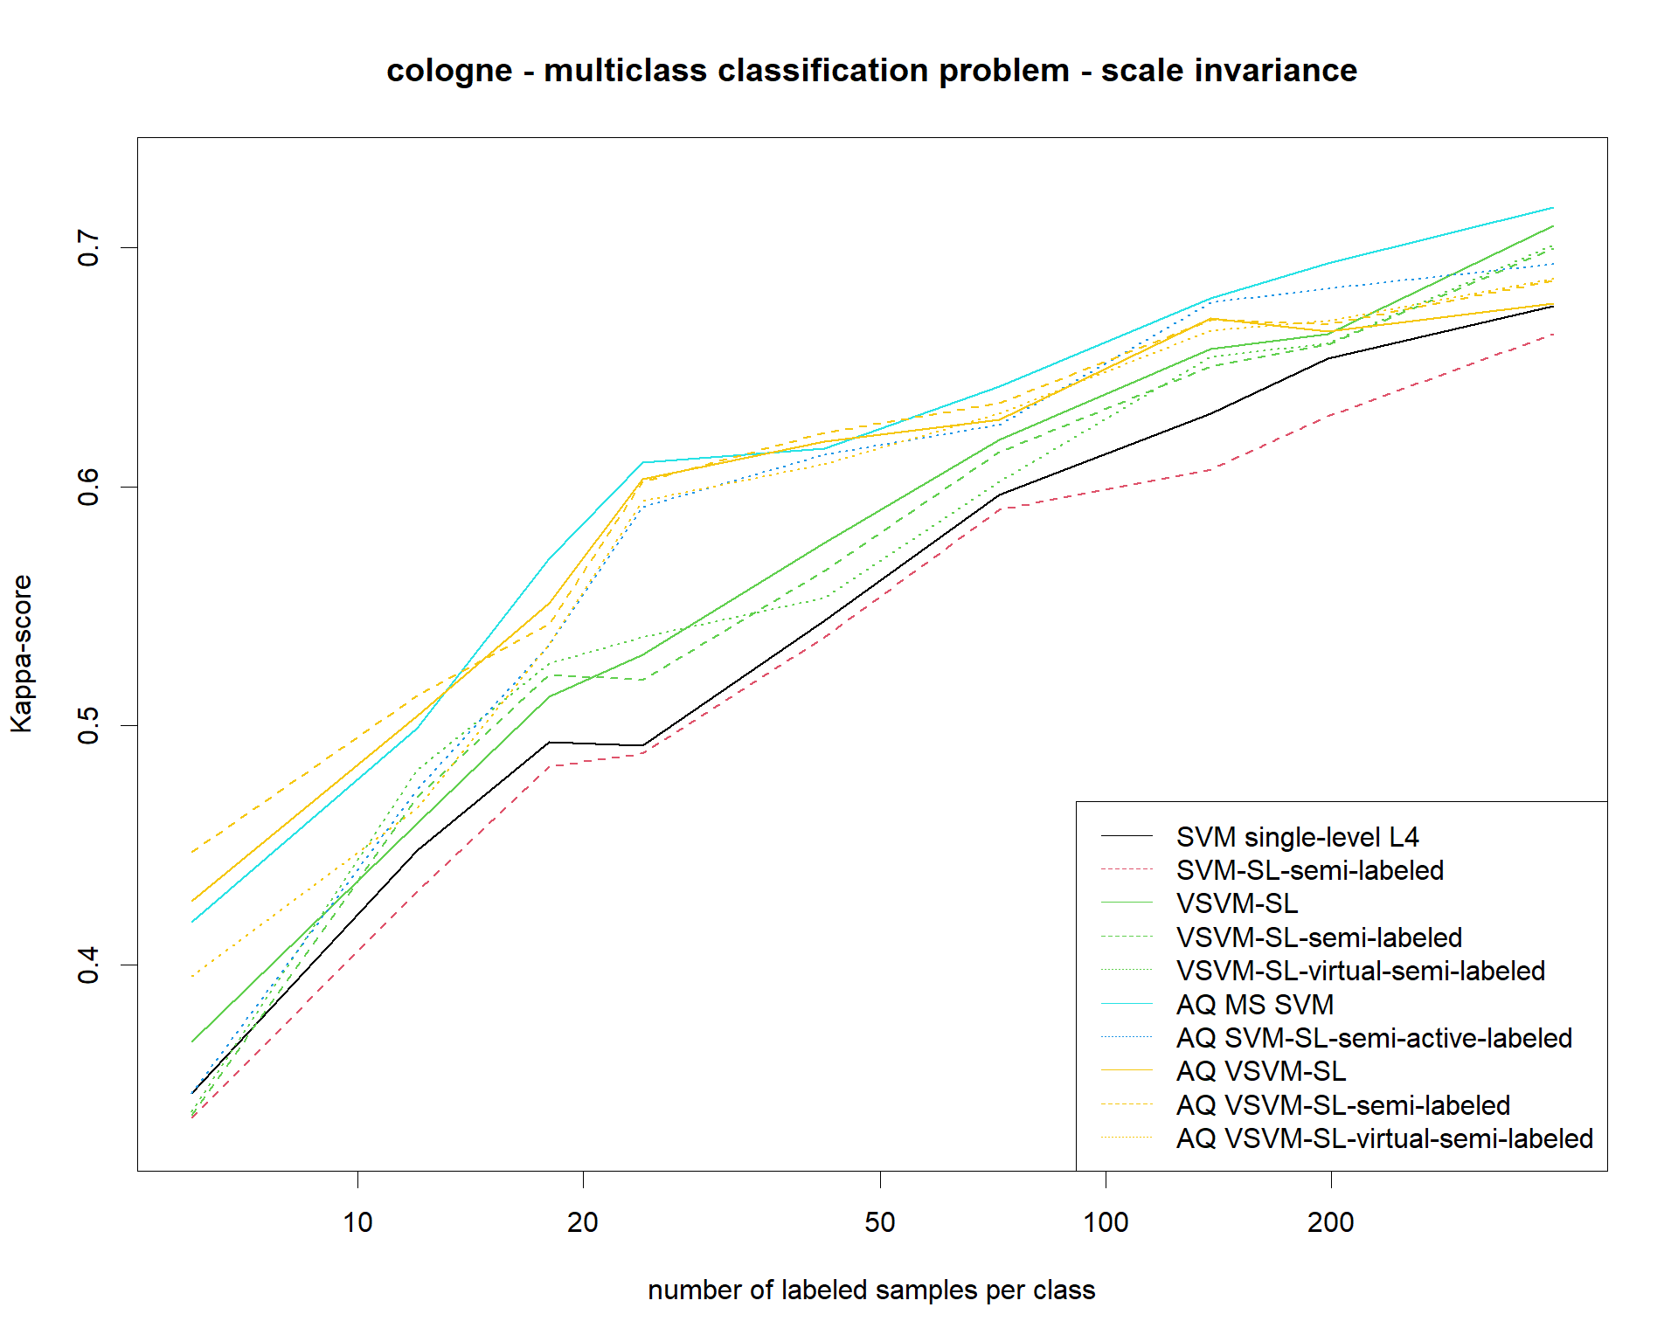

Slide 8
