Slide 1

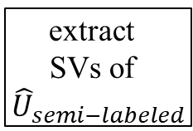
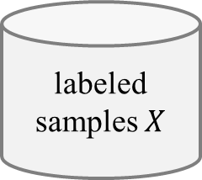

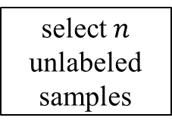


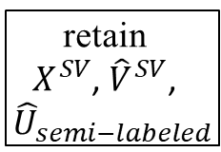
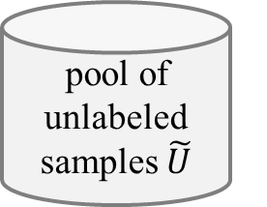




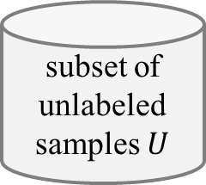



(a) Virtual Support Vector Machine with self-learning constraints and semi-labeled samples
image
labeled samples $X$
subset of unlabeled samples $U$
pool of unlabeled samples $\tilde{U}$
select $n$ unlabeled samples
semi-labeled samples
VSVM
segmentation with initial parameterization
compute
object features
learn SVM model
apply SVM model
$$U_{semi−labeled}$$
extract
SVs
$$X^{SV}$$
$${\hat{U}}_{semi−labeled}$$
relearn model
segmentation with altered parameterization
identify virtual samples
compute
object
features
similarity constraint
margin sampling constraint
$$V^{SV}$$
$${\hat{V}}^{SV}$$
encoding of invariances
self-learning strategy
thematic map
(b) Virtual Support Vector Machine with self-learning constraints and virtual semi-labeled samples
$$X^{SV}$$
$${\hat{U}}_{semi−labeled}$$
relearn model
$${\hat{V}}^{SV}$$
virtual semi-labeled samples
$${\hat{U}}_{semi−labeled}^{SV}$$
extract
SVs of ${\hat{U}}_{semi−labeled}$
retain
$X^{SV}$, ${\hat{V}}^{SV}$,
${\hat{U}}_{semi−labeled}$
identify virtual semi- labeled samples
compute
object
features
similarity constraint
margin sampling constraint
relearn model
$$V_{semi−labeled}^{U}$$
$${\hat{V}}_{semi−labeled}^{U}$$
encoding of invariances
self-learning strategy
thematic map

Slide 2



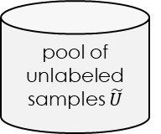
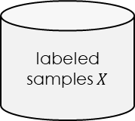


Active learning method with constrained Virtual Support Vector Machine v1
image
labeled samples $X$
pool of unlabeled samples $\tilde{U}$
VSVM
segmentation with initial parameterization
compute
object features
learn SVM model
relabeling
candidates
active learning
uncertainty-distance
function with clustering
$$U_{most−uncertain}$$
$$U_{active−labeled}$$
extract
SVs
iterate
$$X^{SV}$$
segmentation with altered parameterization
identify virtual samples
compute
object
features
similarity constraint
margin sampling constraint
relearn model
$$V^{SV}$$
$${\hat{V}}^{SV}$$
encoding of invariances
self-learning strategy
thematic map

Slide 3




Active learning method with constrained Virtual Support Vector Machine v2
image
labeled samples $X$
pool of unlabeled samples $\tilde{U}$
VSVM
segmentation with initial parameterization
compute
object features
learn SVM model
relabeling
candidates
active learning
uncertainty-distance
function with clustering
$$U_{most−uncertain}$$
$$U_{active−labeled}$$
extract
SVs
$$X^{SV}$$
segmentation with altered parameterization
identify virtual samples
compute
object
features
similarity constraint
margin sampling constraint
relearn model
$${\hat{U}}_{active−labeled}$$
$$V^{SV}$$
$${\hat{V}}^{SV}$$
encoding of invariances
self-learning strategy
thematic map

Slide 4



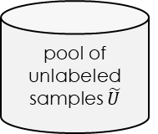

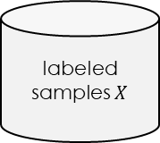


Active learning method for Virtual Support Vector Machine with self-learning constraints
Active learning method with constrained Virtual Support Vector Machine
image
labeled samples $X$
pool of unlabeled samples $\tilde{U}$
VSVM
active learning
segmentation with initial parameterization
compute
object
features
learn SVM model
labeling
candidates
Uncertainty distance
with PCA + clustering
$$U_{most−uncertain}$$
$$U_{active−labeled}$$
iterate
extract
SVs
$$X^{SV}$$
segmentation with altered parameterization
identify virtual samples
compute
object
features
similarity constraint
margin sampling constraint
relearn model
$${\hat{U}}_{active−labeled}$$
$$V^{SV}$$
$${\hat{V}}^{SV}$$
encoding of invariances
self-learning strategy
thematic map

Slide 5
Active learning method with constrained Virtual Support Vector Machine VARIANT
image
labeled samples $X$
pool of unlabeled samples $\tilde{U}$
VSVM
segmentation with initial parameterization
compute
object
features
learn SVM model
labeling
candidates
active learning
Uncertainty distance
with PCA + clustering
$$U_{active−labeled}$$
$$U_{most−uncertain}$$
iterate
extract
SVs
$$X^{SV}$$
segmentation with altered parameterization
identify virtual samples
compute
object
features
similarity constraint
margin sampling constraint
relearn model
$${\hat{U}}_{active−labeled}$$
$$V^{SV}$$
$${\hat{V}}^{SV}$$
encoding of invariances
self-learning strategy
thematic map

Slide 6

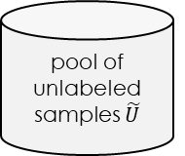

Active learning method with constrained Virtual Support Vector Machine + SEMI
image
labeled samples $X$
pool of unlabeled samples $\tilde{U}$
VSVM
segmentation with initial parameterization
compute
object
features
learn SVM model
labeling
candidates
active learning
Uncertainty distance
with tSNE + clustering
$$U_{active−labeled}$$
$$U_{most−uncertain}$$
iterate
extract
SVs
semi supervised
remaining
candidates
$$X^{SV}$$
$$U_{semi−labeled}$$
segmentation with altered parameterization
identify virtual samples
compute
object
features
similarity constraint
margin sampling constraint
$${\hat{V}}^{SV}$$
relearn model
$$V^{SV}$$
$${\hat{U}}_{active−labeled}$$
$${\hat{U}}_{semi−labeled}$$
encoding of invariances
self-learning strategy
thematic map

Slide 7



SL AL method with constrained Virtual Support Vector Machine + SEMI
image
labeled samples $X$
pool of unlabeled samples $\tilde{U}$
$$U_{active−labeled}$$
VSVM
segmentation with initial parameterization
compute
object
features
learn SVM model
active learning
labeling
candidates
margin sampling distance
$$U_{most−uncertain}$$
iterate
extract
SVs
remaining
candidates
semi labeled samples
$$X^{SV}$$
$$U_{semi−labeled}$$
segmentation with altered parameterization
identify virtual samples
compute
object
features
similarity constraint
margin sampling constraint
relearn model
$${\hat{U}}_{active−labeled}$$
$$V^{SV}$$
$${\hat{V}}^{SV}$$
encoding of invariances
self-learning strategy
thematic map

Slide 8
SL AL method with constrained Virtual Support Vector Machine
image
labeled samples $X$
pool of unlabeled samples $\tilde{U}$
VSVM
segmentation with initial parameterization
compute
object
features
learn SVM model
labeling
candidates
margin sampling distance
multiclass level uncertainty
$$U_{most−uncertain}$$
iterate
with t-SNE + k-means
extract
SVs
$$X^{SV}$$
active learning
$$U_{active−labeled}$$
segmentation with altered parameterization
identify virtual samples
compute
object
features
similarity constraint
margin sampling constraint
relearn model
$${\hat{U}}_{active−labeled}$$
$$V^{SV}$$
$${\hat{V}}^{SV}$$
encoding of invariances
self-learning strategy
thematic map

Slide 9





SL AL method with constrained Virtual Support Vector Machine + SEMI
image
labeled samples $X$
pool of unlabeled samples $\tilde{U}$
$$U_{AL}$$
VSVM
active learning
segmentation with initial parameterization
compute
object
features
learn SVM model
labeling
candidates
$$U_{most−uncertain}$$
margin sampling distance
with clustering
$$V_{AL}$$
iterate
extract
SVs
remaining
candidates
semi labeled samples
$$X^{SV}$$
$$U_{semi−AL}$$
segmentation with altered parameterization
identify virtual samples
compute
object
features
similarity constraint
margin sampling constraint
relearn model
$${\hat{V}}_{AL}$$
$$V^{SV}$$
$${\hat{V}}^{SV}$$
encoding of invariances
self-learning strategy
thematic map

Slide 10



SL AL method with constrained Virtual Support Vector Machine
image
labeled samples $X$
pool of unlabeled samples $\tilde{U}$
VSVM
segmentation with initial parameterization
compute
object
features
learn SVM model
labeling
candidates
margin sampling distance
multiclass level uncertainty
$$U_{most−uncertain}$$
$$V_{AL}$$
$$U_{AL}$$
iterate
With t-SNE + k-means
extract
SVs
$$X^{SV}$$
active learning
segmentation with altered parameterization
identify virtual samples
compute
object
features
similarity constraint
margin sampling constraint
relearn model
$${\hat{V}}_{active−labeled}$$
$$V^{SV}$$
$${\hat{V}}^{SV}$$
encoding of invariances
self-learning strategy
thematic map

Slide 11
AQ-S3VSVM
AL-S3VSVM

Slide 12
SL AL method with constrained Virtual Support Vector Machine
image
labeled samples $X$
pool of unlabeled samples $\tilde{U}$
$$U_{AL}$$
VSVM
active learning
segmentation with initial parameterization
compute
object
features
learn SVM model
labeling
candidates
$$U_{most−uncertain}$$
margin sampling distance
with clustering
$$V_{AL}$$
extract
SVs
remaining
candidates
semi labeled samples
$$X^{SV}$$
$$U_{semi−AL}$$
segmentation with altered parameterization
identify virtual samples
compute
object
features
similarity constraint
margin sampling constraint
relearn model
$${\hat{V}}_{AL}$$
$$V^{SV}$$
$${\hat{V}}^{SV}$$
encoding of invariances
self-learning strategy
thematic map

Slide 13
SL AL method with constrained Virtual Support Vector Machine
image
labeled samples $X$
pool of unlabeled samples $\tilde{U}$
VSVM
segmentation with initial parameterization
compute
object
features
learn SVM model
margin sampling distance
with clustering
$$V_{AL}$$
extract
SVs
$$X^{SV}$$
segmentation with altered parameterization
identify virtual samples
compute
object
features
similarity constraint
margin sampling constraint
relearn model
$${\hat{V}}_{AL}$$
$$V^{SV}$$
$${\hat{V}}^{SV}$$
encoding of invariances
self-learning strategy
thematic map

Slide 14

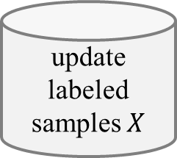




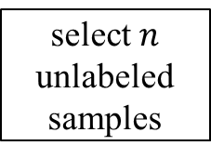
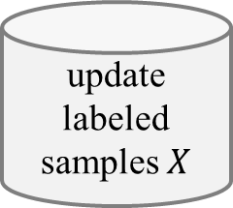







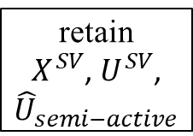
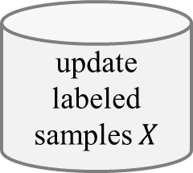


















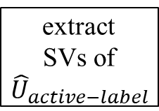
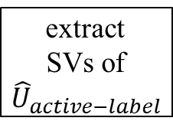






$$X^{}$$
update
labeled samples $X$
(a) Virtual Support Vector Machine with self-learning constraints and semi-labeled samples
(c) Active Learning with constrained and semi-supervised Virtual Support Vector Machines
margin sampling distance
with clustering
$$U_{most−uncertain}$$
labeling m candidates
$$U_{active−label}$$
labeled samples $X$
subset of unlabeled samples $U$
pool of unlabeled samples $\tilde{U}$
$$U_{most−certain}$$
image
select $n$ unlabeled samples
semi-labeled samples
select $n$ unlabeled samples
apply SVM model
relearn model
$$X^{}$$
semi-labeled samples
VSVM
margin sampling distance
with clustering
$$U_{most−uncertain}$$
labeling candidates
$$U_{active−label}$$
$$X^{}$$
segmentation with initial parameterization
compute
object features
learn SVM model
apply SVM model
$${\hat{U}}_{semi−active}$$
retain
$X^{SV}$, $U^{SV}$,
${\hat{U}}_{semi−active}$
update
labeled samples $X$
extract
separating
hyperplane
similarity constraint
margin sampling constraint
$$U_{semi−labeled}$$
active learning
extract
SVs
$$U_{active−label}$$
self-learning strategy
$$X^{SV}$$
relearn model
$${\hat{U}}_{semi−labeled}$$
$${\hat{U}}_{semi−labeled}$$
$$X^{SV}$$
segmentation with altered parameterization
identify virtual samples
compute
object
features
similarity constraint
margin sampling constraint
relearn model
extract
separating
hyperplane
relearn model
relearn model
active learning
$${\hat{V}}_{semi−labeled}^{U}$$
$${\hat{V}}^{SV}$$
$$V^{SV}$$
$${\hat{V}}^{SV}$$
encoding of invariances
self-learning strategy
thematic map
$${\hat{V}}^{SV}$$
thematic map
thematic map
thematic map
$${\hat{V}}_{semi−labeled}^{U}$$
$$U_{active−label}$$
$$X^{SV}$$
(b) Virtual Support Vector Machine with self-learning constraints and virtual semi-labeled samples
relearn model
$${\hat{U}}_{semi−labeled}$$
relearn model
$$X^{SV}$$
$$X^{SV}$$
$${\hat{U}}_{semi−labeled}$$
$${\hat{V}}^{SV}$$
$${\hat{U}}_{semi−labeled}$$
relearn model
multiclass level uncertainty distance
with clustering
$$U_{most−uncertain}$$
labeling candidates
$$U_{active−label}$$
$$X^{}$$
virtual active samples
virtual active samples
$${\hat{U}}_{AL}^{SV}$$
extract
SVs of ${\hat{U}}_{active−label}$
retain
$X^{SV}$, ${\hat{V}}^{SV}$,
${\hat{U}}_{semi−labeled}$
$${\hat{U}}_{AL}^{SV}$$
extract
SVs of ${\hat{U}}_{active−label}$
retain
$X^{SV}$, ${\hat{V}}^{SV}$,
${\hat{U}}_{semi−labeled}$
$$V_{AL}$$
$${\hat{V}}^{SV}$$
update
labeled samples $X$
virtual semi-labeled samples
remaining
candidates
semi labeled samples
$${\hat{U}}_{semi−labeled}^{SV}$$
extract
SVs of ${\hat{U}}_{semi−labeled}$
retain
$X^{SV}$, ${\hat{V}}^{SV}$,
${\hat{U}}_{semi−labeled}$
identify virtual active samples
compute
object
features
similarity constraint
margin sampling constraint
identify virtual active samples
compute
object
features
similarity constraint
margin sampling constraint
$$U_{semi−AL}$$
relearn model
relearn model
$$V_{AL}^{U}$$
$${\hat{V}}_{AL}^{U}$$
$$V_{AL}^{U}$$
$${\hat{V}}_{AL}^{U}$$
similarity constraint
margin sampling constraint
relearn model
$${\hat{V}}_{AL}$$
identify virtual semi- labeled samples
compute
object
features
similarity constraint
margin sampling constraint
extract
separating
hyperplane
relearn model
$$V^{SV}$$
$${\hat{V}}^{SV}$$
relearn model
encoding of invariances
self-learning strategy
encoding of invariances
self-learning strategy
self-learning strategy
$$V_{semi−labeled}^{U}$$
$${\hat{V}}_{semi−labeled}^{U}$$
active learning
thematic map
thematic map
thematic map
encoding of invariances
self-learning strategy
thematic map
thematic map

