Slide 1

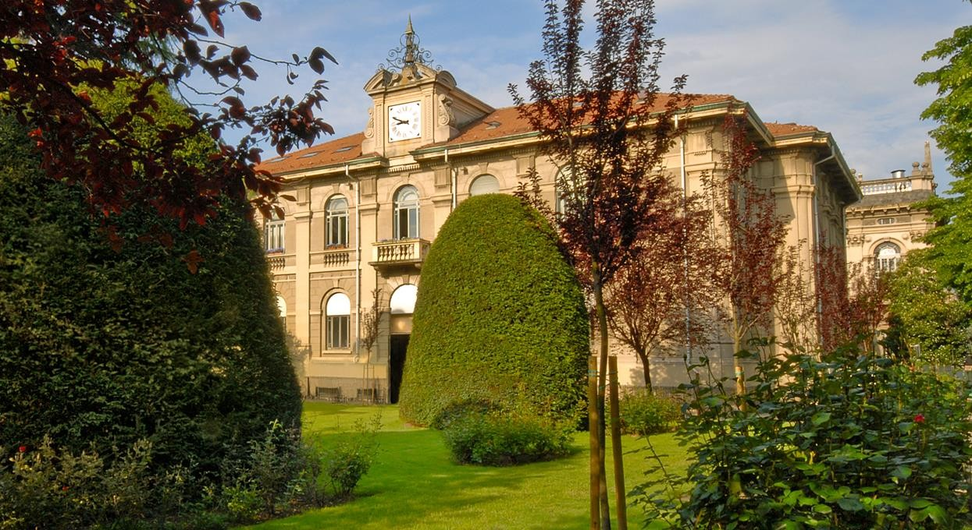

Earth Observation
Assessing Burn Severity Indexes
for Fire Mapping using
Mulstispectral Satellite Imagery
Lorenzo Carlassara
ID: 10601118
2022/2023

Slide 2
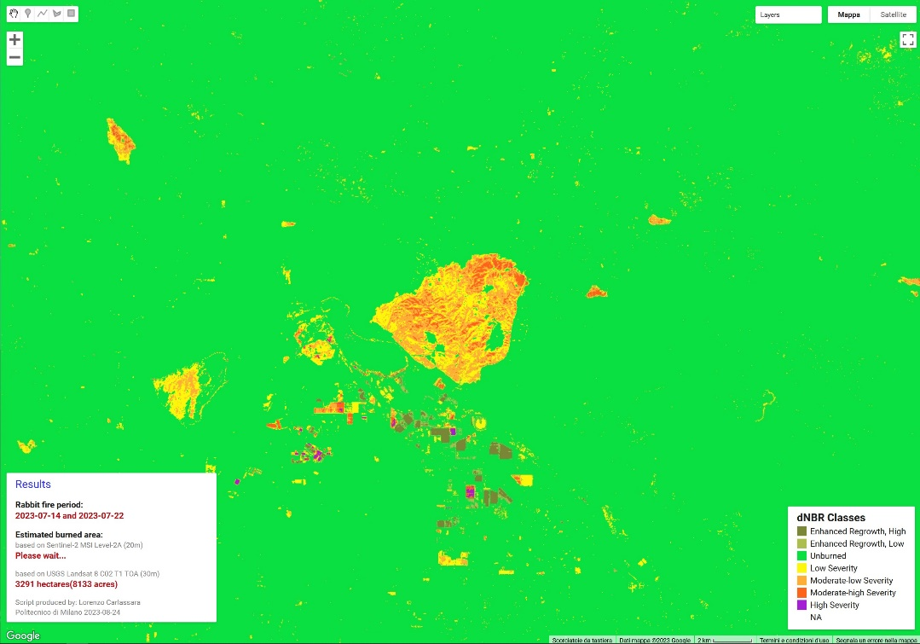
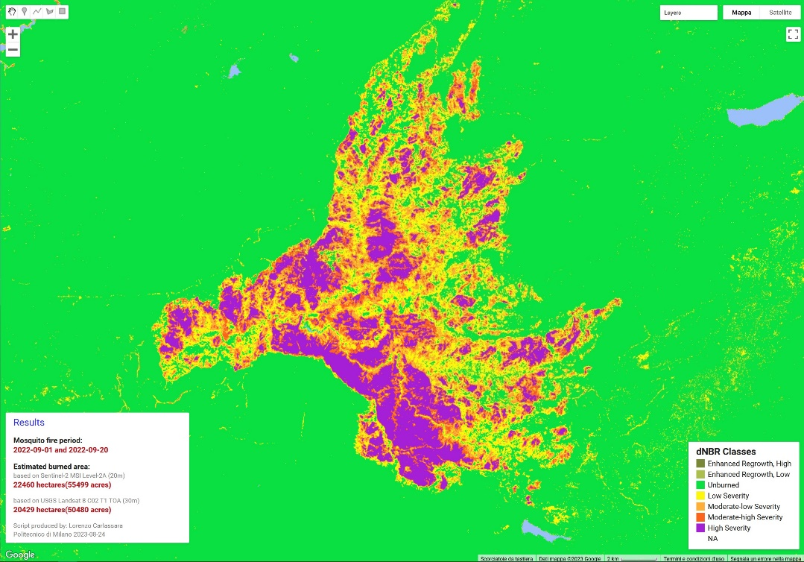
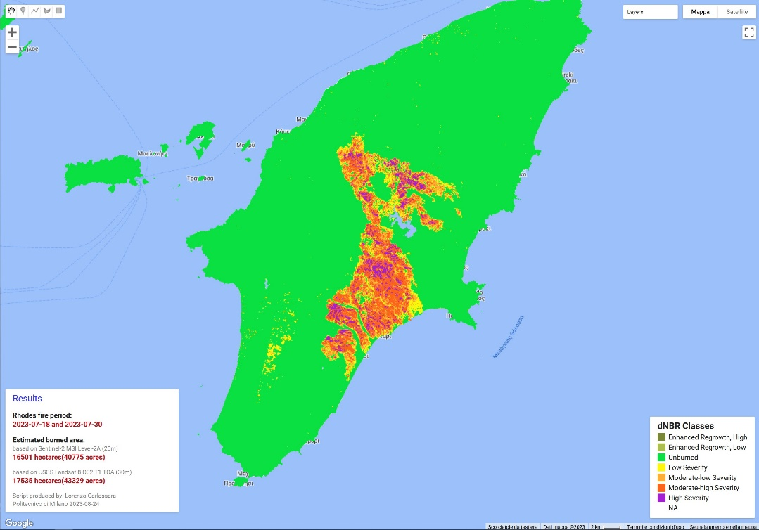
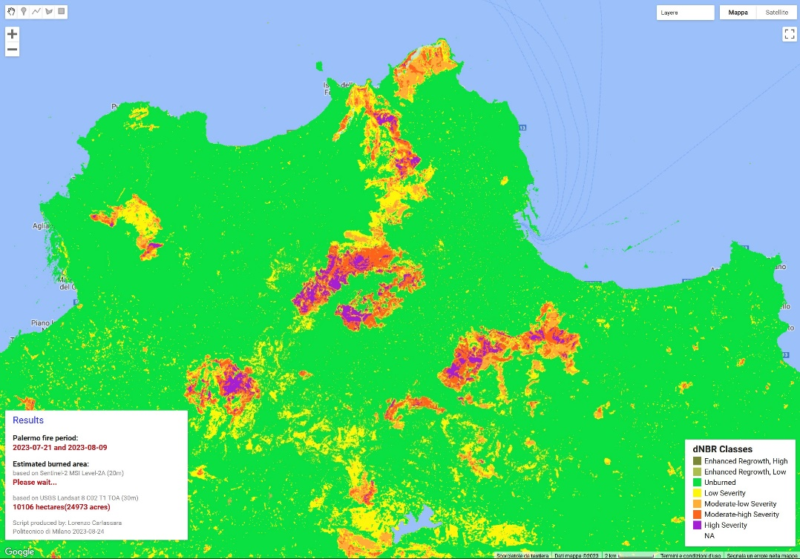


Slide 3
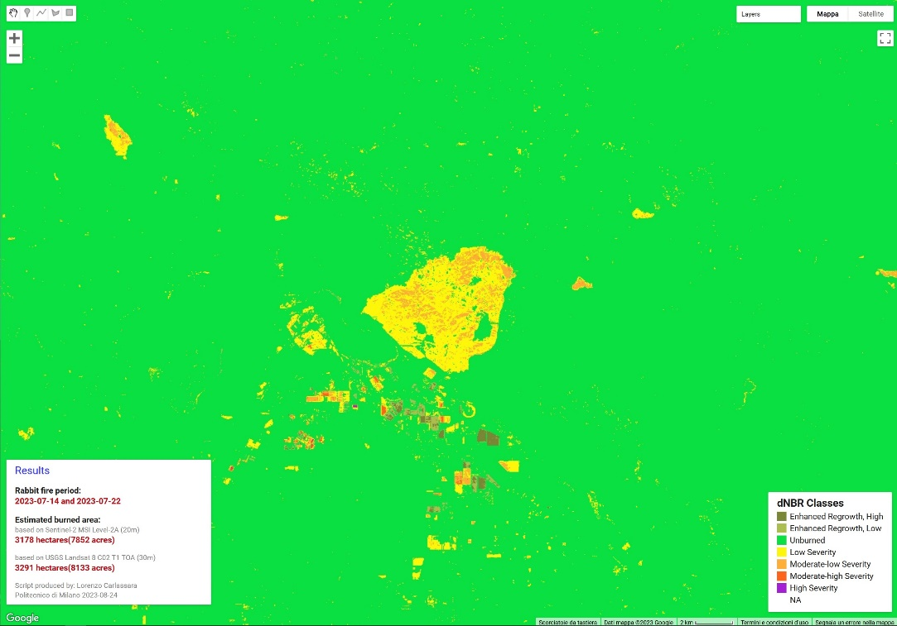
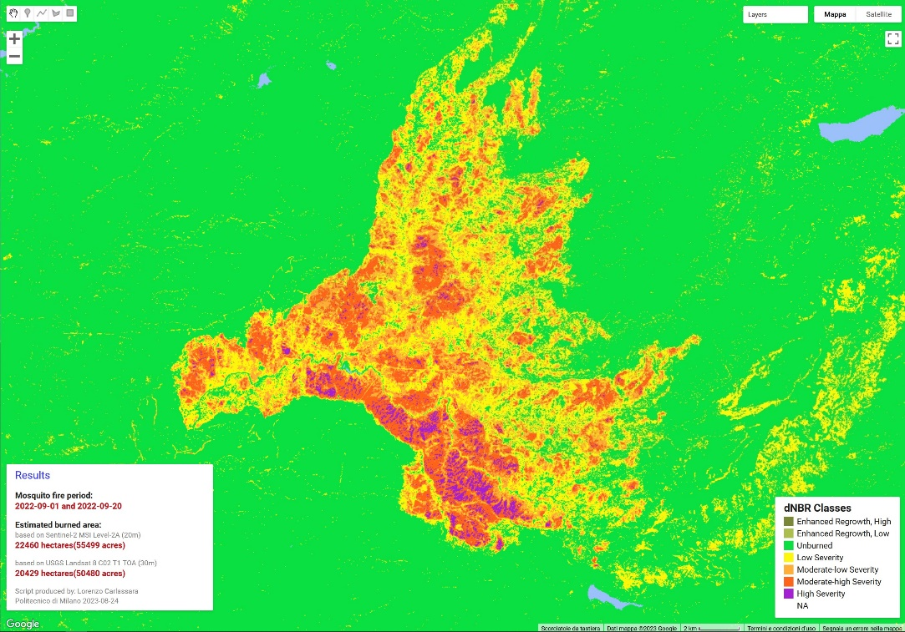
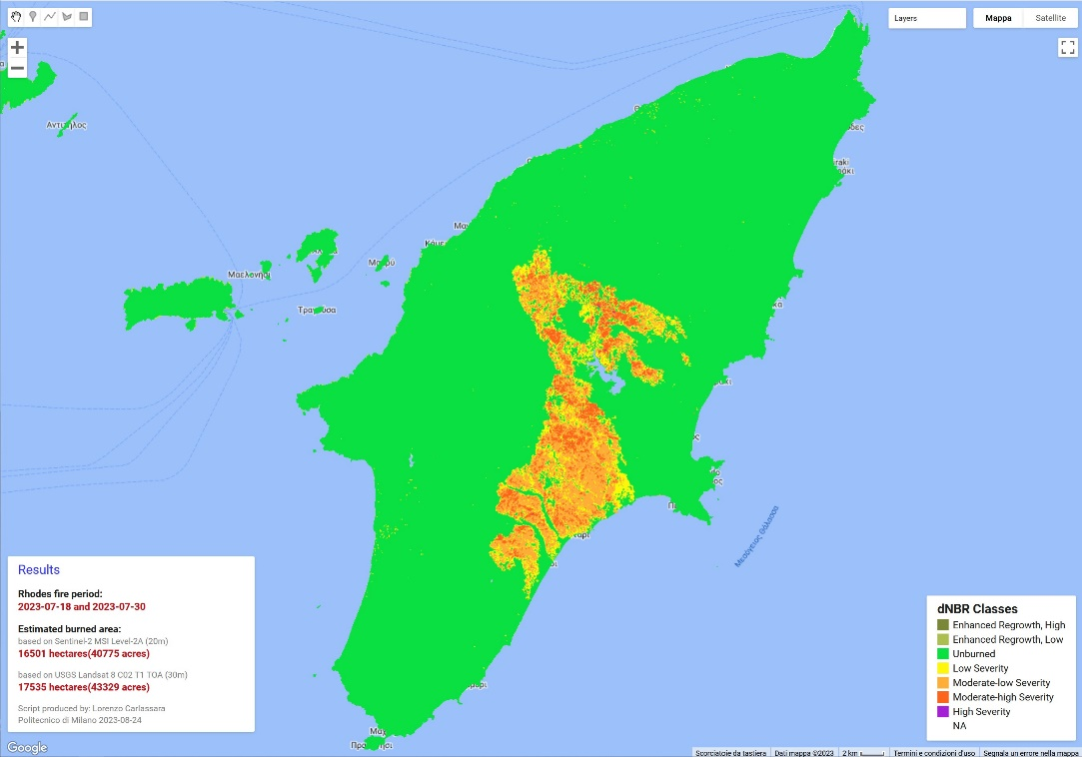
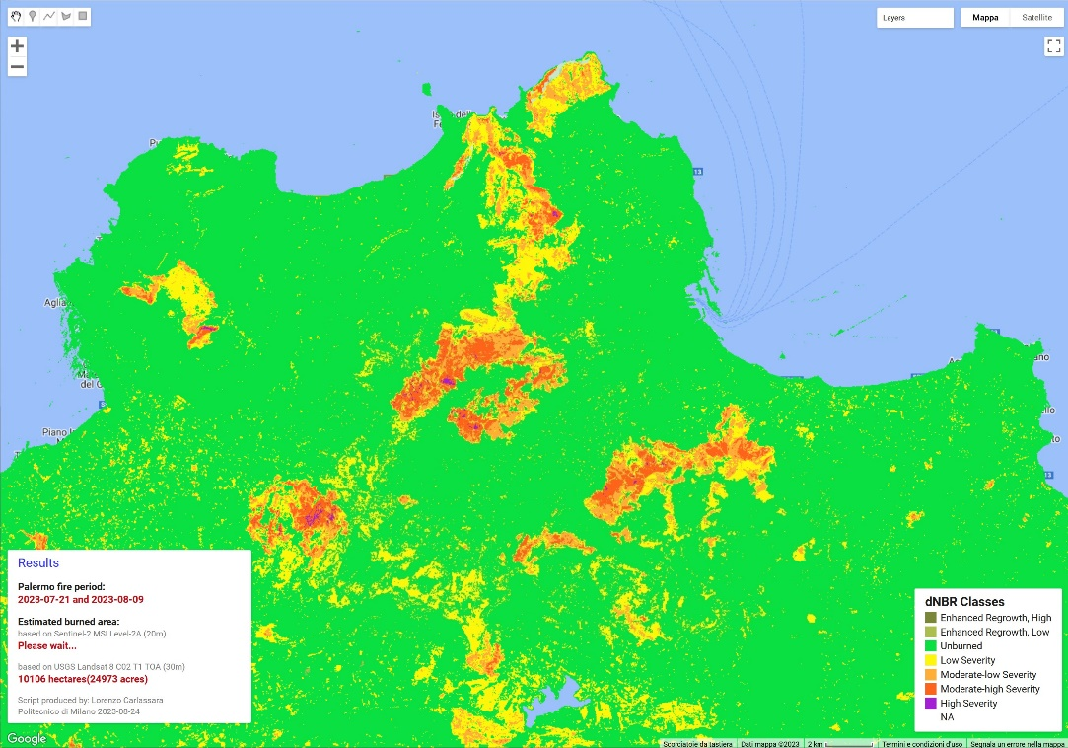

Slide 4
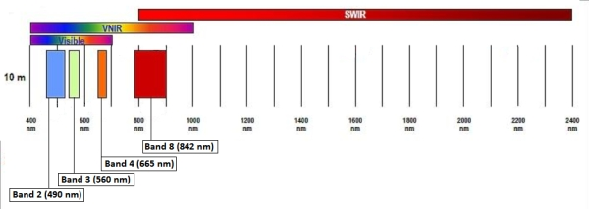
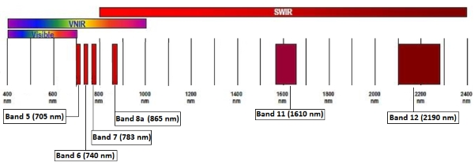


Slide 6
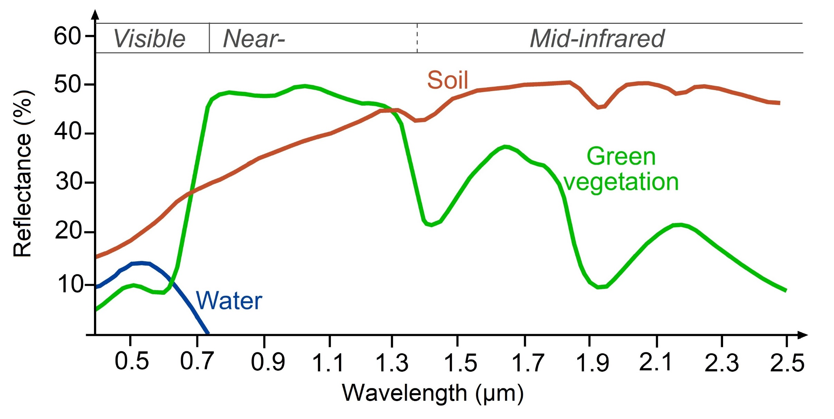

Slide 15
Thanks for your attention!
lorenzo.carlassara@mail.polimi.it
Geoinformatics Engineering
All materials in this presentation are from the public literature and internet. Use herein of copyrighted material is purely for academic purposes.

