Slide 1
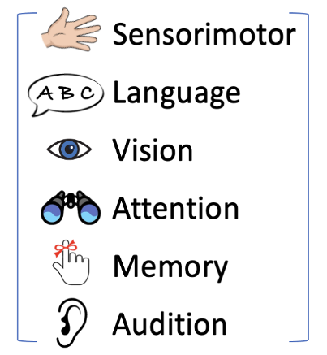
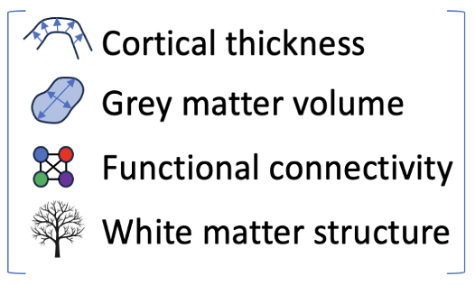
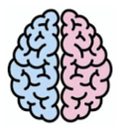
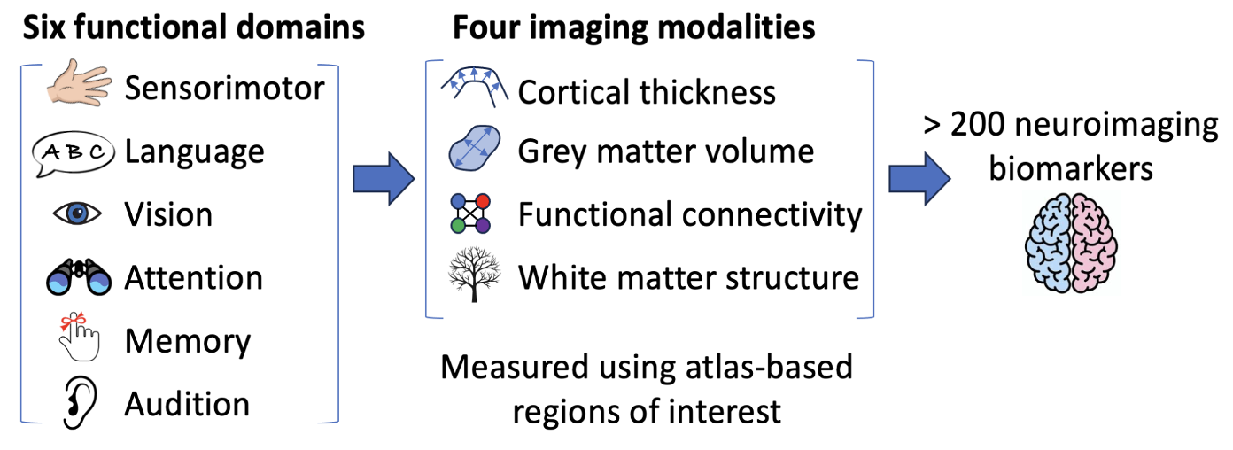
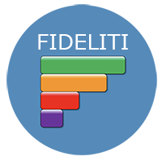
Functional Domains
Neuroimaging metrics
> 150 features of interest
Extracted using atlas-based regions of interest

Slide 2
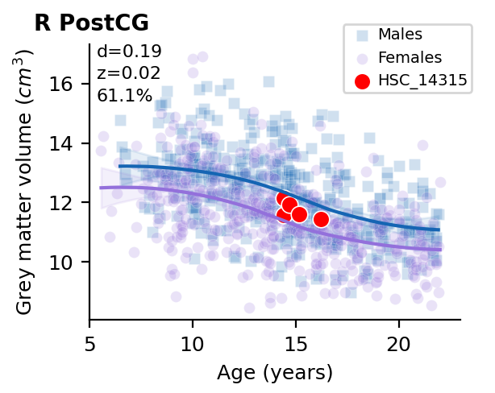
Title: Region(s) of interest
Participant ID
Circle – female
Square - male
Deviation scores
Y-axis: Neuroimaging feature with native units
Symbols:
Purple – females
Blue – males
Red - participant
Regression lines: LOESS curves

Slide 3
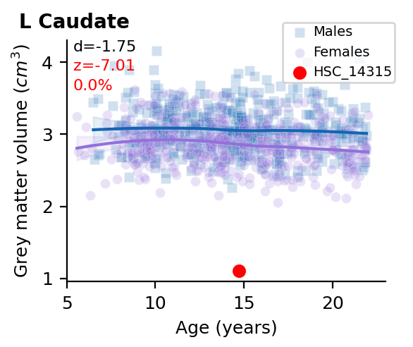
Title: Region(s) of interest
Deviation scores
Y-axis: Neuroimaging feature with native units
Single session data shows deviation from expected values

Slide 4
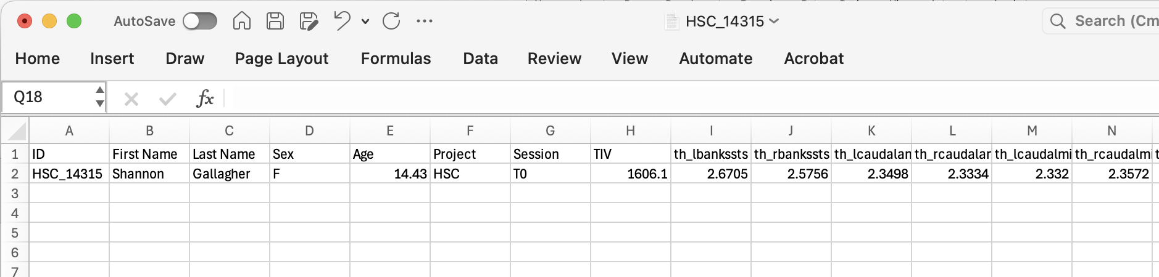
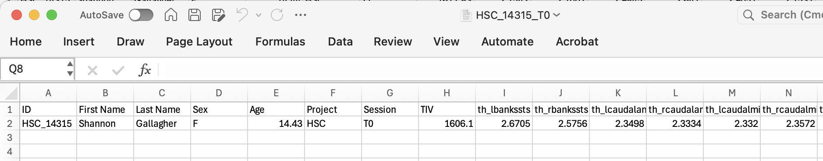
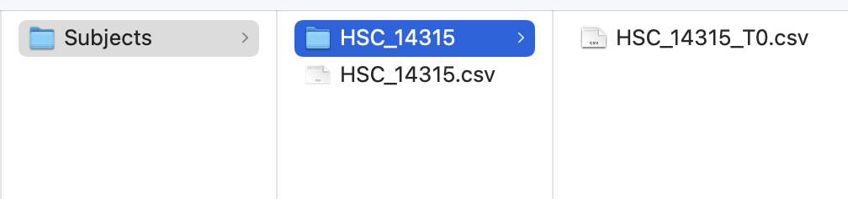
Single session: Save in the Subjects folder
Name this file: ID.csv
Single session: Save in the Subjects/ID folder
Name this file: ID_session.csv
For a participant with a single session, the folder structure should look like this:
FIDELITI working directory
Participant directory with their ID
One .csv file for a single session
Datafile containing a single session

Slide 5
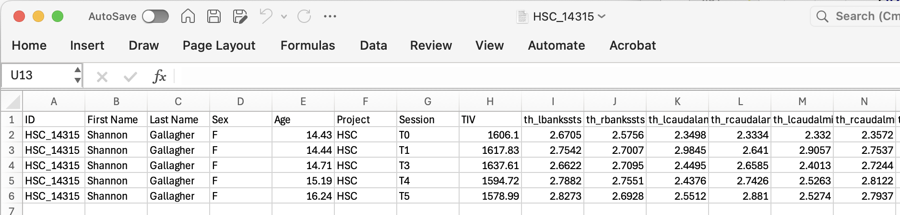
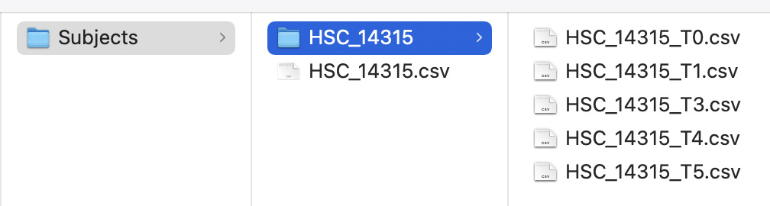
Multiple sessions: Save in the Subjects folder
Name this file: ID.csv
Single session: Save in the Subjects/ID folder
Name this file: ID_session.csv
For a participant with multiple sessions, the folder structure should look like this:
FIDELITI working directory
Participant directory with their ID
One .csv file for each session
Datafile containing multiple sessions

Slide 6
