Slide 1


Jump List Forensics
:::::::::::::::::::::::::::::::::::::::::::::::::::::::::::::::
Computer Science Capstone
John Carlson, Hunter Blakely
carlsonj@sou.edu, blakelyh@sou.edu
@Version: 3-16-2013_4:46pm
:::::::::::::::::::::::::::::::::::::::::::::::::::::::::::::::

Slide 2

Table Of Contents
0.0 Introduction...........................
1.0 Jump List File Structure........
1.1 Writing structures
2.0 Locating Jump Lists..............
2.1 Automatic Destinations
2.2 Custom Destinations
3.0 Hexadecimal File Parsing......
4.0 Automation............................
5.0 Sample Jump List..................
6.0 Forensic Application.............

Slide 3
Introduction 0.0
* Requirements for writing a windows jump list file parser:
1) Understanding the file structure implemented within a windows jump list.
2) How to recognize jump list files, and where to access these files.
3) How to parse a file in hexadecimal format.
4) Automation

Slide 4
Jump List File Structure 1.0
* The file structure utilized in windows jumplists is called COMPOUND BINARY FILE format or CFB for short.
* Microsoft has completely documented the CFB file structure in [MS-CFB].pdf which can be located at:
http://msdn.microsoft.com/en-us/library/dd942138.aspx

Slide 5
Writing Structures 1.1
* For this project, each structure in the [MS-CFB].pdf documentation has been written out in python, and can be downloaded at:
http://github.com/blakelyh/doc/structures/ms_cfb/cfb.txt
* A function has been written for each structure in order to populate the fields of information contained in those structures.

Slide 6
Locating Jump Lists 2.0
* There are two file locations associated with jump lists in Windows 7. One directory for automatic destinations jump lists, and another directory for custom destinations jump lists.
* Automatic Destinations
- C:\Users\username\AppData\Roaming\Microsoft\Windows\Recent\AutomaticDestinations
* Custom Destinations
- C:\Users\username\AppData\Roaming\Microsoft\Windows\Recent\CustomDestinations

Slide 7
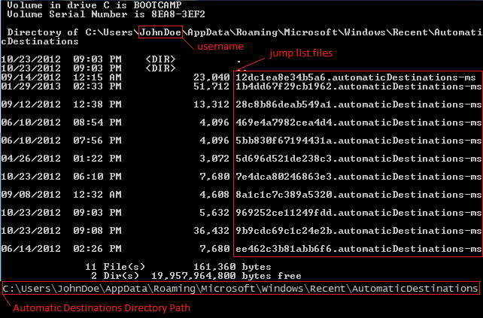
Locating Jump Lists 2.1
AutomaticDestinations

Slide 8
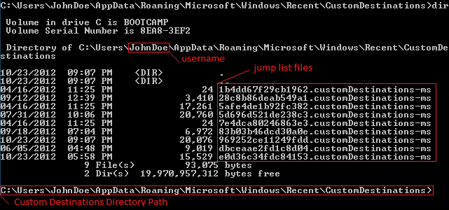
Locating Jump Lists 2.2
CustomDestinations

Slide 9
Hexadecimal File Parsing 3.0
Python Script
import binascii # binary/ascii reading
def seekAndRead(inFile, bOffset, bLength): # args: file, offset, length
try: # exception handling
f = open(inFile, 'r') # open the file to read
except Exception, e: # exception handling
print("Error opening <"+inFile+">: "+str(e)) # exception handling
try: # exception handling
f.seek(bOffset) # go to offset
except Exception, e: # exception handling
print("Error seeking to "+str(bOffset)+" "+str(e)) # exception handling
out = f.read(bLength).encode("hex") # read hex at offset
f.close() # close file
return out # return

Slide 10
Automation 4.0
Pseudocode
1) Find jump list files
2) Read jump list file
3) Fill the jump list structures with appropriate data from corresponding offsets.
4) Repeat steps 2 and 3 until all jump list files have been parsed.
* The above pseudocode implies the use of loops to run through all jump list files. Inside that loop each structure will be filled with corresponding data. Additionally, all arrays will also be populated inside of their own loops accordingly.

Slide 11
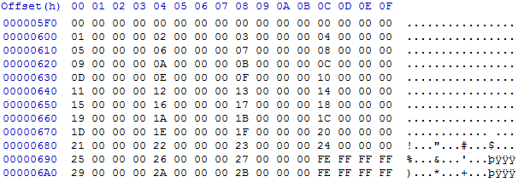


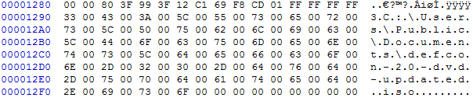
Sample Jump List 5.0
Header
etc...
Directory
etc...
Directory
etc...
File
* The above sample output has been snipped.

Slide 12
Forensic Application 6.0
* Associate a program with the jump list:
- As dictated by RFC 4122 the first portion of the jump list naming convention consists of a Universally Unique IDentifier (UUID) URN Namespace. Parse the unique identifier, and compare it to a list of known ID's.
- List of known ID's can be downloaded here:
http://www.forensicswiki.org/wiki/List_of_Jump_List_IDs
* Parse the MS_SHLLINK files inside of the MS_CFB file to determine recent activity performed with the associated program.

