Slide 1
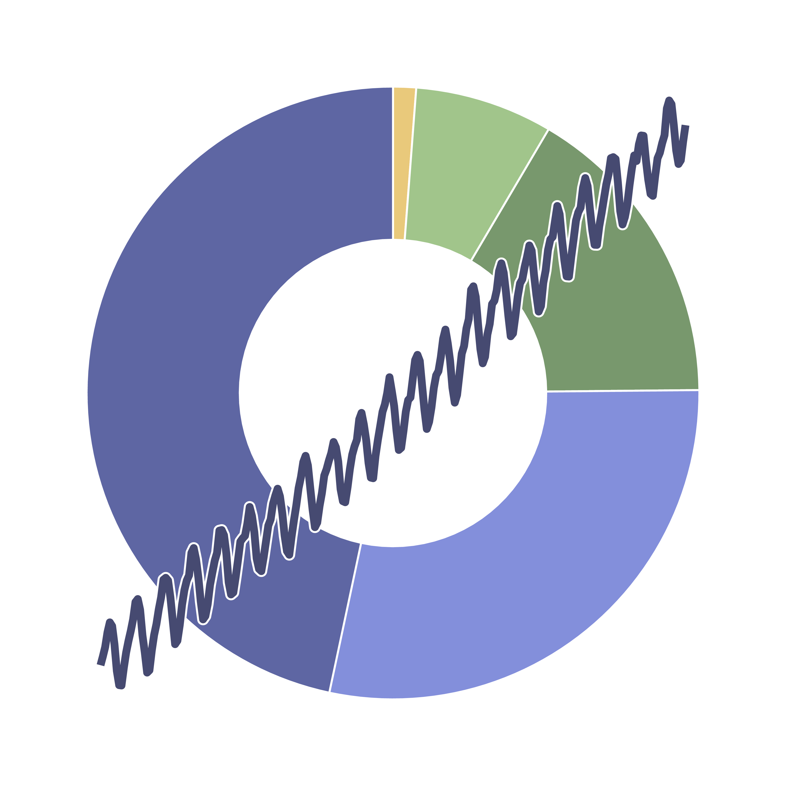
The Global Burden of
Climate Change Study
Working Group

