Slide 1
Exploring Text-to-SQL: Impact on Data Warehouses and Data Governance
Patrick Carlson
Sandia National Lab
NLIT 2025 – May 5-8, 2025
SAND2025-05141C

Slide 2
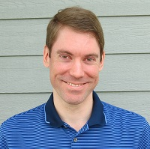
About ME
Data Scientist at Sandia National Labs
8 years at Sandia
Interest in the data lifecycle, tooling and libraries, R&D, and helping enable ML-ops at Sandia
pcarlso@sandia.gov
https://carlsonp.github.io

Slide 3
What is text-to-sql?
Ask a natural language question and get a SQL query that will answer that question
Example:
How many LDRD projects did we have in fiscal year 2024?
Expected result:
select count(distinct(ldrd_project_id)) from ldrd_projects where fiscal_year = 2024

Slide 4
Why text-to-sql is valuable
Helps on-board new analysts, data engineers, and data scientists who work with structured data
Provides another avenue of searching and findability for tables outside a traditional data catalog
Broadens the scope of people who can ask questions and immediately get answers to those that are non-technical or may not understand relational database SQL

Slide 5
My take
Metadata will be even more critical in the future to enable LLMs to understand and extract information from existing data warehouses and data lakehouses.

Slide 6



The filtering process and challenge
Many databases and tables
Step #1
Filter to relevant tables that can fit into the context window
Step #2
LLM
Generated SQL Query

Slide 7
A simple test setup
102 tables in “Sandia Insights”, a set of cross-domain enterprise tables
Most have table descriptions and column descriptions for metadata
13 questions and resulting expected SQL with varying degrees of difficulty and JOINs needed
1-10 subjective rating
Run questions through 6 different LLM models
Codellama 13B
Llama-3.1 8B
Llama-3.3 70B
Phi-4 14B
Mistral 7B
Qwen2.5-coder 14B
Used LlamaIndex as supporting library to enable text-to-sql
Embedding model: BAAI/bge-small-en-v1.5

Slide 8

!!! Warning !!!
Do not leverage an account with write, insert, delete, or other permissions to your SQL database! Limit to only simple SELECT and metadata permissions. These will run arbitrary LLM generated code!

Slide 9
SQL Result subjective Rating
Mostly correct but missing some filtering
Generally close in intent or logic
No SQL provided
Wrong logic and focus is off
Mostly correct but missing table join
Completely hallucinated result
Fully correct SQL and result
Wrong table used
1 2 3 4 5 6 7 8 9 10

Slide 10
How it works
Create sqlalchemy connection to database
Load the embedding model
Down selects “k” numbers of tables from the 102 tables to inject into the question
The LLM runs on the question and responds with the answer
If you know what tables to use, include them in the question and skip this down-selection
query_engine = SQLTableRetrieverQueryEngine(
sql_database, obj_index.as_retriever(similarity_top_k=4)
)

Slide 11
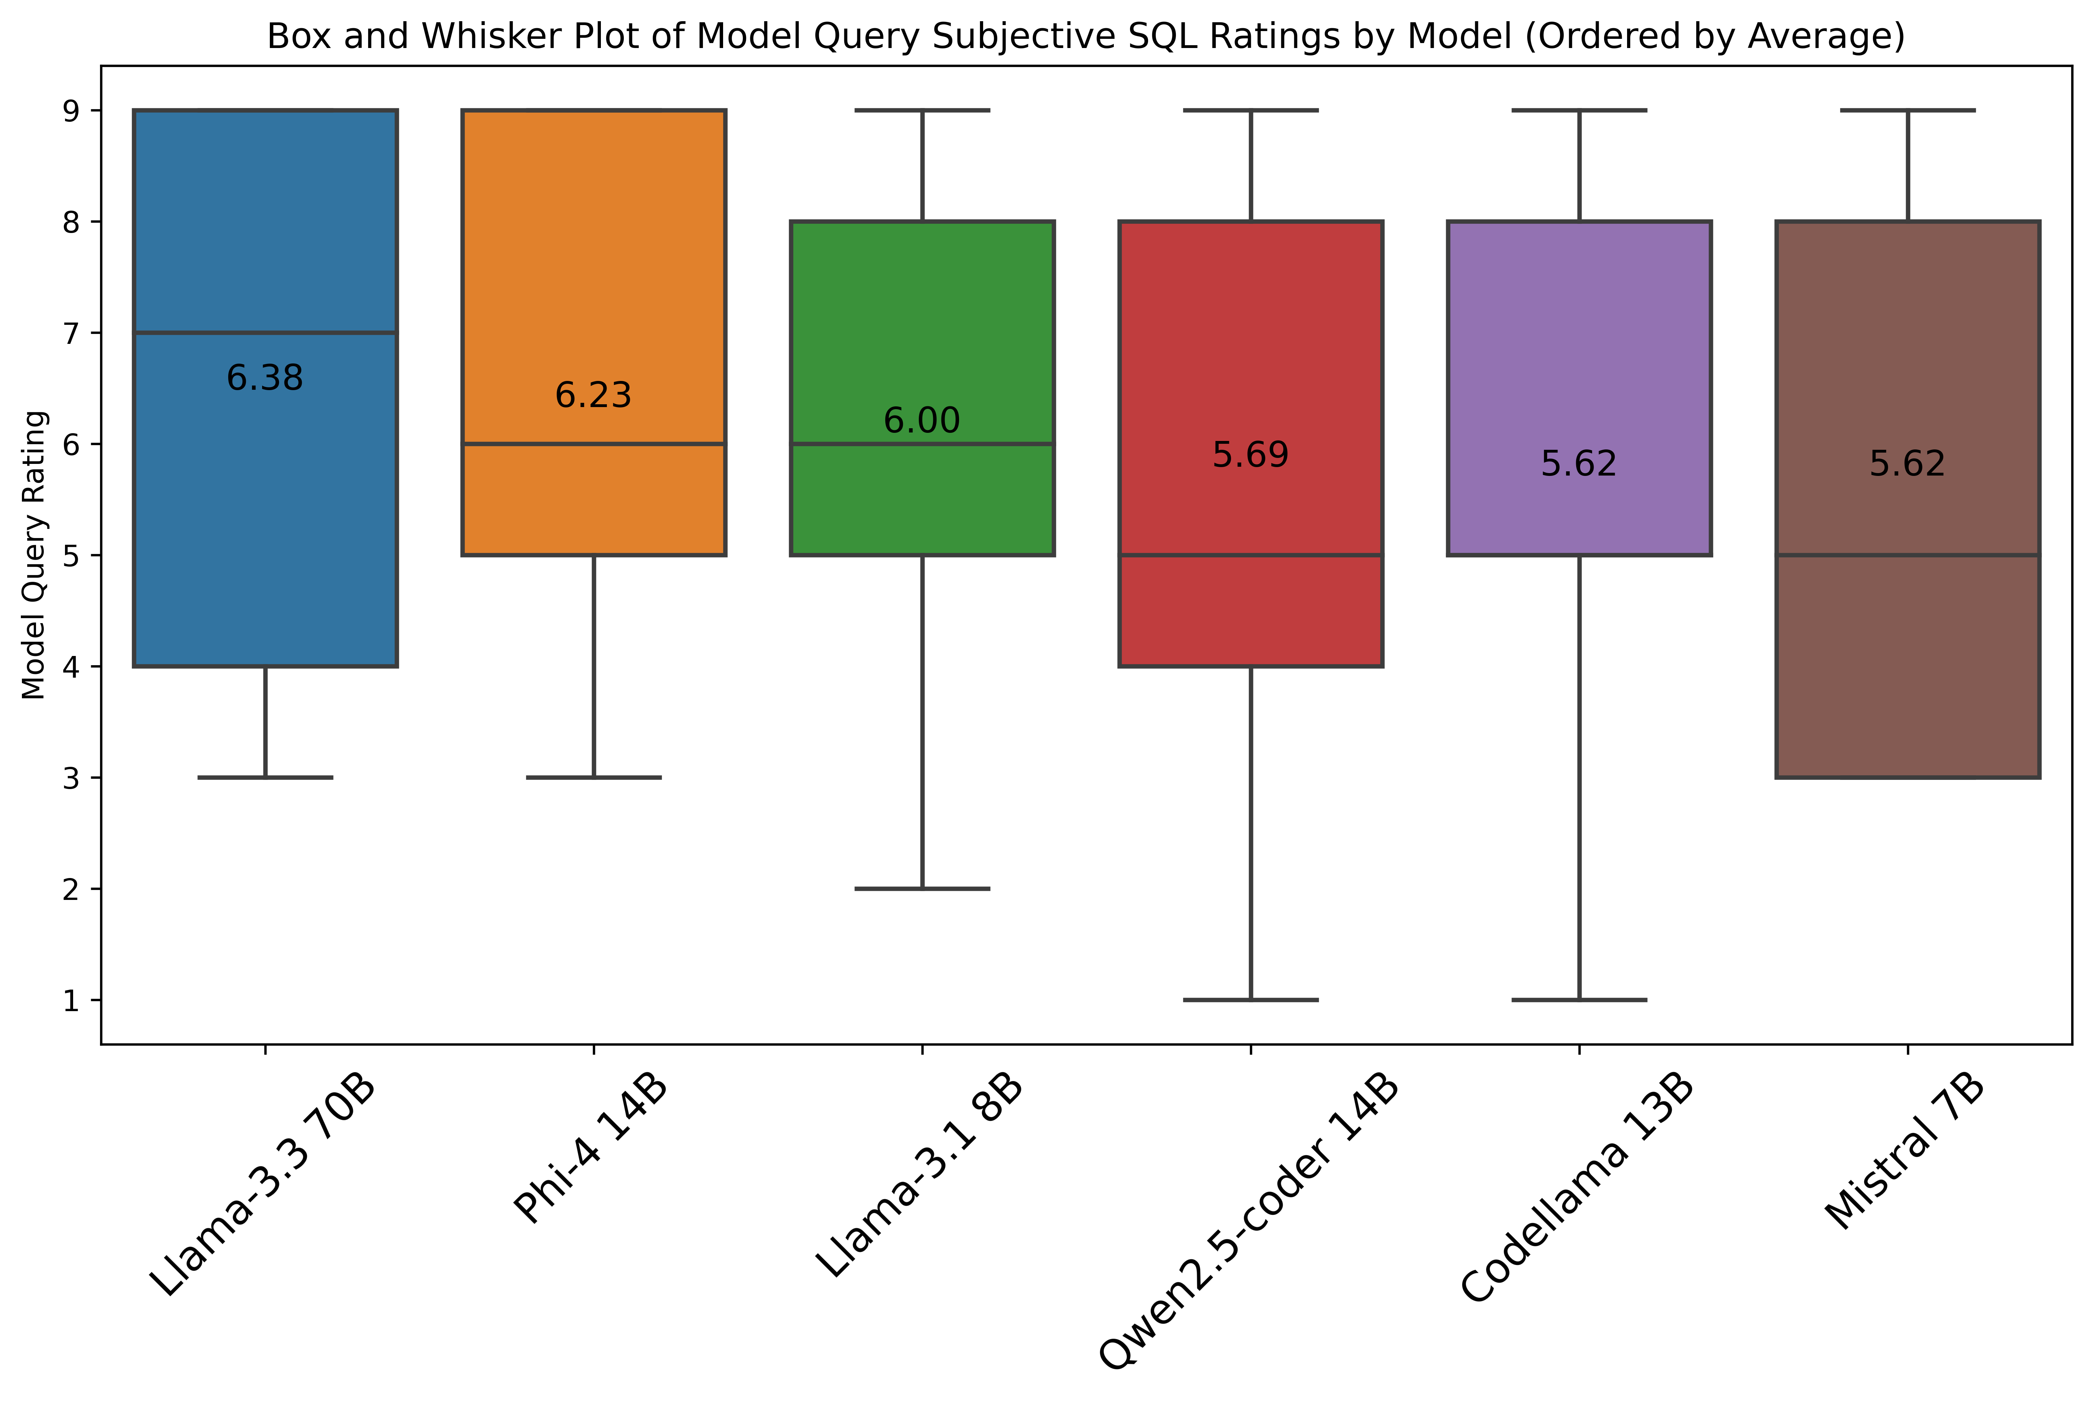

Slide 12
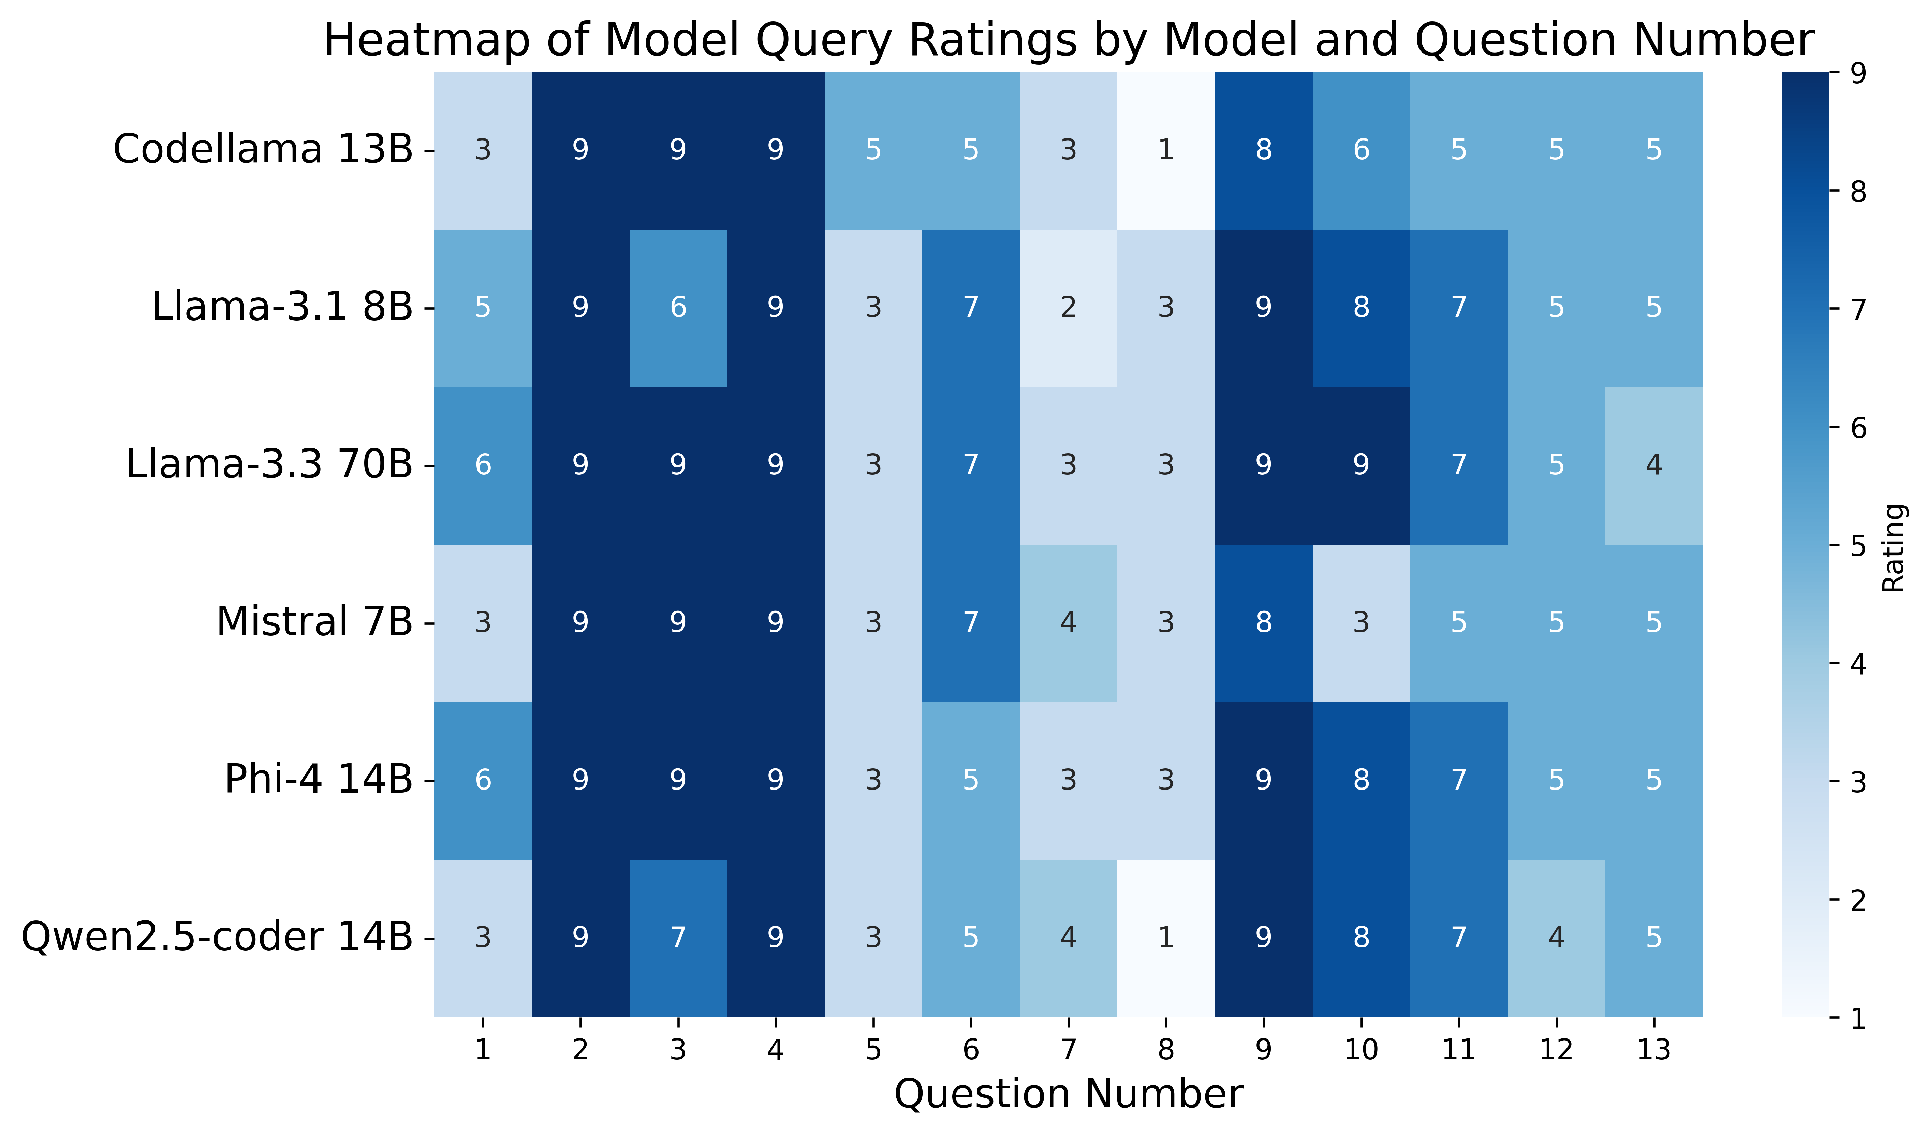

Slide 13
Results
When the LLM gets the wrong down-selected tables, it yields poor results. This may not be a criticism of the model itself.
Best Model: Llama-3.3 70B
Hardest Question: When does the Sandia fiscal year of 2024 start? What date?
When this question is run through the model with the singular table needed to answer the question, it provides a correct answer.

Slide 14

Future Leverage Vector Database
Table Metadata
Store embeddings on past queries, tables, and generated summaries to leverage as a “lookup” when business question prompts come in.
SQL Query Logs
Generate SQL Summary and Tables Used with LLM
Business Question Prompt
Embedding Model
Top K Tables
Vector DB

Slide 15


Future for data integration
Many domain areas with diverse databases and APIs
Cloud LLM
Tools
MCP Server
Resources
REST APIs
Prompts
MCP Client
HR
Transport Layer
Tools
MCP Server
Resources
Local LLM
REST APIs
Prompts
Finance
Model Context Protocol (MCP) Specification

Slide 16
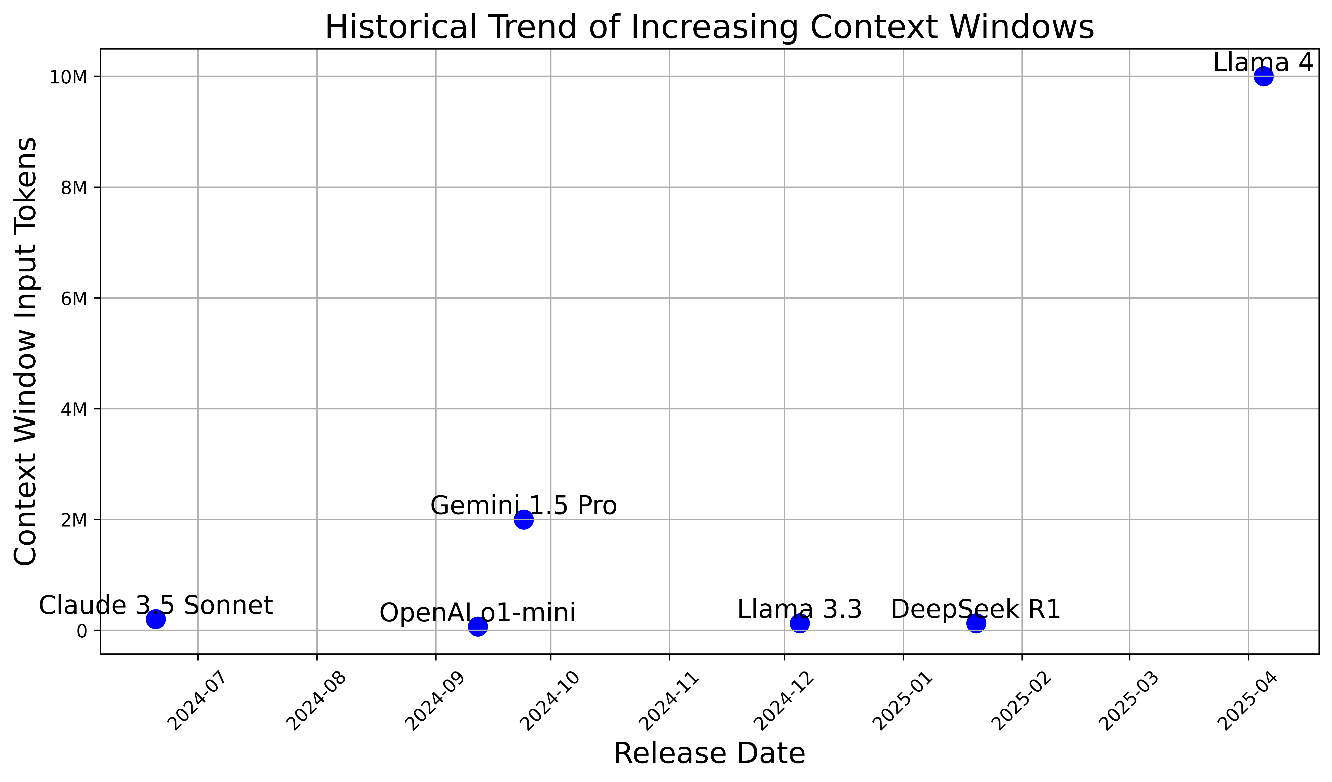
Future considerations on context window size
Notes:
Model context windows increase to a point where down-selecting tables may not be as necessary any more?

Slide 17

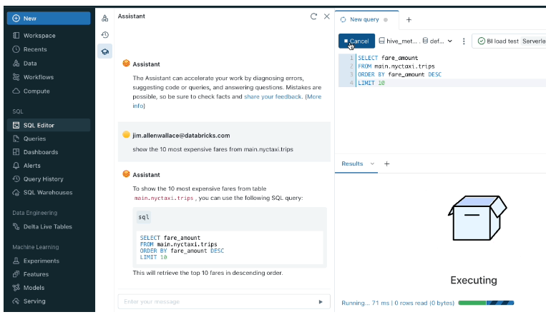
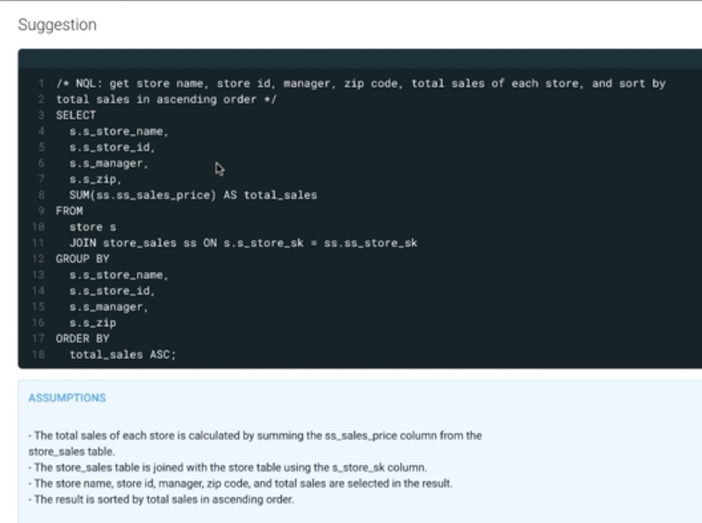
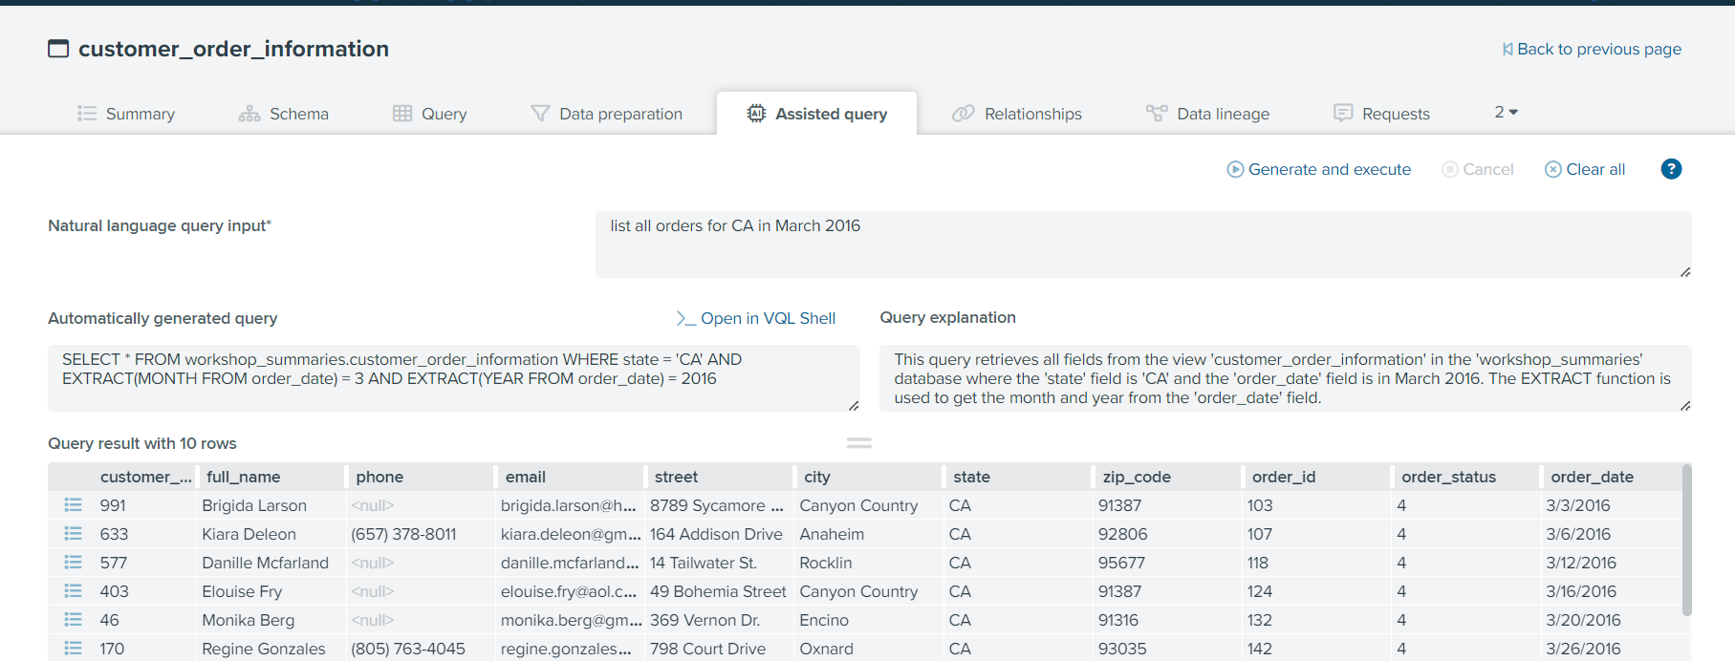


Text-to-sql in cots
And many more…
Notes:
Databricks has an AI assistant.
Denodo has an assisted query feature in their data catalog.
Cloudera has a SQL suggestion feature in Hue.

Slide 18
Recommendations
Use descriptive table and column names
Bad “f_y” column, good “fiscal_year”
Come up with standards for tables, column names, and metadata. Data Governance!
Document your column descriptions
Filter tables by domain area
For example, have HR tag on tables and directly filter them
Have SQL query generation and refinement be an iterative process with feedback from the user
Send usage data and queries to the model as examples, store in vector database. Have users rate or evaluate the resulting generated SQL queries.
Text-to-SQL is a stepping stone to agentic generative AI and more complex use cases

Slide 19

Questions or Comments?
pcarlso@sandia.gov
https://carlsonp.github.io

Slide 20
Appendix

Slide 21
Question list
How many active employees are currently working at Sandia? Employees are a specific type, these are distinct from contractors, students, and other types.
How many LDRD projects did we have in fiscal year 2024?
What is the highest degree the employee with randid 1083387 has obtained?
What school or university did the employee with randid 1083387 attend for their highest degree?
Provide a breakdown of the types of employees and their current counts. I'm expecting to see FTEs, LTEs, students, contractors, etc. as groups.
What single Sandia employee has created the most technical advances at Sandia?
When was the last time the Sandia employee with randid 1083387 has traveled domestically in the US?
When does the Sandia fiscal year of 2024 start? What date?
Group the educational degree, Bachelors, Masters, PhD, etc. for current active employees and provide employee counts for each educational group. Only select their highest degree. Some people may have multiple high degrees.
Where does the employee with randid value 1083387 work? Are they an on-site, hybrid virtual, or remote worker? People who don't have a telework agreement work on-site.
How many people are Research and Development or R&D at Sandia currently? Use the job family column to determine R&D status.
Where are new employees, those who have been at Sandia less than a year coming from and what school or university did they attend? Show the top ten schools or universities that they are coming from.
How many ALDs or associate lab directors do we have at Sandia currently? These are people that are below organization 0001, our lab director.

